Slide 1
Using empirical orthogonal functions to interpret the spatiotemporal variability of crop yields in presence of shallow restrictive soil layer
Seongyun Kim, Craig Daughtry, Andrew Russ, Yakov Pachepsky
May 6th, 2020
USDA-ARS, Beltsville Agricultural Research Center, Beltsville, MD, USA

Slide 2
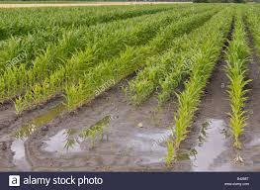
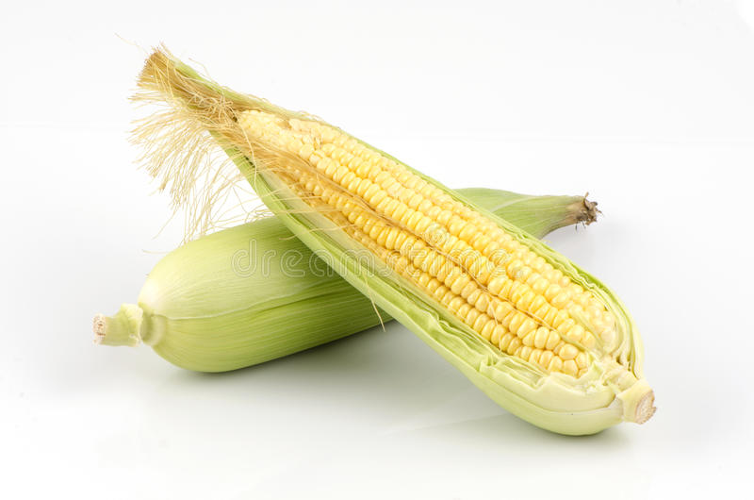
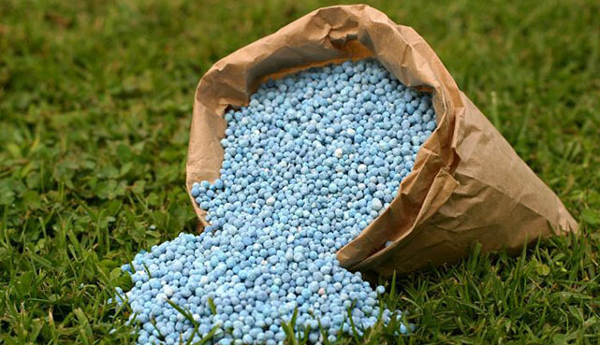
Introduction
Crop yields vary spatially and temporally.
Multiyear observations often show that some sections of fields are less productive than other sections.
This was attributed to the spatial variation of soil fertility, the ability of soil to retain and transmit water, and interactions of the above and other environmental factors.

Slide 3
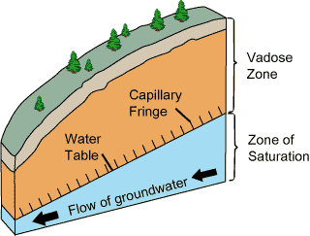
Introduction
The proximity of groundwater and its capillary fringe to the soil surface and root systems can be an important control of the crop yield.
Groundwater depths less than 1 meter have negatively influenced corn yields while intermediate (1-3 meter) groundwater depths have led to the higher corn yields.
Source: United States Geological Survey

Slide 4
Objective
To evaluate variability of multiyear crop yield data for detecting differences in access to shallow groundwater
To evaluate nutrient management across corn fields of an intensively monitored experimental site.
Source: United States Geological Survey

Slide 5
Materials and methods
Site description
Study site is located at the USDA-ARS Beltsville Agricultural Research Center, Beltsville, Maryland.
Field A received manure application. Field B and Field D received chemical fertilizer. Field D were applied precision N application.
 | Corn Grain Yield
Year | Field A | Field B | Field D | Precipitation
 | Kg/ha |  |  | mm
2002 | 4796 | 5259 | 6153 | 275
2004 | 7775 | 7508 | 6346 | 402
2006 | 8783 | 7710 | 7474 | 388
2007 | 4578 | 3428 | 3571 | 188
2008 | 8571 | 7763 | 7359 | 287
2009 | 6166 | 6013 | 6105 | 382
OPE 3 site
https://www.researchgate.net/publication/232840476_Information_and_complexity_measures_applied_to_observed_and_simulated_soil_moisture_time_series/figures?lo=1
Corn grain yields and precipitation for each field

Slide 6
Materials and methods
EOF analysis
EC1
EOF-1
50%
The principal component analysis designed to decompose the spatiotemporal variability into spatial patterns (EOFs) which are constant in time and time series (ECs) which are constant in space
The decomposition equation is:
$Y\left(s, t\right)−\overline{Y}\left(t\right)= EOF1\left(s\right)× EC1\left(t\right)+EOF2\left(s\right)×EC2\left(t\right)….$
Where Y is the measured value at the location s, at time t, $\overline{Y}\left(t\right)$is the average across all location at time t.
2000
2020
EC2
EOF-2
30%
Temporal pattern(EC)
2000
2020
Spatial pattern(EOF)
(Eigen vector)
EC3
EOF-3
10%
Eigen value
2000
2020
EOF-n
10%

Slide 7
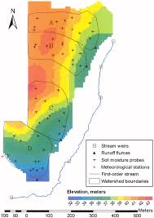
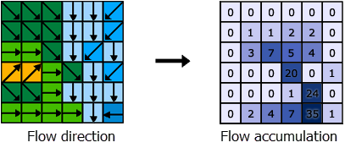
Materials and methods
The restrictive layer topography and Subsurface flow pathways
The ‘flow direction’ and ‘flow accumulation’ tools in ArcGIS were used to determine potential subsurface flow pathways.
The ‘flow direction’ tool in ArcGIS was applied to the DEM of the restrictive layer to create a grid presenting the flow direction from each cell. The ‘flow accumulation’ tool was applied to calculate accumulated water flow from its neighboring cells.
Different flow accumulation threshold (FATs) was applied to choose only subsurface flow pathway network which have a greater number of inflowing cells than threshold. Each subsurface pathway network was changed to feature layer by applying the ‘stream to feature’ tool.
https://naldc.nal.usda.gov/download/39524/PDF
Subsurface pathways with three FAT (2, 8 and 21) were calculated at each field. Three buffer zones (0 to 5 m, 5 to 10 m, and 10 to 15 m) for each field were calculated by buffer function in ArcGIS to determine average EOF1 and EOF2.

Slide 8
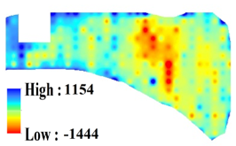
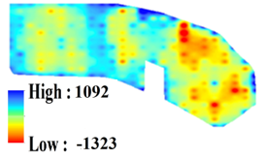
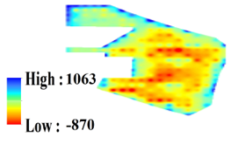
Results and discussion
Empirical orthogonal functions EOF 1 and their coefficients EC1 for corn yield at the field A, B and D.
Field A EOF1(52.9%)
Field B EOF1(52.0%)
Field D EOF1(56.5%)
Field A EC1
Field B EC1
Field D EC1

Slide 9
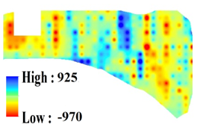
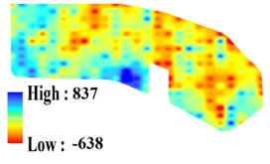
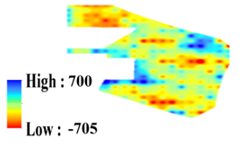
Results and discussion
Empirical orthogonal functions EOF 2 and their coefficients EC2 for corn yield at the field A, B and D.
Field A EOF2(20.8%)
Field B EOF2(17.9%)
Field D EOF2(17.9%)
Field A EC2
Field B EC2
Field D EC2

Slide 10
Results and discussion
Semivariograms of empirical orthogonal functions EOF1,EOF2 and EOF3; Field A Field B Field D.

Slide 11
Results and discussion
Buffer zones of 0-5m, 5-10m, and 10-15 m around the potential subsurface flow pathways derived with three flow accumulation threshold (FAT) values at field A, B and D
FAT =2
FAT =8
FAT =21
Field A
Field B
Field D

Slide 12
Results and discussion
Effect of the flow accumulation threshold(FAT) on the average EOF1 and EOF2 value across buffer zones created with different distances from the hypothetical subsurface flow pathways; 0 to 5 m buffer, 5 to 10 m buffer, 10 to 15 m buffer

Slide 13
Conclusions
The spatial and temporal patterns of corn yields were affected by subsurface preferential lateral flow pathways and different nutrient management practices.
The first pattern was associated with the topography of the subsurface pathways and explained about 52 to 56 % of the interannual yield variability.
The second and third patterns explained much less variability and could not be associated with subsurface topography.
Spatial variability in EOFs was characterized with semivariograms and was more pronounced at the manured field as compared with the fields with the chemical fertilizer application.
The dependence of the yields on the topography of the subsurface restrictive layer was to the large extent eliminated by the precision applications of nitrogen fertilizer.
Establishing spatial patterns of yield variability for this type of agronomic control continues presenting a promising research avenue to explore.
Notes:
Conclusions for all three works.

