Slide 1
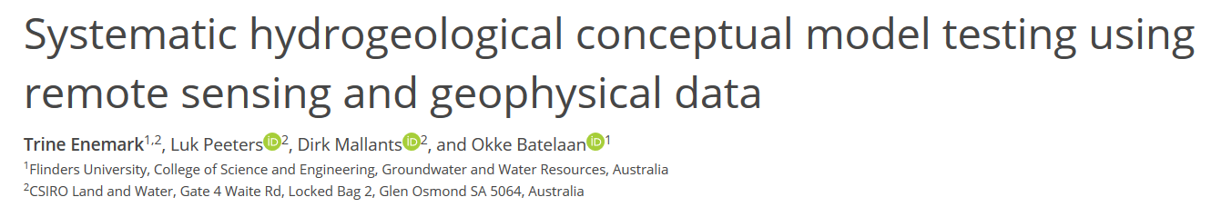
EGU2020-11688
https://doi.org/10.5194/egusphere-egu2020-11688
Session HS-8.1.6 Abstract D463

Slide 2
Specific takeaways
Data should be used for model testing rather than model development.
Using multiple lines of evidence (geophysical and remote sensing data) for model testing to gain more confidence in conceptualisations.

Slide 3
Current approach – using data for model development
The traditional approach is using data for model development. Here parameters of a single conceptual model are tuned to conform with the data through inversion.
Usually the model with the lowest mismatch between observed and modelled response is considered the best model.

Slide 4
Current approach – problems
Inversion is prone to spatial averaging, smoothing, biased parameter values due to inadequate conceptual model.
Many conceptual models represent data equally well but they are rejected by omission by only applying a single conceptual model.
No data left for testing the model → The model is accepted because it fits the data used to develop it (circular reasoning).

Slide 5
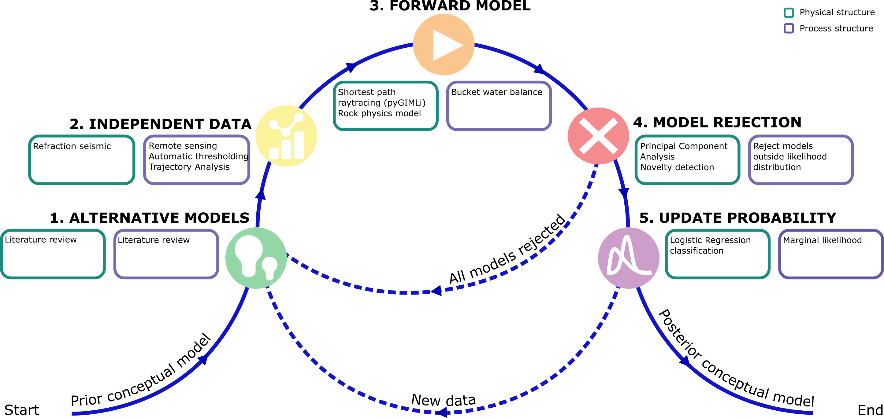
Novel approach
An exploratory systematic testing framework based on Popper-Bayes philosophy is suggested.
The method aims at finding an ensemble of conceptual understandings that can be sufficiently explained by data.

Slide 6
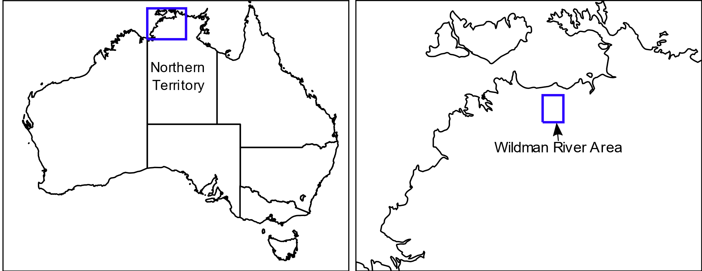
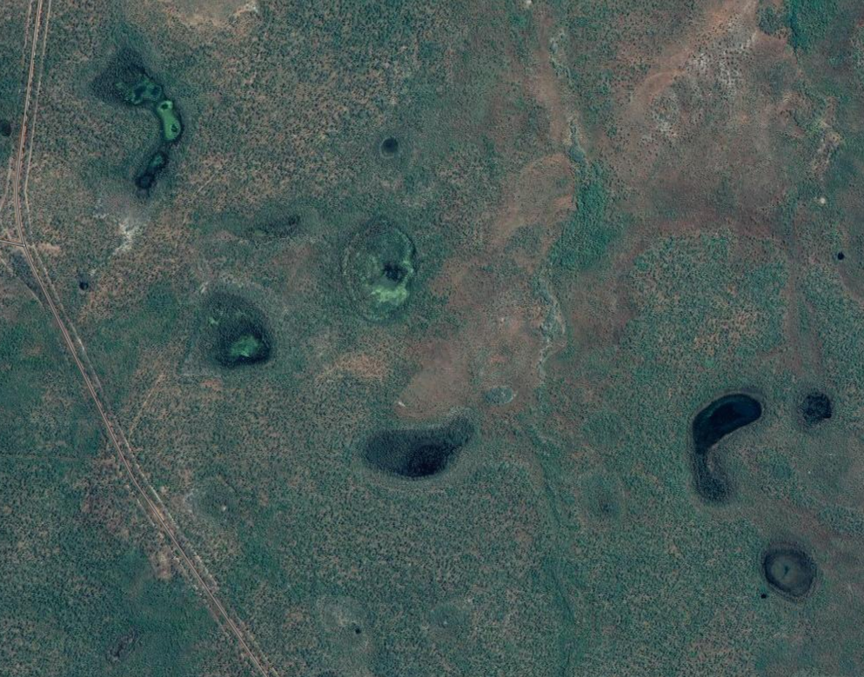
Application study
We apply this approach to a simplified hydrogeological characterisation of the Wildman River Area (Northern Territory, Australia) and evaluate whether sinkhole-type depressions act as conduits for groundwater recharge.
The widespread, enclosed, sinkhole-like depressions have been mapped on satellite imagery.

Slide 7

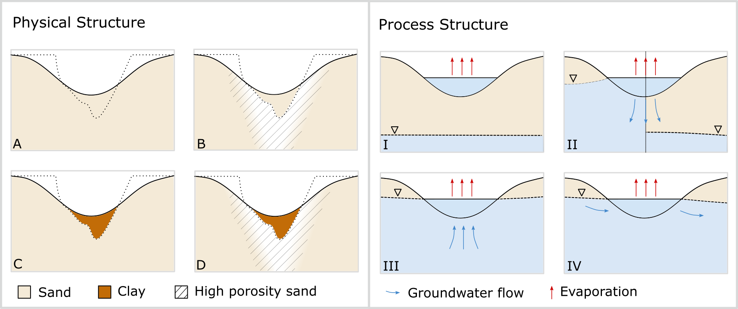
1. Alternative model development
The conceptual model of the depressions consist of a physical structure and a process structure.
Alternative models for the two structure are developed based on a literature review.
The physical structure describes the different lithologies underlying the depressions.
The literature review was based on a general understanding of the geomorphological development of depressions.
The process structure describes water going into and out of the depressions.
The literature review was based on a basic understanding of groundwater-surface water interactions of the depressions.

Slide 8

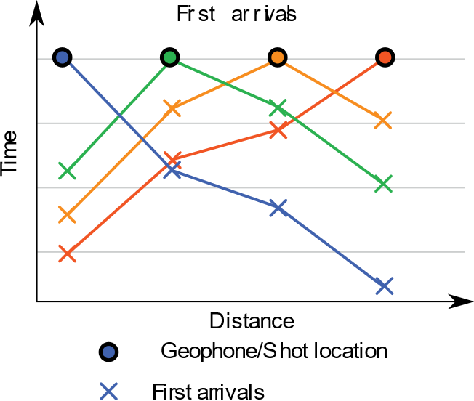
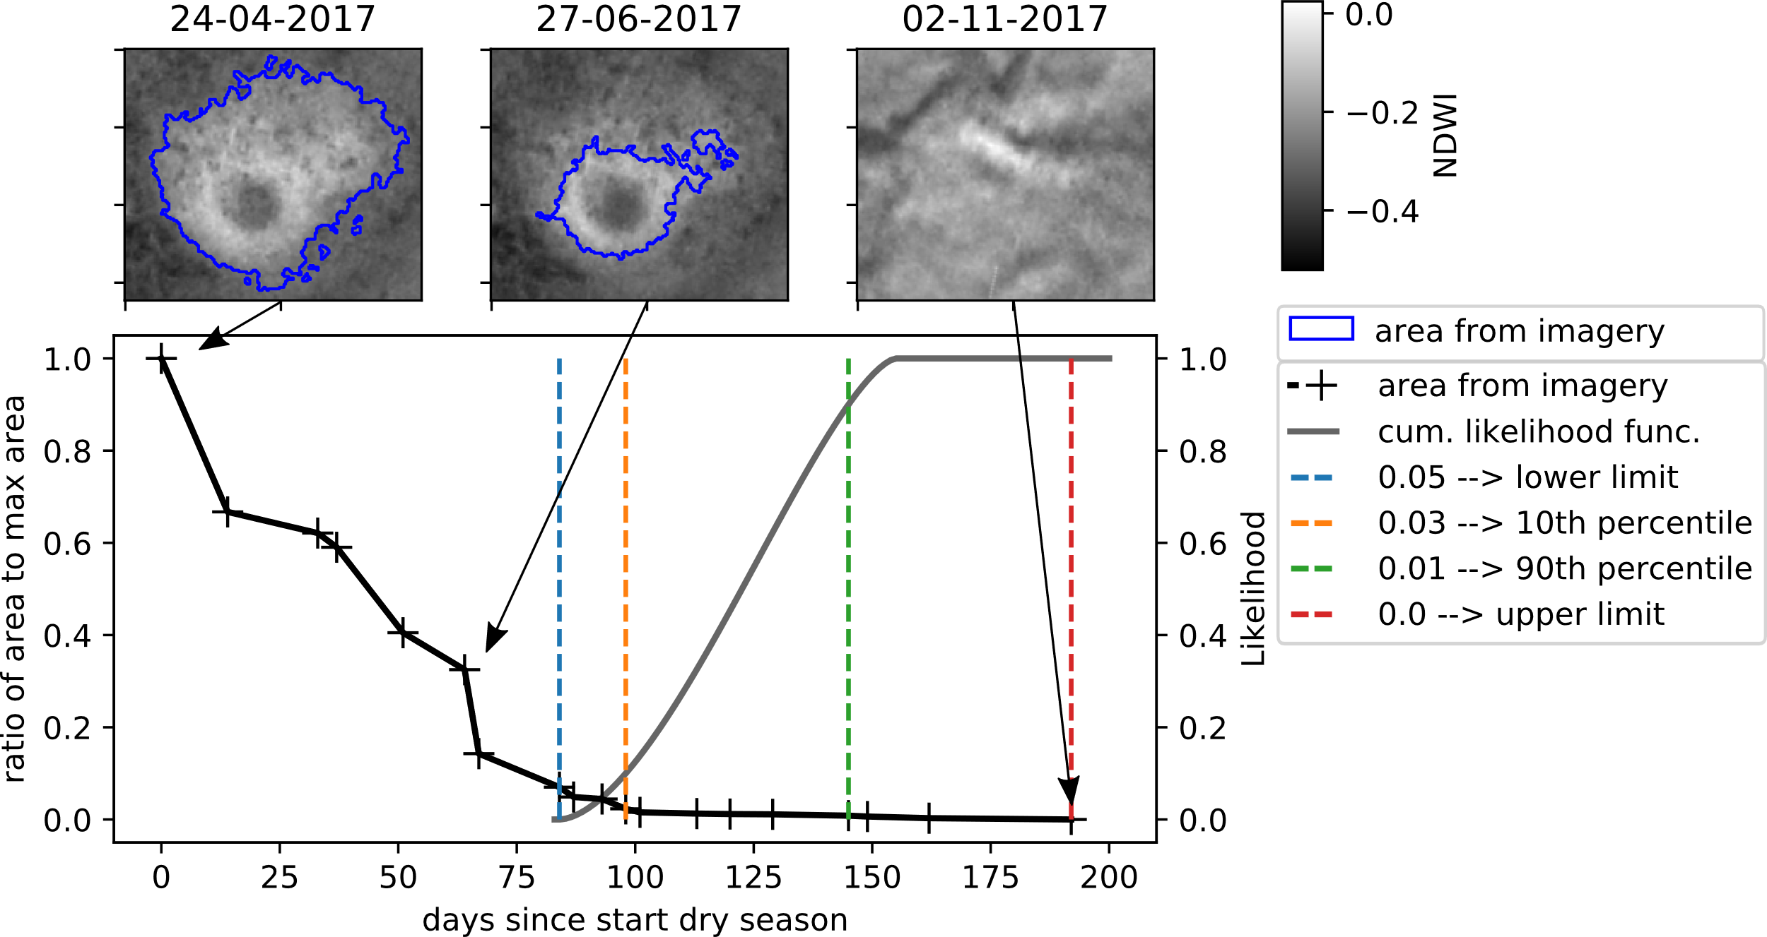
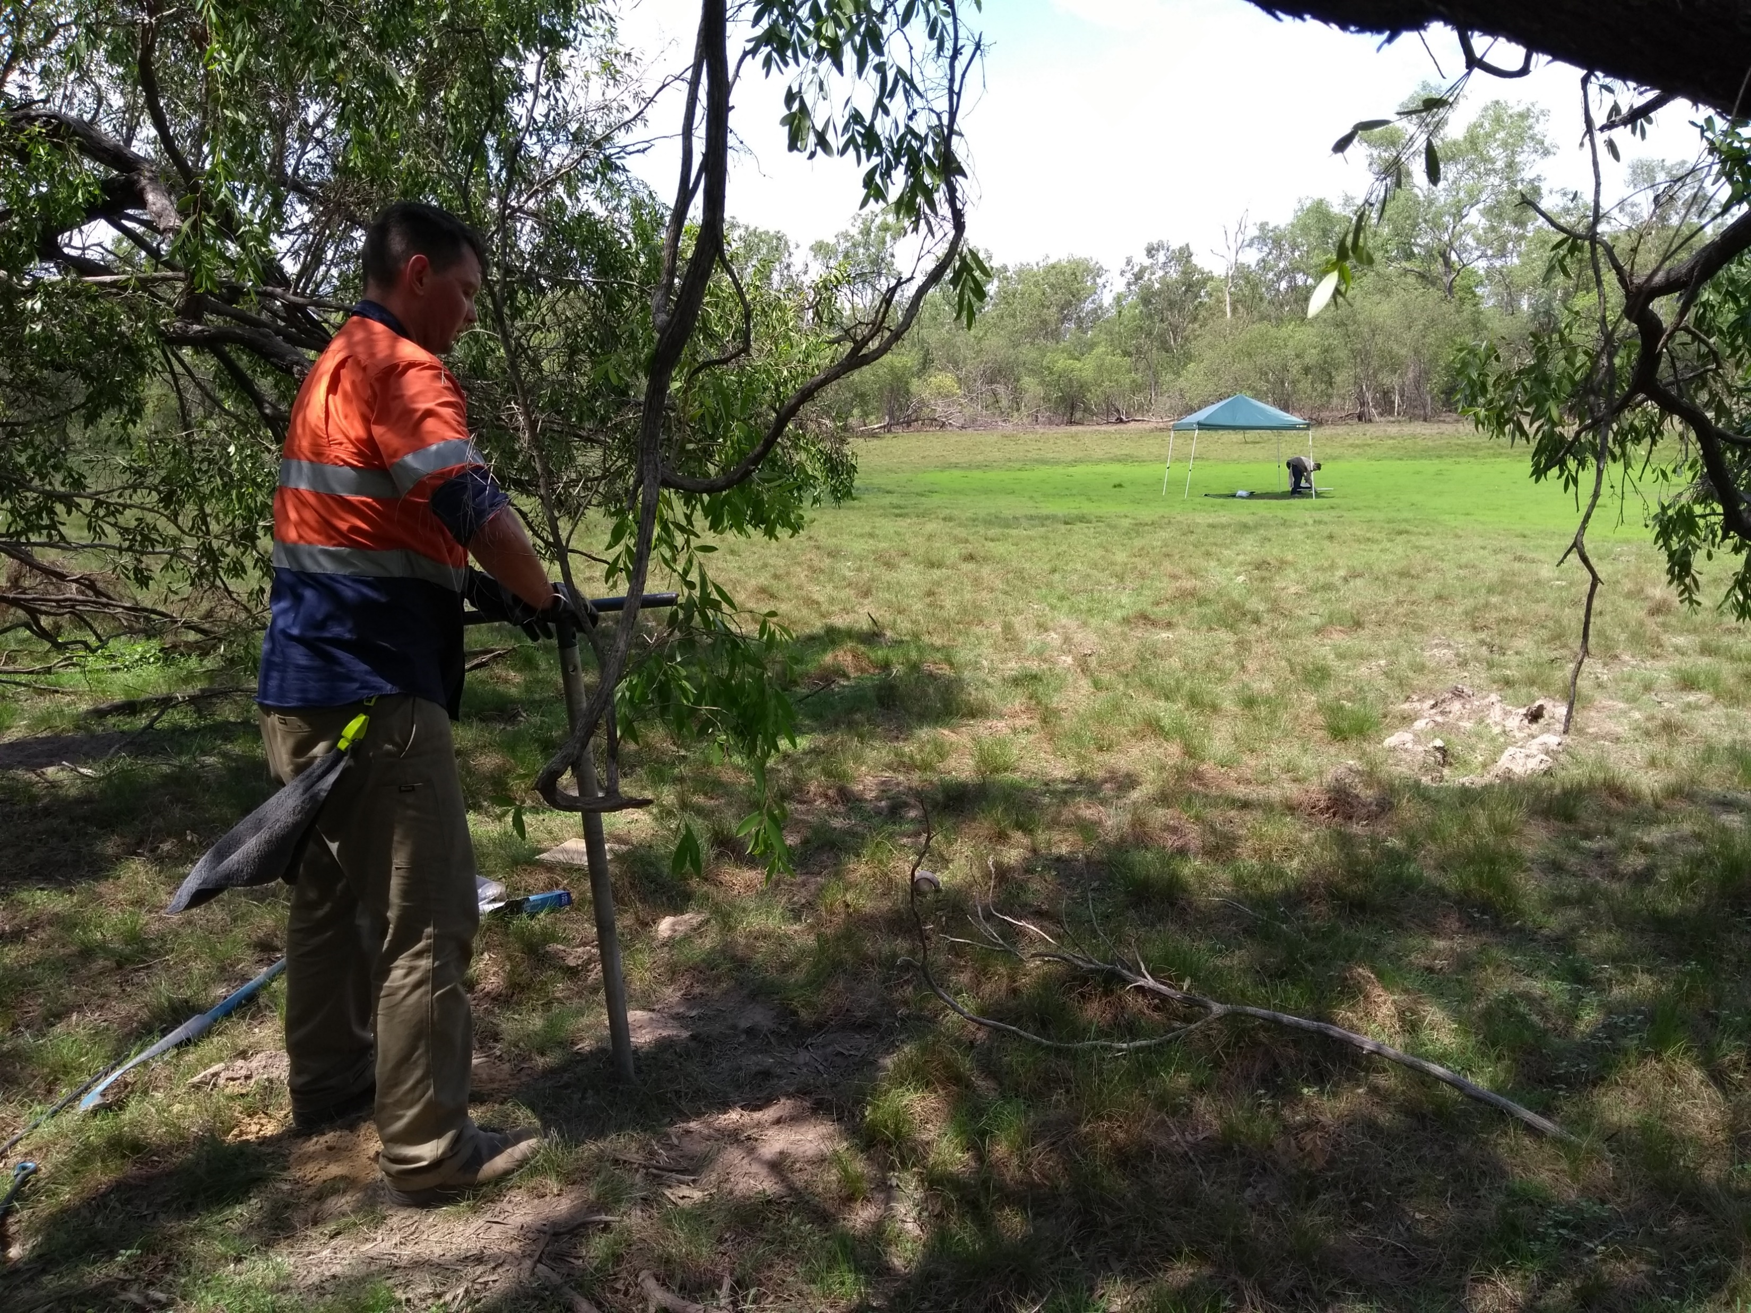
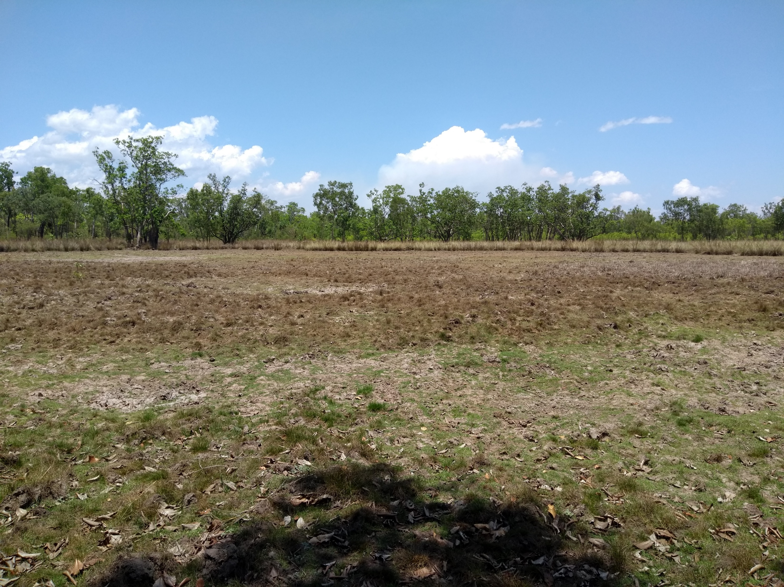
2. Independent data identification
To test the physical structure seismic refraction data was collected at five depressions.
The travel-time of the compressional P-wave from a seismic source to a series of known receiver locations is measured and used directly as testing data.
For testing the process structures, PlanetScope satellite imagery for 19 dates over the dry season was used.
The depressions all run dry during the dry season, albeit at different times; the observation of interest is the last day of water inundation.

Slide 9

3. Forward model run
The forward model for the physical structure is a shortest path raytracing model combined with a rock physics model.
A synthetic dataset of refraction seismic travel times is created
For the process structure the forward model is a bucket water balance model.
Generates a synthetic dataset of the duration of water inundation after the start of the dry season.

Slide 10

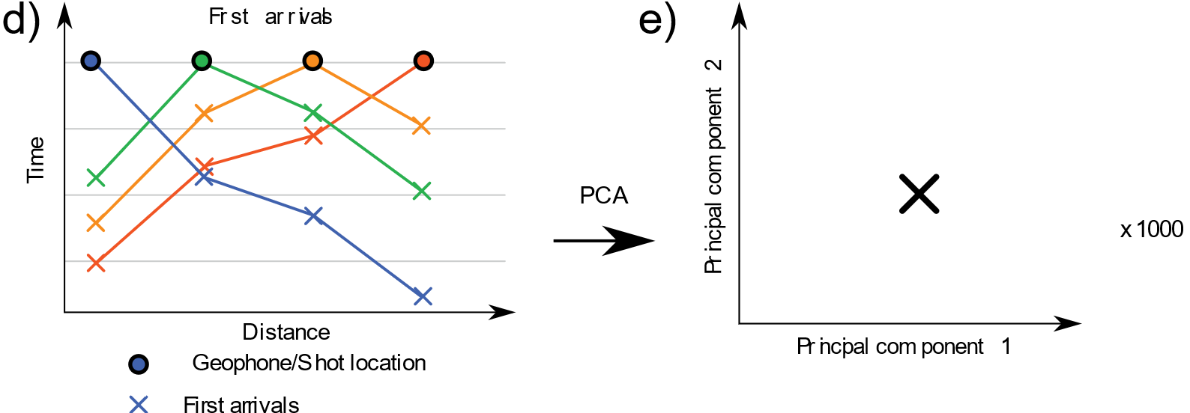
4. Model rejection
Models are rejected through comparison with data rather than intercomparison of model performance.
Physical structures are rejected through a novelty detection in reduced parameter space.
Process structures obtaining zero marginal likelihood are rejected.
When the observation (red cross) is plotting outside cloud of the synthetic realisations, the model is rejected.
Models with all realisations plotting outside the likelihood function (black line) are rejected.
Notes:
To globally test the physical models, we apply a dimension reduction technique to the refraction seismic data. We apply Principal Component Analysis (PCA) using the PCA class from the open-source Python framework scikit-learn (Pedregosa et al., 2011). PCA reduce the number of dimensions by feature extraction, which means that from the first arrival variables (>900) we can create a smaller number of new variables that are combinations of the old variables. These new variables are ordered by how much variability they explain of the old variables. In our case we only keep the two first principal components as they explain more than 90 % of the variability.
Based on the first two components of the PCA, we apply a novelty detection analysis (Markou & Singh, 2003) using the LocalOutlierFactor class from scikit-learn (Pedregosa et al., 2011). Novelty detection evaluates whether a new observation in a dataset is an outlier or not. In this case we evaluated whether the observation dataset (in terms of its first two PCs) is an outlier relative to the synthetic forward model response. If the observation dataset is deemed to be a novelty (i.e., outlier) relative to the model response, the model can be rejected.

Slide 11

5. Update probability
Posterior
The probability of the model structures was updated and combined into conceptual models consisting of a physical structure (A-D) and a process structure (I-IV) for five depressions S1-S5.
Of the 16 different conceptual models, only two would allow for the depression to act as conduits of recharge, A-II and B-II (dashed boxes).
Red crosses (x) represent rejected conceptual models.
In depression S1 a high porosity zone is not likely and recharge limited if any.

Slide 12
5. Update probability
The probability of the model structures was updated and combined into conceptual models consisting of a physical structure (A-D) and a process structure (I-IV) for five depressions S1-S5.
Of the 16 different conceptual models, only two would allow for the depression to act as conduits of recharge, A-II and B-II (dashed boxes).
Red crosses (x) represent rejected conceptual models.
In depression S1 a high porosity zone is not likely and recharge limited if any.
Depression S2, S3 and S4 are definitely a recharge features with a high porosity zone.

Slide 13
5. Update probability
The probability of the model structures was updated and combined into conceptual models consisting of a physical structure (A-D) and a process structure (I-IV) for five depressions S1-S5.
Of the 16 different conceptual models, only two would allow for the depression to act as conduits of recharge, A-II and B-II (dashed boxes).
Red crosses (x) represent rejected conceptual models.
In depression S1 a high porosity zone is not likely and recharge limited if any.
Depression S2, S3 and S4 are definitely a recharge features with a high porosity zone.
Depression S5 is least decisive in terms of the model structure for both the physical structure and the process structure, and more model testing is required to discriminate between model structures.

Slide 14
Conclusions
Rather than obtaining a single best fitting model, an ensemble of models all consistent with prior information is obtained.
Compared to the traditional inversion approach more information is provided on the conceptual model.
Although the framework is not directly prediction oriented, the testing of plausible conceptual models will ultimately lead to increased confidence of any groundwater model based on accepted posterior conceptualisations.

Slide 15
Thank you!
FOR FURTHER INFORMATION
Trine Enemark
trine.enemark@csiro.au
trine.enemark@flinders.edu.au
Land & Water
csiro.au/land-and-water
REFERENCES
Enemark, T., Peeters, L. J. M., Mallants, D., Flinchum, B. A. & Batelaan, O. A systematic approach to hydrogeological conceptual model testing, combining remote sensing and geophysical data. Subm. to WRR.

