Slide 1
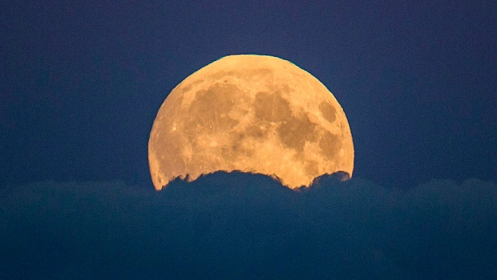
Lunar Impact Cratering History Recorded by Phosphates at µm to nm Scales
Ana Černok
University of Toronto, Royal Ontario Museum, Center for applied planetary mineralogy
With: Kim Tait, Lee White, Mahesh Anand, James Darling, Martin Whitehouse, and Sandra Kamo
© Authors. All rights reserved
Ana Černok, EGU online, May 6th 2020

Slide 2
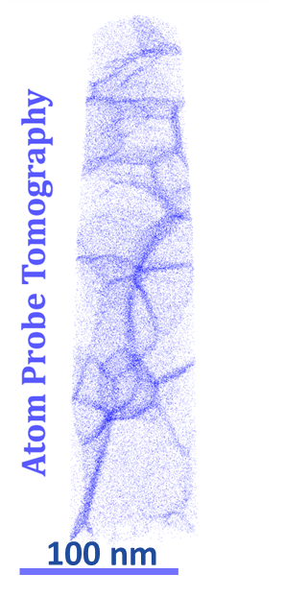
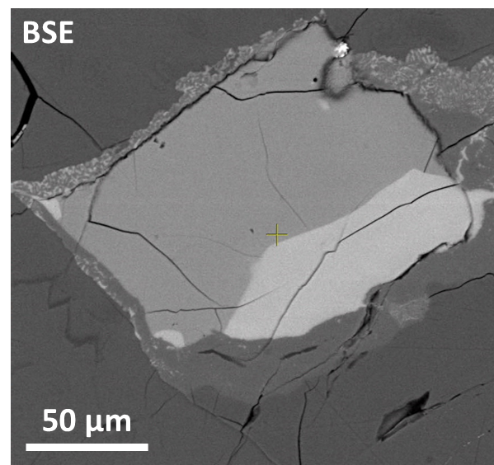
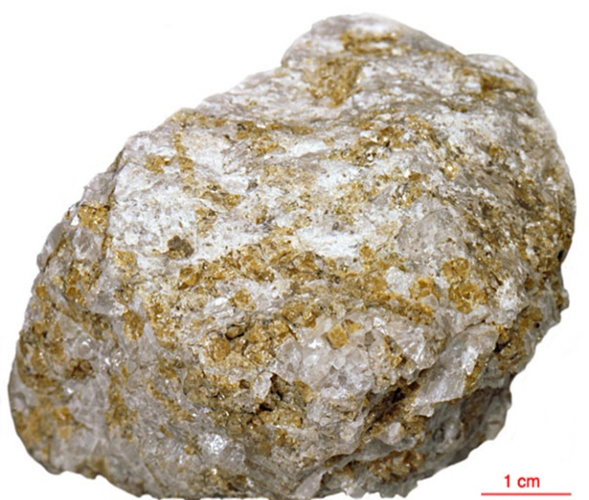
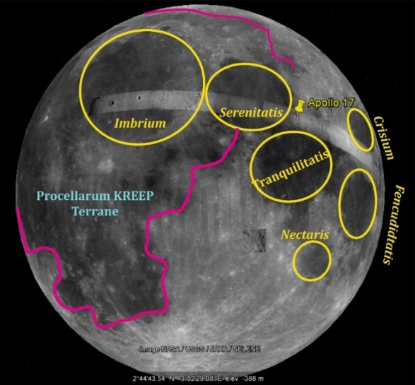
Lunar phosphates: nanoscale to planet
Focus on phosphates in Apollo 17 Mg- suite samples
Apollo 17 mineral
electron microscope image
Apollo 17 rock
hand specimen
Moon
Ana Černok, EGU online, May 6th 2020

Slide 3
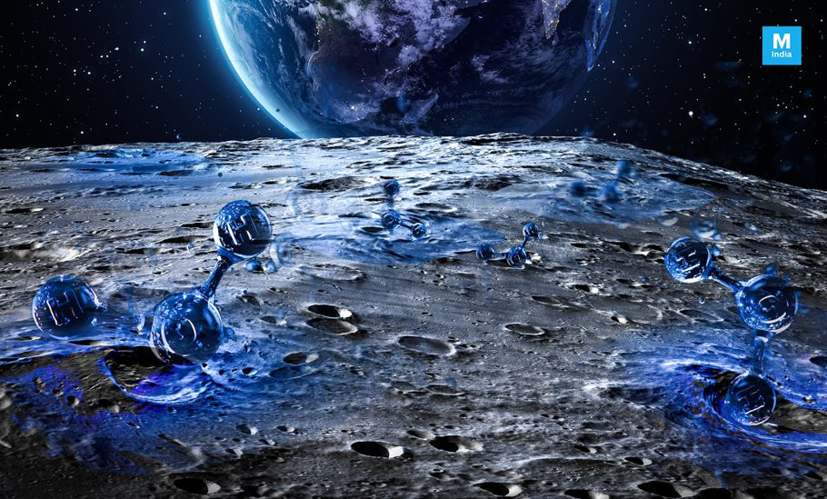
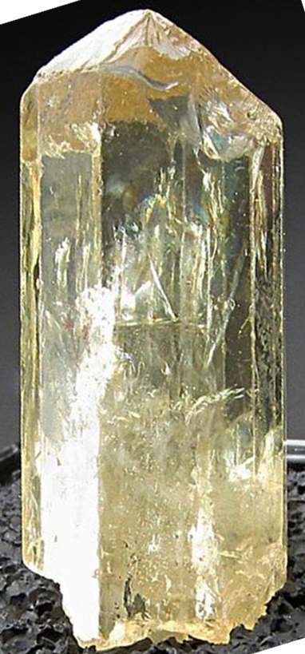
Lunar apatite: a versatile recorder
Water in the Moon: ~10 years since discovery of water in lunar samples (Saal et al. 2008)
Why apatite?
Ca₅(PO₄)₃(F, Cl, OH)
recorder of lunar volatiles
wide range of sample ages, localities, and petrogenetic environments
U-Pb dating of impact events
Why Mg-suite rocks?
Plutonic highland rocks, no degassing
Crystallization ages from 4.4-4.1 Ga
High index of petrological pristinity
Exposed to impacts
Shocked apatite to understand the timing of impacts (in Apollo 17 rocks)
Volatile (F, Cl, OH)
REE
U-Pb
Boyce et al. (2010)
McCubbin et al. (2010)
Ana Černok, EGU online, May 6th 2020

Slide 4
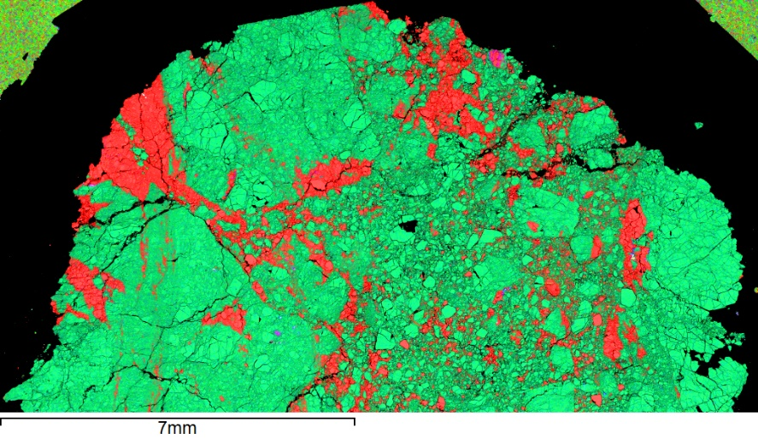
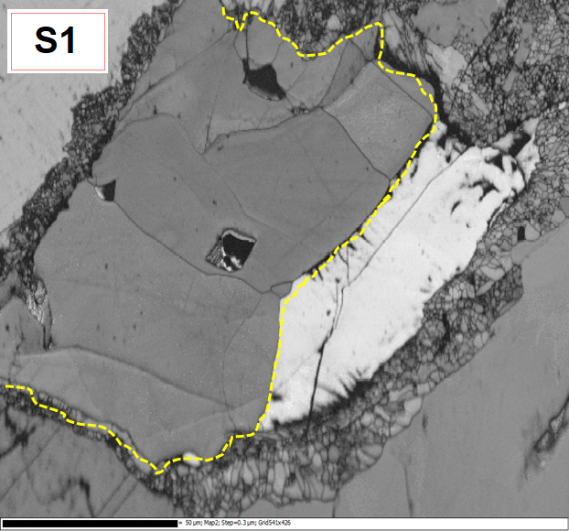
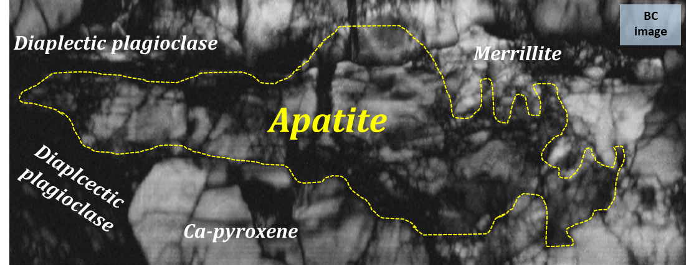
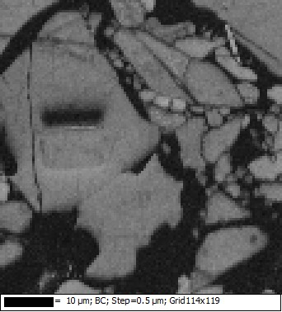
Lunar phosphates: structure
Studied Apollo 17 rocks (EDS maps)
S1
S2
76335 troctolite
S5
S6
R
76255 impact melt breccia
Timing of
Mg
Al
78236 norite
Coarse-grained cumulate
Shocked coarse-grained cumulate
Coarse-grained cumulate inside impact melt
Studied phosphates (EBSD maps)
S5
R
Apatite
Apatite
10 µm
50 µm
EBSD to understand microtexture
Shock deformation stages (R-recrystallized)
10 µm
Černok et al. EGU online, May 6th 2020

Slide 5
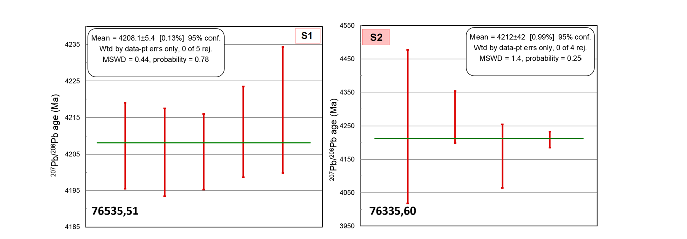
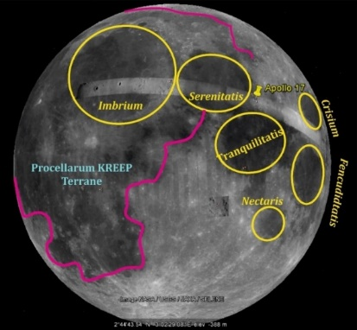
Lunar phosphates: unshocked U-Pb age
SIMS
SIMS
U-Pb ages of unshocked phosphates are concordant
imply crystallization of phosphates within the crustal Mg-suite at ~4.2 Ga
Ana Černok, EGU online, May 6th 2020

Slide 6
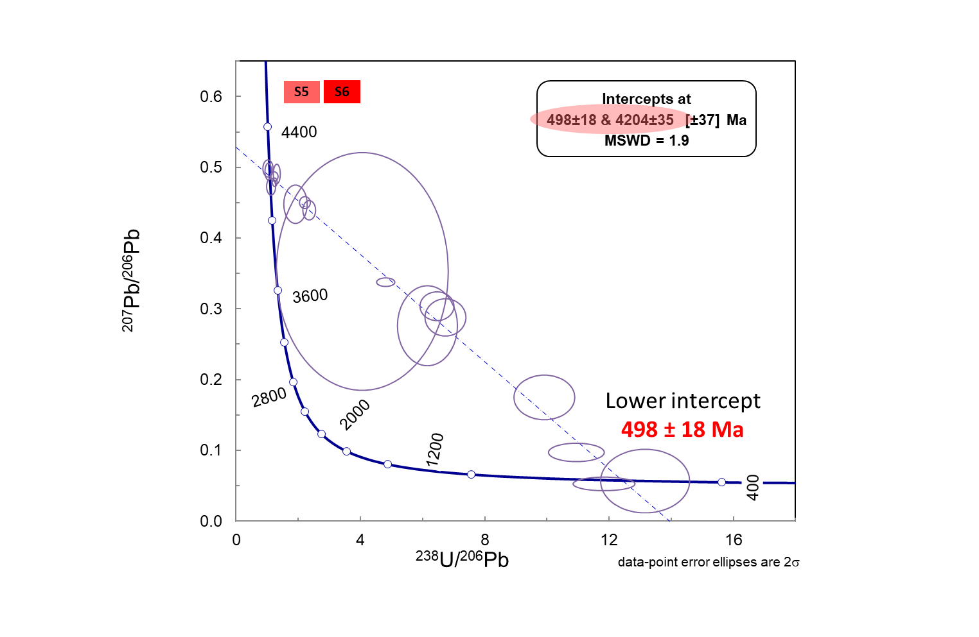
Lunar phosphates: highly shocked U-Pb age
U-Pb ages of highly shocked apatite (Apollo 17 norites) are discordant
Upper intercept
4204 ± 35
Pb – loss!
SIMS
Apatite: impact sensitive geochronometer
Ana Černok, EGU online, May 6th 2020

Slide 7
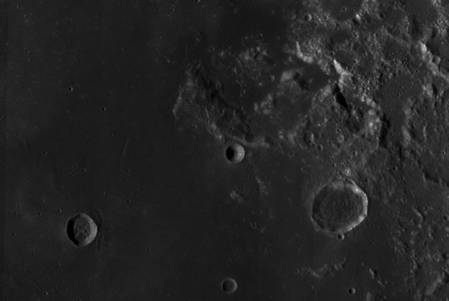
Lunar phosphates: highly shocked U-Pb age
Possible impact event at ~500 Ma related to nearby craters
Apollo 17
Norite 78235
Serenitatis
~ 140 km
Dawes (~ 18 km)
500 Ma
Mazrouei et al. 2019
Ana Černok, EGU online, May 6th 2020

Slide 8
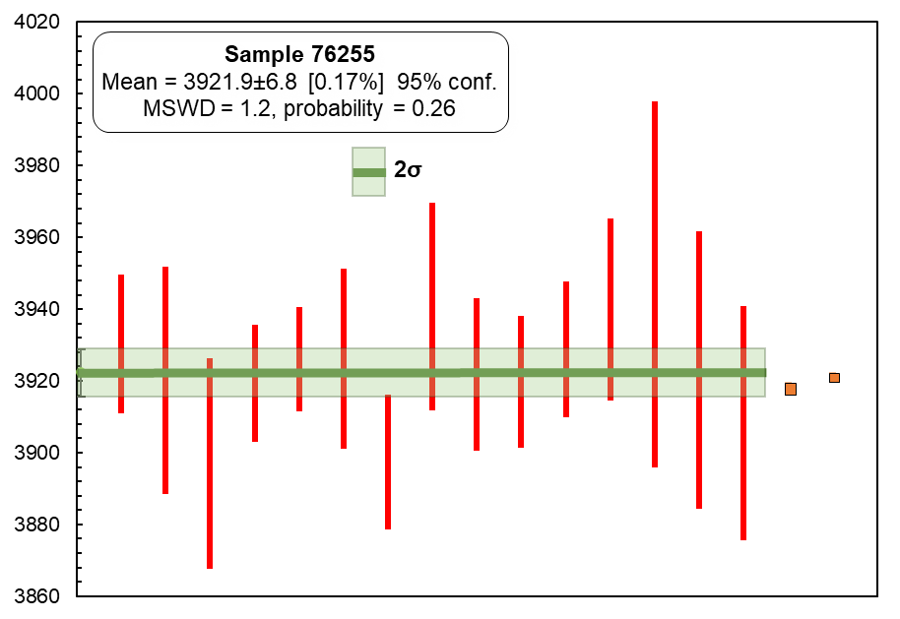
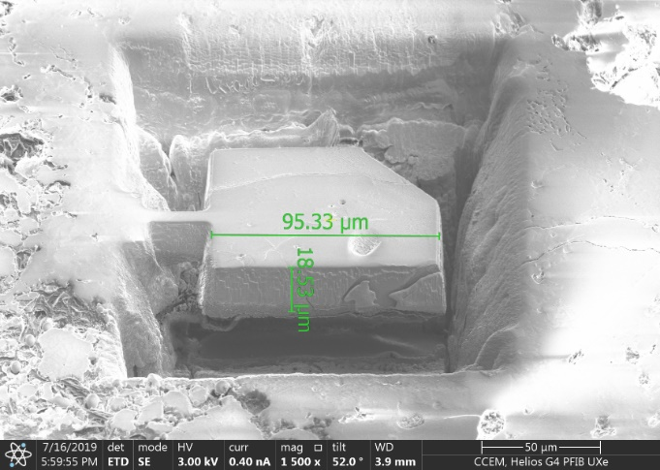
Lunar apatite: U-Pb age of impact melt rocks
U-Pb ages of shocked apatite from impact melt breccia in Apollo 17 are fully reset
Phosphate FIB-liftout for TIMS
TIMS
SIMS
High-precision TIMS ages of recrystallized apatite sampled by FIB
TIMS ages are within the range of the weighted average of the 76255 SIMS ages
Possibly related to Imbrium event
Černok et al. EGU online, May 6th 2020

Slide 9
Lunar apatite: a nanoscale story-teller
U-Pb/Pb-Pb systematics of phosphates is very sensitive to shock deformation, particularly to heat source
Apatite: impact sensitive geochronometer
Microstructure to help discern crystallization vs. deformation ages
Refining the record of multiple impact events close in time to what is interpreted as the Imbrium event by FIB-TIMS
Ana Černok
acernok@rom.on.ca
Černok et al., Lunar apatite, Goldschmidt 2019, Barcelona

