Slide 1
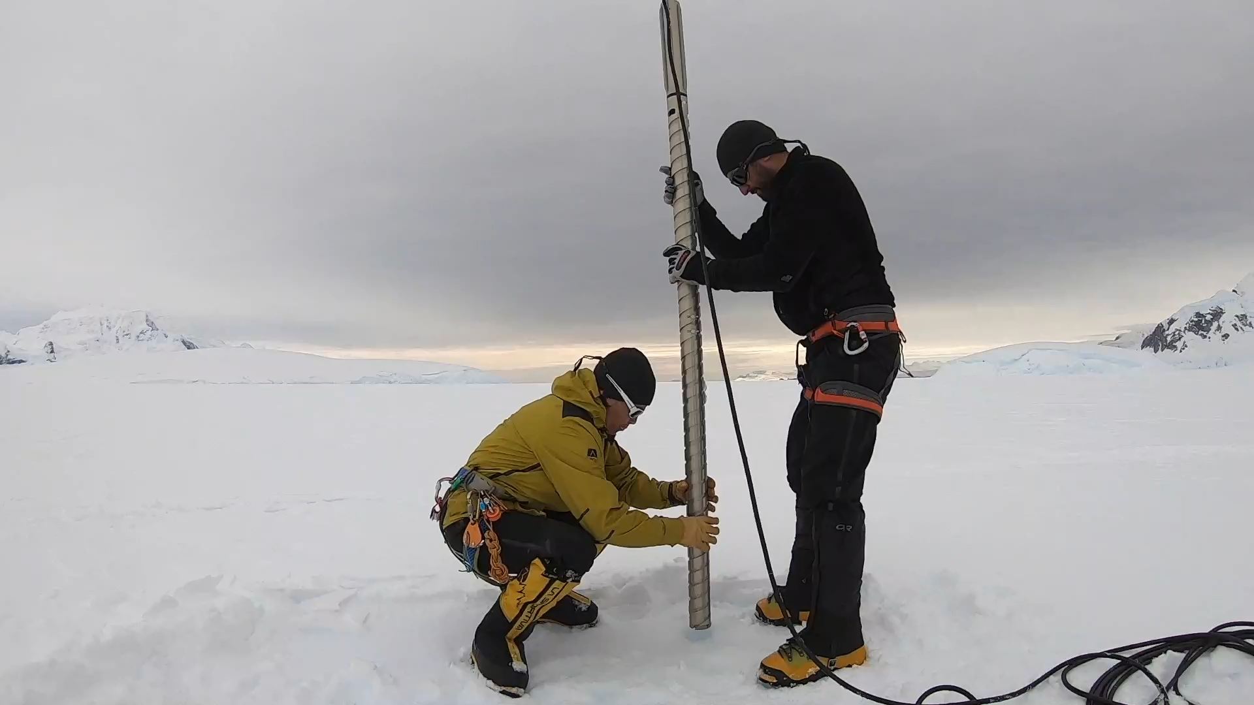
Exploring firn aquifers on the Müller Ice Shelf, Antarctica
Shelley MacDonell et al.
Firn core taken at 4 m depth. Late February 2019.
All rights are reserved but I still grant Copernicus Meetings the right to hold my presentation materials online for viewing and download by individuals

