Slide 1
Steve: The optical signature of
subauroral ion drifts
W. E. Archer, B. Gallardo-Lacourt, G. Perry,
J.-P. St.-Maurice, S. C. Buchert, E. Donovan
6 May 2020
Photograph by Alan Dyer

Slide 2
Steve: What do we know about him?
Steve is a white light continuum with a red-line enhancement [Gillies et al. 2019]
Spans:
10s of km N-S
1000s of km E-W
From ~140km to 270 km altitude
Occurs equatorward of auroral oval
Lasts roughly 1 hour [Gallardo-Lacourt et al. 2018a]
Does not seem to involve particle precipitation [Gallardo-Lacourt et al. 2018b]
[Gallardo-Lacourt et al. 2018a]
[Archer et al. 2019]
Photograph by Alan Dyer

Slide 3
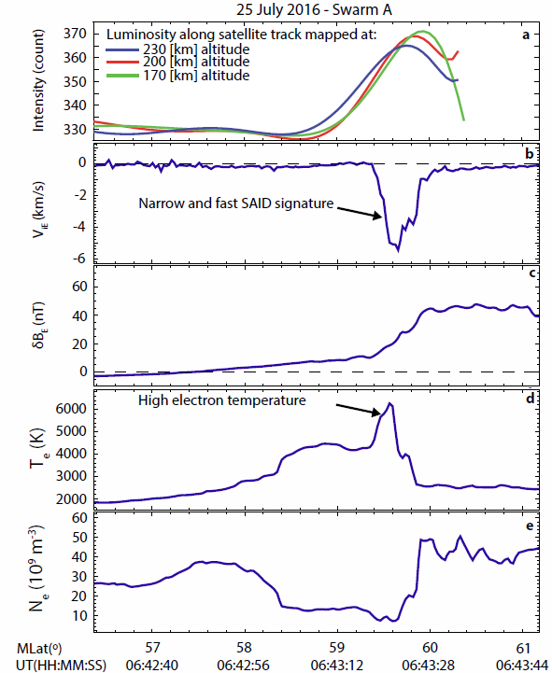
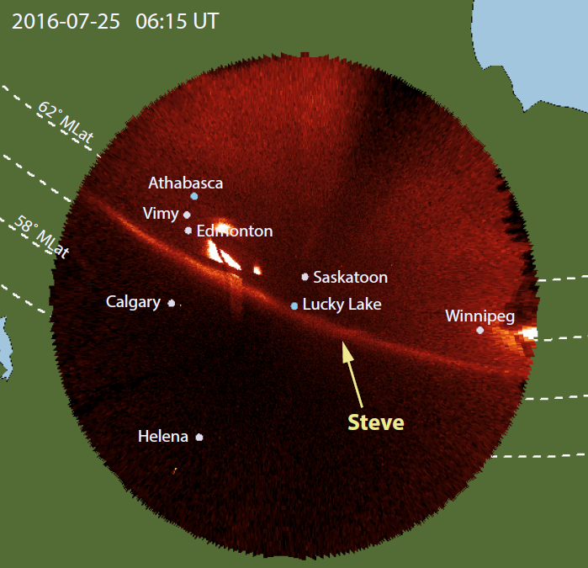
First Swarm observations of Steve
Macdonald et al. [2018] identified Steve event in coincident all-sky and Swarm measurements. Steve was observed coincident with an extreme SAID.
Is this normal?

Slide 4
Next step
We identified 8 Steve events with coincident or near coincident all-sky imager and Swarm observations.
We consistently observed SAID roughly coincident with Steve. (next slide)
Plasma minimum, electron temperature maximum (mid-latitude density trough)
Weak upward FAC
Narrow flow channel

Slide 5
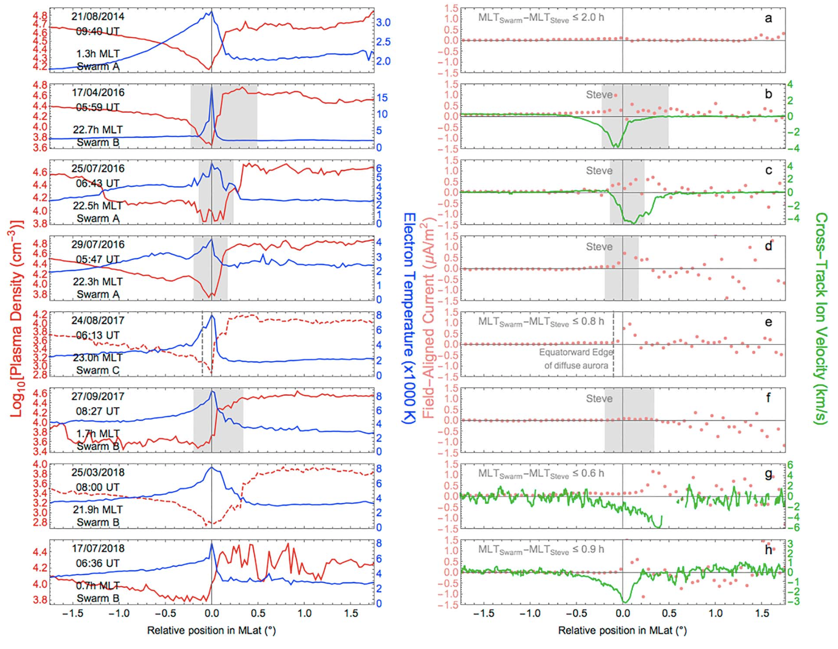
Swarm observations of Steve

Slide 6
“Typical” SAID
To compare these events with “typical” SAID, we identified 122 SAID events in Swarm data
The Steve events have larger ion velocities, deeper troughs, and larger electron temperatures relative to typical SAID
Steve appears to be consistently associated with extreme SAID

Slide 7
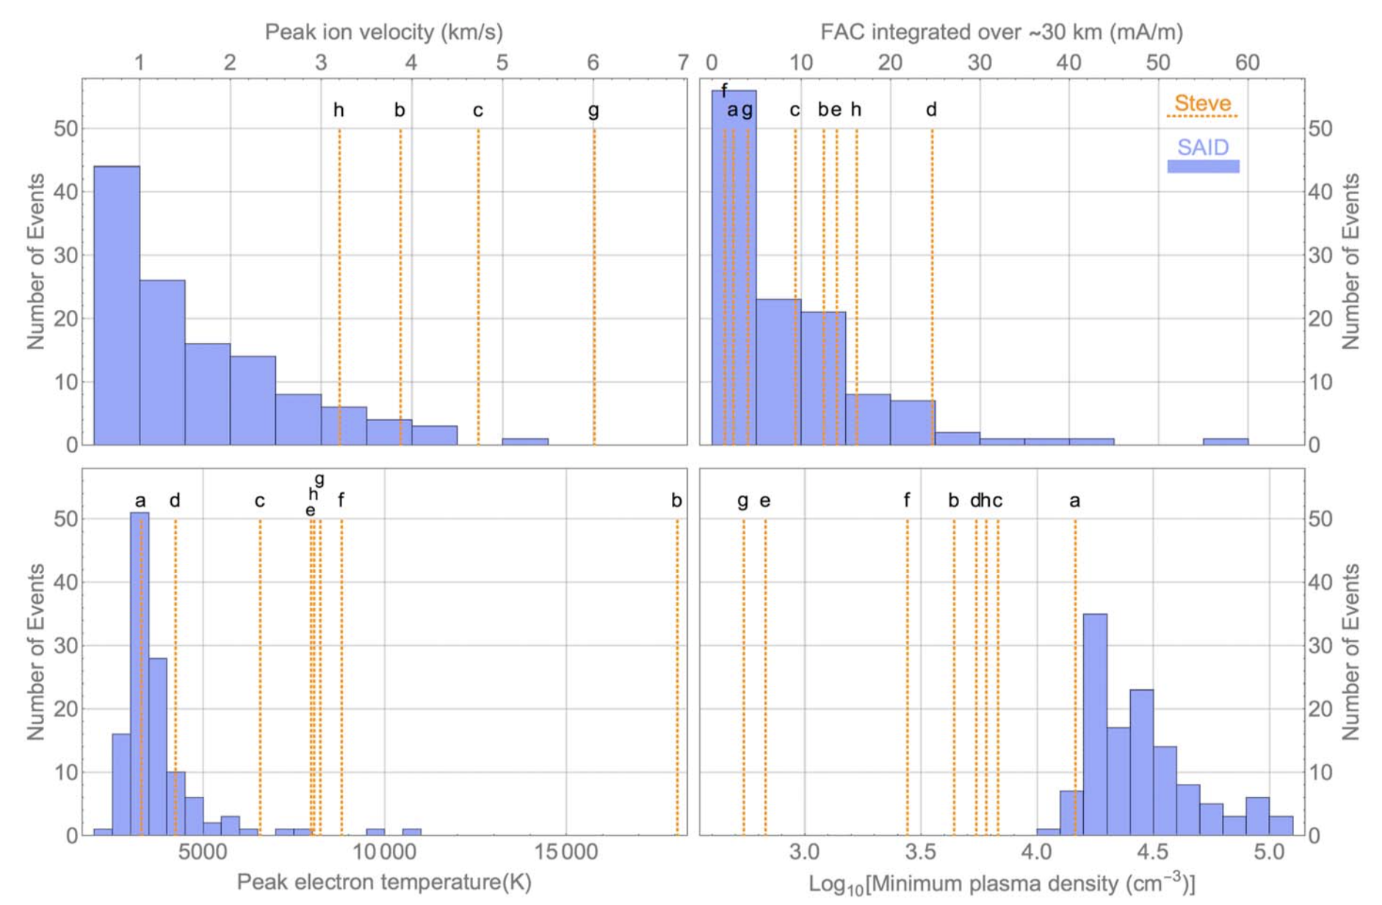
Swarm and Steve

Slide 8
The implications of these results
Harding et al. [2020] present a simple model for Steve in which:
Fast ion flows result in NO production
NO + O recombination results in a continuum emission
The observations from Swarm were key to constraining this initial model for Steve

Slide 9
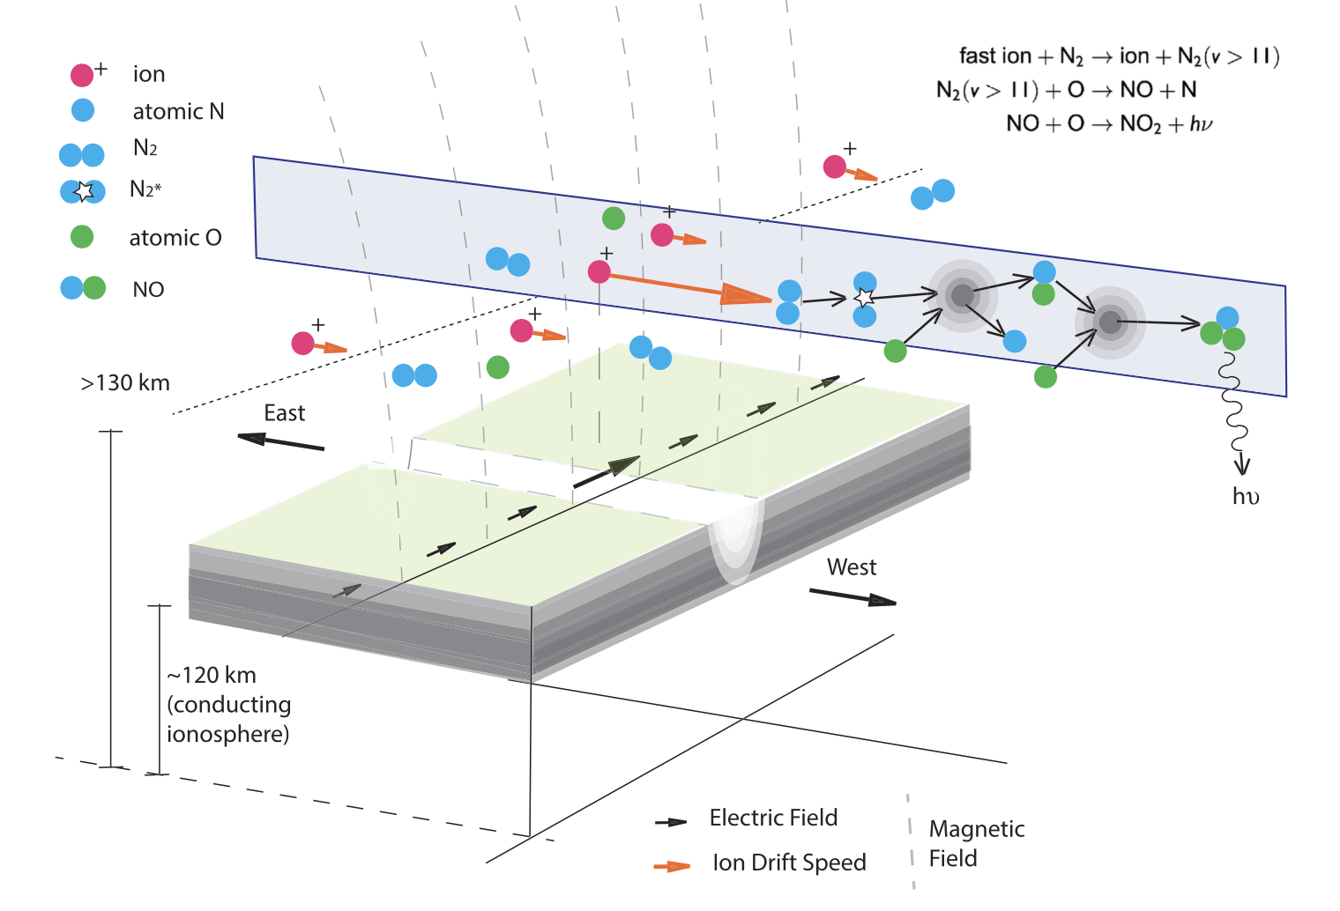
A mechanism for the Steve continuum emission [Harding et al. 2020]

Slide 10
References
[1] Gallardo‐Lacourt, B., Y. Nishimura, E. Donovan, D. M. Gillies, G. W. Perry, W. E. Archer, O. A. Nava, and E. L. Spanswick. "A Statistical Analysis of STEVE" Journal of Geophysical Research: Space Physics 123, no. 11 (2018): 9893-9905.
[2] Gallardo‐Lacourt, B., J. Liang, Y. Nishimura, and E. Donovan. "On the Origin of STEVE: Particle Precipitation or Ionospheric Skyglow?" Geophysical Research Letters 45, no. 16 (2018): 7968-7973.
[3] MacDonald, E. A., E. Donovan, Y. Nishimura, N. A. Case, D. M. Gillies, B. Gallardo-Lacourt, W. E. Archer et al. "New science in plain sight: Citizen scientists lead to the discovery of optical structure in the upper atmosphere." Science advances 4, no. 3 (2018): eaaq0030.
[4] Spiro, R., R. Heelis, W. Hanson, ”Rapid subauroral ion drifts observed by atmosphere explorer C” Geophysical Research Letters, Vol. 6, No 8 (1979): 657-660
[5] Khalipov, V. L., Yu. I. Galperin, A. E. Stepanov, L. V. Shestakova, “Formation of a polarization jet during the expansion phase of a substorm: Results of ground-based measurements” Cosmic Research, Vol. 39, No. 3 (2001): 244-253
[6] Sazykin, S., B. G. Fejer, Yu. I. Galperin, L. V. Zinin, S. A. Grigoriev, M. Mendillo “Polarization jet events and excitation of weak SAR arcs”, Geophysical Research Letters, Vol. 29, No. 12 (2002): 24-27
[7] Kozyra, J. U., A. F. Nagy “High-altitude energy source(s) for stable auroral red arcs. Reviews of Geophysics, Vol. 25, No. 96 (1997): 155-190
[8] Harding, B.J., Mende, S.B., Triplett, C.C. and Wu, Y.J.J., A mechanism for the STEVE continuum emission. Geophysical Research Letters.

