Slide 1
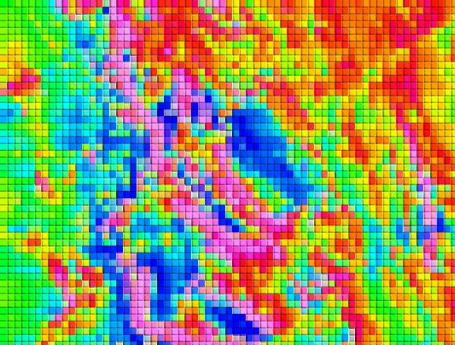
Implications of magnetic secular variation for interpretation of crustal field anomalies
Rick Saltus¹, Maj. Aaron Canciani², Brian Meyer¹, and Arnaud Chulliat¹
¹University of Colorado
²Air Force Institute of Technology
Notes:
Hi – I’m Rick Saltus from the CIRES geomag team at the University of Colorado. Along with my co-authors Aaron Canciani, Brian Meyer, and Arnaud Chulliat, we are investigating the behavior of crustal magnetic anomalies as the Earth’s magnetic field changes over time.

Slide 2
ABSTRACT
We usually think of crustal magnetic anomalies as static (barring some major seismic or thermal disruption). But a significant portion of the crustal magnetic field is caused by the interaction of magnetic minerals with the Earth’s magnetic field. This induced magnetic effect is dependent on the direction and magnitude of the ambient field. So, of course, as the Earth’s magnetic field changes over time, the form and magnitude of induced magnetic anomalies will vary as well. These changes will often be negligible for interpretation when compared with measurement and other interpretational uncertainties. However, with the reduction of various sources of measurement noise and increased fidelity of interpretation, these temporal anomaly changes may need to be considered.
In addition to considerations relating to interpretation uncertainty, these temporal anomaly changes, if they are measured in multiple magnetic epochs, can theoretically provide valuable information for use in source inversion. For example, since crustal magnetic anomalies arise from a combination of induced (dependent the ambient field) and remanent (not dependent on ambient field) magnetic sources, measurements of secular magnetic variation can assist in separating these two sources during inversion.
We will report modeling of the expected form and magnitude of predicted induced anomaly variations, the possible implications of these variations for data compilation and interpretation, and on the availability of relevant data for measuring them. Recent research into the use of high-resolution magnetic anomaly maps for airborne magnetic navigation has also brought the issue of changing magnetic fields into focus. Initial work indicates that changes in induced anomalies could affect navigation accuracy in certain situations.
Notes:
Here is the abstract for our presentation. The main point is that the magnetic anomalies caused by the interactions of the Earth’s magnetic field with magnetic minerals in Earth’s crust will change in shape and size as the Earth’s field changes with time. These changes are relatively small and are often ignored in magnetic studies, but, in some situations and for some applications, these changes are important to consider and can, in fact, be quite helpful.

Slide 3
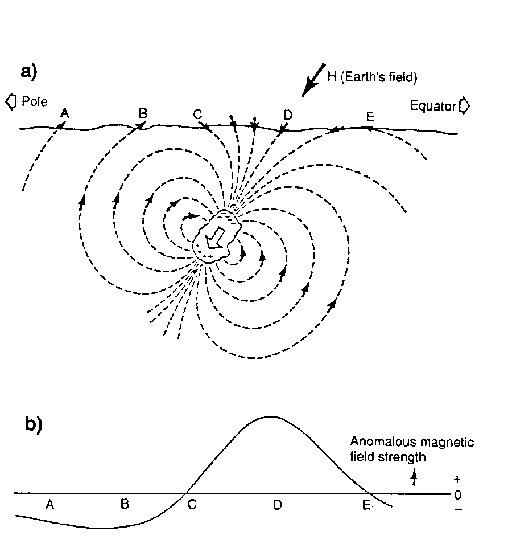
Induced Magnetic Anomaly
Notes:
This figure illustrates the induced magnetic anomaly (lower panel) caused by a rock containing magnetic minerals, such as magnetite, that interact with the Earth’s magnetic field. The dashed lines illustrate the magnetic field induced by the rock. When the magnetic field lines from the rock oppose the Earth’s field (depicted with the heavy black arrow), then the field you measure at that point will be reduced (for example, at points A and B). If the induced field is perpendicular to the Earth’s field, then it will not change the measured field (point C). When the rock’s field aligns with the Earth’s field, then you will measure a higher field (point D). The shape of the anomaly (the curve in the lower panel) will change if the Earth’s field (the dark H arrow in the upper panel) changes.
Rocks containing magnetic minerals react with the Earth’s magnetic field to cause local perturbations, which are called anomalies.
We get highs when the induced field lines are aligned with the Earth’s field and lows when they oppose the Earth’s field.
Note that we get a high somewhere above the center of the magnetic rock body (offset by the inclination of the Earth’s field) and a surrounding low. If you sum the areas under the anomaly curve (in 3 dimensions) the high and low areas cancel out to zero.

Slide 4
 | Epoch 1 | Epoch 2
Field Strength | 50000 | 51000
Inclination* | 60 | 80
Declination* | na | na
Mag Intensity | 3141.59 | 3204.4218
 |  |  |  | Source body parameters
 |  |  |  | Induced | Remanent
 |  |  | Inclination | get from epoch | 60
 |  |  | Radius | 2000 | 2000
 |  |  | Mag Intensity | get from epoch | 3000
 |  |  | K (SI x 10-3) | 10.00 | na
 |  |  | Z height | -5000 | -5000
 |  |  | x position | 5000 | 5000
Notes:
This slide is an introduction to the two slides that follow. The tables show magnetic field and magnetic source values used to produce the curves in the two figures. There are two magnetic epochs. In epoch 1 the intensity of the magnetic field is 50,000 nT. In epoch 2 the intensity is 51,000 nT. In epoch 1 the inclination of the field is 60 degrees and in epoch 2 the inclination is 80 degrees. This means that the magnetic pole is closer to the source body in epoch 2 than it was in epoch 1. For both epochs the source body is a sphere with both induced and remanent magnetization. The sphere has a radius of 2 km and is buried at 5 km depth centered at 5 km distance in the center of the plots.

Slide 5
Notes:
The calculated model curves in this panel show profiles over a magnetic dipole with both induced and remanent magnetization. Induced magnetic anomalies will vary as the Earth’s magnetic field changes in strength and direction over time. Remanent magnetic anomalies are not dependent on the current Earth’s magnetic field direction. The “Total 1” and “Total 2” curves show how the total (induced plus remanent) magnetic anomaly will differ from one magnetic epoch to another. The brown “Diff” curve shows the difference.

Slide 6
Notes:
This panel shows two simple navigational error scenarios based on the difference between the total magnetic anomaly in the two magnetic epochs. The “Xoffset1” curve shows the along profile navigational error if you allow for an adjustment of the magnetic base level (a DC shift) before matching to the calculated anomaly. The “Xoffset2” curve gives the estimated navigational error if you do not do a level adjustment. Navigational errors can exceed 1 km for this test and can vary abruptly depending on the shape of the magnetic anomaly.

Slide 7
Problem Setup
Green Dots: Observations
Blue and Red Prisms: Pure Remnant Magnetization
Yellow and Purple Prisms:
Induced Magnetization
Notes:
The next 6 slides illustrate proof of concept work by my co-author Aaron to demonstrate that if you have knowledge of magnetic anomalies measured in two different epochs you can use this information to constrain a source-parameter inversion and differentiate remanent (which will not change with epoch) vs induced (which will change with epoch) sources.
The synthetic model consists of 4 rectangular prism sources – two are induced and two are remanent as shown in the figure.

Slide 8
Classical Inversion Results – Induced Component
Notes:
This slide shows what happens if you apply standard inversion methods (we are using Matlab with some assumptions that prefer a smoothly varying source distribution) to data from a single epoch. The predicted induced source distribution (top panel) includes solutions in both the induced and remanent synthetic source regions.

Slide 9
Classical Inversion Results – Z Remnant Component
Notes:
Similarly, the inverted solution for remanent sources also includes both synthetic source regions.

Slide 10
Dual Time Inversion – Change and Data Fit
Notes:
This slide shows the synthetic forward calculation of the magnetic anomalies from these source bodies using data from two magnetic epochs. The anomalies for the two epochs don’t look very different to the eye, but the lower left panel shows that there is definitely a difference between the anomalies in the two epochs. The lower right panel shows the anomaly field for epoch 1 calculated from the source inversion using data from the two epochs.

Slide 11
Dual-Time Inversion Results – Induced Component
Notes:
This slide shows that the dual time inversion did a good job of isolating the induced source body. Note that there is a very faint induced source prediction in the upper right remanent source region.

Slide 12
Dual-Time Inversion Results – X Remnant Component
Notes:
Here is the remanent source result – this turns out to be a bit messier, but the remanent source is predominately attributed to the correct region.
This set of slides illustrates the theoretical ability to use data from two magnetic epochs to map induced vs remanent source domains.

Slide 13
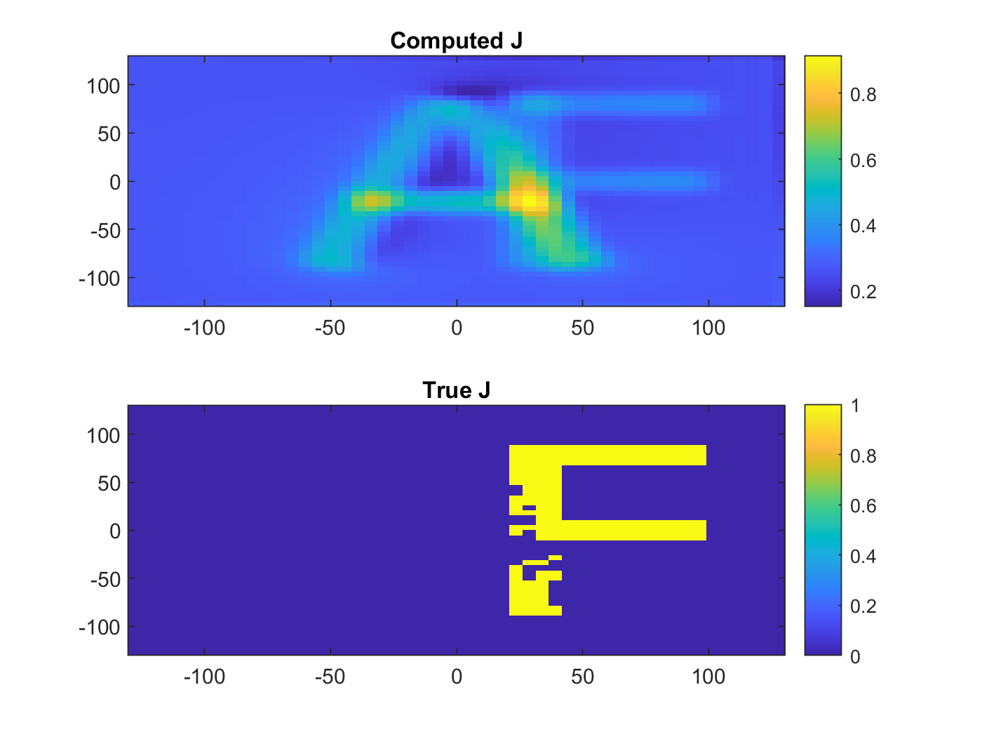
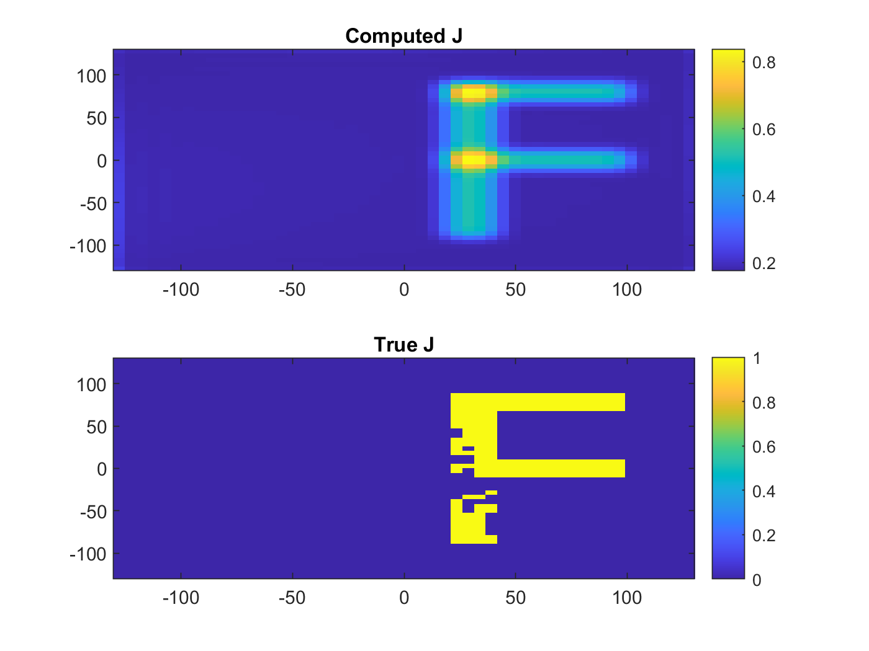
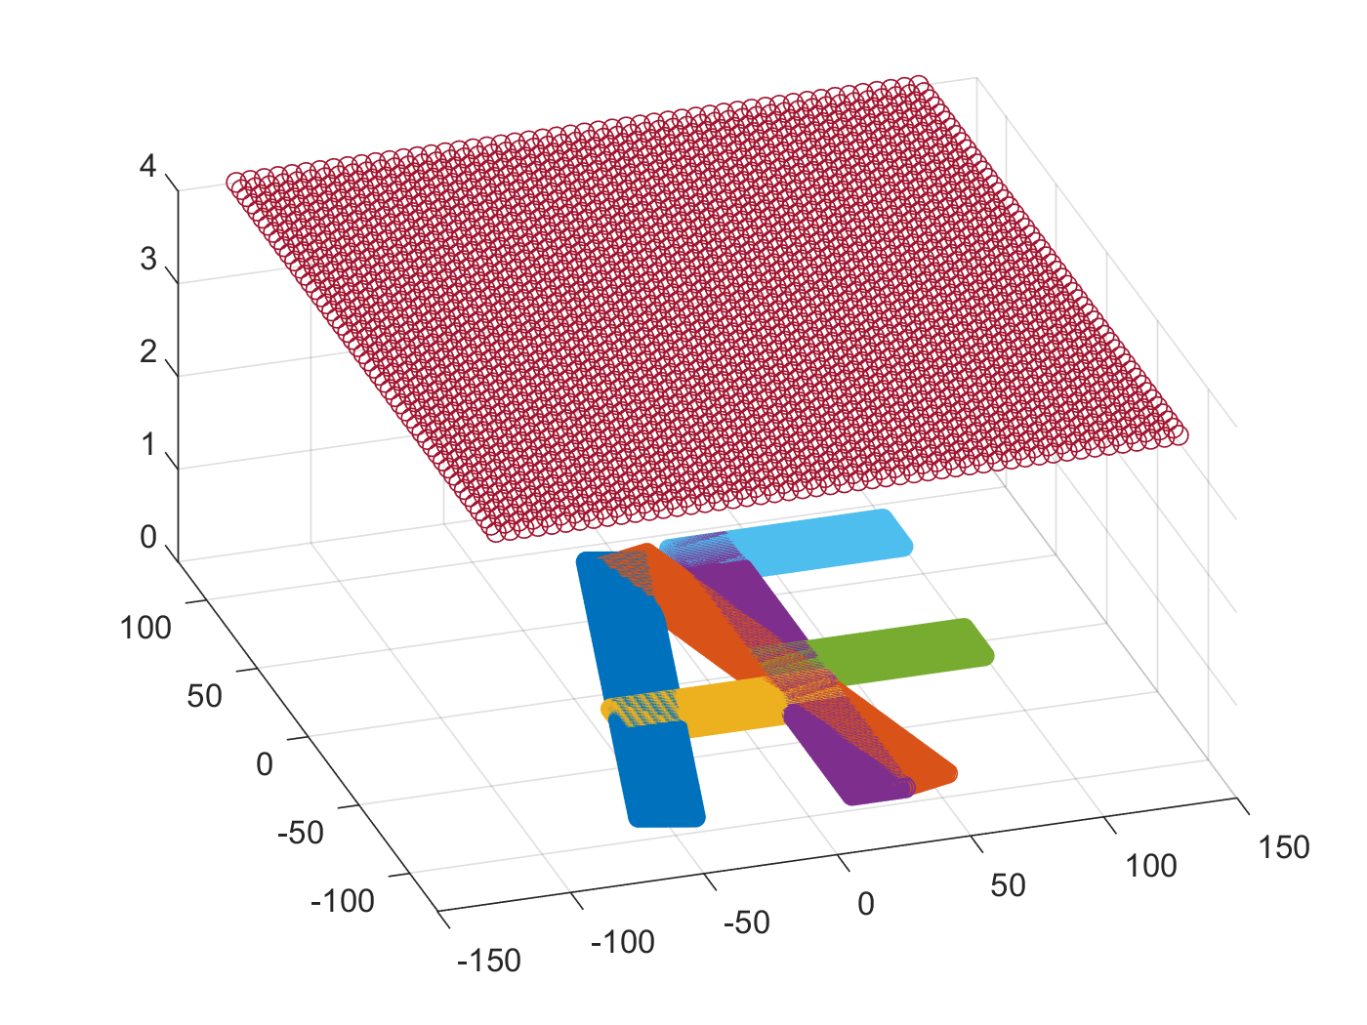
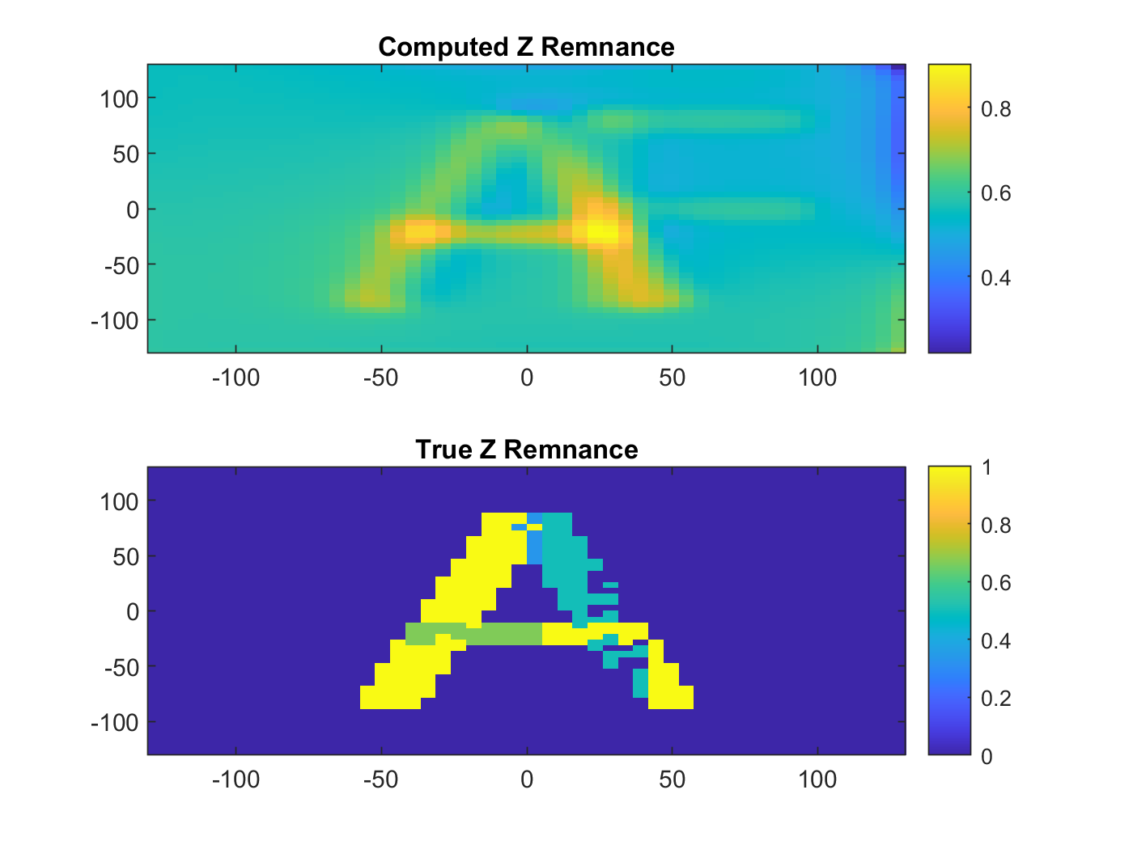
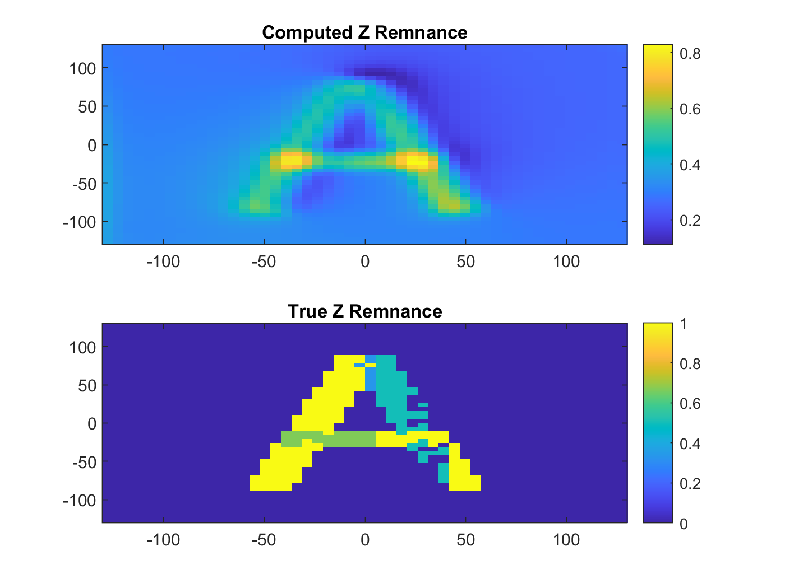
Another example of dual epoch inversion
single epoch
dual epoch
induced mag
model set-up
renament mag
Notes:
This slide shows results of a second inversion test using overlapping remanent (the “A”) and induced (the “F”) sources. Together they are the initials of Air Force… Comparison of the computed versus true source distributions again demonstrate the value of including data from two magnetic epochs in the inversion.

Slide 14
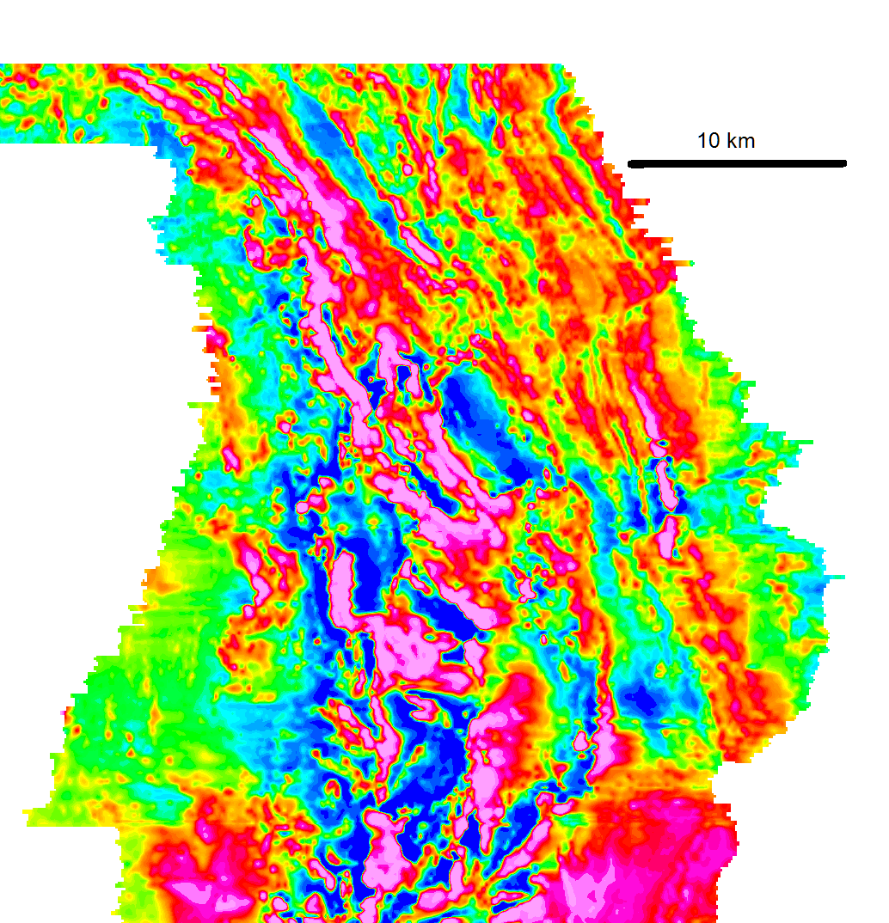
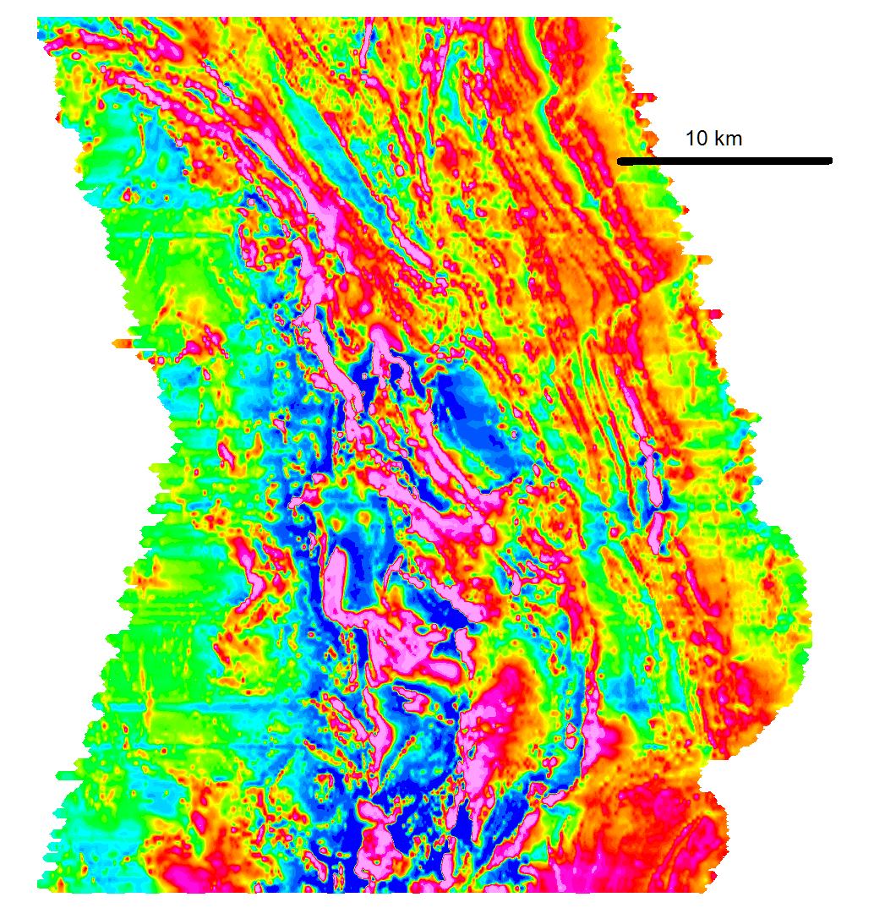
Karasjok, Norway region
NGU 1988
GTK 2008
Notes:
We contacted our friend Odleiv Olesen at the Norwegian Geological Survey and he told us about these two high quality magnetic surveys that cover a similar area near Karasjok, Norway. The data were collected 30 years apart. The anomaly patterns look very similar for the two epochs. The small rectangular boxes on each survey show some isolated anomalies that we will zoom into in the next slide.

Slide 15
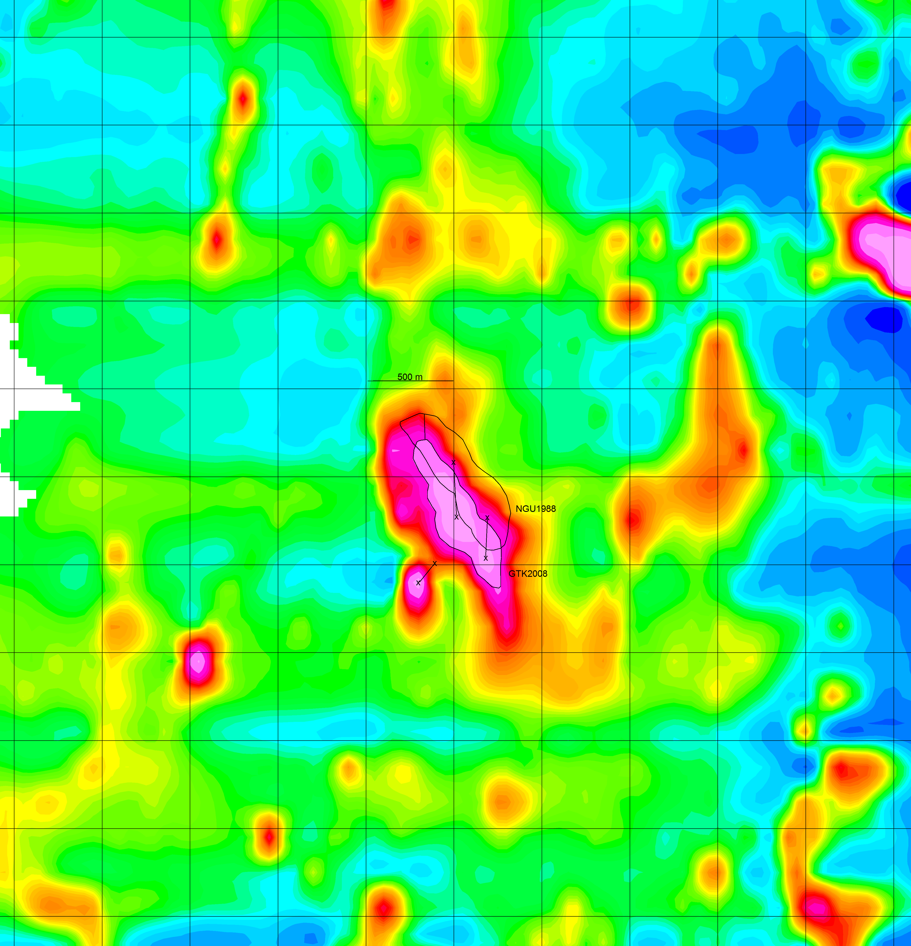
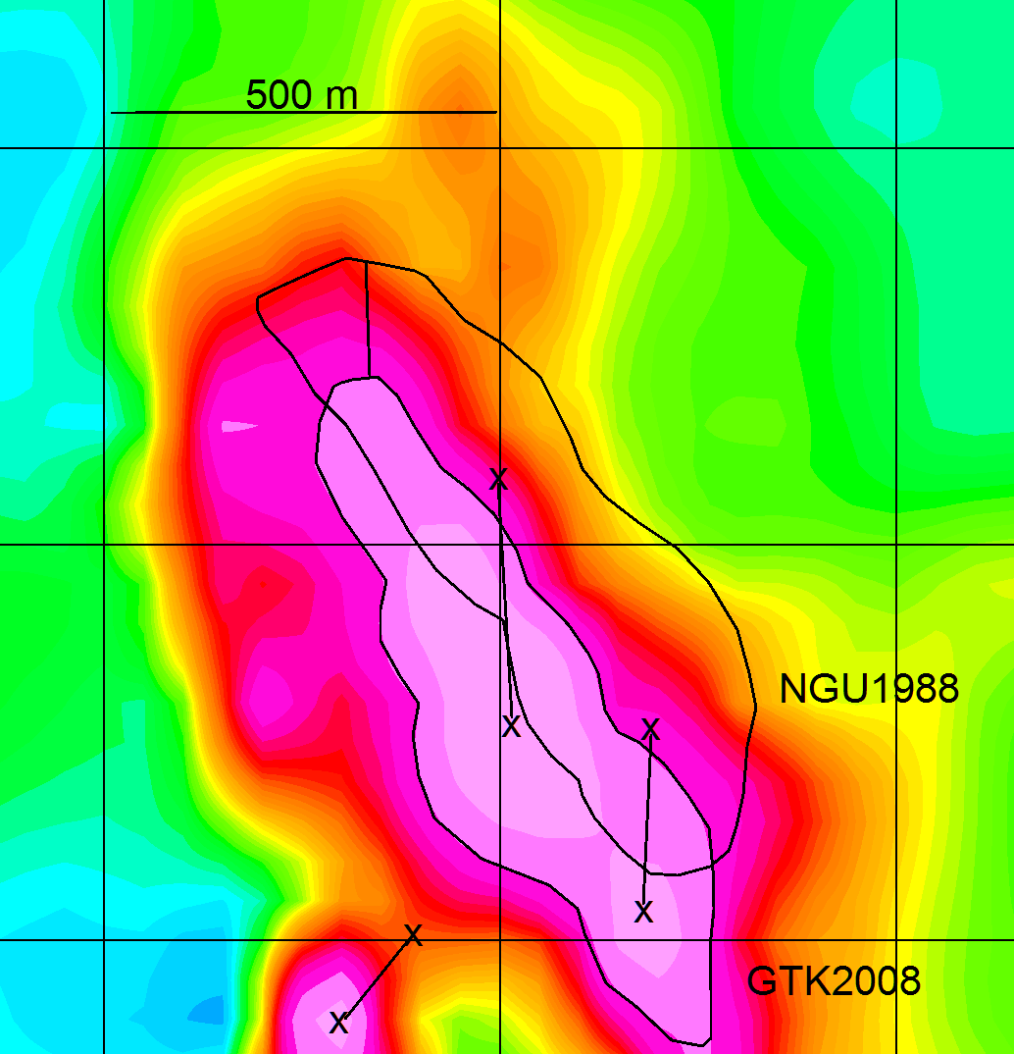
Karasjok GTK 2008 vs NGU 1988 – change in anomaly position
Notes:
These two panels show the GTK 2008 data with line tracing of the same anomaly from the earlier NGU survey. This isolated anomaly has shifted about 500 m to the south vs the position measured in 1988. The small isolated anomaly lobe in the lower part of the feature appears to have shifted about 150 m to the southwest.
This example shows that magnetic navigation with the old map would differ by 100s of meters versus the newer map.
We tried running a test inversion using these data for the two epochs, but the results were inconclusive – it seems likely that at least some of the difference between the two surveys is related to navigational uncertainty of the surveys themselves, especially the older, pre-GPS survey. We need to work harder on cleaning up these data before we can more satisfying results.

Slide 16
DISCUSSION / NEXT STEPS / CHALLENGES
Induced crustal magnetic anomalies change as the Earth’s magnetic field changes.
These changes can be large enough to make a difference for data compilation, interpretation, or use in alternate navigation.
Measurements of these changes can be used to improve magnetic source inversion, particularly for the separation of induced vs. remanent sources.
We are planning to test source inversions using satellite-derived long wavelength crustal field from different epochs – can we make tectonic-scale maps of induced vs remanent source domains?
We are looking for examples of high-quality magnetic surveys from different epochs (like the Norway example) that can be used for simultaneous inversion.
Goals of this work are to inform our ability to:
Evaluate the navigational uncertainty when using older crustal magnetic anomaly measurements for alternate navigation
Potentially be able to correct older measurements for navigational use
Use repeat surveys for geologic interpretation in complex magnetic source environments.
Notes:
So, obviously this is still a work in progress, but we wanted to share this idea and let folks know that we are working on this problem.
I’ll let you read the slide text, but we are excited at the potential for this approach to inform construction and uncertainty assessment for magnetic maps for use in alternative navigation as well as (when suitable repeat data can be found or collected) assist in separation of induced and remanent sources in magnetic interpretation.

Slide 17
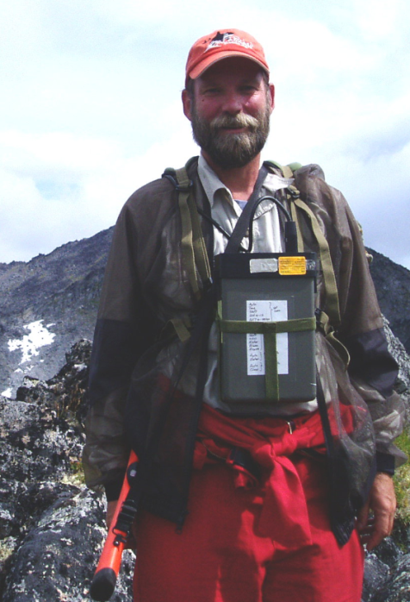
Rick with a magnetometer
(a long time ago…)
Aaron when he was a Captain (he’s a Major now…)
Notes:
Thanks for checking out our presentation – we look forward to your comments and questions - sorry we couldn’t meet you in person this year – hope to see you next year in Vienna. Also, auf wiedersehen naechstes Jahr!

