Slide 1
Elias Roussos*
The in-situ exploration of Jupiter’s radiation belts
Max Planck Institute for Solar System Research, Göttingen, Germany
(*extended team list in the final slide)

Slide 2
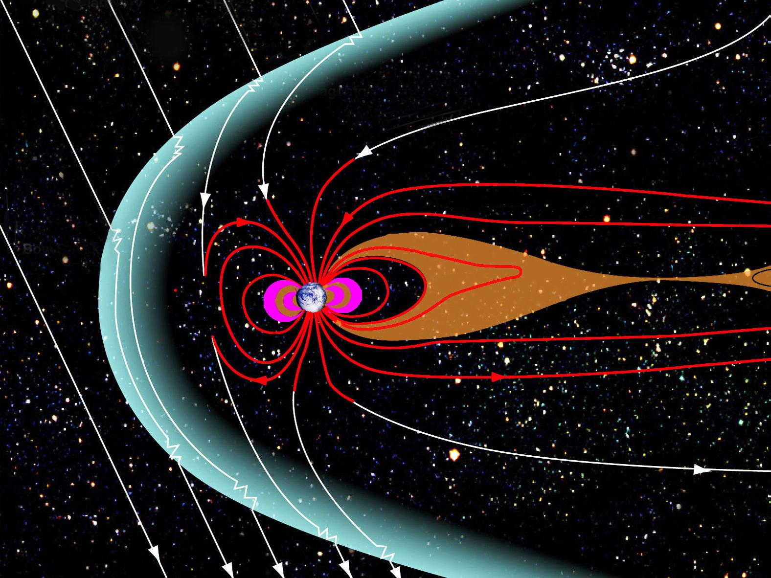
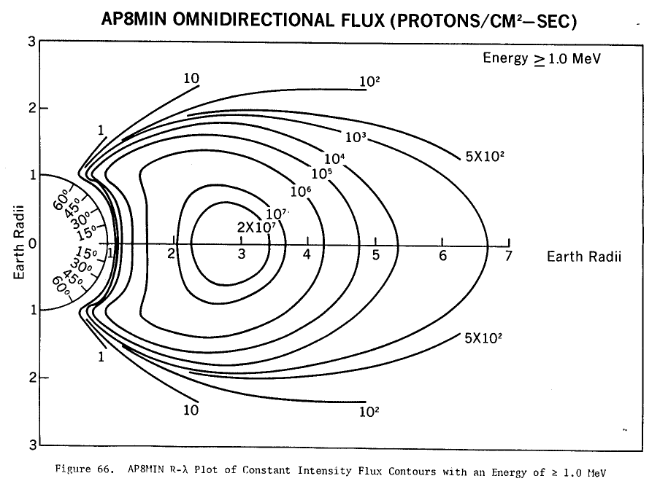
Planetary radiation belts
Basic component of all planetary magnetospheres
Magnetic trapping of energetic charged particle radiation (electrons, protons, ions)
Energies: several 10 keV up to few GeV
Accumulation of high particle fluxes
Source: Caltech
Vette et al. 1991
Notes:
2

Slide 3
Why do we study radiation belts?
Understanding high energy particle dynamics
In-situ measurement capabilities, fully resolvable spatial & time scales (“in-situ astrophysics”)
Strong planet/moon/ring-radiation links (“energetic particle geophysics”)
Space weather, spacecraft safety
Notes:
3

Slide 4
Jupiter’s radiation belts
Image sources: Nenon et al. (2017, 2018), Mauk and Fox [2010], Mauk [2014], John Spencer
Notes:
4

Slide 5
Why explore Jupiter’s radiation belts (1)?
Jupiter‘s magnetosphere: solar system‘s most powerful charged particle accelerator
Energies: up to 100s of MeV for electrons, up to 10s-100s of GeV for protons/ions (all other planets: 1-2 orders of magnitude lower)
Extensive parameter space: multi-ion composition, diverse space environments, active moons allow for multiple ways to produce and destroy particle radiation
Astrobiological implications: Radiation is catalytic for oxidant production in Europa’s ice (H₂O₂), but can also destroy potential biosignatures
Radiation-material interactions: Unparalled regime (high energies, high fluxes) to explore the impact of radiation on pristine materials (e.g. ices)
Best analogue to astrophysical radiation belts: e.g. brown dwarfs magnetospheres
Notes:
5

Slide 6
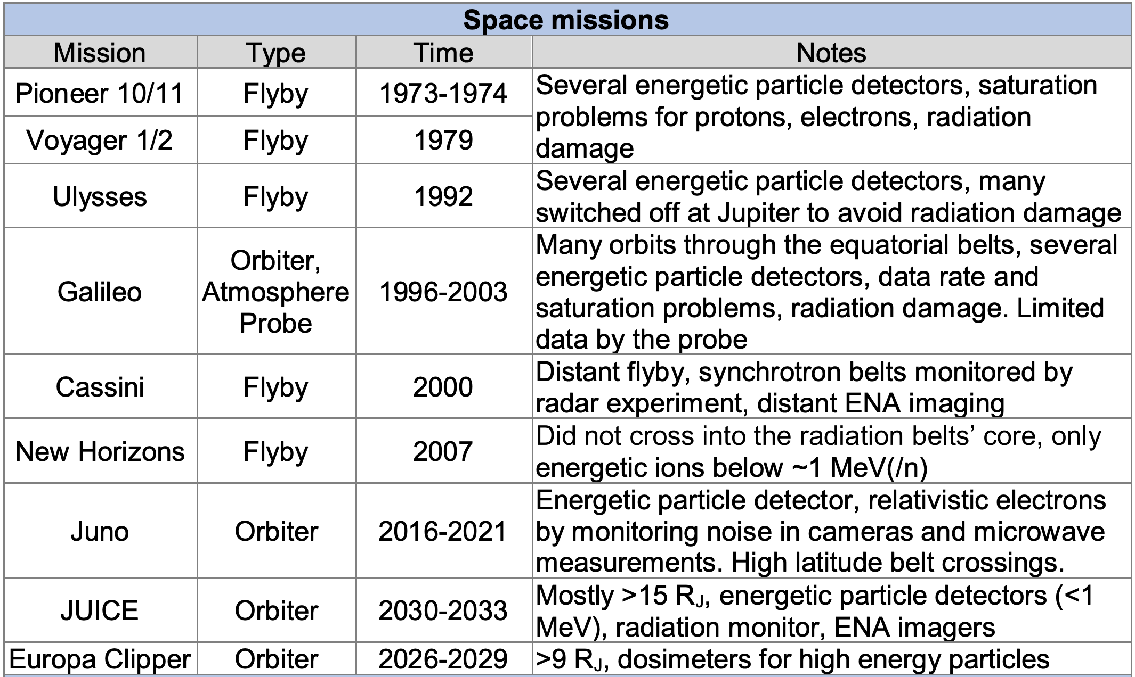
Why explore Jupiter’s radiation belts (2)?
Many Jupiter missions avoid them in favor of spacecraft safety
No mission was or is designed to explore them comprehensively
Challenging for conventional, low mass/power instrumentation Jupiter‘s radiation belts remain largely unexplored!
Notes:
6

Slide 7
Outstanding science questions
in Jupiter’s radiation belts

Slide 8
Key science & relevance to ESA’s Cosmic Vision
1. Adiabatic vs. non adiabatic electron acceleration in Jupiter’s radiation belts (example slide 9)
2. Cosmic Ray Albedo Neutron Decay as a universal proton radiation belt source (example slide 10)
3. The enigmatic origin of Jupiter’s heavy and light ion radiation belts
4. High latitude charged particle acceleration as a universal radiation belt source (example slide 11)
5. Planetary space weather (dynamics) in Jupiter’s radiation belts
6. Radiation processing of moon surface material and astrobiological implications
7. Jupiter’s moon Io a dominant regulator of global radiation belt dynamics
ESA Cosmic Vison 2015-2035 | Relevant overarching scientific questions for Jupiter’s radiation belts | Key science goals
How does the Solar System work? | Why are Jupiter’s belts so intense and its magnetosphere such powerful accelerator? | 1-7
What are the fundamental physical laws of the Universe? | What can we learn for high energy plasma physics by studying different planetary radiation belts? | 1-5, 7
What are the conditions for planet formation and the emergence of life? | What are the astrobiological implications of charged particle radiation in Jupiter’s mini solar system and especially Europa? | 1-3, 6
Notes:
8

Slide 9
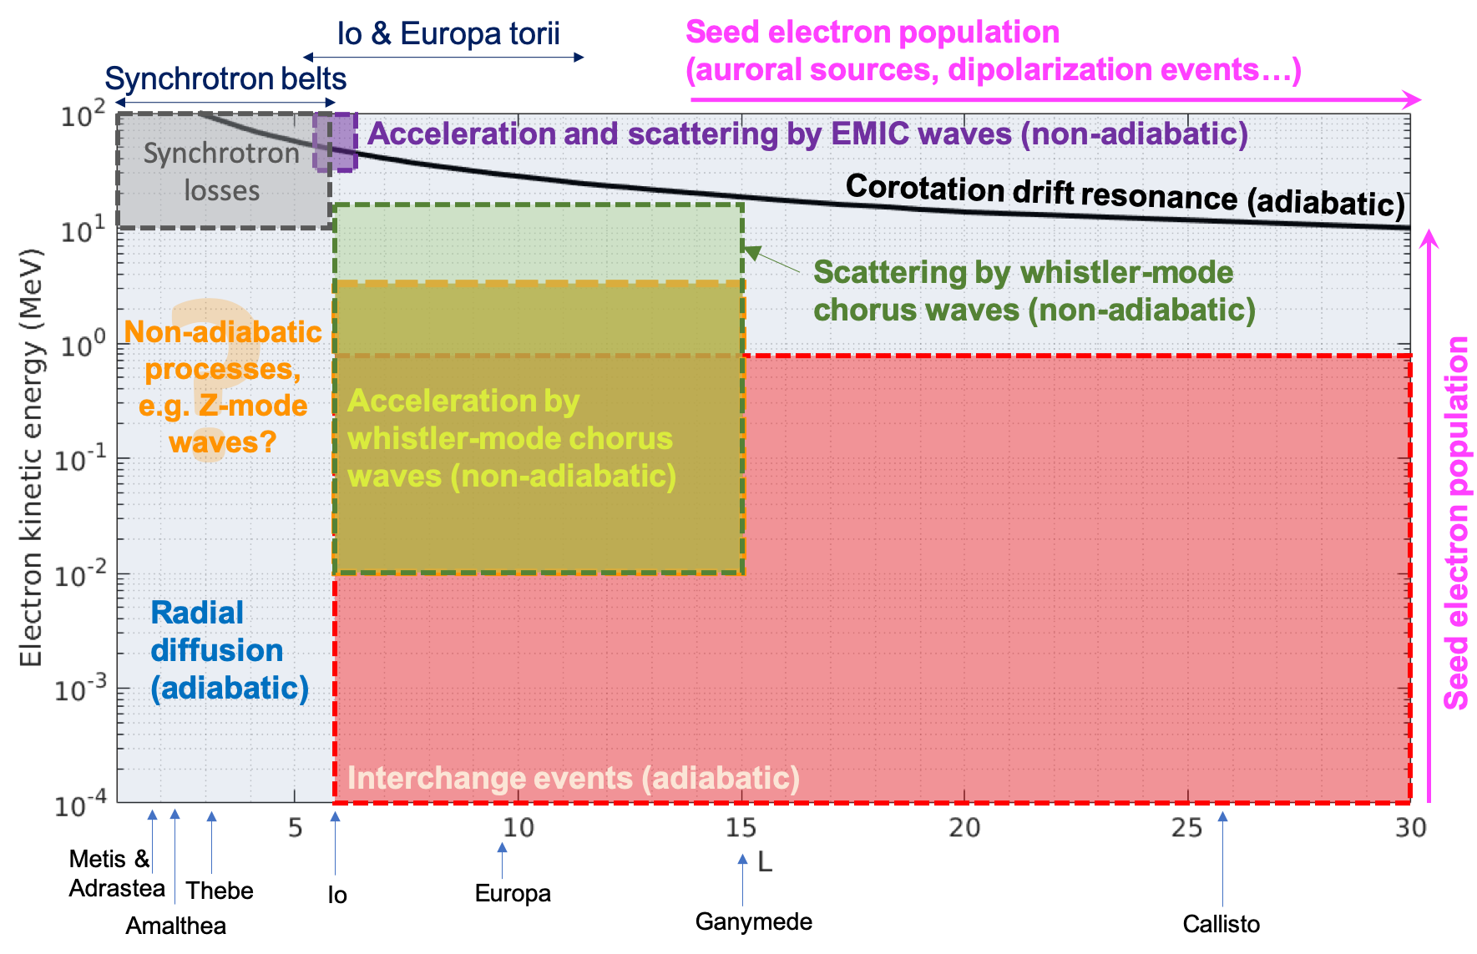
Example 1: Adiabatic vs. non-adiabatic
electron acceleration
How do overlapping processes synergize to produce solar system’s harshest electron environment?
Notes:
9

Slide 10
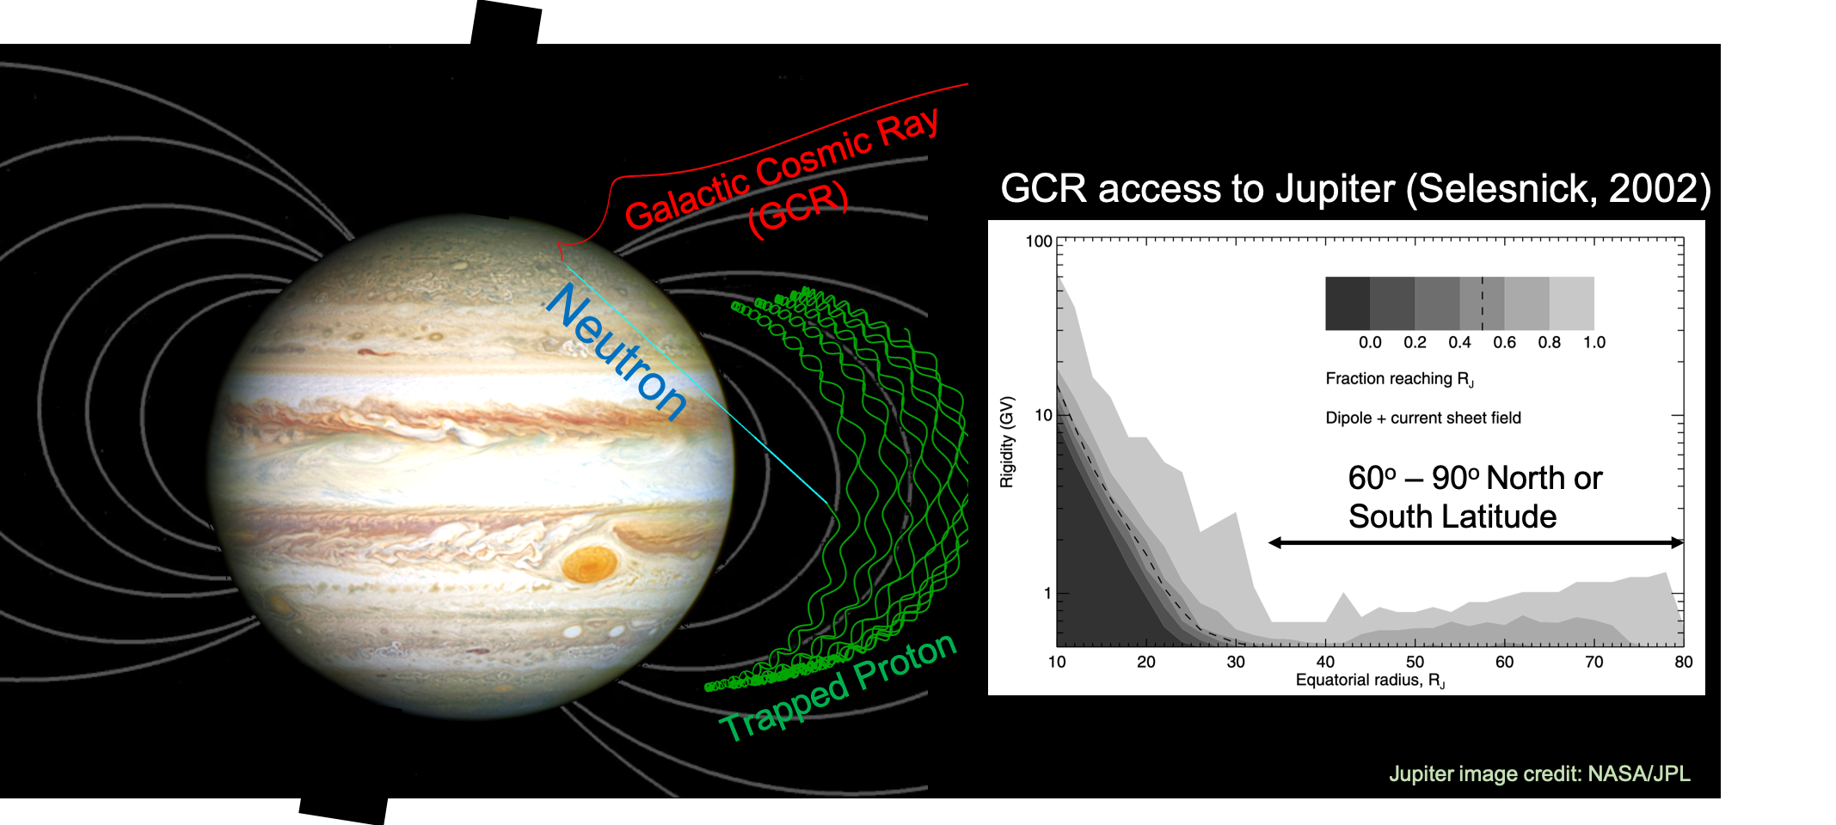
Example 2: Cosmic Ray Albedo Neutron Decay (CRAND) as a universal proton radiation belt source
Is CRAND proton production enforced or weakened by Jupiter’s strong magnetic field and dense atmosphere?
Notes:
10

Slide 11
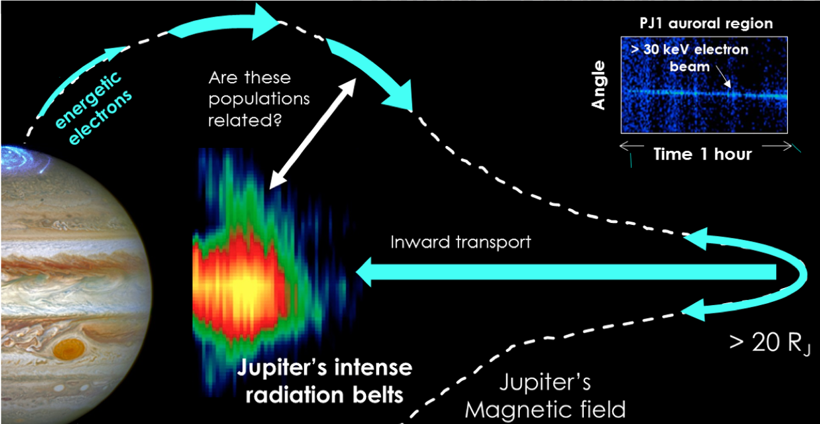
Example 3: High latitude charged particle acceleration as a universal radiation belt source
How are high latitude particle acceleration sources contribute to the radiation belts’ seed population?
Notes:
11

Slide 12
Key space mission requirements and challenges

Slide 13
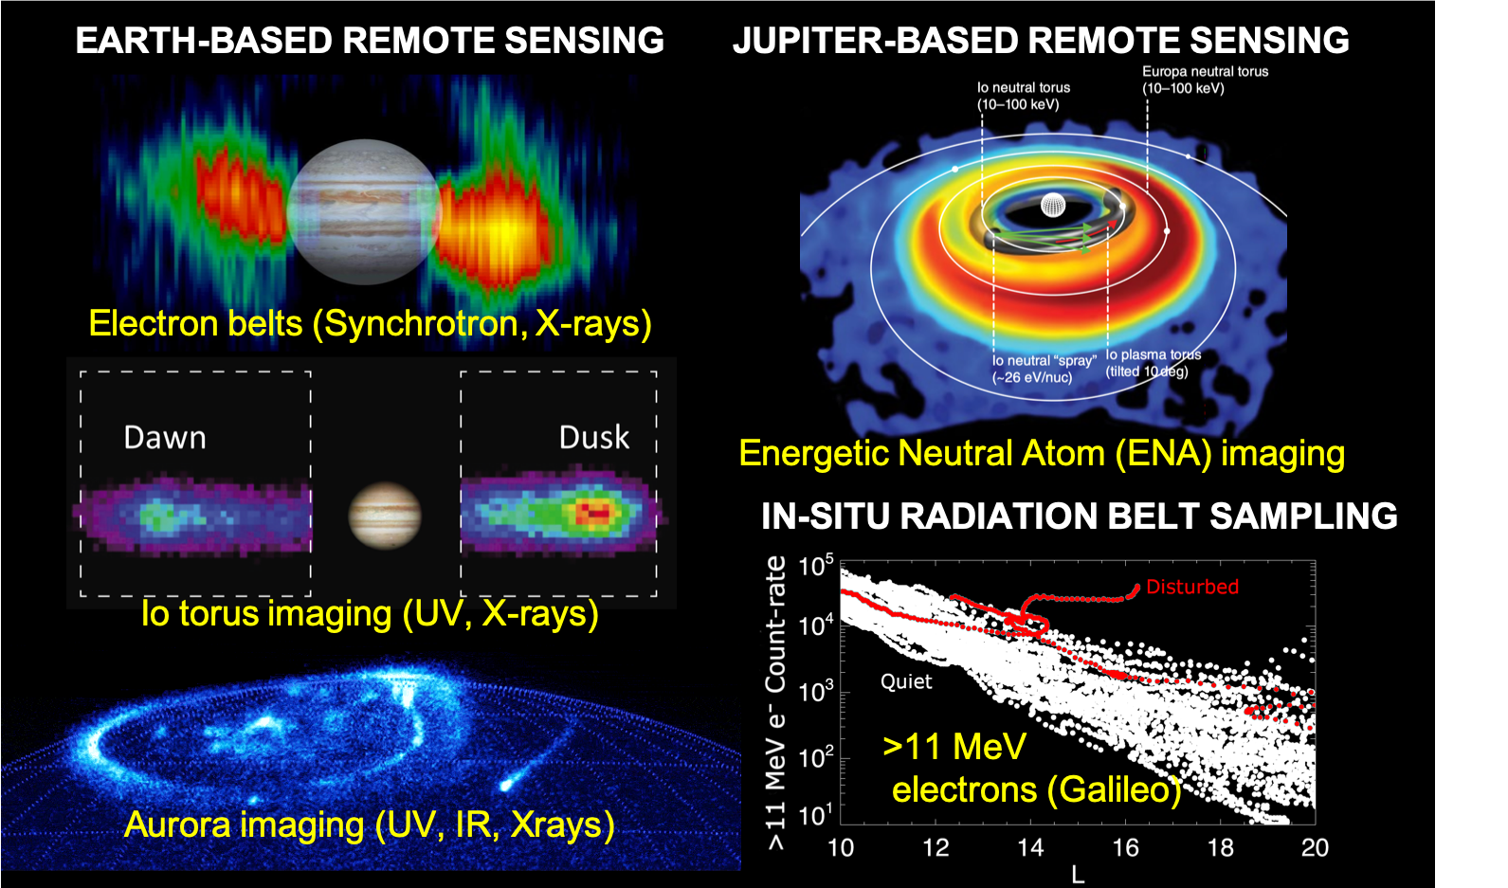
Methods of observation (1)
Comprehensive observations of particle distribution functions from plasma to relativistic energies, electromagnetic fields & waves (as for the Van Allen Probes)
Synergies of in-situ measurements & remote sensing
 | Plasma | Magnetic field | Electric field | Waves | Energetic particles |  | ENA and/or X-Ray imaging (from Jupiter) | Solar wind in-situ monitoring | Earth-based monitoring
 |  |  |  |  | Non-relativistic | Relativistic
Electron radiation belts | X | X | X | X | X | X | X | X | X
CRAND protons |  |  |  |  | X | X
Ion radiation belts | X | X | X | X | X |  | X | X | X
High latitude sources | X | X | X | X | X | X | X | X | X
Space weather | X | X | X | X | X | X | X | X | X
Moon surfaces |  |  |  |  | X | X
Image/plot credits: synchrotron belts (NASA/JPL), torus imaging [Murakami et al. 2016], aurora image (NASA/STScI), ENA image simulation [Brandt et al. 2018], in-situ data plot based on Roussos et al. [2018].
Notes:
13

Slide 14
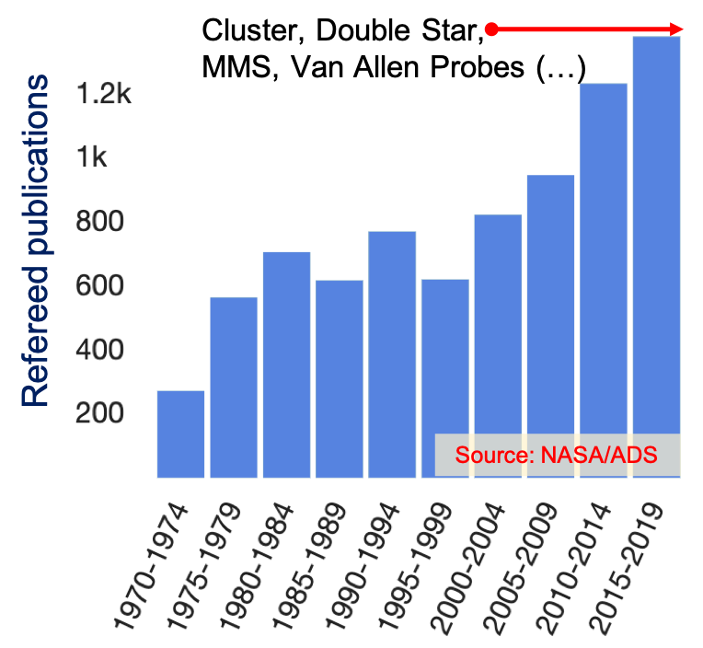
Methods of observation (2)
Multi-point, in-situ space plasma measurements are critical
Targets | Multi-spacecraft missions
Earth magnetosphere | Cluster, Double-Star, Themis, MMS, Van Allen Probes etc.
Mercury’s magnetosphere | Bepi-Colombo
Mars-solar wind interaction | ESCAPADE
Moon-solar wind interaction | Themis (Artemis)
Comet-solar wind interaction | Comet Interceptor
Outer planets (incl. Jupiter) | ???
Sharp increase of refereed publications on terrestrial radiation belts, following the realization of multi-point spacecraft measurements
Multi-spacecraft missions is the norm for the advanced study of space plasma interactions
Notes:
14

Slide 15
Key Challenges
Radiation dose: Up to 100 krad/day (5 g/cm² Al) in the belts core
Mass/Power: Multi-spacecraft mission, heavy radiation shielding, high power consumption (e.g. from advanced instruments)
Instrumentation: Miniaturization of relativistic particle detectors typical for astroparticle physics (using strong magnets), S/N for plasma/”soft” energetic particle instruments in harsh radiation environments
Notes:
15

Slide 16
Recommendations
Keep considering and further consider Jupiter’s radiation belts as a prime science target for space plasma physics & astrophysics
Support technology and feasibility studies for missions that would dig in the innermost and most extreme region of Jupiter’s radiation belts
Support the development of high-energy (1-1000s MeV) charged particle instruments with high energy and mass resolution for planetary missions
Consider any missions targeted towards Jupiter an opportunity to study its radiation belts with dedicated energetic particle instruments instead of radiation monitors (e.g. dosimeters) intended for engineering purposes.
Maintain and enhance regular campaigns of remote observations of the Jovian radiation belts (synchrotron radiation at radio wavelengths and X-rays).

Slide 17
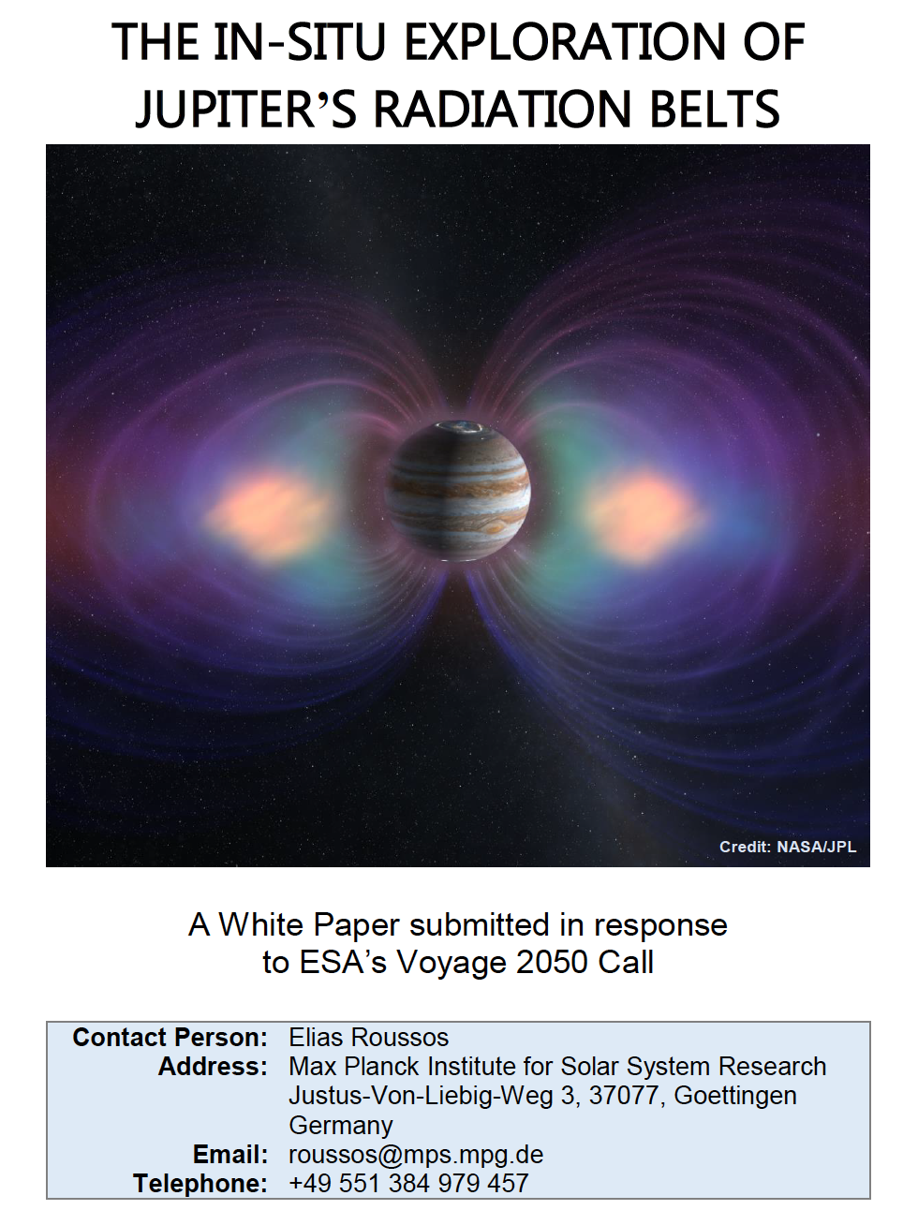
More information
White Paper in response to ESA’s Voyage-2050 call:
https://bit.ly/2Sdp1K8 (under review)
White Paper in response to National Research Council Planetary Science and Astrobiology Decadal Survey 2023-2032 (open for endorsement and comments!): https://bit.ly/2L3rItS
We invite you to endorse the NRC version of the White Paper
Contact:
a) Quentin Nenon (Univ. of Berkeley): nenon@berkeley.edu
and/or
b) Elias Roussos (Max Planck Institute for Solar System Research): roussos@mps.mpg.de

Slide 18
Team (Leads/Coauthors & Endorsers until May 2020):
Elias Roussos [Max Planck Inst. for Solar System Research, Germany]
Oliver Allanson [University of Reading, UK]
Livia Alvez [INPE, France]
Nicolas André [Research Inst. for Astrophysics & Planetology, France]
Bruna Bertucci [University of Perugia, Italy]
A. Brunet [ONERA, France]
Graziella Branduardi-Raymont [UCL MSSL, UK]
George Clark [Johns Hopkins Applied Physics Laboratory, USA]
I. Cohen [Johns Hopkins Applied Physics Laboratory, USA]
John F. Cooper [NASA GSFC, USA]
Ioannis Daglis [University of Athens, Greece]
Iannis Dandouras [IRAP, France]
Kostantinos Dialynas [Academy of Athens, Greece]
Ravindra Desai [Imperial College London, London, UK]
E. Echer [INPE, Brazil]
Shahab Fatemi [Swedish Institute for Space Physics, Sweden]
Colin Forsyth [UCL Mullard Space Science Laboratory, UK]
Yoshifumi Futaana [Swedish Institute for Space Physics, Sweden]
Matina Gkioulidou [Johns Hopkins Applied Physics Laboratory, USA]
W. Hadjas [PSI, Zurich, Switzerland]
Geraint Jones [UCL Mullard Space Science Laboratory, UK]
Insoo Jun [Jet Propulsion Laboratory, USA]
Peter Kollmann [Johns Hopkins Applied Physics Laboratory, USA]
Anna Kotova [IRAP, France]
Elena Kronberg [University of Munich, Germany]
Norbert Krupp [Max Planck Inst. for Solar System Research, Germany]
Wen Li [Univerity of Boston, USA]
Lucas Luizzo [Space Sciences Laboratory, Berkeley, USA]
V. Maget [ONERA, France]
J. P. Marchezi [Instituto Nacional de Pesquisas Espaciais, Brazil]
Go Murakami [Institute of Space and Astronautical Science, Japan]
Quentin Nénon [Space Sciences Laboratory, Berkeley, USA]
Tom Nordheim [Jet Propulsion Laboratory, USA]
Benjamin Palmaerts [University of Liege, Belgium]
Chris Paranicas [Johns Hopkins Applied Physics Laboratory, USA]
Christina Plainaki [Agenzia Spaziale Italiana (ASI), Italy]
Imke de Pater [University of Berkeley, USA]
Andrew R. Poppe [Space Sciences Laboratory, Berkeley, USA]
Jonathan Rae [University College London, UK]
Ondrej Santolik [Charles University, Prague, Czech Republic]
Daniel Santos-Costa [Southwest Research Institute, USA]
Theodore Sarris [Democritus University of Thrace, Greece]
Yuri Shprits [Helmholtz-Zentrum, Germany]
Angelica Sicard [ONERA, France]
Ligia Da Silva [Instituto Nacional de Pesquisas Espaciais, Brazil]
Ali Sulaiman [University of Iowa, Iowa, USA]
J. Szalay [Princeton University, USA]
A.M. de Souza Franco [Inst. Nacional de Pesquisas Espaciais, Brazil]
Drew L. Turner [Johns Hopkins Applied Physics Laboratory, USA]
Luis E. A. Viera [INPE, Brazil]
Peter K. G. Williams [Harvard University, USA]
Emma Woodfield [British Antarctic Survey, Cambridge, UK]
Xin Wu [University of Geneva, Switzerland]
Zhonghua Yao [University of Liege, Liege, Belgium]
Philippe Zarka [LESIA, Paris, France]

