Slide 1
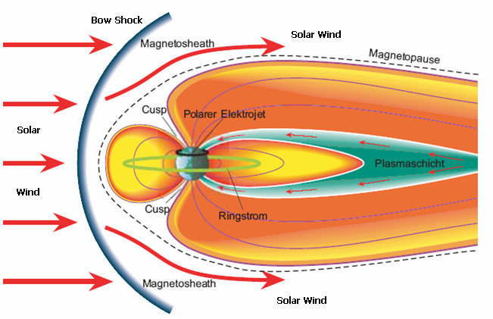
Electron holes in the Earth's magnetotail current sheet: role of magnetic field gradients and electron anisotropy
Shustov Pavel, Kuzichev Ilya, Vasko Ivan, Artemyev Anton, Petrukvich Anatoliy
Space Research Institute RAS, Russia, Moscow

Slide 2
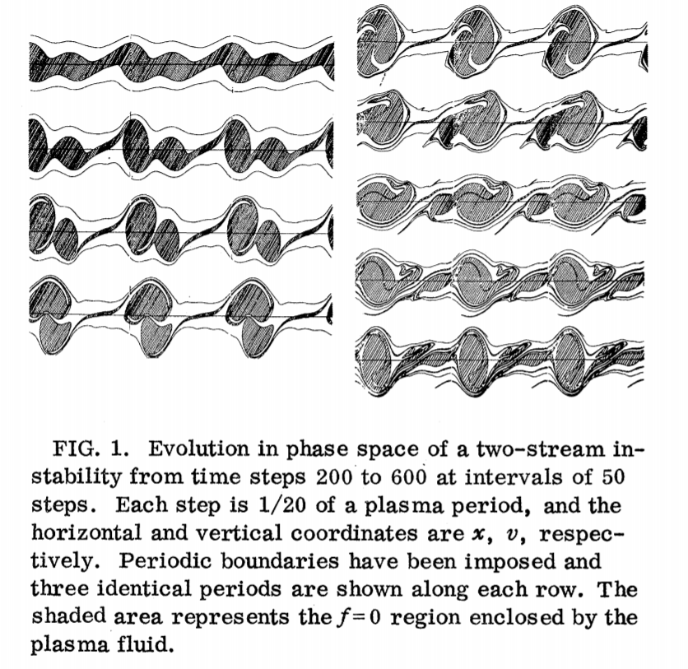
Electron holes are electrostatic soliton structures. It is a localized structures in which the electron density is lower than in the background plasma.
The decrease in the electrons density inside the hole is associated with a corresponding increase in the charge density (and, as a consequence, the maximum scalar potential), which in a self-consistent manner leads to the capture of electron trajectories.
Berk and Roberts, 1967

Slide 3
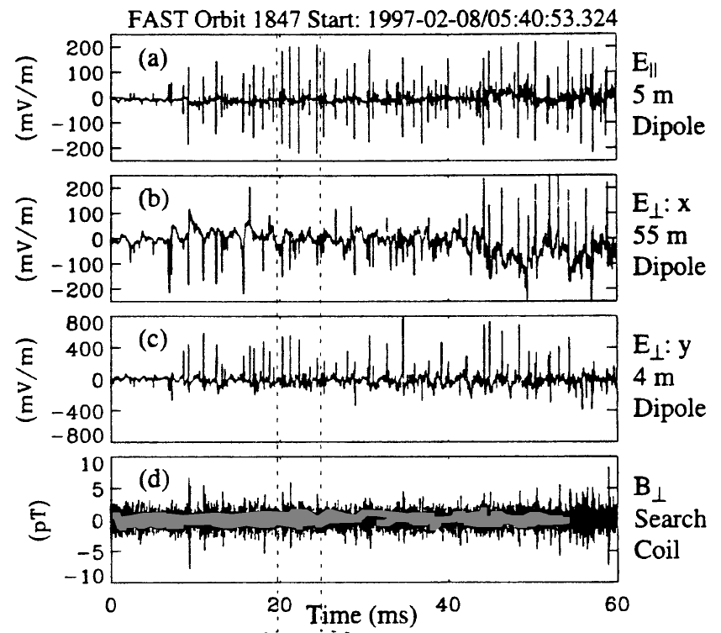
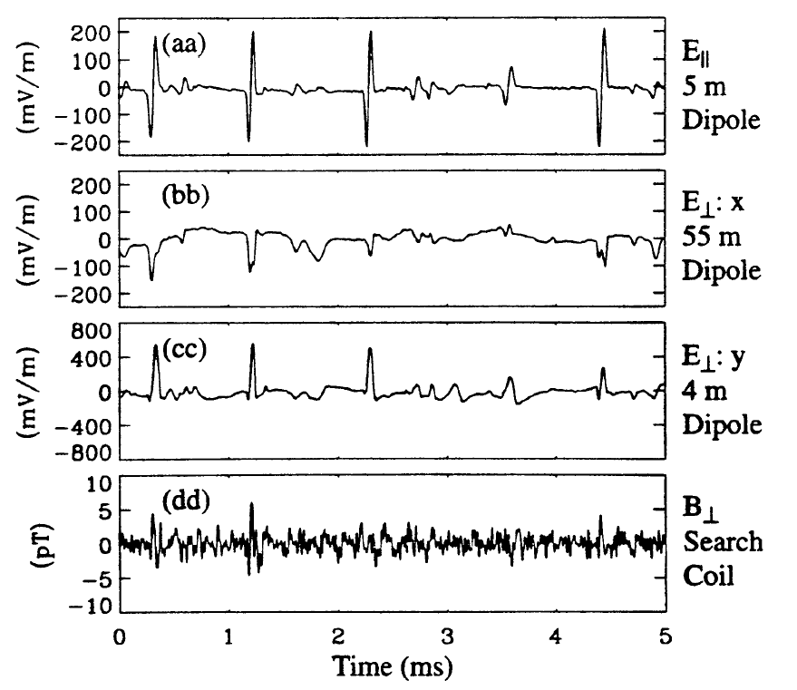
High-amplitude soliton waves (up to several V/m)
Velocity - much more than the velocity of the ion sound (up to several thousand km/s)
Size - several Debye radii
Ergun et al., 1998
Observations: at the boundary of the plasmasheet, at the boundary of the shock wave, in the auroral region

Slide 4
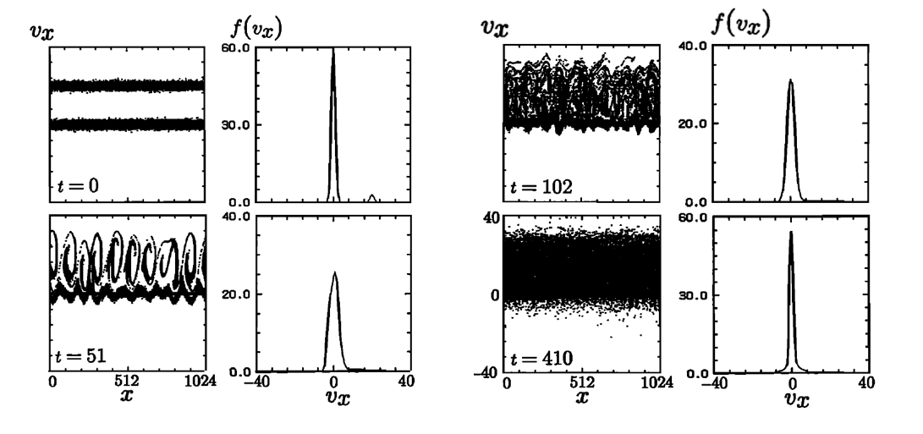
Simulation of the counterstreaming electron beams - depending on the parameters, leads to the formation of soliton structures - electron holes
Omura et al. 1996

Slide 5
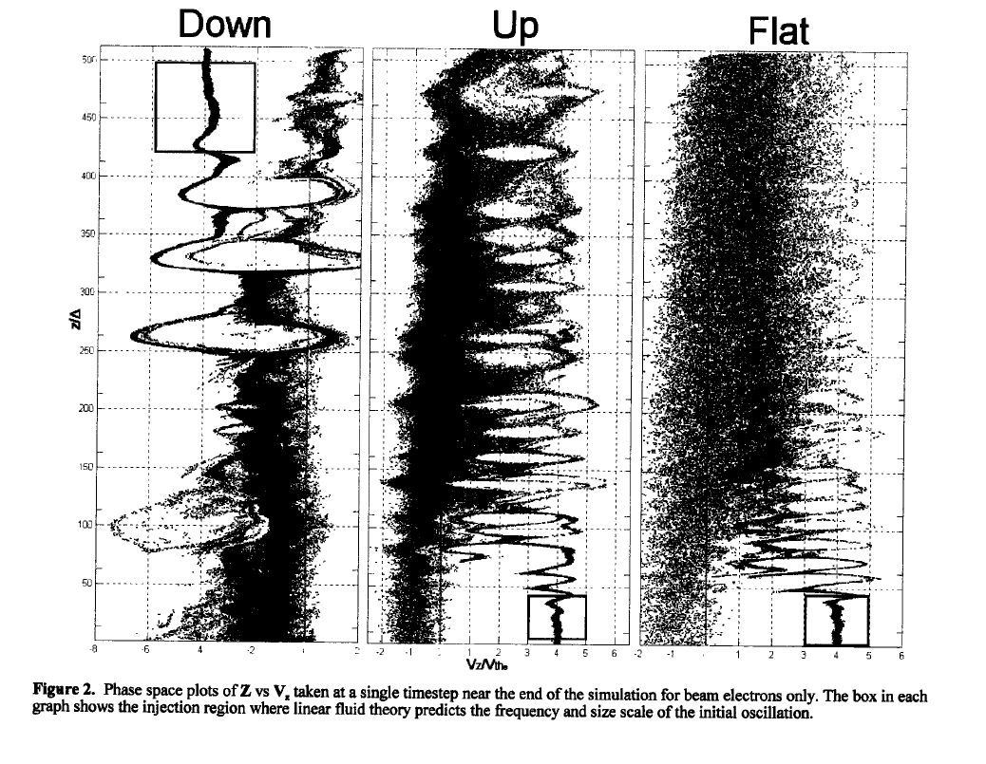
Modeling of the soliton structures in an inhomogeneous plasma - interaction with a cold plasma in a gravitational field
Mandrake et al. 2000

Slide 6
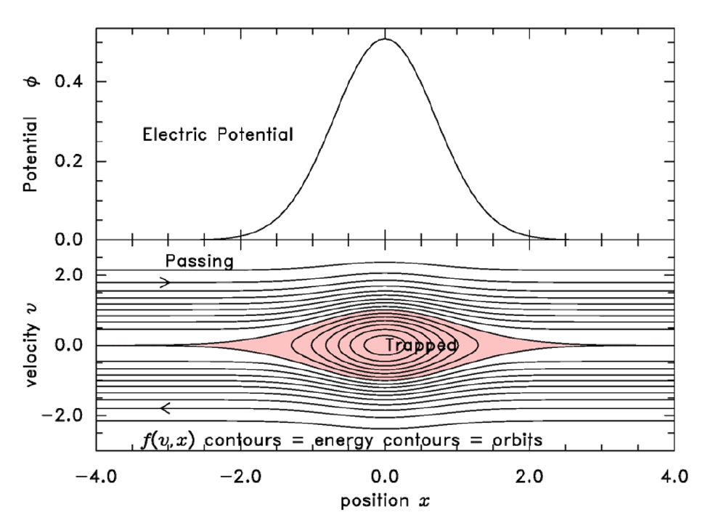
Full energy of a particle: $E=v^{2}−φ$
Particles whose kinetic energy is less than the potential value are captured by an electron hole

Slide 7
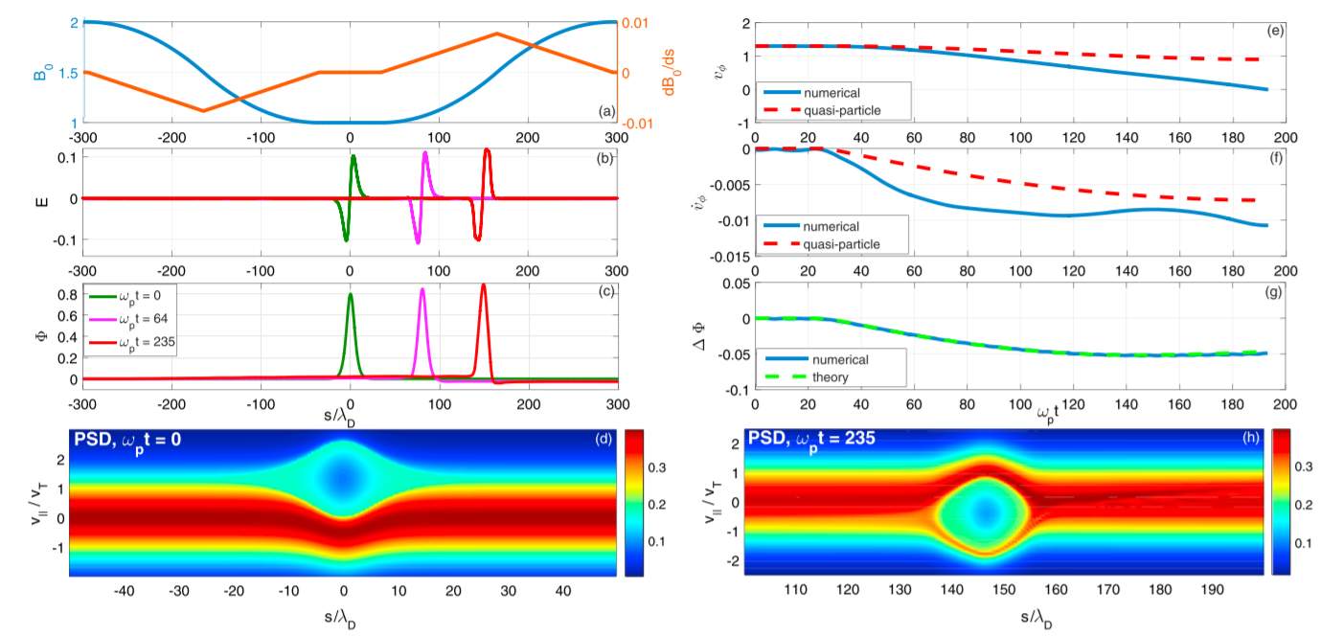
The effect of an inhomogeneous magnetic field on the propagation of electron holes
Kuzichev et al. 2017

Slide 8
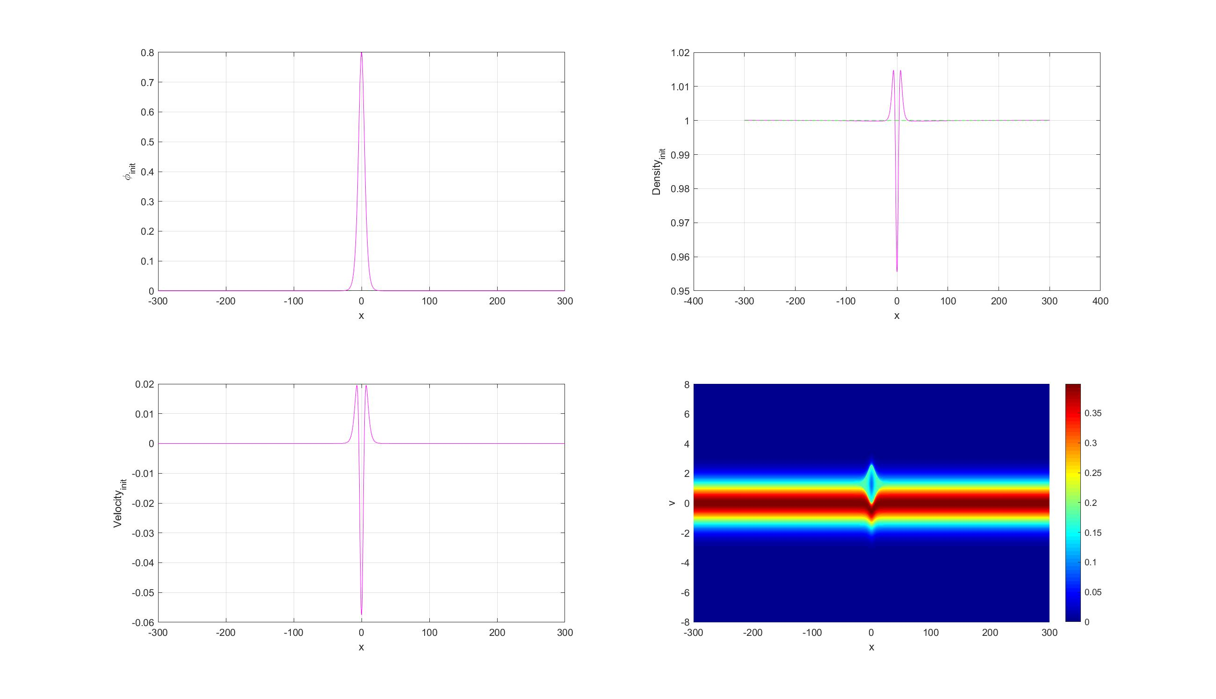
Scalar potential of the hole
Density of the electrons and ions
$$φ$$
$$n$$
Ion density is a constant
$$x$$
$$x$$
Initial distribution function
$$j$$
$$v$$
$$x$$
$$x$$

Slide 9
Evolution of the electron hole distribution function when it propagates toward an increasing magnetic field
V/V_{T}
$$s/λ_{D}$$

Slide 10
Evolution of a slice of the distribution function in the region of an electron hole as it propagates toward an increasing magnetic field
$$f(s=s_{hole})$$
V/V_{T}

Slide 11
Evolution of the parameters of electron hole
$$E_{∥}$$
$$Φ$$
$$ρ$$

Slide 12
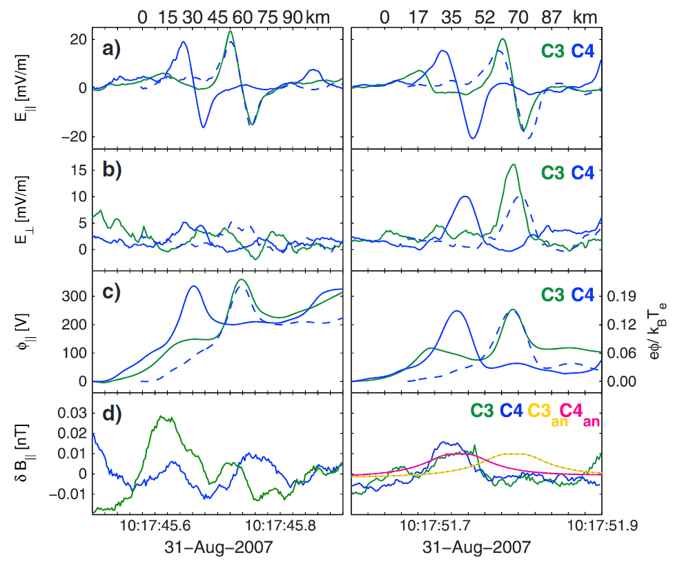
Slow electron holes in the magnetotail
Relatively slow (~ 500 km / s) electron holes are observed near the plasmasheet in the magnetotail
Norgen et al. 2015

Slide 13
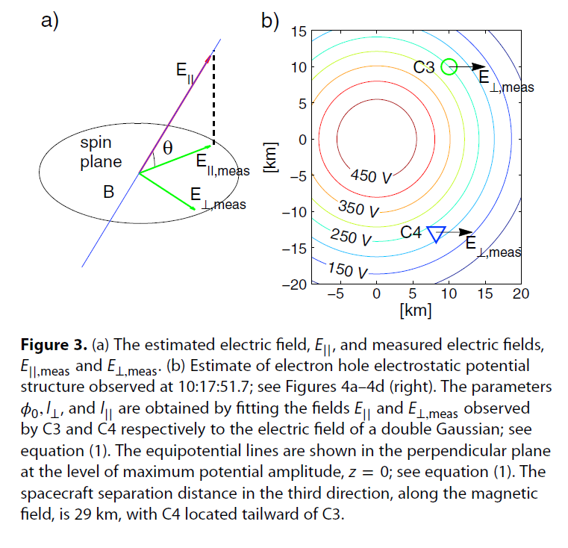

Slide 14
Consider a current sheet with an inhomogeneous magnetic field $b(s)$, and a constant ion density along the magnetic lines (Schindler current sheet models). We assume that the electrons are magnetized and have Maxwell distribution with predetermined temperature anisatropy in the neutral plane: $A= {\left({T_{∥}}/{T_{⊥}}\right)}_{s=0}$
where $φ\left(s\right)$ is the electrostatic potential arising due to quasinetrality with anisotropy. Initial distribution:

Slide 15
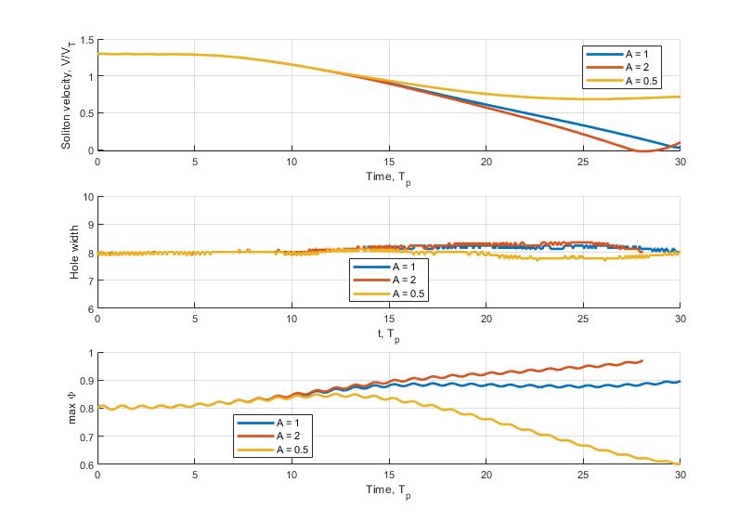
Temperature anisotropy ($A≠1$) leads to a change in the acceleration rate of the hole as it moves toward an increase in the magnetic field.
The width of the magnetic hole remains unchanged.
The amplitude of the potential (peak in the electric field) changes

Slide 16
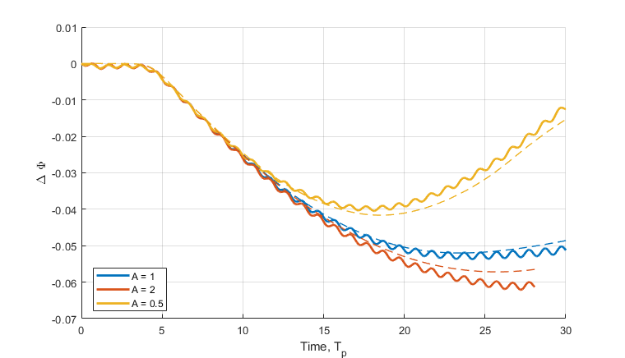
By integrating the equation of conservation of momentum along the magnetic lines, we can obtain the equation for the jump in potential and compare it with the solution obtained in a numerical calculation:
$$\frac{∂f}{∂t}+v_{∥}\frac{∂f}{∂s}+\left(\frac{∂φ}{∂s}−μ\frac{∂b}{∂s}−E_{∥}\right)\frac{∂f}{∂v_{∥}}=0$$
$$−\frac{∂j_{∥}}{∂t}=−\frac{∂p_{∥}}{∂s}+\frac{p_{∥}−p_{⊥}}{b}\frac{∂b}{∂s}+\left(\frac{∂φ}{∂s}−E_{∥}\right)n_{e}=0$$
$$ΔΦ≈\int{\left(p_{∥}−p_{⊥}+E_{∥}^{2}−E_{∥}\frac{∂φ}{∂s}\right)\frac{∂\ln\left(b\right)}{∂s}ds}+\int{\frac{∂φ}{∂s}\frac{∂E_{∥}}{∂s}ds}\sim D\frac{ΔB}{ΔL}$$

Slide 17
Results:
We have demonstrated the effects of the temperature anisotropy on electron hole propagation.
Anisotropy leads to additional acceleration of holes in an inhomogeneous magnetic field
Simulation results may be useful for interpreting the observation of electron holes in magnetotail

