Slide 1
Farewell to IceBridge: 10 years of polar sea ice remote sensing
Photo Credit: Jeremy Harbeck
Linette Boisvert, Joseph MacGregor, Brooke Medley, Nathan Kurtz, Ron Kwok, Ed Blanchard-Wrigglesworth, Alek Petty and Jeremy Harbeck
Notes:
Hi everyone, this is Linette Boisvert, the DPS of OIB. I am here to talk to you about NASA's Operation IceBridge, the largest and longest running NASA airborne mission, and the sea ice research and scientific findings that it helped produce over its 10 year run.

Slide 2
What is IceBridge?
2003
2009
2018
2020
ICESat Launched
ICESat Mission Ended
IceBridge initiated
“Bridge the Gap”:
To maintain a record of ice sheet elevation and sea ice freeboard
ICESat-2 Launched
September 15
IceBridge Ends
ICESat: measuring ice sheet mass balance, cloud and aerosol heights, as well as land topography and vegetation characteristics.
ICESat-2: measuring ice sheet elevation and sea ice thickness, as well as land topography and vegetation characteristics.
IceBridge: utilizes a highly specialized fleet of research aircraft and the most sophisticated suite of innovative science instruments ever assembled to characterize annual changes in thickness of sea ice, glaciers, and ice sheets.
Notes:
In 2003 NASA launched ICESat, a laser altimeter that would measure the elevation of the earth's polar ice. ICESat mission ended in2009, and its follow-on mission IS-2 wasnt supposed to launch for a few years. So in order to continue monitoring the earth's polar ice, OIB, an airborne mission, was created to bridge the gap between the 2 satellites.

Slide 3
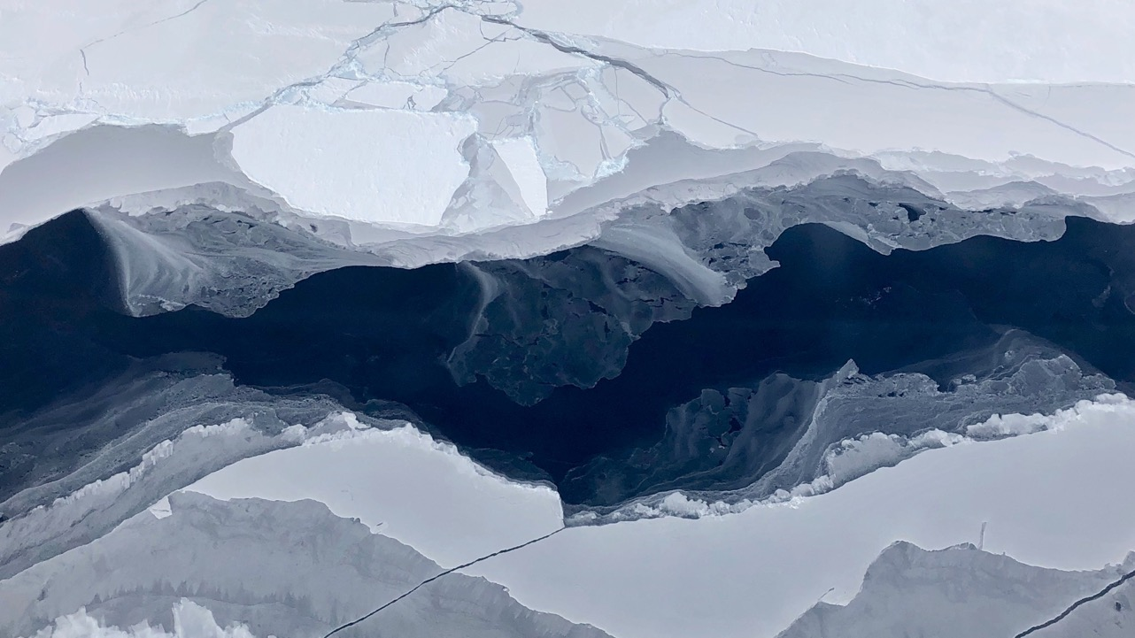
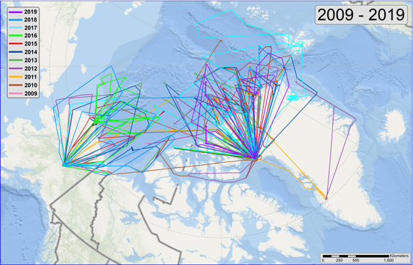
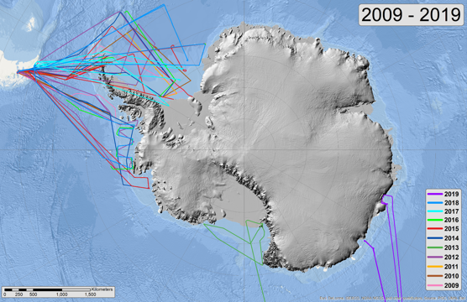
IceBridge sea ice missions
A multi-year, dual-pole airborne campaign
2009-2019
157 sea ice science missions flown!
Arctic sea ice science missions flown
Antarctic sea ice science missions flown
Maps produced by Jeremy Harbeck
Notes:
OIB flew for 10 years, each spring flying at the end of the Arctic growth season, and each fall at the end of the Antarctic growth season. OIB flew 157 sea ice missions, with most of those occurring in the Arctic north of Greenland in the Lincoln sea and norht of Alaska in the Chukchi and Beaufort seas. The majority of ANtarctic sea ice flights ocurred in the weddell and admundsen seas. Repeat missions were flown to assess interannual changes in the ice.

Slide 4
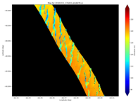
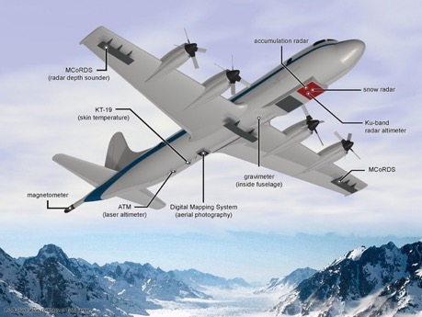
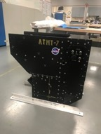
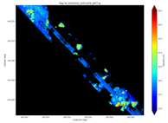
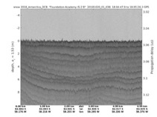
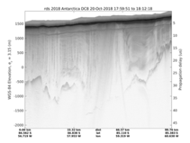
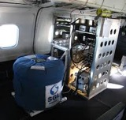
What instruments are on board?
Multi-instrument: ATM T6 (wide scan) & T7 (narrow scan, IR) laser altimeters, snow radar, accumulation radar, MCoRDS, DMS, AIRGrav, FLIR, KT-19, Headwall, GPS
DMS & CAMBOT
ATM
FLIR
CRESIS radars
AIRGrav
Notes:
OIB flew 2 laser altimeters: ATM t6 and t7, snow radar, visible imagers, infrared temperatures, hyperspectral imager, and gravimeters.

Slide 5
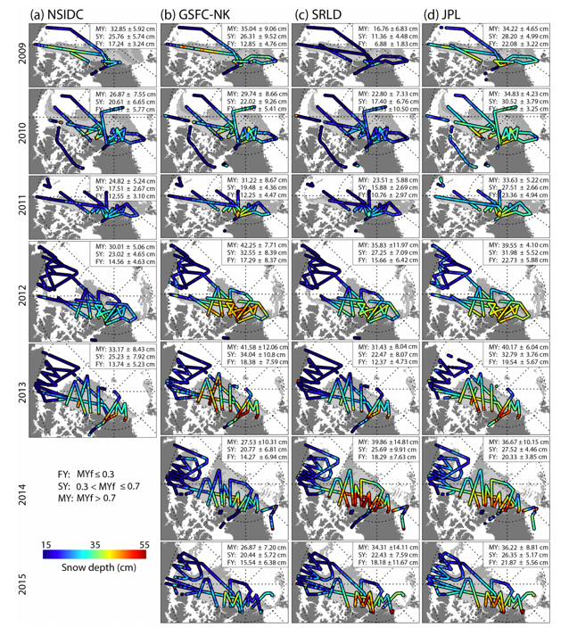
Snow on sea ice
Snow thickness on sea ice is essential for inferring the thickness of sea ice from freeboard observations.
Prior to OIB, knowledge of the regional distribution and interannual variability of snow thickness was poor across both the Arctic and Southern Oceans.
OIB flew an ultra-wideband snow radar, enabling the first contemporary basin-scale estimates of snow depth
Multiple algorithms have been developed to infer snow thickness from OIB snow radar data. Each algorithm takes a different approach to determining the range to the air–snow and snow–sea-ice interfaces, and to addressing inherent challenges associated with system noise and resolution
These products show good agreement in the regional snow distribution, but can exhibit large inter-product differences
All products produce the thickest snow on thick, multiyear ice north of Greenland and in the Lincoln Sea, with thinner snow on the thinner, first year ice (e.g. in the Chukchi and Beaufort seas).
Figure from Kwok et al., 2017
Notes:
Snow radar onboard OIB allowed for snow depth on sea ice estimates to be produced. Snow thickness on sea ice is essential for determining the sea ice thcikness from sea ice freeboards measured by altimeters. These measurements provided the first contemporary basin-scale estimates of snow depth and its large interannual variability. Multiple algorithms have been developed to detemrine snow depths, but all products show good agreement in the regional snow distribution. All products produce the thickest snow over MY sea ice north of greenland and thinner snow over FY sea ice in teh Chukchi/Beaufrot seas.

Slide 6
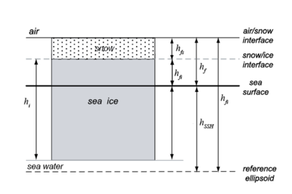
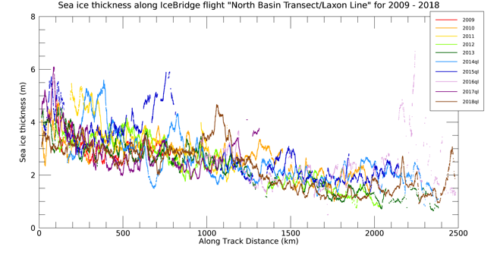
Sea ice thickness
Sea ice thickness is estimated from ATM freeboards and snow radar thicknesses with assumptions of hydrostatic balance
Multiple OIB Arctic sea ice thickness products have been produced
All show thickest sea ice north of Greenland in the Lincoln sea and thinner sea ice in the Chukchi/Beaufort seas
Thickness also exhibits significant interannual variability (e.g. Laxon line)
Weddell sea ice thicknesses have been produced, but is still an area of active research.
Produced by Jeremy Harbeck
From Kwok and Kacimi, 2018
Notes:
Using both the snow depth products and ATM freeboards, the thickness of hte se aice an be infered with hydrostatic assumptions. Multiple products have been produced, but all show similar thickness distributions. Since OIB flew a few sea ice missions , like the laxon line each year, we are able to see the interannual varability of sea ice thickness across the Arctic Basin. Sea ice is thicker over MY ice north of greenland, and thinner over FY ice norht of alaska. Kwok and Kacimi also created antarctic sea ice thickness estiamtes using OIB across the Weddell Sea and found that thickest ice occurred near the Antarctic peninsula where it was highly deformed, and thinner ice in the east.

Slide 7
Using IceBridge thickness to assess satellite thickness products
772,090 estimates of sea ice thicknesses derived to assess the accuracy of CS-2 sea ice thickness retrievals
Multiple other studies have used OIB data to assess thickness and snow products from both satellite derived and modeled thicknesses
Figures from Tilling et al., 2018
Notes:
OIB sea ice thicknesses have been used in several studies to assess the sea ice thickness measurements produce by satellite altimeters. Here I show an example from Tilling et al., where OIB thicknesses are compared with CryoSat2 thicknesses and snow good agreement. Without OIB data satellite altimeters would be difficult to assess on larger scales.

Slide 8
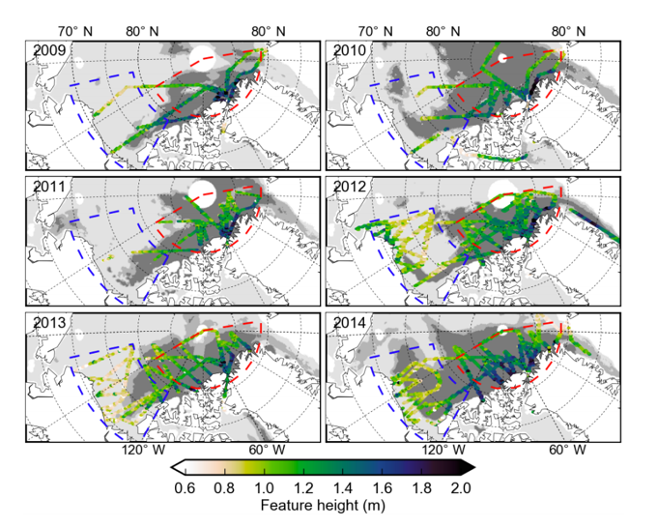
Surface Roughness
Sea ice is rough comprised of sea ice floes, ridges and rubble fields
Surface roughness affects the transfer of momentum and turbulent fluxes
Using ATM waveforms feature heights on the sea ice for 6 years of campaigns were created using a feature picking algorithm
Features are smaller on first year ice and larger on multi year ice
Multi year ice has more interannual variability and is affected by proximity to the coast lines where sea ice gets more deformed
Figure from Petty et al., 2016 the Cryosphere
Notes:
OIB ATM data have also been used to produce surface roughness of the sea ice, which is composed of floes, pressure ridges and rubble fields. Surface roughness is importatnt for the transfer of momentum and heat and moisture from the surface to the atmopshere. Petty et al. created a picking algorithm that would determine feature heights from ATM waveforms to determine the heights of hte surface features. They foiund that featuers were smaller on FY ice norht of Alaska, and larger on MY ice north of greenland where there was more variaiblity from year to year and are likelly affected by deformations due to the proximity of the coast lines.

Slide 9
Melt Ponds
DMS visible imagery from 2 OIB summer sea ice campaigns were used to produce a surface classification algorithm to discern sea ice, melt ponds, and open water
First year sea ice was found to have more melt ponds compared to multi-year sea ice
Melt ponds on first-year sea ice tended to be darker than on multi-year sea ice
Figures from Buckley et al., 2020 JGR-Oceans
Notes:
3 OIB summer campaigns were flown during the OIB lifetime, and 2 of these were used to look at meltponds. Buckely et al. used DMS visible imagery to produce a surface classification algorithm to pick out sea ice, melt ponds and their color, and open water. From this they found that FY ice had more melt ponds compared to MY ice and that the melt ponds on FY ice were darker than those on MY ice.

Slide 10
Sea Ice Temperature from KT-19
Independent validation of skin temperature over Arctic sea ice
Large area and different ice types covered
Highlights warm bias from ERA-Interim reanalyses on snow/ice in spring
Need for improved sea ice/snow representation in climate models
NASA AIRS instrument much more accurate
Figures from Boisvert et al., 2015 JGR-Atmos
Notes:
OIB also flew KT-19 surface temperature sensors onboard and these have been used by Boisvert et al for independ validation of NASA's AIRS instrument and ERA-I. The AIRS instrument showed a higher correlation with KT-19 compared to ERA-Interim which had a warm bias over the springtime snow and ice. This highlights the need for improved sea ice/snow respresentation in climate models

Slide 11
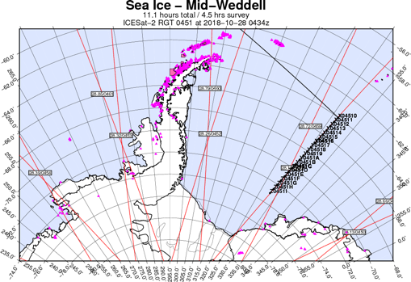
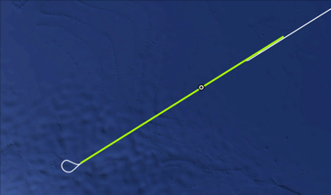
Large image: Time: 3:02:30 Z Altitude: 565 m Small image: Time: 4:11:21 Z Altitude: 982 m Time difference: 1:08 Drift: 550 meters
IceBridge and ICESat-2 Sea Ice Under flights
Chasing sea ice!
Taking wind speed and direction measurements at 500ft throughout the flight and correcting for sea ice drift so we fly over the same sea ice that IS-2 flew over along our whole flight line
Notes:
Once IS-2 launded in fall 2018 OIB, part of OIB was designated for validation, and multiple underflights of IS-2 were flown. However, sea ice moves! Since airplanes are much slower than satellites, in order to fly over teh same sea ice on OIB that IS-2 flew over required that OIB accounted for sea ice drift during flight. To do this we developed an algorithm that calculated the direction and distance the sea ice traveled by taking wind measurements during flight. In fall 2018 we tested our method durinfg a weddell sea flight and found that it worked. These pictures show the same sea ice flow on the inbound and outbound track, taken 1 hr apart and which had drifted 550 meters!

Slide 12
IceBridge for use in validation of ICESat-2 over Arctic sea ice
Applied the same method for ‘Chasing sea ice’ in the Arctic Ocean in Spring 2019 that we successfully implemented in Antarctic 2018
Sea ice freeboard from ATM was compared with freeboard from ICESat-2
Freeboards were nearly identical
Figure from Kwok et al., 2019
Notes:
This same dirft correction method was applied during the Spring of 2019 when OIB and IS-2 coincidentally flew over the same sea ice in the Lincoln Sea. Kwok et al compared the ATM freebaords during 2 flights with IS2 freeboards and found that they were nearly identical! Thus showing that IS-2 was working properly.

Slide 13
IceBridge data enabled….
Using IceBridge ATM and CryoSat-2 freeboards we can derive snow thickness and hence sea ice thickness by differing the freeboards
IS-2 sees snow-air surface & CS-2 sees snow-ice surface
This has led the way for using ICESat-2 and CryoSat-2 freeboards to derive basin-wide Arctic sea ice thickness estimates not that both satellites are in orbit
IceBridge ATM data allowed for this theory to be tested
From Kwok and Markus, 2018
Notes:
Laser altimeters like ATM and IS-2 measure the snow-air interface, and radar altimeters like CS2 measure teh snow-ice interface. First done by Giles et al in 2002, radar and laser altimeters were differenced in order to determine snow thickness and also sea ice thickness. This method was applied by Kwok and Markus in 2018 over Arctic sea ice using ATM and CS-2, allowing for this theory to be tested on a much larger area. These results show that having more coincident measurements of CS2 and IS2 would greatly improve our snow and sea ice thickness measurements.

Slide 14
IceBridge Sea Ice Data have …
Allowed for continued monitoring of Arctic sea ice during the data gap between ICESat and ICESat-2
Allowed for validation of ICESat-2
Given the scientific community a better understanding of the interannual and spatial variability of snow on sea ice, sea ice thickness, roughness, and melt pond distribution in the western Arctic
Allowed for a large scale look at Antarctic sea ice characteristics, specifically in the Weddell Sea
Provided an independent dataset for comparing sea ice thickness, snow thickness to existing satellite altimeters and modeling efforts
Enabled us to leverage both ICESat-2 and CryoSat-2 to determine sea ice and snow on thickness on an Arctic-wide scale

Slide 15
Future of Airborne Science
Most Important: Highlighted the need for more coincident under flights of ICESat-2 and CryoSat-2 crossovers for both Arctic AND Antarctic sea ice
More overflights of in situ data
More data collection over all Antarctic sea ice and Eastern Arctic sea ice areas
More missions occurring at different times of the year
Notes:
OIB has given us many new insights in to the polar sea ice, but has also highlighted where currently our knowledge is lacking. OIB has demonstrated the need for leveraging coincident IS2 and CS2 ground track crossovers to enjance our science. OIB has shown that there are still uncertainties iwth measurements over sea ice, and more overflihgts of in situ field data are necessary for improving these and other sea ice data products.
Future airborne missions would benefit from covering areas of the eastern Arctic Ocean, and all areas of Antarctic sea ice, and in other seasons than just the spring to utilize and improve our satellite altimetery measurements of sea ice.

