Slide 1
Impacts of Land Use Change on Food Security in Nigeria: An integration of stakeholder participation in bioeconomic modelling
Ivo Kashimana
Universität Hamburg, Germany
Abstract ID: EGU2020-1206
EGU 2020 session ITS1.12
Notes:
Please edit and upload this presentation of your work onto the EGU website by April 30.
Before saving your slides, your are highly encouraged to add an audio recording (maximum 4 minutes of speech): to record an audio presentation of your slides in powerpoint,
- select Slide Show > Record Slide Show
- if your laptop microphone is connected, your voice will be recorded
- when finished, select Save as format "PowerPoint Show" (.ppsx). This means people will see the slideshow only (with audio), and not the typical editing mode shown when saving as .pptx.

Slide 2
Introduction and motivation
Questions…
How can land use be optimized for agricultural production and biodiversity conservation to ensure food security in Nigeria?
…What are the needed policy and technology combinations?
Importance…
An integrated assessment of food security from a land use perspective makes evident options for ensuring sustainable food systems and hence improved livelihood and sustainability.
Gaps …
A simultaneous assessment of factors affecting food systems in Nigeria
A nutrient-based instead of calorie-based security assessment
Ways to optimize land use for food production and biodiversity conservation

Slide 3
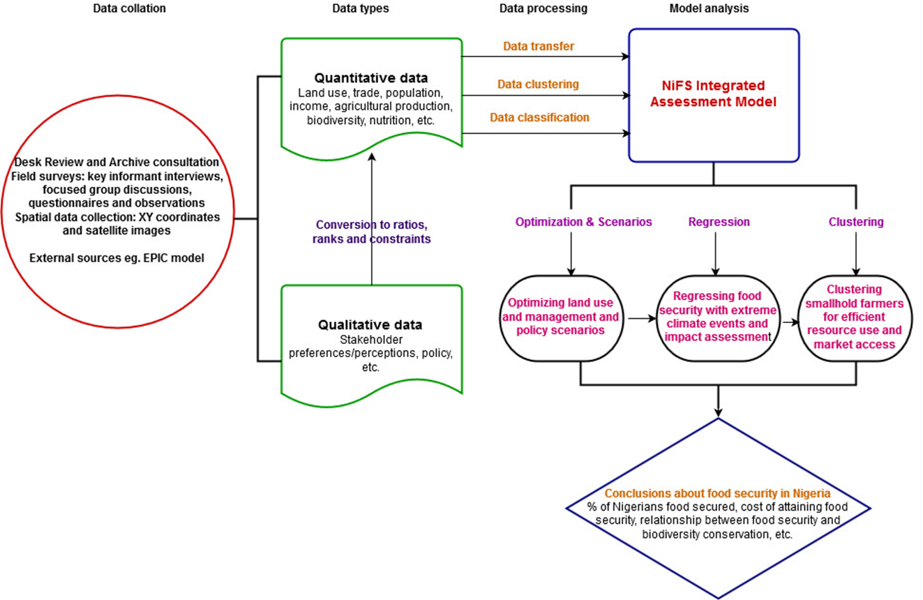
Data and approach
Data…
Resource use
Socioeconomic
Nutrition, perceptions
Biodiversity
Analysis…
Qualitative, quantitative
GAMS model scenarios
Assumptions…
Data correctness
Averaging decisions
Accurate base model is enough validation

Slide 4
Findings
Limitations…
Data availability
Time frame
Resolution trade offs
Results …
Little disparity in food security among population groups
No correlation between education level and nutrition awareness
Inverse relationship between food security and biodiversity conservation
Unique combinations of management technologies and policies are required in different regions
Findings and knowledge gaps…
Land optimization for food security means adopting management technologies and policies at the smallest possible community units
Ensuring food and nutrition security requires inclusiveness at various scales and sectors

Slide 5
Conclusions and recommendations
More sustainable food systems…
…Knowing what is practical, feasible, plausible and most importantly acceptable by actors in a food system and taking into consideration regional peculiarities will give way for entry steps to more sustainable adaptive measures and hence food systems
Next steps…
In Nigeria, food systems at the production phase are driven primarily by smallholder farmers whom are the most food insecure, finding ways to jointly ensure their livelihoods while preserving the climate and environment will be a next good step
Key message…
…Adaptation measures should pay close attention to peculiarities within regions and localities to the smallest unit as much as possible

