Slide 1
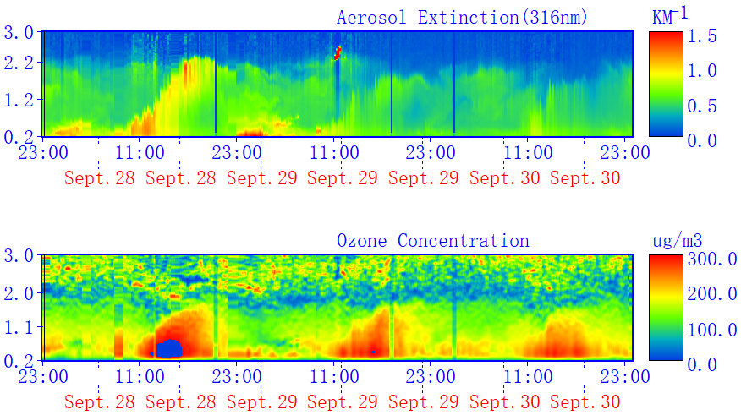
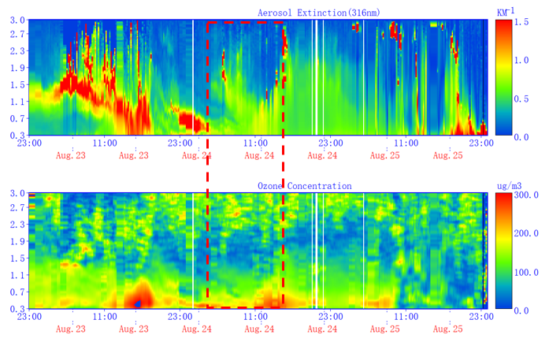
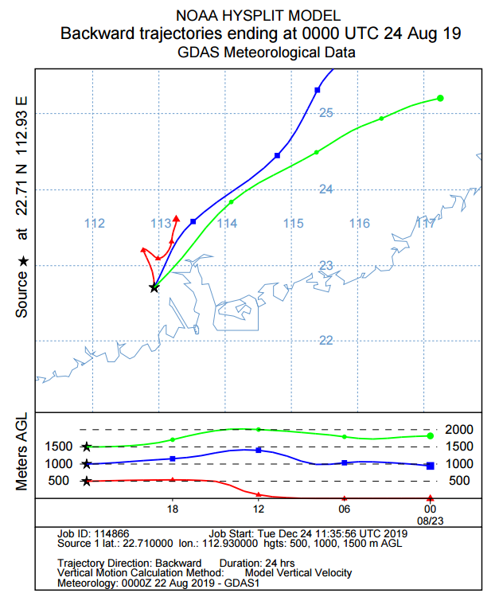
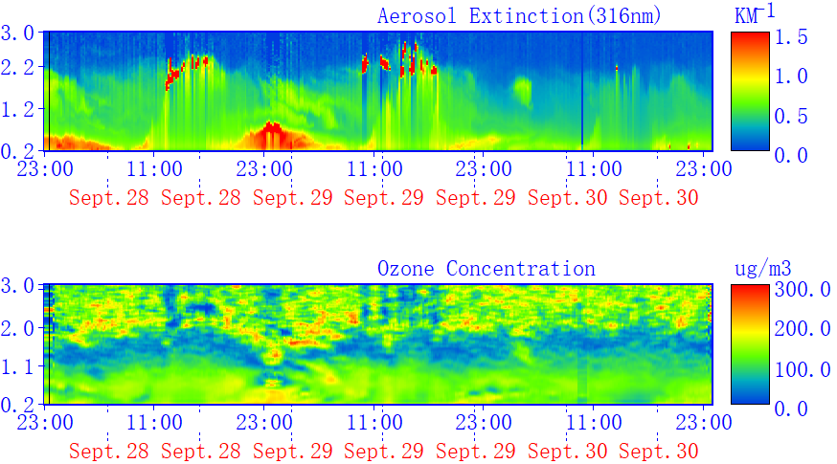
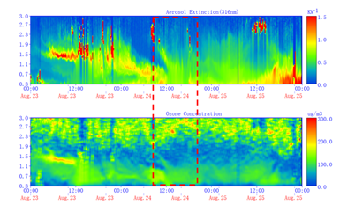
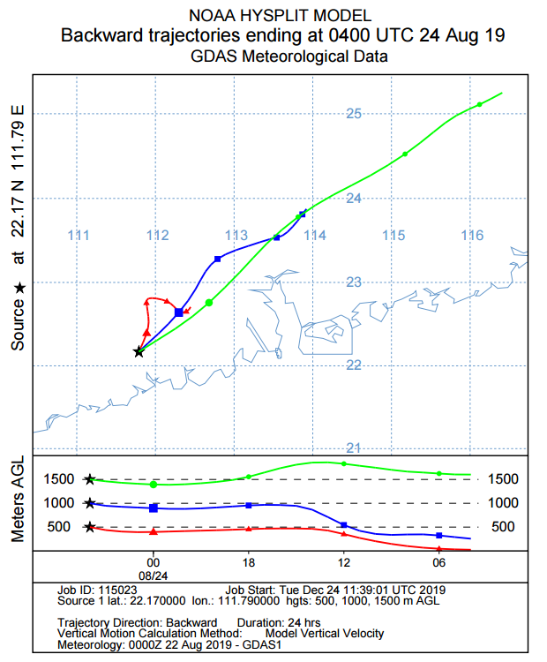
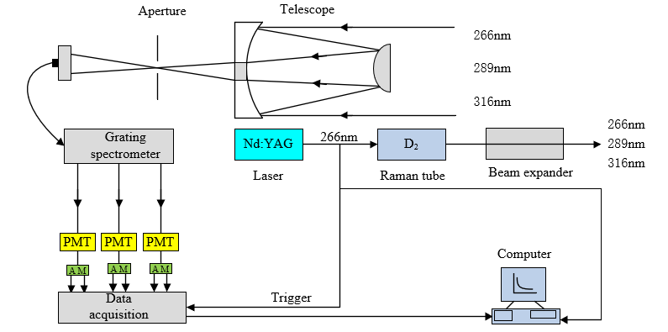
Vertical distribution of ozone in summer and autumn in Guangdong Province, Southern China
EGU General Assembly 2019
EGU2019-545432
Xinqi Wiang, Tianshu Zhang*, Yan Xiang, Lihui Lv
Institute of Physical Science and Information Technology, Anhui University, Hefei, Anhui 230601, China
Email：xinqiWangcc@163.com
1. Introduction
3. Analysis of the characteristics of ozone pollutions
5. Case study
A differential absorption lidar was used to study the vertical structure of ozone in Jiangmen city and Yangjiang city, Guangdong Province, Southern China in summer and autumn of 2019, and analyze the two typical pollution characteristics and spatial-temporal distribution characteristics of atmospheric ozone local pollution and regional transport. The results show that the vertical concentration of ozone in Jiangmen city in the summer and autumn seasons is characterized by a single peak of ozone in the afternoon. It is mainly distributed below 600 m in summer and mainly distributed within 1.0 km in autumn. There is ozone residual in Yangjiang city in summer at night. In summer, the differences between the average ozone values in Jiangmen city and Yangjiang city are small, being 92.22 μg/m³ and 82 μg/m³, respectively. In autumn, the average ozone concentration in Jiangmen city is 1.58 times the ozone concentration in Yangjiang city, which is 122.27 μg/m³ and 77.36 μg/m³. In the process of local pollution, high-concentration ozone is mainly concentrated near the ground, and the ozone concentration of 1.5-2km tends to be uniformly distributed. In regional transport, the transport heights of the two stations are mainly in two height intervals, ranging from 0.7 to 1.1 km and above 1.1 km. And use TrajStat to perform trajectory clustering analysis on the main airflows that affect Jiangmen city and Yangjiang city in summer and autumn, the dominant directions of ozone transport at the two cities in summer and autumn are analyzed. In addition, we studied two typical pollution processes, on August 24, the lidar of both cities detected the presence of ozone input and sedimentation at a height of about 1.5 km, and found that the ozone transport came from the northeast through the backward trajectory. During September 28-30, the two cities were locally polluted by ozone and there were obvious ozone residues at night.
From September 28 to 30, Jiangmen city and Yangjiang city ozone were mainly local pollution, Jiangmen's daily change was obvious, and there was ozone residue at night in Yangjiang city.
Lidar monitored the presence of ozone input and deposition at a distance of 1.5 kilometers on August 24. The time at Jiangmen city was about 7:00 and the time at Yangjiang city was about 10:00.
Air quality comes from the northeast direction.
A
The first column is local pollution, with ozone gradually increasing below 0.5km, gradually decreasing around 0.5-1.5km, and evenly distributed above 1.5km.
The ozone transport layer is mainly at two different heights, 500 meters to 1100 meters, and more than 1,100 meters.
(a₁)
(a₂)
(a₃)
F
wind
wind
wind
wind
E
PM_{2.5}
PM_{2.5}
PM_{2.5}
PM_{2.5}
B
D
29 Nov 2017
30 Nov 2017
01 Dec
02 Dec 2017
(b₁)
(b₂)
wind
wind
wind
wind
C
(b₃)
Fig2. Hourly mean profile of local ozone pollution and Extinction coefficient and ozone profile at different ozone transmission heights (the black horizontal lines represent the minimum and maximum values, the red solid lines and black squares represent the median and average values, and the top and bottom of the box-shaped box represent the 75th and 25th percentile)
PM_{2.5}
PM_{2.5}
PM_{2.5}
PM_{2.5}
03 Dec 2017
04 Dec 2017
05 Dec 2017
06 Dec 2017
Fig5. Vertical profile of ozone distribution from September 28 to 30, 2019 (a₁)JM, (b₁)YJ
Fig6. Vertical profile of ozone distribution from August 23 to 25, 2019 (a₂)JM, (b₂)YJ
Fig7. Backward trajectory on August 24, 2019 (a₃)JM, (b₃)YJ
2. Method and Instrument
4. Vertical distribution of ozone from lidar
6.Conclusion
The differential absorption lidar system is mainly composed of a laser emitting system, an optical receiving system, and a data acquisition and control system.
The ozone ultraviolet band has a wide absorption cross-section and a wide range of wavelengths for the emitted laser. Because the Nd: YAG solid-state laser quadruple-frequency laser pumped gas Raman tube can not only produce multi-wavelength ultraviolet laser, but also has high pumping efficiency and simple structure, so Become the most commonly used light source for differential absorption lidar.
The Nd: YAG laser output 266 nm laser beam enters the D2 Raman tube to generate stimulated Raman scattering, which generates 289 nm and 316 nm lasers respectively. The two wavelength lasers and the remaining 266 nm laser are vertically expanded by the beam expander Launched into the atmosphere, the telescope receives three-wavelength elastic backscattered light, which is split by a grating spectrometer. The three-wavelength scattered light is converted into a current signal by a photomultiplier tube (PMT) and collected by a transient recorder. The collected original data is saved by a computer The inversion of the ozone concentration can be obtained by the differential absorption algorithm. The main parameters are shown in Table 1.
The high concentration of ozone in local pollution is mainly concentrated near the ground, with a maximum hourly concentration of about 350m, or 162.1 μg/ m³, higher than 1.5 kilometers. Ozone concentration tends to be evenly distributed; regional transmission is mainly carried out at two height intervals: 500-1100m, above 1100m. It was found that when there is ozone transport, ozone has peaks at different transport heights, and the extinction coefficient has the same characteristics.
The average ozone concentration in Jiangmen city in autumn is higher than that in summer, while the difference between Yangjiang city in summer and autumn is very small.
Acknowledgements
This work was supported by Anhui Provincial Natural Science Foundation Youth Project (1908085QD160, 1908805QD170); Anhui Provincial Science and Technology Major Project (18030801111)
Table.1. Main parameters of the lidar
Parameter | Specification
Transmitter
Laser source | Nd:YAG
Raman tube | D₂
Wavelength/nm | 266, 289, 316nm
Receiver
Telescope type | Cassegrain
Detector | PMT
Fig3 . Diurnal variation of ozone in summer in (a₁)Jiangmen city
and (b₁)Yangjiang city
Fig4 . Diurnal variation of ozone in autumn in (a₂)Jiangmen city
and (b₂)Yangjiang city
References
In summer, Jiangmen's daily changes are obvious, and the ozone concentration is lower in the morning and evening, while there is residual ozone in Yangjiang city at night.
In autumn, the ozone in Jiangmen city is significantly greater than that in summer, and the high-concentration ozone can reach about 1km in the afternoon, but the difference in Yangjiang city is not much.
[1] Xiang, Y., et al., Atmosphere boundary layer height and its effect on air pollutants in Beijing during winter heavy pollution. 2019. 215(JAN.): p. 305-316.
[2] Cheng, N. et al., Ground ozone variations at an urban and a rural station in Beijing from 2006 to 2017: Trend, meteorological influences and formation regimes, Journal of Cleaner Production, 235, 11-20.
[3]Chi, X. Y. et al., Observations of ozone vertical profiles and corresponding precursors in the low troposphere in Beijing, China, Atmospheric Research, 213, 224-235, 10.1016/j.atmosres.2018.06.012, 2018.
[4 ]Klein, A., et al., Characterizing the seasonal cycle and vertical structure of ozone in Paris, France using four years of ground based LIDAR measurements in the lowermost troposphere, Atmospheric Environment, 167, 603-615, 10.1016/j.atmosenv.2017.08.016, 2017.
Fig.1 Schematic diagram of lidar system

