Slide 1
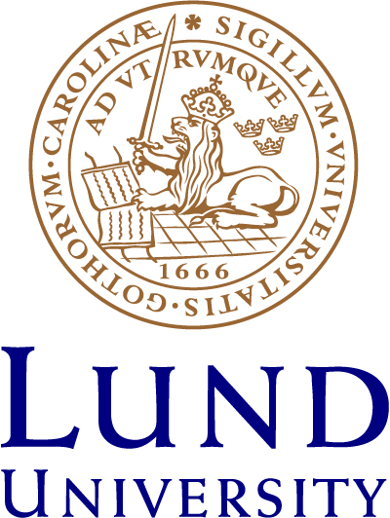
Anchita, Kamshat Tussupova and Peder Hjorth Division of Water Resources Engineering, Lund University
EGU Conference 2020
4-8th May, Vienna
HS 1.2.4 Panta Rhei: Hydrology, Society and Environmental Change
DRYING LAKES: A REVIEW ON HEALTH CONDITIONS AND RESTORATION STRATEGIES
Notes:
Abstract:
Decrease of saline lakes, which comprises of 44% of all the available lake water, is a major concern. It additionally brings to desertification process to the region. Thus, various countries have taken different actions in protecting their lake’s water level. The aim of this paper is to assess different strategies directed to tackle the decreasing saline lake water levels. Lake Urmia and the Aral Sea which split into North Aral and South Aral were among the world's largest saline lakes and now have reduced to 10% of their original size. A thorough review of academic reports, official documents and databases were considered. Although the dry-up of the lake is a natural process, it has been sped up by human interventions in the hydrology cycle. Dust storms (strong winds) in the case of the Aral Sea, transmit the pollutants from dry lake surface which initially accumulated in the lakebed causing severe health issue. Various strategies were implemented to manage the socio-economic conditions caused due to the drying of lakes. The strategy implemented for the North Aral Sea was to restore the lake by reducing the water withdrawal from tributary rivers which leads to increased water level in the sea. The strategy implemented for Lake Urmia was to restore the lake by water transfer activities from neighbouring water sources which until now show no increase in water level. The strategy implemented for the South Aral Sea was to use a dry lakebed to diversify the economy by oil and mineral extraction which shows the adaptation to the environmental conditions with no restoration strategy. As a conclusion, it is found that there is no common best solution for this kind of problem. The best fit depends on the local context and it is strongly path dependent.
1

Slide 2
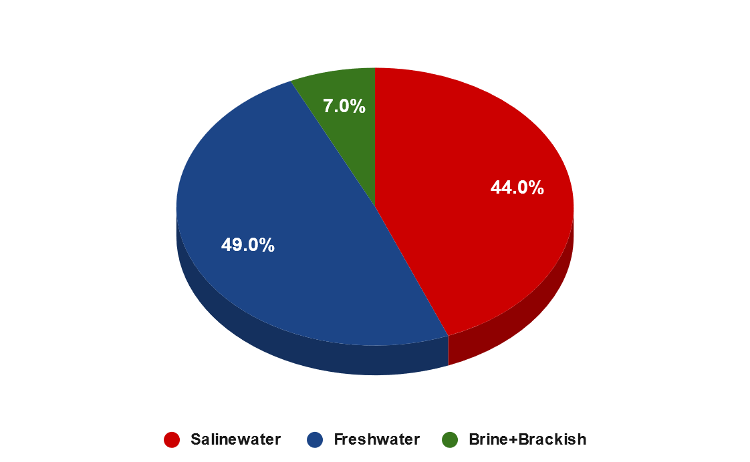
INTRODUCTION
Lake is a water-filled region surrounded by land on all its sides
Classified based on origin, size, frequency of filling and Hydro-regime
Hydro - Regime : Freshwater and Saltwater
Brackish (0.5-30 ppt) Saline (30-50 ppt) Brine (above 50 ppt)
*ppt = Parts Per Thousand
EGU Conference, Vienna, Austria, 5th May 2020
Notes:
Lake is water filled region surrounded by land on all its sides. They are classified based on origin, size, frequency of filling and Hydro-regime.
Hydro-regime is classified into freshwater and saltwater.
In this research, we focused mainly on Saltwater Lakes.
2

Slide 3
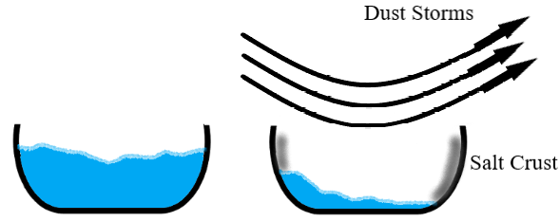
Background
Process of Drying of Lakes
Salt lakes are endorheic in nature
Rivers, groundwater and precipitation are the means of inflow
Evaporation is the prominent means of outflow
Reduced inflow or increased evaporation are the causes for the drying of salt lakes
EGU Conference, Vienna, Austria, 5th May 2020
Notes:
The drying of salt lakes exposes the salt-rich bottom to the surface, which are then spread around by the prevailing strong winds called dust storms.

Slide 4
Aim Of The Research
To assess the governmental actions on increasing the water level and additionally to study the health impacts of the decreased water level on the surrounding population.
EGU Conference, Vienna, Austria, 5th May 2020
Notes:
4

Slide 5
Selection of Case Study
Material and Method
Literature review: 91 various publications were referred
The reports by World Bank, Relevant Official Government Records and databases from Food and Agriculture Organization (FAO) and Central Asia Water (CAWater)
Aral Sea & Lake Urmia
Saline by nature
Fastest drying lakes in past 50 years
Reduced to 10% of former area
EGU Conference, Vienna, Austria, 5th May 2020
Notes:
Aral Sea and Lake Urmia are among the fastest drying saltwater lakes observed in the past 50 years.
These two lakes are saline by nature and have reduced by 90% of their former area over the last 40-50 years.

Slide 6
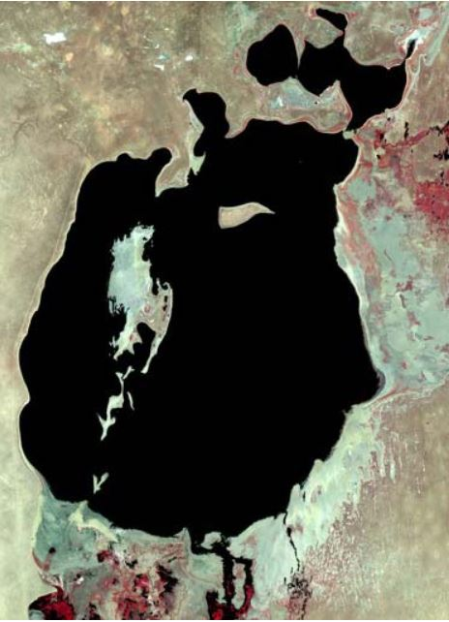
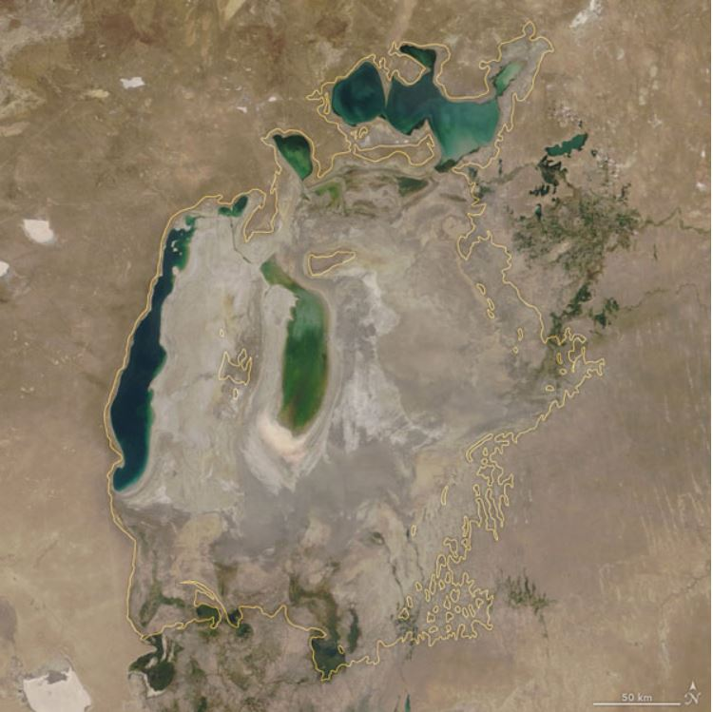
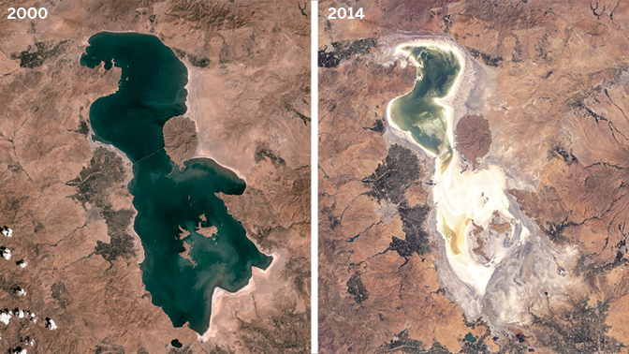
Aral Sea:
1960 and 2019
Urmia Lake:
1960 and 2019
EGU Conference, Vienna, Austria, 5th May 2020
Notes:
Aral Sea is surrounded by countries like Kazakhstan, Kyrgyzstan, Tajikistan, Turkmenistan and Uzbekistan. It has 2 Tributaries namely Amu Darya and Syr Darya.
The total Area of Aral Sea is 68,478 km² and Volume is 1093 km³ . The Water Level of the Aral Sea decreased from 53.4 m to 41.02 m during the period 1960 – 1986.
Urmia lake is situated in the Northeast Iran surrounded by East Azerbaijan, West Azerbaijan, Kurdistan, Ardebil and Zanjan provisions. Urmia lake has an Area of 5200 km² and Depth of 16 m. The Water Level of the Urmia Lake decreased from 1277.95 m to 1270 during the period 1966 – 2018.

Slide 7
The Aral Sea And Related Health Issues
Articles related to Health issues around Aral Sea was studied
According to researchers,
In Khorezm region and in Karakalpakstan (Uzbekistan) the Respiratory disorder is 3 and 2 times National Average
In Kyzylorda district (Kazakstan), mortality case of women was 3155 who belonged to Reproductive age
According to survey in Kazalinsky district (Kazakhstan) and Yany-Kurgan district (Uzbekistan) 1/10th of women suffered from Nervous system disorder
A total of 10,382 Cancer incidents were recorded in Aral Sea region
EGU Conference, Vienna, Austria, 5th May 2020
Notes:
The Aral Sea had more health-related case studies as compared to other Lakes. Thus, the Aral Sea was chosen for health impact assessment.

Slide 8
The Aral Sea And Related Health Issues
Pollutants
Industrial and Agricultural wastewater discharges and mining activities added the pollutants to the Aral Sea
The dry lake bottom which is rich in salt concentration and infused with lethal pollutants were picked up by the dust storms and spread across the Aral Sea region
Dry lakebed is infused with pollutants like: POP, DDE, HCH, DDT, Propanide and Heavy metals
Population of Aral Sea was exposed to pollutants through air, water and food
EGU Conference, Vienna, Austria, 5th May 2020

Slide 9
The Aral Sea And Related Health Issues
Discussion
Respiratory diseases found in the region may be due to pollutants
High toxic substances could be the cause for Nervous system disorders
Reproductive disorders and perinatal mortality could be due to malnutrition Traces of chemical pollutants were detected in food and in human body
Cancer could be caused due to inhalation and oral intake heavy metals and chemical pollutants
Cross sectional and Case controlled studies
Good to find the prevalence of diseases
Not good for finding the cause
EGU Conference, Vienna, Austria, 5th May 2020
Notes:
These studies are cross-sectional, and case controlled with several uncontrollable variables which makes the results less reliable

Slide 10
Lake Restoration Strategies: Case study of three lakes
Lake Urmia, Iran - A lake amidst the restoration process
Northern Aral Sea, Kazakhstan - A successfully restored lake
Southern Aral Sea, Uzbekistan - A lake where the efforts to restore were ceased
EGU Conference, Vienna, Austria, 5th May 2020
Notes:
These three salt lakes serve as an ideal example because their respective governments had a contrasting approach towards the identical problem of drying salt lake.

Slide 11
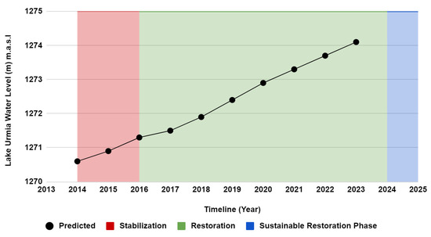
Lake Restoration Strategies: Case study of three lakes
Restoration of Lake Urmia
Water Transfer Activities
Urmia Lake Restoration Program - US $1.3 Billion
Annual inflow of 3.1 BCM
Aras River; Caspian Sea
Wastewater discharge
EGU Conference, Vienna, Austria, 5th May 2020
Notes:
Lake Urmia started shrinking at a rapid rate since 1995. In the efforts of restoring Lake Urmia, the Iranian government announced the Urmia Lake Restoration Program (ULRP) under the Urmia Lake Restoration Program National Committee (ULRNC) headed by the Vice President to save the lake.
ULRP has several water transfer activities included in their program. To achieve the restoration of Lake Urmia, wastewater collection networks will be installed, dams will be constructed, river networks will be renovated and reconstructed and canals will be added to the conveyance network.
Water will be transferred from (1) wastewater treatment plants, (2) the Zab River and (3) transfers through Hasanloo Dam.
In addition to these, Inter-basin transfer projects have been proposed from the Aras River and the Caspian Sea.

Slide 12
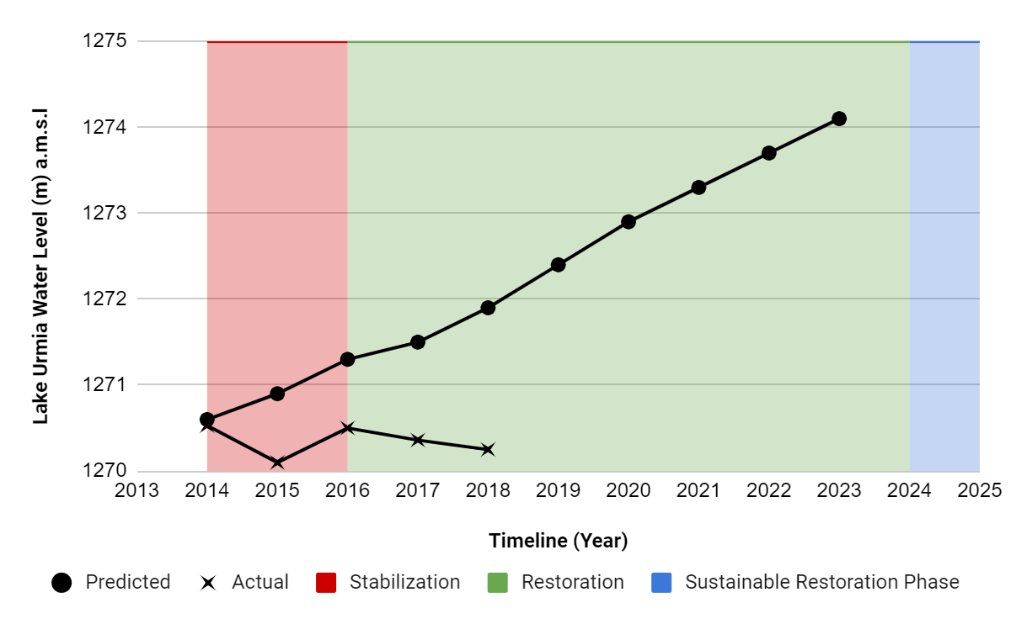
Lake Restoration Strategies: Case study of three lakes
Restoration of Lake Urmia
Eutrophication
Usage decreased
The water level did not meet the predicted level
EGU Conference, Vienna, Austria, 5th May 2020
Notes:
Drawbacks: Eutrophication due to discharge of nutrients from wastewater, Usage of lake decreased due to low water level, The actions taken by government did not meet their expected results.
The overall ULRP restoration is estimated to cost US $1.3 Billion but the budget for the year 2015 - 2016 alone was US $626,592,000
12

Slide 13
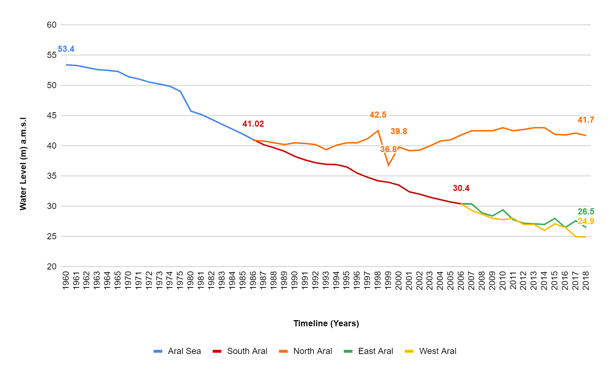
Lake Restoration Strategies: Case study of three lakes
Restoration of North Aral Sea
1960-1986, water level of NAS dropped from 53.4 m to 41.02 m
EGU Conference, Vienna, Austria, 5th May 2020
Notes:
During the period 1960-1986, the water level of North Aral Sea dropped from 53.40 m to 41.02 m resulting in a reduction of the shoreline
13

Slide 14
Lake Restoration Strategies: Case study of three lakes
Syr-Darya Control and Northern Aral Sea Project (SYNAS)
Construction of new dike to stop the flow of water from NAS to SAS
World Bank and Kazakhstan government initiated SYNAS-1 project through 2001-2008 with US $83.34 million
SYNAS Activities
Recuperation of Northern Aral Sea
Improvement of Hydraulic regulators of Syr Darya
Rehabilitation of Chardara Dam
Restoration of Aquatic resources and development of Fisheries
Monitoring and Evaluation
Project Management
EGU Conference, Vienna, Austria, 5th May 2020
Notes:
Advantages: Increase in surface area, water level and Capacity of river, Increase in Fishery and Agricultural yield, Decrease in Salinity level, Reduction in water loss
Disadvantages: With the lake restored, many people from service sector are back for fishing leading to overfishing, With increase in population, there are possibilities of increasing water withdrawal rate.

Slide 15
Lake Restoration Strategies: Case study of three lakes
Restoration of South Aral Sea
The water surface in the South Aral was 36960km² in 1989 and 6717km² in 2011
30,243 km² of empty land
Requires more than US $83million.
Government of Uzbekistan have invested in the exploration of oil and gas, salt extraction and tourism
Plantation of trees on the dry lakebed
EGU Conference, Vienna, Austria, 5th May 2020
Notes:
Advantage: Focused in economic development and providing job opportunities, Developed afforestation by planting drought resistant saplings
Disadvantage: Economic development might be a short-term success if the environment condition is bad for survival
15

Slide 16
Conclusion
Drying of a lake is a natural process but accelerated due to anthropogenic activities
The Dust storms with pollutants could have been the cause for health issues in the Aral region
Restoration is a viable option if sustenance of the restored lake can be promised
The restored lake might end up in current drying conditions when the regional economy continues to depend on the high-water withdrawal from lake tributaries
EGU Conference, Vienna, Austria, 5th May 2020
Notes:
16

Slide 17
THANK YOU
EGU Conference, Vienna, Austria, 5th May 2020

