Slide 1
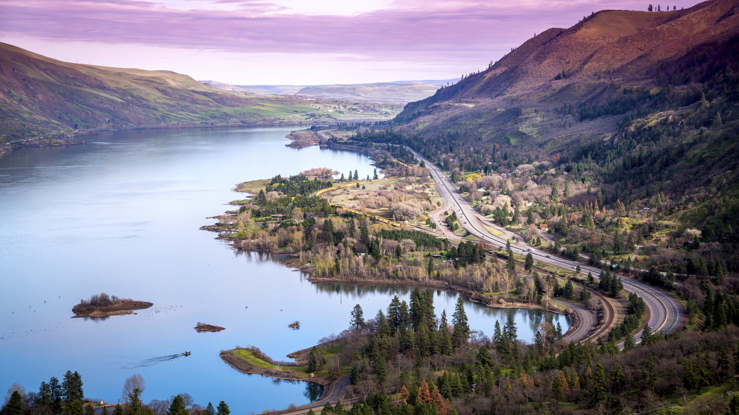
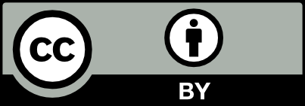
Socio-Hydrological Modelling of the Tradeoff Between Flood Control and Hydropower Provided by the Columbia River Treaty
Charlotte Cherry¹, Felipe Arguello de Souza², Samuel Park³, Ashish Shrestha⁴, Liu Yang⁵, Marlies Barendrecht⁶, Jing Wei⁷, and Fuqiang Tian⁷
1 University of Illinois Urbana Champaign, USA
2 University of São Paulo, Brazil
^{3 Purdue University, USA}
4 Arizona State University, USA
^{5 Yunnan University, China}
6 Vienna University of Technology, Austria
^{7 Tsinghua University, China}
Notes:
Thank you all for coming today. I will be presenting our work on socio-hydrological modelling of the tradeoff between flood control and hydropower provided by the Columbia River Treaty. This work was started during the Sociohydrology Summer Institute on Transboundary Rivers hosted this past summer at Yunnan University in China.

Slide 2
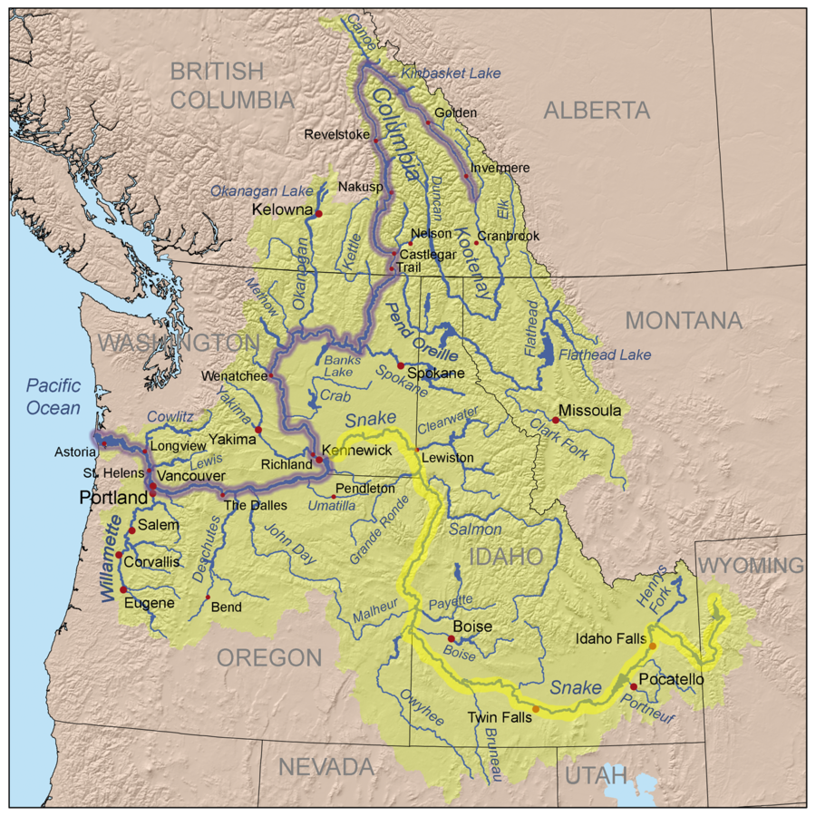
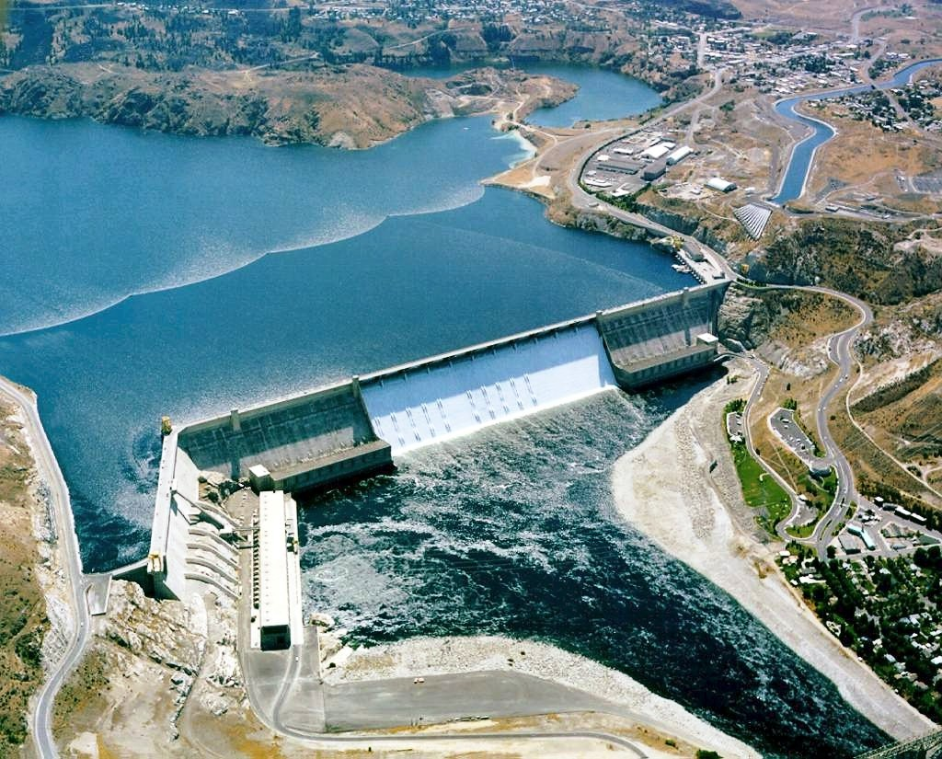
The Columbia River is of great importance for hydropower production and flood control in the Pacific Northwest
Notes:
The Columbia River is the fourth largest river in North America, and it is shared between British Columbia, Canada, in the north, and the states of Washington and Oregon in the south. Cooperation along the river has allowed for major development of dams, which have created a powerful machine harnessed for hydropower production and flood control.

Slide 3
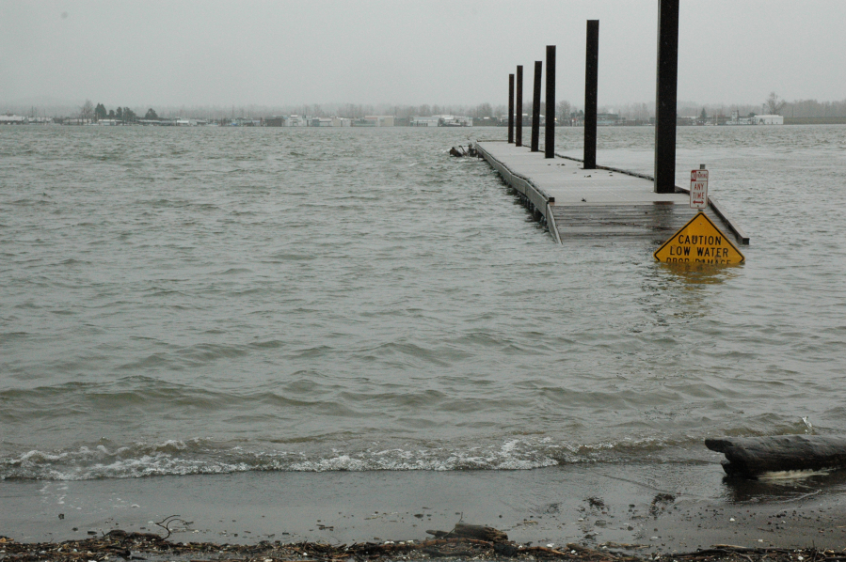
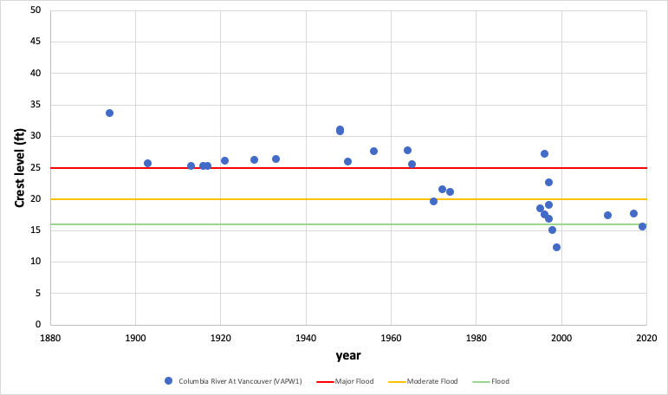
Cooperation has reduced flood peaks downstream in the Columbia River
Columbia River Treaty
Implemented
Notes:
Historically, downstream communities in Oregon and Washington experienced destructive floods. These floods, particularly the Vanport Flood in 1948, were the impetus for the U.S. to seek cooperation. The U.S. found that it would be excessively difficult to control flood levels within their portion of the river. The U.S. approached Canada about building storage dams upstream near the headwaters of the Columbia River. After the Columbia River Treaty was established in 1961 and these dams were built, there was a significant decline in major flood levels in downstream communities.

Slide 4
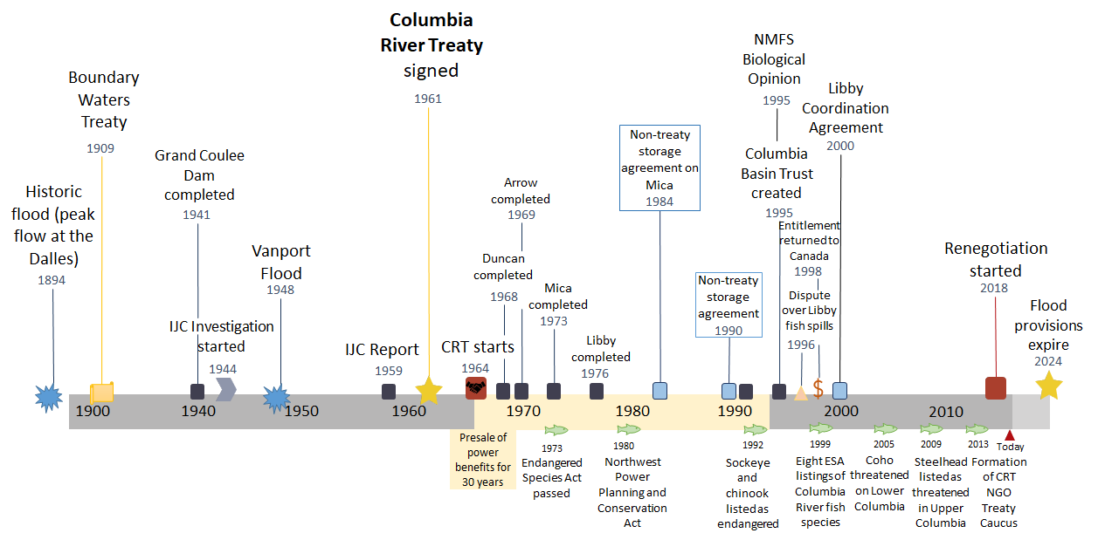
The Columbia River Treaty is a key example of successful transboundary river management
Notes:
There is a long history of cooperation between the U.S. and Canada, including early agreements about management of transboundary waters. However, large-scale, coordinated management had not been done. After major floods like the Vanport flood in 1948, the U.S. and Canada came together to establish the Columbia River Treaty. A major part of this agreement was that Canada would build several large storage dams upstream – Duncan, Arrow, Mica, and Libby, which were constructed through the early 1970s. These dams are jointly managed between countries to provide guaranteed flood protection downstream. This storage also provides more predictable flows downstream and allows the U.S. to operate dams to maximize hydropower production, the benefits of which are shared with Canada as compensation for their cooperation. The key flood protection provisions of the treaty are set to expire in 2024 and as of last year the renegotiation has started to determine what the next phase of cooperation will look like.
However, since the Columbia River Treaty was implemented, there have been a number of major changes created in the system due to dam construction. The construction of the Grand Coulee Dam completely blocked the migration of fish between the U.S. and Canada. Downstream, dam construction has made fish passage more challenging and, as shown below the timeline, a number of critical fish species have become endangered along the river since the treaty was negotiated. These environmental and social concerns have become a major topic as the U.S. and Canada entered into renegotiations in 2018.
The Columbia River Treaty is touted as a key example of successful transboundary river management. As the renegotiation is underway, we are interested in understanding the mechanisms that contribute to maintaining stability in transboundary river management. Through our modeling efforts, we aim to assess how the share of benefits each side receives changes over time and what impact this will have on each sides’ willingness to cooperate.

Slide 5
Hypothesis: Social drivers have altered the relative share of benefits between Canada and the U.S., which influences their willingness to cooperate
Decreasing fish populations along the Columbia
Increasing social awareness and pressure to protect fish
Changes in national law and regulations
Decrease in hydropower production
Dam operations changed to spill water for fish migration
Increased U.S. reliance on flood protection
Increasing development downstream
Increasing population in PNW
Increased value at risk
Notes:
There have been social changes that have affected both components of the Columbia River Treaty. Concerns over declining fish populations in the U.S. have resulted in increased spills over U.S. dams to aid fish passage, which has decreased the water available for hydropower production. However, as the payment for hydropower benefit to Canada has not changed, this has created the perception of decreased benefit on the U.S. side. At the same time, the U.S. has more to lose if flood protection from Canada was lost because growing development along the downstream portion of the river has increased the value at risk.
We hypothesize that these changes have created imbalance in the perceived share of benefits, and that these social shifts will need to be considered in the renegotiation to bring the system back into balance.
These new conditions have created a state of imbalance in the benefits received from cooperation that will need to be addressed in the renegotiation.

Slide 6
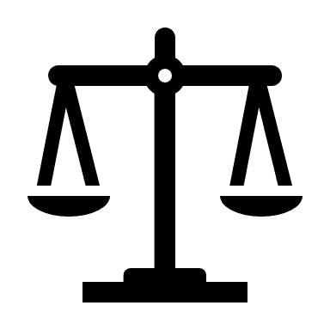
Causal Loop Diagram
Cooperation
Coordinated dam operation
Hydropower and flood control
Perceived share of benefits
Social and environmental pressure
Notes:
The general premise of our modeling effort was to consider how coming together in the Columbia River Treaty affected how each side operated their dams for maximum joint benefit, which produced these benefits in the form of hydropower and reduced flood damages. Then, due to cooperation, these benefits were shared. And, if the perceived share of benefits is agreeable, they continue to cooperate. Then, we introduce the new scenario where the U.S. side is required to change dam operations due to external social and environmental pressure that affects operation on their side, and thereby propagates changes throughout the system.

Slide 7
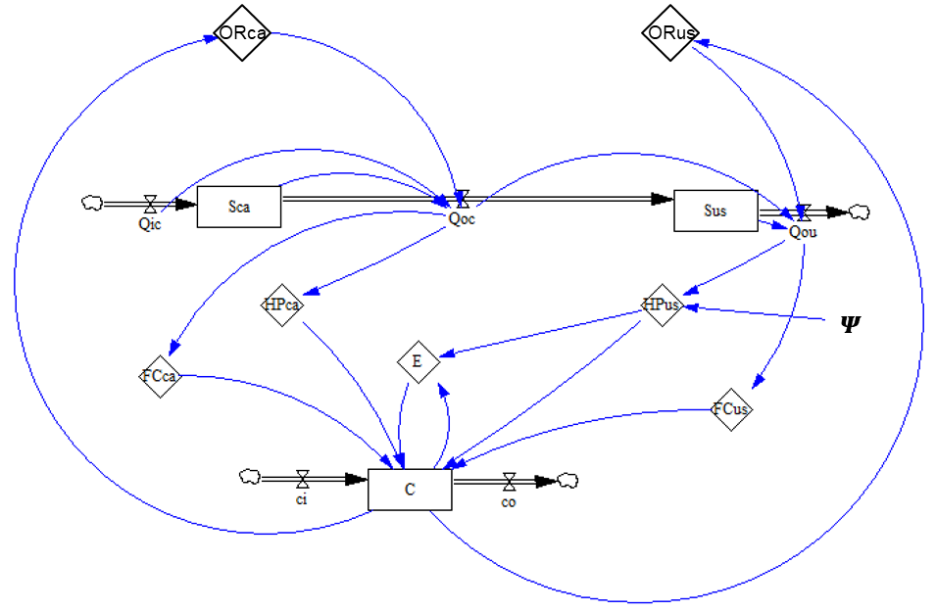
A system dynamics model pairs hydrological and social system components
Hydrological system
Stock
Sca: Storage Canada (m³)
Sus: Storage U.S. (m³)
C: Willingness to cooperate
Variable
HP: Hydropower benefit (US$)
FC: Flood prevention benefit (US$)
E: Entitlement (US$)
OR: Operation rules (m³)
Parameter
𝜳: Monthly fish spill(%)
Social system
Notes:
Here is a more complicated view of our system dynamics model that pairs the hydrological system with social system components. The hydrology consists of a basic inflow, outflow, and storage system, which contributes to economic benefits through hydropower and flood control, in addition to the exchange of benefits involved in the treaty. And these feed back into cooperation and cooperation influences operations rules of the dams.

Slide 8
Cooperation is modelled based on shared benefits between two actors
Inequity Aversion: Used in behavioral economics to describe preference for equal payoffs with others (Fehr and Schmidt, 1999)
Modeling Change in Willingness to Cooperate
$$\frac{dC}{dt}=\left(χ−\frac{| Net Benefit CA − Net Benefit US |}{Benefit CA + Benefit US}\right)∗\left(C−1\right)∗C$$
$$=\left(χ−\frac{|\left({HP}_{ca}+{FC}_{ca}+E\right)−\left({HP}_{us}+{FC}_{us}−E\right)|}{{HP}_{ca}+{FC}_{ca}+{HP}_{us}+{FC}_{us}}\right)∗\left(C−1\right)∗C$$
$C$: Willingness to cooperate (0 < $C$ < 1)
$E$: Canadian entitlement (US$)
${HP}_{us}$: Hydropower benefit U.S. (US$)
${HP}_{ca}$: Hydropower benefit CA (US$)
${FC}_{us}$: Flood prevention benefit U.S. (US$)
${FC}_{ca}$: Flood prevention benefit CA (US$)
Notes:
One of the innovations of our model is developing a way to model cooperation. We’ve conceptualized this in a way that is similar to the idea of inequity aversion from behavioral economics which explains the preference for equal or fair benefits compared to others. Our equation is based on change in willingness to cooperate being a factor of the proportion of total benefits that each side receives. And, it also depends on whether each side is in a state of cooperation or noncooperation initially.

Slide 9
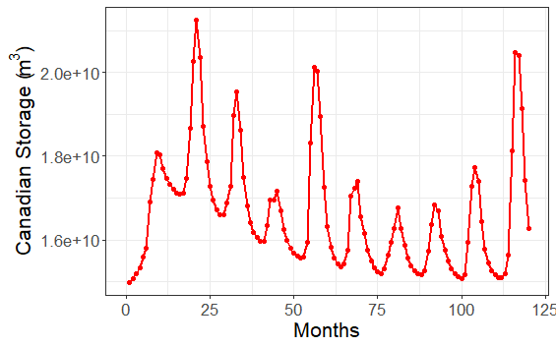
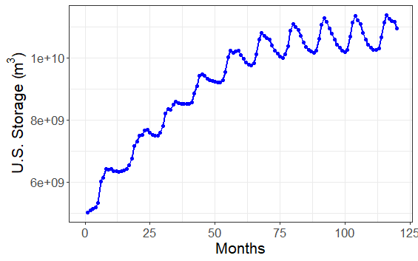
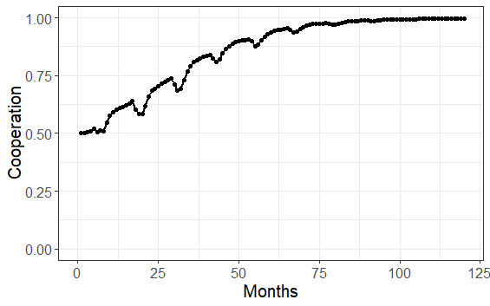
Under cooperation, Canada lowers storage to provide flood control
Notes:
The preliminary results of our model demonstrate the expected direction of change. Using 10-year monthly data, we are modeling storage levels in the U.S. and Canada, and then running our model to show cooperation based on generated benefits. As you can see on the left side, Canadian storage declines generally (with the variation showing seasonal changes), and this is in order to lower storage levels before the flood season to provide flood protection. Due to this change, the U.S. can increase total storage in order to maximize hydropower production. And, under these conditions, cooperation goes towards a maximum stable state. The initial rise is due to our initial assumptions and the end of the simulation shows the equilibrium state.

Slide 10
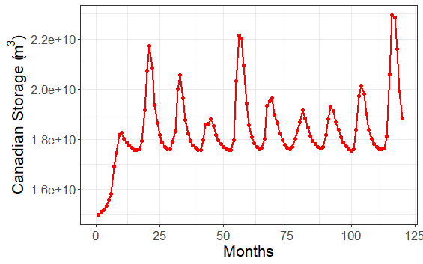
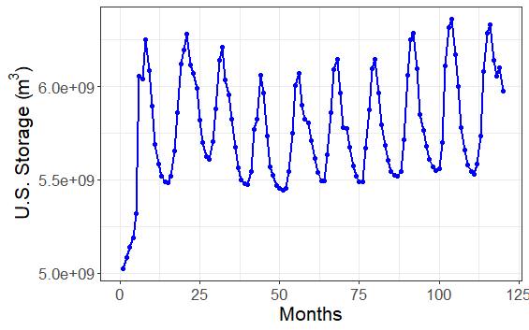
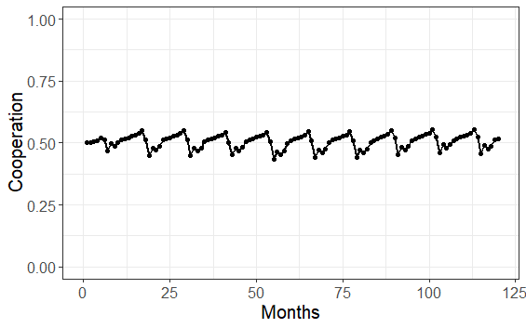
When fisheries are considered, storage changes and cooperation declines
Notes:
However, when we include environmental concerns and changes in U.S. dam operations to protect fish, we can see that this reduces U.S. storage, thereby reducing the total hydropower benefit. Under these conditions, cooperation falls and Canada increases storage in order to increase their own hydropower production.

Slide 11
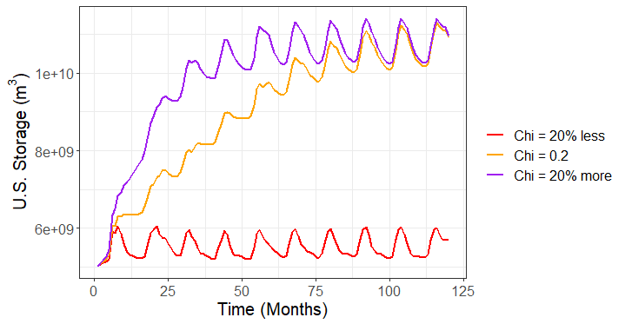
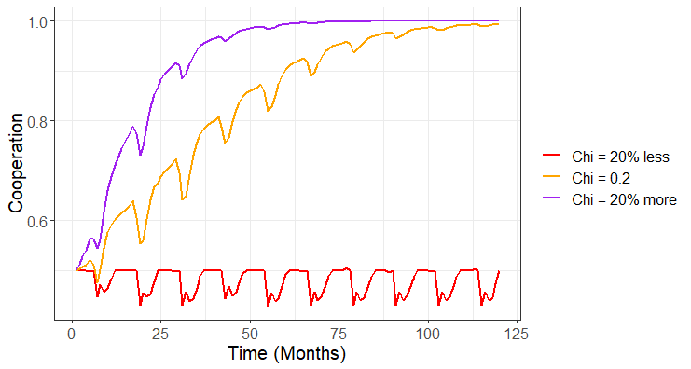
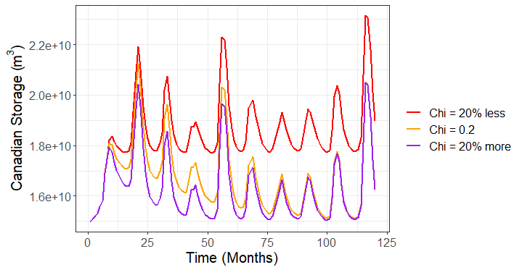
Cooperation is most sensitive to changes in “institutional capacity”
Notes:
In testing our model, we found that the equation for cooperation is most sensitive to a factor we call “Institutional capacity”. We can see in the graph of sensitivity testing that when this value is reduced slightly, it throws the system out of balance and cooperation declines. This decline also corresponds to a drop in U.S. storage which aligns with the theory that the U.S. would have to provide substantial flood protection in U.S. dams if Canadian dams were not cooperating.

Slide 12
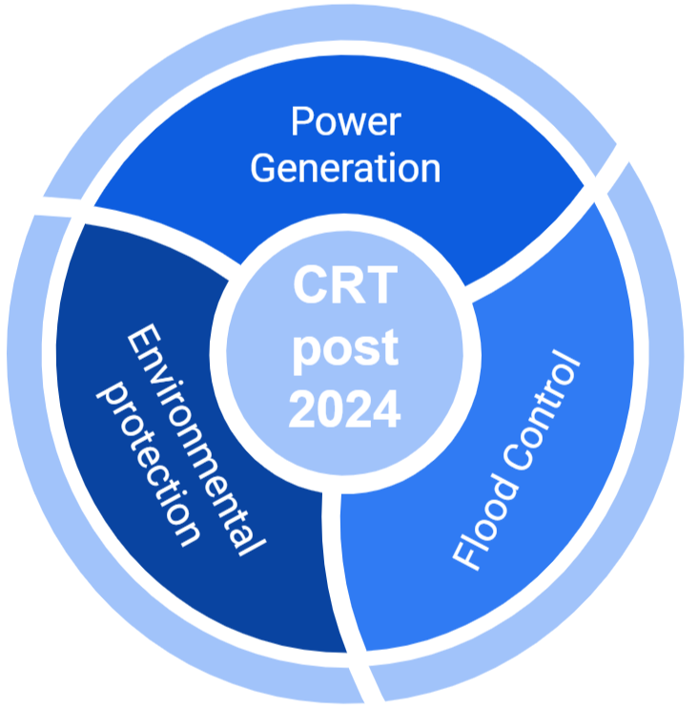
Significant changes may be required to support cooperation during treaty renegotiation
Added priority of environmental protection
Perceived change in benefits and unilateral concerns that affect willingness to cooperate
New treaty may require a rebalancing of benefits
Notes:
As the treaty is renegotiated, there are stakeholders on each side who believe that they are not getting a good deal out of the treaty. We are creating a model to help provide insight into the factors that contributed to stable equilibrium state of cooperation previously and how, with the consideration of these new environmental factors, the share of benefits is no longer in balance. This added priority, which is not shared equally between both sides, will need to be incorporated into the new treaty. It can no longer be solely about maximizing flood control and hydropower production. In the larger geopolitical framework of U.S.-Canada relations, it seems likely that they will come to some new agreement with new terms and we hope to be able to use this as an example of coordinated management that provides insight on the conditions required to enable cooperation.
Represent this rebalancing act and how the system can return to equilibrium.

Slide 13
Next Steps
Continue model improvements to better represent the system and test alternative scenarios
Provide insight into the drivers of cooperation. Part of ongoing and growing work on cooperation transboundary water management, including two other study basins (Mekong and Nile)
Engage with stakeholders involved in Treaty renegotiation
Notes:
We will continue to work on our model to make improvements. Also, this is part of a broader comparative study of three different transboundary river basins. We are using similar frameworks to understand the common factors and drivers of cooperation. As the Columbia River case is one where cooperation has worked for some time due to their share of created benefits on the river, this can be an example of understanding cooperation in a transboundary river setting.

Slide 14
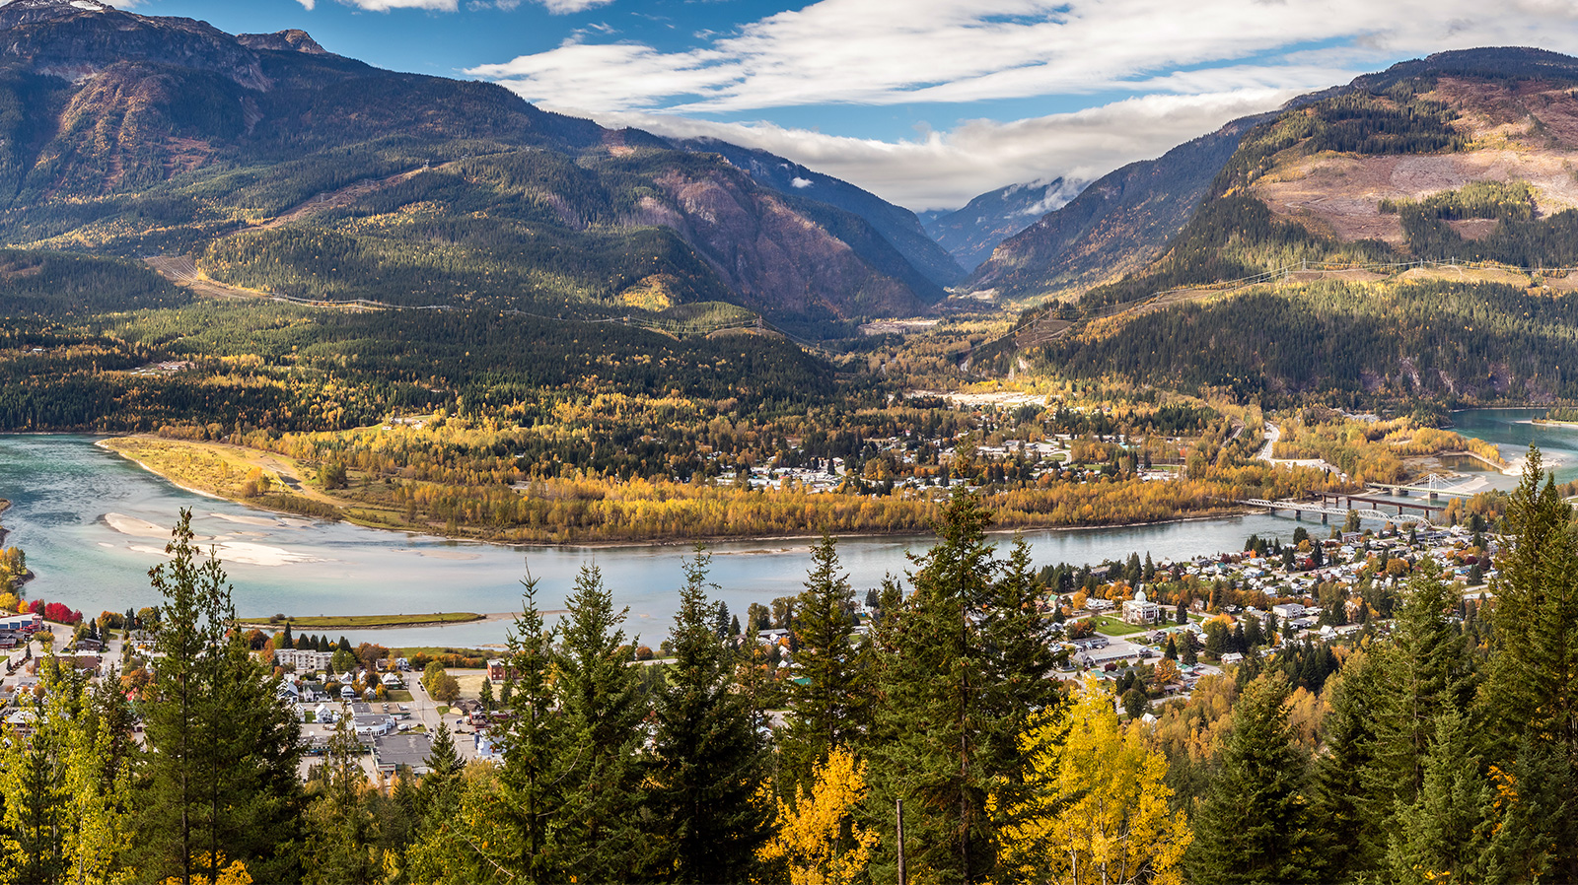
Special Thanks to:
Yunnan Sociohydrology Summer Institute for Transboundary Rivers
Dr. Murugesu Sivapalan, University of Illinois
Dr. Margaret Garcia, Arizona State University

