Slide 1
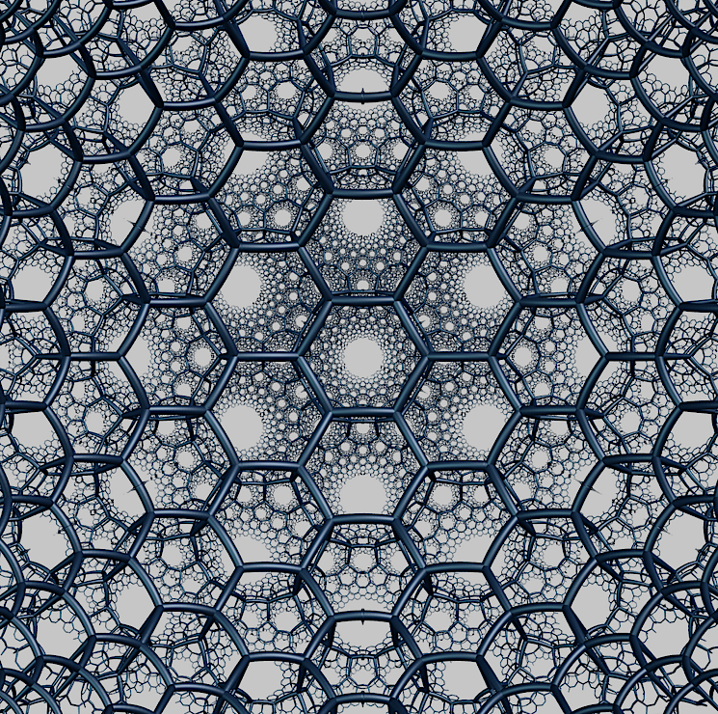
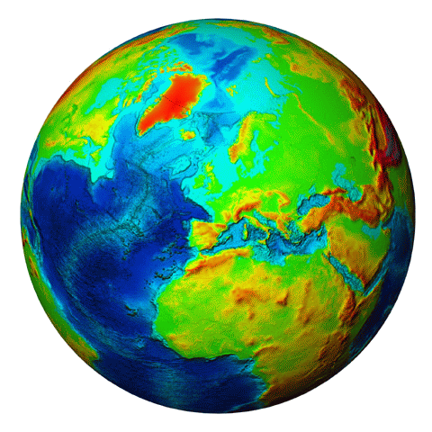
Hyperbolic geometry of earthquake networks
Ilya Zaliapin and Karla Henricksen
Department of Mathematics and Statistics
University of Nevada, Reno
Konstantin Zuev
Department of Computing and Mathematical Sciences
California Institute of Technology
EGU2020-12091 | SM3.2 | Monday, May 4

Slide 2
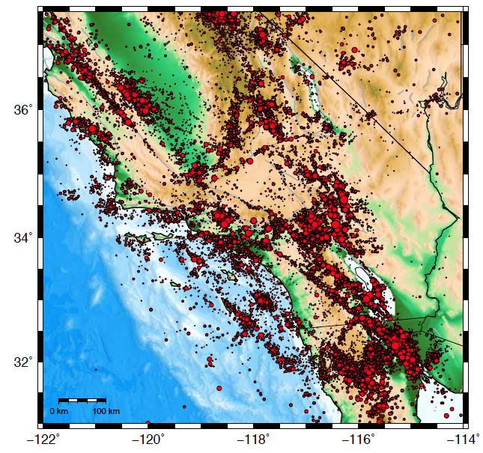
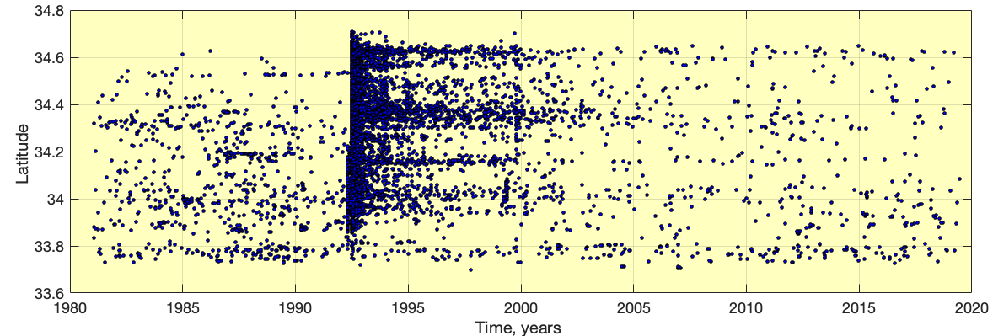
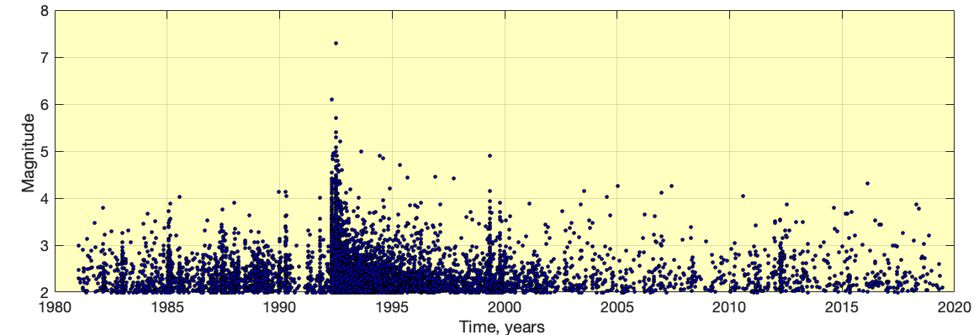
Earthquakes: complex dynamics in space-time-magnitude domain
Catalog of Hauksson et al. [2012] extended to 1981–2019.5, m ≥ 2.
Southern California (map view), 1981–2019.5
Time-latitude sequence (Landers fault zone)
Time-magnitude sequence (Landers fault zone)

Slide 3
Large-scale view: hyperbolic spaces are approximately trees
(Negatively curved) hyperbolic plane and tree are the same
when looked at from afar
(Flat) Euclidean plane and rectangular grid are the same
when looked at from afar
Bridson and Haefliger [1999], Gromov [1987]

Slide 4
Large-scale view: hyperbolic spaces are approximately trees
Any quadruple on a tree is geodesically connected as shown on the right

Slide 5
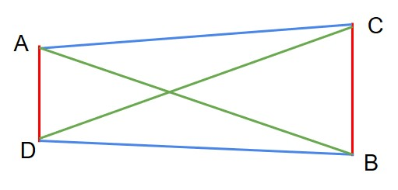
Large-scale view: Gromov 𝜹-hyperbolicity
Definition 1 [Four-point condition]
Consider a metric space (X,d). For each quadruple define L ≥ M ≥ S as shown above.
A quadruple satisfies 𝜹-four point condition if Δ = (L – M)/2 ≤ 𝜹.
A metric space is said to be 𝜹-hyperbolic if each quadruple satisfies 𝜹-four point condition.
Bridson and Haefliger [1999], Gromov [1987]

Slide 6
Large-scale view: Gromov 𝜹-hyperbolicity
Tree
Hyperbolic space
Euclidean space
𝛅 = 0
𝛅 > 0
𝛅 = ∞
Bridson and Haefliger [1999], Gromov [1987]

Slide 7
Estimating 𝜹-hyperbolicity
Consider multiple (uniform random) quadruples
For each quadruple i, find Δ_{i} = (L_{i} – M_{i})/2
The estimator of 𝜹 is max(Δ_{i})
Tested in multiple applied networks:
Kennedy, Narayan, Saniee [2013] – Facebook, Google, AT&T IP;
Boguna et al. [2009] – Internet;
Montgolfier et al. [2011], Coudert et al. [2016], Cohen et al. [2017], etc.

Slide 8
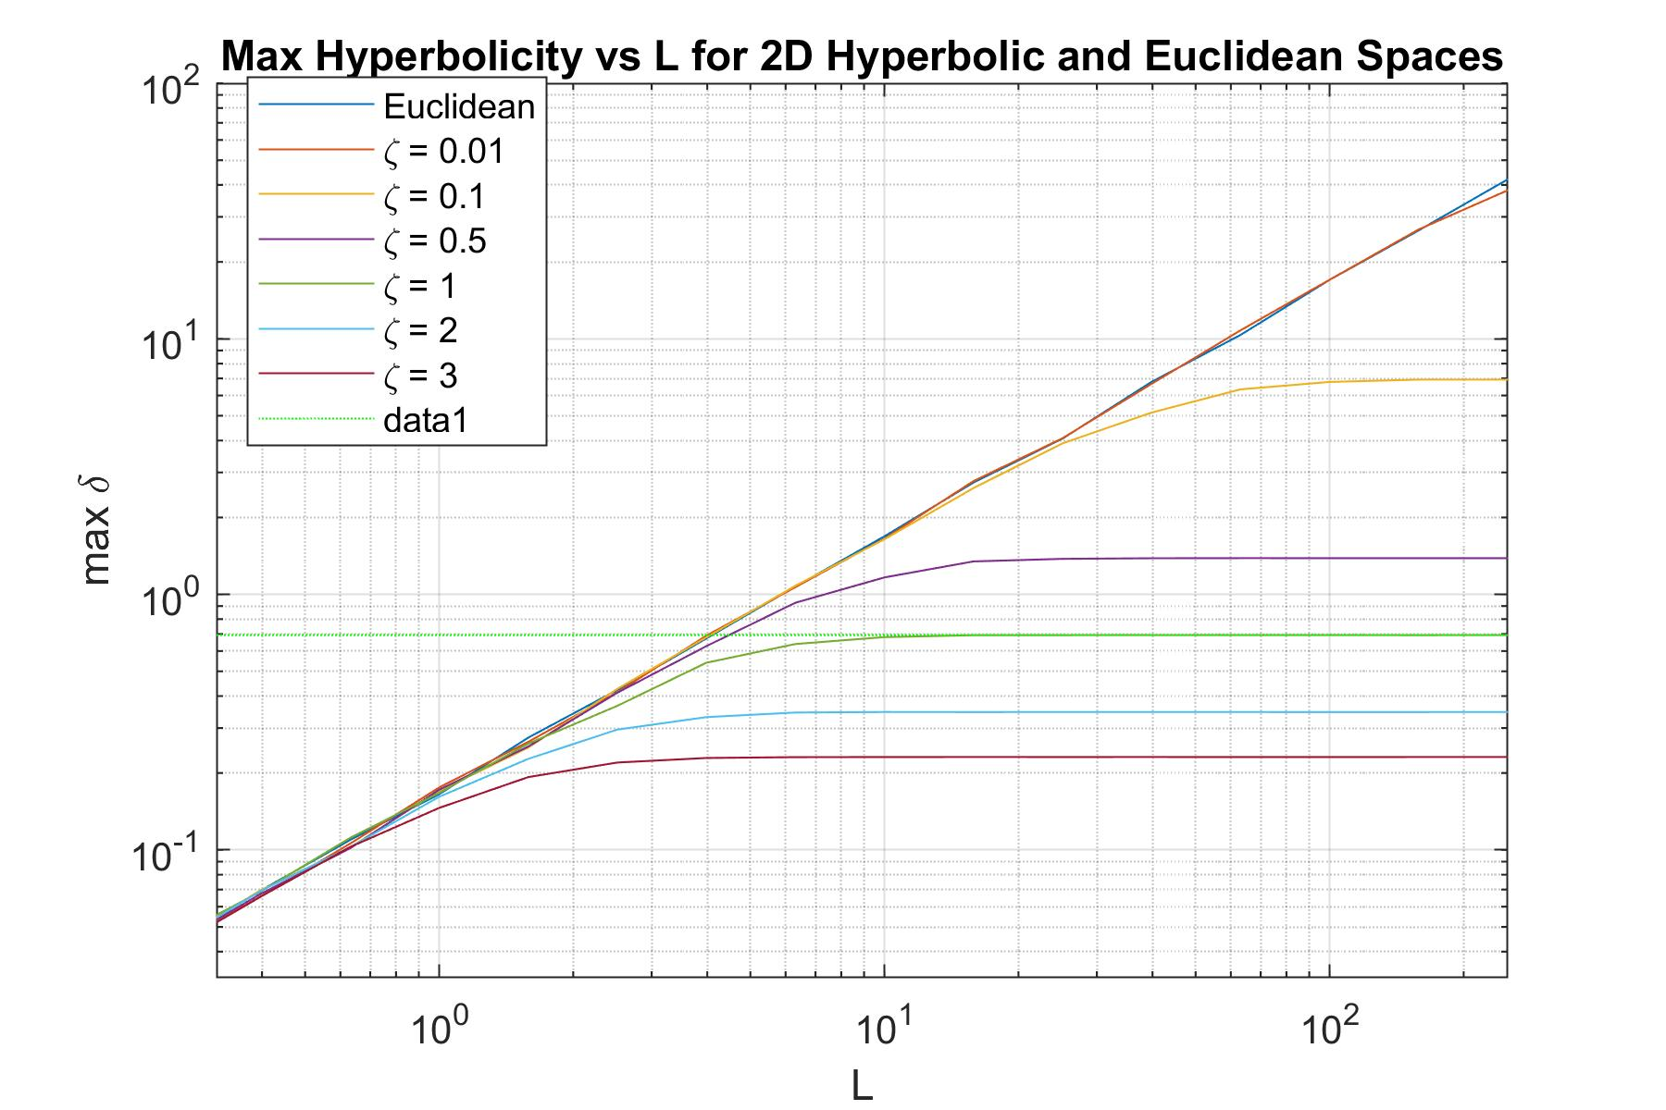
Estimating 𝜹-hyperbolicity in Euclidean and hyperbolic spaces
For Euclidean space, δ increases linearly with quadruple size L
For hyperbolic space, δ saturates for large quadruples (large L)
For hyperbolic space, as curvature decreases, the space becomes “more Euclidean” and max(δ) increases
Curves for both spaces overlap for small quadruples (small neighborhoods are always Euclidean)
max Δ
$$\log{(2)}$$
Quadruple diameter L
Numerical simulations:
Uniform quadruples in 2D Hyperbolic and Euclidean circles

Slide 9
Earthquake proximity
For any earthquake j define its proximity to an earlier earthquake i as:
$ɳ_{ij}=\left\{\begin{aligned}\left(t_{j}−t_{i}\right)r_{ij}^{f}{10}^{−b\left(m_{i}^{}−m_{0}^{}\right)},t_{j}−t_{i}≥0 \\ ∞ ,t_{j}−t_{i}<0\end{aligned}\right.$ ,
where t_{i} is the occurrence time, m_{i} is the magnitude of earthquake i, r_{ij} is the surface distance between earthquakes, f is the fractal dimension of the epicenters, and b is the parameter of the Gutenberg-Richter law.
i
Δt
The proximity equals the average number of events with magnitude m_{i} “between” i and j in a catalog with uniform time, homogeneous space, and exponential magnitude coordinates
space
r_{ij}
time
j
Baiesi and Paczuski [2004], Zaliapin and Ben-Zion [2013]

Slide 10
Earthquake proximity
Studying scale-free structure of earthquake networks
Baiesi and Paczuski [2004]
Identification of earthquake clusters (aftershocks, foreshocks, swarms, etc.)
Zaliapin et al. [2008], Zaliapin and Ben-Zion [2013], Gu et al. [2013], Ruhl et al. [2016]
Classification of seismic clustering in relation of the properties of the lithosphere
Davidsen et al. [2015], Moradpour et al. [2014], Reverso et al. [2015], Zaliapin and Ben-Zion [2016], Trugman et al. [2017], Kossobokov and Nekrasova [2017], Gentili et al. [2017, 2019], Peresan and Gentili [2018], Martinez-Garzon et al. [2018]
Discriminating between human-induced and natural seismicity
Schoenball et al. [2015], Zaliapin and Ben-Zion [2016], Schoenball and Ellsworth [2017], Vasylkivska and Huerta [2017], Martínez-Garzón et al. [2018]
Studying laboratory fracture (AE) data
Davidsen et al. [2017]
Developing earthquake catalog declustering techniques
Zaliapin and Ben-Zion [2016, 2020]

Slide 11
Estimating 𝜹-hyperbolicity for earthquakes
(1) Actual proximity
(2) Unweighted proximity network
(edge corresponds to 𝜂 < 𝜂₀)
(3) Weighted proximity network
(edge corresponds to 𝜂 < 𝜂₀)
𝜂₅
𝜂₁
𝜂₆
1
𝜂₁
𝜂₄
1
𝜂₄
𝜂₃
1
𝜂₃
𝜂₂
1
𝜂₂

Slide 12
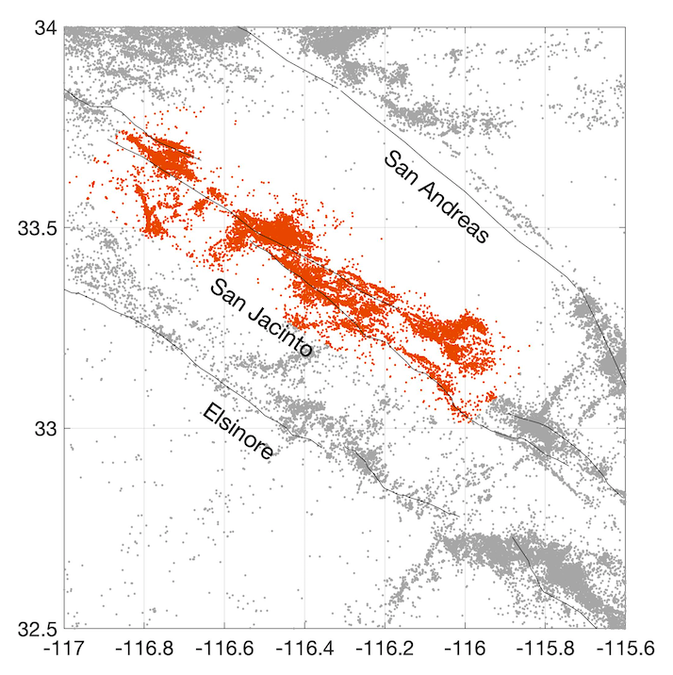
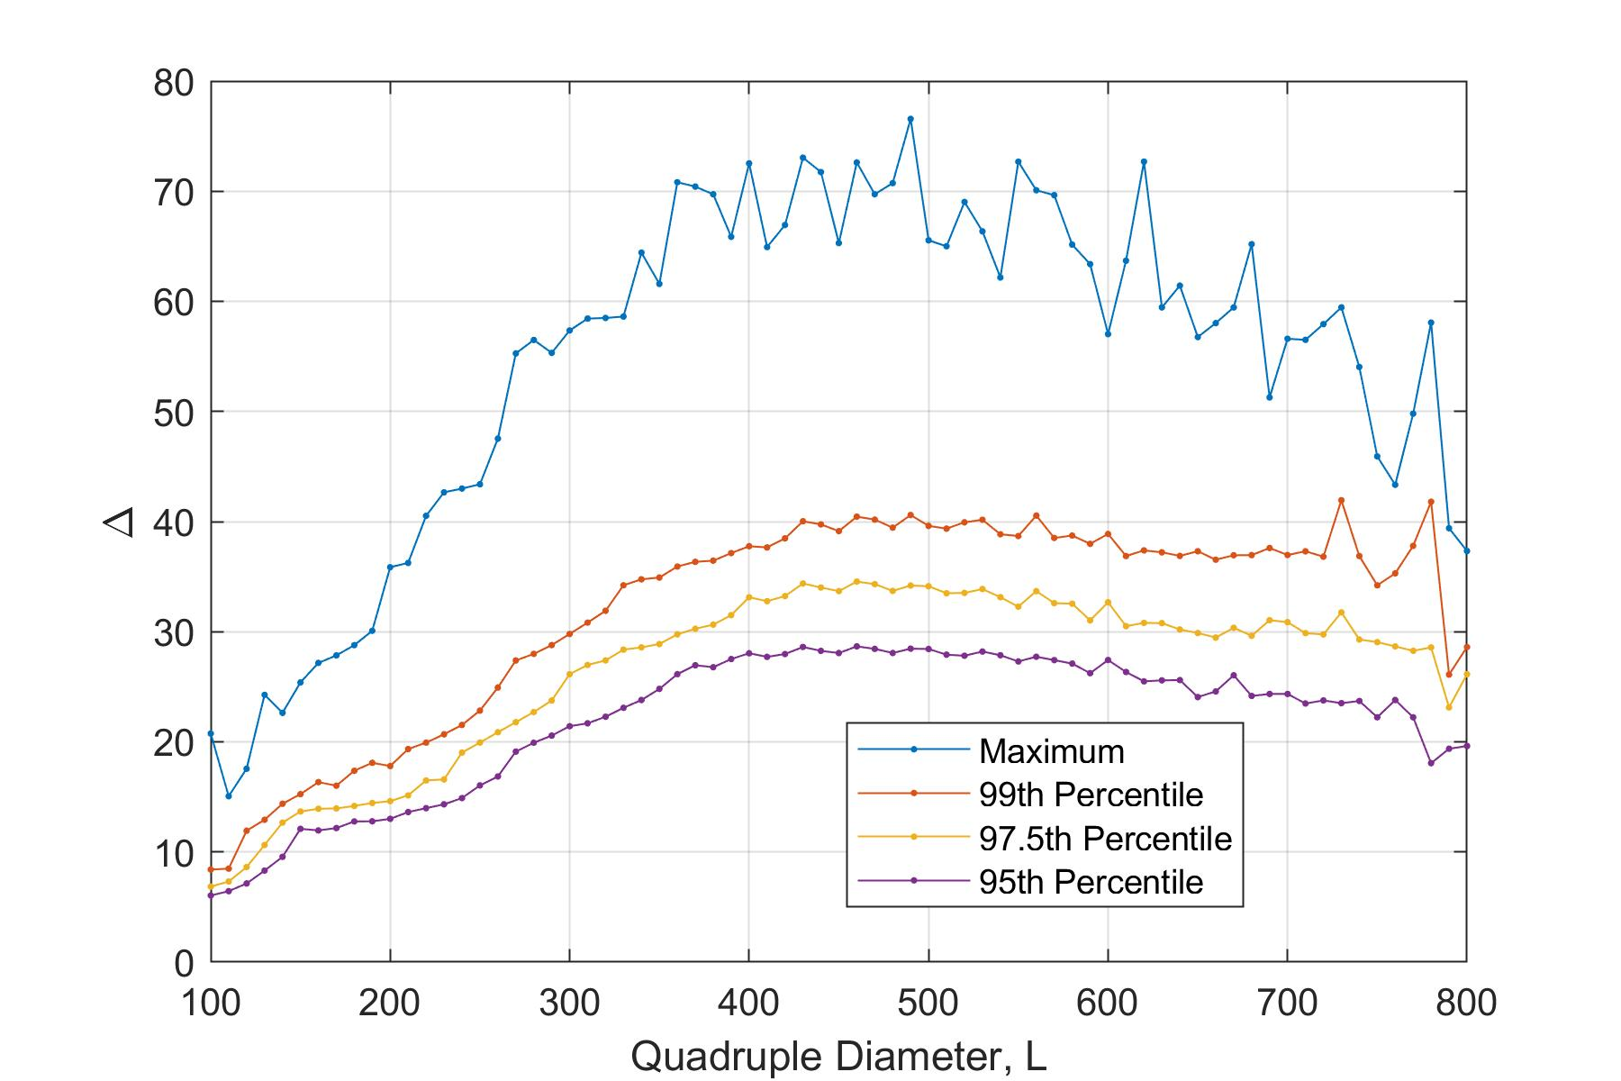
Estimating 𝜹-hyperbolicity: San Jacinto Fault Zone
Slope 0
Slope 0.1
10,000,000 uniform random quadruples
Weighted proximity network
Values of Δ_{i} are examined within uniform bins for L
Time span 38.5 years, magnitude m ≥ 1.5

Slide 13
Estimating 𝜹-hyperbolicity: Alternative catalogs
North-West Pacific Ocean

Slide 14
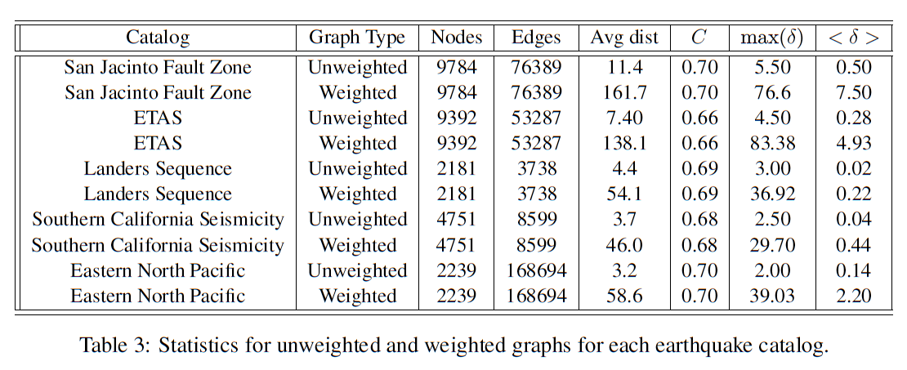
Estimating 𝜹-hyperbolicity: Alternative catalogs
Results
San Jacinto FZ
ETAS
Landers FZ
Southern California
N-W Pacific Ocean

Slide 15
Hyperbolic geometry of earthquakes: Implications
Explains power-law degree distributions and high value of cluster coefficient in earthquake networks [Baiesi and Paczuski, 2004; Baiesi, 2006] via theoretical results of Krioukov et al. [2010].
Suggests a natural (hyperbolic) neighborhood of an earthquake in space-time-magnitude domain. This can be used for identifying aftershocks/foreshocks, triggered event in areas of induced seismicity, etc.
Explains concave shape [Baiesi and Paczuski, 2004; Zaliapin and Ben-Zion, 2013] of an earthquake neighborhood (e.g., aftershock zone is wide at short times after the mainshock and narrows down at later times).
Suggests an actual hyperbolic distance that is approximated by the earthquake proximity of this talk (which is not a proper distance) for well separated events.
Simplifies parameterization of earthquake models.
Ref:

Slide 16
Thank you!

