Slide 1



A Study on the Effects of the Anthropogenic Heat Fluxes on the Temperature Distribution in an Urban Area
Da-Som Mun, Jae-Jin Kim
Division of Earth Environmental System Science (Major of Environmental Atmospheric Sciences)
ksektha@gmail.com
jjkim@pknu.ac.kr

Slide 2

Abstract
In this study, we investigated the effects of the anthropogenic heat caused by the energy usage on the air temperature distributions in an urban area using a CFD model. We calculated the anthropogenic heat fluxes using a top-down method with monthly and hourly allocation coefficients and the total amount of the yearly electrical energy usage of buildings. To construct the buildings and to estimate the anthropogenic heat fluxes in the CFD model for the target area, we used the land use and GIS data. We conducted the CFD simulations for the heatwave period (2018.08.02 ~ 2018.08.08) in a building-congested district around the Seoul ASOS (ASOS 108) to see how the anthropogenic heat fluxes affected the thermal environment in the target area. The target area is mostly composed of the commercial and residential areas. The temperature increased near the roads and buildings. At the night time, the temperature increase near the buildings with high anthropogenic heat fluxes was more significant than the daytime. The comparison with the ASOS-observed temperatures showed that the inclusion of the anthropogenic heat fluxes improved the CFD simulations of temperatures.
Key words: CFD model, heat wave, anthropogenic heat fluxes, temperature distribution

Slide 3
Methods
LDAPS-UFS model
LDAPS (UM based)
GIS
U, V (wind data)
T (temperature data)
Building data
Contour line data
LDAPS-UFS model
Realistic meteorological fields
Used for thermal environment analysis and risk mapping
Horizontal and vertical interpolation to fit
UFS model grids
Surface temperature input to terrain and buildings
<LDAPS-UFS Modeling System Flowchart>
Produce temperature distribution data considering energy use in urban areas
By each city, total electrical energy usage
Classification of building use in the target area
Calculate anthropogenic heat according to the purpose of the building in the target area
Details are explained on the next page.

Slide 4



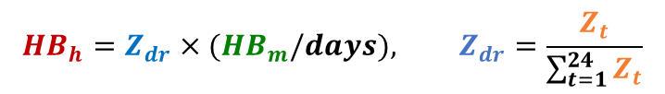
Methods
Produce temperature distribution data considering energy use in urban areas
Utilizes national hourly / sectoral power consumption and monthly trial/sector power consumption provided by KEPCO(Korea Electric Power Corporation)
→ Artificial heat calculation by hourly sector
[Ahn et al., 2002]
$${HB}_{h}=Z_{dr}×{(HB}_{m}/days), Z_{dr}=\frac{Z_{t}}{\sum_{t=1}^{24}{Z_{t}}}$$
${HB}_{m}$ = Anthropogenic heat by building use (per monthly) ($KJ/m^{2}∙month$)
${HB}_{h}$ = Anthropogenic heat by building use (per hourly) ($KJ/m^{2}∙hour$)
$Z_{t}$ = Hourly electrical consumptions by building use ($KJ/m^{2}∙hour$)
$Z_{dr}$ = Time variation coefficient
LDAPS-UFS Model Thermodynamic Energy Equations
$$\frac{∂T}{∂t}+U_{j}\frac{∂T}{∂x_{j}}=κ\frac{∂^{2}T}{∂x_{j}∂x_{j}}−\frac{∂}{∂x_{j}}\left(\overline{T^{′}u_{j}}\right)+S_{h}+{HB}_{h}$$
Hourly anthropogenic heat
Used as a heat source for thermodynamic equations

Slide 5

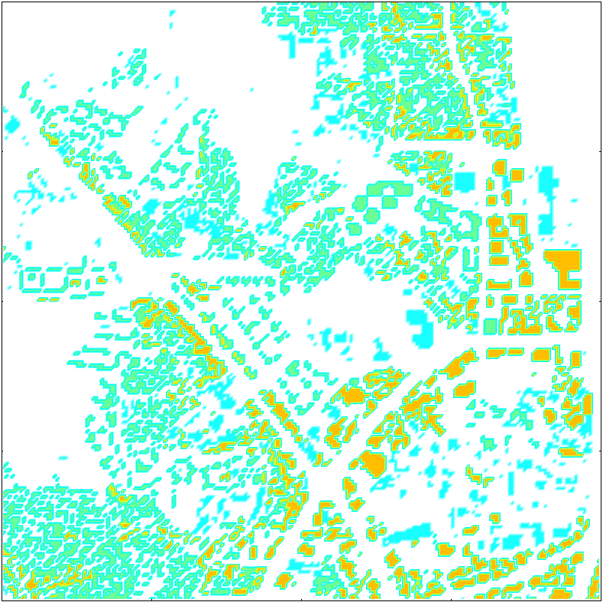

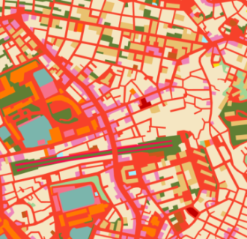
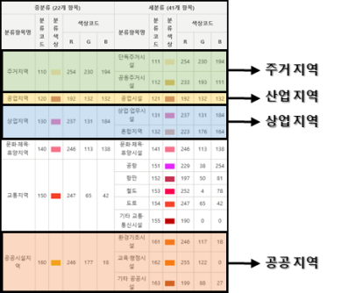
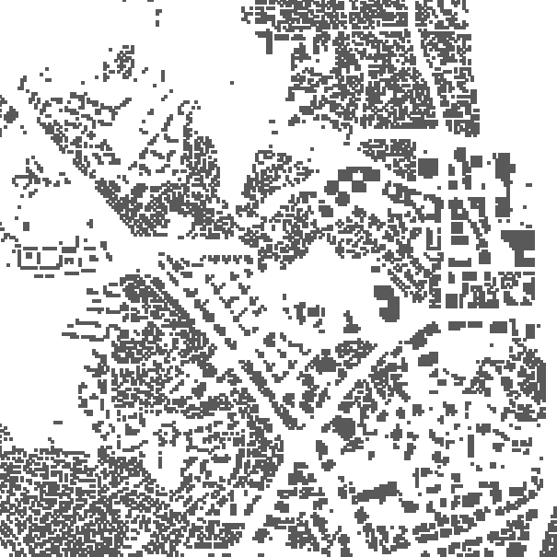
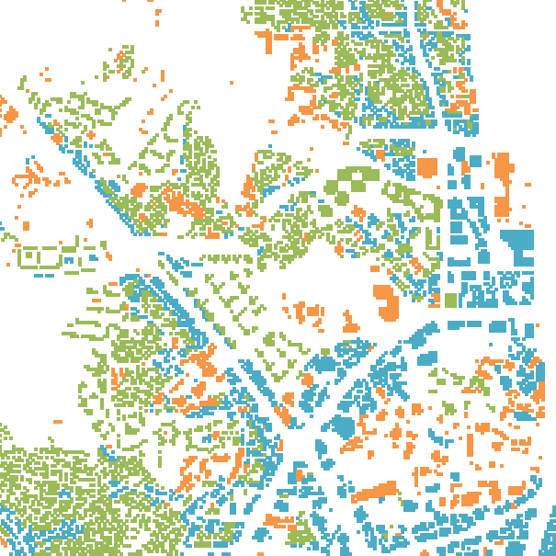
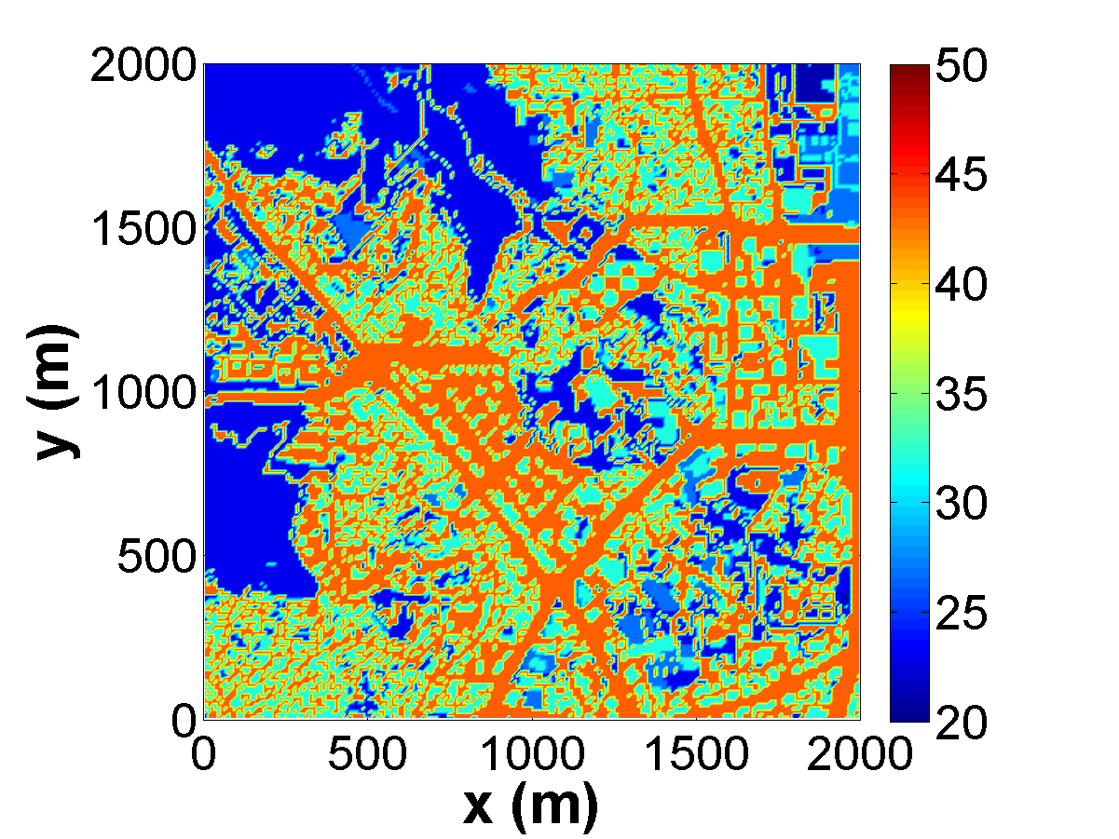
Methods
Produce temperature distribution data considering energy use in urban areas
KST
Construction of artificial heat input data for each grid of the LDAPS-UFS model using artificial heat for each building used by time and classified building use
It is classified into residential, industrial, commercial, and public areas by using the subdivision land cover data provided by the Ministry of Environment's Environmental Spatial Information Service and the digital topographical map of the National Geographic Information Institute.
Subdivision land cover data
Land cover classification system
Classification of building use
Anthropogenic heat input data
by grids and hourly
Building data
Classify into residential, industrial, commercial, and public areas using the land cover classification system
Classification of building uses to fit the LDAPS-UFS model grid
Anthropogenic heat by building use and hourly
Surface temperature input data
by grids and hourly

Slide 6
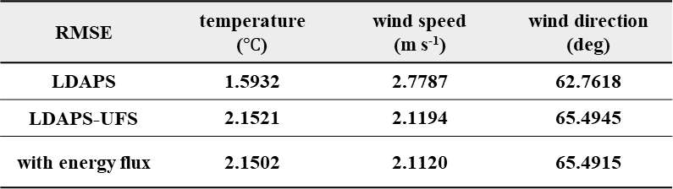
Results
Comparison of observations and model results
RMSE | temperature ($℃$) | wind speed (m s⁻¹) | wind direction (deg)
LDAPS | 1.5932 | 2.7787 | 62.7618
LDAPS-UFS | 2.1521 | 2.1194 | 65.4945
with energy flux | 2.1502 | 2.1120 | 65.4915
→ When comparing the time series at the observation point, there is little difference between the case of considering artificial heat emission (LDAPS-UFS with A.H.) and the case of not considering (LDAPS-UFS).

Slide 7

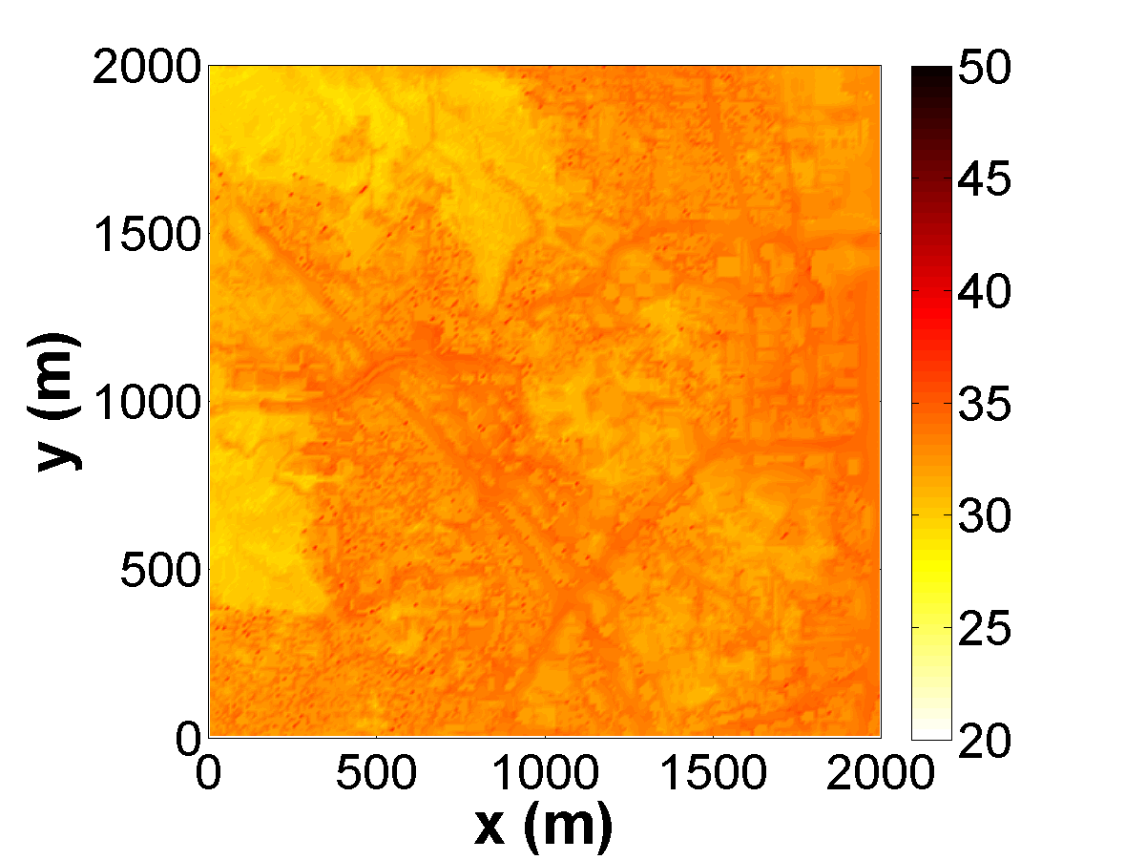

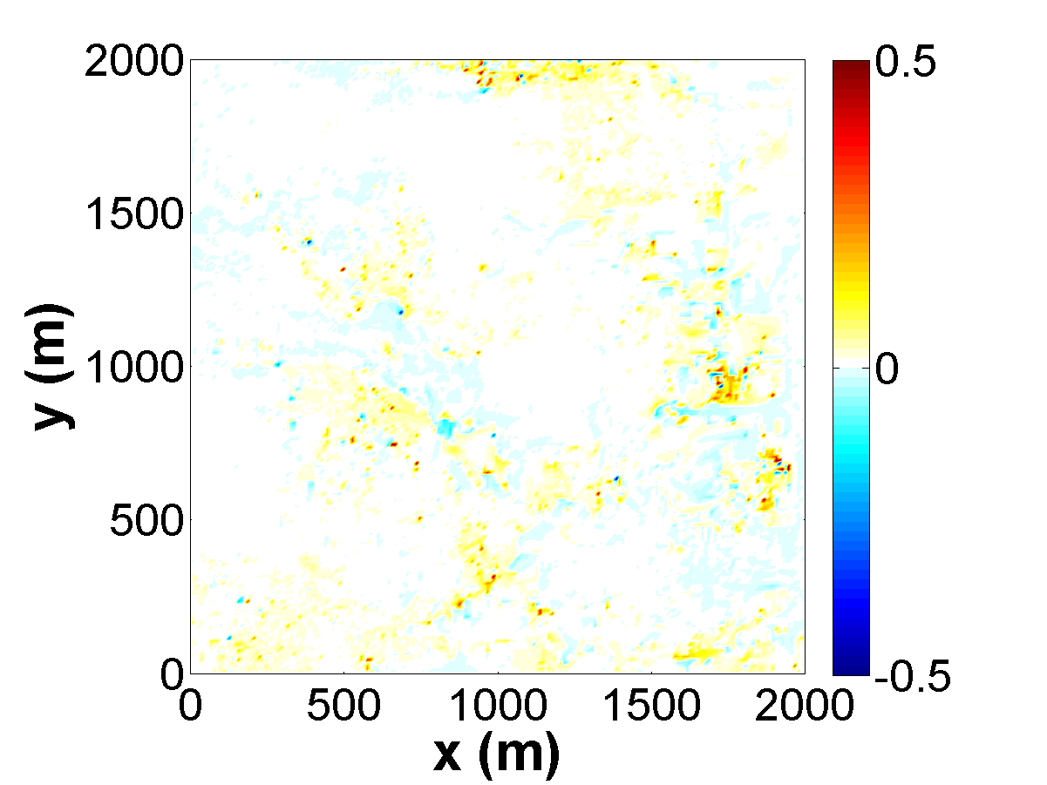



Results
LDAPS-UFS Observation Altitude Temperature Field (z = 2.5 m)
LDAPS-UFS with A.H. Observation Altitude Temperature Field
①-② (difference)
[$℃$]
[$℃$]
[$℃$]
Temperatures rise in areas with many buildings.
In particular, the temperature rises in industrial and residential areas.
In the case of nighttime, the nighttime temperature increases significantly near industrial facilities with high artificial heat compared to daytime.

Slide 8
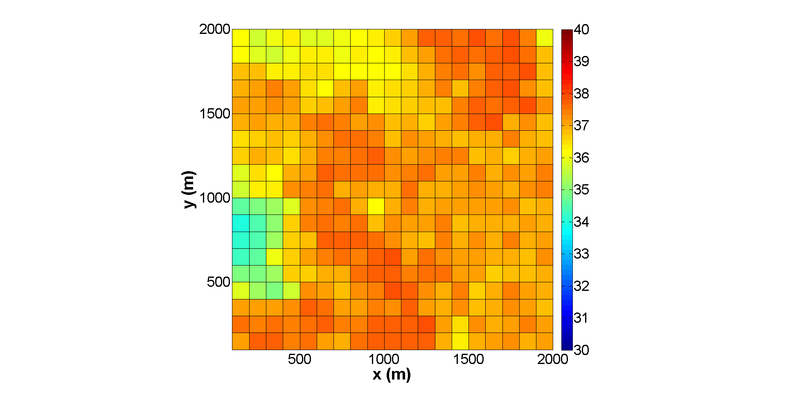
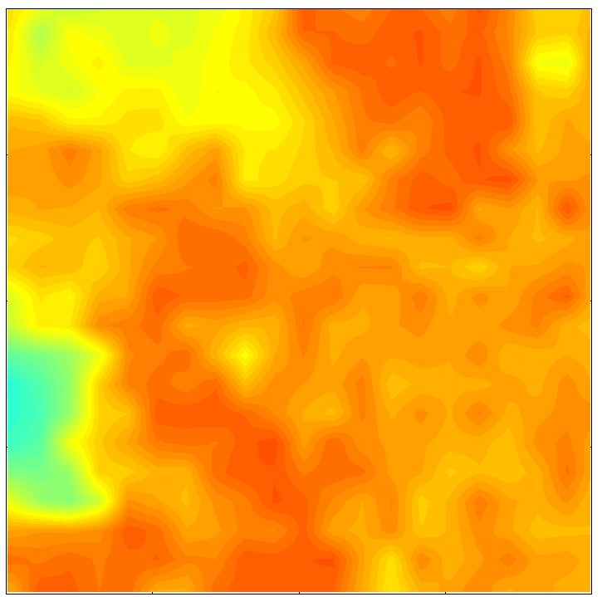
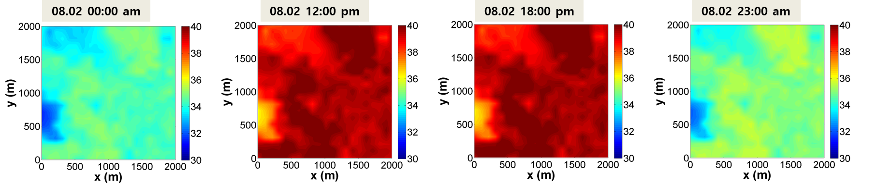
Future study …
Construction LDAPS-UFS-AI system
Constructing the LDAPS-UFS model surface temperature data using the satellite surface temperature calculated using machine learning
Surface temperature using machine learning
DLST (100 m)
LST (10 m)
Interpolate 100 m resolution to 10 m resolution
LDAPS-UFS-AI system surface temperature input data construction

