Slide 1


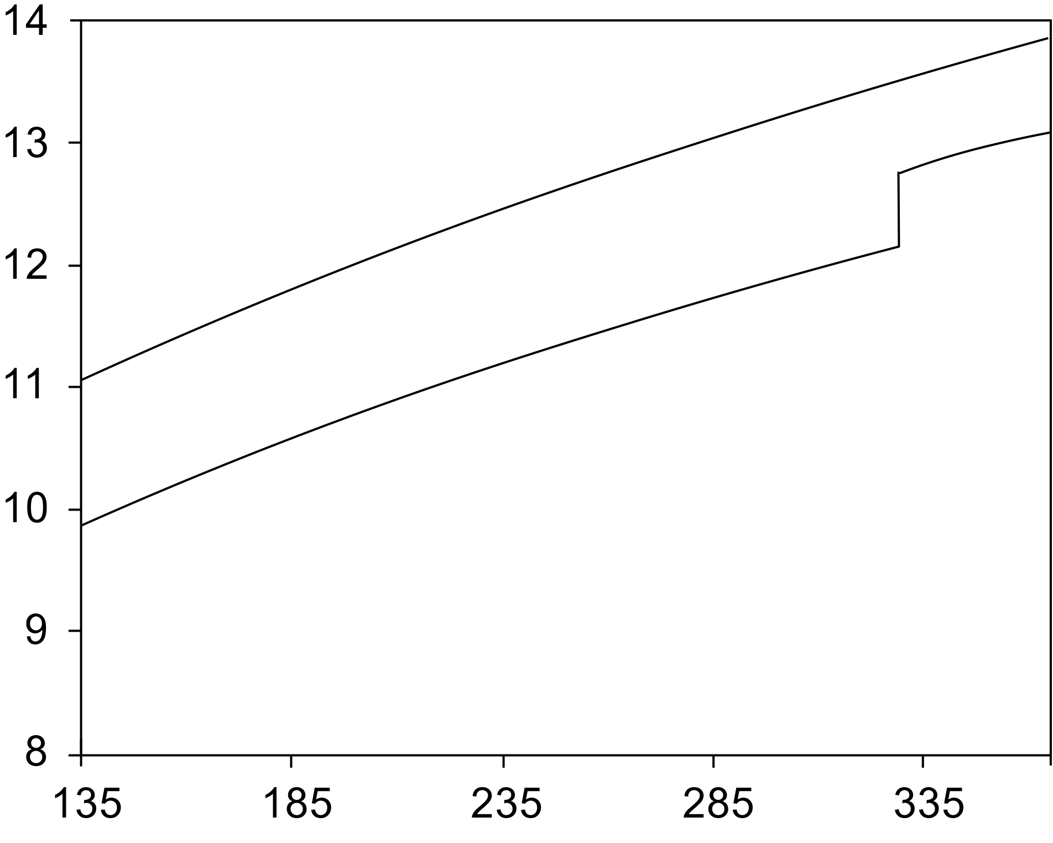


Composition of the Earth’s inner core from high pressure
sound velocity measurements of Fe-Ni-Si alloys
S. Dominijanni¹, C. McCammon¹, E. Ohtani², D. Ikuta², T. Sakamaki², T. Ishii¹
¹ Bayerisches Geoinstitut, University of Bayreuth, Germany
² Department of Earth and Planetary Material Science, Graduate School of Science, Tohoku University, Sendai Miyagi, Japan.
Scientific background
Earth’s inner core likely consist of hcp-Fe-Ni alloys + ~10 % of “light elements” to match the density and sound wave velocities of seismological models, like the Preliminary Reference Earth Model (PREM, Fig. 1);
Knowledge of the high-pressure and high-temperature behaviour and properties of Fe-Ni alloys that contain light elements, such as silicon, is still limited;
We therefore investigated the sound velocities and density of B2-Fe_{0.78}Ni_{0.07}Si_{0.15} alloy to clarify the role of Si as light element in the Earth inner core.
Density deficit
(O, Si, S, C, H)
Pure iron
ICB
Earth’s core
center of the Earth
Density (g/cm³)
Pressure (GPa)
Fig. 1. Density profile of hcp-Fe (Dewaele et al., 2006) compared with the PREM (Dzievonski and Anderson, 1981).
Serena.Dominijanni@uni-bayreuth.de

Slide 2
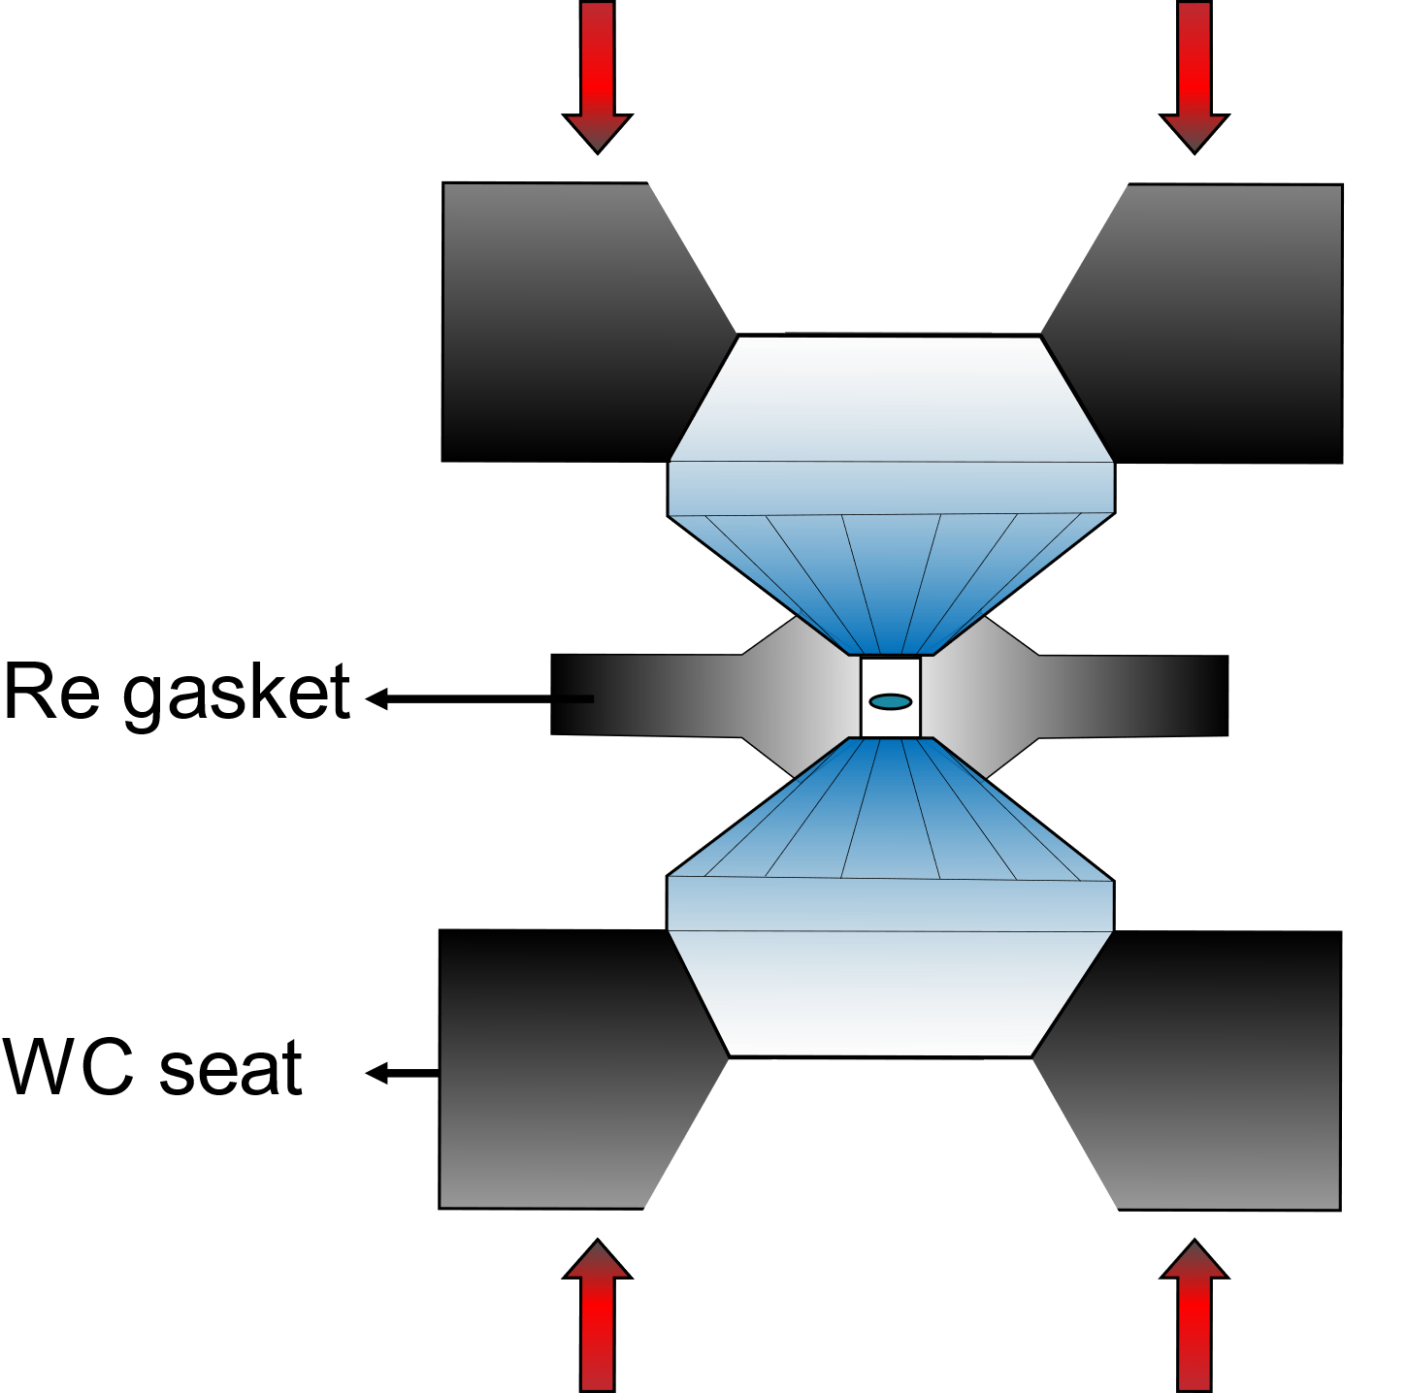
Experimental methods
Synthesis of the sample
Multi anvil apparatus – Pressure 8(1) GPa, Temperature 1200(50) °C
Starting material: Fe (0.78 wt. %), Ni (0.07 wt. %), Si (0.15 wt. %)
2) Analyses of the run products
SEM analysis were performed to verify the homogeneity of the sample (Fig. 2)
3) High pressure experiments in diamond anvil cell (DAC)
Inelastic X-ray scattering (IXS): SPring-8 synchrotron facility (BL35XU beamline, JP)
Powder X-ray diffraction (XRD): DESY synchrotron facility (P02.02, PETRA III, DE)
Data processing
IXS spectra were fitted using Lorentzian functions
XRD patterns have been refined with the LeBail method
20 µm
Fig. 2. Backscattered electron image of the synthesized sample.
Fig. 3. Schematic diagram of a BX90 type diamond anvil cell.

Slide 3
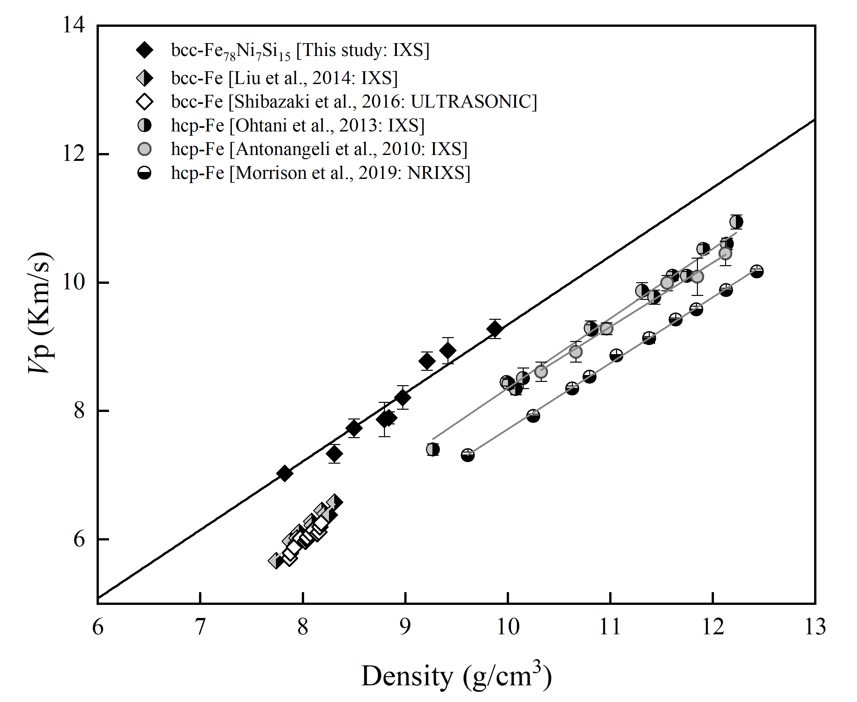
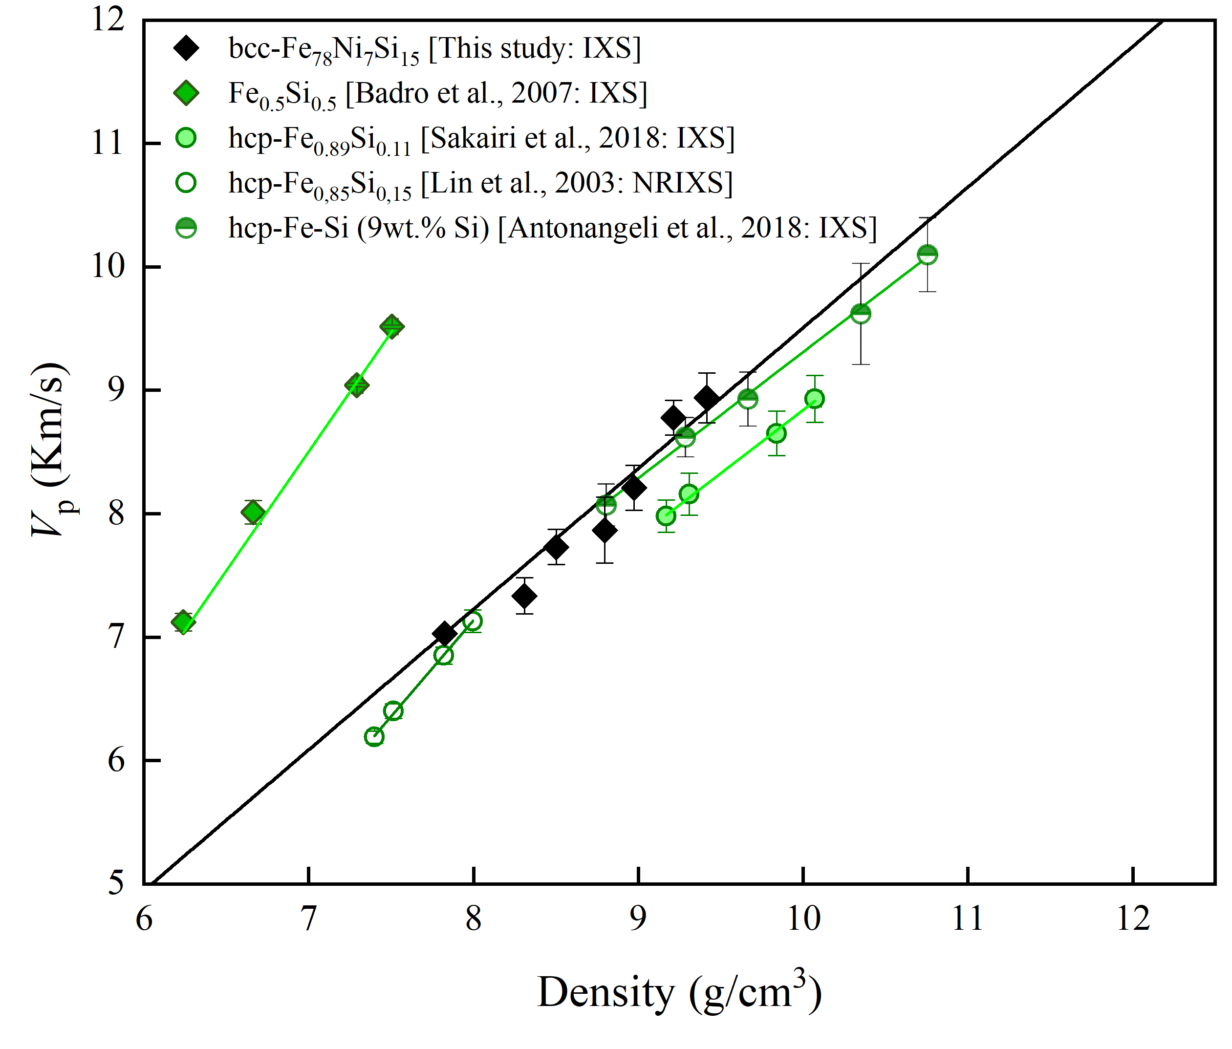
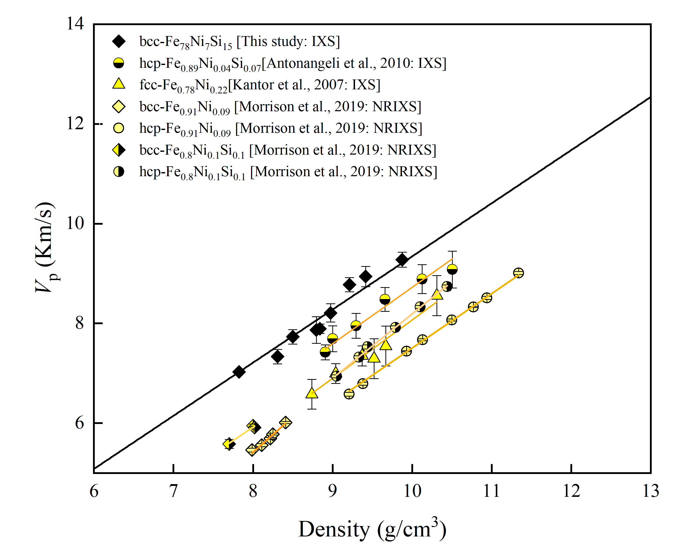
Discussions and conclusions
The relation of the sound wave velocities V_{P} (m/s), V_{s} (m/s) and density ρ (kg/m³) follows Birch’s law (i.e. there is a linear relationship between density and sound velocities):
Comparison with pure Fe
Comparison with Fe-Si alloys
Comparison with Fe-Ni-Si alloys
a
b
c
Fig. 4. Birch’s law of B2-Fe_{0.78}Ni_{0.07}Si_{0.15} alloy compared with previous studies of pure Fe (a) Fe-Si (b) and Fe-Ni-Si alloys (c).

Slide 4
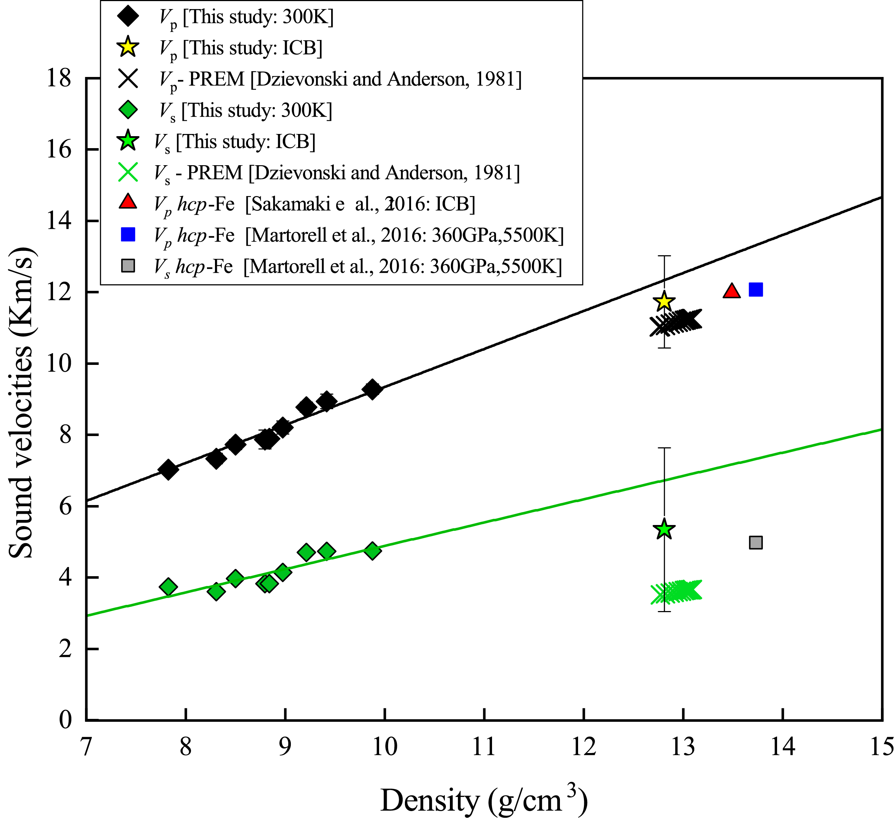
Discussions and conclusions
Our results compared with previous studies suggest that the presence of Si in the alloy reduces both density and sound velocities (V_{p} and V_{s}) of iron in the Earth’s inner core. This can be clearly observed in Fig. 5, in which our Birch’s law extrapolated at inner core boundary (ICB) conditions provides a closer match to PREM than pure iron.
Based on the results of this study we suggest that a combination of bcc-Fe_{0.78}Ni_{0.07}Si_{0.15} alloy and hcp-Fe is a viable candidate to match with the geophysical observations of Earth’s inner core.
Fig. 5. Comparison of the proposed density dependence of the aggregate compressional (V_{p}) and shear (V_{s}) sound velocities with the PREM (Dzievonski and Anderson, 1981).

