Slide 1
Experimental Modelling of Black Carbon Emissions from Gas Flares in the Oil and Gas Sector
Parvin Mehr
Parvin Mehr, Bradley M. Conrad, Matthew R. Johnson
NSERC FlareNet Strategic Network
Energy and Emissions Research Lab.,
Dept. of Mechanical and Aerospace Engineering,
Carleton University, Ottawa, Canada

Slide 2
This video gives a brief back ground about black carbon and why it’s important to quantify its contribution to climate change.
Play me!

Slide 3
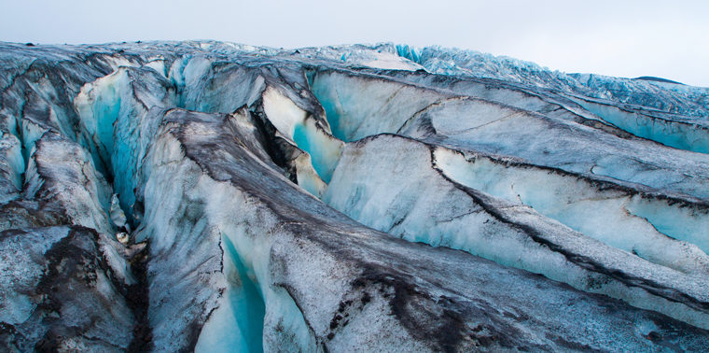
Aim and objectives
Objective:
Investigate the effect of key aerodynamic parameters, flame regimes, and fuel compositions on BC yield trends in turbulent diffusion flames of practical interest;
Evaluate practical methods to model and predict BC emissions from this critically important atmospheric source.

Slide 4
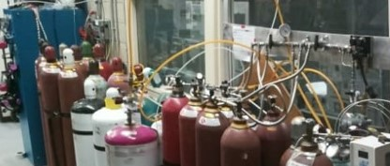
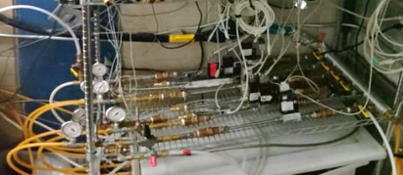
Experimental Setup & Method
Liquids (C5-C7)
Gas-phase fuels were flow-controlled using Mass Flow Controllers (MFCs) calibrated to high-accuracy.
*
MFC
Filt.
*
Gases (C1-C4)
Liquid-phase fuels were flow-controlled using Coriolis flow meters, evaporated and mixed with a methane carrier gas, and forwarded to a fuel mixing chamber via a heated line (maintained at ~80°C).
Heated Line
Filt.
MFC
*
MFCs
Conrad & Johnson 2019
This figure shows a simplified schematic of Carleton University Flare Facility (CUFF).

Slide 5
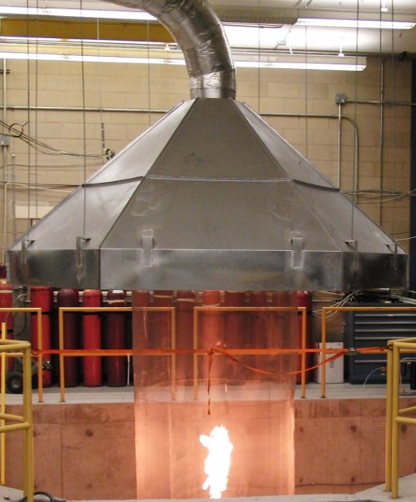
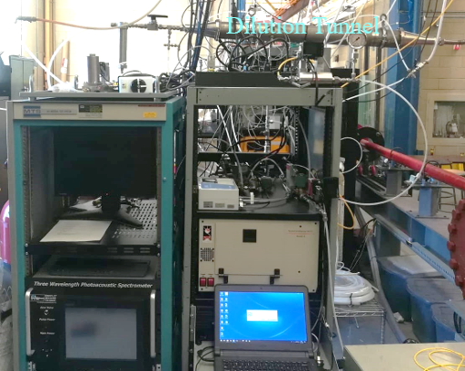
Experimental Setup & Method
Fuel mixtures were then forwarded to vertically oriented flare stacks of 12.7 - 76.2 mm in internal diameter. Combustion products mixed with diluent air were captured by a fume hood.
To prevent overload of the solid-phase instrument, extracted combustion products were optionally diluted further in a sampling tunnel.
*
Fume hood
To quantify BC yield a thermal-optical organic/elemental carbon (OCEC) instrument (Sunset Labs model 4) was used to analyze diluted combustion products extracted from the exhaust duct.
Flare stack (12.7-76.2mm)
OCEC

Slide 6
Flare Gas Composition
Jurisdiction | Fuel ID | C1 | C2 | C3 | nC4 | iC5 | nC6 | nC7 | N₂ | CO₂ | MW [g/mol] | HHV_{V} [MJ/m³] | CHR [−]
Alberta | AB-L | 92.39 | 0.32 | 0.09 | 0.40 | 0.06 | 0.03 | 0.03 | 1.54 | 5.16 | 17.98 | 37.73 | 0.253
 | AB-M | 86.36 | 6.83 | 2.36 | 0.97 | 0.33 | 0.13 | 0.18 | 1.62 | 1.22 | 19.03 | 43.81 | 0.271
 | AB-H9 | 75.68 | 11.52 | 6.06 | 2.60 | 0.78 | 0.23 | 0.21 | 1.70 | 1.22 | 21.77 | 49.54 | 0.290
 | AB-H6 | 75.16 | 11.44 | 6.02 | 4.48 | - | - | - | 1.69 | 1.21 | 21.76 | 46.53 | 0.290
Bakken | BK-1 | 49.12 | 20.97 | 15.04 | 6.72 | 2.15 | 0.87 | 0.78 | 3.66 | 0.70 | 29.13 | 64.33 | 0.329
 | BK-2 | 57.78 | 19.97 | 11.35 | 3.81 | 0.93 | 0.22 | 0.15 | 5.22 | 0.57 | 25.22 | 55.19 | 0.310
Ecuador | EC-O2 | 58.89 | 7.80 | 9.29 | 5.19 | 2.18 | 0.89 | 0.81 | 5.75 | 9.20 | 27.71 | 51.54 | 0.315
 | EC-O3 | 40.82 | 8.16 | 16.93 | 14.75 | 6.81 | 2.06 | 1.38 | 3.37 | 5.71 | 36.57 | 75.17 | 0.355
 | EC-O4 | 55.22 | 7.63 | 11.65 | 8.79 | 3.95 | 1.37 | 0.94 | 4.12 | 6.31 | 30.31 | 60.92 | 0.331
North Sea | NS-A | 82.48 | 8.09 | 4.06 | 1.53 | 0.40 | 0.16 | 0.15 | 1.43 | 1.70 | 20.07 | 45.65 | 0.278
Russia | RU-G1 | 73.96 | 3.08 | 7.87 | 6.79 | 2.35 | 0.63 | 0.57 | 1.90 | 2.85 | 24.80 | 54.15 | 0.306
 | RU-G2 | 77.05 | 5.29 | 8.24 | 4.28 | 1.24 | 0.30 | 0.27 | 1.56 | 1.76 | 22.72 | 51.07 | 0.295
Experimental | CH₄ | 100.00 | - | - | - | - | - | - | - | - | 16.04 | 37.67 | 0.250
 | CH₄/C₃H₈ | 50.00 | - | 50.00 | - | - | - | - | - | - | 30.07 | 65.76 | 0.333
Twelve flare gases sourced from field measurements in five globally relevant oil and gas jurisdictions.
Two additional, easily replicated fuel mixtures, pure methane and an equal mixture by volume of methane and propane.
This table summarizes the studied flare gas compositions alongside key relevant metrics: molecular weight (MW), volumetric higher heating value (HHVv), and carbon-hydrogen ratio (CHR).

Slide 7
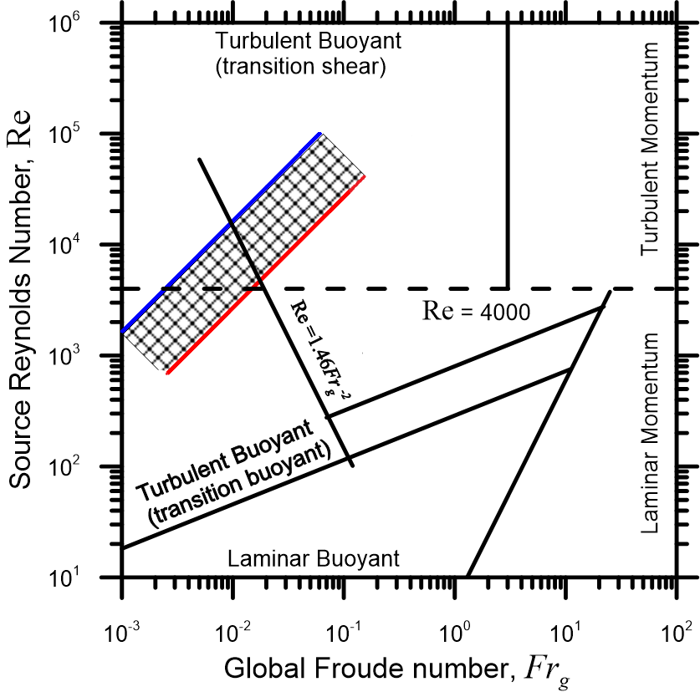
Test Conditions
To evaluate the effect of aerodynamic parameters on BC yield, the regime map of Delichatsios [1] was used as a guideline for the design of the conditions tested.
The flowrate and diameters were selected so that the resulting Re and Frg coordinates would encompass the shaded inclined rectangle in this figure, and thereby closely approximate the estimated aerodynamic regime of typical UOG flares.

Slide 8
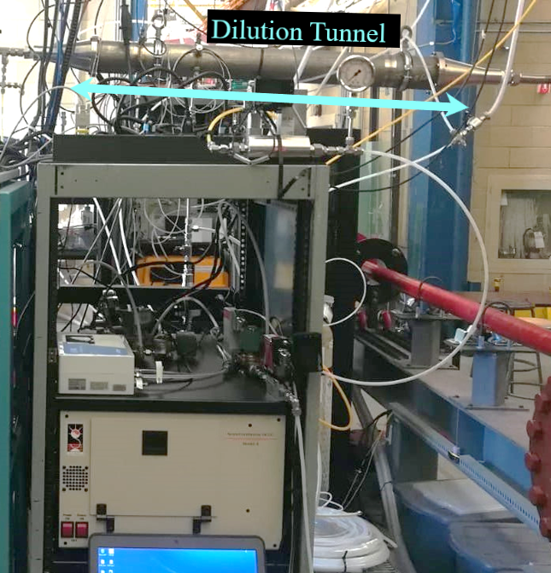
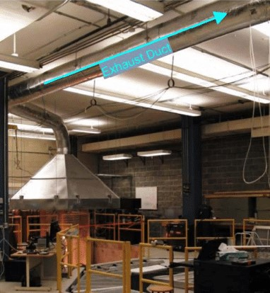
Soot yield calculations and Uncertainty analysis
$$Y_{BC}=$$
$$ρ_{BC}$$
$$δ_{1}$$
$$δ_{2}$$
And the volumetric dilution factor of the raw combustion products as they are captured into the fume hood.
Carbon mass concentration in the solid-phase sampling and dilution tunnel, obtained by measuring:
the carbon mass present in the extracted sample using the OCEC and,
the sampled volume with a high-accuracy thermal mass flowmeter (Bronkhorst EL-FLOW Prestige).
Volumetric dilution factor of the diluted combustion products as they enter the solid-phase sampling and dilution tunnel
quantified using a CO₂-balance on the sampling and dilution tunnel, with CO₂ quantities measured using a non-dispersive infrared detector (LI-COR LI-850).
To compute BC yield ($Y_{BC}$) with precisely quantified uncertainties at the CUFF, simultaneous and accurate knowledge of three data is required:
Notes:
A detailed uncertainty analysis was conducted using the Monte Carlo method. And both bias and precision were considered.

Slide 9
Accounting for deposition losses
FlareNet Particle Penetration Calculator (FPPC)-a program written in collaboration with UBC- can quantify and account for sampling losses from various mechanisms.
Allows robust quantification of measurement uncertainties and is an essential component of developing scientifically defensible particulate matter emission factor data and models.
Notes:
Aerosol instruments are reliant on the sampling lines that feed them, where sampling lines with different attributes such as diameter and length can affect particle deposition within the lines and hence change the output of the instruments at the end of the line.

Slide 10
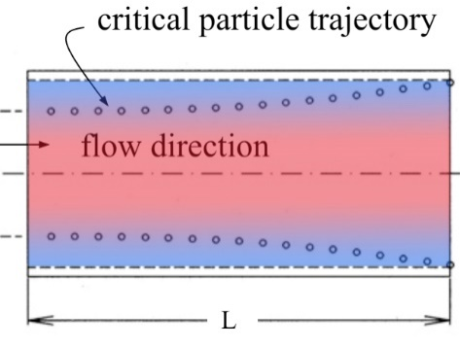
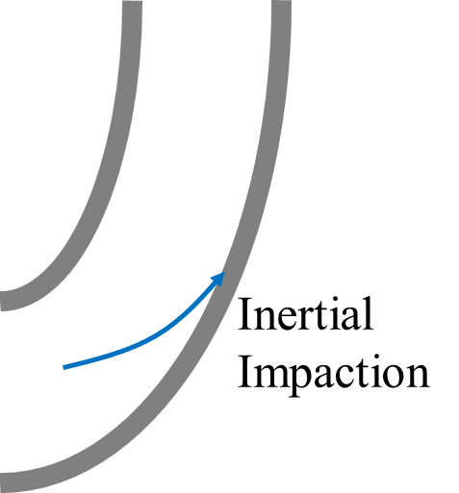
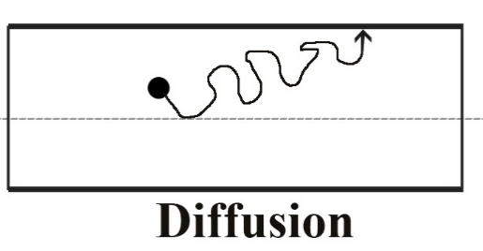
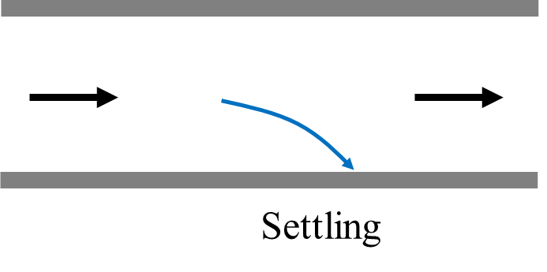
Some of the Loss Mechanisms
Thermophoresis
Temperature gradient drives particles from hot gas toward cold wall
Asymmetric pressure on particle from molecules from hot/cold parts of the flow.
Inertial Deposition in Bend
Momentum / inertia of large particles prevents transport through bends
Increased losses for higher velocities and larger particles
Diffusion
Diffusion of particles driven by concentration gradients
Important loss mechanism for small particles
Gravitational Settling
Gravitational settling of particles
Important loss mechanism for large particles moving at slow velocity
Notes:
These are some of the loss mechanisms incorporated in the code. The principle driving forces for these mechanisms are gravitational, inertial and diffusive. they are potentially important depending on the particle size distribution. generally speaking, larger particles are more strongly influenced by gravitational and inertial forces, whereas smaller particles with higher diffusion coefficients are more easily lost due to diffusion.

Slide 11
Mass loss quantification
FlareNet Mass Loss Calculator (FMLC): uses the fitted particle penetration curves calculated with FPPC program to calculate mass losses of different flare condition.
Raw SMPS data
Fitted curve coefficients
Flaring condition + sampling line properties
FPPC
FMLC
Mass loss
Particle loss/penetration for each instrument
Notes:
After calculating particle losses and penetration for each instrument using FPPC program, FMLC was created to quantify mass losses. For running the program, the user should provide the fitted curves coefficients of the penetration in the excel input folder for different dilution conditions and the raw data from the one point of the instrument measurements (SMPS).

Slide 12
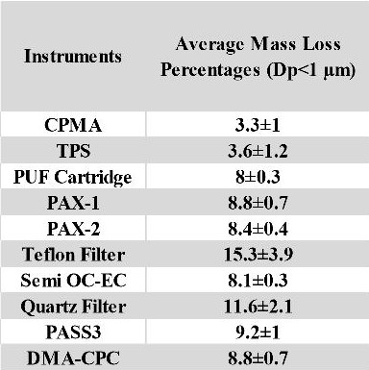
Mass Loss %
This table summarizes the results from the program. we particularly were interested in the ECOC losses since that’s the main instrument that we use to quantify BC.

Slide 13
Comparison To literature (I)
The operating conditions for the current data plotted on the non-dimensional map suggested by Delichatsios [1], as well as data found in literature (updated from [2]).
Current soot yield data spans the “transition buoyant” and “transition shear” regimes defined by the solid diagonal line.
A comparison of SGE data for flames from Becker and Liang [3] and corresponding results from the current work.
Values measured by Becker and Liang [3] are approximately an order of magnitude larger. This is most likely due to:
Different flow conditions,
Fuel compositions and,
Differences in sampling protocols.

Slide 14
Comparison To literature (II)
A comparison of SGE versus τr* for flames from [3,4] and results from the current tests:
Becker and Liang’s [3] data appear to show upward trends with increasing τr* whereas the present data do not show any clear trend.
Fire Froude number suggested by Delichatsios [1] was also tested in an attempt to scale soot yield values.
There is a trend similar to Becker and Liang [3] among the data.
The data for propane and ethylene of Sivathanu and Faeth [4] seem to complete the trend of Becker and Liang [3].
Becker and Liang [3] calculated τr* from their measured flame length, whereas Sivathanu and Faeth [4] measured residence time via flame photography.

Slide 15
Scaling BC [g/Kg]
Three controlled variables:
the fuel velocity,
the burner exit diameter, and
the fuel.
Froude number
Volumetric Air to Fuel ratio (AF_{v}),
Carbon to Hydrogen ratio (CHR),
Mean number of Carbon in Hydrocarbons (C#),
Stoichiometric mixture fraction (S) and,
the temperature ratio defined as:
$$T_{ratio}=\frac{293.15}{T_{ad}−293.15}$$

Slide 16
Scaling BC (I)
This figure shows some of the combinations tested for the 25.4mm burner.
The percentage error (E%) of each model was defined as:
$$E\%= \frac{\left.{BC yield}_{actual} \left[\frac{g}{kg}\right]−{BC yield}_{theoretical} [\frac{g}{kg}\right]}{\left.{BC yield}_{actual} [\frac{g}{kg}\right]} ×100$$
It can be seen that both models are left skewed. However, ${Fr}^{2}T_{ratio}/{AF}_{v}{C\#}^{2}$ is the more suitable scaling parameter among the tested combinations, since it has a lower range of percentage error (±30%).

Slide 17
Scaling BC (II)
Only the 25.4mm burner has the full spectrum and other diameters are incomplete due limitation of CUFF
Model inconclusive and unsuitable to use.
The steep ramp up at lower scaling parameter values and the flat shape of the curve as the scaling parameter approaches infinity, points out that two different regions may exist
Data can possibly be scaled better if separating the two regimes as suggested by Delichatsios [1].
3D plot of emissions scaled by ${Fr}^{2}T_{ratio}/{AF}_{v}{C\#}^{2}$ and separated by diameters in the third axis

Slide 18
Scaling BC (Transition Buoyant)

Slide 19
What does it mean?
$$BC yield \left[\frac{g}{kg}\right]×{\left(\frac{T_{ratio}}{C\#}\right)}^{0.9559}=0.0001329\frac{1}{V^{0.9259}}×{\left(\frac{L_{f}}{D_{e}}\right)}^{2}$$
Mixing area

Slide 20
Scaling BC (Transition Shear)

Slide 21
What does it mean?
$$BC yield \left[\frac{g}{kg}\right]×{\left(\frac{T_{ratio}}{C\#}\right)}^{1.004}=0.1701\frac{1}{V^{1.004}}×\frac{L_{f}}{D_{e}}$$
Mixing length

Slide 22
Scaling BC Rate (Transition Buoyant)
In transition buoyant regime, as defined by Delichatsios [1], BC (when corrected by carbon number) simply scales with mass flow rate.
$$\left.BC rate \left[\frac{g}{s}\right]=BC yield \left[\frac{g}{kg}\right]×Flare gas mass flow rate [\frac{kg}{s}\right]$$

Slide 23
Scaling BC Rate (Transition Shear)

Slide 24
What does it mean?
$$\frac{BC Rate}{{C\#}^{3}}=10$$
$$\frac{V_{e}}{L_{f}}$$
$$\frac{{D_{e}}^{3}}{{L_{f}}^{0.646}}$$
$$mixing volume=area ×length= {D_{e}}^{2}×\frac{D_{e}}{{L_{f}}^{0.646}}$$
1/Mixing time
$$mixing rate= \frac{mixing volume}{mixing time}=diffusivity ×mixing length$$
$$\frac{BC Rate}{{C\#}^{3}}=10$$
$$\frac{{D_{e}}^{2}}{\frac{L_{f}}{V_{e}}}$$
$$\frac{D_{e}}{{L_{f}}^{0.646}}$$
Mixing length
Turbulent mixing coefficient (eddy diffusivity)

Slide 25
Modified regimes
In an attempt to find a better model with lower range of E%, regimes defined by Delichatsios [1] were slightly modified.
Delichatsios himself in [1] points out that there is some fuzziness in the determination of the lines, not only because of uncertainties concerning the location of the lines, but also because he does not include situations which involve instabilities and oscillations of the flames.

Slide 26
Scaling BC Rate (Modified Transition Buoyant)
The dashed blue line in this figure shows the new limit for transition buoyant going to transition shear regime.
Still scales with flowrate!
Not surprisingly, the range of E% increases from ±24% to ±30%.

Slide 27
Scaling BC Rate (Modified Transition Shear)
What does it mean?
$$\frac{mixing volume}{}$$
$$=mixing rate$$
$$mixing time$$
$$\frac{BC Rate}{{C\#}^{2}}=84.85\frac{L_{f}{D_{e}}^{0.5}}{Residence time}$$
The range of E% decreases from ±28% to ±21%.

Slide 28
Comparison to Current emission factors
The current emission factors lie in the region between the AB-M and BK-1 flare gases.
This suggests that these emission factors were based on flare gas compositions containing similar hydrocarbons to the flare gases of the current work.
The CAPP factor predicts a soot yield value much higher than those measured in the current work- for flare gases shown which have heating values in the range of 43-64 MJ/m³.
This suggests that the application of this factor to flares in the upstream energy industry with nominal heating value of 45 MJ/m³ is questionable.
Comparison of EFs from the literature with current results a)Buoyant b) Shear c) Modified buoyant d) Modified shear

Slide 29
References
[1] M.A. Delichatsios, Transition from momentum to buoyancy-controlled turbulent jet diffusion flames and flame height relationships, Combust. Flame. 92 (1993) 349–364. doi:10.1016/0010-2180(93)90148-V.
[2] J.D.N.B. carbon particulate matter emission factors for buoyancy-driven associated gas flares McEwen, M.R. Johnson, Black carbon particulate matter emission factors for buoyancy-driven associated gas flares, J. Air Waste Manag. Assoc. 62 (2012) 307–321. doi:10.1080/10473289.2011.650040.
[3] H.A. Becker, D. Liang, Total emission of soot and thermal radiation by free turbulent diffusion flames, Combust. Flame. 44 (1982) 305–318. doi:10.1016/0010-2180(82)90080-3.
[4] Y.R. Sivathanu, G.M. Faeth, Soot volume fractions in the overfire region of turbulent diffusion flames, Combust. Flame. 81 (1990) 133–149. doi:10.1016/0010-2180(90)90060-5.

