Slide 1
Time Synchronization Based on Real-Time
Precise Point Positioning
Daqian Lyu, Fangling Zeng, Xiaofeng Ouyang
College of Electronic Engineering
National University of Defense Technology
dq_lyu@hotmail.com

Slide 2
00
OUTLINE
Principle of real-time PPP technique
Time synchronization based on real-time PPP
Implementation of time synchronization system
Results and discussion
Summary/Outlook

Slide 3
01
Principle of real-time PPP technique
The precise point positioning (PPP) technique is an effective method for time and frequency applications. Using phase/code observation data and precise products, the PPP technique allows for time transfer of sub-nanoseconds within a latency of less than a few days.
In April 2012, the IGS launched an open-access real-time service (RTS). The RTS project broadcasts the high-accuracy satellite orbit and clock corrections using the NTRIP protocol on the Internet, which then enables real-time PPP for time transfer.

Slide 4
01
Principle of real-time PPP technique
Phase /code observation
+
Broadcast ephemeris
+
SSR corrections of satellite orbit /clock
One-way time transfer
Receiver clock offset with respect to the time reference
or
Principle of RT-PPP time transfer
Receiver clock offset with respect to the other receiver clock
Inter-station time transfer

Slide 5
01
Principle of real-time PPP technique
Observation equation
In the time community, the ionosphere-free (IF) combination of phase and code observation is used to reduce the first-order ionospheric delays and can be expressed as
The extend kalman filter or least square adjustment is adopted for data processing, the estimation parameters include:
Coordinates
Clock offset
Tropospheric delay
Ambiguity

Slide 6
Principle of real-time PPP technique
Time synchronization based on real-time PPP
Implementation of time synchronization system
Results and discussion
Summary/Outlook

Slide 7
02
Time synchronization based on real-time PPP
Diagram of time synchronization based on RT-PPP
All the nodes are equipped with GNSS receivers. The RT-PPP time transfer method is used to compute the receiver clock offset with respective to the time reference. Then, we steer the local clock according to clock offsets. In this way, all the local clocks are synchronized to the time reference, making local clocks synchronized with each other.

Slide 8
Principle of real-time PPP technique
Time synchronization based on real-time PPP
Implementation of time synchronization system
Results and discussion
Summary/Outlook

Slide 9
03
Implementation of time synchronization system
Structure of time synchronization terminal
The GNSS receiver is required to be equipped with an atomic clock as the external local clock. The receiver provides phase/code observation for RT-PPP data processing. Then, the stream of receiver clock offsets is transmitted to frequency/phase adjustment module. The frequency and phase information of 1PPS (1 Pulse Per Second) is adjusted, steering the clock signals synchronized to the time reference.

Slide 10
03
Implementation of time synchronization system
The processing strategy of RT-PPP technique
Items | Descriptions
Software | Rtklib 2.4.3
Estimator | Extend Kalman Filter
Elevation cut | 10°
Stochastic models | A prior precision of 0.003 m and 0.9 m for the zenith raw GPS phase and code observations, respectively
Satellite phase center correction | IGS14.atx
Receiver clock | Estimate as epoch-wise white noise
Coordinates | Consider as constants in static mode
Tropospheric delay | Saastamoinen model as a prior value and wet delay estimated using the NMF map function
Solid earth tide, ocean tide loading, phase wind-up relativistic effect and pole tide | IERS conventions 2010

Slide 11
GPS Integer-PPP technique
Day boundary of IPPP
The continuous PPP time transfer with ambiguity resolution
Results and discussion
Summary/Outlook

Slide 12
04
Result and discussion
Evaluation of one-way time transfer using different RTS products
Station | Receiver | Clock
BRUX | SEPT POLARX4TR | UTC(ROB)
NRC1 | JAVAD TRE_G3TH | UTC(NRC)
SPT0 | SEPT POLARX5TR | UTC(SP)

Slide 13
04
Result and discussion
Evaluation of one-way time transfer using different RTS products

Slide 14
04
Result and discussion
Evaluation of one-way time transfer using different RTS products
Standard deviation of receiver clock with respect to GPST
 | BRUX | NRC1 | SPT0
IGS01 | 0.642 | 0.637 | 0.632
CLK10 | 1.772 | 1.762 | 1.774
CLK53 | 0.275 | 0.272 | 0.279
CLK80 | 0.273 | 0.271 | 0.271
CLK93 | 1.274 | 1.298 | 1.271

Slide 15
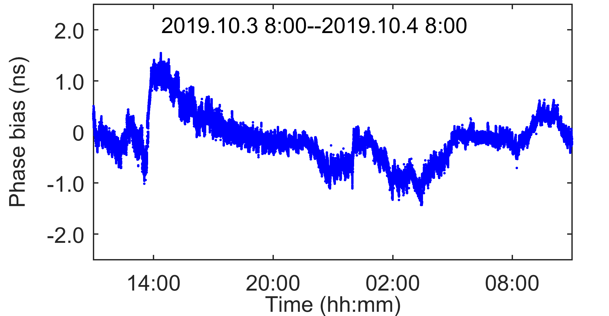
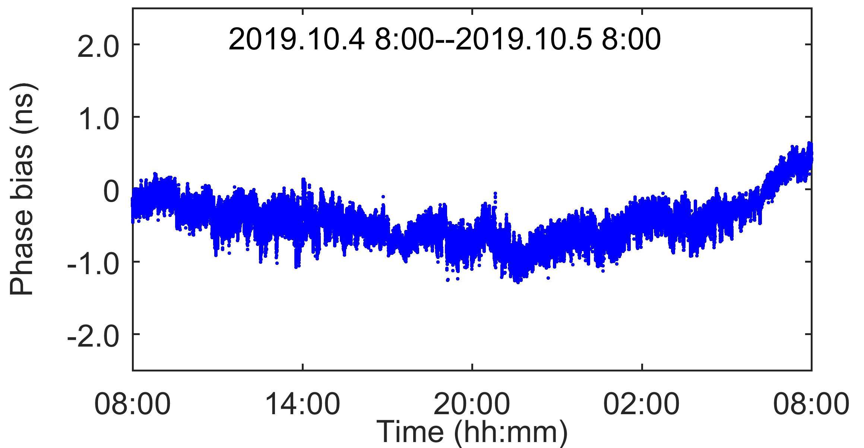
04
Result and discussion
Evaluation of time synchronization performance
Diagram of time synchronization experiment
Maximum error :1.52 ns Minimum error :-1.14 ns Root square mean:0.41 ns

Slide 16
GPS Integer-PPP technique
Day boundary of IPPP
The continuous PPP time transfer with ambiguity resolution
Results and discussion
Summary/Outlook

Slide 17
05
Summary/Outlook
The time synchronization based on RT-PPP is suitable to solve the problem of time synchronization for the distributed system.
The product quality and time reference stability of CLK53 and CLK80 performed well to provide the time reference support for PPP time synchronization.
The experimental results show that the root mean square error (RMSE) of GPS PPP time synchronization experiment was about 0.41 ns .
The experiment was implemented in a static mode. More research will be focused on time synchronization in the kinematic mode.

Slide 18
Thank you for your attention!

