Slide 1
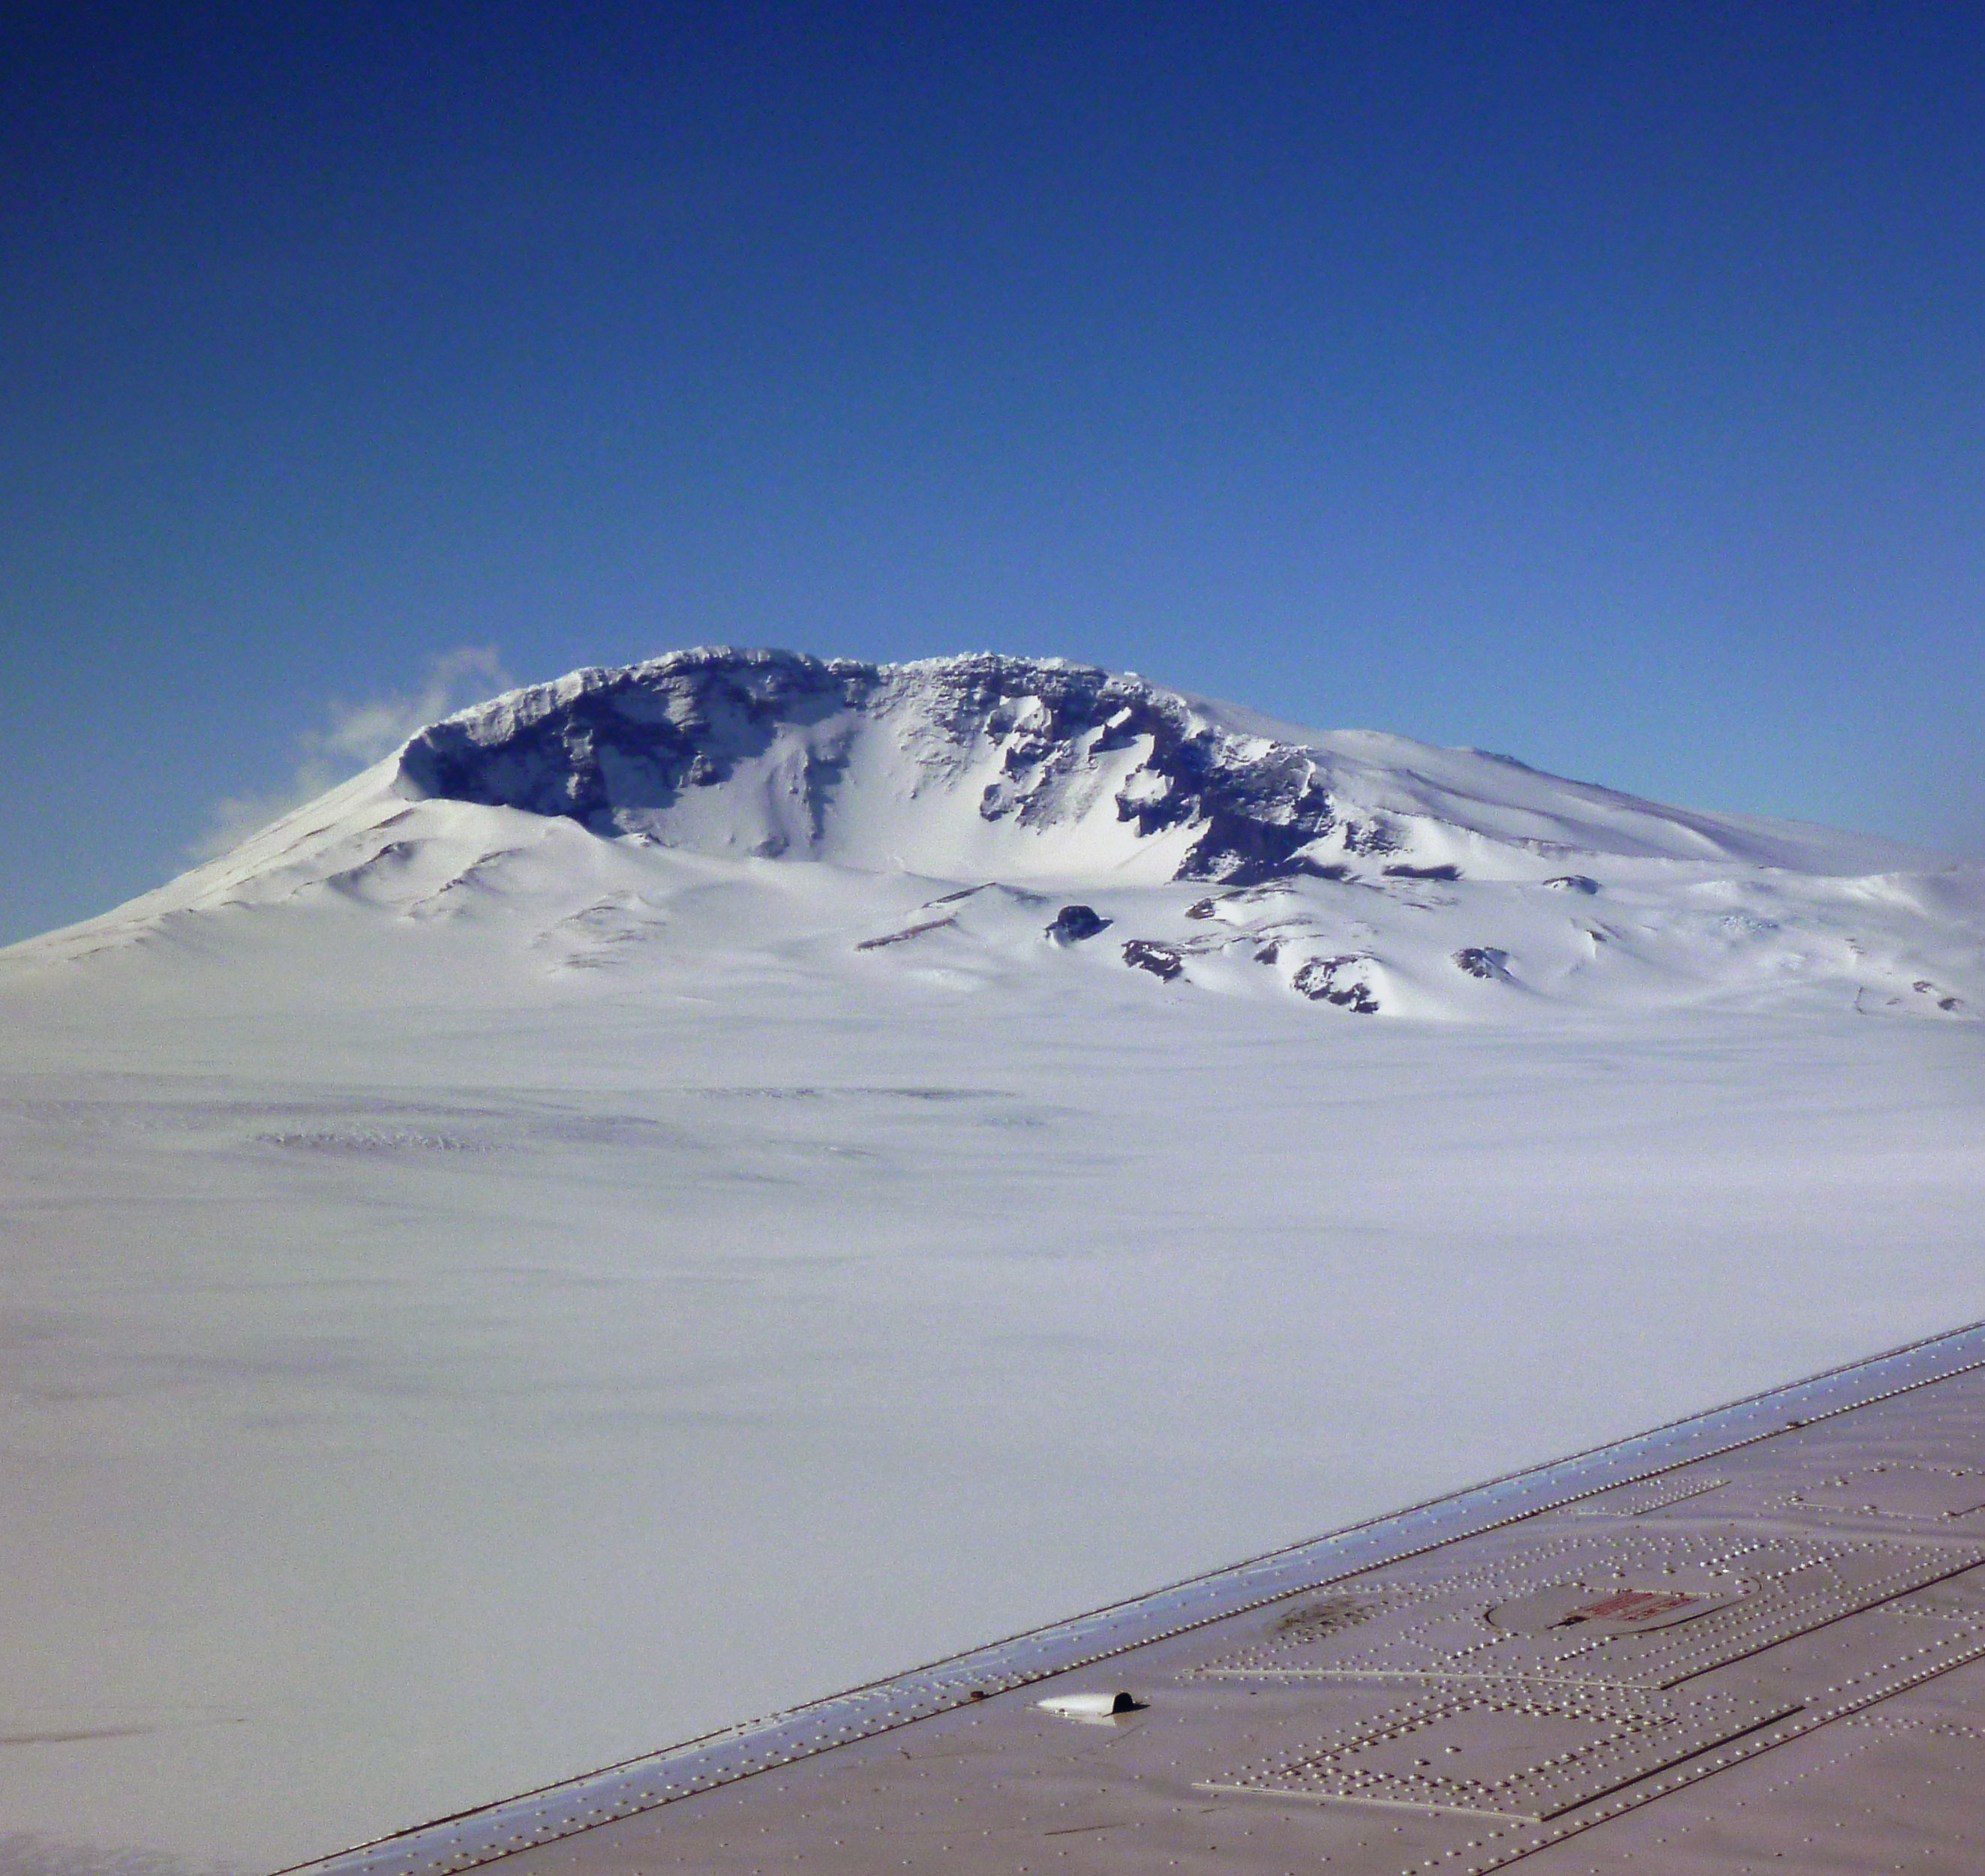



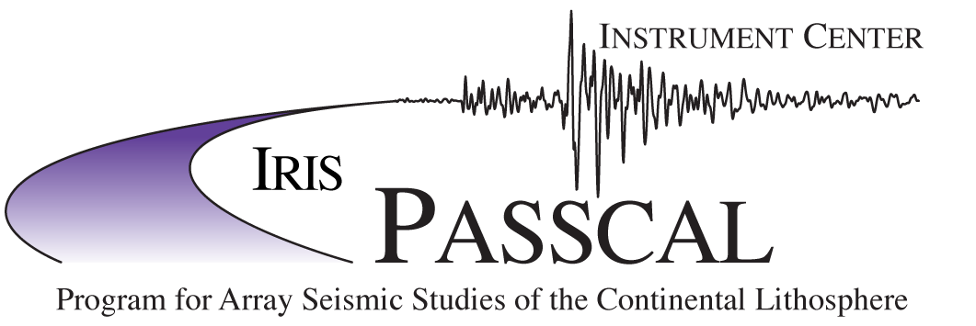

Mantle viscosity structure and lithospheric thickness beneath Antarctica
Mt. Sidley volcano
Marie Byrd Land
Antarctica
Douglas Wiens¹, Andrew Lloyd¹, Weisen Shen², Andrew Nyblade³, Richard C. Aster⁴, Terry Wilson⁵
¹Washington University in St. Louis
²Stony Brook University
³Penn State University
⁴New Mexico Tech
⁵Ohio State University

Slide 2
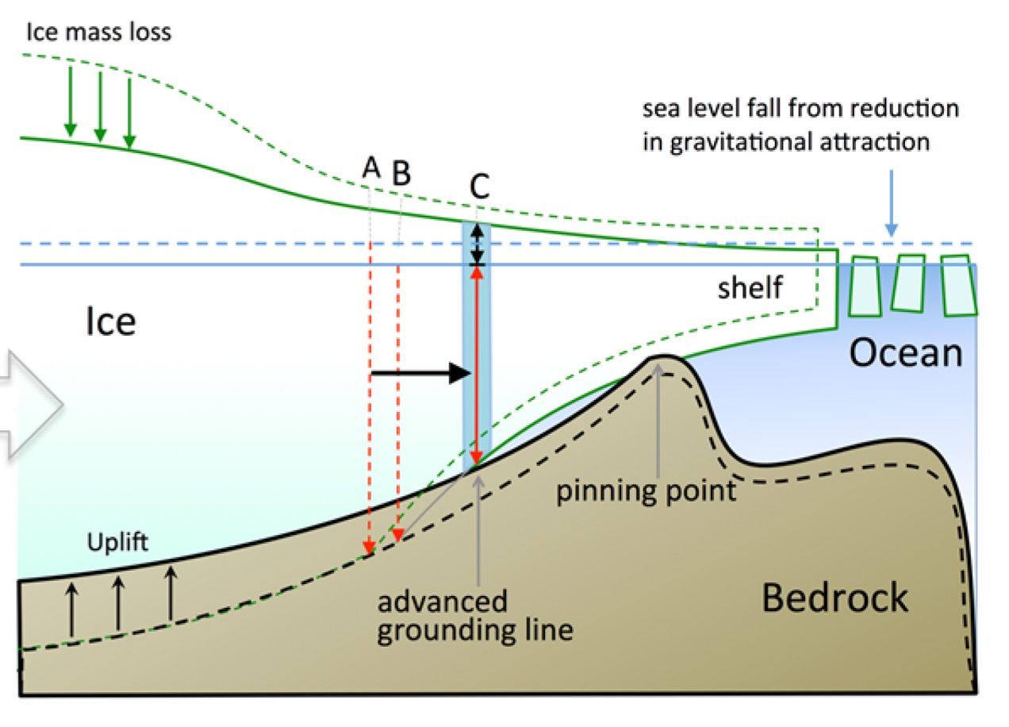
The need for laterally varying lithospheric thickness and mantle viscosity models of Antarctica
Uplift rates from GPS do not match
predictions of 1-D structure models
Rapid GIA caused by low viscosity mantle reverses
bed slope, may slow the rate of ice sheet retreat
OSU Solution: G06cR
LGM ice load centers
Barletta et al. (2018)

Slide 3
New Antarctic seismic models useful for GIA studies
Seismic models - requirements
-- detailed structure of West Antarctica to give lithospheric thickness and
mantle temperature
-- GIA models require viscosity estimates at least down to the transition zone and
extending to the surrounding ocean basins
Strategy – develop two new seismic models with somewhat different data, methodology and focus
-- Bayesian Monte Carlo inversion of well-instrumented West and Central Antarctica to depths of ~ 200 km (Shen et al., 2018)
-- Combined inversion of phase velocities from earthquake and ambient noise correlation along with receiver functions
-- Detailed model of structure including crustal thickness; we also do a thermal inversion to estimate lithospheric thickness, mantle temperature, and heat flow
-- Full waveform adjoint inversion of earthquake data south of 45˚S (Lloyd et al., 2019)
-- Inverts the entire 3 component seismic waveforms
-- provides resolution to depths of ~ 800 km and extends to ocean basins

Slide 4
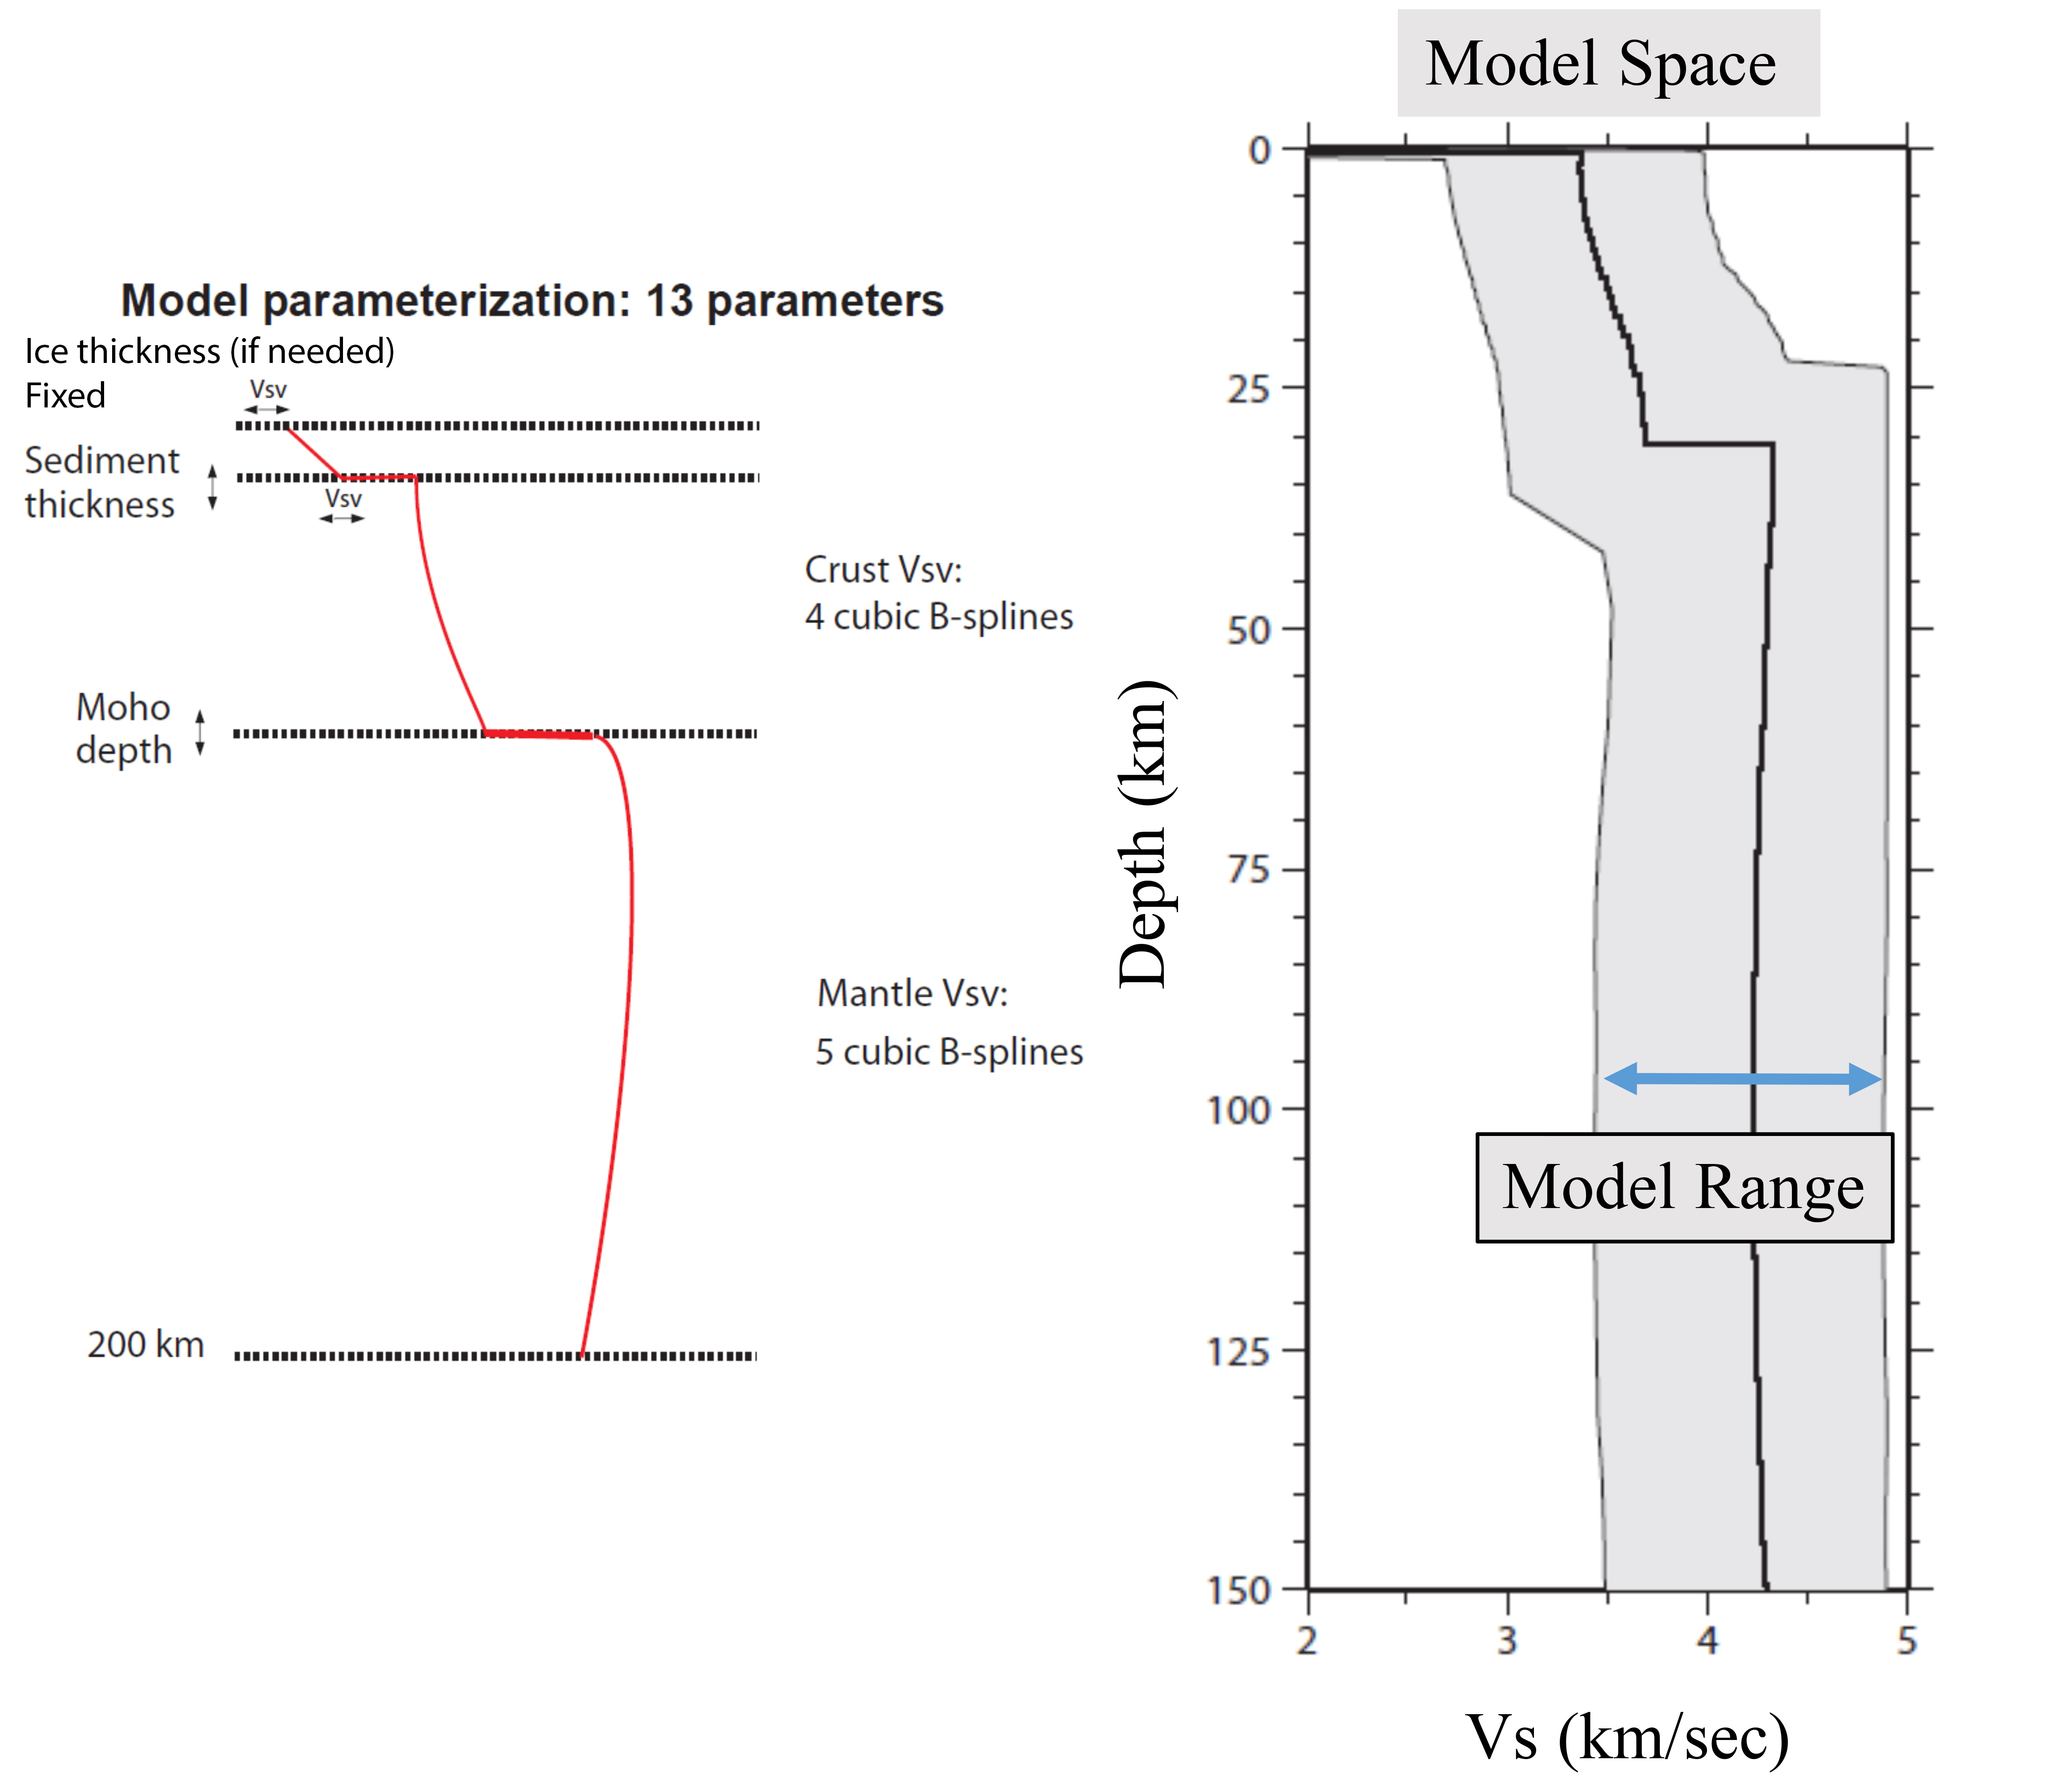
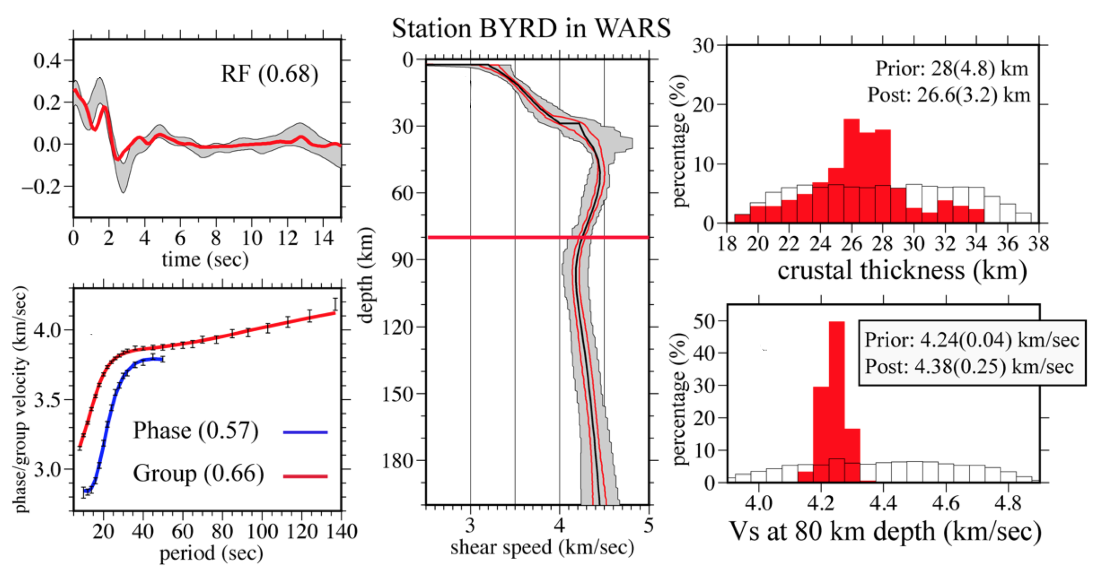
Monte-Carlo inversion of Rayleigh waves and Receiver functions
Typical seismic analyses analyze only one phase or type of data
Bayesian Monte Carlo method allows us to jointly analyze several datasets
Rayleigh waves from earthquakes and ambient noise constrain seismic velocity in the upper 200 km
Receiver functions constrain Moho depth and other discontinuities
Bayesian analysis also provides uncertainty estimates for velocity and crustal thickness
Shen et al., in prep
Shen et al. [2018]

Slide 5
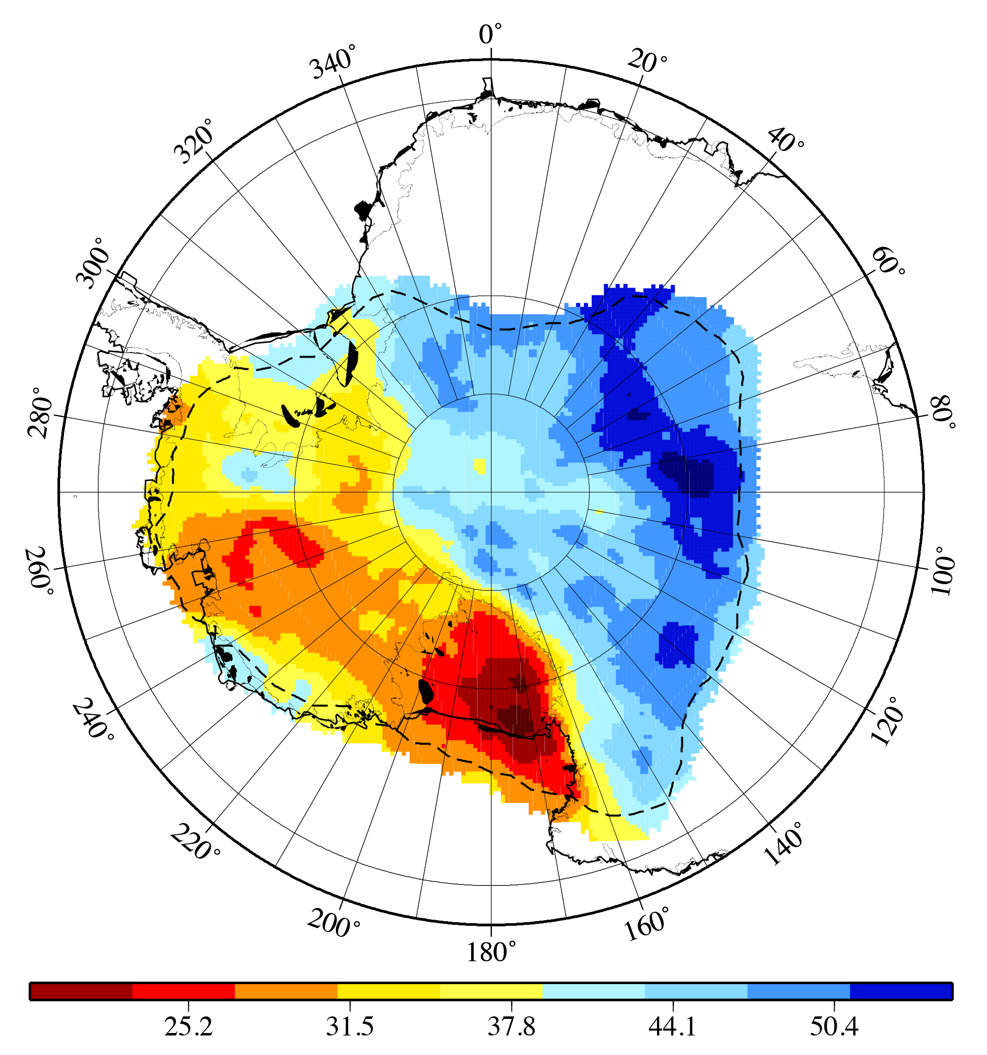
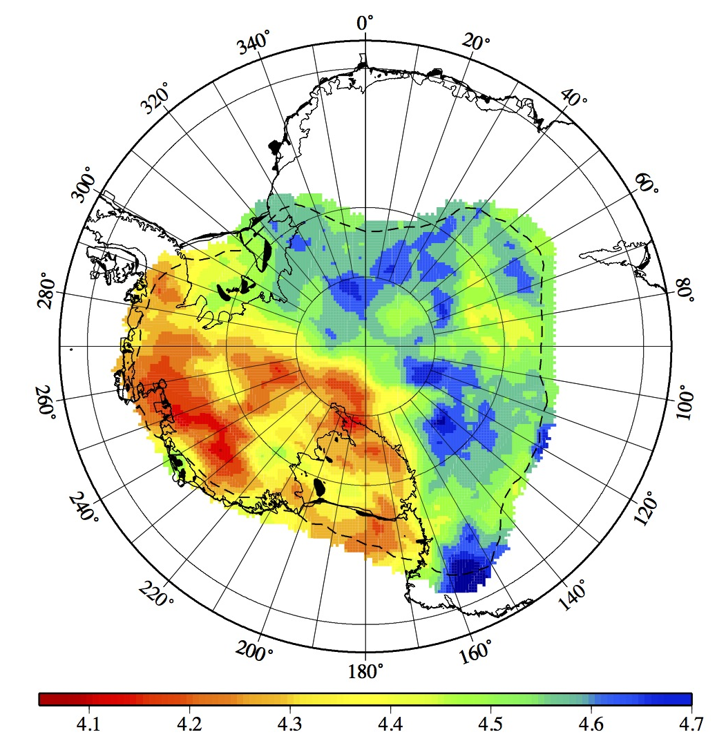
Monte-Carlo joint inversion results
Crustal Thickness (km)
Shear Velocity at 80 km depth
East
Antarctica
West
Antarctica
Shen et al. [2018]

Slide 6
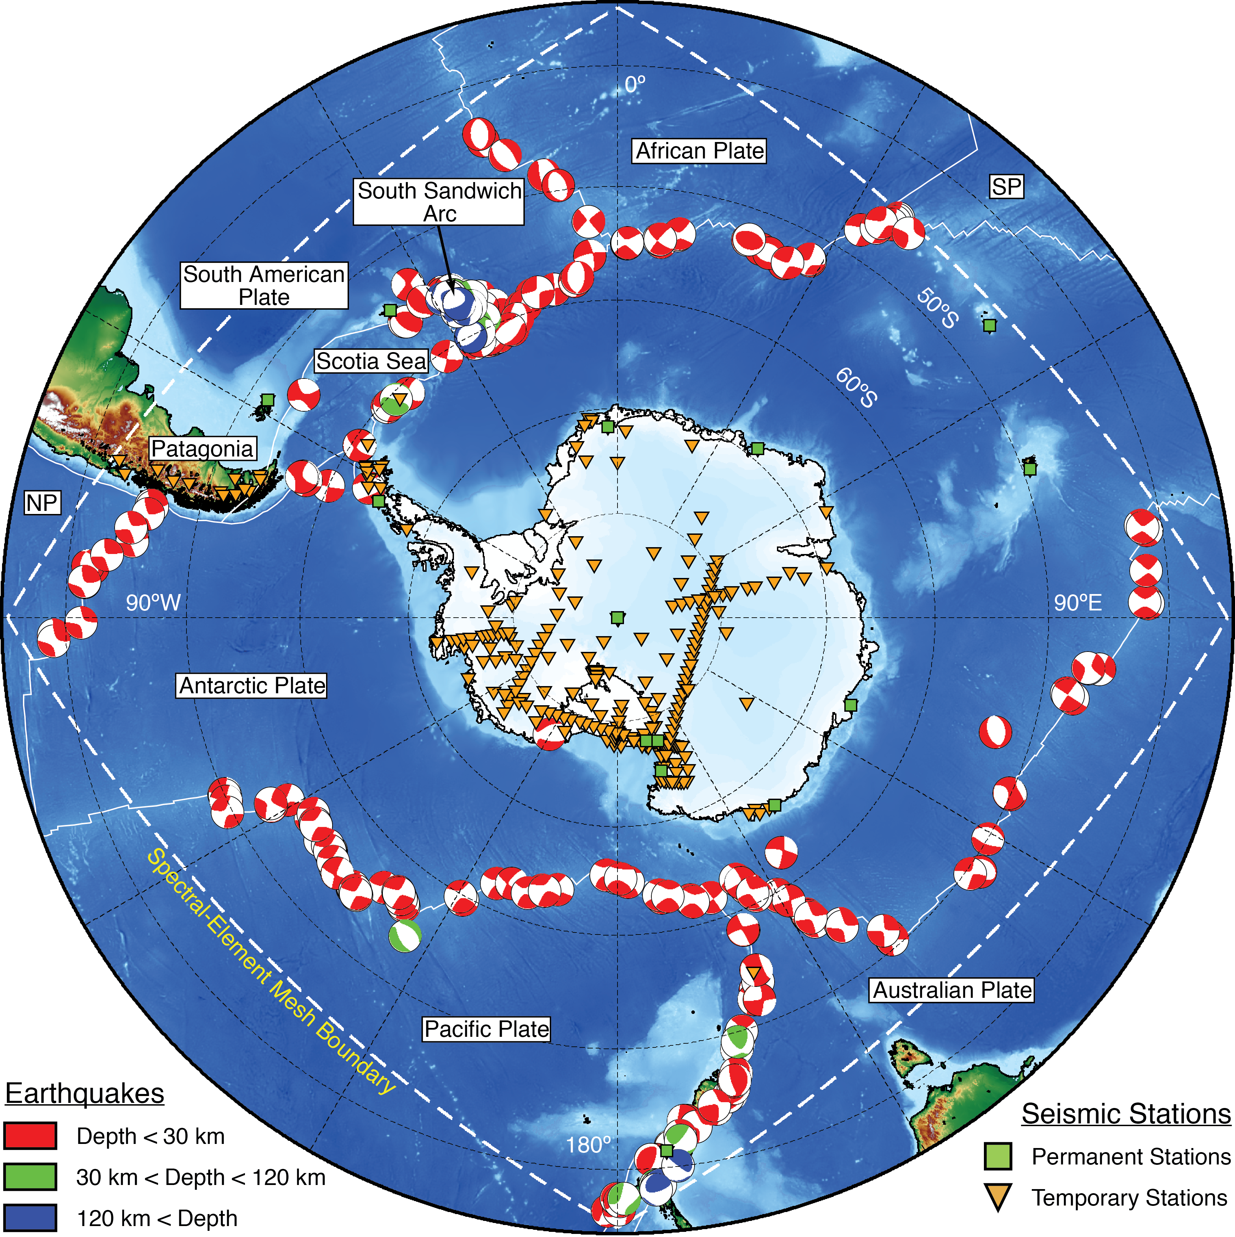
Adjoint full-waveform inversion for large-scale structure
Earth structure is determined by computing synthetic seismograms in a 3D earth model with the spectral element method
We use 258 earthquakes recorded at more than 300 stations
The structure is parameterized as
elastic transversely-isotropic, with
crustal and ice thickness fixed.
The structure is then improved using kernels constructed from the forward and adjoint wavefields (Tromp et al., 2005)
Carried out 20 iterations
(consumed 6 M CPU hours on the
Texas Stampede cluster)
Lloyd et al. [2019]

Slide 7
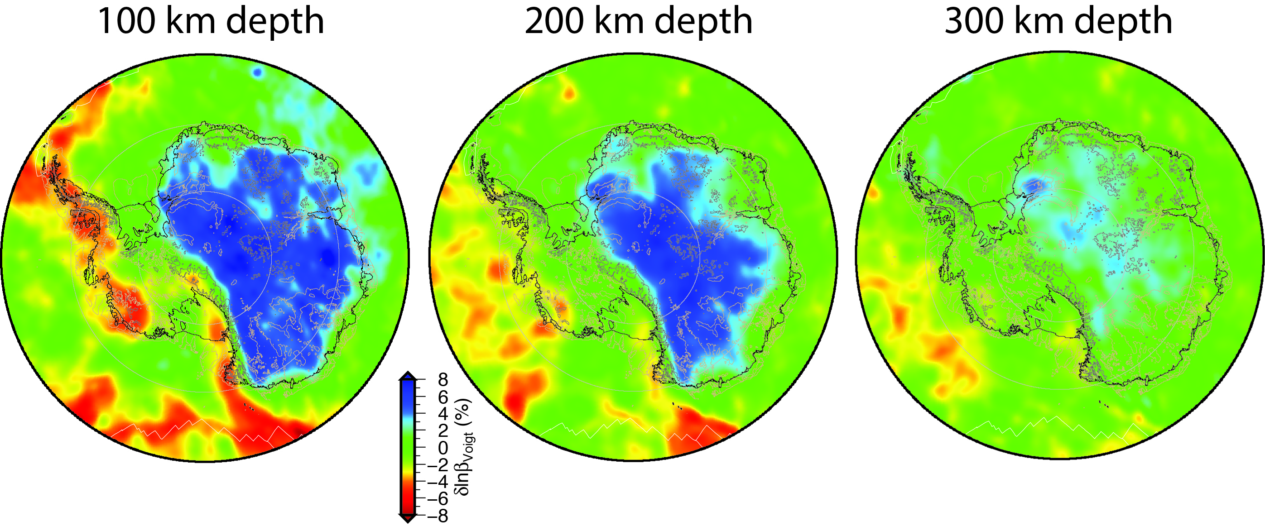
Shear Velocity from the Adjoint Full-Waveform Inversion
The East Antarctic lithosphere is extremely fast down to ~ 250 km, with some notable gaps
Very slow velocities @ 100-200 km beneath Marie Byrd Land, Amundsen coast, and Antarctic Peninsula
Deeper slow anomalies (300+ km) beneath Ross Island, Marie Byrd Land, and the Amundsen Sea
Lloyd et al. [2019]

Slide 8
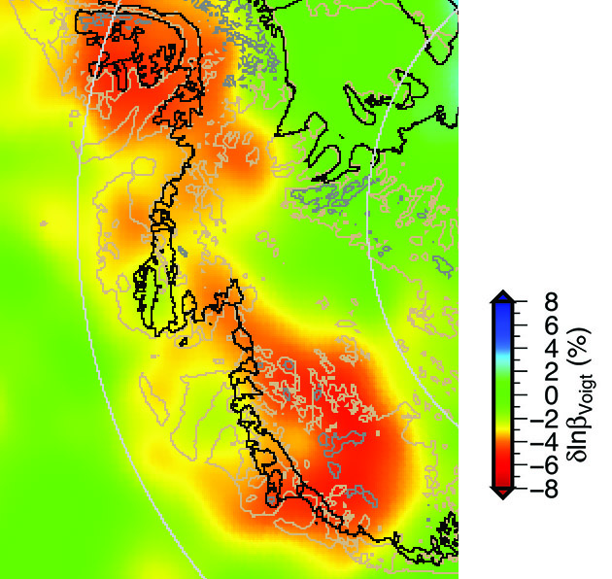
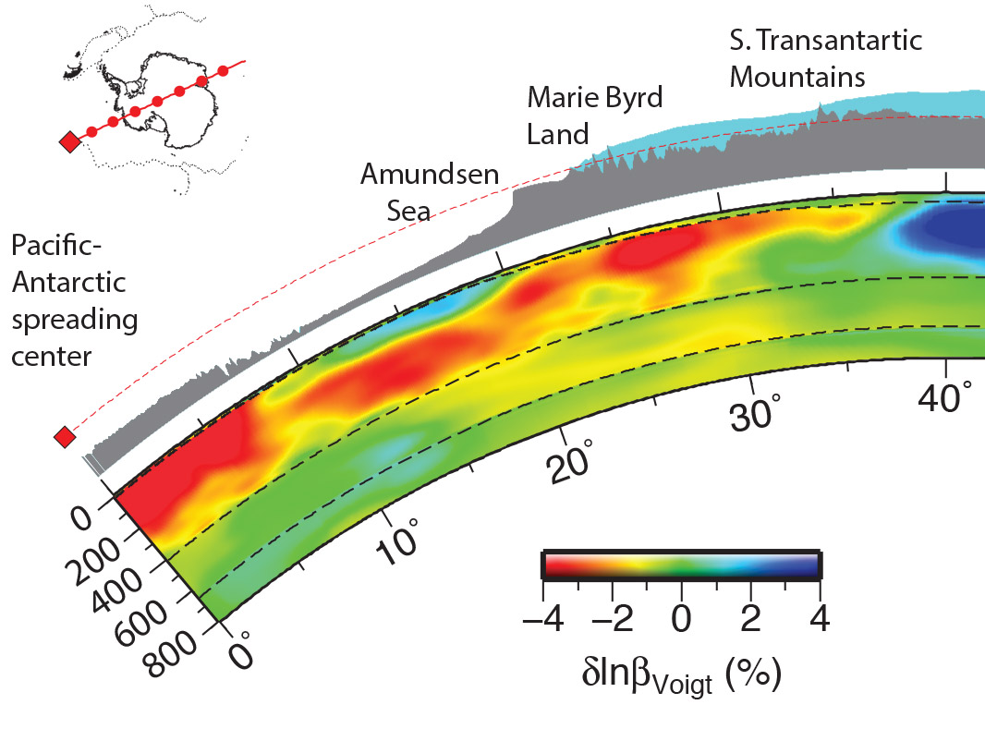
Amundsen Sea Thermal Anomaly extends beneath Thwaites coast
Shear velocity at 100 km depth
Profile along 115˚W
Amundsen
Sea
Marie
Byrd Land
Profile
Lloyd et al. [2019]
The extremely low velocity region beneath the Amundsen Sea extends underneath the coast
This low velocity region is associated with anomalous seafloor topography and volcanic islands
Low velocities shallow as the thick ocean lithosphere gives way to thin lithosphere in West Antarctica
Consistent with observations of low mantle viscosity along Amundsen coast & Thwaites/Pine Island glaciers

Slide 9
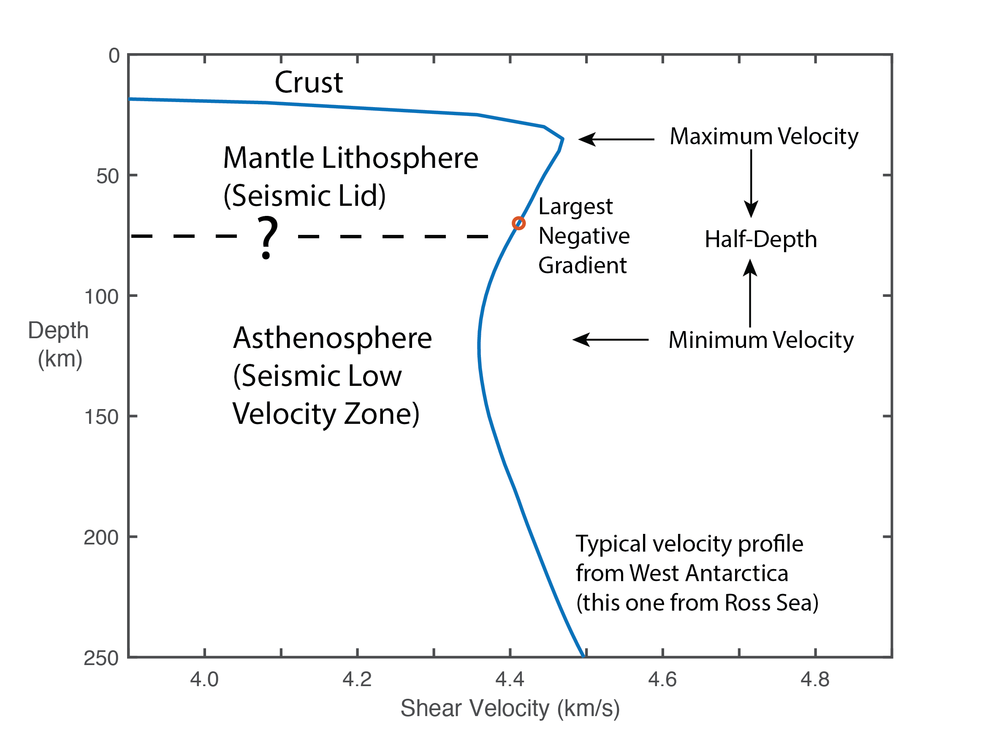
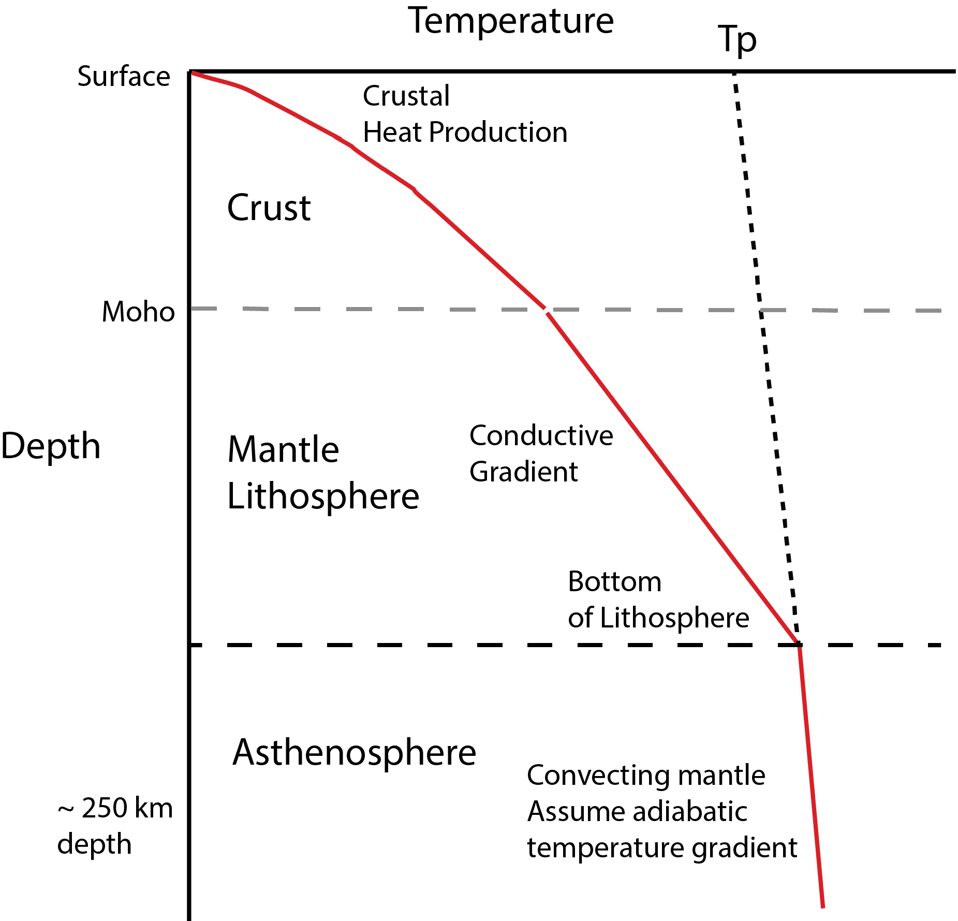
Estimating Lithospheric Thickness from Seismic Velocity
For GIA, the lithosphere is defined rheologically, so interpretation is required
Vs and rheology are functions of temperature, composition (especially volatile content), grain size
Some studies have used a velocity, such as V_{S} = 4.4 km/s, to define the bottom of the lithosphere
Problems:
-- Different velocities are needed in tectonic and cratonic areas
-- Choice of velocity is arbitrary
Thermal Lithosphere
Convert seismic velocity to temperature
Fit conductive and adiabatic gradients
Largest Negative Gradient or Half-Depth

Slide 10
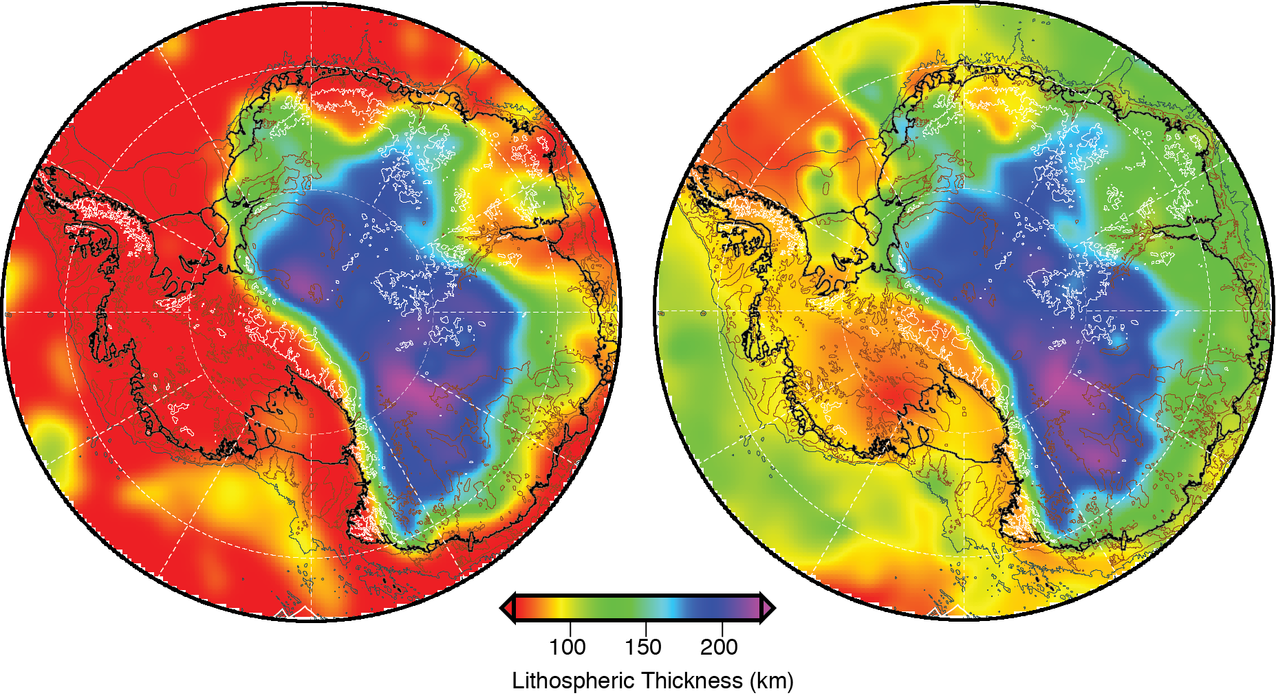
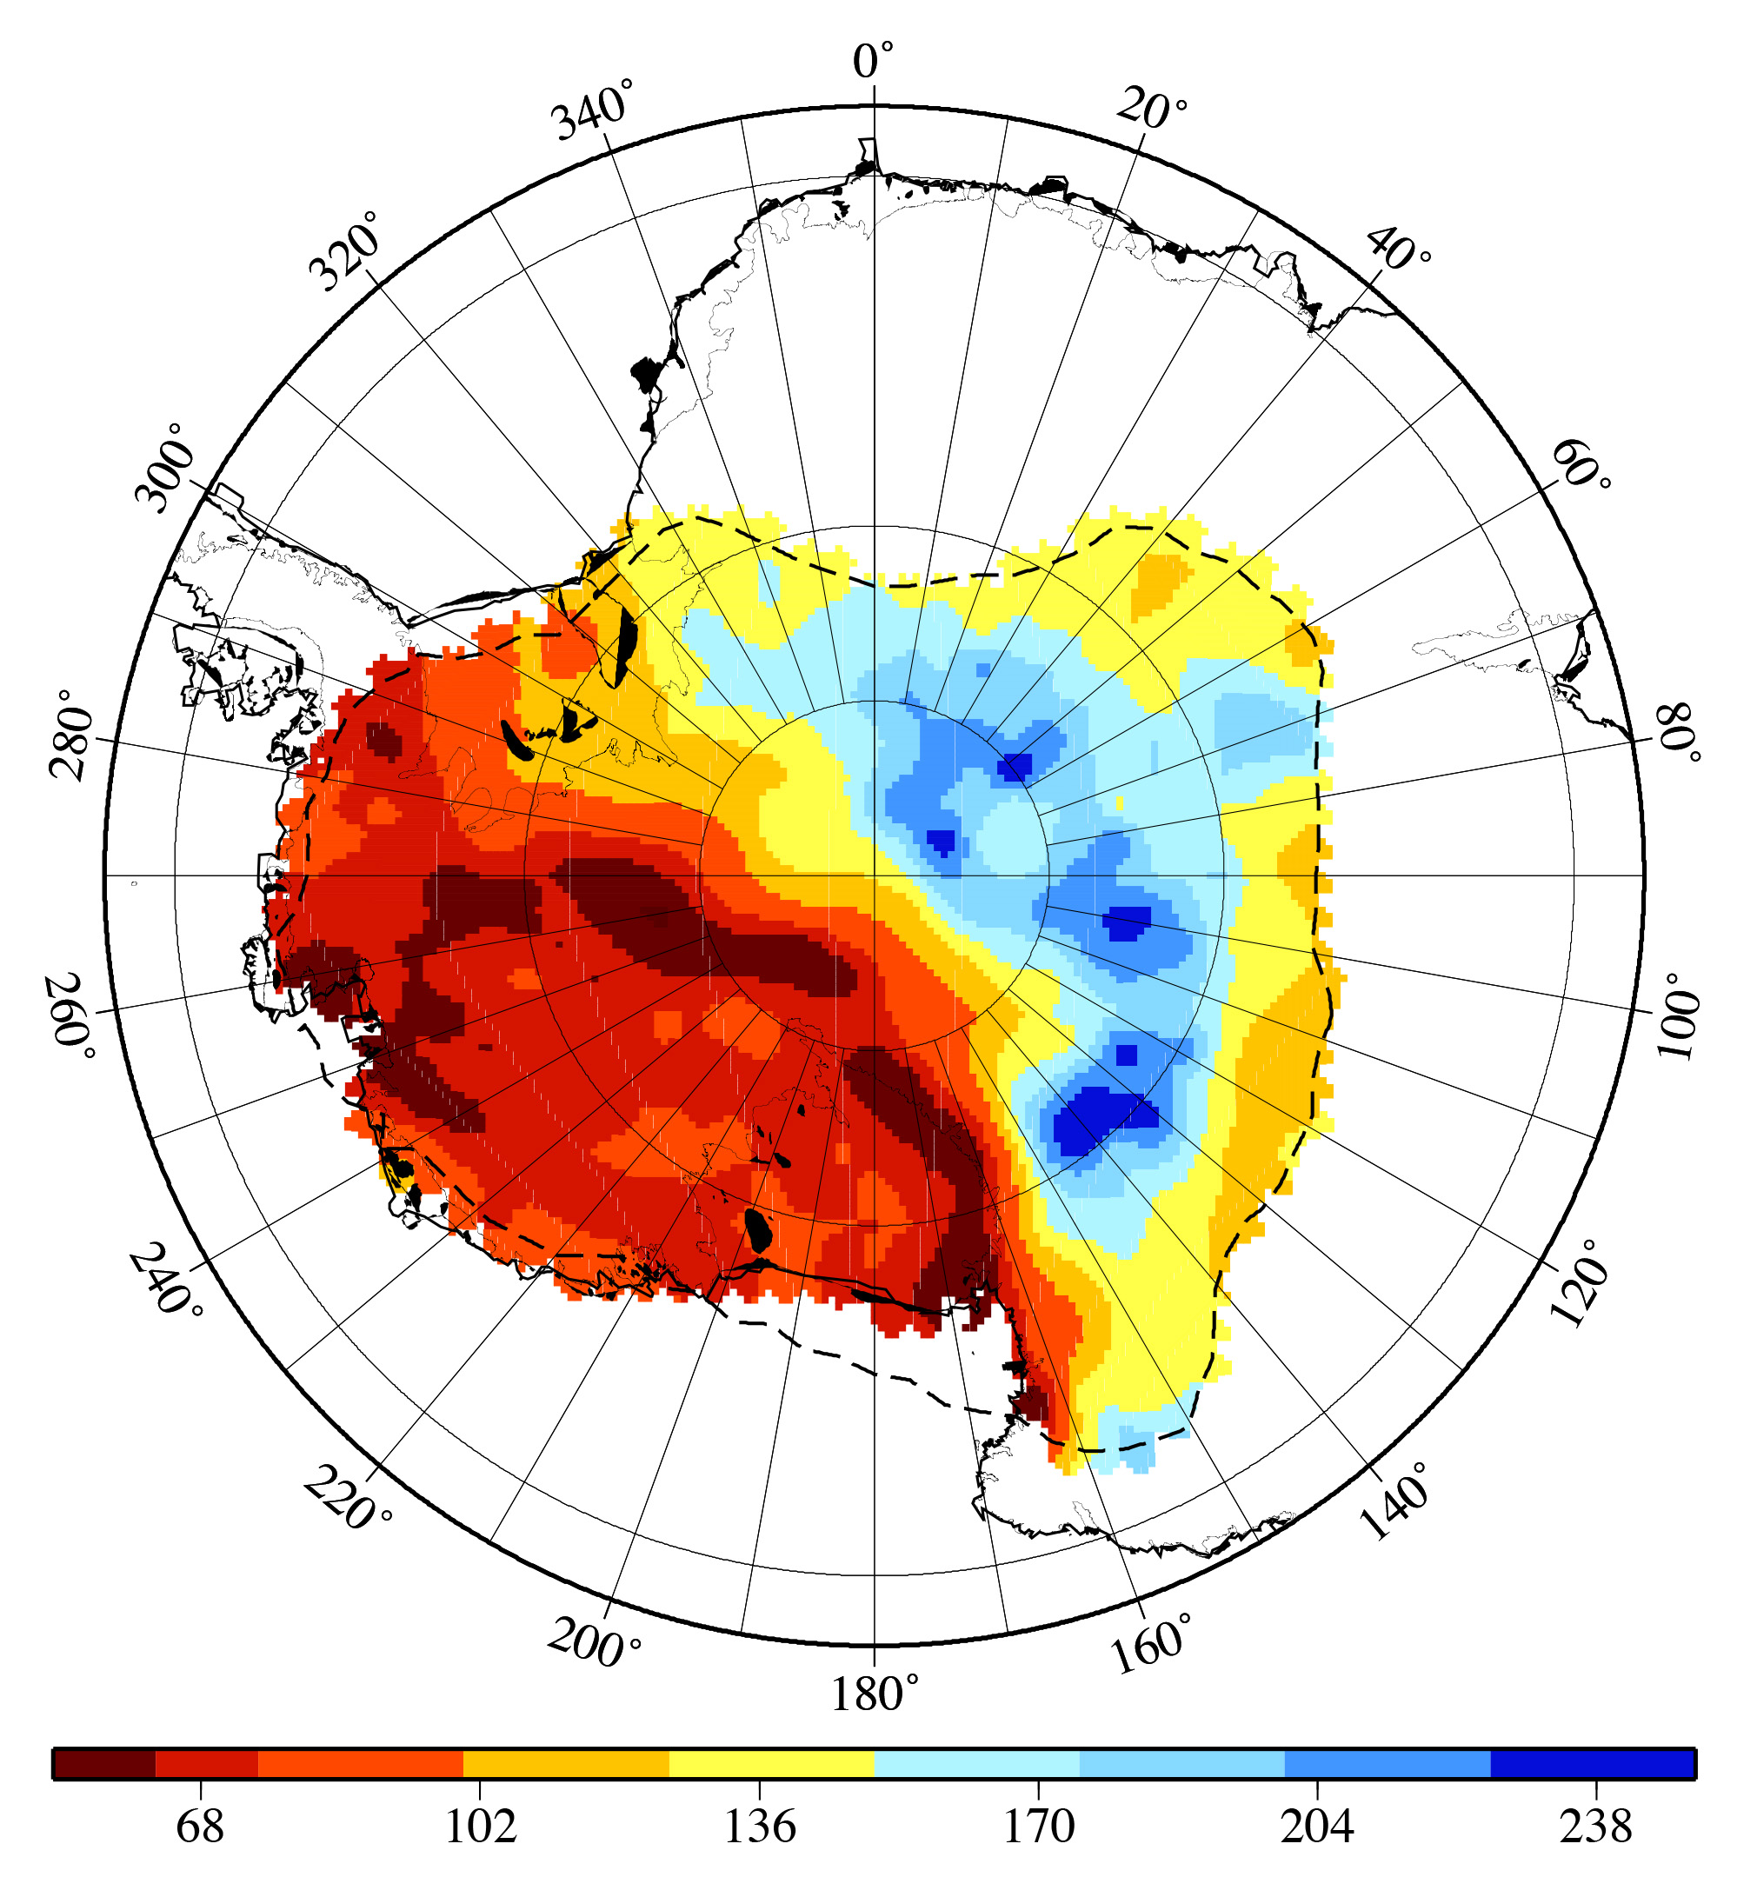
Estimated Lithospheric Thickness Maps
Maximum Gradient
Half-Depth
Estimated Thermal Lithosphere
Dronning
Maude Land
Lambert
Graben
Shen et al, in prep
Very thin lithosphere (50-90 km) in West Antarctica, much thicker (120-240 km) in East Antarctica
Thickest cratonic lithosphere confined largely to the center part of East Antarctica
Much thinner lithosphere beneath Dronning Maude Land highlands and Lambert Graben
Thinnest lithosphere in West Antarctica is near the TAM front and Amundsen Sea

Slide 11
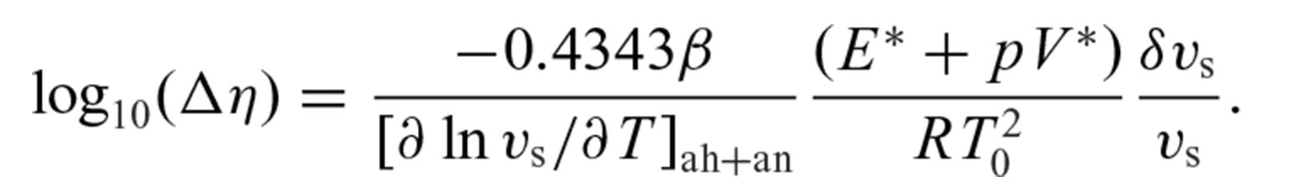
Estimating Viscosity Structure from the Seismic Model
Here we use seismic anomalies relative to a global 1D reference model (STW105) to compute temperature anomalies relative to a temperature geotherm, and then viscosity variations relative to reference viscosities. We assume linear viscosity.
Other approaches estimate the mantle temperature and then directly use experimental flow laws to determine viscosity, but they require more assumptions, such as composition and grain size
Use (Wu et al, 2012):
-- Temperature derivative from Karato (2008)
-- T₀ - reference temperature – assume 1315 °C adiabat
-- E* and V* - activation energy and volume –from Hirth & Kohlstedt (2003); initially use dry olivine but test others (hydrous olivine, etc)
-- β - percent of seismic anomaly due to temperature

Slide 12
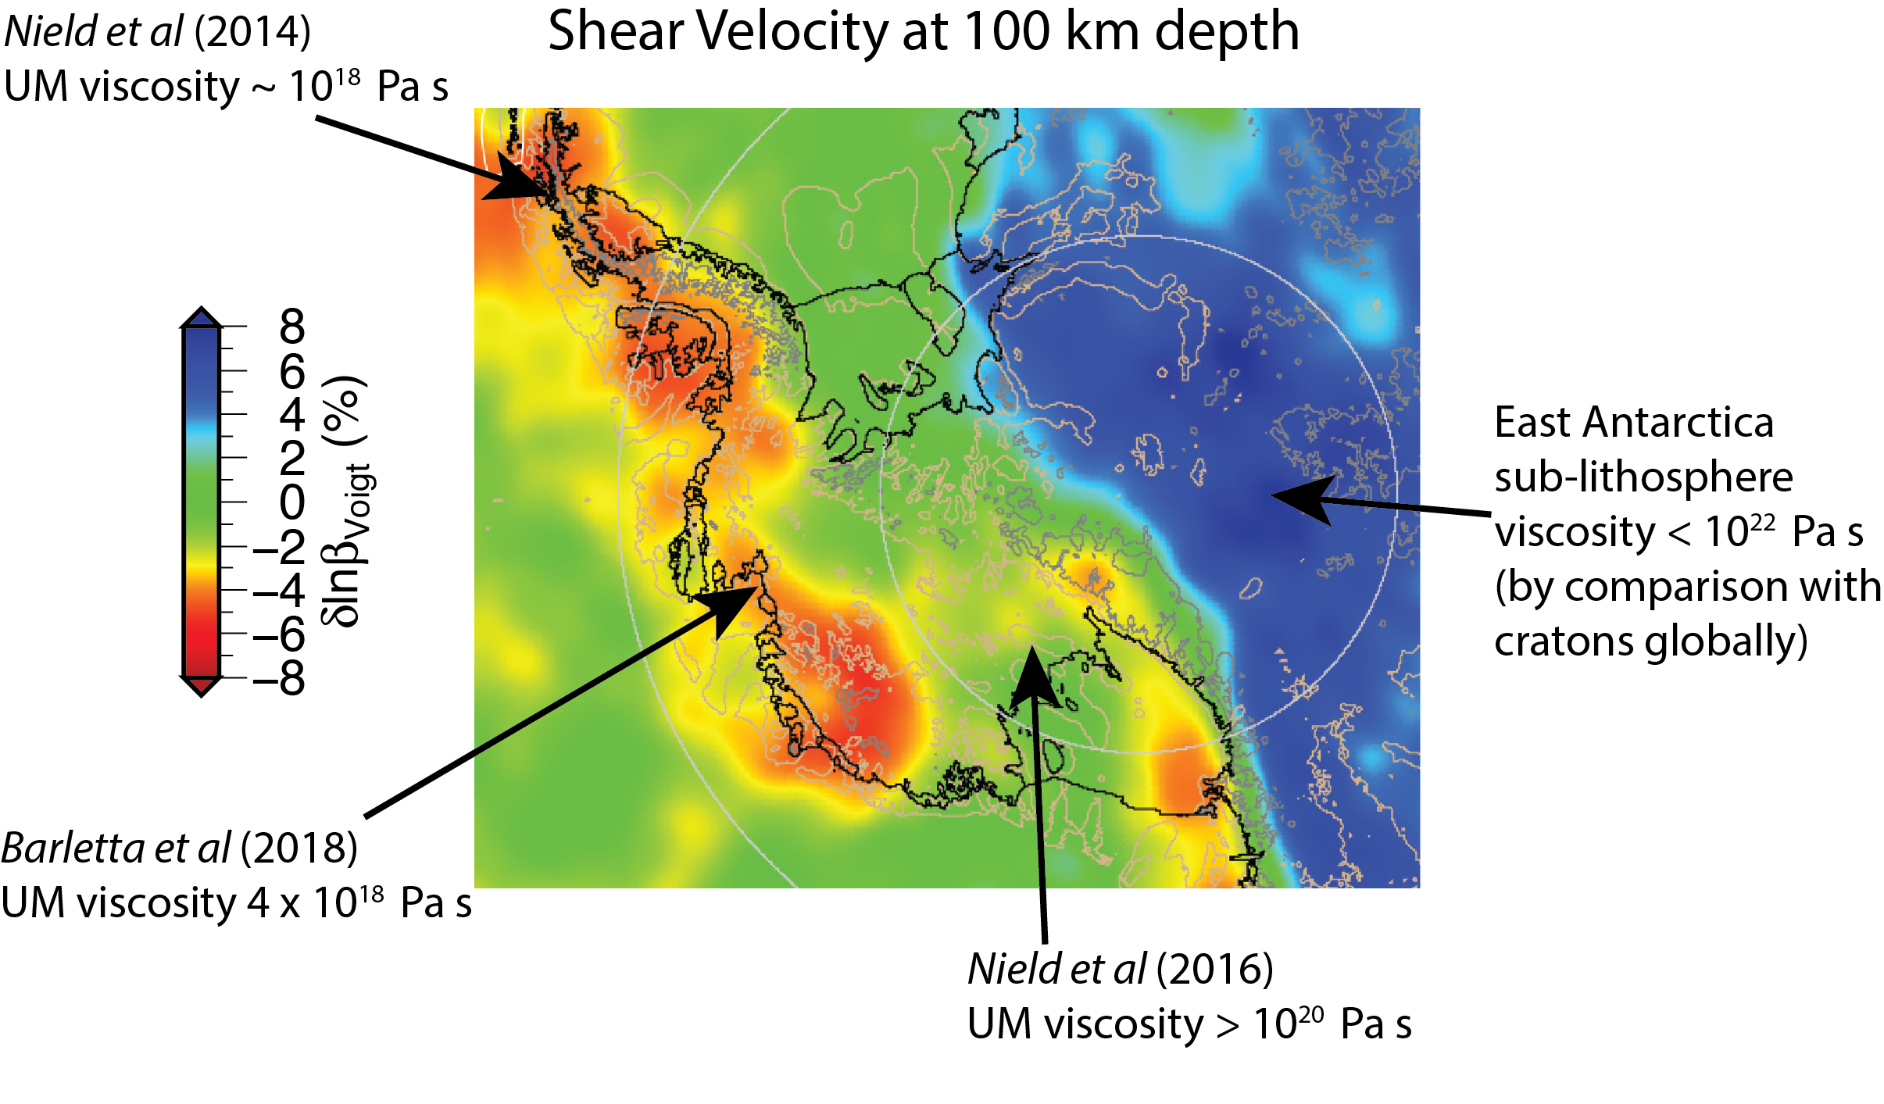
Calibrating Viscosity Conversion
Choose: Dry olivine diffusion creep rheology from Hirth & Kohlstedt (2003)
Background upper mantle viscosity IJ05-R2 (Ivins & James, 2013)
Velocity anomalies entirely due to temperature (𝛽 = 1.0)
Made a correction for depleted continental lithosphere in East Antarctica (Lee , 2003)

Slide 13
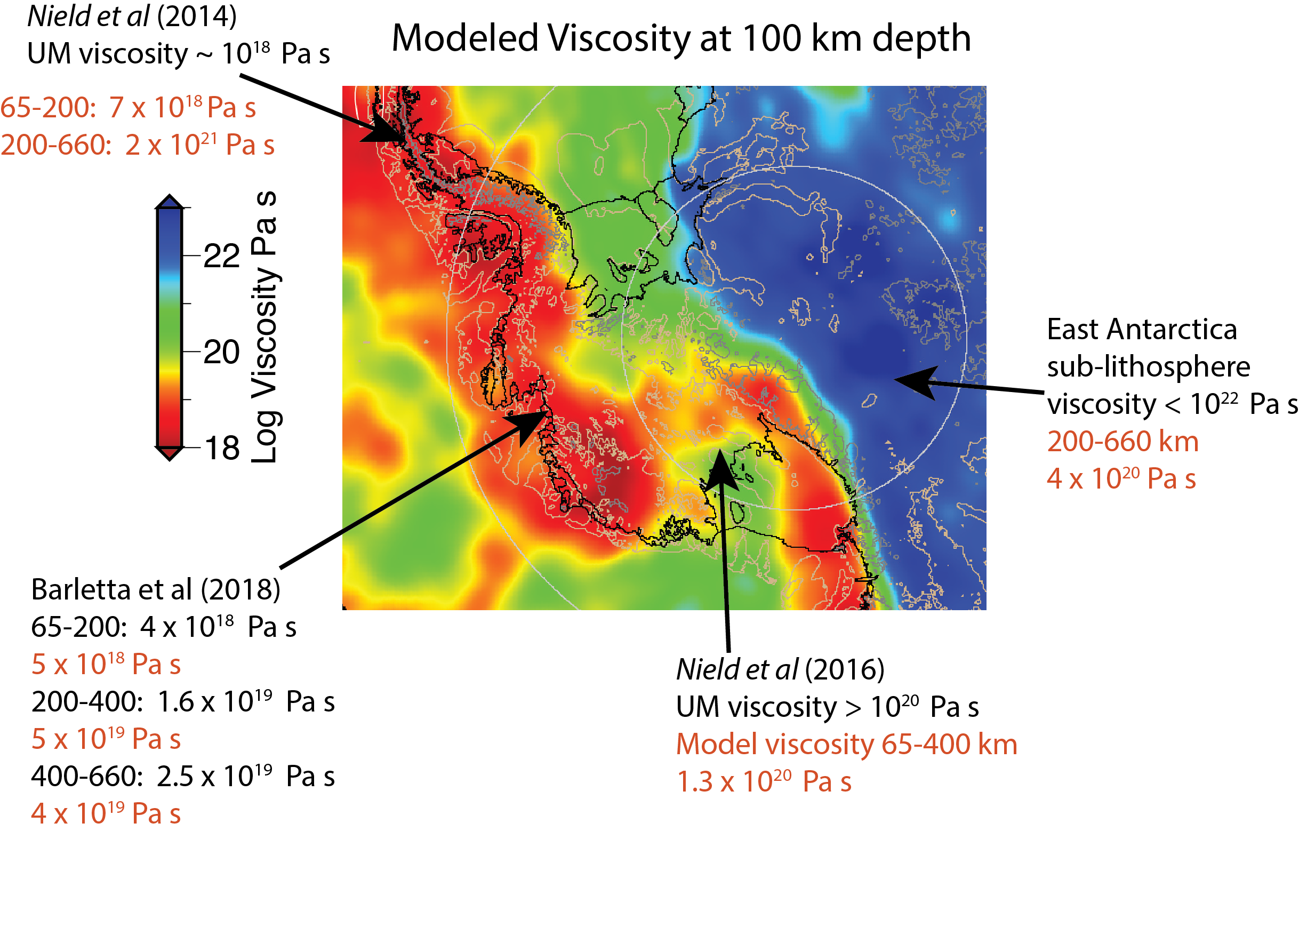
Fit to Viscosity Estimates

Slide 14
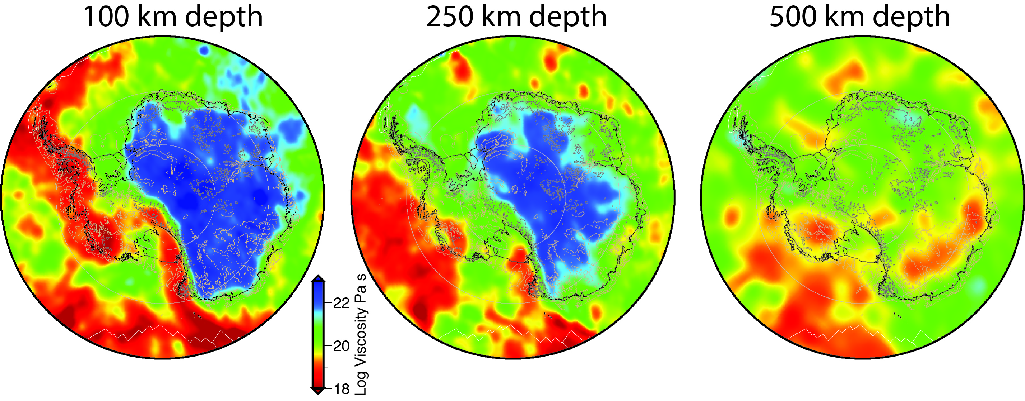
Estimated Mantle Viscosity Maps
Extremely low viscosity (~ 10¹⁸ – 10¹⁹ Pa s) throughout the upper mantle beneath Marie Byrd Land and the Amundsen Coast
Very low viscosity shallow (< 200 km) and thin lithosphere beneath the Peninsula, but high viscosity deeper, perhaps due to subducted slab material.
Higher viscosity (~ 10²⁰ Pa s) beneath Siple Coast and Ronne Ice Shelf region

Slide 15
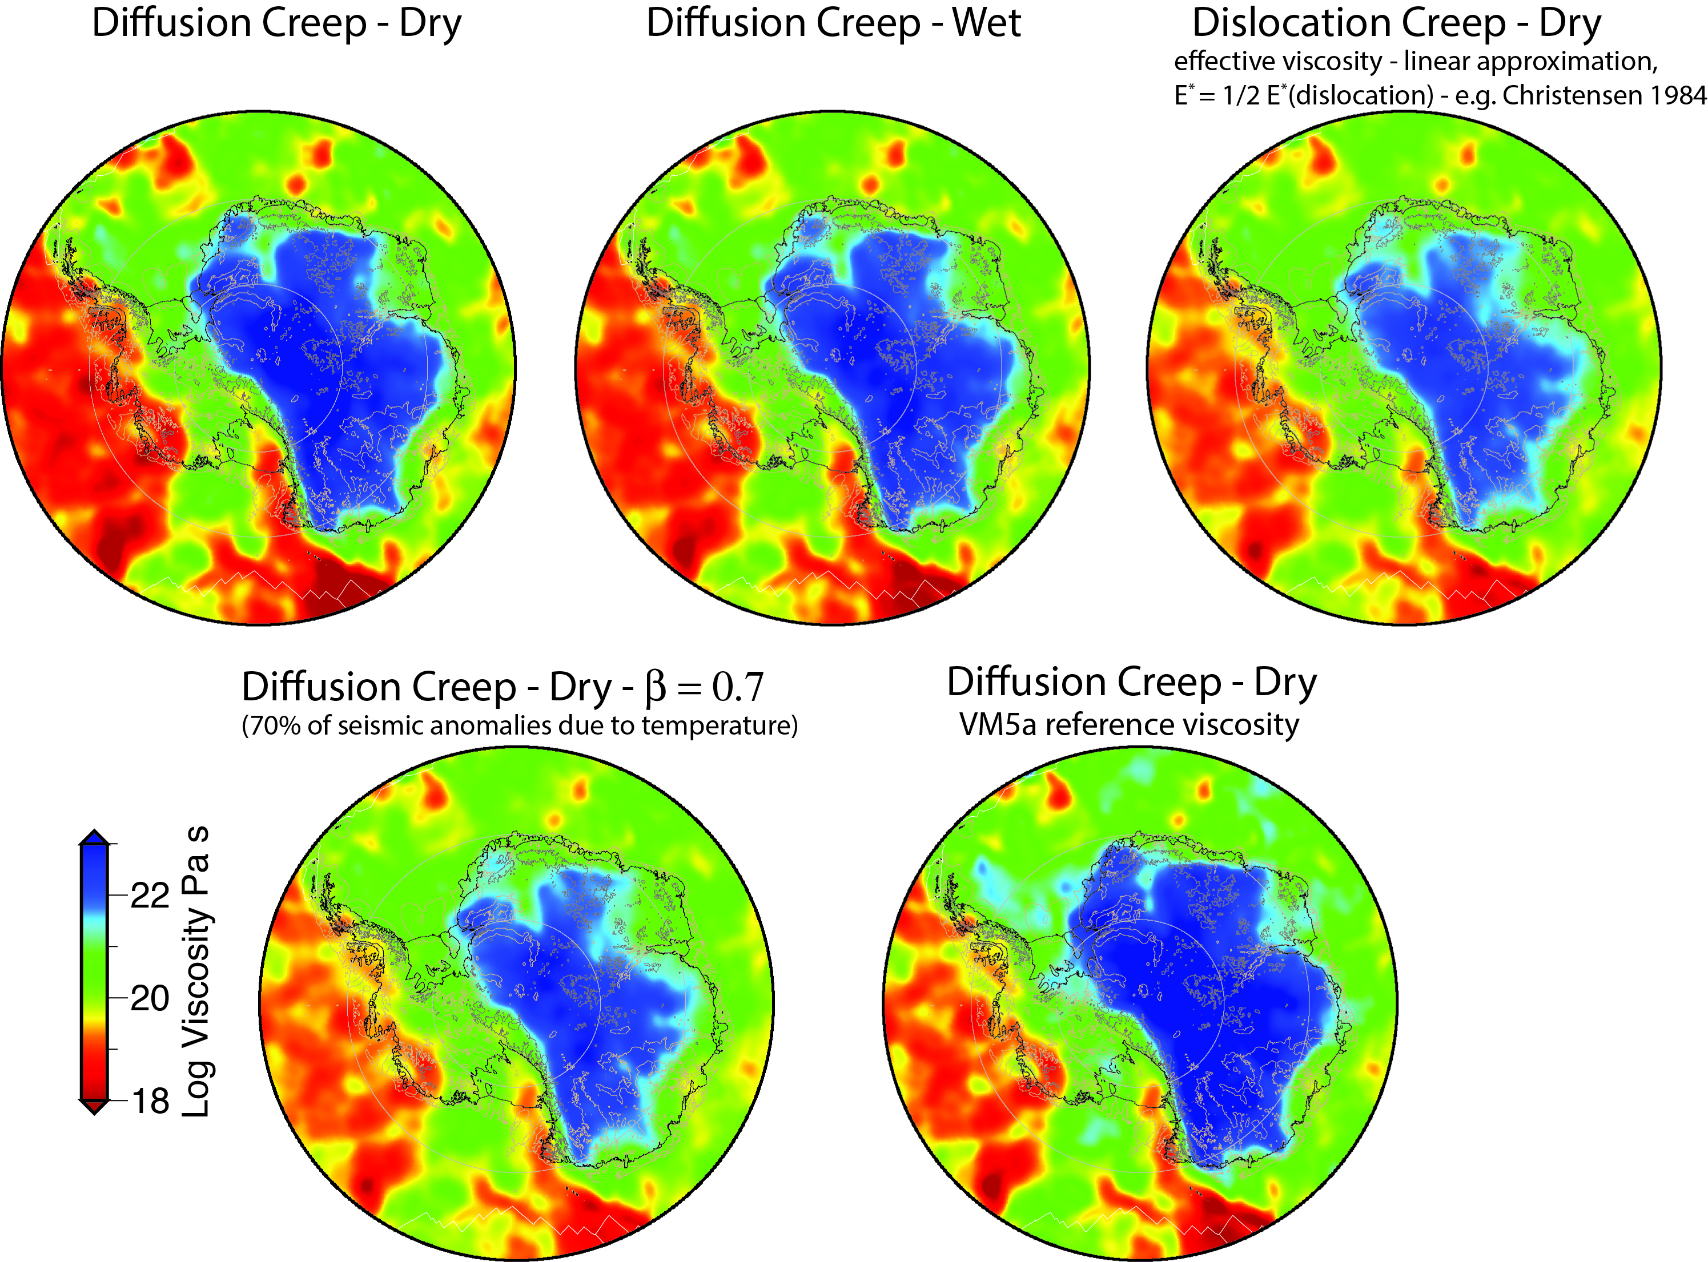
Sensitivity Analysis
Perturbation of assumptions generally results in similar patterns with somewhat less viscosity variation
This is because the calculation is based on anomalies relative to reference models
Use of VM5a reference viscosity model raises viscosities by 1/3 order of magnitude
These models do not attain the very low viscosities inferred for Amundsen Sea and the Peninsula

Slide 16
Conclusions
New seismic models, with recent data, allow the estimation of higher resolution lithospheric thickness and viscosity models for Antarctica.
Lithospheric thickness varies between up to ~ 220 km in East Antarctica to ~ 60 km in parts of West Antarctica and the Transantarctic Mtn. front.
Thick Archean lithosphere in central East Antarctica; thinner lithosphere beneath Dronning Maude Land and Lambert Graben due to lithospheric thinning or destruction during Phanerozoic tectonism
We develop a new viscosity model for Antarctica by computing relative viscosity anomalies from seismic anomalies. Tuning the parameters allow us to match recent viscosity estimates in West Antarctica.
Results show very low viscosity (10¹⁸ – 10¹⁹ Pa s) beneath the Peninsula, Amundsen coast, Marie Byrd Land, and Ross Island regions, suggesting glacial isostatic response times of ~ 100 years.
The Siple coast and Ronne Ice Shelf region show higher viscosity (~ 10²⁰ Pa s) and somewhat thicker lithosphere.

