Slide 1
Northwest U.S. crustal seismic anisotropy suggests
crustal flow driven by vertical loads in the underlying mantle
Eugene Humphreys
Jorge Castellanos
Robert Clayton
Jonathan Perry-Houts
YoungHee Kim
Bart Niday
Christian Stanciu
What do we see?
A remarkable pattern of azimuthal anisotropy
in the NW U.S.
©
I still don’t know what this is about
upper crust
lower
crust
mantle
lithosphere
z
How do we explain this?
Mantle loading squirts the crust
(crust drawn toward down loads)

Slide 2
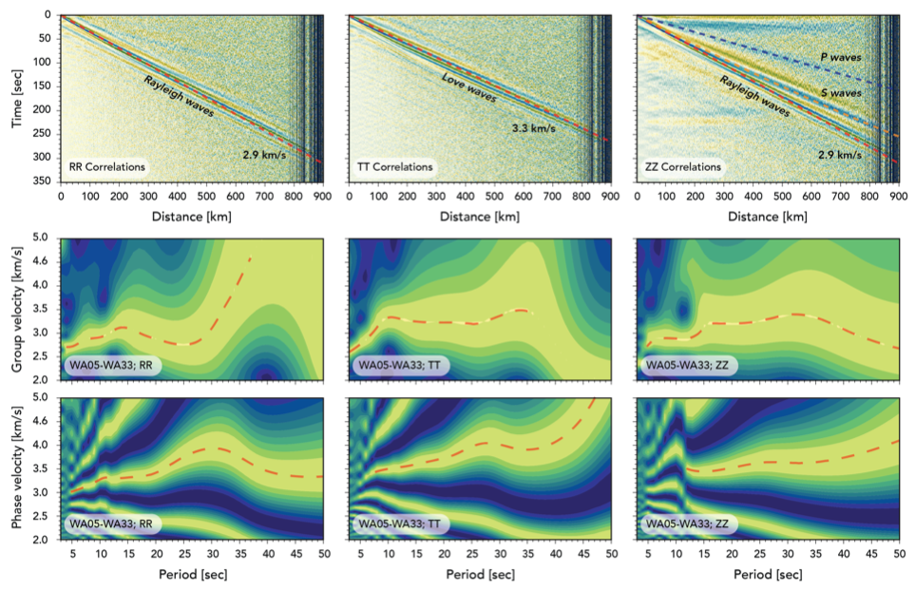

Slide 3
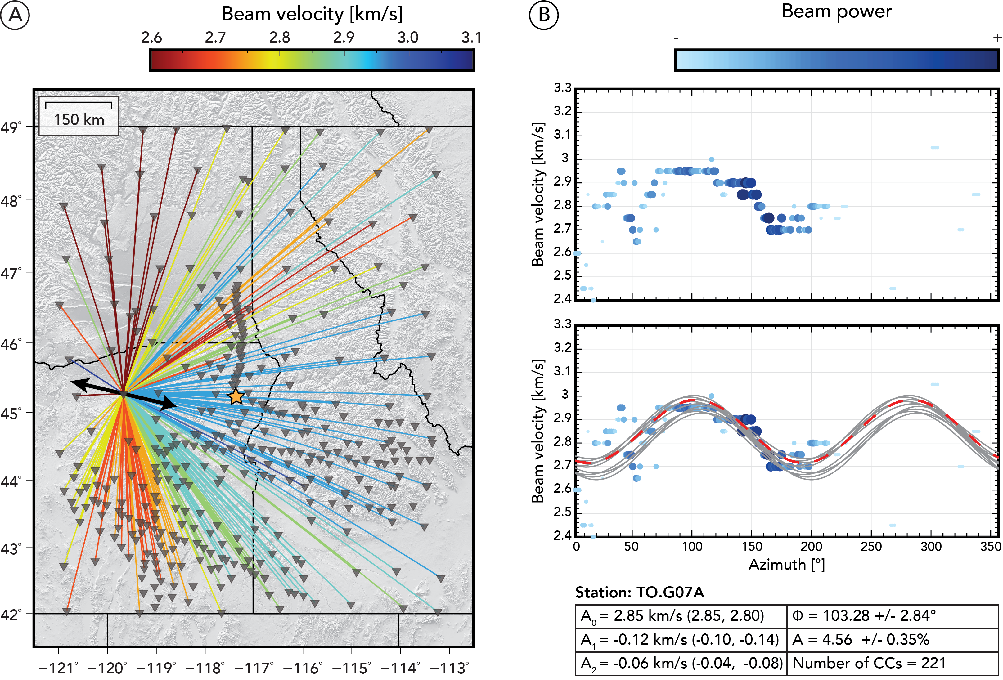

Slide 4
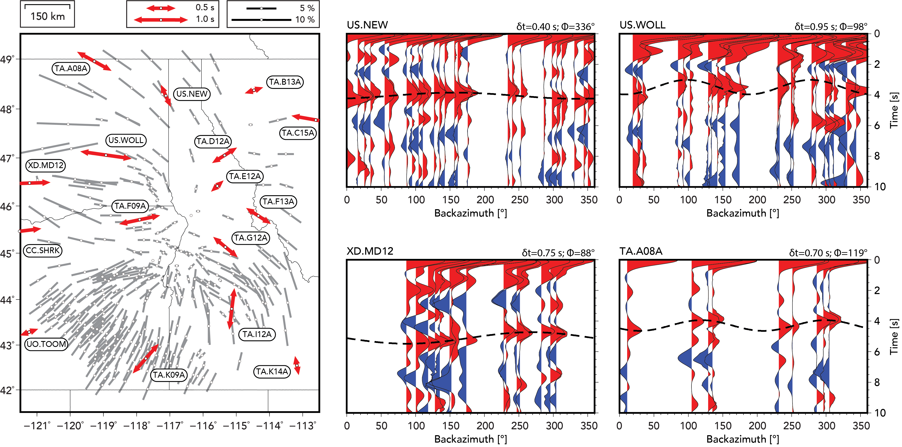
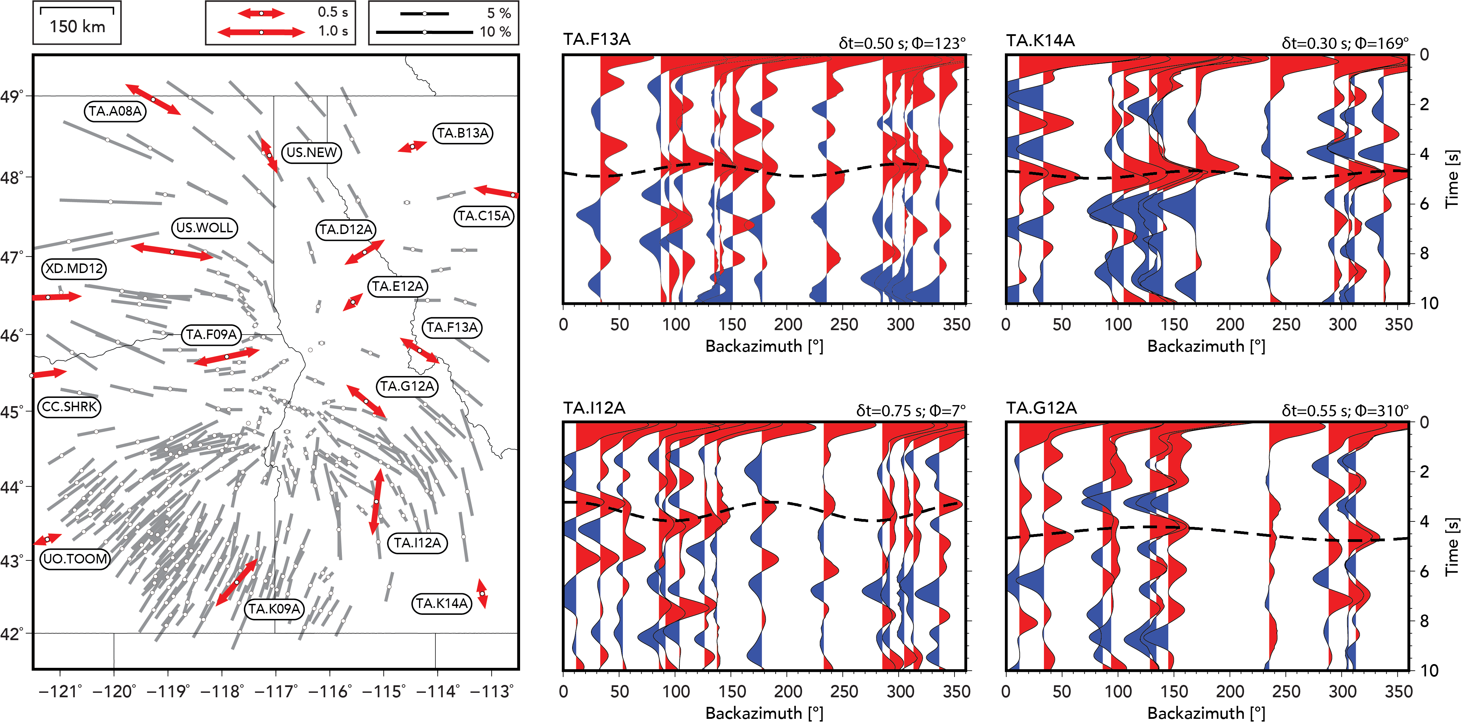
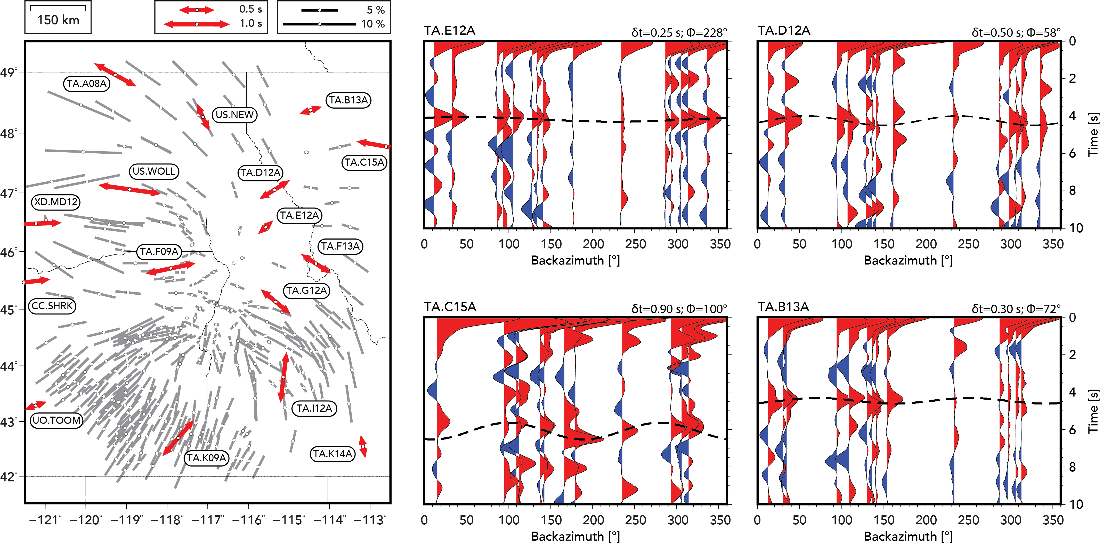
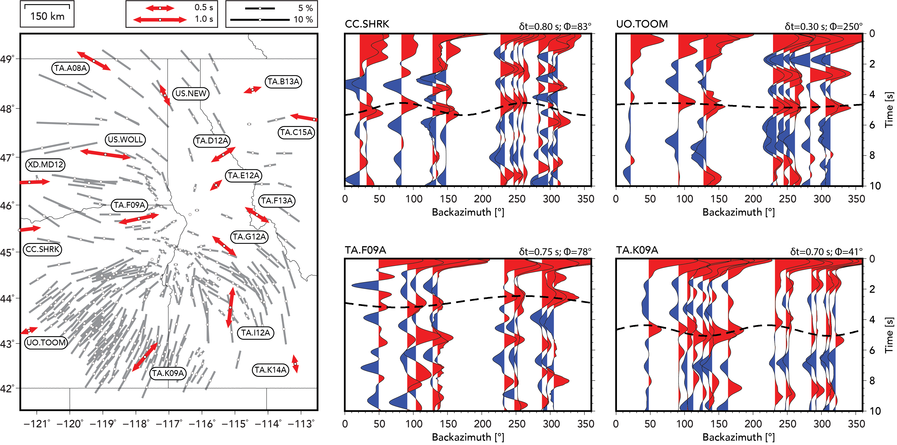
Comparison between crustal anisotropy and azimuthal dependence of receiver functions

Slide 5
What we see
A remarkable pattern of azimuthal anisotropy
in the NW U.S.
Azimuthal anisotropy
from 3-17 s Rayleigh wave phase velocity
Contours of
line-crossing density
(the other azimuthal terms are not significant & are not shown)
What creates this pattern?
Stress?
Strain?
Crustal structure?
Azimuth (degrees)

Slide 6
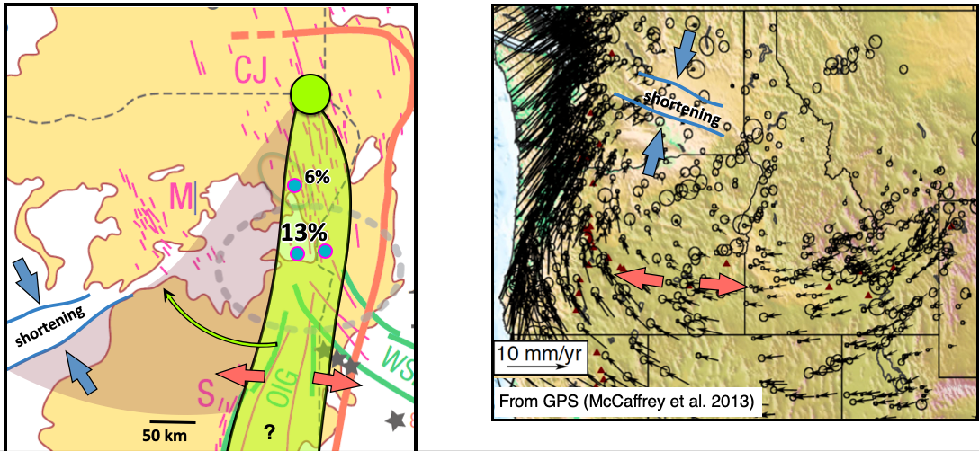
Young to current
Stress & Strain
Typical stress & strain rate in the last 16 m.y.
What creates this pattern?
16 Ma
Current
Crustal structure
It doesn’t appear to be stress, strain or crustal structure
(or mantle anisotropy)
20 km
30 km

Slide 7
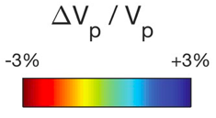
Strong correlation with mantle structure
Stanciu & Humphreys, 2020
%
Juan de Fuca slab
Juan de Fuca slab
Idaho curtain
Juan de Fuca slab
Wallowa anomaly
Juan de Fuca slab
Vp at 230 km
How do we explain this?

Slide 8
How do we explain this?
Mantle loading squirts the crust
(crust drawn toward down load)
%
Vp at 230 km
upper crust
Poiseuille
flow
lower
crust
Flow is toward thickened crust
Juan de Fuca slab
Juan de Fuca slab
mantle
lithosphere
z
Does not affect the crust
Couette
flow
asthenosphere
Note:
(1) lithosphere load need not be sinking … it’s the force that counts
(2) the lithosphere isolates the crust from asthenosphere flow

Slide 9
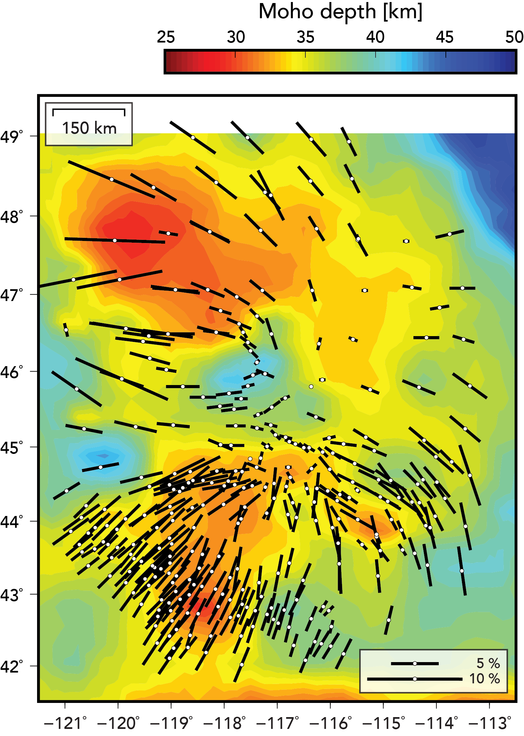
P-wave tomography
Receiver function imaging
The crust is thick
above the top of the
Wallowa anomaly
Vp at 230 km
Juan de Fuca slab
Juan de Fuca slab
Moho depth
25
30
Vp
-3
-2
-1
0
1
2
3%
35
40
45
50
km
Moho
100
S
H. Gao
N
200
300
410
km
S
Darold & Humphreys
N

Slide 10
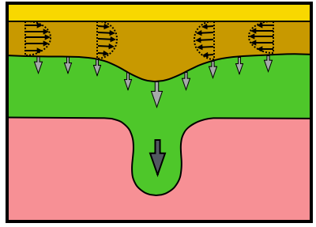
Crustal flow modeling
Moho vertical stress
10
MPa
-40
-20
0
1.0
20
40
Poor Fit
Poor Fit
0.1
Fast mantle is negatively buoyant
Slow mantle is positively buoyant

Slide 11
Crustal flow modeling
Fast mantle is negatively buoyant
Fast mantle is negatively buoyant
Slow mantle is positively buoyant
Slow mantle is neutrally buoyant

Slide 12
Two more subjects, if there is interest–
(1) The Wallowa Batholith root, centered near the anisotropy focus, foundered 10-15 Ma
(2) Mantle anisotropy

Slide 13
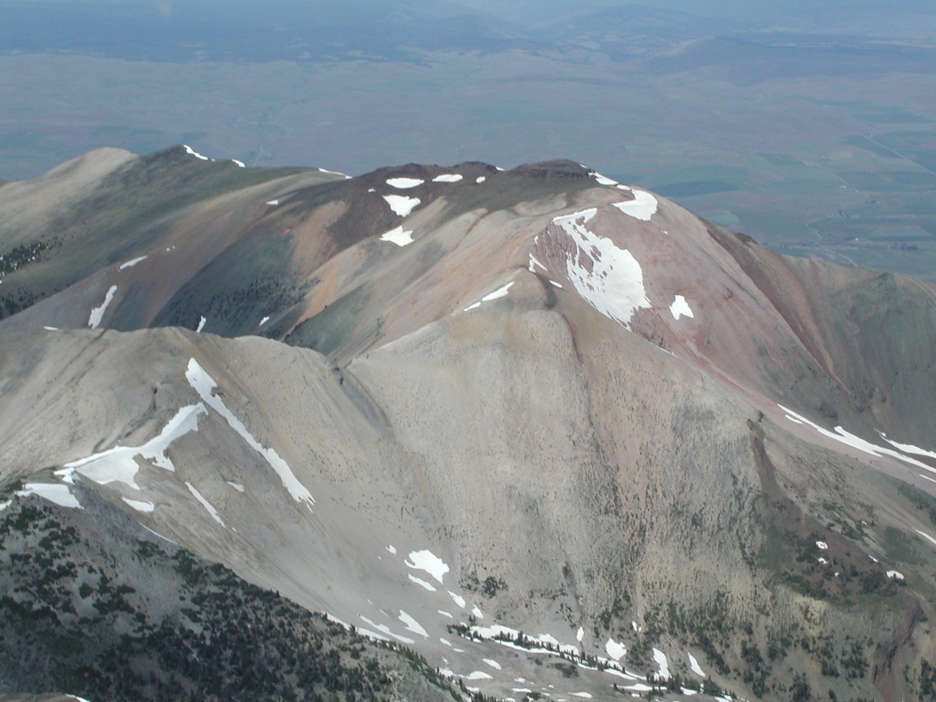
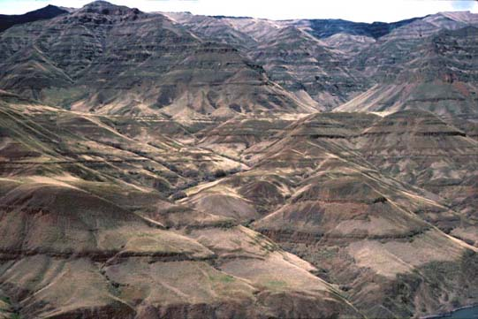
Topography... making the Bullseye during or after the CRB flows
...foundering of a batholith root
2 km uplift since 16 Ma eruptions
2 km
Wallowa Mountains
30 km
1 km
Hales et al.
2005
0
Flood basalt uplift surface
140-120 m.y. old batholiths
in the Blue Mts terrane
Hells Canyon

Slide 14
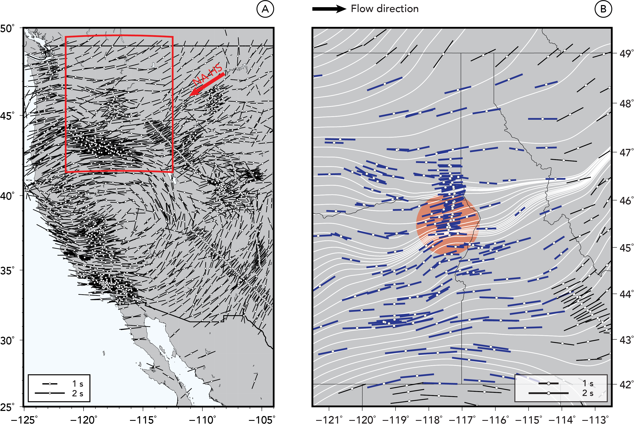
SKS splits
and the mantle anisotropy

Slide 15
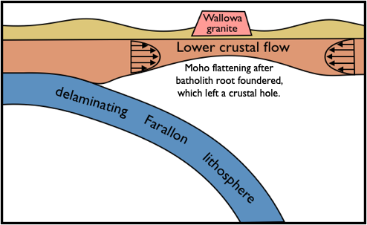
Lower crustal flow into the “hole” & making the moat
255 km
Root
foundering
Crustal flow
Castellanos et al., in review
Lower crustal inflow suggested by:
> bullseye moat
> lower crustal anisotropy
(Jorge Castellanos & Rob Clayton)

Slide 16
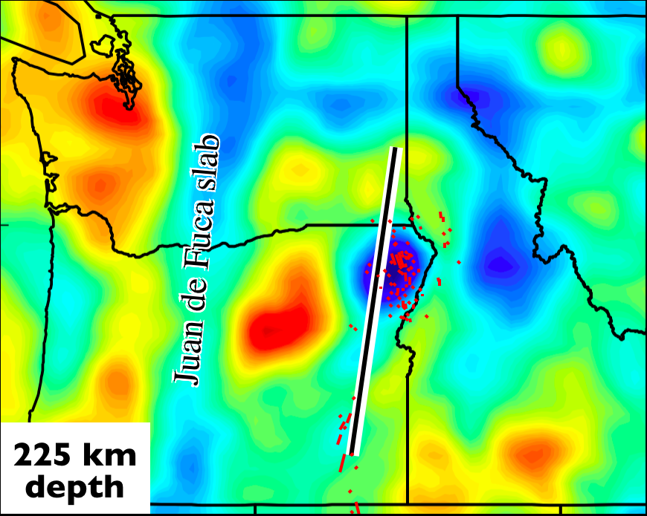
The fast mantle: Subduction… accretion… abandoned slab
S-to-N delamination
55 Ma
50 Ma
(inactive)
Farallon
plate
Siletzia
arc
Farallon plate
dangling across upper mantle
Cr
in upper mantle
in lower crust
Moho
- 0
100
Juan de Fuca
200
Farallon
slab
300
- 410
410
km
S
N
- 660
km
230 km
Vp
-3
-2
-1
0
1
2
3%

Slide 17
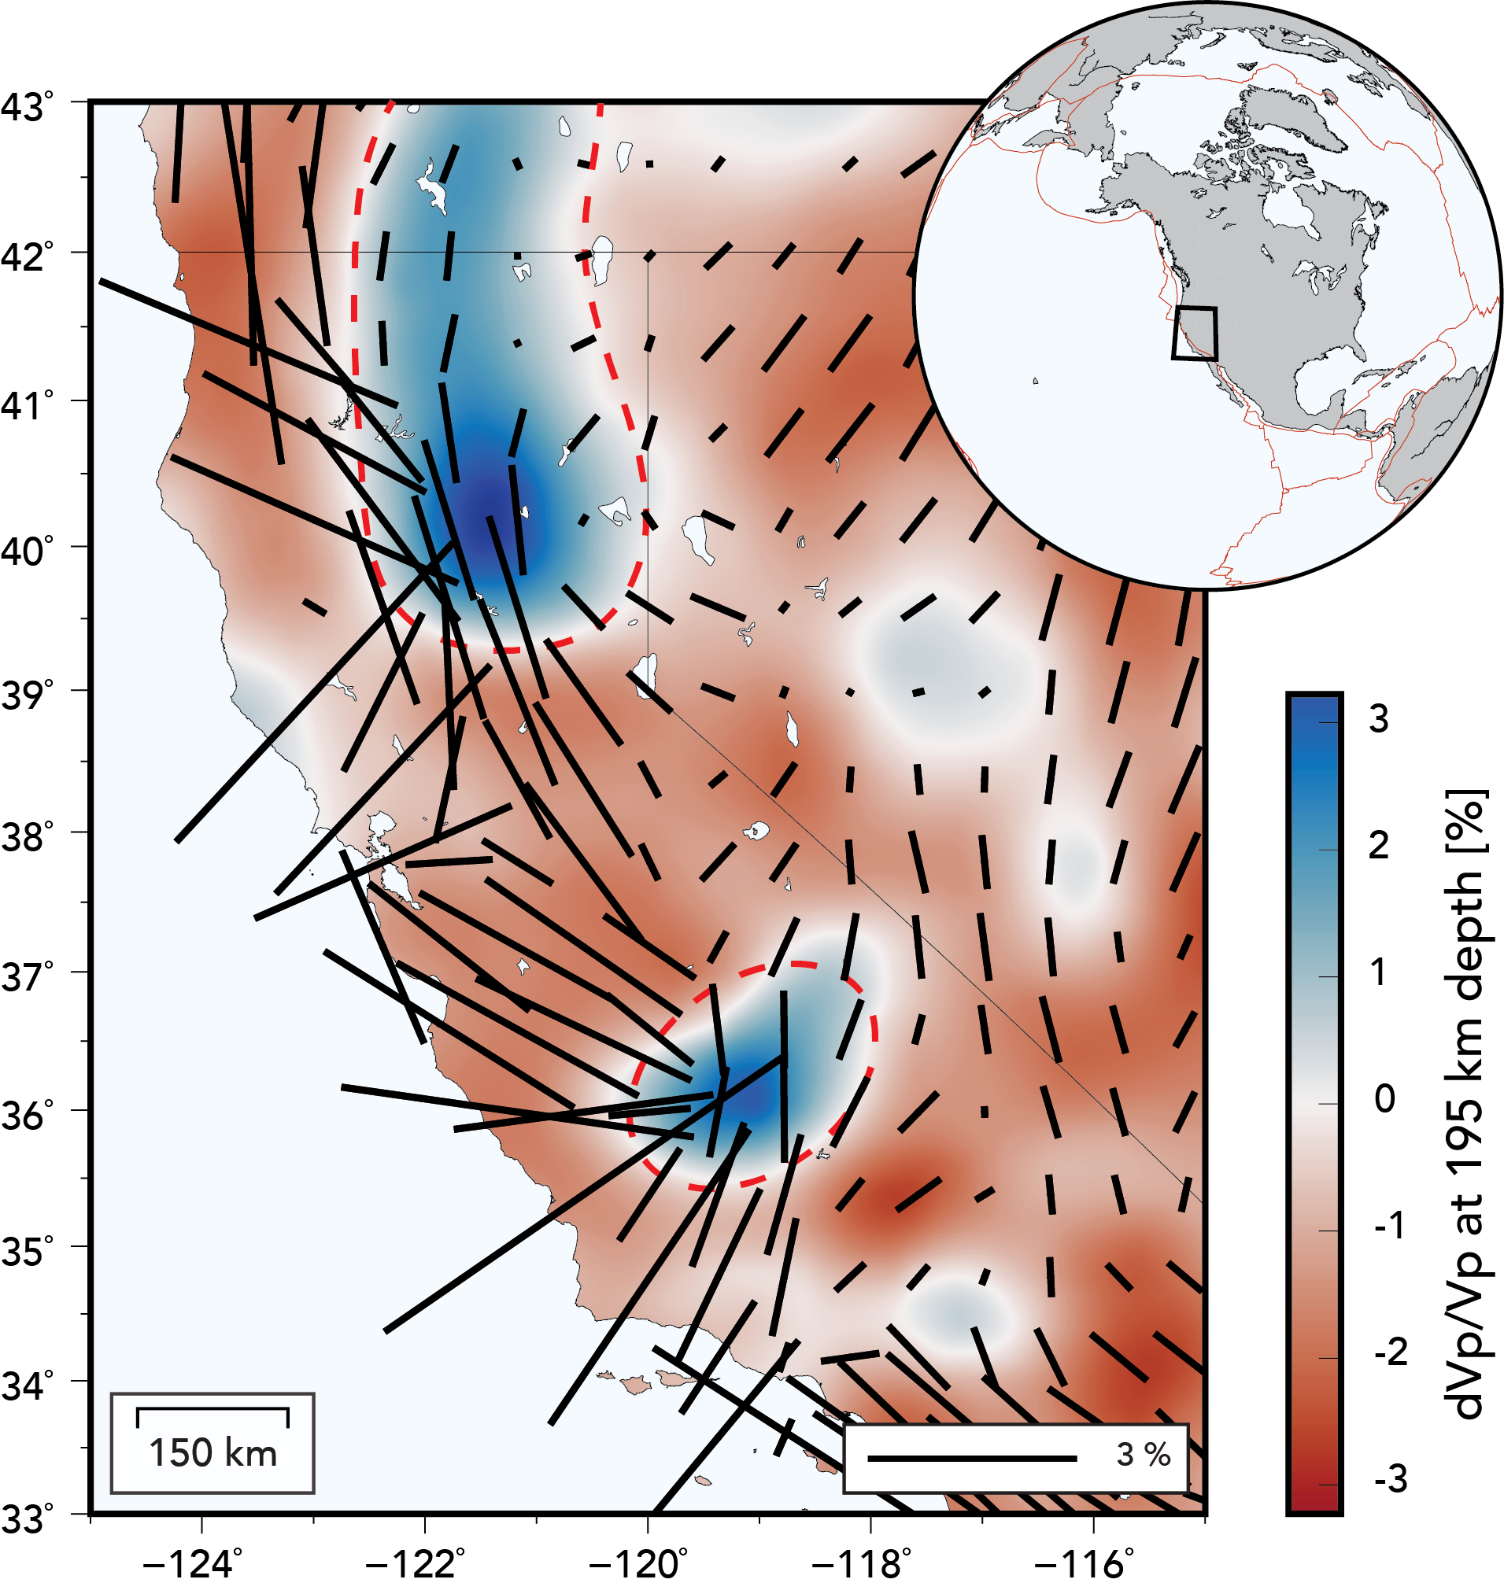
V_{P} at 195 km
Another example
California
southern Juan de Fuca
%
Isabela anomaly
foundered
Farallon slab

