Slide 1
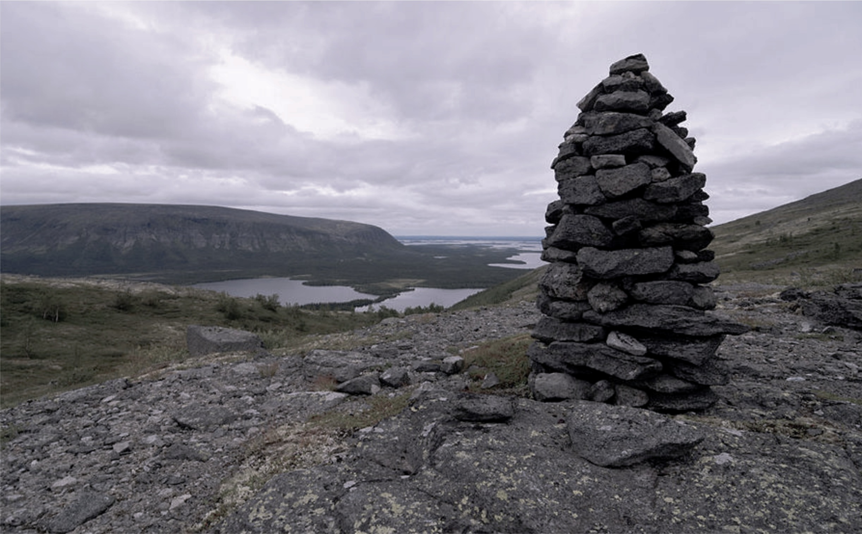
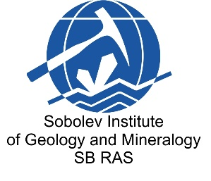
Melt inclusions in forsterites from phoscorites of the Kovdor massif
Anna Redina, Cora Wohlgemuth-Ueberwasser, Julia Mikhailova, and Gregory Ivanyuk

Slide 2
Kovdor massif, location and composition
The Kovdor massif is located in the northwest of Russia and a part of the Paleozoic Kola alkaline province.
The Kovdor intrusion is a central-type, multiphase volcano-plutonic complex.
[Ivanyuk G.Yu., Yakovenchuk V.N., Pakhomovsky Ya.A. (2002) Kovdor. Laplandia Minerals, Apatity]

Slide 3
Melt inclusions in forsterite from early phoscorite
Silicate-carbonate
melt inclusion
Carbonate melt inclusions
images in transmitted light; solid phases were identified using laser Raman spectroscopy
bst – hydroxylbastnaesite, phl – phlogopite, calc – calcite, carb – carbonate
Mineral phases: carbonates (calcite, Na-Ca carbonate, hydroxylbastnaesite, Sr-Ba-REE carbonate, strontianite, dolomite), phlogopite, magnetite.

Slide 4
Melt inclusions in forsterite from late-stage phoscorite
Silicate-carbonate melt inclusions
Carbonate
melt inclusion
transmitted light
BSE image
transmitted light
solid phases were identified using laser Raman spectroscopy and scanning electron microscopy
phl – phlogopite, mont - monticellite, mgt – magnetite, calc – calcite, carb – carbonate
Mineral phases: carbonates (calcite, Na-Ca carbonate, northupite, hydroxylbastnaesite, barytocalcite,
Sr-Ba-REE carbonate, strontianite), silicates (phlogopite, amphibole?, monticellite), magnetite.

Slide 5
Rare earth elements
The rare earth elements composition of melt inclusions from both types of rocks is characterized by the predominance of light REE. The content of REE, especially light ones, in inclusions from late-stage phoscorite is higher.

Slide 6
Trace elements
There are notable variations in concentrations of thorium, uranium, tantalum, zirconium etc. in inclusions.

Slide 7
Conclusion
Melt inclusions from early and late-stage phoscorites contain carbonate and silicate mineral phases in various proportions;
Inclusions from late phoscorite represent a more evolved magma with higher concentrations of rare metals;
Inclusions in forsterite from early and more evolved facies of phoscorites are probably related by fractional crystallization of calcite;
Heterogeneous trapping of crystalline phases and two immiscible melts (silicate and carbonatite) may be assumed.

