Slide 1
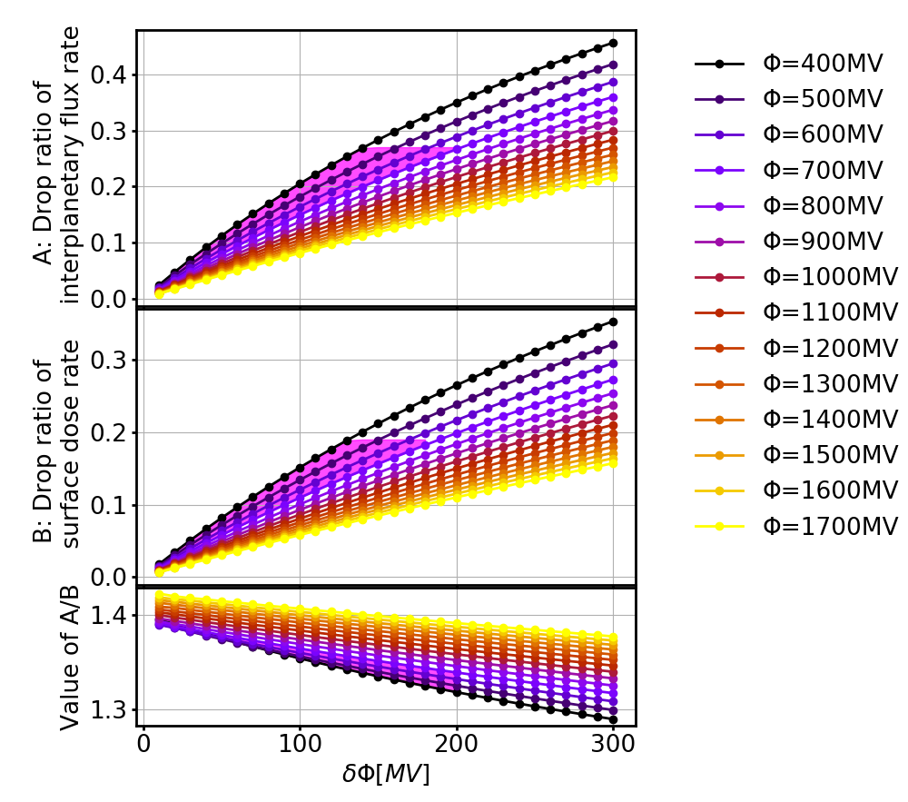
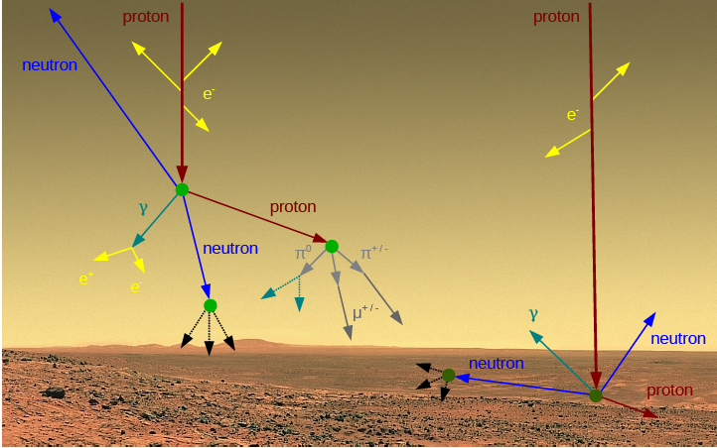
EGU 2020, Vienna, Austria
A new model describing Forbush Decreases at Mars:
combining the heliospheric modulation and the atmospheric influence
Jingnan Guo^{1,2}, Robert F. Wimmer-Schweingruber², Mateja Dumbović³, Bernd Heber², and Yuming Wang¹
1, CAS Center for Excellence in Comparative Planetology, University of Science and Technology of China, Hefei, China. E-mail: jnguo@ustc.edu.cn.
2, University of Kiel, Kiel, Germany. 3, Hvar Observatory, Faculty of Geodesy, University of Zagreb, Croatia
Scan to check out our paper for more details!
Abstract
Forbush decreases are depressions in the galactic cosmic rays (GCRs) that are caused primarily by modulations of interplanetary coronal mass ejections (ICMEs, as shown in Fig. 1) but also occasionally by stream/corotating interaction regions (SIRs/CIRs). Forbush decreases have been studied extensively using neutron monitors at Earth; recently, for the first time, they have been measured on the surface of another planet, Mars, by the Radiation Assessment Detector (RAD) on board the Mars Science Laboratory’s (MSL) rover Curiosity.
The modulation of GCR particles by heliospheric transients in space is energy-dependent; afterwards, these particles interact with the Martian atmosphere, the interaction process depending on particle type and energy. In order to use ground-measured Forbush decreases to study the space weather environment near Mars, it is important to understand and quantify the energy-dependent modulation of the GCR particles by not only the pass-by heliospheric disturbances but also by the Martian atmosphere. Accordingly, this study presents a model that quantifies — both at the Martian surface and in the interplanetary space near Mars — the amplitudes of Forbush decreases at Mars during the pass-by of an ICME/SIR by combining the heliospheric modulation of GCRs with the atmospheric modification of such modulated GCR spectra. The modelled results are in good agreement with measurements of Forbush decreases caused by ICMEs/SIRs based on data collected by MSL on the surface of Mars and by the Mars Atmosphere and Volatile EvolutioN (MAVEN) spacecraft in orbit. Our model and these findings support the validity of both the Forbush decrease description and Martian atmospheric transport models.
3: Modelling of particle spectra evolution from space to Mars’ surface: Energy-dependent GCR spectra in space (green box, under different solar modulations) being modified by the Martian atmosphere as calculated using the GEANT4 Martian atmospheric particle transport model (blue box, the Mars response function) and resulting in the surface spectra under different modulation conditions (red box).
5. Quantification of the FD amplitude in space and on Mars. The top and middle panels show the modelled FD amplitude at Mars’s orbit (assuming Ec = 100 MeV/nuc for the MAVEN/SEP penetrating particle flux) and on Mars’ surface (calculated as surface dose rate of that measured by MSL/RAD), respectively. The bottom panel shows the ratio of the above two FD amplitudes, which falls within the range of about 1.3 to 1.45. The magenta areas mark the points with FD amplitude and solar modulation values falling into the observational range between 2014 and 2016. The ratios within the magenta are about 1.36.
The Martian atmospheric function
for incoming protons
Proton →
Surface downward proton
modelled FD amplitude at Mars’s orbit seen by MAVEN
Proton Energy on Mars (MeV)
Mars surface proton spectra under different solar modulations
Interplanetary-space proton spectra under different solar modulations
modelled FD amplitude at Mars surface seen by MSL
Proton Energy in deep space(MeV)
1. ICME and Forbush Decrease (FD):
Left: Visualization of ICME-driven Forbush decrease when ICME is encountered head-on (A) and at the flank (B) (Richardson & Cane, 2011).
Right: in situ Earth measurements of an ICME and the corresponding 2-step Forbush decrease.
The shock/sheath region is in green and magnetic ejecta region is in red (adapted from Dumbović et al., 2012).
GCR spectra in the interplanetary space are calculated using the Badhwar–O’Neill model (O‘Neil 2010) which describes the GCR spectra via the spherically symmetric Fokker–Planck equation that accounts for particle propagation in the heliosphere due to diffusion, convection, and adiabatic deceleration.
Particle transport through the Martian atmosphere has been modelled using GEANT4 simulation tools.
Mars atmospheric condition is loaded from Mars Climate Database: 95% CO₂ with a surface pressure of about 800 Pa
The above GEANT4 and atmosphere step is validated by Matthia+ 2016, 2018 & Guo+ 2019 SWSC against the surface particle spectra measurement by the Radiation Assessment Detector (RAD, Hassler+ 2012) aboard the MSL mission.
Forbush decrease
The ratio of the two
plasma density
temperature
4: Calculation of FD in space and on Mars: the total amplitude of the FD defined as the drop ratio of the depressed GCR count rate compared to the GCR background flux before the ICME arrival.
6. Comparison with observational results. In Guo et al 2018 A&A, we made a list of 121 Forbush decreases detected at Mars during 2014 October – 2016 September both on surface by MSL and in orbit by MAVEN, shown in the left and middle panels.
Right panel: The magnitude for each FD detected at orbit versus that seen on the surface fitted with a linear function shown as the red line. The function has a slope of 1.33$±$0.14 which is the averaged ratio of the FD amplitude in space to that on Mars. This is in excellent agreement with the modelled results.
Solar wind speed
C_{bkg} = C($φ$)
Magnetic field
strength
Magnetic field
fluctuation
histogram of FD amplitude at Mars’s orbit
C_{min} = C($φ$+ $δφ$)
FDs are seen at Mars’s orbit by MAVEN
2. GCR interaction with the Mars Environment: Schematic view of GCR particle interaction with the atmosphere as well as with the soil. Adapted from http://www.db-prods.net/marsroversimages/galerie.html
(Equation 1)
(1) GCR spectra (before and during the FD)
FDs are seen at Mars’s surface by MSL
histogram of FD amplitude at Mars’s surface
(2) Interaction with the atmosphere
Interplanetary-space proton spectra under different solar modulations
Mars surface proton spectra under different solar modulations
Conclusions: The good quantitative agreement between the modelled results and empirical measurements suggests that our model would, in principle, be a good approach for quantifying the amplitude of FDs during solar eruptions both in space and also on the surface of Mars. However, there has not been a physical function describing how the modulation parameter would change, i.e., δ_{Φ} in equation (1), depending on the properties of the interplanetary transient, an ICME or an SIR. So the current status of our model can not yet directly predict the FD amplitude from solar eruptions. But the main advantage of this approach is that we can quantify the relative FD amplitudes as caused by the same interplanetary transient measured by different instruments, which is important to account for when studying the evolution of propagating ICMEs passing different locations in the heliosphere.
(3) Surface GCR and FD
Ec = 100 MeV at Mars orbit (in space), e.g., as measured by the MAVEN /SEP penetrating counter.
Ec $≈$ 20 MeV at Mars surface, e.g., as measured by the MSL/RAD dose rate channel.

