Slide 1
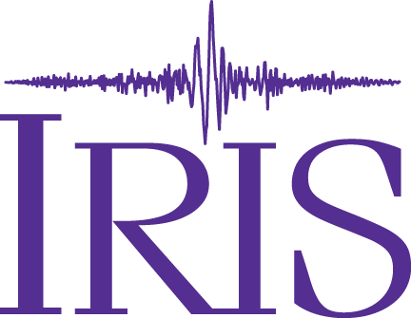
Converging Seismic and Geodetic Data Services
Jerry A Carter¹, Charles Meertens², Chad Trabant¹, and James Riley²
²UNAVCO Data Services, Boulder Colorado, United States of America. ¹IRIS Data Services, Seattle WA, United States of America

Slide 2
Common Cloud Platform (CCP) Project Goal
Design and build a unified platform for ingestion, archiving, curation, high-level product generation, quality measurements, and distribution in a cloud environment for the operation of a combined Geodetic and Seismological data services facility.

Slide 3
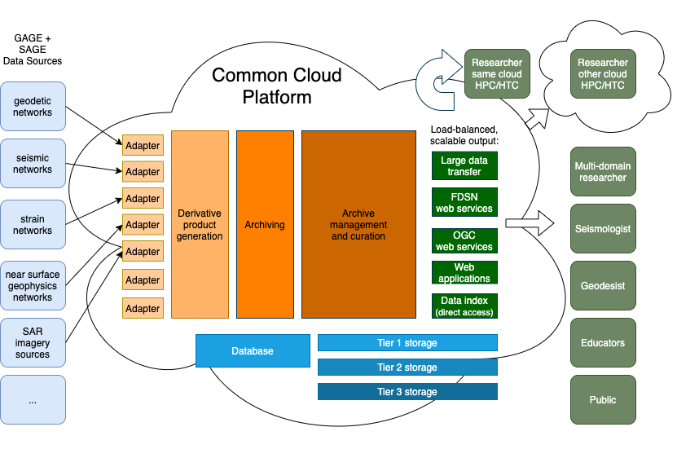
Common Cloud Platform (CCP) Concept

Slide 4
CCP Design Guidelines
Support operation according to FAIR data principles.
Adopt modern, cloud-friendly/native components that are as “COTS” as possible (e.g., application deployment and orchestration, object storage).
Be as cloud-agnostic as possible; avoid adopting proprietary components that are not easily replaced.
Avoid duplicated functionalities (e.g., one QA subsystem, one identity management subsystem, one performance metrics and logging/stats subsystem).
Utilize common data container formats and software frameworks whenever possible - the overall platform should be as simple as possible without sacrificing utility.

Slide 5
CCP Design Guidelines (Continued)
Provide horizontal scalability to accommodate future growth.
Support data identification and licensing schemes (and distribution to users).
Support existing data access mechanisms that are not expected to be retired in the short term (e.g., existing web services).
Provide enhanced data access for data users to leverage the computing resources in or near the environment of the platform.
Provide enhanced large volume data transmission to different sites.

Slide 6
Expected Benefits
Data processing in the same cloud resource removes the need to transfer data to other systems
Services such as large volume data transfer that are currently very challenging can be provided
Capacity can be scaled for burst needs on demand as well as to accommodate growth trends

Slide 7
Fostering Interdisciplinary Research
Integrated, multi-domain data access from a single facility makes gathering interdisciplinary data sets easier
Standardization of data formats available for delivery improves the prospects for combined data processing
Merging the two data services helps conjoin the Geodetic and Seismological communities, which improves the prospects for interdisciplinary collaborations

