Slide 1
Late Permian – Triassic Granitic Magmatism of western part of the Northern Taimyr: evidence for two magmatic events
Mikhail Kurapov¹, Victoria Ershova¹, Andrei Khudoley¹,
Aleksandr Makariev², Elena Makarieva²
¹St. Petersburg State University, St. Petersburg
²Polar Marine Geosurvey Expedition, St. Petersburg

Slide 2
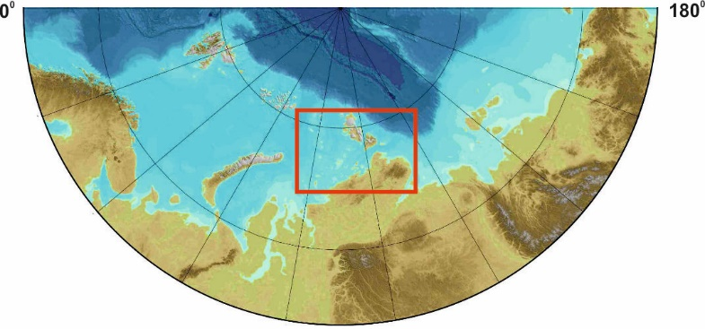
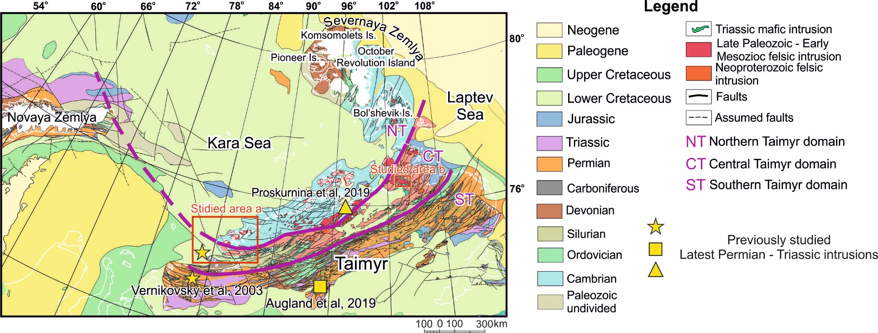
Location of studied areas
Novaya
Zemlya
Taimyr
The Taimyr–Severnaya Zemlya Fold and thrust belt is located north of Siberian Platform and comprises the Taimyr Peninsula, Severnaya Zemlya Archipelago, and the adjoining shelf of the Kara Sea. Latest Permian to Triassic granite intrusions are known within all three Taimyr tectonic domains Such distribution distinguishes them from Carboniferous – Middle Permian granite intrusions localized in the Northern and Central Domains
Siberia

Slide 3
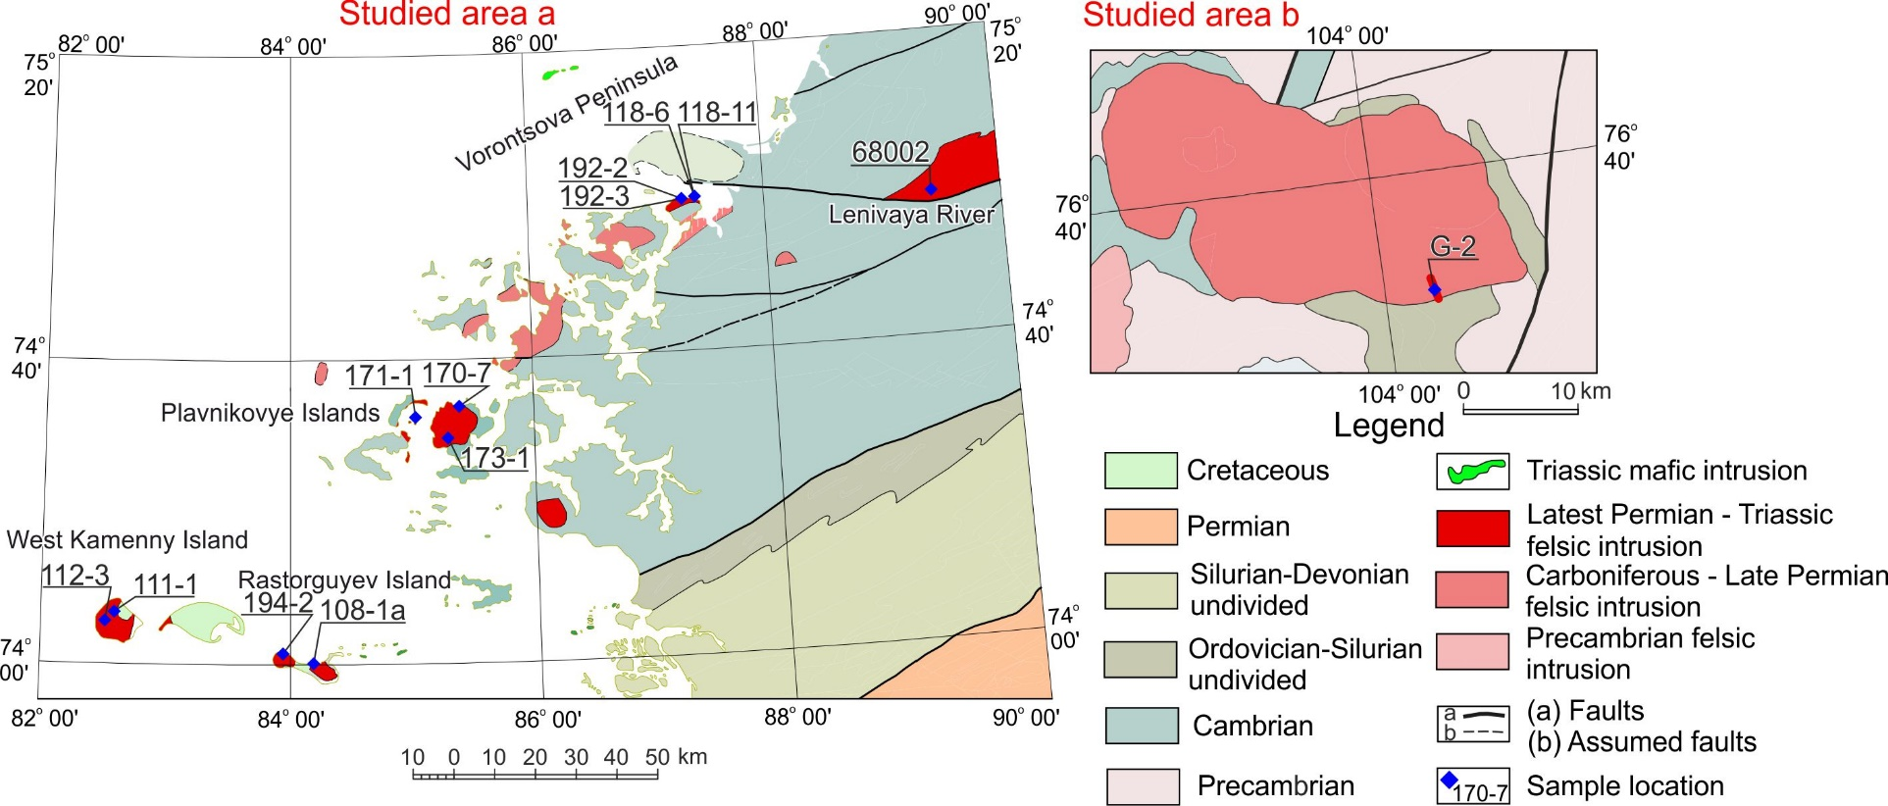
Samples location
Studied Latest Permian – Triassic intrusions are exposed on the northwestern coast of the Taimyr Peninsula, on several islands in Kara Sea (area a) and in northeastern part of Taimyr Peninsula (area b).

Slide 4
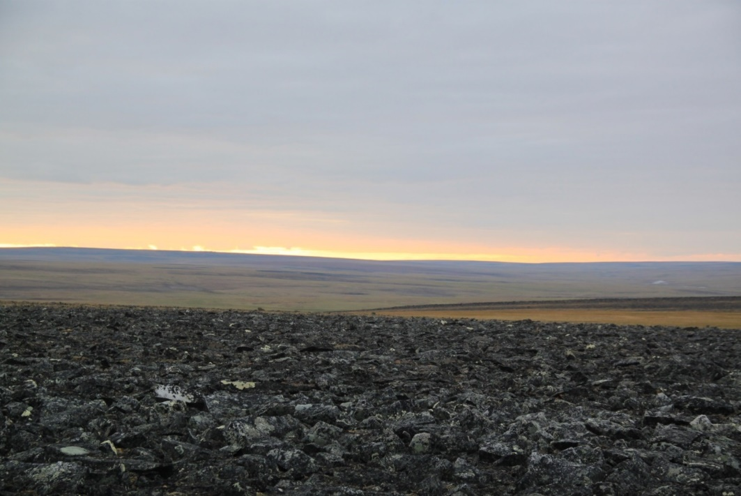
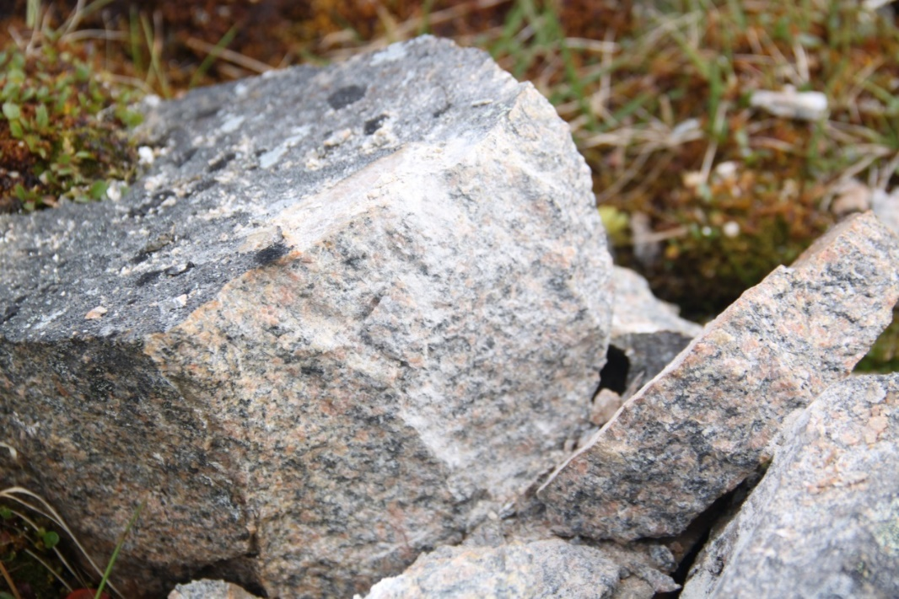
Petrography
Lenivaya River Pluton
Granodiorites of Lenivaya River Pluton
The plutons are represented by medium- to coarse-grained granites and granodiorites (Vorontsova Peninsula, Plavnikovye Islands and Lenivaya River; syenites and granosyenites (West Kamenny Island, Rastorguyev Island and Astronomicheskiy Creek)

Slide 5
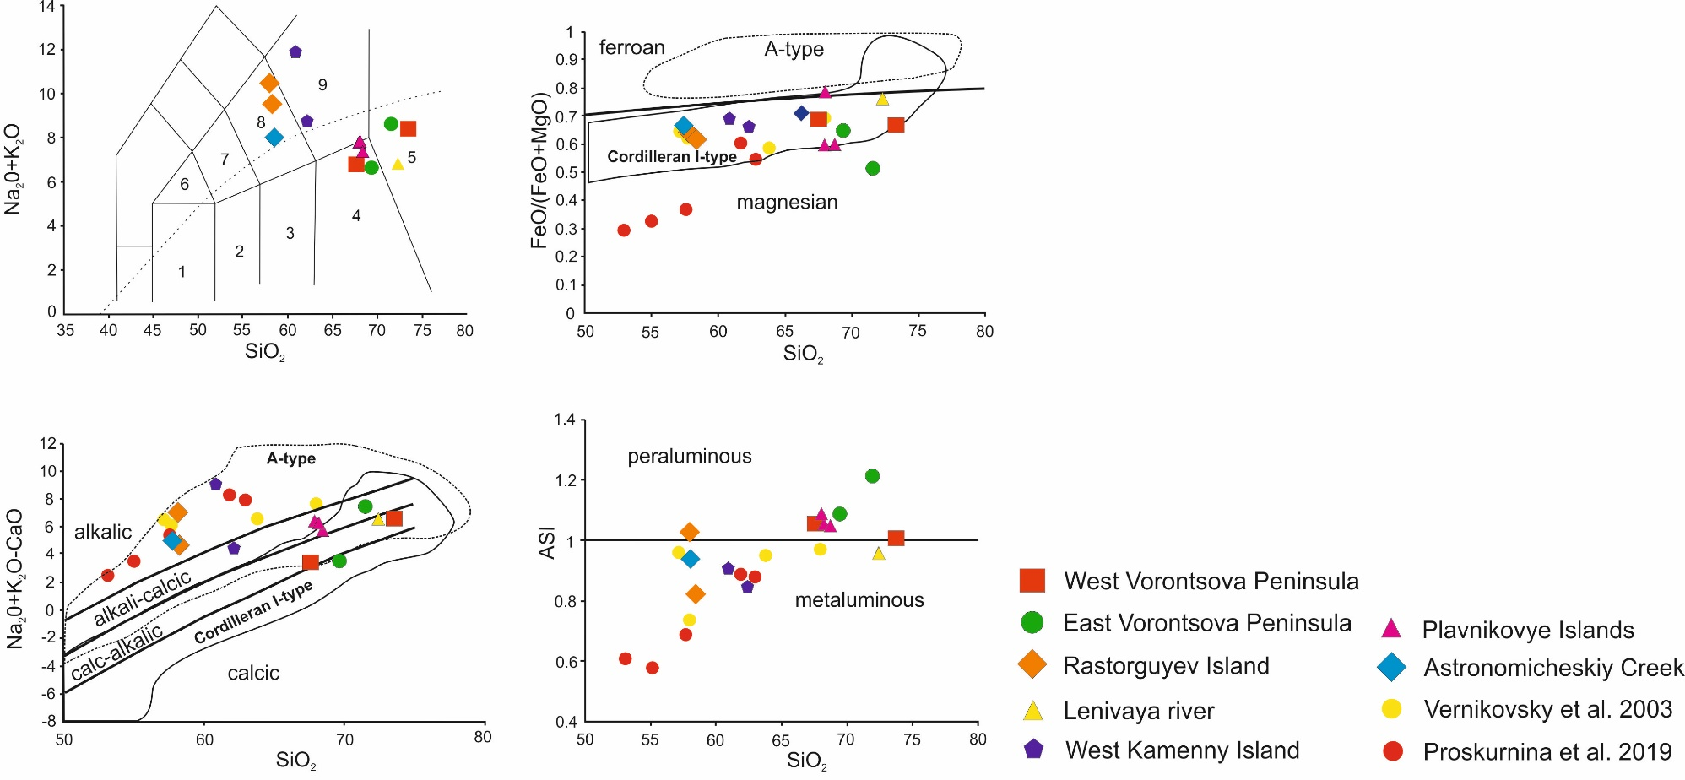
Geochemical composition of studied intrusions
The samples are classified as granites, granodiorites, monzonites and quartz monzonites on a TAS classification diagram (Middlemost, 1994). Studied igneous rocks are magnesian, calc-alcalic to alkalic, metaluminous to peraluminous according to the classification of Frost et al., (2001).
Middlemost, (1994)
Frost et al., (2001)
Fields on TAS diagram: 1, gabbro; 2, gabbro–diorite; 3, diorite; 4, granodiorite; 5, granite; 6, monzogabbro; 7, monzodiorite; 8, monzonite; 9, quartz monzonite.

Slide 6
REE distribution
Distribution of REE elements is with slight deviation similar for all of the samples with enrichment in LREE, depletion in HREE and mainly negative Eu anomaly. On the N-MORB-normalized diagrams granitoids are enriched in LILEs and characterized by Th, Nb and Ta negative anomalies

Slide 7
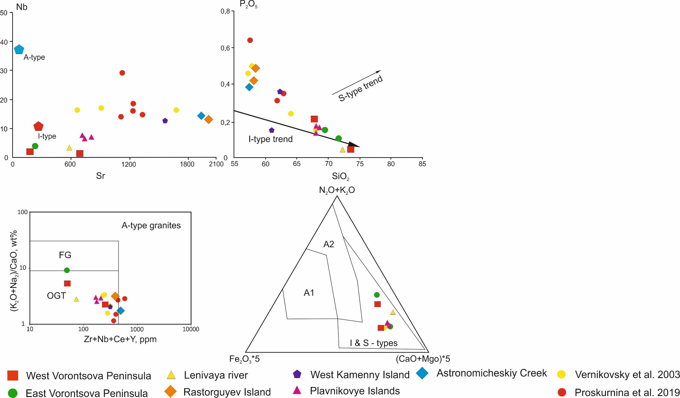
Petrogenesis of studied intrusions
On the Nb–Sr plot, chemical compositions granitoids cluster close to the mean value for I–type granites, and on the P₂O₅–SiO₂ plot they show a negative correlation between P₂O₅ and SiO₂ which is typical for I-type granites (Whalen et al., 1987) .
On the Zr + Nb + Ce + Y vs. (Na₂O + K₂O) / CaO discrimination diagram (Whalen et al., 1987) the chemical compositions of samples fall in the field of non-fractioned M-, I-, and S-type granites (OGT), suggesting that they are not typical A-type granites.
On the ternary discrimination diagram (Grebennikov, 2014) the chemical compositions of samples plot in the field of I- and S-type granites supporting their difference from A-type granites.
Whalen et al., (1987)
Grebennikov, (2014)

Slide 8
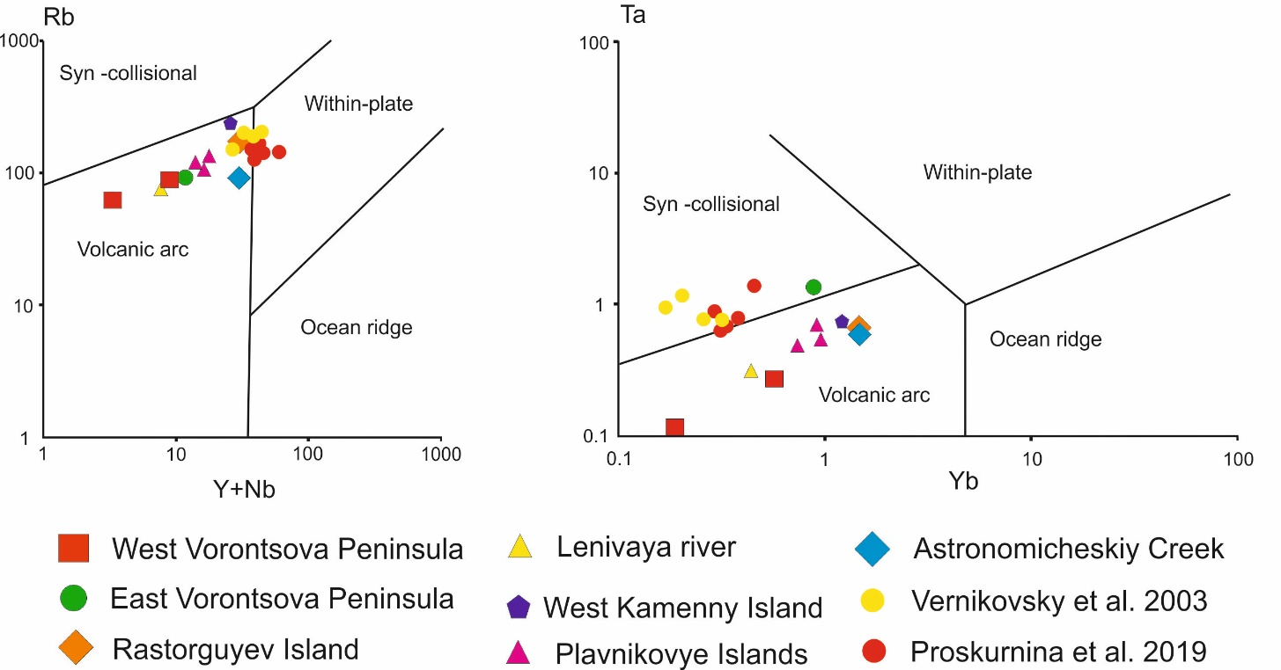
Petrogenesis of studied intrusions
Chemical compositions of the granitoids plot mainly in the volcanic arc field on the (Y + Nb) vs. Rb and the Y vs. Nb discrimination diagrams of Pearce et al., (1984). Basing on geochemical data we consider studied granites are I-type granites.
Geochemical composition of previously reported Latest Permian – Triassic Taimyr syenite-granite intrusions differ from granites described in current study. Northwestern Taimyr syenite-granite described by Vernikovsky et al., (2003) intrusions are referred to A-type granites and Northern Taimyr intrusions described by Proskurnina et al., 2019 are interpreted as SH-type granites
Pearce et al., (1984)

Slide 9
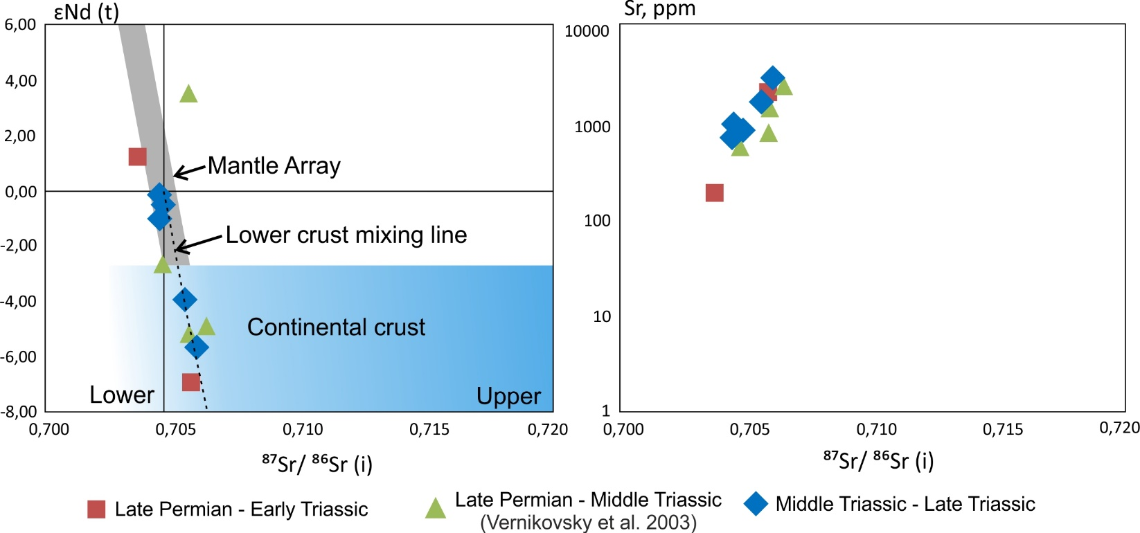
Isotopic composition
Granites have heterogeneous source with varying degree of mixing of mantle and crustal components. The Sr contents grow with an incensement of initial ⁸⁷Sr/⁸⁶Sr ratio, but show no age dependence. Obtained data support previously published isotopic data from northwestern Taimyr syenite-granite intrusions (Vernikovsky et al., 2003), suggesting mutual source of these intrusions. Heterogeneous mantle-crustal source is typical for LIPs.

Slide 10
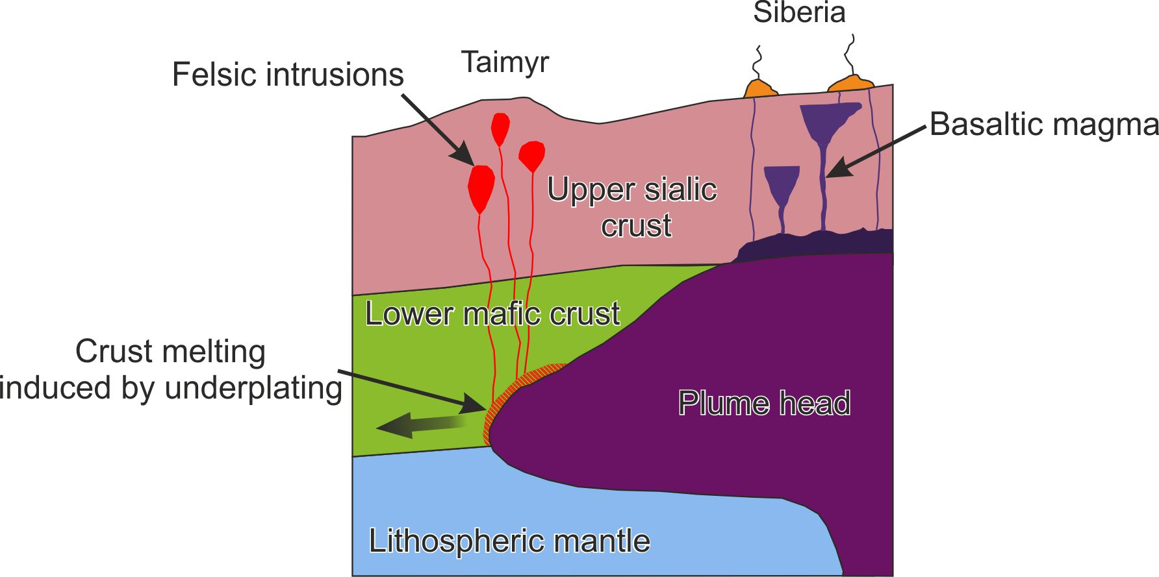
Latest Permian – Triassic LIP magmatic system scheme for Siberia and Taimyr
Lower crust remelting caused by underplating of Siberian LIP basaltic magmas, together with significant magma mixing, produced the studied Taimyr I-type granites in a non-subduction zone setting. Association of intraplate I- and A-types granites may occur within LIP.
Late Paleozoic – Early Mesozoic A-type (Vernikovsky et al., 2003) and I-type (this study) syenite-granite intrusions support significant influence of Siberian LIP on Taimyr fold belt.

Slide 11
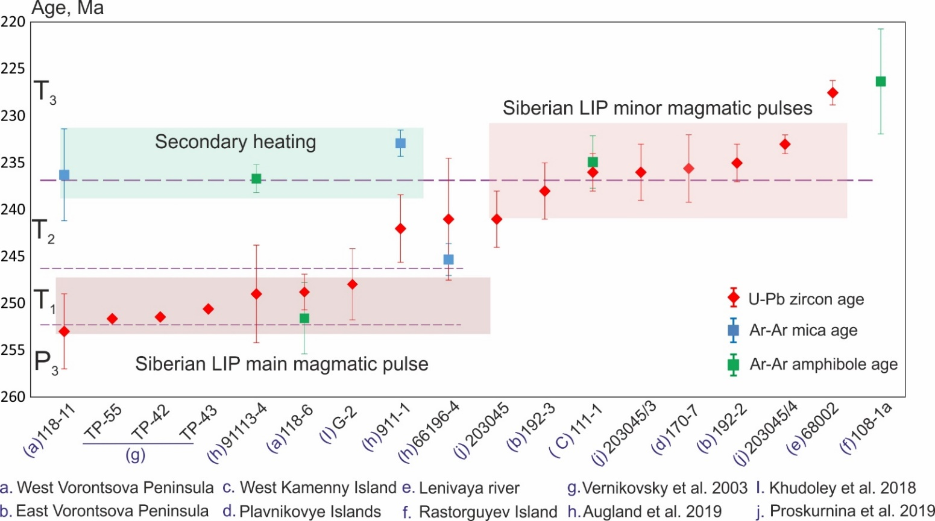
Geochronology
U-Pb zircon age of studied intrusions varies from ca 253 to 228 Ma, defining the crystallization age of studied plutons. Obtained geochronological data allows us determine two magmatic events within the Taimyr fold belt in Latest Paleozoic – Earliest Mesozoic: Latest Permian – Early Triassic and Middle – Late Triassic.
For most of the dated samples Ar-Ar ages match the U-Pb zircon ages, thus showing fast cooling of the plutons. But for a few samples Ar-Ar ages most likely reflect the secondary heating caused by the emplacement of Middle – Late Triassic intrusions.

Slide 12
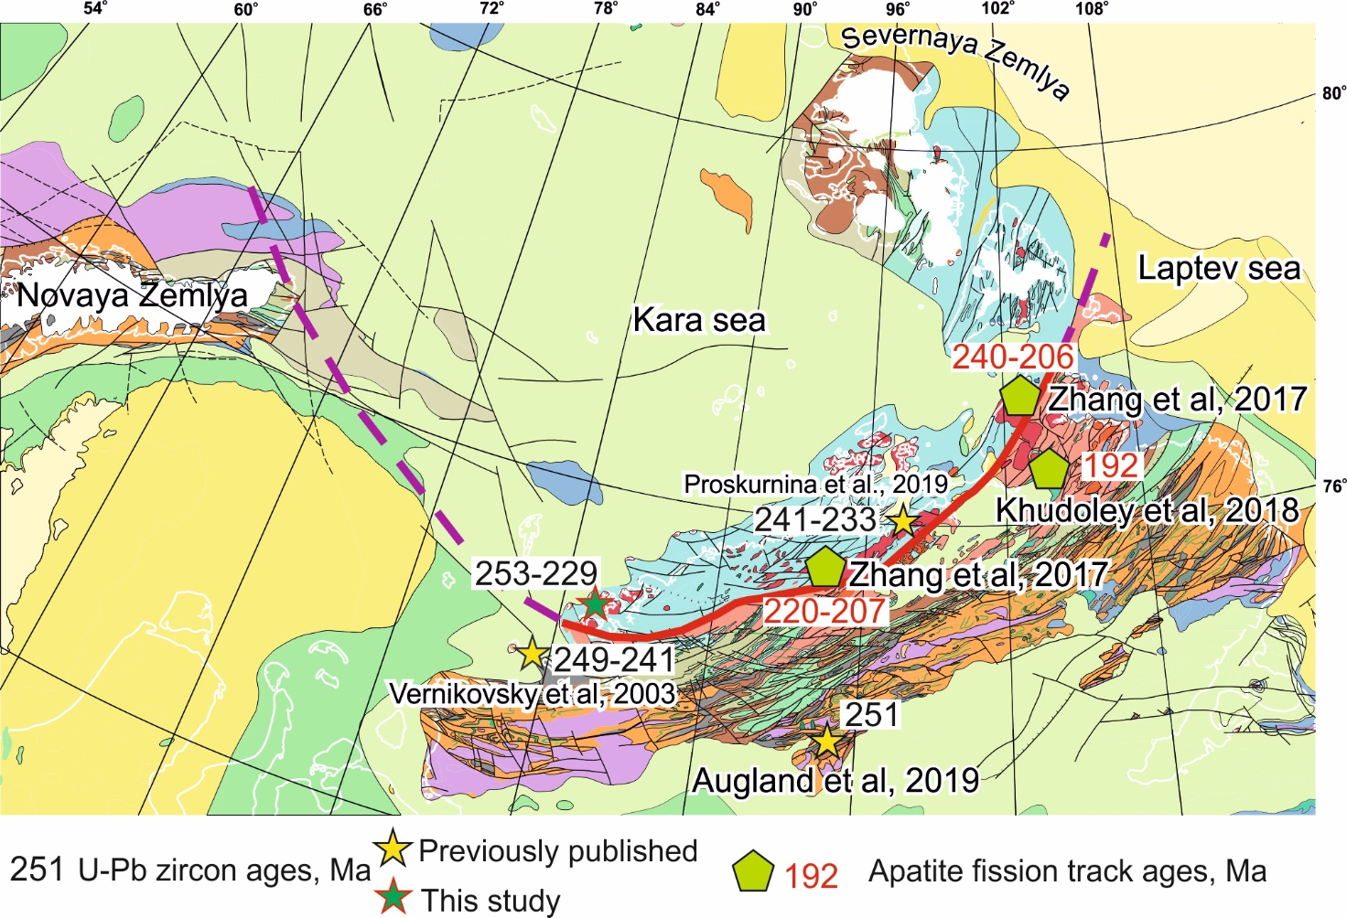
Thermal effect of Siberian LIP magmatism over Taimyr
The thermal effect of magmatism related to the Siberian LIP and its influence across Taimyr fold belt remains insufficiently studied. Recently published apatite fission track (AFT) dating results provides the only information of Early Mesozoic thermal events in the region. The AFT ages from Central and Norther Taimyr domains reported by range between c. 240 Ma and 190 Ma.
Our data well correlates with Early – Late Triassic AFT data suggesting broad geothermal effect of Siberian LIP magmatism in the studied region.

Slide 13
Conclusions
U-Pb zircon dating defines the crystallization age of studied Taimyr intrusions from Latest Permian (Changhsingian) to Late Triassic (Carnian) c. 253 to 229 Ma. U-Pb zircon age distribution suggests two magmatic events: Latest Permian – Early Triassic and Middle – Late Triassic.
Majority of obtained Ar-Ar ages show rapid cooling of the studied intrusions. But for a few samples Ar-Ar ages reflect the re-heating induced by the emplacement of Middle – Late Triassic syenite-granite intrusions.
The petrography and geochemistry of the studied granites suggests their similarity to I-type granites. Given the isotopic composition, we assume that studied Taimyr granites have heterogeneous source with varying degree of mixing of mantle and crustal components, typical for LIP-related magmatic rocks. Crust remelting induced by underplating of Siberian LIP basaltic magmas, together with significant magma mixing, produced the studied Taimyr granites in a non-subduction zone setting.
Taimyr Latest Permian – Early Triassic and Middle – Late Triassic granitic magmatism was associated with the two pulses of Siberian LIP magmatism.

Slide 14
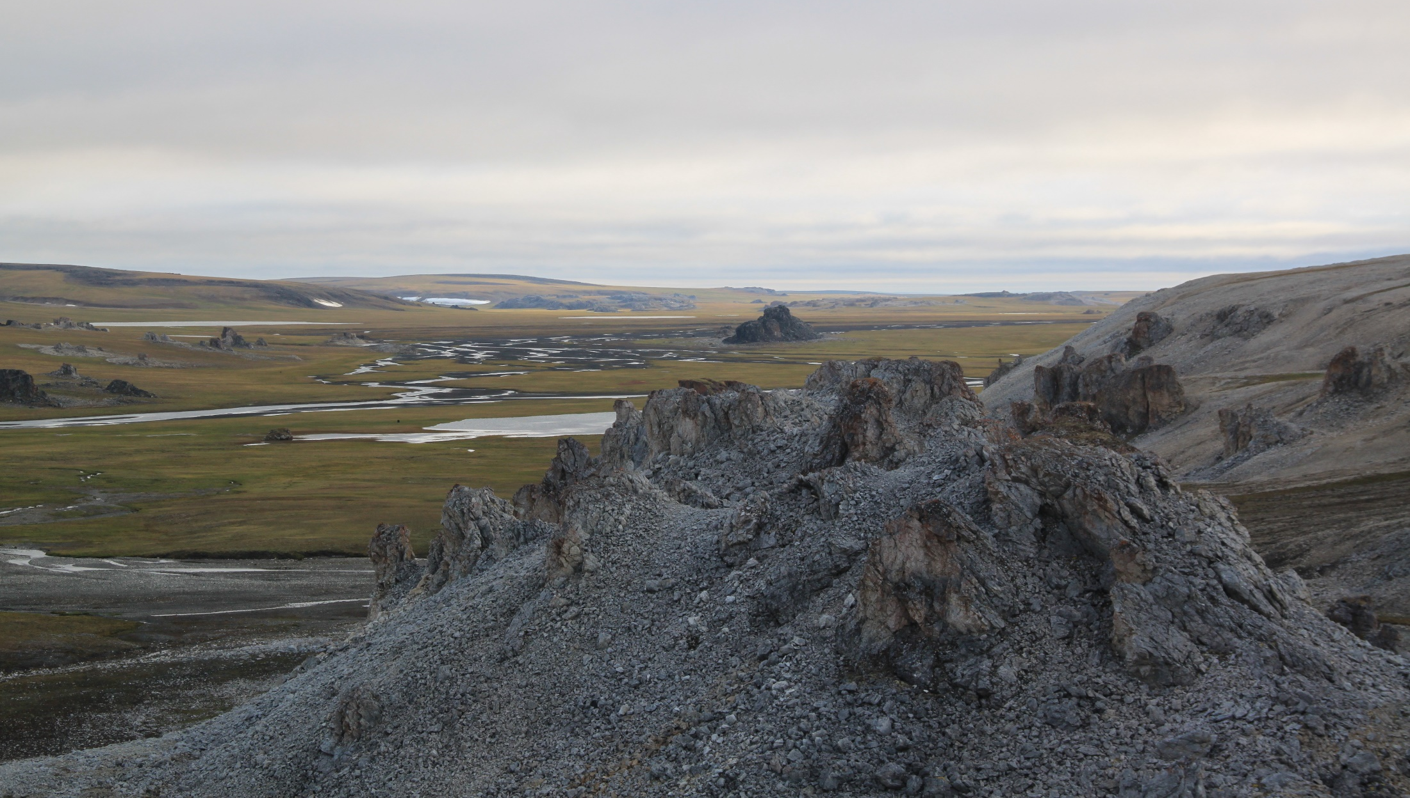
Thank you for attention!

