Slide 1
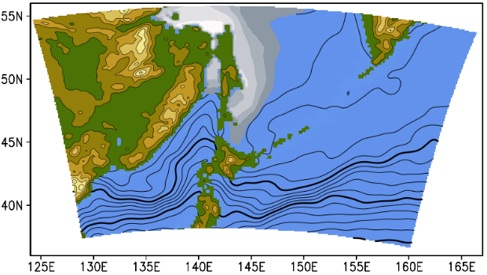
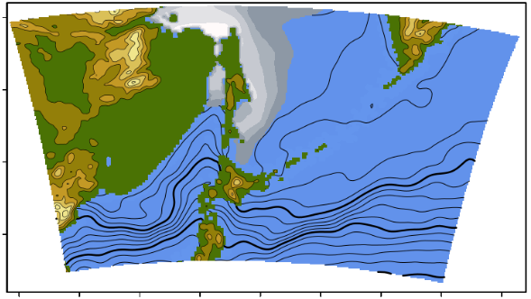
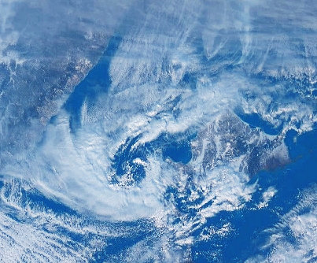
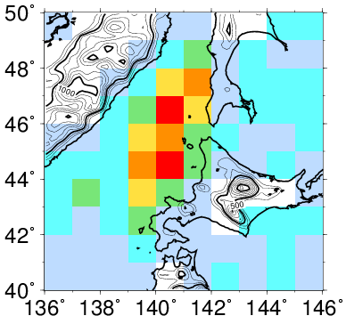
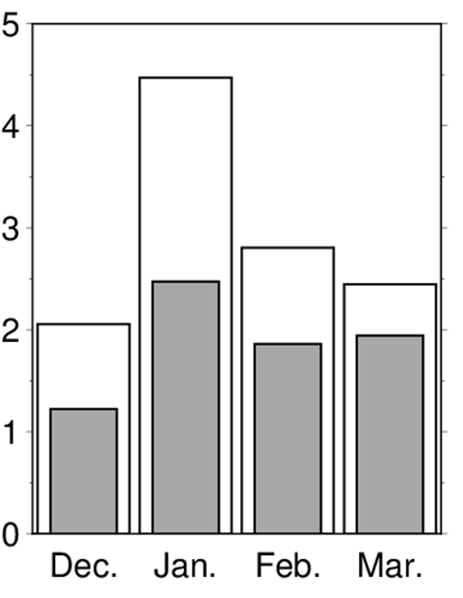
Diverse Responses of Polar Mesocyclones Genesis Attributable to Orographic Forcing
*Kenta Tamura¹, Tomonori Sato²
¹Graduate School of Environmental Science, Hokkaido University, Sapporo, Japan. ²Faculty of Environmental Earth Science, Hokkaido University, Sapporo, Japan.
1. Polar mesocyclones (PMCs)
2. Method
REAL
PMCs are mesoscale, maritime cyclones that occur over warm oceans in high-latitude regions (Rasmussen and Turner, 2003).
We analyzed PMCs behaviors simulated in 36-years-long regional climate model experiments (Fig. 2).
1200
NoMt
Sikhote-Alin
Kamchatka
Around the offshore west of Hokkaido, PMCs frequently occur affected by cold air outbreaks from the Eurasian Continent.
900
Sikhote-Alin mountain range
WRF-ARW version 3.2.1
(Skamarock et al. 2008)
Forcing: JRA55 (6hourly), OISST (daily)
Mesh size: 20km (140$×$100)
Vertical Levels: 32 layers
Period: 1981/12/01–2017/03/31(Dec.–Mar.)
600
Sakhalin
900
300
Sea of Japan
5
Flat
Strait of Tartary
70
Mountains on the eastern end of the Eurasian Continent (Sikhote-Alin) affect the PMCs genesis (Watanabe et al., 2017).
0
10
50
(m)
5
Hokkaido
5
30
10
10
10
Hokkaido
(%)
PMC
Fig. 2: Topography of WRF domains. Contours and gray shading shows SST and sea ice fraction in January.
- REAL: Realistic topography
- NoMt: Remove Sikhote-Alin Mts.
However, previous study validates the effect of the mountains for the specific PMC only.
Fig. 1: Himawari-8 satellite visible image in Jan. 11, 2018.
This study investigates the effect of the mountains for many PMCs generated around the offshore west of Hokkaido.
3. Tracking Algorism
20km mesh grid
100km mesh grid
4. Effect of the mountain on the number of PMC genesis
Detecting the low-pressure centers
Whose Z850hPa is lower than surrounding 8 grid points.
Relative vorticity is higher than
1×10⁻⁵s⁻¹.
2. Tracking the low-pressure centers
Track a nearest the low-pressure center with 1-hour interval.
Apply 1–2 for smoothed data.
3. Filtered out the small scale low-
pressure (PMC)
Remove the low-pressure which are identical in both data (20 km and 100 km).
The remaining low is defined as PMC.
PMCs that have continued for more than 12 hours are analyzed.
(a)
PMC
(d)
PMCs frequency is high over the offshore west of Hokkaido to Strait of Tartary (Fig. 3).
Sikhote-Alin mountain range strongly affects the PMCs genesis in January (Fig. 4).
Synoptic low
REAL
NoMt
Increase?
1. Detecting the low pressure centers
ST-PMC
(b)
(e)
Low pressure center
WH-PMC
138°E–42°E 43°N–49°N
Decrease
2. Tracking the low pressure centers
(c)
t=1
t=3
(f)
t=3
Fig. 3: Distribution of number of PMC genesis (/year)
Fig. 4: Number of PMCs for each month.
Fig. 5: Difference in the distribution of PMC genesis in January (NoMt minus REAL).
t=4
t=1
t=1
The influences of mountains on PMC genesis are different depending on the region (Fig. 5).
PMCs are more sensitive over the western offshore of Hokkaido (hereafter, WH-PMC), less sensitive over the Strait of Tartary (hereafter, ST-PMC).
3. Filtered out the small scale low pressure
(g)
t=1
Reference
Rasmussen, E., and J. Turner, 2003: Polar Lows. Cambridge University Press, 612 pp. Yanase et al. (2016), J. Clim., 29, 419–437. Watanabe et al. (2017), MWR, 145, 2217–2233. Tamura, K., and T. Sato, Spatial variations in response of polar mesocyclone genesis to topographic forcing, J. Meteor. Soc. Japan, in revision.
t=4

Slide 2
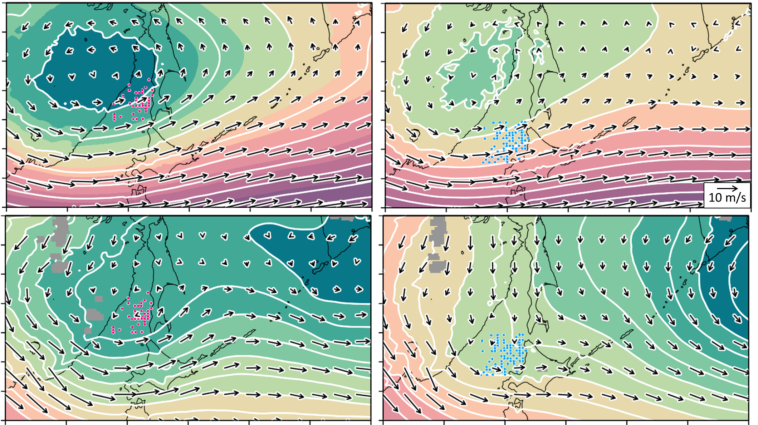
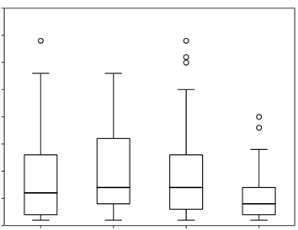
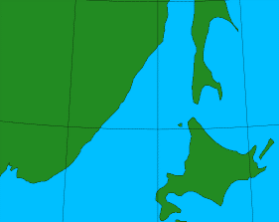
5. Atmospheric conditions on PMC genesis in REAL
6. Mountain modulates the lower-level wind
Strong upper-level low pressure reaches on the west of the ST-PMC (Fig. 6a).
⇒This PMC type could develop from baroclinic instability (Yanase et al., 2016).
WH-PMCs are generated within a western part of Aleutian low that exists on the east of Hokkaido (Fig. 7d).
By removing the mountain range, cold air outbreaks over the offshore west of Hokkaido become strong especially in WH-PMCs cases (Fig. 8).
The mountain modulate only the lower-level wind in WH-PMC (Fig. 9).
(a)
ST-PMC
500
ST-PMC
WH-PMC
(a)
500hPa
(b)
500hPa
600
700
(b)
WH-PMC
800
ST-PMC
WH-PMC
(m)
900
(hPa)
(c)
850hPa
(d)
850hPa
N
10 m/s
REAL
NoMt
REAL
NoMt
Fig. 8: Composite fields of the differences between the experiments (NoMt−REAL) in potential temperature and horizontal winds at 850 hPa for the 12 hours before PMC genesis in REAL. Dots and thick arrows indicate statistical significance at the 5% level for the difference.
Fig. 9: Average horizontal wind over the sea in the black rectangle in Fig. 8 (138ºE–42ºE, 43ºN–49ºN) composited at each pressure height at 12 hours before the PMC genesis. Red arrows indicate statistical significance at the 5% level for the difference between the experiments.
ST-PMC
WH-PMC
(m)
7. More landfall if mountain is absent
35
ST-PMC
WH-PMC
Fig. 6: Composite fields of geopotential height (contour; m) in REAL experiment.
Light blue and pink dots indicate the location of ST-PMC and WH-PMC genesis.
The mean duration in the NoMt (6.4 h) is significantly shorter (Welch’s t-test, p = 0.008) than in the REAL (9.7 h) in WH-PMC (Fig. 10).
Sikhote-Alin mountain controls PMCs make landfall.
30
PMCs are characterized as a shallow system at their early developmental stage (Fig. 7). ⇒Lower-tropospheric wind might affect the development of early-stage PMCs.
25
20
REAL
ST-PMC
NoMt
15
(a)
ST-PMC
(b)
WH-PMC
10
500
5
600
REAL
NoMt
REAL
NoMt
Pressure height (hPa)
WH-PMC
Fig. 10: Duration between PMC genesis and landfall (hour) (lifetime≥6 hours).
700
Relative vorticity (×10⁻⁵/s)
800
Conclusion
This study investigated the effect of the Sikhote-Alin mountains on PMCs genesis around Hokkaido by using the regional climate model.
PMCs generated over the offshore west of Hokkaido are more sensitive to the modulated lower-level wind by the mountains than that generated over the Strait of Tartary.
This result suggests the effect of the mountain on PMC varies with the location.
900
0
8
12
4
0
4
8
12
Fig. 7: Time series of the PMC’s relative vorticity composited at each pressure height until 12 hours after the PMCs genesis.

