Slide 1
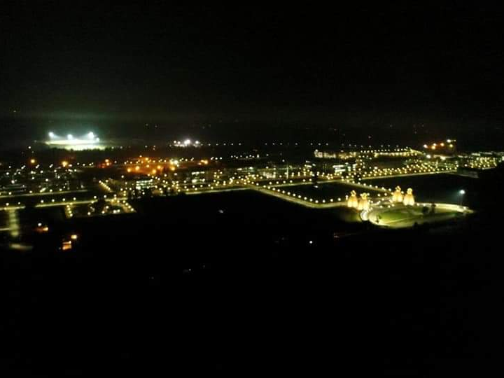


Paper id: EGU2020-12870
AN UNSUPERVISED SOIL MOISTURE ESTIMATION MODELLING APPROACH USING C-BAND DUAL PolSAR DATA
By-
Dr. Reet Kamal Tiwari and Akshar Tripathi
Department of Civil Engineering,
Indian Institute of Technology (IIT) Ropar
Rupnagar (Punjab)-140001
Email: reetkamal@iitrpr.ac.in

Slide 2
Introduction
The food demand is high due to population rise and will increase in coming future. Hence, to ensure food security vertical development in agriculture is the need of the hour.
For this a combined structural and methodological approach like variety inception, pesticide & fertilizer management, integrated cropping, rainwater harvesting, efficient irrigation techniques etc. would be required.
Since, crop yield depends directly upon the soil health which is dependent upon several factors, study and analysis of soil becomes even more crucial for food security.
Soil health is defined as the soil’s capacity to function within natural or managed ecosystem boundaries and to sustain plant productivity while reducing soil degradation.
Soil quality has a complex functional concept which cannot be measured directly in the field or laboratory but can only be inferred from soil characteristics.

Slide 3
Introduction
Soil classification maps are needed to study the different types of soils and their behaviors across ecosystems, under defined situations and addressing soil quality will require soil scientists to use their knowledge to identify the critical functions that soils preform.
Remote sensing, since its inception has found diverse areas of application and has today revolutionized the field of soil health study, analysis, Access and benefit sharing (ABS).
Benefits of remotely sensed data include-
1) continual spatial coverage across the landscape
2) enabling variation within, and between, paddocks to be identified
3) long archives of data, allowing spatial trends over time to be monitored
4) readily available data acquired at frequent time intervals
5) and the ability to integrate information with other sources of spatial data such as soil and landform mapping, and climatic data.

Slide 4
Remote sensing
Of many types, based on sensor and location of sensor or type of platform.
Platform based is of three types-
Aerial (Aircrafts and UAVs)
Terrestrial (e.g. LiDAR)
Spaceborne
Sensor based is of two types-
Active (LiDAR, RADAR etc)
Passive (Optical, Thermal)

Slide 5
Optical Vs Microwave/RADAR remote sensing
Optical remote sensing data which is frequently used for land cover (LC) mapping has its own constraints, it does not have an all-weather availability like Microwave/SAR data.
Microwave remote sensing has added advantages of its own, it can penetrate through clouds thus giving it an all-weather availability.
RADAR Waves can even penetrate through soil up to some extent and can reveal information about topsoil, and active microwave doesn’t have to depend upon the sun for illumination as the case with optical data.
Microwave remote sensing also has various wavelength bands available which have different interactions with different features on ground and in turn revealing information which is not revealed by optical remote sensing.
While SAR data has speckle noise, optical data doesn’t have this ambiguity.

Slide 6

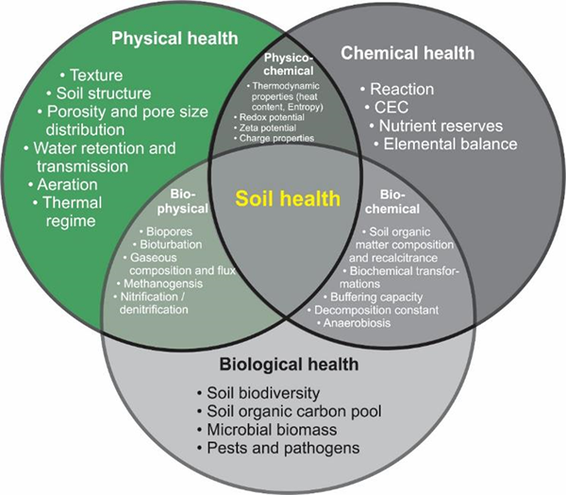
SOIL HEALTH PARAMETERS

Slide 7

Soil health parameters from Remote Sensing
Soil Moisture
Soil Nitrogen Content
Soil salinity
Soil Organic Carbon Content

Slide 8
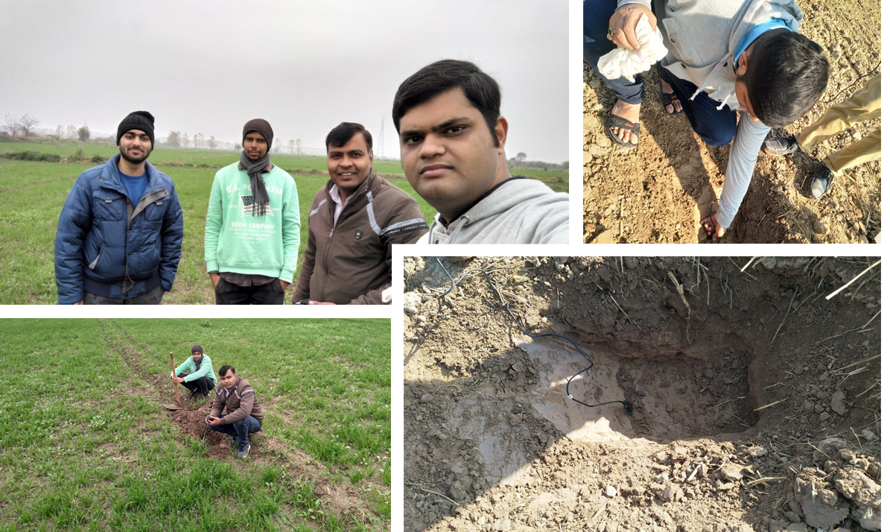
Time Series Sentinel-1A SAR data
Calibration
Soil Moisture Estimation Methodology
Deburst
Pre-processing
Multilook
Terrain Correction
Generation of RADAR moisture indices
NDMI from Sentinel-2 Optical Data
Time Series Sentinel-2 Optical data
Unsupervised Modelling
Correlation of RADAR Backscatter in dB and Field Soil Moisture
Field Soil Moisture
Results and Discussion
Supervised Modelling
Accuracy Assessment

Slide 9
Work Done So Far
A simple linear regression model developed using moisture indices obtained from Optical and RADAR data, which gave good results in soil moisture prediction, even though due to unavailability of field data. The results are expected to improve once field data for soil moisture is supplemented.
After getting the field equipment, field validation is underway and same model would be used with adding actual moisture values from field and results would be compared.
The Root Mean Squared Error (RMSE) and R²- statistics values for this unsupervised modelling approach were found to be 0.24 and 0.72 respectively for more than a lakh data points in Ropar area- 72% prediction accuracy.
Soil electrical conductivity and soil temperature data are also being collected to be used for modelling for soil salinity

Slide 10
Soil Moisture Model Details
• The Unsupervised model developed is as follows-
X 2019 = β0+ β1×(X2017)+ β2×(X2018) + (β3×Y12017)+ (β4×Y22017)+ (β5×Y12018) + (β6×Y12018) + (β7×Y22019) + (β8×Y22019)
Where, X is NDMI and Y1 is backscatter for VH and Y2 is backscatter for VV polarization channels. The same model was run for March, April and May (one month at a time) from 2017 to 2019 and NDMI for 2019 was predicted.
Normalized Differential Moisture Index (NDMI)= (NIR-SWIR)/(NIR+SWIR)

Slide 11
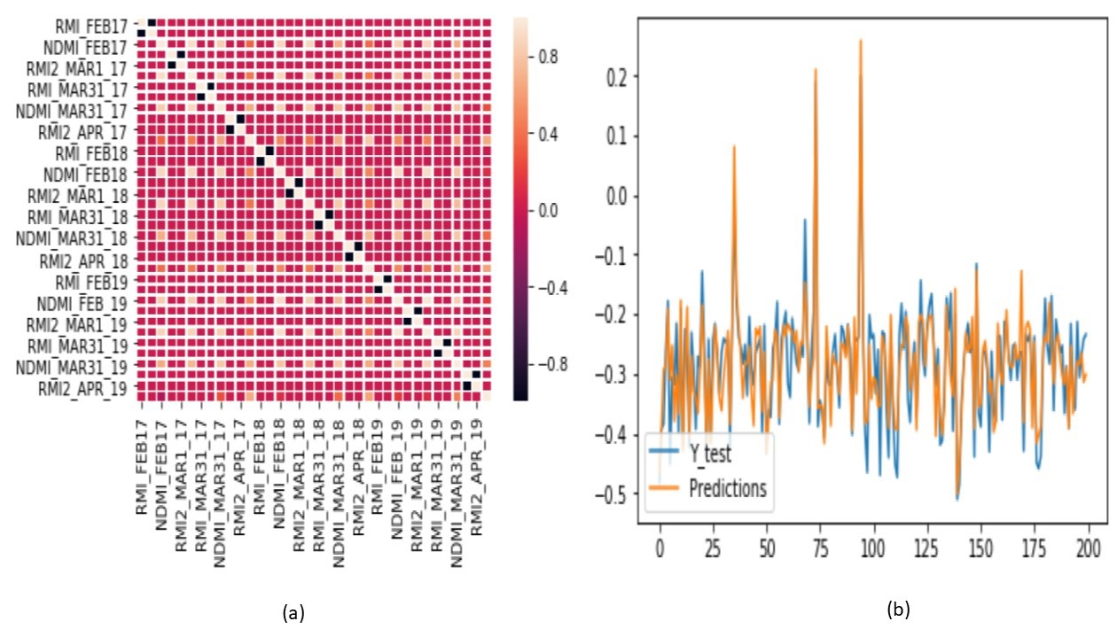
Results
(a) Correlation Heat Map (b) Goodness of Fit

Slide 12
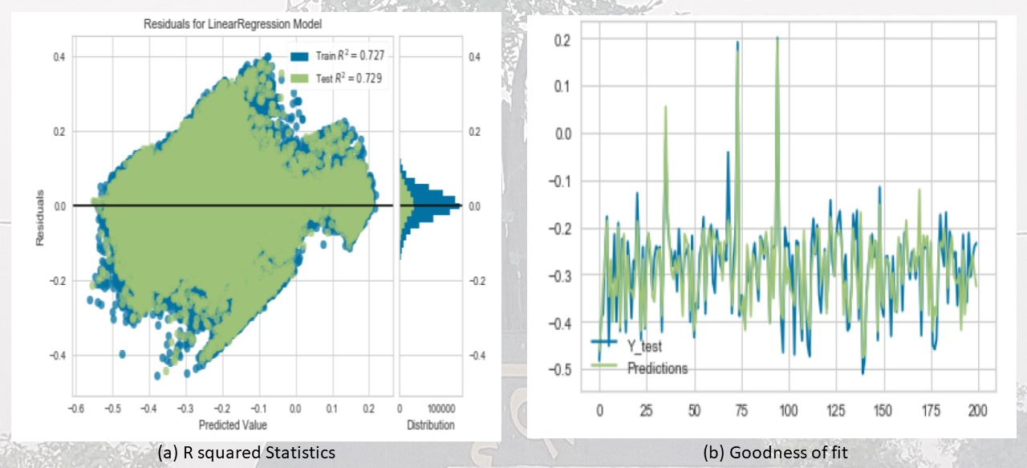
Results

Slide 13
Major Findings
• Firstly, it uses both the available polarization channels from dual Pol Sentinel-1 datasets for modelling and shows that if SAR and optical data can be used synergistically together, the field validation exercises for soil moisture estimation can be eased out in future.
• Secondly, the study makes use of freely available SAR and optical datasets for modelling and soil moisture estimation which makes it cost effective.
• Thirdly, despite the limited polarization channels available, the study gives comparable R2-Statistics of more than 70%, similar to many complex machine learning models as used in a number of studies and establishes the feasibility of Sentinel-1, dual PolSAR data in C-band for surface soil moisture estimation with Ordinary Least Squares (OLS) Regressor.

Slide 14
Conclusion
In this age of cyber savvy necessity, it is important to be technology oriented. With new remote sensors coming up in the horizon and Machine learning and Artificial Intelligence being used hand in hand, we continue to move to an era of technological agricultural management.
Where like other things, agricultural and soil preparation practices would be a fire and forget system. The need is to bring the end results of researches to the end users- the Farmers on ground, rather than shelving the research.
With industry and academia working together, food security and climate change challenges can be met easily.

Slide 15

Thank You

