Slide 1
Soil P, Arbuscular mycorrhizal spore count and root colonization of cowpea in biochar amended soils under maize/cowpea cropping systems
Uzoh, I.M.
Department of Soil Science
University of Nigeria, Nsukka

Slide 2
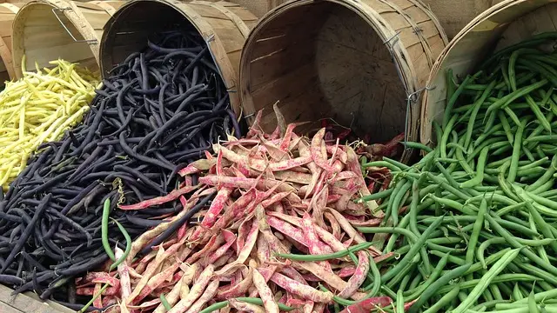
INTRODUCTION
Cowpea though a very important crop for food and nutrition security and environmental sustainability still faces low yield
Cowpea importance:
rich protein source for rural and urban dwellers in sub-Saharan Africa
fresh leaves and young pods are consumed as vegetables
the dry seeds are used for different food preparations while
the leaves are fed to livestock as fodder
Cowpeas are important part of agricultural production systems since
nitrogen fixation makes agricultural systems sustainable
Inspite of the importance of cowpea, yield is still very low,
(275 kg ha⁻¹ – 450 kg ha⁻¹)
Increasing demand for sustainable and bio-based
alternatives to fossil based fertilizer has become a global challenge

Slide 3
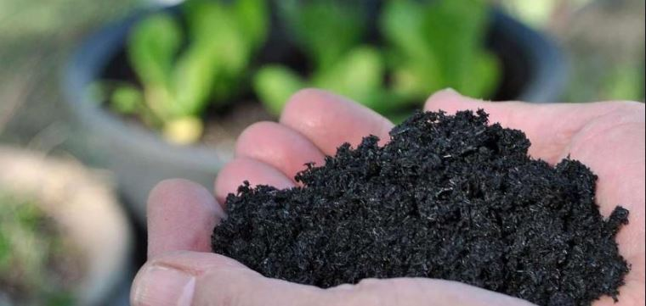
Biochar Soil Amendment
an end product of organic matter pyrolysis
advocated for use as sustainable bio-based soil amendment
Biochar has been implicated for other several functions
in addition to Increasing carbon sequestration such as:
increased soil fertility
Increased plant microbe interaction
Increased yield
There is paucity of information on the mechanism
of biochar effect on soil fertility and its interaction
with intercropping type is still a challenge

Slide 4
Objective of the study
This research was set to determine the effect of;
biochar amendment on soil phosphorus, VAM, Soil microbial biomass carbon, nitrogen and phosphorus,
cropping system; sole, intra and intercropping on soil phosphorus, VAM, soil microbial biomass carbon, nitrogen and phosphorus and
interaction of biochar and cropping system on soil phosphorus, VAM, soil microbial biomass carbon, nitrogen and phosphorus

Slide 5
MATERIALS AND METHODS
Experimental Site
Location: Faculty of Natural and Agricultural Science Farmland, North-West University, Mafikeng, South Africa
Longitude 25˚ 48' S
Latitude 25˚ 38’ E
Altitude: 1218 m asl
Soil: brown to dark reddish-brown sandy loam classified as Hutton
Rainfall: The rainfall pattern is unpredictable, temporarily and spatially highly variable, with summer annual mean rainfall of 571 mm
Agro-ecological Zone: semi-arid tropical savanna climate

Slide 6
Materials and methods
Irrigated field experiment
Experimental design was 3 x 3 Factorial in randomized complete block design (RCBD)
3 rates of biochar amendment and 3 cropping systems, replicated thrice
The field was cleared, tilled, ridged and demarcated into 27 plots
The total area was 42.75m x 6.75m and each plot size was 3.75m x 1.25m
The plots and blocks were 1m apart.

Slide 7
Materials and methods cont’d
Cowpea and maize seeds were planted three seeds per hole at a spacing of 0.75m x 0.25m and the seedlings were thinned down to one per hole after three weeks of germination
Each plot had 20 cowpea plant populations an
biochar at 0, 2.5 and 5 tha⁻¹ were applied two weeks after germination
Weeding and irrigation were carried out appropriately
Two periods of cropping were undertaken: the first cultivation took place between October, 2017 and February, 2018, which was harvested after grain production; the second cropping was planted at the end of February 2018 and dry matter harvested in June 2018 because winter disrupted it from grain production

Slide 8
Materials and Methods Cont’d
Sample/Data collection: The following data were collected:
Soil sample was collected at onset and end of the experiment
For determination of soil available P, total spore count, microbial biomass carbon, soil microbial nitrogen, soil microbial biomass phosphorus
Dry matter and/or grain yield were also collected at the end of each cropping though not reported here

Slide 9
Laboratory Studies
Soil samples were air dried, passed through 2mm sieves
The samples < 2mm were used to determine pH, SOC, soil available P, Soil microbial biomass carbon (SMBC), Soil microbial biomass nitrogen (SMBN) and Soil microbial biomass phosphorus (SMBP)

Slide 10
Data Analysis
Statistical analysis
Data generated from this research were subjected to analysis of variance using GENSTAT discovery 4 edition
significant means were separated using Fischer’s least significant difference
Correlation analysis was also done

Slide 11
Effect of cropping system on soil microbial biomass carbon, soil microbial biomass N and soil microbial biomass P
Intra-cropping had the highest SMBC , SMBN and SMBP
Sole had the least SMBN while intercropping had the least SMBC and SMBP
Cropping system | SMBN mg kg⁻¹ | SMBC mg kg⁻¹ | SMBP mg kg⁻¹
Sole | 0.0024 | 0.0247 | 0.0003
Intra | 0.0029 | 0.0250 | 0.0005
Inter | 0.0026 | 0.0221 | 0.0006
F-LSD _{(0.05)} | 0.0004 | NS | NS

Slide 12
RESULTS AND DISCUSSIONS
Effect of biochar application on soil microbial biomass carbon, soil microbial biomass N and soil microbial biomass P
Plots with biochar at 2.5 tha⁻¹ (B1) had the highest SMBN while plots with biochar at 5tha⁻¹ (B2) had the highest SMBC and SMBP
The least SMBN was gotten from B2 and the least SMBC and SMBP were gotten from control (B0)
Biochar rate | SMBN mg kg⁻¹ | SMBC mg kg⁻¹ | SMBP mg kg⁻¹
B0 | 0.0020 | 0.021 | 0.0002
B1 | 0.0040 | 0.023 | 0.0005
B2 | 0.0018 | 0.028 | 0.0007
F-LSD _{(0.05)} | 0.0004 | 0.0026 | NS

Slide 13
Interaction effect of biochar and cropping system on soil microbial biomass
Interaction of intra-cropping and B1 had the highest SMBN while interaction of sole and B2 had the highest SMBC and intra-cropping with B2 amendment had the highest SMBP
Cropping system | Rate | SMBN mg kg⁻¹ | SMBC mg kg⁻¹ | SMBP mg kg⁻¹
Sole | B0 | 0.0020 | 0.0212 | 0.0002
 | B1 | 0.0035 | 0.0243 | 0.0003
 | B2 | 0.0016 | 0.0286 | 0.0004
Intra | B0 | 0.0021 | 0.0231 | 0.0001
 | B1 | 0.0045 | 0.0237 | 0.0005
 | B2 | 0.0022 | 0.0280 | 0.0008
Inter | B0 | 0.0019 | 0.0180 | 0.0003
 | B1 | 0.0041 | 0.0193 | 0.0006
 | B2 | 0.0017 | 0.0289 | 0.0008
F-LSD _{(0.05)} |  | 0.0007 | NS | NS

Slide 14
Effect of cropping system on soil pH, available phosphorus, total nitrogen and organic carbon
Cropping system did not significantly (p<0.05) affect the chemical properties
Intracropping had the highest pH, TN and SOC while sole had the highest Av.P,
Considering sole and mixed cropping, mixed cropping (intra and intercropping) had higher pH, TN and SOC than sole cropping
Cropping systems | pH | AV.P | TN | SOC
Sole | 8,06 | 15,61 | 0,103 | 0,747
Intra | 8,13 | 11,63 | 0,11 | 1,032
Inter | 8,06 | 12,76 | 0,098 | 0,831
F-LSD _{(0.05)} | NS | NS | NS | NS

Slide 15
Effect of biochar on soil chemical properties
Biochar significantly (p<0.05) affected only available P among all the measured chemical properties.
B2 increased the pH most, had the highest available P and SOC.
Control had the least pH, Av.P and SOC
Rate | pH (H₂O) | %N | Av.P | SOC
B0 | 8.03 | 0.107 | 11.55 | 0.774
B1 | 8.10 | 0.106 | 14.51 | 0.852
B2 | 8.12 | 0.098 | 15.50 | 0.984
F-LSD _{(0.05)} | NS | NS | 3.03 | NS

Slide 16
Interaction effect on soil chemical properties
There was no significant interaction effect on measured soil chemical properties
Intra-cropping with B1 amendment increased soil pH most while the highest Av.P and TN occurred in interaction of sole cropping with B1 whereas SOC was highest in interaction on intra-cropping with B2
Cropping system | Biochar | pH | Av.P | TN | SOC
Sole | B0 | 8,03 | 11,84 | 0,104 | 0,696
 | B1 | 8,01 | 17,64 | 0,119 | 0,603
 | B2 | 8,13 | 16,35 | 0,085 | 0,943
Intra | B0 | 8,03 | 10,12 | 0,104 | 0,858
 | B1 | 8,21 | 11,55 | 0,119 | 0,975
 | B2 | 8,15 | 16,55 | 0,085 | 1,26
Inter | B0 | 8,04 | 12,69 | 0,102 | 0,768
 | B1 | 8,07 | 14,33 | 0,093 | 0,979
 | B2 | 8,09 | 13,6 | 0,101 | 0,75
F-LSD _{(0.05)} |  | NS | NS | NS | NS

Slide 17
 | SMBN | SMBC | SMBP | VAM | pH(H20) | %N | Bray P | Olsen P | % OC
SMBN | 1.00
SMBC | 0.02 | 1.00
SMBP | -0.24 | .577** | 1.00
VAM | -0.17 | 0.08 | 0.18 | 1.00
pH(H20) | -0.30 | 0.20 | -0.02 | -0.36 | 1.00
%N | .524** | 0.26 | -0.03 | 0.25 | -.456* | 1.00
Bray P | -0.18 | -0.01 | -0.13 | -0.04 | 0.03 | -0.04 | 1.00
Olsen P | -0.18 | -0.11 | -0.11 | 0.04 | -0.03 | -0.01 | .820** | 1.00
% OC | 0.20 | .398* | 0.14 | 0.28 | -0.23 | .749** | 0.01 | 0.06 | 1
**. Correlation is significant at the 0.01 level (2-tailed).
*. Correlation is significant at the 0.05 level (2-tailed).

Slide 18
Conclusion
Mixed cropping system with biochar amendment improved some of the microbial properties and chemical properties especially intra-cropping
Application of biochar also enhanced some of the measured soil properties

Slide 19
THANK YOU…

