Slide 1
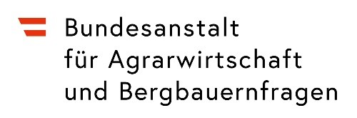
RAIN –
A Living Lab Concept for Circular Economy, Cooperation and Innovation in Rural Regions
Klaus Wagner
Sigrid Egartner, Heidelinde Grüneis, Karin Heinschink, Julia Niedermayr
EGU General Assembly 2020
Vienna, 6.5.2020
Federal Institute of Agricultural Economics, Rural and Mountain Research, Vienna, Austria www.bab.gv.at klaus.wagner@bab.gv.at
LIVERUR has received funding from the European Union's Horizon 2020 research and innovation programme under grant agreement 773757

Slide 2

H2020 project LIVERUR
2018-2021
23 partner countries, 13 pilot regions
Coordination: UCAM (ES)
Objective: LIVERUR project aims at modernising the small – medium rural businesses present in the European territory
https://liverur.eu
https://liverur.eu/

Slide 3
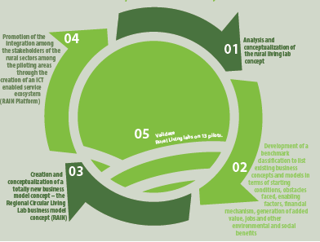
https://liverur.eu/

Slide 4
Important terms
Living Lab user-centred, open-innovation ICT enabled ecosystems often operating in a territorial context integrating concurrent research and innovation processes.
Circular Economy regenerative system in which resource input and waste, emission and energy leakage are minimised by slowing, closing and narrowing material and energy loops.
Open Innovation knowledge flows that cross organisational boundaries to improve the success. These flows may be inbound from and/or outbound to its external partners
Quadruple Helix interactive process involving different spheres of actors (e.g. universities, industries, governments and the civil society)
Business Model Concept underlying baseline for the creation of a business model

Slide 5
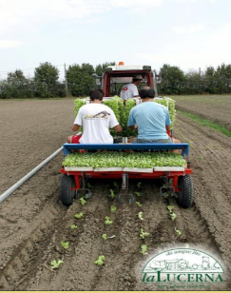
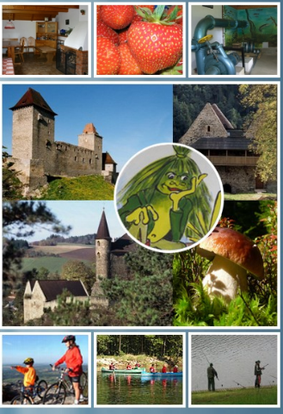
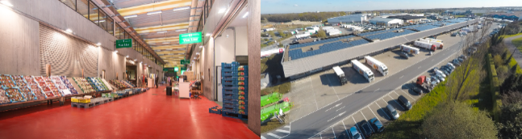
Main types of existing business models in rural region
Mainstream Farm Enterprises
Diversified Agricultural Enterprises
Food and Beverages Industry
Rural SMEs and Craft Businesses
Rural Tourism Enterprises
Rural Services
https://liverur.eu/scientific-outputs/
Fotos: Cadiou, 2018

Slide 6
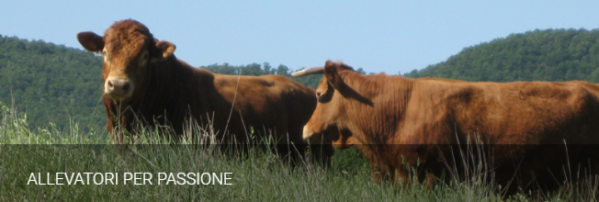
Challenges of businesses in rural regions
Costs, profitability, economy of scales
Low population densities, outmigration, brain drain
Poor technical and social infrastructure
Low public investment, support, services
High share of enterprises with high dependency on weather, climate conditions
Fotos: Cadiou, 2018
https://liverur.eu/scientific-outputs/

Slide 7
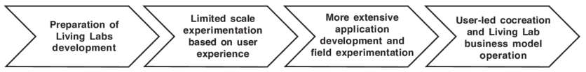
Living Labs Assets
New product-service-process systems
Focused on the economic & social needs of people
Aiming at open innovations and sustainable development
Public private people partnership
https://liverur.eu/scientific-outputs/

Slide 8
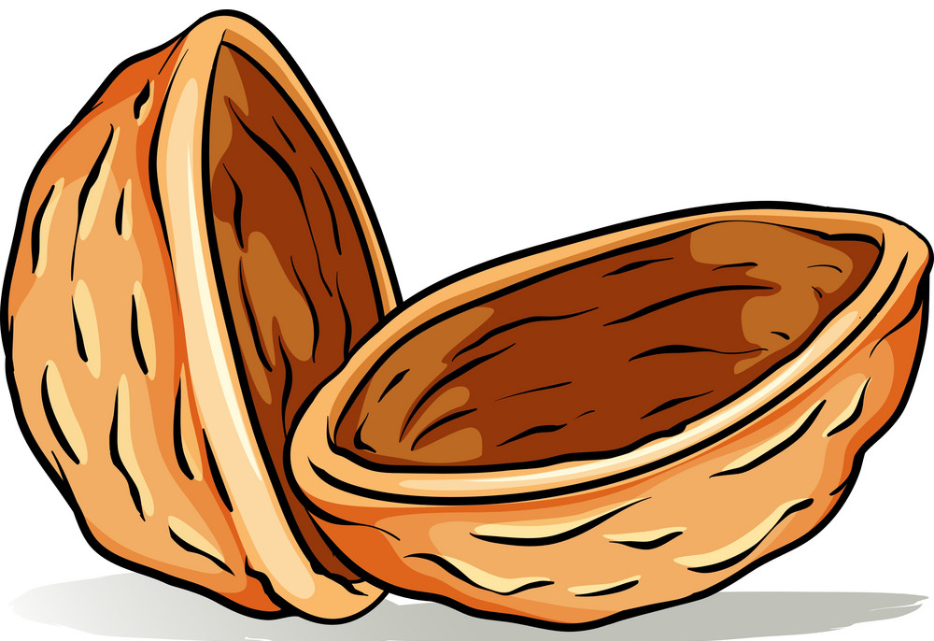
RAIN (=Regional Circular Living Lab) Concept
(Egartner et al. 2020)
Objective
Creation of a new viable business model in rural context, merging Living Lab and Circular Economy Theory
Provide a structured approach for developing a business or project or initiative in rural regions

Slide 9
RAIN Concept
The RAIN Concept has three layers:
RAIN Core Elements
RAIN Principles
RAIN Real Life Setting

Slide 10
RAIN Concept
The RAIN Core Elements capture the central business model.
Legend
RAIN Core Elements
RAIN Principles
RAIN Real Life Setting
Implementation
Development
Product
Service
Process
Marketing
Distribution
Financial
Aspects
Vision
Business Idea
Resources
Research
Innovation
People
Management
Organisation

Slide 11
RAIN Concept
Each RAIN Principle should be embedded in each core element.
Legend
RAIN Core Elements
RAIN Principles
RAIN Real Life Setting
Ecological Sustainability
Social Sustainability
Product
Service
Process
Economic Sustainability
Implementation
Development
Marketing
Distribution
Financial
Aspects
Vision
Business Idea
Resources
Circular Economy
Open Innovation
Research
Innovation
People
Management
Organisation
ICT
Stakeholder Involvement / Openness

Slide 12
RAIN Concept
The RAIN Real Life Setting limits or enables the business model.
Environment and Climate
Legend
RAIN Core Elements
RAIN Principles
RAIN Real Life Setting
Ecological Sustainability
Societal Context and Social
Infrastructure
Economic context
Social Sustainability
Product
Service
Process
Economic Sustainability
Implementation
Development
Marketing
Distribution
Financial
Aspects
Vision
Business Idea
Resources
Circular Economy
Open Innovation
Research
Innovation
People
Management
Organisation
Food Security and Safety
Legal, Institutional and Political Framework
ICT
Stakeholder Involvement / Openness
Rural Technical Infrastructure

Slide 13




RAIN application in 5 tasks
1. To start: Choose the RAIN Core Element Vision/Business Idea and take the regional specific worksheet RAIN Real Life Setting into consideration
2. Choose one of the suggested methods to elaborate this RAIN Core Element (following the LIVERUR Toolbox)
Vision
Business Idea
Worksheet
Real Life Setting
3. Follow the working steps for this RAIN Core Element („piece of the puzzle“)
Method
Clarify
Status Quo
Evaluate, Rethink, Restart
Set goals
What? When? How?
example
RAIN Core Elements
Vision
Business Idea
Specify
Responsibilities
Timelines
Integrate
RAIN Principles
Worksheet
RAIN Principles
Draft
Measures
4. Summarise all findings regarding the chosen RAIN Core Element (corresponds to one chapter of your RAIN Business Plan)
5. Choose next RAIN Core Element („piece of the puzzle“) - go back to task 2 and through all tasks for all 9 RAIN Core Elements
Business
Plan
Result: RAIN Business Plan

Slide 14
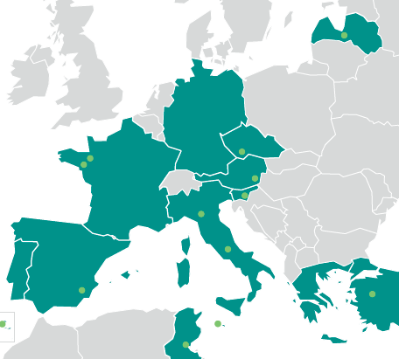
Implementation in 13 Pilot Regions
(businesses in development, activities in progress)
Austria, Südburgenland
Czech Republic, Jihozápadní Čechy
Spain, Vega del Segura
France, Bretagne
France, Pays de la Loire
Italy, Unione dei Comuni del Trasimeno Area
Italy, Provincia di Reggio Emilia
Latvija
Malta
Portugal, Acores
Slovenija
Tunesia, Ouedhref
Turkey, TR33
https://liverur.eu/

Slide 15
References:
https://liverur.eu/
Cadiou, F. (2018). Living Lab research concept in rural areas – LIVERUR Deliverable 2.1 Report on existing business models in EU countries and regions. [retrieved from: https://liverur.eu/phase-01/ 5.2.2019]
Egartner, S., Grüneis, H., Heinschink, K., Niedermayr, J., Wagner, K. (2020): D4.3 RAIN Concept – Concept of a Regional Circular Living Lab Approach in rural areas. Deliverable D4.3 of the LIVERUR project, EU research project, Horizon 2020 grant agreement no. 773757. URL: https://ec.europa.eu/eip/agriculture/en/find-connect/projects/living-lab-research-concept-rural-areas (accessed 17.01.2020); URL: https://liverur.eu/ (accessed 28.01.2020).
https://liverur.eu/

Slide 16

K. Wagner,
S. Egartner, H. Grüneis, K. Heinschink, J. Niedermayr
Fotos, graphs and findings taken from various deliverables of the LIVERUR project, https://liverur.eu/scientific-outputs/
This project has received funding from the European Union’s Horizon 2020 research and innovation programme under grant agreement No 773757.
Disclaimer:
The information and views set out in this report are those of the author(s) and do not necessarily reflect the official opinion of the European Union. Neither the European Union institutions and bodies nor any person acting on their behalf may be held responsible for the use which may be made of the information contained therein for the use which may be made of the information contained therein.

