Slide 1
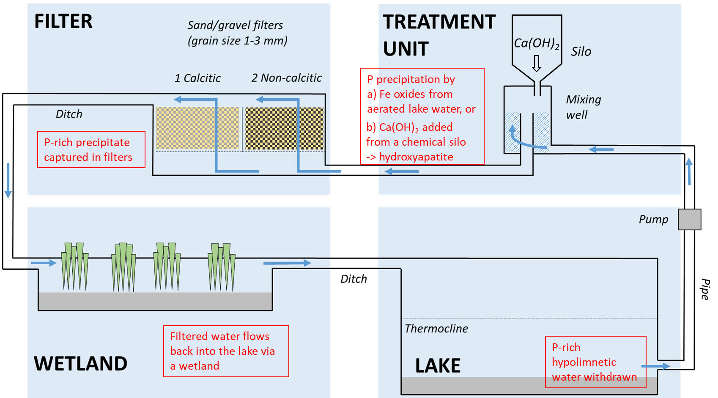
Recovering P from a eutrophic lake via hypolimnetic withdrawal and purification: Summary
Soila Silvonen¹, Juha Niemistö¹, Leena Nurminen¹, Anne-Mari Aurola², Ismo Malin³, Matti Kotakorpi³, Jukka Horppila¹, Tom Jilbert¹
A simple water purification system allows P to be harvested from the hypolimnion of eutrophic lakes

Slide 2
Recovering P from a eutrophic lake via hypolimnetic withdrawal and purification
Soila Silvonen¹, Juha Niemistö¹, Leena Nurminen¹, Anne-Mari Aurola², Ismo Malin³, Matti Kotakorpi³, Jukka Horppila¹, Tom Jilbert¹
¹ University of Helsinki, Viikinkaari 1, P.O. Box 65, 00014, University of Helsinki, Finland
² AFRY, P.O. Box 50, FI-01621 Vantaa, Finland
³ City of Lahti, Askonkatu 2 FI-15100 Lahti, Finland
Photo: J. Horppila

Slide 3
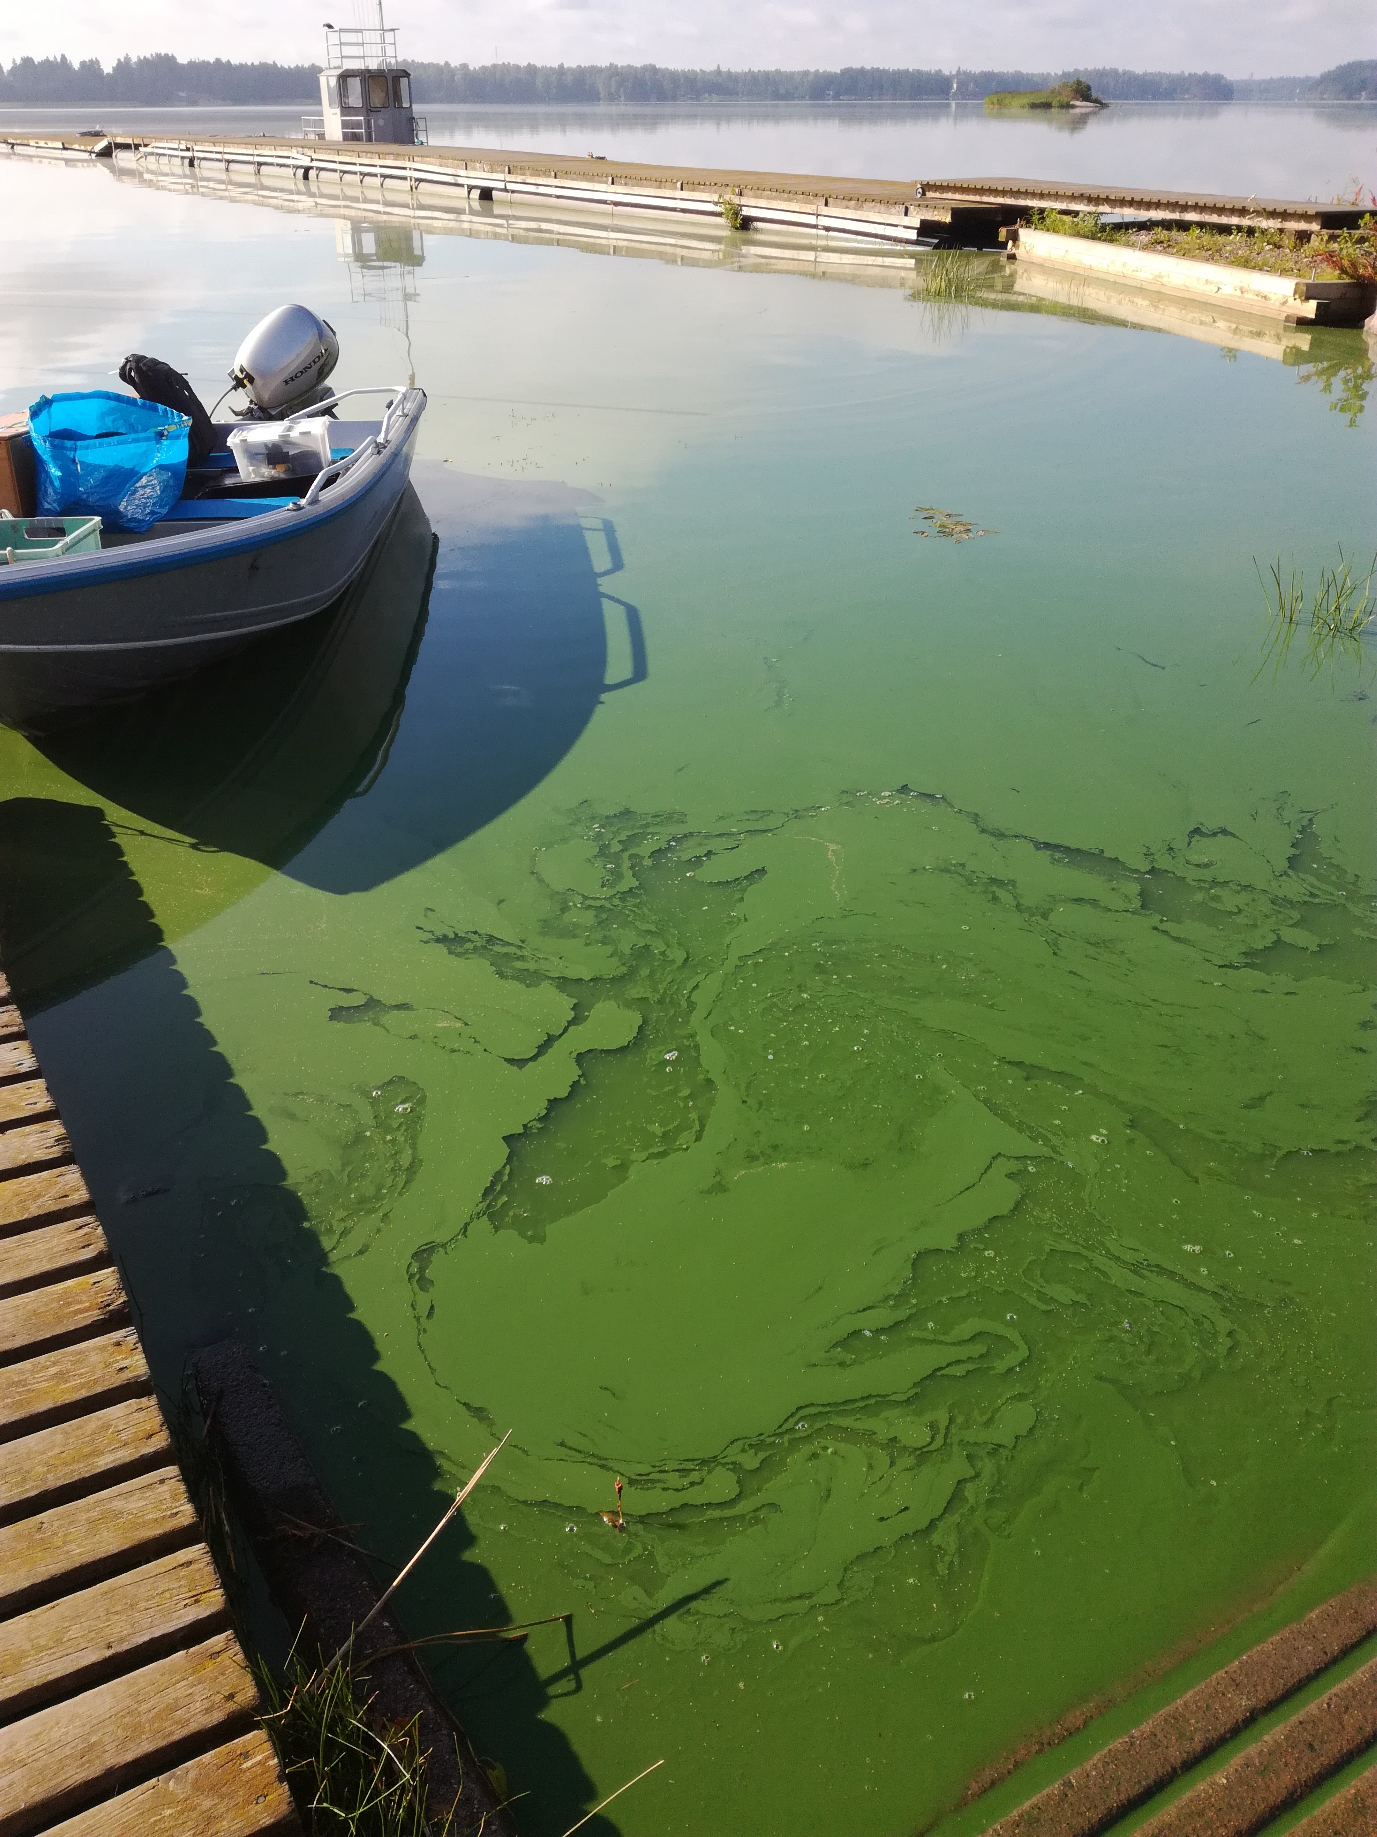
P and eutrophication of lakes
P runoff into lakes is a significant factor in lake eutrophication, which manifests itself as e.g.
Harmful algal blooms
Fish kills
P accumulated in lakes can be considered “lost”, out of reach – problematic, as P is a finite resource
Globally, the annual accumulation of P in lakes is 1-3.1 Tg (10⁶ tonnes) (Bennett et al. 2001)
Photo: S. Silvonen

Slide 4
Hypolimnetic withdrawal – removing P from lakes
Background: In thermally stratifying lakes, P typically accumulates in near-bottom water (hypolimnion) due to different release mechanisms from sediment, and decomposition of settling organic matter
Conventional withdrawal
Principle: P-rich water is led downstream from the lake
Widespread approach (Nürnberg, 2007)
Closed purification circuit
P-rich water is pumped into a P-capturing unit and back into the same lake
Hardly any documented instances, under development
Withdrawal pipe (Olszewski tube)
Withdrawal pipe (Olszewski tube)
Lake outflow
P
P
Hypolimnion
Hypolimnion
P
P
P
P
P
P
Sediment
P
P
P
P
Sediment
P
P
P
P
P
P
Water purification unit

Slide 5
Study questions
Is it possible to remove and capture significant amounts of P from a lake with a simple water purification unit?
How P-concentrated can the material extracted in such a system be?
What are the possible forms in which P can be captured?

Slide 6
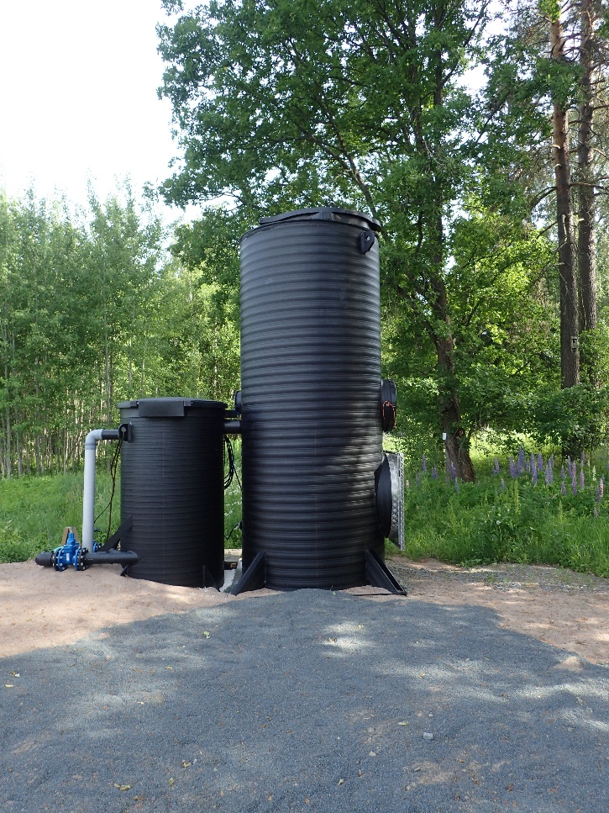
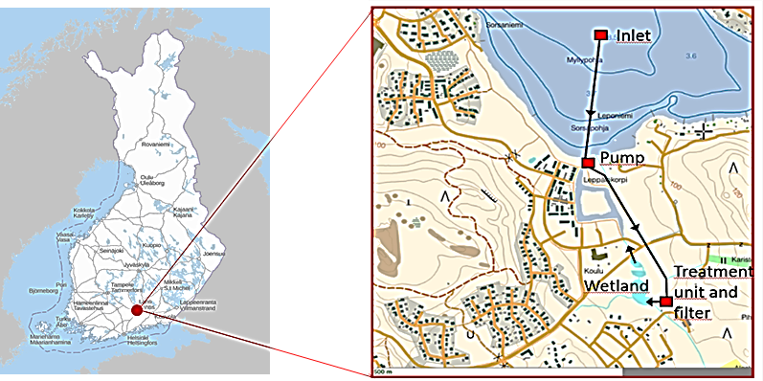
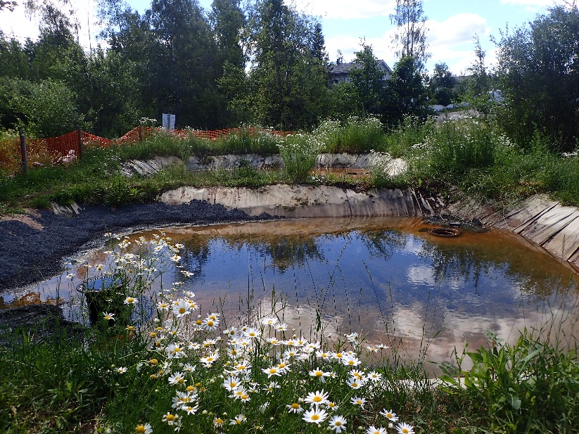
Study methods
Treatment unit
Filter
Source of map: National Land Survey of Finland
Photo: J. Horppila
Study site: Lake Kymijärvi (Southern Finland) – small (~6 km²) boreal dimictic lake
A pilot version of a hypolimnetic withdrawal and purification system built in 2018
Photo: J. Horppila

Slide 7
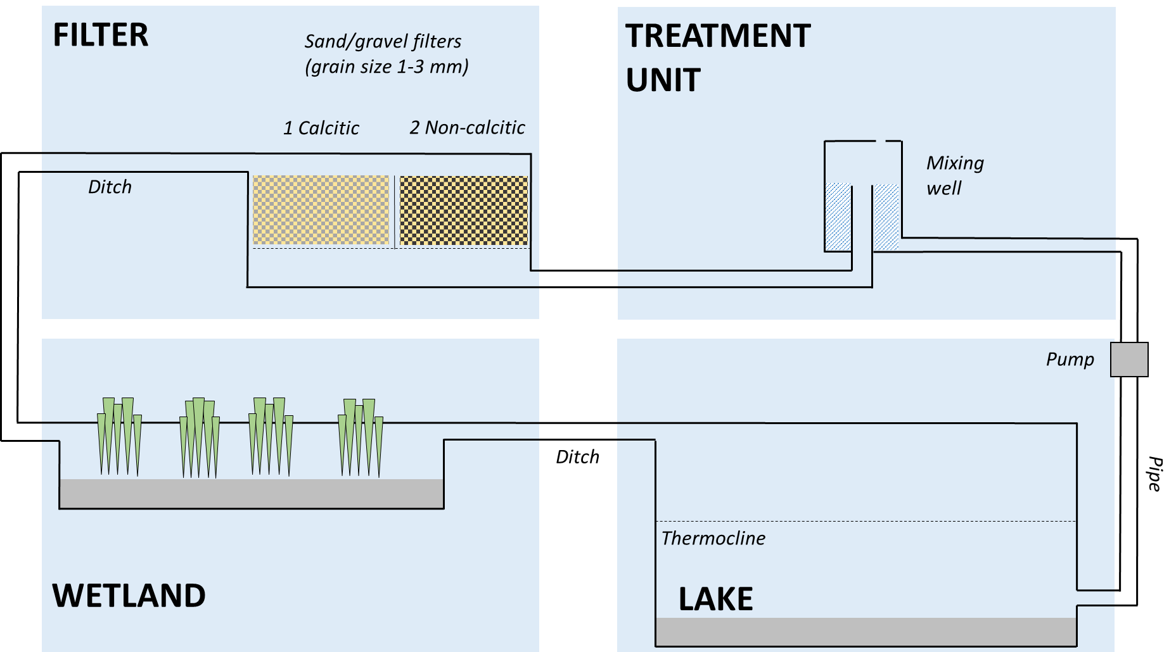
Functioning of the system
Ca(OH)₂
Silo
P precipitation by
a) Fe oxides from aerated lake water, or
b) Ca(OH)₂ added from a chemical silo
-> hydroxyapatite
P-rich precipitate captured in filters
Filtered water flows back into the lake via a wetland
P-rich hypolimnetic water withdrawn

Slide 8
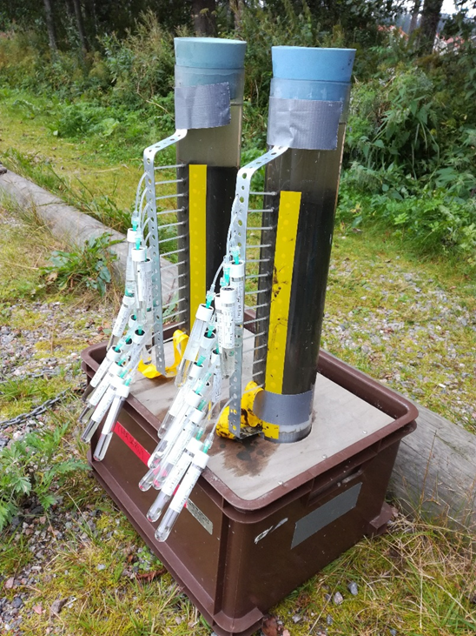
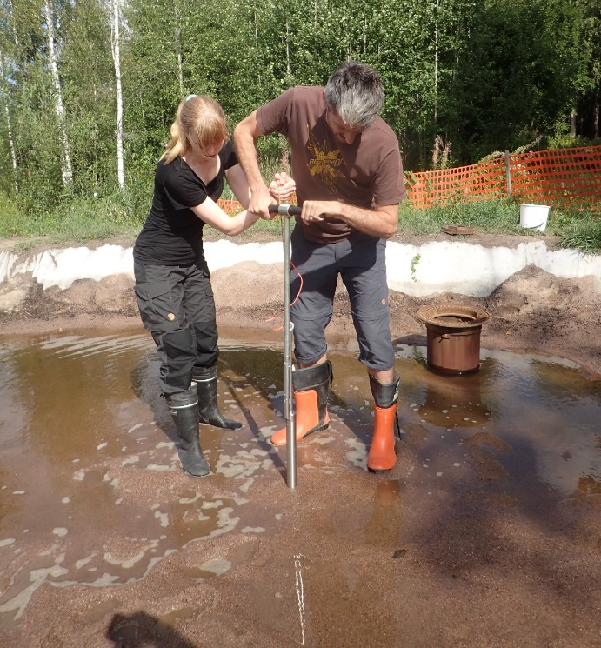
2017: Preliminary investigations on the potential for P removal in study lake during thermal stratification:
P content of sediment and accumulation in pore water
P accumulation in hypolimnetic water
2018 & 2019: Test runs of hypolimnetic withdrawal and purification system pilot:
Two P precipitation pathways: water aeration (Fe precipitation) and Ca(OH)₂ addition (hydroxyapatite Ca₅OH(PO₄)₃ formation)
Two parallel filter materials (calcitic & non-calcitic sand/gravel)
Data collection: water samples (P capture), solid material from filters (P concentration and association with Fe/Ca in precipitate)

Slide 9
Results
P accumulation in the hypolimnion
P diffusive flux from sediment into water
22.8.2017
D = temperature-corrected diffusion coefficient of H₂PO₄⁻
dC = P concentration difference between surface sediment pore water and near-bottom water
dz = diffusion distance
Θ = tortuosity
Water column
From: Boudreau (1997)
Sediment pore water

Slide 10
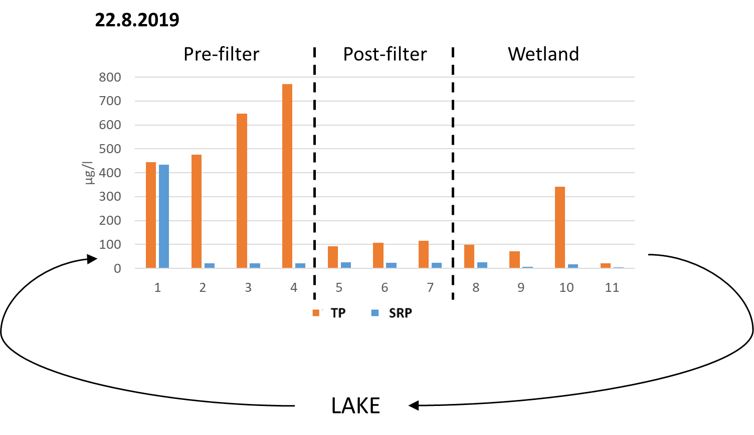
Test runs of hypolimnetic withdrawal and purification system: P retention (water samples)
Water aeration only
Ca(OH)₂ addition
Sampling points
P retention in filters
TP: 85%
SRP: 97%
P retention in filters:
TP: 75%
SRP: 94%
1 Pre-treatment tap
2 Treatment well (aeration/Ca(OH)₂ addition)
3 Non-calcitic gravel, inflow
4 Calcitic sand, inflow
5 Non-calcitic gravel, outflow
6 Calcitic sand, outflow
7 Post-filter well
8 Wetland inflow
9 Wetland 1, 1.5 m
10 Wetland 2, 1.5 m
11 Wetland outflow

Slide 11
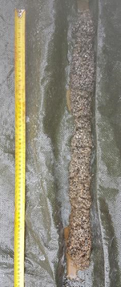
Test runs of hypolimnetic withdrawal and purification system: P content of extracted material
Water aeration only Filter material: Non-calcitic sand/gravel
V of water flowed through: 2088 m³
Ca(OH)₂ addition Filter material: Non-calcitic sand/gravel
V of water flowed through: 194 m³
Photo:T. Jilbert
TP
Coring sample from filter
P fractions

Slide 12
First conclusions
There is great potential in eutrophic lakes for harvesting P from hypolimnetic water
A simple purification system based on P precipitation and filtering effectively removes P from water
Different precipitation mechanisms may be equally effective, but they will affect the composition of the captured material – including the form of P

Slide 13
Thank you for your interest!
Cited literature:
Bennett, E. M., Carpenter, S. R., & Caraco, N. F. (2001). Human impact on erodable phosphorus and eutrophication: a global perspective: increasing accumulation of phosphorus in soil threatens rivers, lakes, and coastal oceans with eutrophication. BioScience, 51(3), 227-234.
Boudreau, B. P. (1997). Diagenetic models and their implementation. Springer.
Nürnberg, G. K. (2007). Lake responses to long-term hypolimnetic withdrawal treatments. Lake and Reservoir Management, 23(4), 388-409.
Photo: J. Horppila

