Slide 1
AS5.24: Advances in emission estimation based on observations and inversion techniques
Improved Inversion of Monthly Ammonia Emissions in China Based on the Chinese Ammonia Monitoring Network and Ensemble Kalman Filter
Xiao Tang, Lei Kong, Jiang Zhu, Zifa Wang, Yuepeng Pan, et al
LAPC & ICCES, Institute of Atmospheric Physics, Chinese Academy of Sciences, China
College of Earth and Planetary Sciences, University of Chinese Academy of Sciences, China
College of Global Change and Earth System Science, Beijing Normal University, China
Chengdu University of Information Technology, China
Center for Global and Regional Environmental Research, University of Iowa, USA
04/05/2020

Slide 2
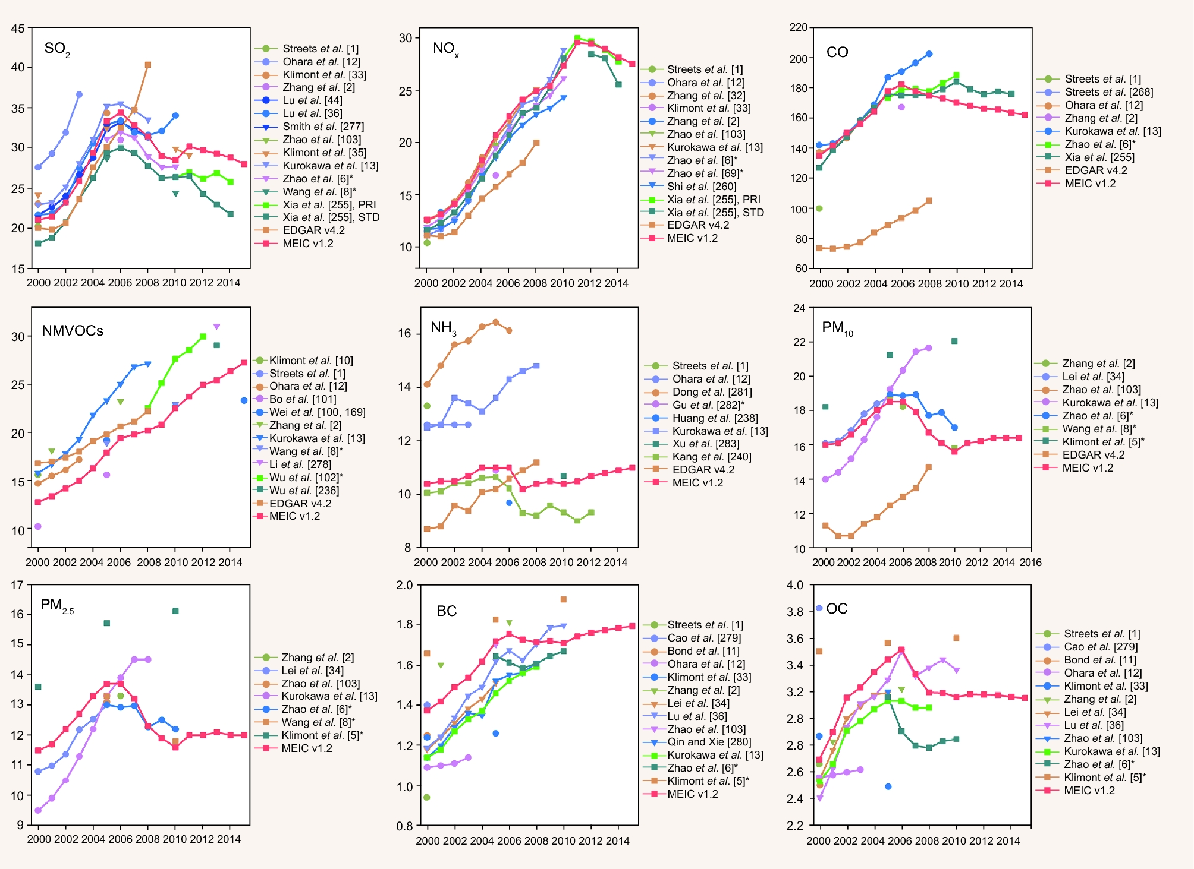
Background
NH₃ emissions were closely related to the environmental problems like air pollution, nitrogen deposition and rain acidification. A proper estimate of NH₃ emissions is essential for quantification of their environmental impacts and implementation of effective mitigation strategy.
There were still large uncertainties on the current NH₃ emissions in China with regards to the magnitude, and spatial-temporal variations .
(Li et al., 2017)

Slide 3
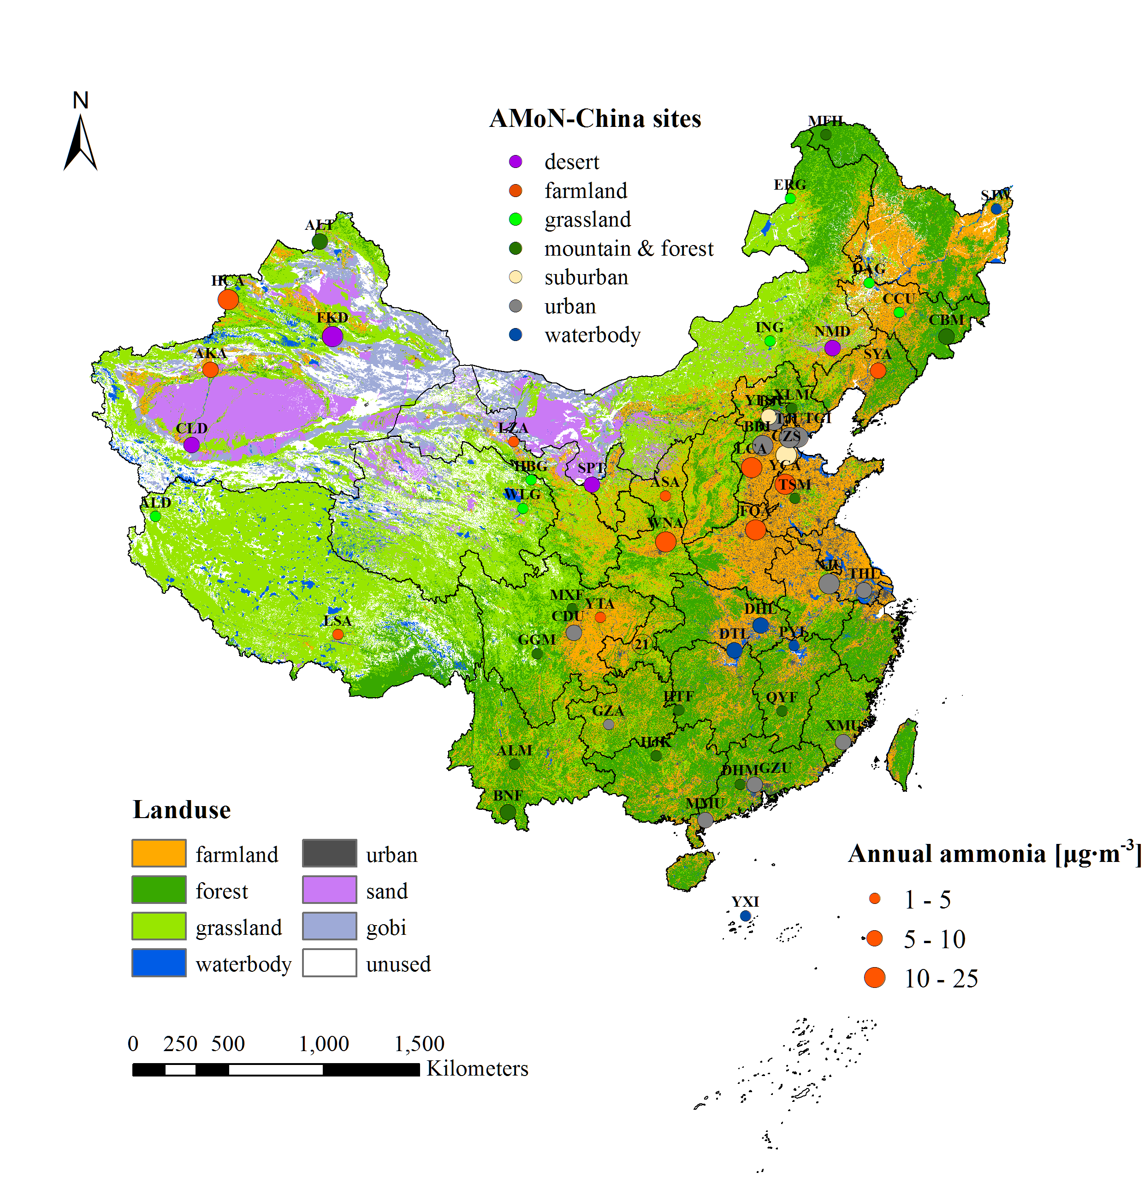
Ammonia Monitoring Network in China (AMoN-China)
The new surface observation provides us the new insight into the NH₃ emissions in China
The network contains 53 sites
The sites are located over the major NH₃ sources in China
It has one year observations (Sep, 2015 – Aug, 2016)

Slide 4
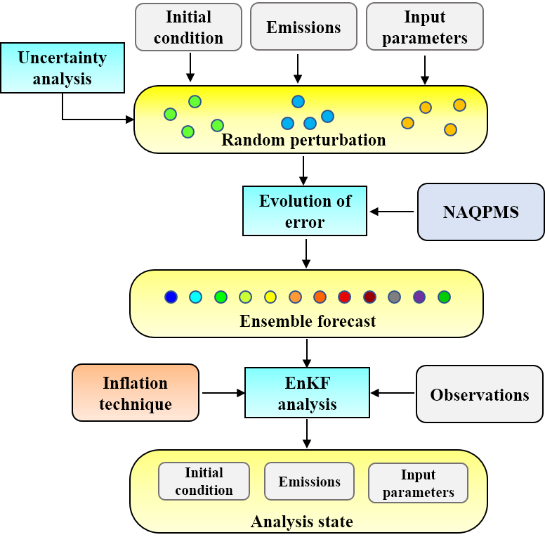
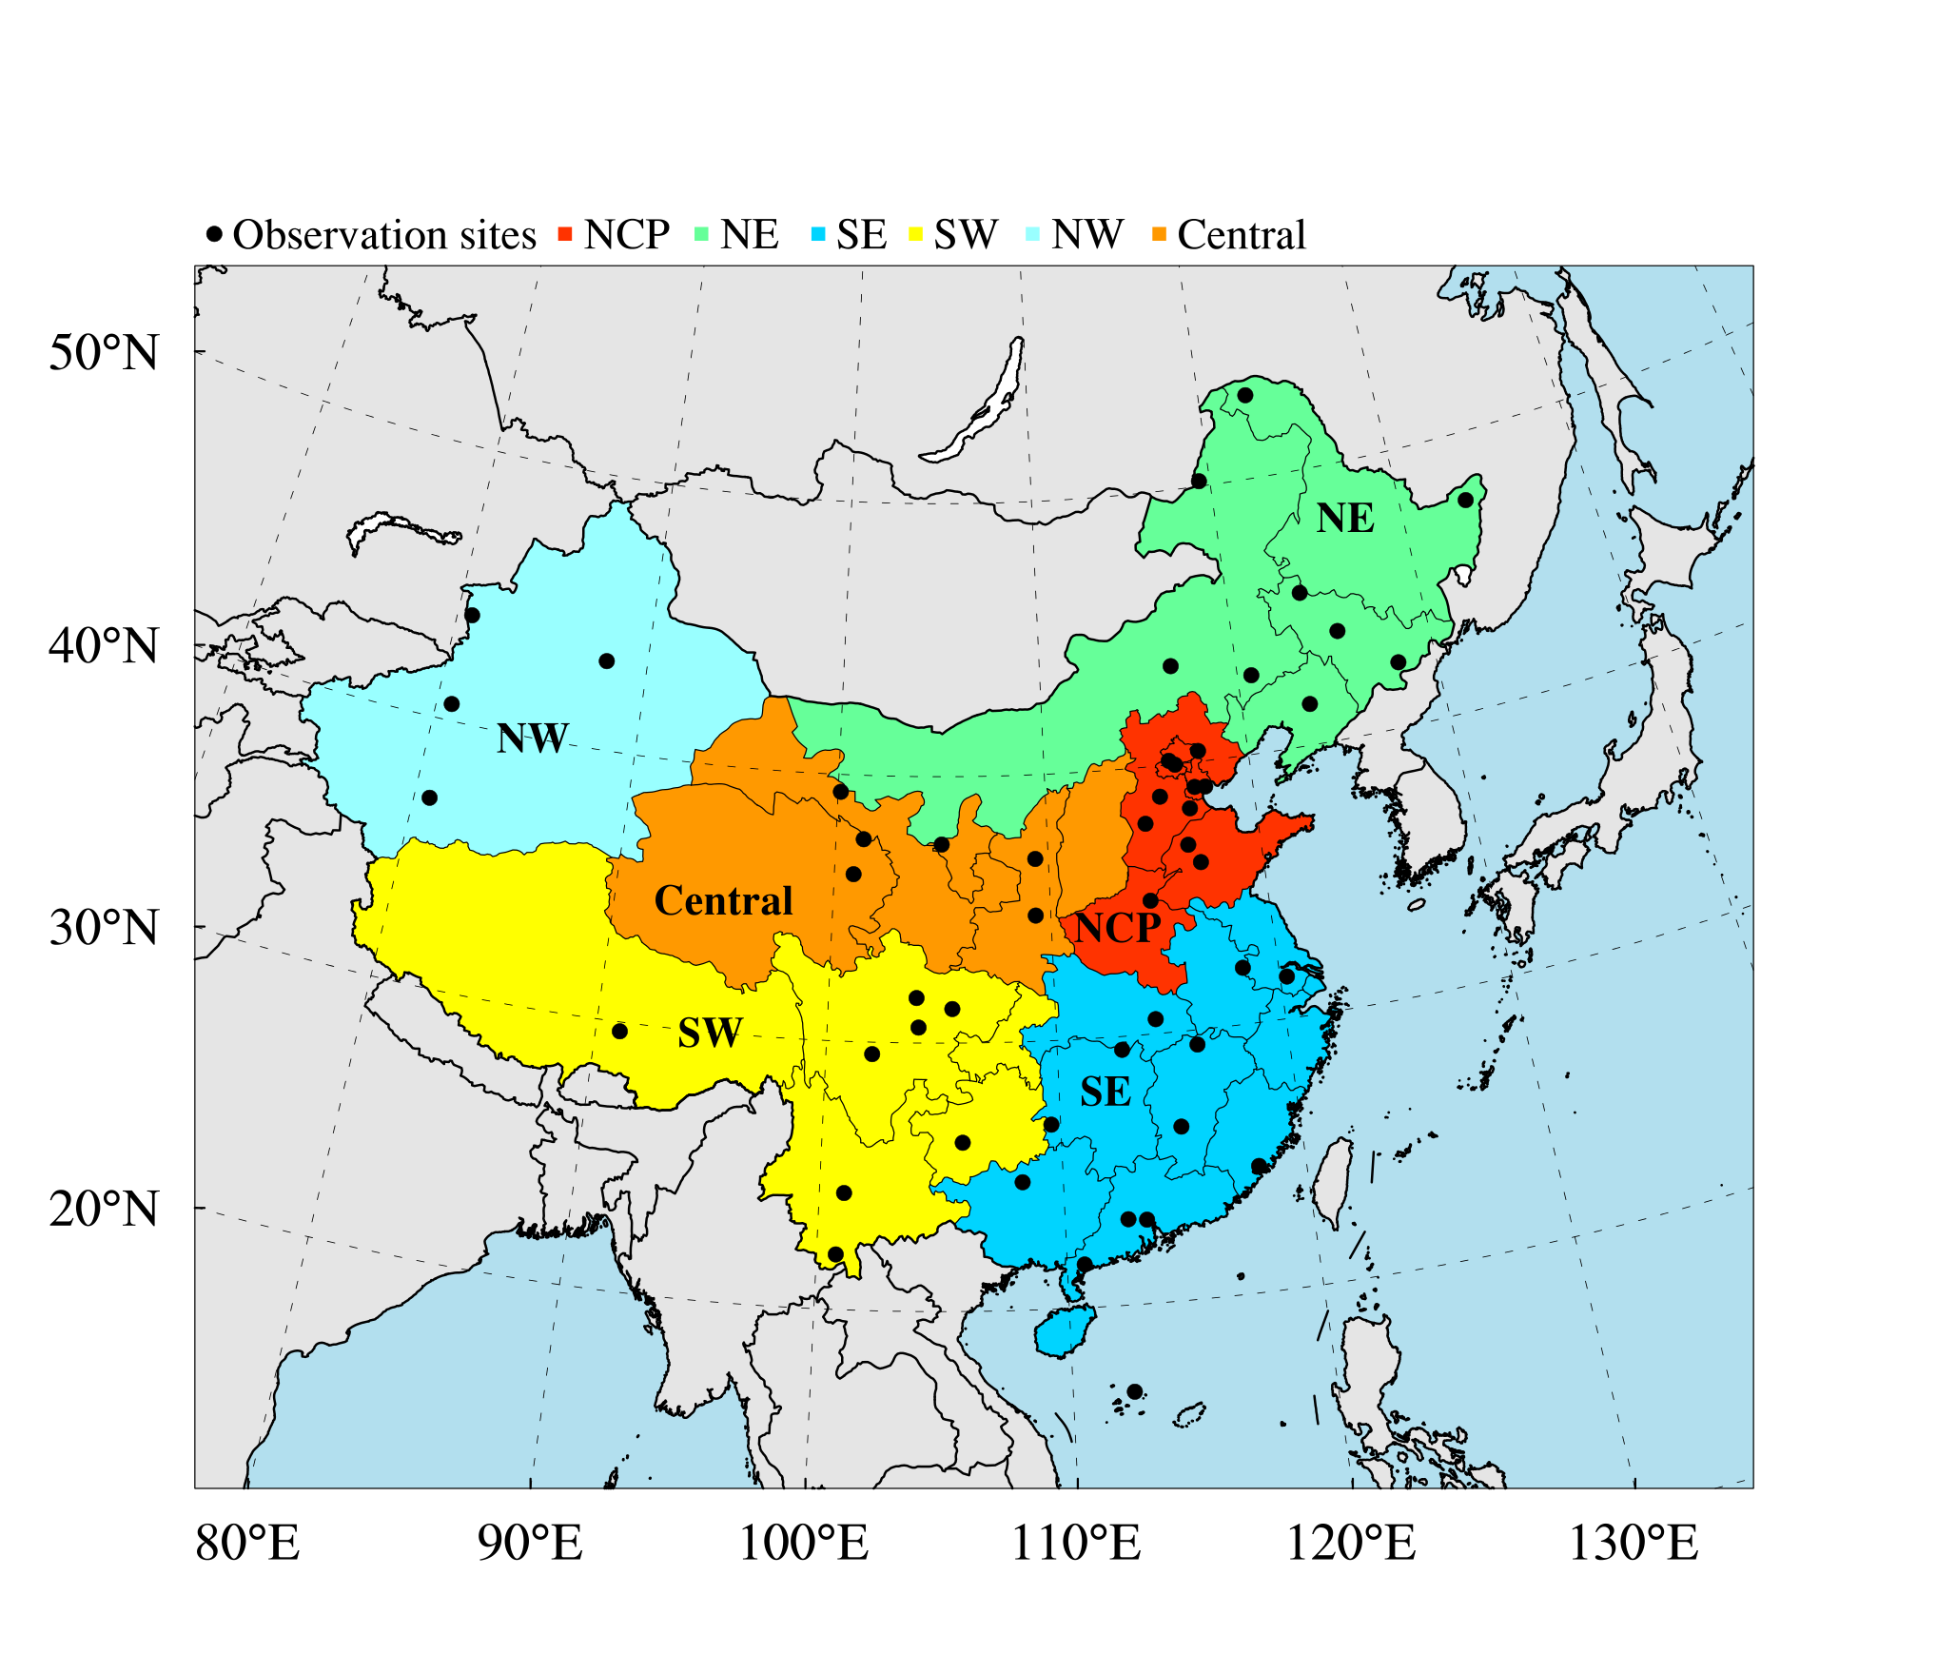
Establishment of Inversion Estimation System
Assimilation method: Ensemble Kalman Filter (EnKF)
Inflation technique: Maximum likelihood estimation
Assimilated variables: Emissions and concentrations
Localization Scale: 150km (10 grids)
Ensemble size: 50
Chemical transport model: NAQPMS
(Nested Air Quality Prediction Model System)
Meteorological model：WRF
Horizontal resolution: 15km$×$15km
Experiment period: Sep, 2015–Aug, 2016
First guess emission inventory: MEIC-2016
Modeling domain
(ChemDAS & NAQPMS)

Slide 5
Inversion Estimation Scheme
Since we mainly focused on the monthly emissions, the filter was applied independently in each month after a free run of ensemble simulations from September, 2015 to August, 2016.
Inversion method: EnKF + State augmentation technique
$x={\left(c^{T}, E^{T}\right)}^{T}$
$x^{a}=x^{b}+BH^{T}{\left(HBH^{T}+R\right)}^{−1}\left(y^{o}−Hx^{b}\right)$
State variable
Background error
Observation error
Background error: Ensemble estimation with Inflation technique (Maximum likelihood estimation)
$−2L\left(λ\right)=ln\left\{det\left(HλP_{e}^{b}H^{T}+R\right)\right\}+d^{T}{\left(Hλ{P_{e}^{b}H}^{T}+R\right)}^{−1}d$
$d=y^{o}−H\left(\frac{1}{N}\sum_{i=1}^{N}{x_{i}^{b}}\right)$
Innovation
Likelihood function
Observation error: measurement error（3%；von Bobrutzki et al., 2010）+ representativeness error (Chang et al., 2019)

Slide 6
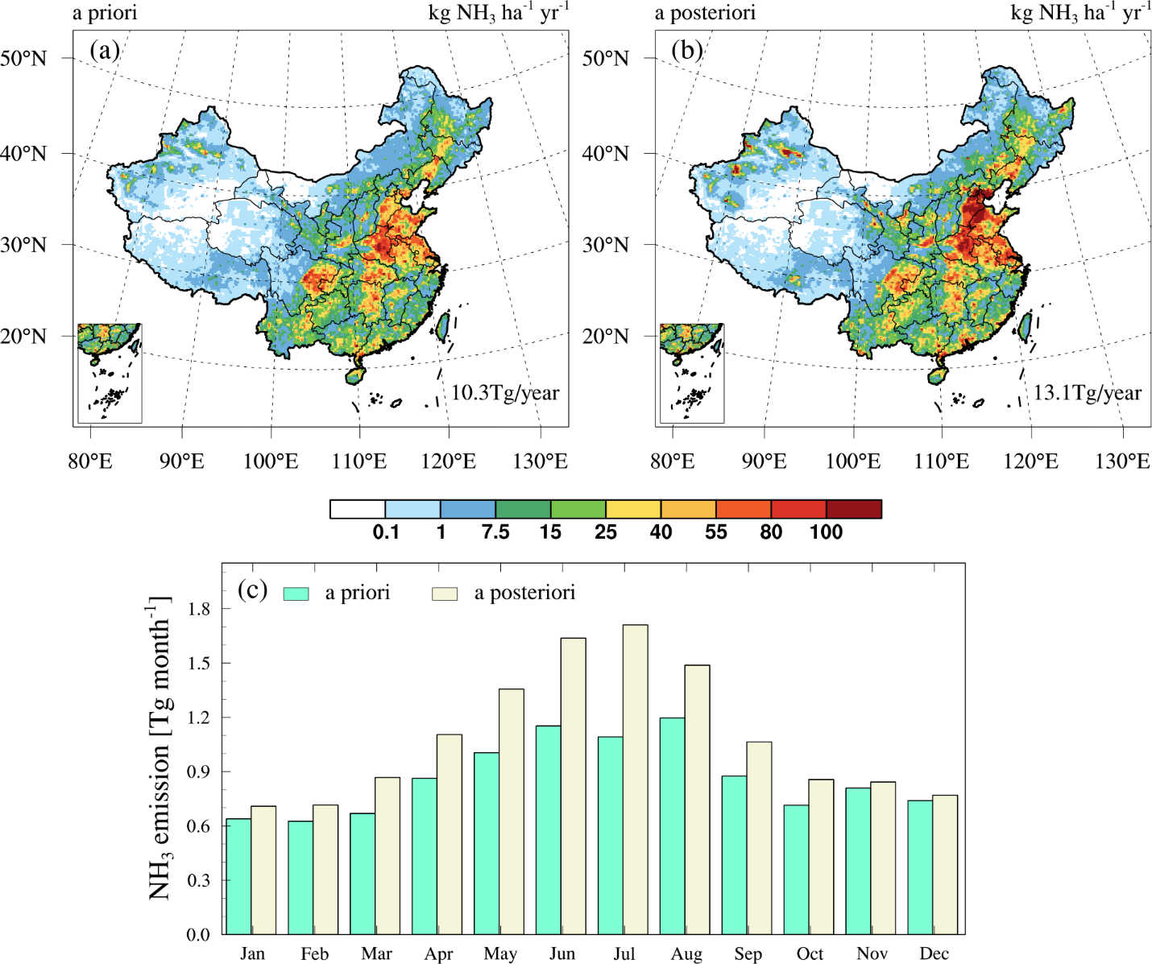
Inversion Emission Inventory (IEI): Spatial distribution
1）The IEI shows substantial increases in NH₃ emissions in North China, especially in northwest China where enhanced NH₃ hotspots were detected.
Region | A priori（Tg/yr） | A posteriori（Tg/yr） | A posteriori $−$ a priori
NCP | 2.23 | 3.21 | 0.98 (43.9%)
NE | 1.43 | 1.89 | 0.46 (32.2%)
SE | 3.56 | 3.93 | 0.37 (10.4%)
SW | 1.96 | 2.09 | 0.13 (6.6%)
NW | 0.35 | 0.79 | 0.44 (125.7%)
Central | 0.79 | 1.13 | 0.34 (43.0%)

Slide 7
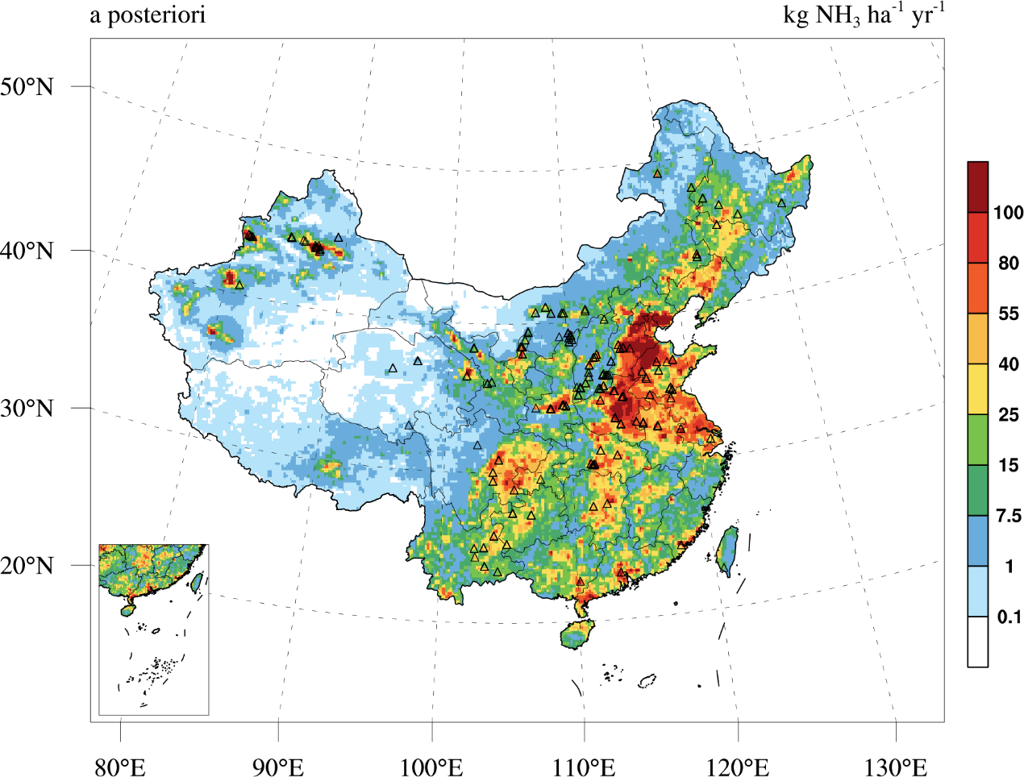
Possible explanations for the enhanced NH₃ emission hotspots
2）The IEI agrees well with the industrial NH₃ emission hotspots detected by the IASI and CrIS measurements，which suggested that these NH3 emissions may be closely related to the industrial activities there.
:Industrial points
Data source：
Van Damme et al., 2018 and Dammers et al., 2019

Slide 8
Inversion Emission Inventory (IEI): Monthly Variation
1）The IEI shows more distinct seasonality than the a priori with the largest NH₃ emissions in July.
A priori
A posteriori

Slide 9
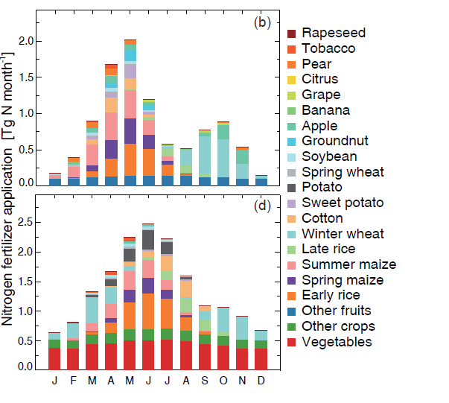
Possible explanations for the monthly variations of NH₃ emissions
Basal fertilizer
The monthly variations of NH₃ emissions are closely related to the monthly variations of activity level and emission factor；
It has been estimated that over 70% of nitrogen fertilizers are applied during March–August in China;
The high temperature in summer also favors the volatilization of NH₃；
Top dressing fertilizer
(Zhang et al. 2018)

Slide 10
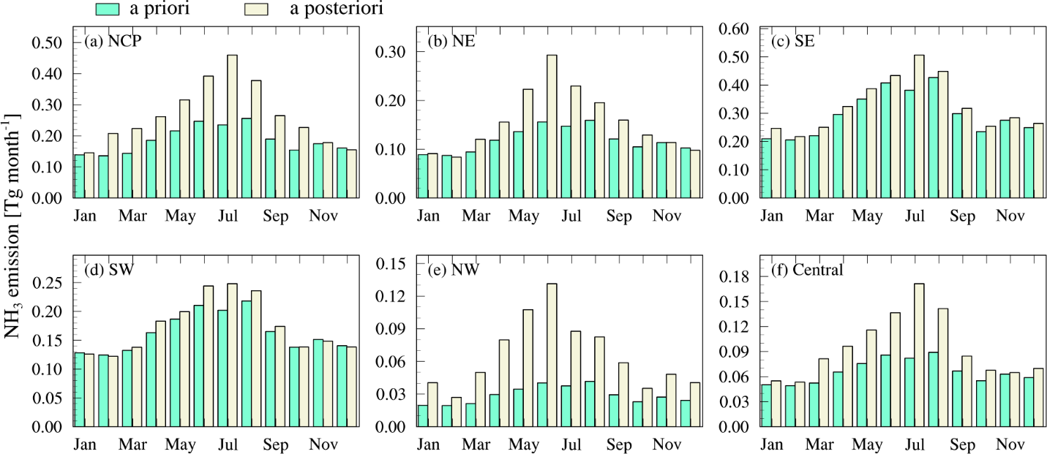
Monthly variations of NH₃ emissions in different regions of China
4）The a posteriori emissions showed different monthly variations of NH₃ emissions in different regions, which may be related to the local farming practices and climate conditions
A priori
A posteriori

Slide 11
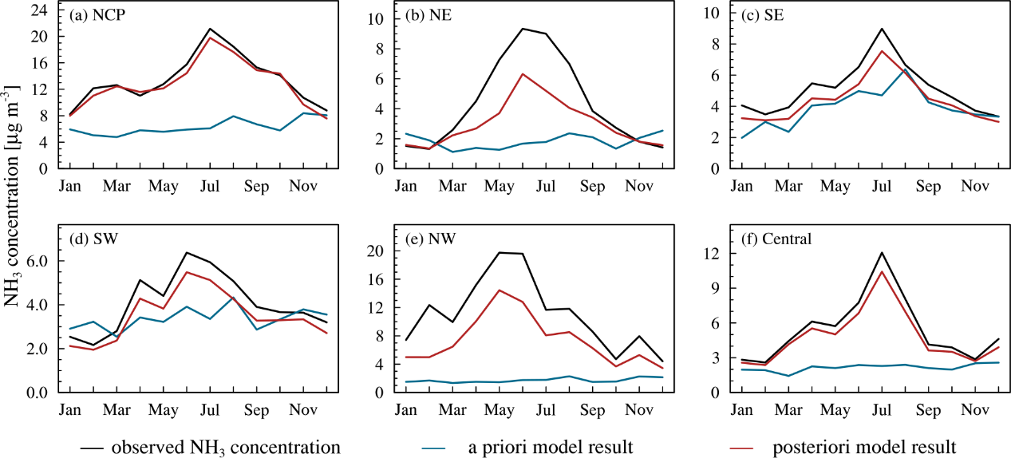
Validation of IEI using AMoN-China
 | NCP | NE | NW | SE | SW | Central
MBE($μg/m^{3}$) | -0.63 | -1.33 | -3.70 | -0.73 | -0.57 | -0.62
NMB (%) | -4.7 | -30.6 | -33.3 | -14.3 | -13.9 | -11.5
RMSE ($μg/m^{3}$) | 1.52 | 2.48 | 4.99 | 1.09 | 0.72 | 0.71

Slide 12
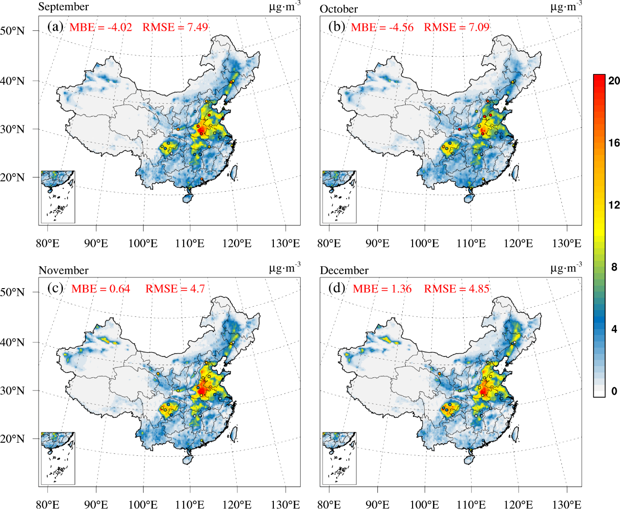
Independent Validation of IEI
Surface NH₃ observations from NNDMN (National Nitrogen Deposition Monitoring Network)
A priori simulation

Slide 13
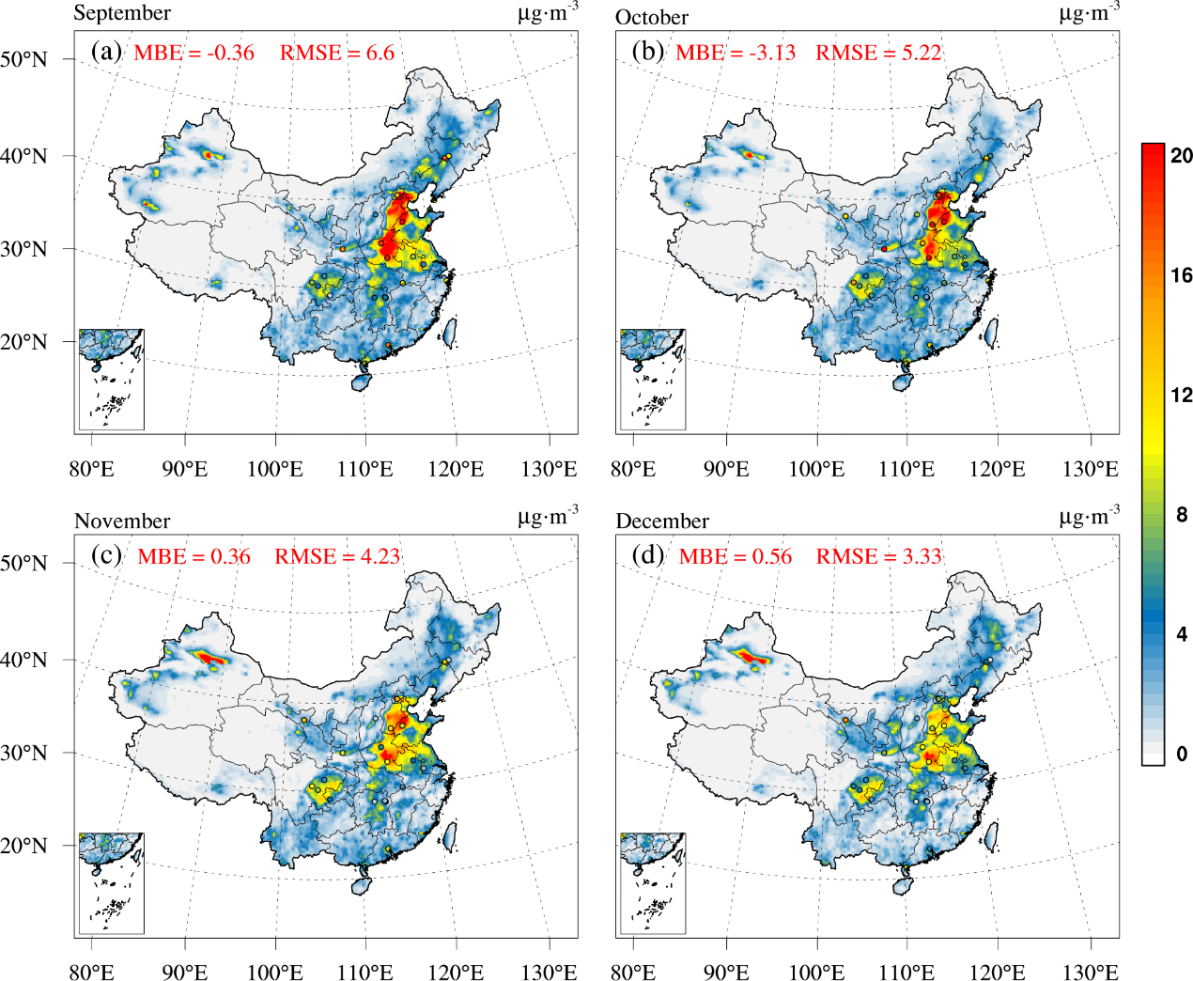
Independent Validation of IEI
Surface NH₃ observations from NNDMN (National Nitrogen Deposition Monitoring Network)
A posteriori simulation

Slide 14
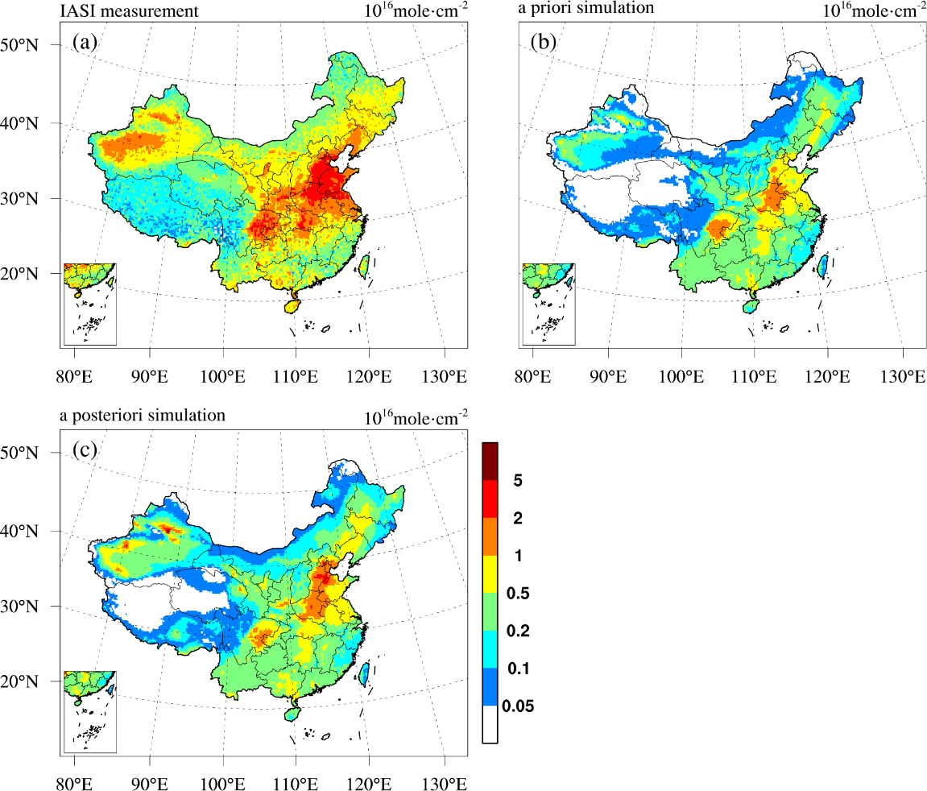
Independent Validation of IEI
Satellite observations of NH₃ total columns from IASI
IASI
A priori simulation
The a posteriori simulation agrees better with the IASI measurement in terms of the high NH₃ columns in NCP, NW and Central, which confirms the enhanced NH₃ emission hotspots over these regions.
A posteriori simulation

Slide 15
Independent Validation of IEI
Satellite observations of NH₃ total columns from IASI
The a posteriori NH₃ emissions improved the fits to the satellite measured monthly variations of NH₃ columns in NCP, NE and Central, especially with regards to the timing of peak values.

Slide 16
Summary and discussion
The total NH₃ emissions were about 13.1 Tg during the period Sep, 2015 – Aug, 2016，27% higher than the a priori estimate.
Consistent with satellite measurements，the IEI shows enhanced NH₃ emission hotspots in China, especially in northwest China.
The optimized NH₃ emissions exhibited a more distinct seasonality than the a priori with highest values in July.
The a posteriori NH₃ emissions were well validated by independent surface and satellite datasets, which suggested that the improved inversion estimate can be used to advance our understandings of NH₃ emissions in China and their environmental impacts.

Slide 17
Thanks for your attention!
tangxiao@mai.iap.ac.cn
Kong, L., Tang, X., Zhu, J., Wang, Z., Pan, Y., Wu, H., Wu, L., Wu, Q., He, Y., Tian, S., Xie, Y., Liu, Z., Sui, W., Han, L., Carmichael, G., 2019. Improved Inversion of Monthly Ammonia Emissions in China Based on the Chinese Ammonia Monitoring Network and Ensemble Kalman Filter. Environ Sci Technol. http://dx.doi.org/10.1021/acs.est.9b02701

