Slide 1
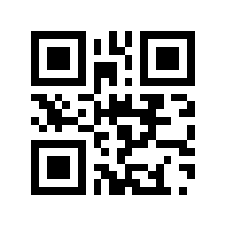
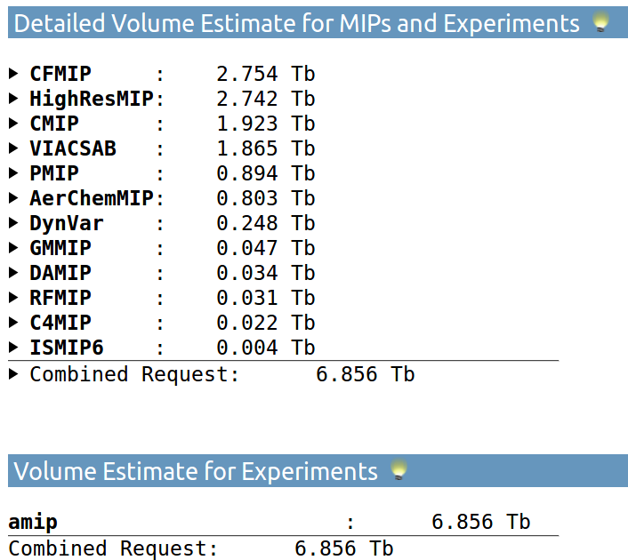
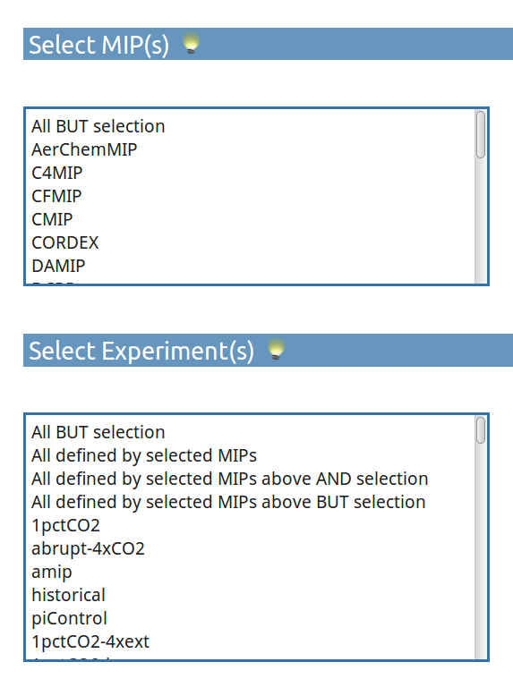
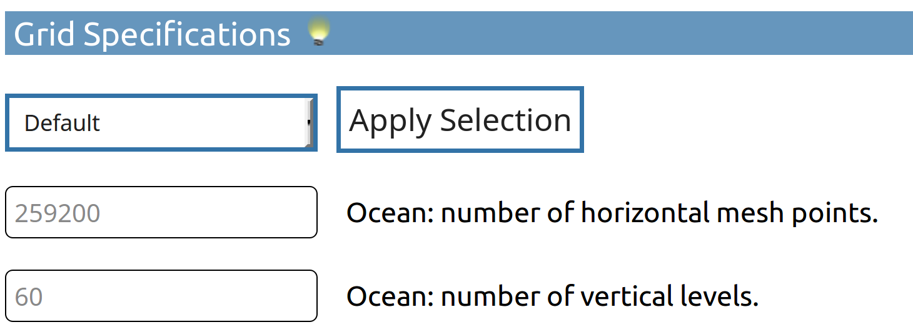
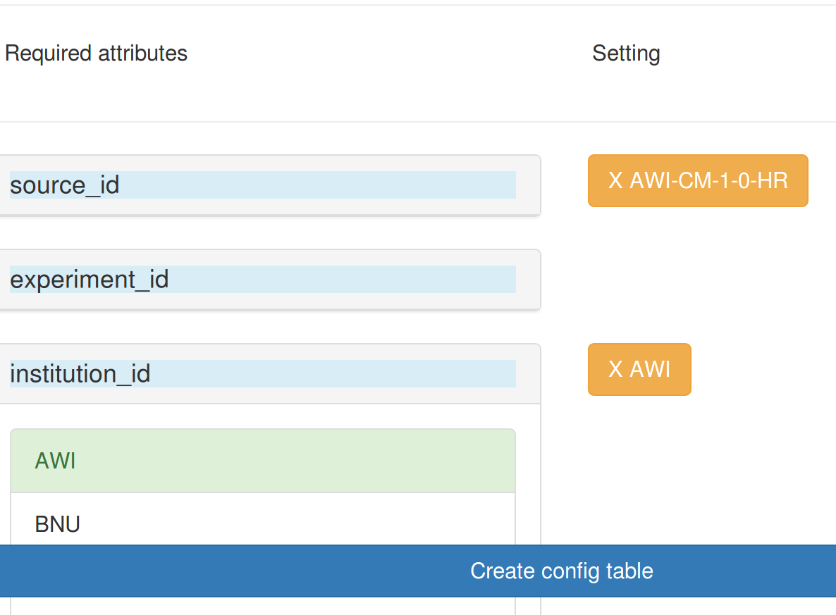
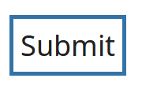
Web-based post-processing workflow composition for CMIP6
EGU2020
-13105
Schupfner, M.¹⁾, Wachsmann, F.¹⁾
1) German Climate Computing Center (DKRZ), https://www.dkrz.de
https://c6dreq.dkrz.de
CMIP6
For the 6th phase of the Coupled Model Intercomparison Project (CMIP6), a new design has been introduced which allows to tackle several scientific challenges by coordinating multiple Model Intercomparison Projects (MIPs) within CMIP. These “CMIP6 endorsed MIPs” profit from predefined basic experiments as well as the generalised data standards in CMIP and additionally define their own experiments. As during the 5th phase of CMIP, the German Federal Ministry of Education and Research (BMBF) is supporting the German climate research.
The WebGUI
The enhanced complexity in the CMIP design translates into the project’s data request and the data processing workflow. The WebGUI helps to maintain an overview of the more than 2000 variables requested by the endorsed MIPs for the numerous experiments and guides the user through the various steps of the post-processing workflow.
Beside CMIP6 also other projects can be supported. The infrastructure is also being used for CORDEX2 and PRIMAVERA.
The varying needs of the different MIPs and the large number of experiments lead to a complex structure of the CMIP6 data request. The web-based GUI guides through the steps of generating a customized data request, thereby facilitating the use of the Data Request Python API (DreqPy). This python library is being provided by the WGCM Infrastructure Panel.
The expected data volume for the planned experiments can be estimated, taking into account customized compression ratio and grid specifications. Hereby, also the python library DreqPy is being used.
The rhs shows an example calculation for all MIPs, experiment amip and default grid specifications.
More than 20 MIPs
Excel Sheets of the requested variables
Long name | units | Variable name | dimensions
Near-Surface Air Temperature | K | tas | longitude latitude time height2m
Surface Air Pressure | Pa | ps | longitude latitude time
More than 280 experiments
CMIP6_CV.json
#Controlled Vocabulary
“required_ global_attributes”:{
“source_id”,
“experiment_id”,
“institution_id”, ...
Climate model output configuration
Post-processing tool configuration
The info_table is a collection of attributes that are either part of the metadata standard or serve as configuration for the CMOR rewrite using cdo cmor.
Create customized data request
Calculate estimated data volume of customized data request
Generate Mapping and Diagnostic Tables required for CDO application
Generate script fragments based on CDO and WebGUI entries
Generate a configuration file for CMOR application
The mapping information is used to create diagnostic and CMOR-rewrite script fragments. A selection of variables can be excluded from the post-processing using a white- or blacklist that can be configured by every user.
info_table
source_id="AWI-CM-1-0-HR"
institution_id="AWI"
mip_era=”CMIP6”
Diagnostic for MPI-ESM ECHAM6
CMOR-rewrite for MPI-ESM ECHAM6
cn='tas ts'
for var in $cn; do
(if_requested $member $atmmod Amon $var $chunk || continue
cdo cmor,Amon,\
cmor_name=$var,\
info= ,\
mapping_table= \
infile )&
done
The WebGUI provides the possibility to map request variables (“CMOR variables”) to their model counterparts.
Diagnostic recipes that can be interpreted by the CDO operators “expr” and ”exprf” can be entered as well.
Several users can work simultaneously.
User changes will be logged and can thus be reverted.
Updates to the request variable definitions introduced by new versions of the data request will be displayed.
The variable mapping can be downloaded in plain text or json format.
info_table
mapping_table
mapping_table
Model variable CMOR variable
name=temp2 units=”degC” cmor_name=tas project_MIP_table=Amon
name=temp units=”degC” cmor_name=ts project_MIP_table=Amon
name=U2M units=”km s-1” cmor_name=uas project_MIP_table=Amon
Once created, the scripts and all verbose information will be stored in a database. The database enables other users to access/download this scripts and connected metadata.
NEXT
In case this presentation is not displayed correctly, please follow this Link to the GoogleSlides presentation.

Slide 2
The WebGUI guides through the process of generating project compliant data
1 – Which variables are requested for the experiments I plan to conduct?
Select the MIPs (Model Intercomparison Projects) to be supported.
Select the Experiments you plan to conduct.
2 – Which model variable corresponds to which variable of the Dreq?
Map the CMOR variables of the Data Request to their respective model counterparts.
Add diagnostics if needed. Supported are all operations of the Climate Data Operators (CDO) expr operator.
3 – Compose all medadata information needed by CMOR / CDO cmor.
Select the appropriate metadata entries based on the latest CV (Controlled Vocabulary) / DRS (Data Reference Syntax) requirements of the project.
4 – Download auto-generated scripts that make use of the CDO operators cmor and expr to reformat your data according to the project standard.
Manually mask variables from being processed or from being added to the script in the first place.
Generate an estimate of the data volume to be expected.
Generate a more accurate estimate of the expected data volume containing only the mapped variables.
Download the mapping information in CDO interpretable text and json format.
Create scripts out of the previously entered mapping information.
Download the scripts to your workstation or the super computer hosting your model output.
They will be stored for a later download and can be shared.
The mapping information will be stored in a database. Changes will be tracked.
Multiple users can edit the mapping information of your model output at the same time.
Select from predefined settings.
Download the Data Request as a costumizable CSV file or as EXCEL table.
Download the metadata information in CDO cmor interpretable text format.
The WebGUI makes use of Martin Juckes‘ DreqPy API for CMIP6.
Data Request
(Dreq)
Variable Mapping
DRS / CV
Diagnostic & CMOR Scripts
BACK
https://c6dreq.dkrz.de

Slide 3
The WebGUI guides through the process of generating project compliant data
1 - Data Request - Which variables are requested for the experiments I plan to conduct?
BACK

Slide 4
The WebGUI guides through the process of generating project compliant data
2 - Variable Mapping - Which model variable corresponds to which CMOR variable of the Dreq?
BACK

Slide 5
The WebGUI guides through the process of generating project compliant data
3 - DRS / CV - Compose all medadata information needed by CMOR / CDO cmor
BACK

Slide 6
The WebGUI guides through the process of generating project compliant data
4 - CMOR - Generate scripts using CDO to reformat your data according to the project standard
BACK

