Slide 1
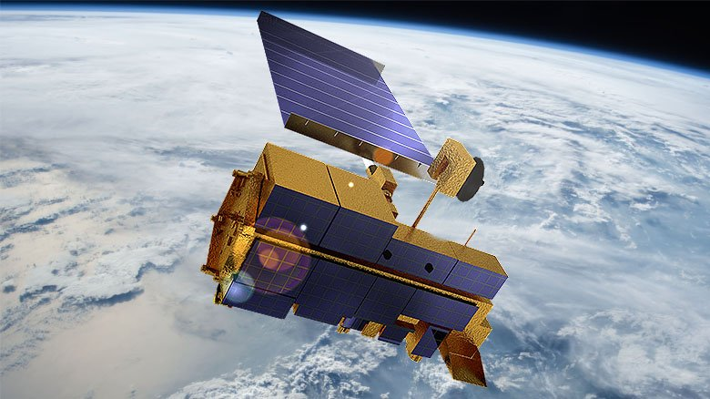
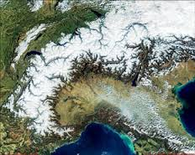
Latest Advances in Fractional Snow Cover Mapping on MODIS Data by Machine Learning Algorithms
4-8 May 2020 Online
Semih Kuter¹ Zuhal Akyürek^{2, 3}
¹Çankırı Karatekin University, Faculty of Forestry, Forest Engineering Department, 18200 Çankırı, Turkey
²Middle East Technical University, Department of Civil Engineering, Ankara, 06800 Ankara, Turkey
³Middle East Technical University, Graduate School of Natural and Applied Sciences, Department of Geodetic and Geographic Information Technologies, 06800, Ankara, Turkey
METU

Slide 2
Outline
Introduction
Study Area
Image Dataset (MODIS – Landsat 8 OLI)
FSC Mapping by Machine Learning Algorithms
Neural Networks (ANNs)
Multivariate Adaptive Regression Splines (MARS)
Random Forests (RF)
Support Vector Regression (SVR)
Conclusions

Slide 3
Introduction
Study Area – European Alps

Slide 4
Introduction
Image Dataset – 20 MODIS – Landsat 8 pairs
Image pair no | Date of acquisition | Scene time Landsat/MODIS | OLI tile Path/Row - Processing level | Number of available pixels
Training scenes
1 | 18.04.2013 | 10:19/09:45 | 195/29 - L1T | 47,369
2 | 15.01.2014 | 10:18/09:45 | 195/29 - L1T | 63,789
3 | 08.03.2014 | 09:52/09:20 | 191/28 - L1T | 75,880
4 | 13.03.2014 | 10:11/09:35 | 194/28 - L1T | 66,027
5 | 07.04.2014 | 10:04/09:30 | 193/27 - L1T | 82,381
6 | 14.04.2014 | 10:10/09:35 | 194/28 - L1T | 73,053
7 | 12.12.2014 | 09:58/09:25 | 192/27 - L1T | 41,004
8 | 13.01.2015 | 09:58/09:25 | 192/27 - L1T | 53,101
9 | 10.02.2015 | 10:23/09:50 | 196/29 - L1T | 78,894
10 | 12.02.2015 | 10:10/09:35 | 194/29 - L1T | 39,116
11 | 19.02.2015 | 10:17/09.45 | 195/29 - L1T | 66,396
12 | 18.03.2015 | 09:57/09:25 | 192/27 - L1T | 70,155
13 | 20.12.2015 | 10:17/09:45 | 195/28 - L1T | 37,146
14 | 21.01.2016 | 10:17/09.45 | 195/29 - L1T | 57,258
15 | 22.12.2016 | 10:17/09.45 | 195/29 - L1T | 69,606
Test scenes
A | 16.12.2013 | 10:06/09:30 | 193/28 - L1T | 59,984
B | 01.01.2014 | 10:05/09:30 | 193/28 - L1T | 38,479
C | 13.03.2014 | 10:10/09:35 | 194/27 - L1T | 81,481
D | 12.02.2015 | 10:10/09:35 | 194/28 - L1T | 53,587
E | 24.04.2015 | 10:16/09:45 | 195/28 - L1T | 64,061
Combined | N/A | N/A | N/A | 297,592
All MOD02HKM images are reprojected to a common WGS84/UTM coordinate system.
MODIS pixels with water, cloud, cloud shadow and pixels adjacent to clouds are masked and excluded from further analysis.

Slide 5
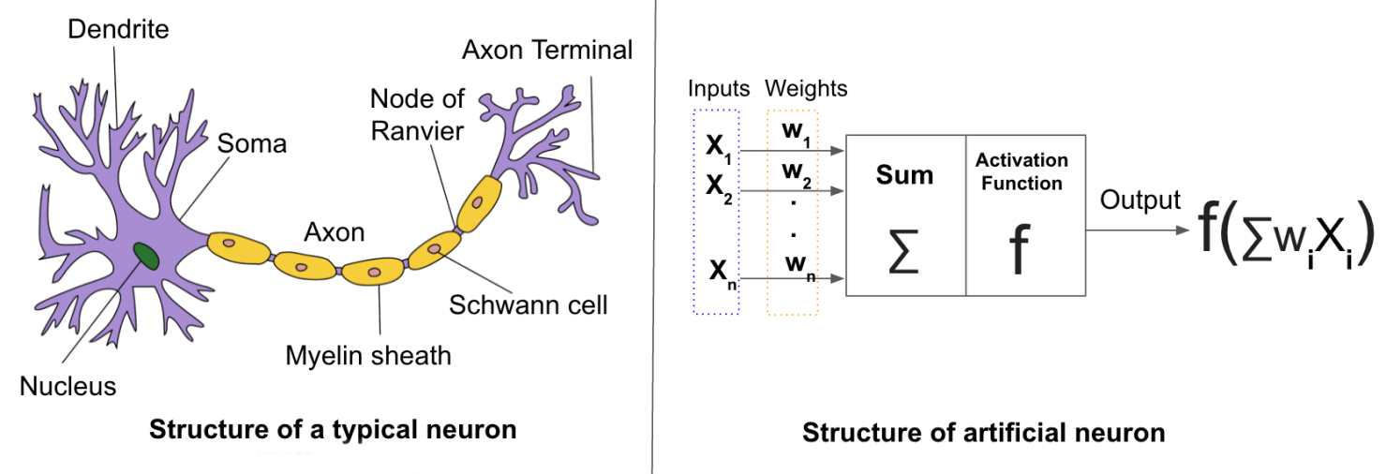
FSC Mapping by ANNs, MARS, RF & SVR
Artificial Neural Networks (ANNs):
A machine learning algorithm that can generate an information processing model by resembling the knowledge acquisition mechanism of the brain from the environment.
A neural network can approximate highly nonlinear relationships between input variables and a target variable without requiring a priori knowledge of the nature of this relationship.
Notes:
NDSI ≥ 0.4 and band 2 reflectance > 11% (to separate snow from water) and band 4 reflectance ≥ 10% (to prevent dark targets from being erroneously classified as snow despite high NDSI values) (Klein & Barnett, 2003). The later and upgraded versions of the algorithm include; i) the combination of NDSI with Normalized Difference Vegetation Index (NDVI) by employing MODIS bands 1 (0.620 - 0.670 µm) and 2 (0.841 - 0.876 µm) to improve snow cover mapping accuracy in dense forest stands (Klein et al., 1998), and ii) the implementation of a thermal mask by using MODIS infrared bands 31 (10.78 - 11.28 µm) and 32 (11.77 - 12.27 µm) to eliminate much of the spurious snow cover found in many parts of the globe in the earlier MODIS snow maps (Hall et al., 2006).
Spectral mixture analysis is perhaps the most commonly used method to estimate FSC, and based on the assumption that the radiance measured by a sensor is a linear combination of radiances reflected from individual surfaces, i.e., end members, whose spectral signatures are unique and well separated above a random image noise level
Another method for subpixel snow fraction mapping from Terra and Aqua MODIS images was developed through establishing a statistical linear relationship between NDSI and FSC in a MODIS pixel by using higher resolution Landsat snow maps as an estimate of reference FSC (Salomonson & Appel, 2004, 2006)

Slide 6
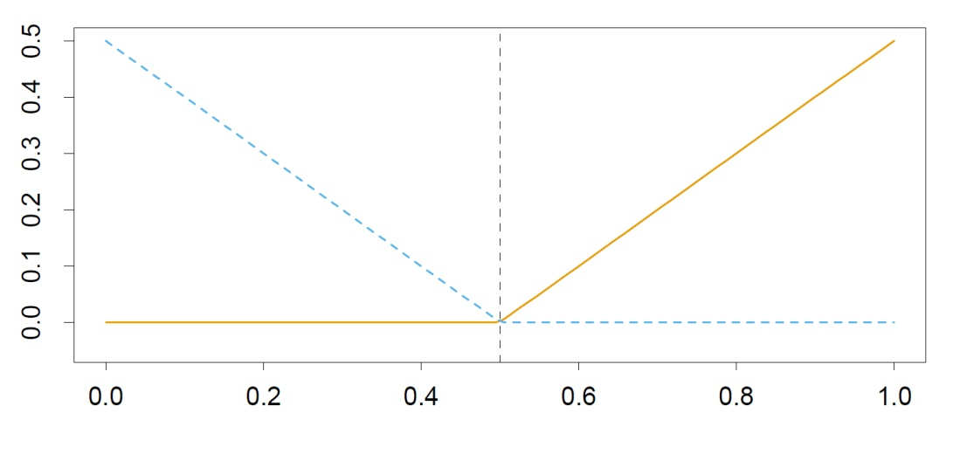
FSC Mapping by ANNs, MARS, RF & SVR
Multivariate Adaptive Regression Splines (MARS)
A state-of-the-art nonparametric regression procedure introduced by Friedman in 1991.
Expansions of the truncated piecewise linear functions:
Reflected pair
τ
x
y : Response variable,
x = (x₁, x₂,…,x_{p})^{T}, vector of predictors,
ε: observation error with zero mean and finite variance.

Slide 7
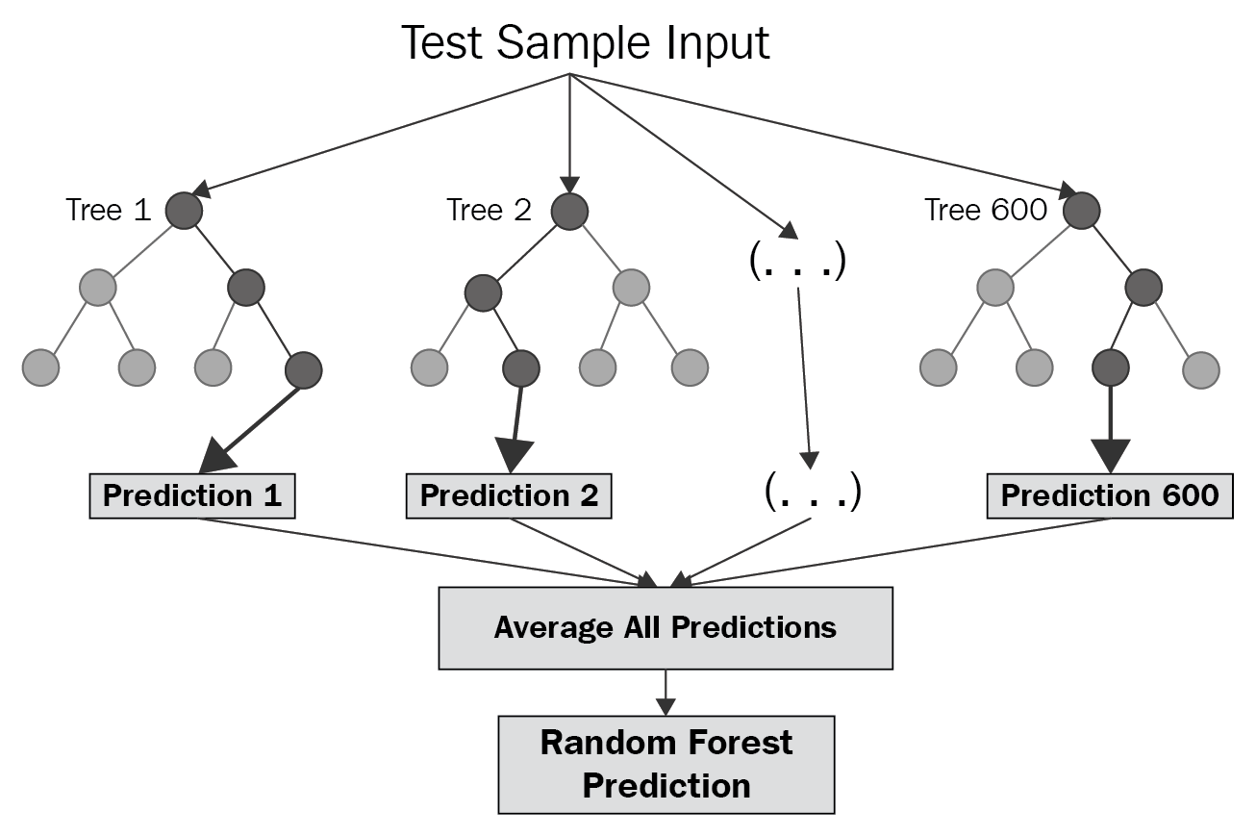
FSC Mapping by ANNs, MARS, RF & SVR
Random Forests (RF)
RFs introduced by Breiman (2001) is an ensemble of Classification and Regression Trees and fundamentally based on the Breiman’s bagging idea.

Slide 8
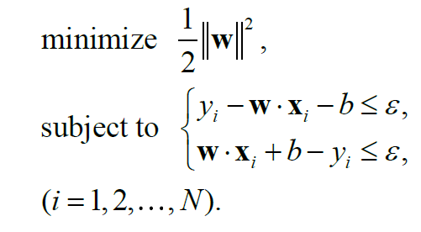
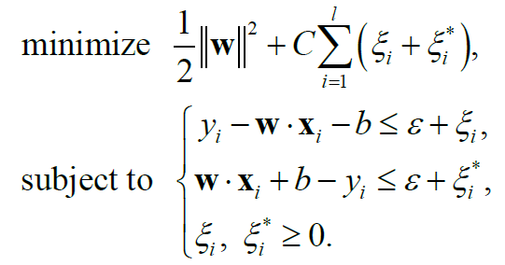
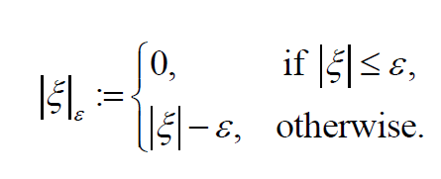
FSC Mapping by ANNs, MARS, RF & SVR
Support Vector Regression (SVR)
SVMs have also exhibited quite satisfying performance in regression even though they were initially developed for pattern recognition tasks.

Slide 9
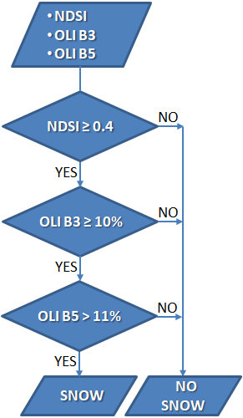
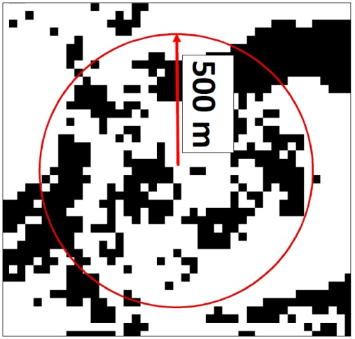
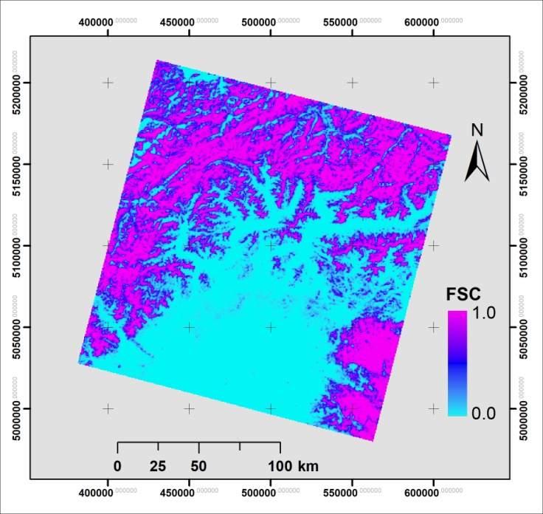
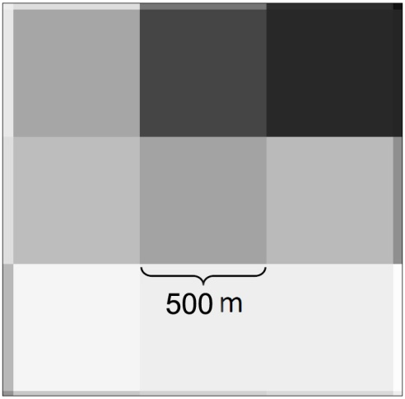
FSC Mapping by ANNs, MARS, RF & SVR
Dependent variable (Target): % snow-covered area in a MODIS pixel.
Reference FSC maps derived from higher resolution OLI data:
Landsat OLI Binary Snow Map
Reference MODIS FSC map
for test scene D
MODIS FSC Map

Slide 10
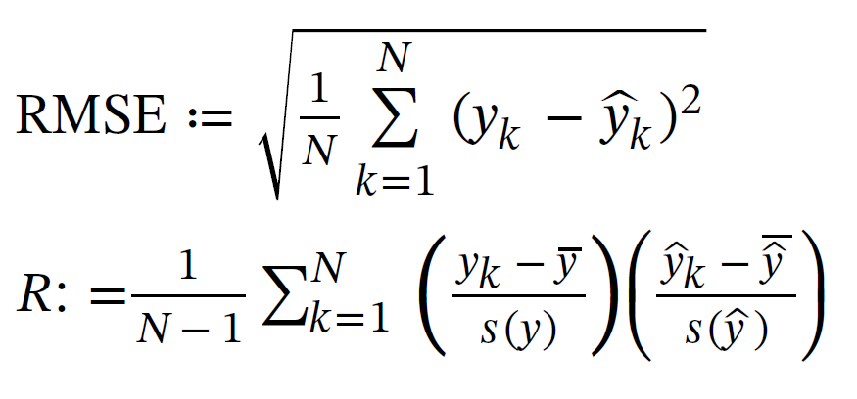
FSC Mapping by ANNs, MARS, RF & SVR
Independent variables (Input)
TOA reflectance values of MOD02HKM bands 1-7, NDSI, NDVI and IGBP land cover class (MCD12Q1 data)
Total number of available pixels for training | 921,175
Sample size | Sampling type | Number of sampled pixels
Small (2%) | SR | 18,424
 | STR_FSC | 18,425
 | STR_FSC_LC | 18,423
Medium (15%) | SR | 138,176
 | STR_FSC | 138,177
 | STR_FSC_LC | 138,178
Large (30%) | SR | 276,353
 | STR_FSC | 276,354
 | STR_FSC_LC | 276,358
Performance Metrics
SR: Simple random sampling.
STR_FSC: Stratified random sampling with respect to FSC.
STR_FSC_LC: Stratified random sampling with respect to both FSC and land cover class.

Slide 11
FSC Mapping by ANNs, MARS, RF & SVR
Results on independent test datasets:
According to the results of the repeated analysis of variance (RANOVA) test at α = 0.05, there are statistically no significant differences in the performance of the ANN, MARS, RF and SVR models with respect to RMSE and R values and they all outperform MOD10A1 product on all test datasets.
Test set | A |  | B |  | C |  | D |  | E |  | Combined
Model | RMSE | R | RMSE | R | RMSE | R | RMSE | R | RMSE | R | RMSE | R
ANN | 0.1592 | 0.8850 | 0.1464 | 0.9248 | 0.0953 | 0.9674 | 0.1976 | 0.8616 | 0.0851 | 0.9754 | 0.1377 | 0.9373
MARS | 0.1622 | 0.8818 | 0.1491 | 0.9220 | 0.1000 | 0.9651 | 0.2011 | 0.8580 | 0.0883 | 0.9736 | 0.1410 | 0.9351
RF | 0.1611 | 0.8792 | 0.1499 | 0.9211 | 0.1010 | 0.9638 | 0.2037 | 0.8526 | 0.0870 | 0.9742 | 0.1415 | 0.9336
SVR | 0.1699 | 0.8795 | 0.1599 | 0.9099 | 0.1037 | 0.9621 | 0.2057 | 0.8536 | 0.0877 | 0.9743 | 0.1461 | 0.9307
MOD10A1 | 0.2279 | 0.8375 | 0.2435 | 0.8533 | 0.1573 | 0.9455 | 0.3039 | 0.7933 | 0.1025 | 0.9702 | 0.2082 | 0.9066

Slide 12
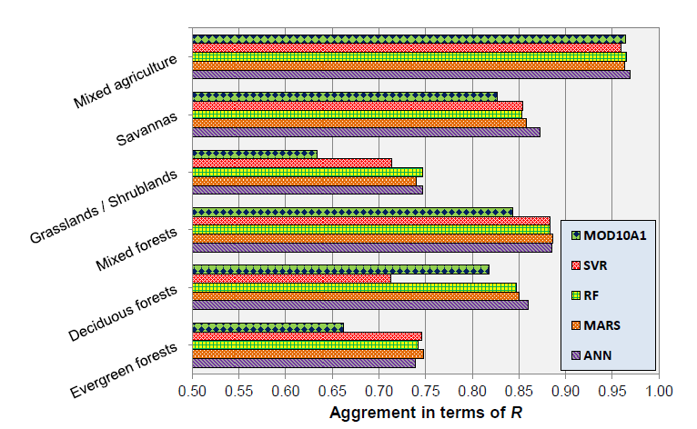
FSC Mapping by ANNs, MARS, RF & SVR
Performance of models on Combined test dataset with respect to IGBP land cover classes:

Slide 13
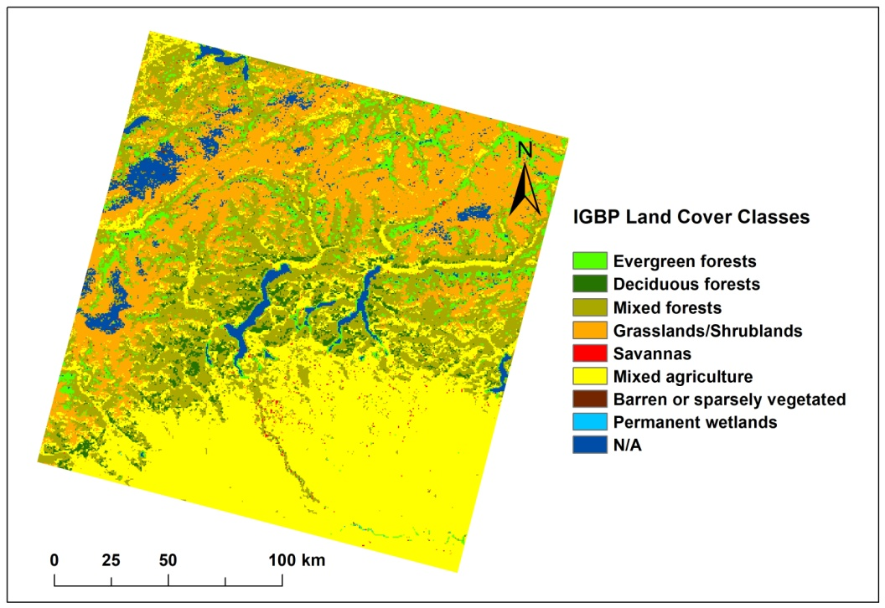
FSC Mapping by ANNs, MARS, RF & SVR
Test Image D (12 Feb 2015 – Landsat 8 Tile 194/28):

Slide 14
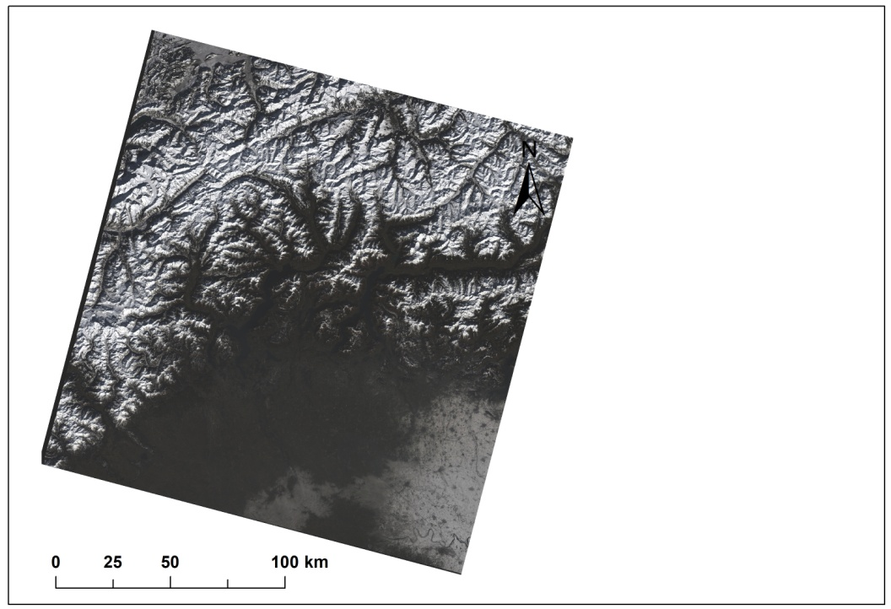
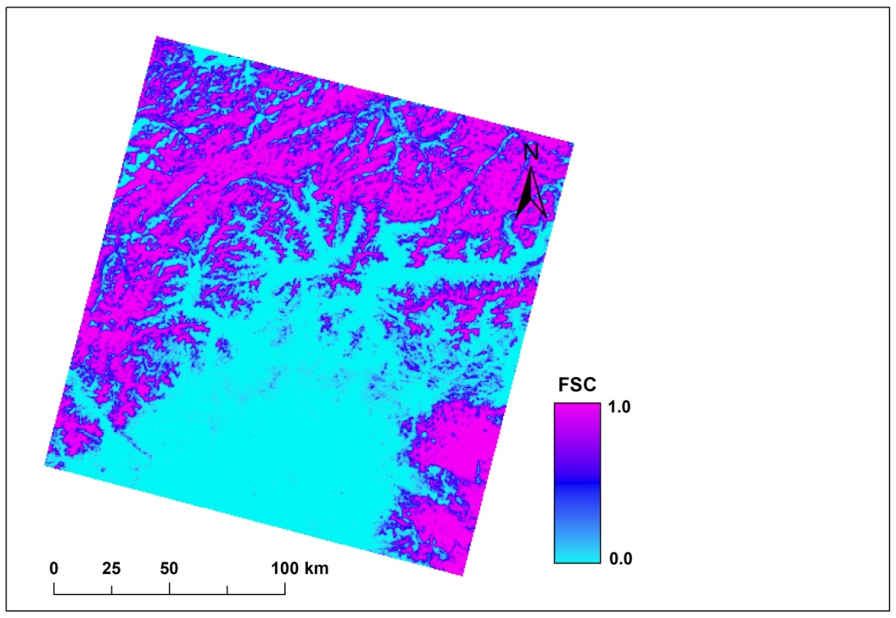
FSC Mapping by ANNs, MARS, RF & SVR
Test Image D (12 Feb 2015 – Landsat 8 Tile 194/28):
RGB Real Color
Landsat 8 derived reference FSC map

Slide 15
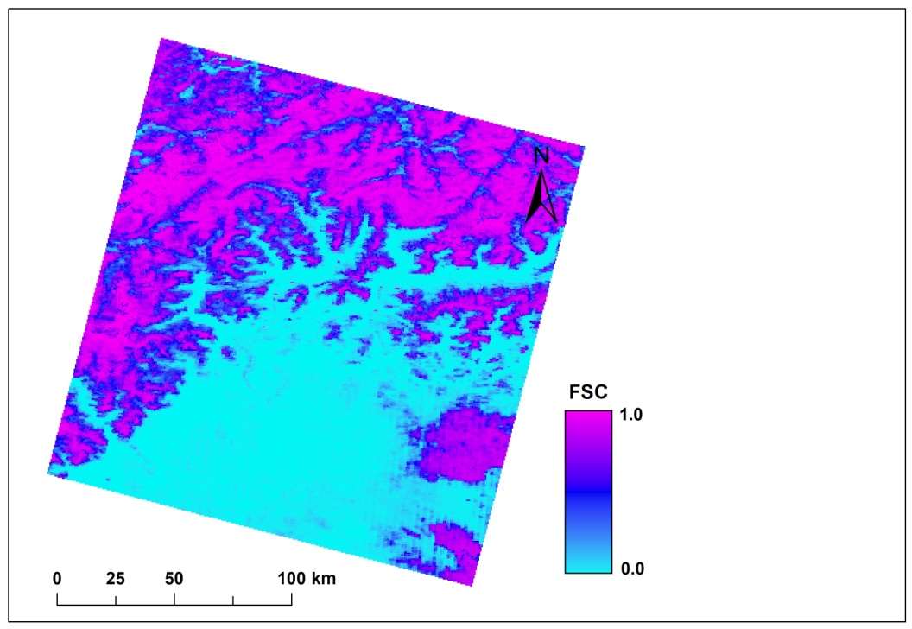
FSC Mapping by ANNs, MARS, RF & SVR
Test Image D (12 Feb 2015 – Landsat 8 Tile 194/28):
ANN FSC
Landsat 8 derived reference FSC map

Slide 16
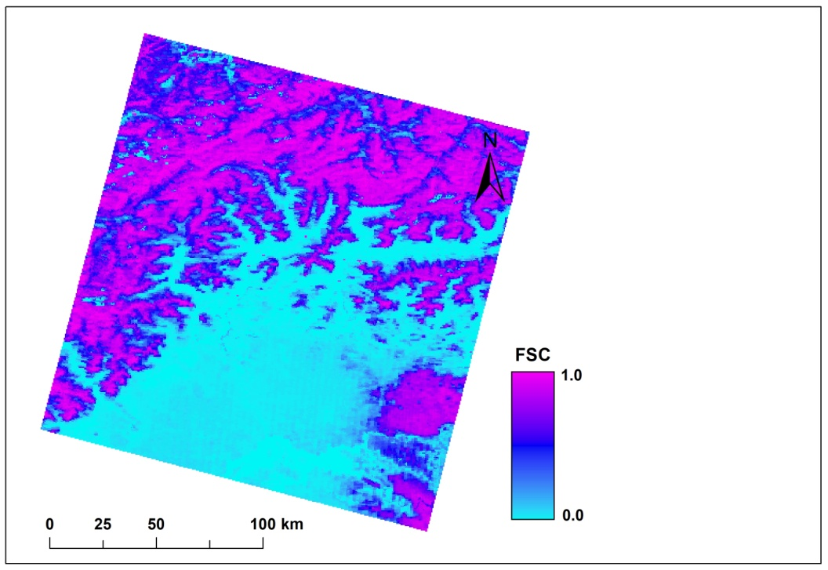
FSC Mapping by ANNs, MARS, RF & SVR
Test Image D (12 Feb 2015 – Landsat 8 Tile 194/28):
MARS FSC
Landsat 8 derived reference FSC map

Slide 17
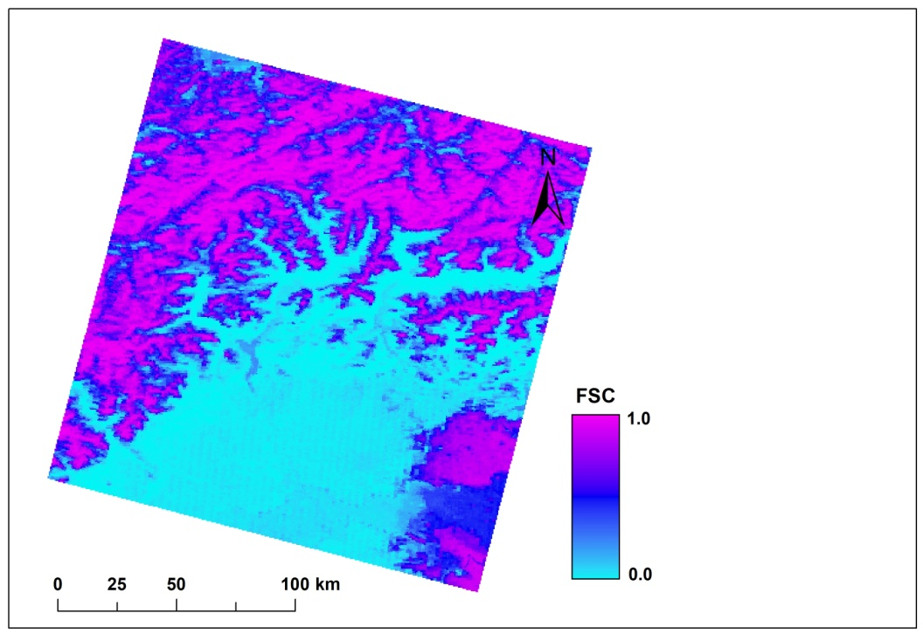
FSC Mapping by ANNs, MARS, RF & SVR
Test Image D (12 Feb 2015 – Landsat 8 Tile 194/28):
RF FSC
Landsat 8 derived reference FSC map

Slide 18
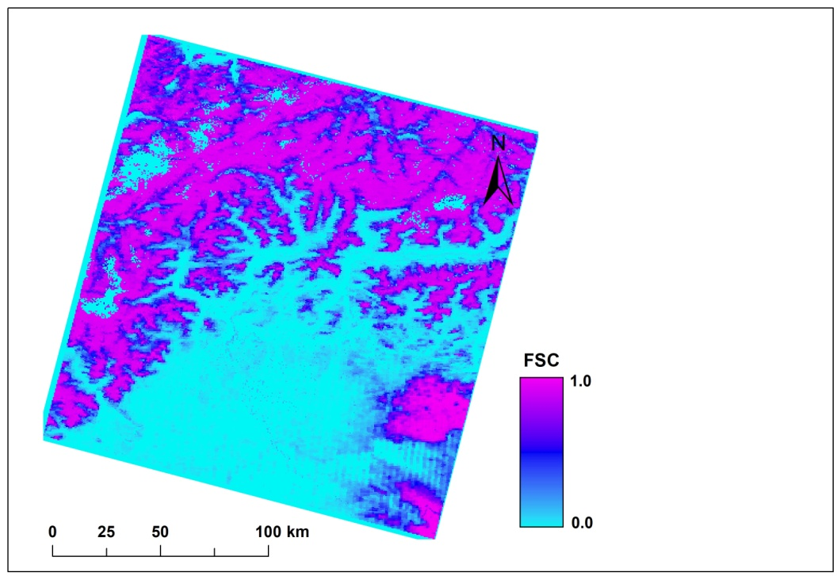
FSC Mapping by ANNs, MARS, RF & SVR
Test Image D (12 Feb 2015 – Landsat 8 Tile 194/28):
SVR FSC
Landsat 8 derived reference FSC map

Slide 19
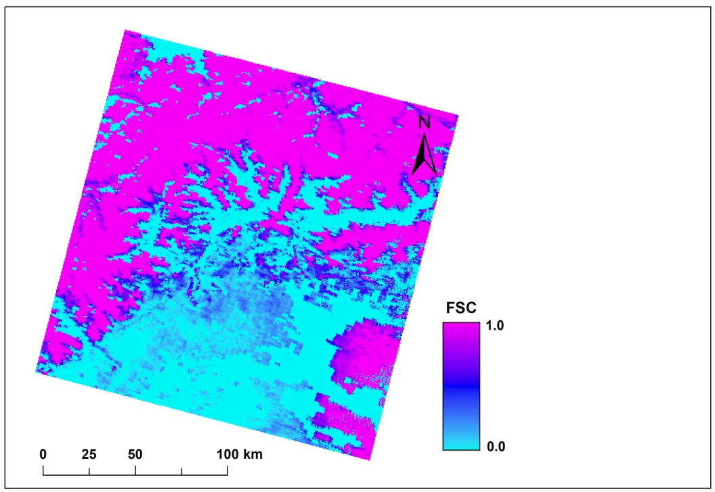
FSC Mapping by ANNs, MARS, RF & SVR
Test Image D (12 Feb 2015 – Landsat 8 Tile 194/28):
MOD10 FSC
Landsat 8 derived reference FSC map

Slide 20
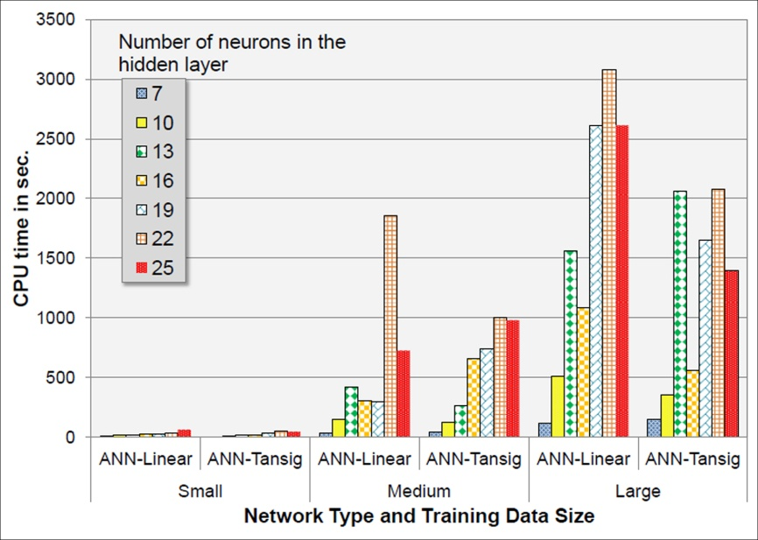
FSC Mapping by ANNs, MARS, RF & SVR
Performance of models in terms of average CPU times (sec.) with respect to training data size:
PC with an AMD FX 8320 3.5 GHz CPU & 16GB 1600 MHz RAM

Slide 21
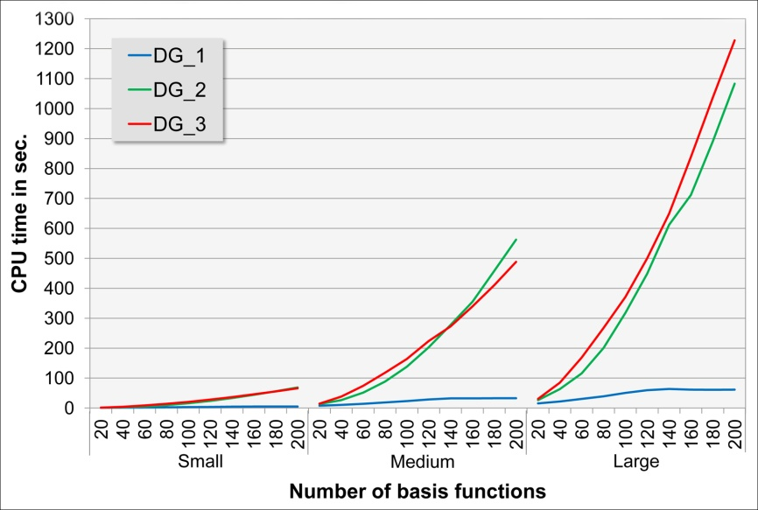
FSC Mapping by ANNs, MARS, RF & SVR
Performance of models in terms of average CPU times (sec.) with respect to training data size:
MARS

Slide 22
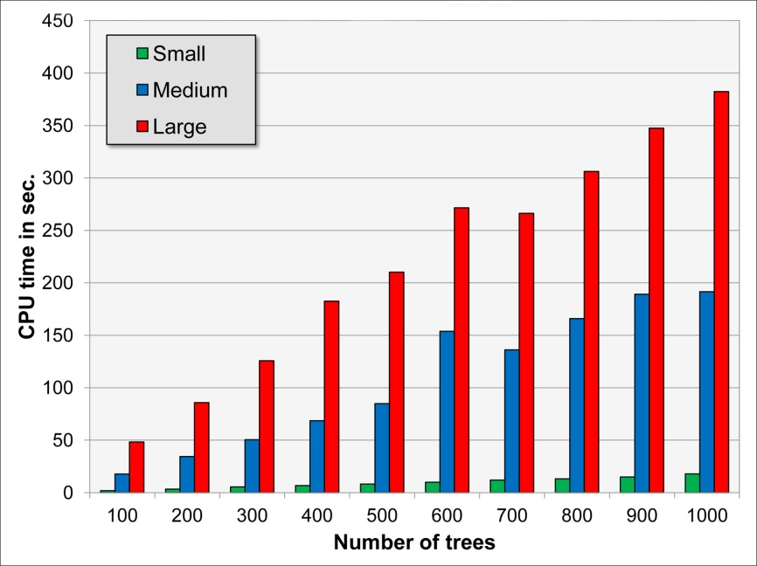
FSC Mapping by ANNs, MARS, RF & SVR
Performance of models in terms of average CPU times (sec.) with respect to training data size:
RF

Slide 23
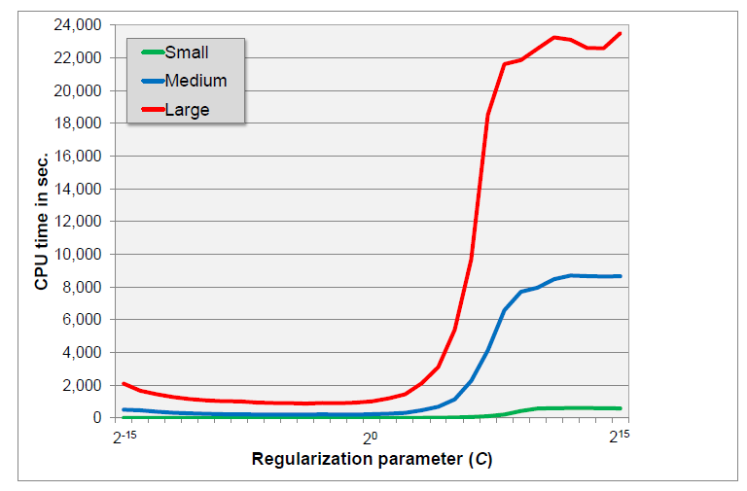
FSC Mapping by ANNs, MARS, RF & SVR
Performance of models in terms of average CPU times (sec.) with respect to training data size:
SVR

Slide 24
FSC Mapping by ANNs, MARS, RF & SVR
Variable importances in MARS and RF:
Predictor Name | MARS (%) | RF
Band 1 | 5.6 | 1.02
Band 2 | 32.2 | 1.62
Band 3 | 17.7 | 1.09
Band 4 | 9.8 | 0.95
Band 5 | 12.0 | 5.06
Band 6 | 17.7 | 3.91
Band 7 | 0.0 | 3.64
NDSI | 100.0 | 2.28
NDVI | 10.4 | 0.97
Land Cover | 15.0 | 12.21

Slide 25
Conclusions
Promising results by machine learning algorithms in FSC mapping.
ANNs & SVR: Suffering from black-box phenomenon:
Difficult to provide a comprehensible explanation of the process through which a given output has been obtained from the inputs.
MARS and RF have distinctive advantages:
Simplicity in model building: No. of model tuning parameters,
The speed during model training,
Variable importance,
A regression-like function that can be used to understand and explain the final model.
Notes:
The SVM algorithm has 2 ultimate objectives: 1st and 2nd bulleted entries…

Slide 26
References
Breiman, L. (2001). Random forests. Machine Learning, 45, 5-32.
Czyzowska-Wisniewski, E. H., van Leeuwen, W. J. D., Hirschboeck, K. K., Marsh, S. E. and Wisniewski, W. T. (2015). Fractional snow cover estimation in complex alpine-forested environments using an artificial neural network. Remote Sensing of Environment, 156(0), 403-417.
Dobreva, I. D. and Klein, A. G. (2011). Fractional snow cover mapping through artificial neural network analysis of MODIS surface reflectance. Remote Sensing of Environment, 115(12), 3355-3366.
Friedman, J. H. (1991). Multivariate adaptive regression splines. The Annals of Statistics, 19(1), pp. 1-67.
Hall, D. K., Riggs, G. A. and Salomonson, V. V. (1995). Development of Methods for Mapping Global Snow Cover Using Moderate Resolution Imaging Spectroradiometer Data. Remote Sensing of Environment, 54, 127-140.
Hastie, T., Tibshirani, R. and Friedman, J. (2009). The Elements of Statistical Learning: Data Mining, Inference, and Prediction (2nd ed.). NY, USA: Springer.
Painter, T. H., Dozier, J., Roberts, D. A., Davis, R. E. and Green, R. O. (2003). Retrieval of subpixel snow-covered area and grain size from imaging spectrometer data. Remote Sensing of Environment, 85(1), pp. 64-77.
Salomonson, V. V. and Appel, I. (2004). Estimating fractional snow cover from MODIS using the normalized difference snow index. Remote Sensing of Environment, 89, pp. 351-360.
Sirguey, P., Mathieu, R. and Arnaud, Y. (2009). Subpixel monitoring of the seasonal snow cover with MODIS at 250 m spatial resolution in the Southern Alps of New Zealand: Methodology and accuracy assessment. Remote Sensing of Environment, 113(1), pp. 160-181.
Vapnik, V. (2000). The Nature of Statistical Learning Theory. New York: Springer-Verlag.
Zhu, J., Shi, J. and Wang, Y. (2012). Subpixel snow mapping of the Qinghai–Tibet Plateau using MODIS data. International Journal of Applied Earth Observation and Geoinformation, 18, pp. 251-262.
Notes:
The SVM algorithm has 2 ultimate objectives: 1st and 2nd bulleted entries…

Slide 27
4-8 May 2020 Online
Thank You…
METU
Notes:
The SVM algorithm has 2 ultimate objectives: 1st and 2nd bulleted entries…

