Slide 1
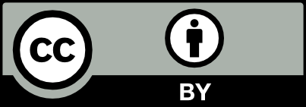
The reason versus the emotion and the perfect Wave. Report of a witness.
Eduardo Marone
CEM/UFPR – IOILACTC - IAPG

Slide 2
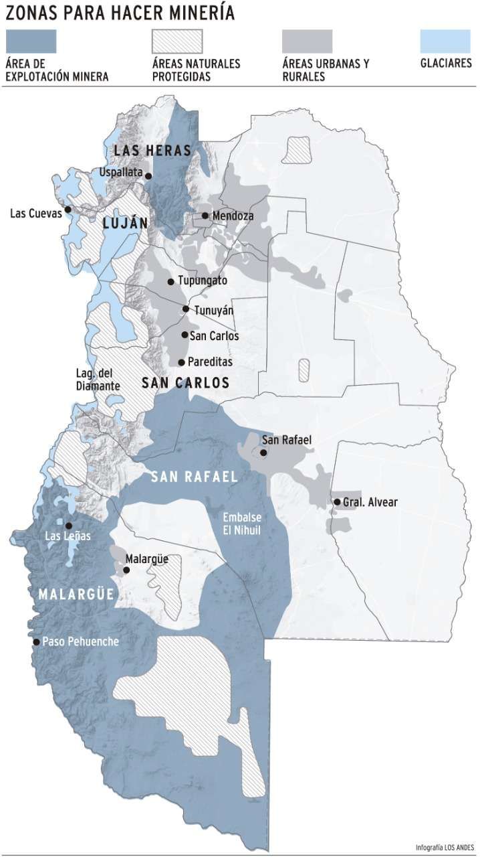
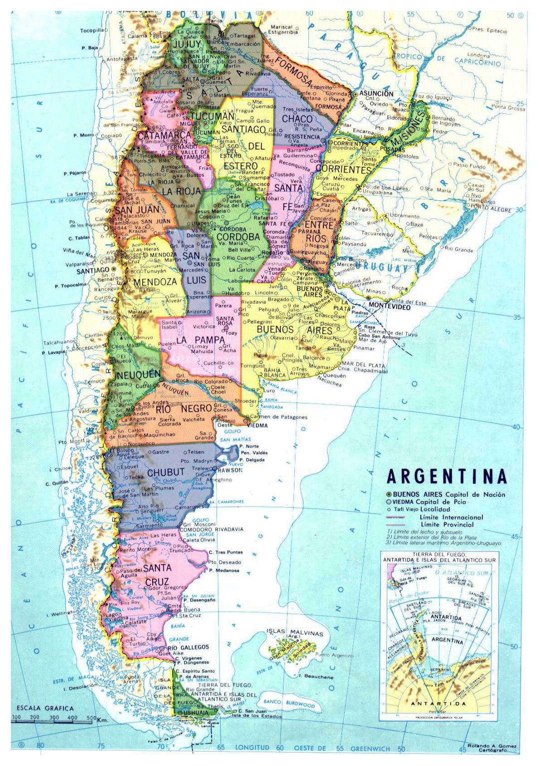
BEING IN THE RIGHT PLACE IN THE RIGHT TIME
At the end of 2019, for personal reasons, I was visiting Mendoza, Argentina and had the opportunity of witnessing a social movement against a change in the State Mining Law (or Code).
Mendoza, at the piedmont of the Andes, is a semi-arid region (less than 250 mm of rain per year). Agriculture represents one important activity (consuming around 80% of the water). A little more than 10% is for human consumption, around 4% for recreational/environmental use, 1% for Industry and 1% for the oil and mining industry⁽¹⁾. All this water came from the melting of the Andes ice and snow and aquifers, resources depleted⁽²⁾ due to climate changes and overexploitation.
Apologises but most of the linked material is in Spanish
⁽¹⁾ Departamento General de Irrigación. Mendoza. 2019.
⁽²⁾ Martín Rizzo product, Mendoza’s Reservoirs changes 1985-2014 – from internet on May 5, 2020

Slide 3
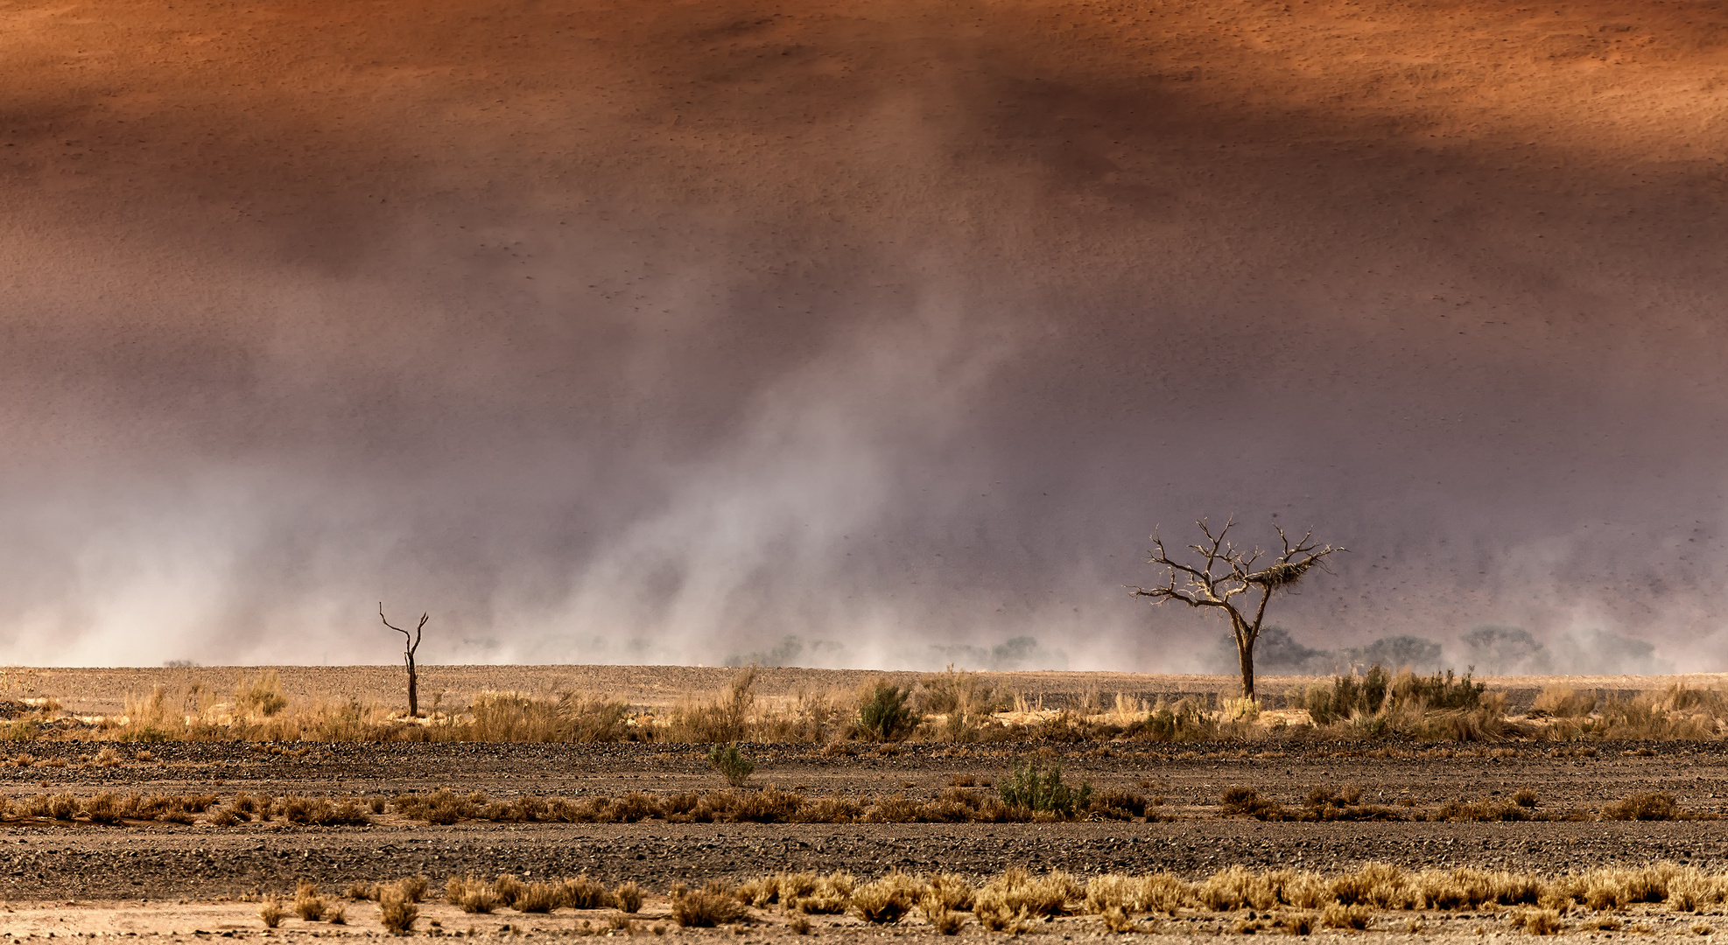
The PERFECT STORM
Mendoza has a very advanced and environmentally friendly Mining Code (Law 7722) but seen as too restrictive from others. It limits projects in glacier areas and the use of chemicals to extract minerals like gold and others.
At the end of 2019, the new elected Government decided to modify the Mining Code keeping near glacier limitations but allowing the controlled use of chemicals for mining and establishing many mechanisms to theoretically ensure the enforcement of the new code, to protect the environment and the scarce water resources. It has to be noted that the new law was a campaign promise. It was quickly approved at the State Congress, but the wave against it was already in motion helped by social networks and other hidden actors. It has to be noted that the new law complain with most of the IAPG White Paper on Responsible Mining⁽³⁾.
Protestors closed roads, claiming the water would be contaminated, that agriculture would suffer from pollution, even worrying about water shortage and other panicking scenarios.
⁽³⁾ Arvanitidis N., Boon J., Nurmi P. and Di Capua G. 2017. White Paper on Responsible Mining. IAPG - http://www.geoethics.org/wp-responsible-mining

Slide 4
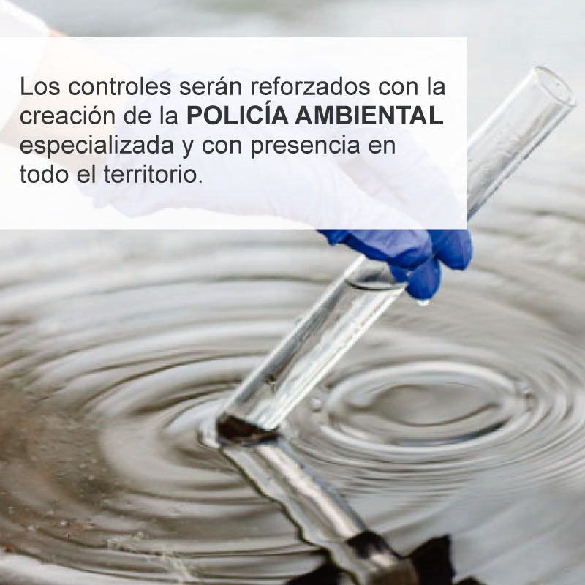
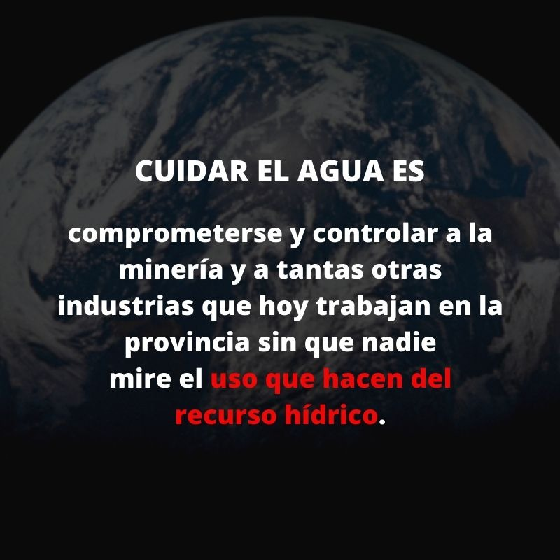
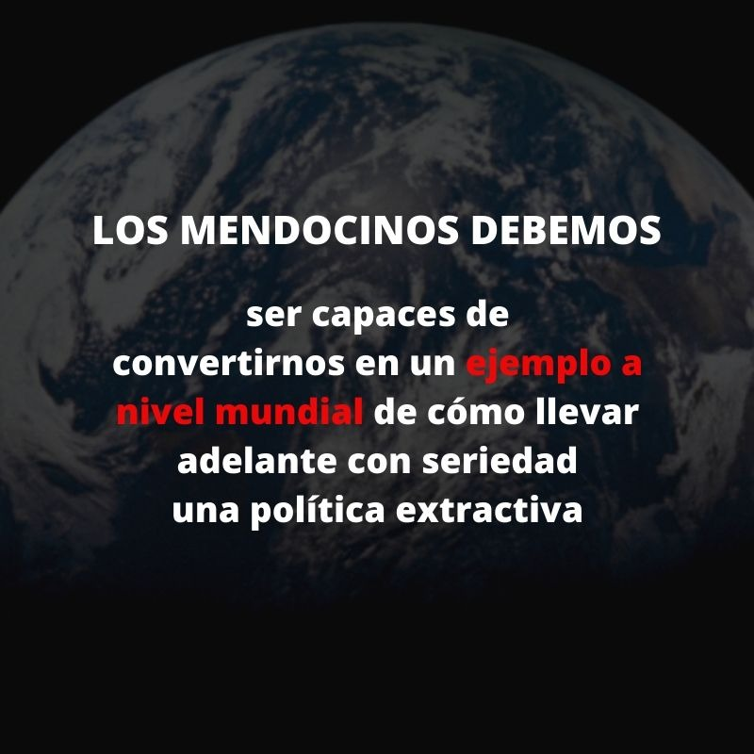
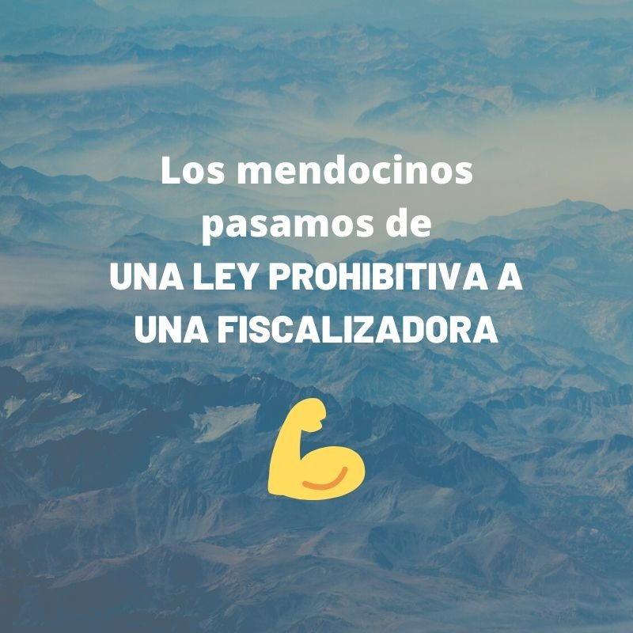
WAS SO WRONG THE NEW LAW?
Not in the written form, even because it followed many of the Responsible Mining recommendations not only from IAPG’s White Paper but from many professional, scientific and environmental organizations. Precautionary mechanisms were established as external audits.
A Social Contract System was proposed, as well as an environmental
enforcement corp. Why the Government proposal did not work?
MISINFORMATION & MANIPULATION
CONFLICT OF INTERESTS
FEAR AND ITS IRRATIONAL CONSEQUENCES
DISTRUST ON INSTITUTIONS
IMPROPER SCIENTIFIC COMMUNICATION
HISTORICAL AND RECENT MINING HAZARDS
INEFFICIENT GOVERNMENT COMMUNICATION
EMOTION TAKING OVER RATIONAL DIALOG

Slide 5
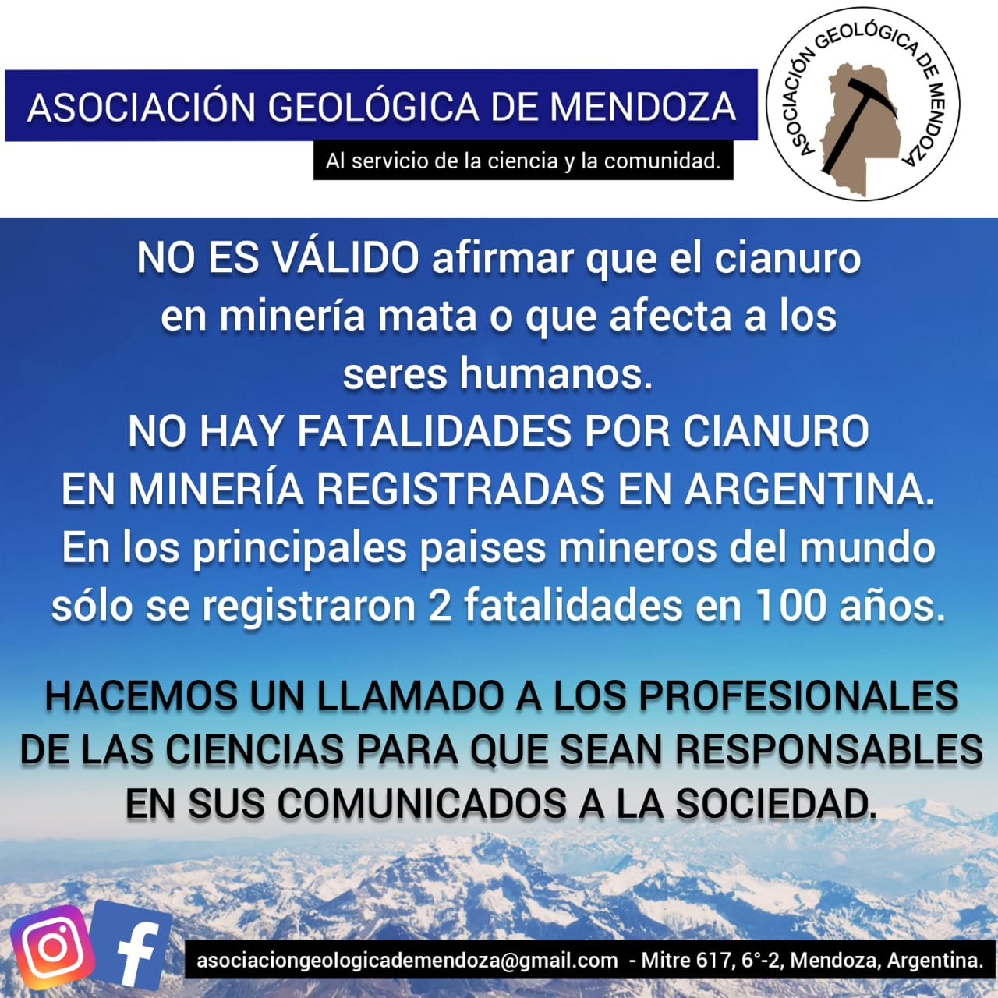
HOW SCIENCE FAILED?
In spite of the efforts of the professional associations and the science supporting the potential benefits of the new code, it was not enough:
The usual lack of proper communication skill of the scientific community to inform the public efficiently in times of social networks⁽⁴⁾.
The lack of financial power to inform the public.
The ethical conflict between the role as scientists or citizens⁽⁵⁾.
⁽⁴⁾ Begon, M. 2017. Winning Public Arguments As Ecologists: Time for a New Doctrine? Trends in Ecology & Evolution 32 (6): 394–96. https://doi.org/10.1016/j.tree.2017.03.009.
⁽⁵⁾ Marone E. and Marone L. 2019. Ethical dilemmas of the citizen Geoscientist doing science, technology, and profession. EGU2019

Slide 6
WHY THE GOVERNMENT RETIRED THE NEW LAW?
It was not only because the social pressure, considering they adopted the Social Contract model. The emotional reaction of the population could be misinterpreted by an outsider as an overreaction, but it can’t tell you all the history. The disbelief on State control of any activity has deep roots on this part of the world, even if it is the most rational.
Also, this mistrust is supported by the extended and mostly right conviction that the corruption is a central problem that will not help in distributing fairly the benefits of mining industry
On the corruption side, social networks informed the citizens that high ranked politicians from the most important parties were opening small mining companies days before the law was approved by the Congress.
Finally, the Governor derogated the new law.
Concluding, a lost-lost situation

Slide 7
AND NOW, WHAT?
NO NEW MINING ACTIVITIES THAT COULD ENHANCE THE STATE ECONOMY.
NO CONTROL OVER THE LESS EFFICIENT ACTIVITY (AGRICULTURE) THAT WASTES 50% OF THE WATER.
NO CONTROL with gauges, EVEN, OF WATER CONSUMPTION ON HOUSEHOLDS.
NO NEW FUNDS FROM ROYALTIES TO REDUCE SOCIAL INEQUALITIES.
NO NEW FUNDS FROM ROYALTIES TO PROTECT THE ENVIRONMENT BETTER.
NO NEW FUNDS FROM ROYALTIES TO CREATE A MITIGATION PLAN AGAINST CLIMATE CHANGE.
WHY? BECAUSE OUR SOCIETY IS NOT READY TO ACT ETHICALLY; FROM THE STATE OFFICIALS, TO THE STAKEHOLDERS; FROM SCIENTISTS AND PROFESSIONALS TO REGULAR CITIZENS; FROM NGOs TO INDUSTRIES.

Slide 8
RESPONSIBLE MINING (AND OTHER HUMAN ACTIVITIES) ARE POSSIBLE. WE JUST NEED RESPONSIBLE HUMANS.
THANKS AND TAKE CARE!

