Slide 1
EGU2020-1322 Acoustic Monitoring of Anomalous Stressed Zones, Determination of their Positions, Surfaces, Evaluation of Catastrophic Risk. Olga Hachay and Oleg Khachay

Slide 2
Abstract
A new approach to the interpretation of wave fields has been developed to determine the contours or surfaces of composite local hierarchical objects.
An iterative process has been developed to solve a theoretical inverse problem for the case of determining the configurations of 2D hierarchical inclusions of the l-th, m-th, and s-th ranks located one above the other in different layers of the N-layer medium and various physical and mechanical properties for active acoustic monitoring with sources of longitudinal and transversal waves.
When interpreting the results of monitoring, it is necessary to use data from such observation systems that can be configured to study the hierarchical structure of the environment. Such systems include acoustic (in the dynamic version) and electromagnetic monitoring systems.
The hierarchical structure of the geological environment is clearly visible when analyzing rock samples taken from ore mines. On the other hand, the more complex the environment, the each wave field introduces its information about its internal structure, therefore, the interpretation of the seismic and electromagnetic fields must be conducted separately, without mixing these databases.
This result is contained in the explicit form of the equations of the theoretical inverse problem for a 2D electromagnetic field (E and H polarization), as well as for the propagation of a linearly polarized elastic wave when excited by an N-layer conducting or elastic medium with a hierarchical conducting or elastic inclusion located in the ν-th layer. In the present work, the inverse problem for a complicated hierarchical model of inclusions is considered. It can be used when conducting monitoring seismic and acoustic borehole studies to monitor the fluid return of oil fields, to analyze the dynamic state of a mountain range of deep-seated deposits which are under various mechanical effects.

Slide 3
INTRODUCTION
An important role for understanding the formation and development of a hierarchy of structural levels of deformation in solids is played by theoretical and experimental results obtained on samples [Panin V.E., et al., 1985].
With their help, an approach has been developed that uses ideas about dissipative structures in noneqiulibrium systems [Nikolis G., Prigozin I., 1979], for which self-organization processes take place at each of the hierarchical levels. As shown in [Nikolis G., 1989], self-organization occurs when there is a hierarchical structure.
This approach can be applied to the study of such natural and man-made systems, such as rock massifs, which are in the process of mining. The model of an open dynamic system [Nikolis G., Prigozin I., 1990] is applicable for their description. Analysis of the manifestations of self-organization processes can give an idea of ​​the stability of the system and contribute to the development of criteria for the stability of the state of the array as a whole regarding the dynamic phenomena of a given energy class. This satisfies the statement expressed in [Goldin S.V., 2002], which consists in the hypothesis about the divisibility of medium scales. While the destruction of smaller scales fits into the concept of a nonstationary random process, for which the prediction of individual events is not possible.

Slide 4
INTRODUCTION
In [Hachay О.А., 2004; Hachay O.A., et al., 2003], using 3D electromagnetic induction space-time monitoring [Hachay О.А., 2007, Hachay O.A. et al., 2001], it was possible to show that the model of a hierarchical discrete environment is applicable to describe the structure of an array of rocks of different material composition. Within the framework of a specific modification of the method, it was possible to trace two hierarchical levels. The zones of disintegration [Shemjakin E.I.et al., 1986; Shemjakin E.I.et al., 1992] in the near-working space are located asymmetrically in the soil and roof, which may be evidence of a non-equilibrium state of the system. These zones are located discretely, i.e. there are intervals of their total absence in the near-working space. The maximum changes in the massif, which is under the anthropogenic influence, manifest themselves in the change over time of the morphology of the spatial position of these zones (Figure. 1 (a-d))

Slide 5
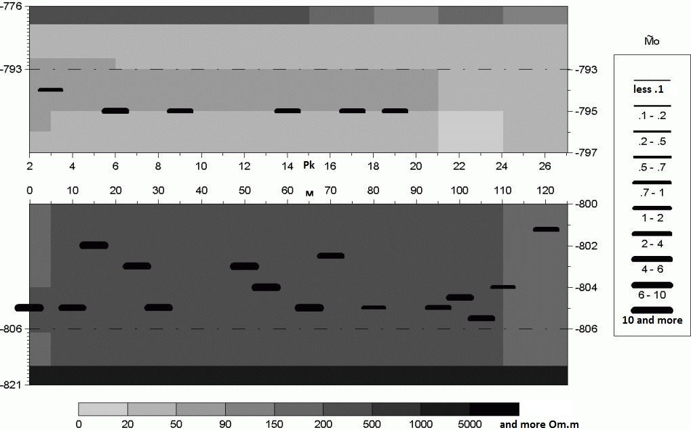
INTRODUCTION
a

Slide 6
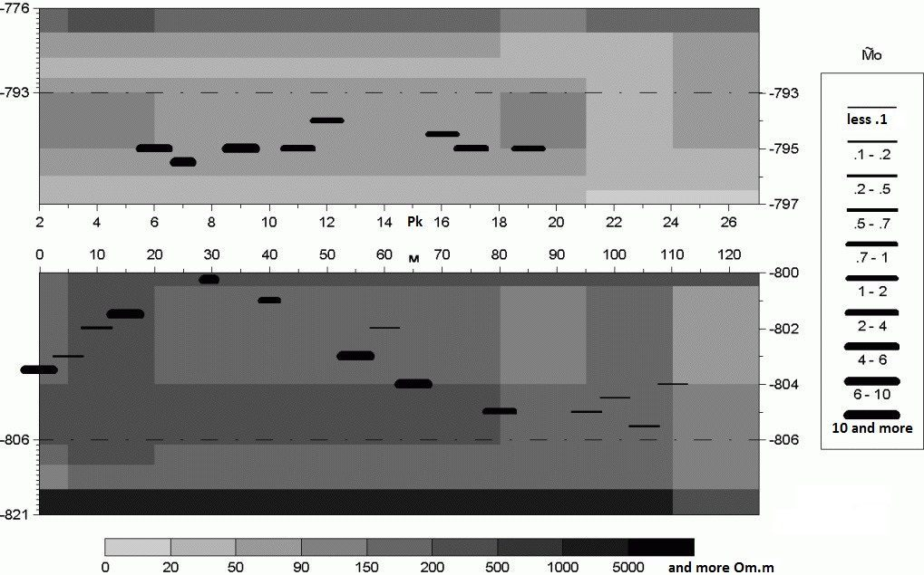
INTRODUCTION
b

Slide 7
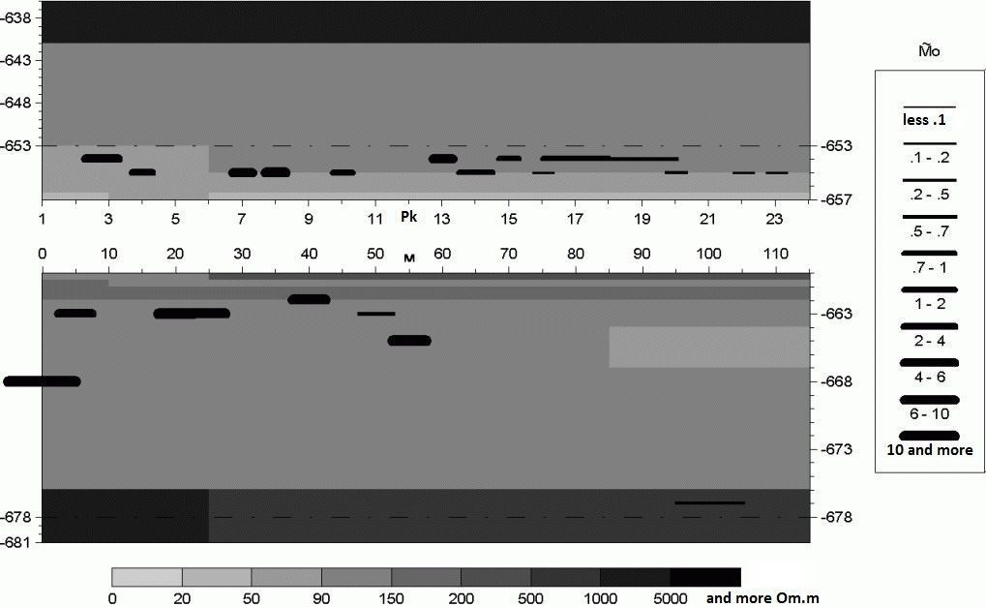
INTRODUCTION
c

Slide 8
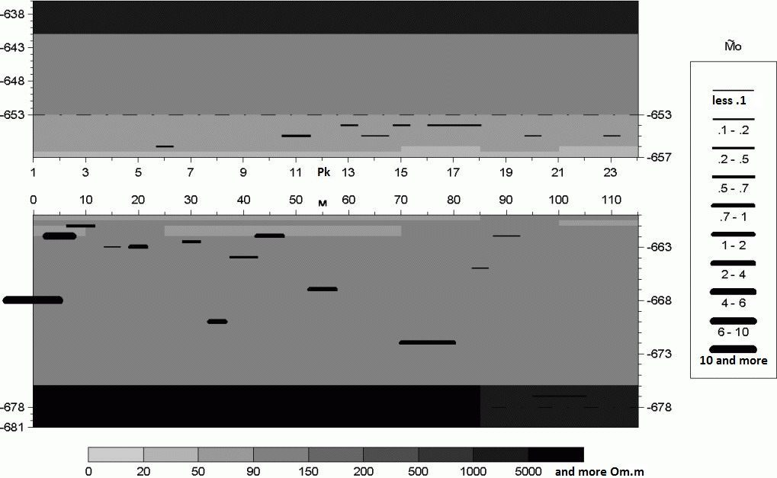
INTRODUCTION
d

Slide 9
INTRODUCTION
Figure1. The manifestation of the process of self-organization in the morphology of the zones of disintegration identified according to the data of electromagnetic induction monitoring a) Geoelectrical section according to ort 19, horizon –350, frequency 20 kHz, observations 2002; b) Geoelectrical section of the ort 19, horizon –350, frequency 20 kHz, observations 2003; c) Geoelectrical section ort 8, horizon –210, frequency 10 kHz, observations 2002; d) Geoelectrical section in line 8, horizon –210, frequency 10 kHz, observations 2003.

Slide 10
INTRODUCTION
At present, theoretical results on modeling the electromagnetic and seismic field in a layered medium with inclusions of a hierarchical structure are in demand. Simulation algorithms are constructed in the electromagnetic case for the 3D heterogeneity, in the seismic case for the 2D heterogeneity [Hachay O.A., Khachay A.Yu., 2016a; Hachay, O., Khachay A., 2017; Hachay O.A. et al. 2018a; Hachay O. A. et al., 2018b; Hachay, O. A. et al., 2015; Hachay, O. A. et al., 2016; Hachay O.A. et al. 2017a]. It is shown, that with the increase of hierarchy degree of the environment, the degree of spatial distribution nonlinearity of the seismic and electromagnetic fields components increases also. That corresponds to the detailed monitoring experiments conducted in the hazardous mines of the Tashtagol mine and SUBR. The theory developed demonstrated how complex the process of integrating methods using an electromagnetic and seismic field to study the response of a medium with a hierarchical structure. This problem is inextricably linked with the formulation and solution of the inverse problem for the propagation of electromagnetic and seismic fields in such complex environments.

Slide 11
INTRODUCTION
In [Hachay O.A., Khachay A.Yu.,2015; Hachay O.A., Khachay A.Yu.,2016b; Hachay O.A. et al., 2017b], the problem of constructing an algorithm for solving an inverse problem using the equation of a theoretical inverse problem for the 2D Helmholtz equation was considered. Explicit equations of the theoretical inverse problem are written for cases of electromagnetic field scattering (E and H polarization) and scattering of a linearly polarized elastic wave in a layered conducting and elastic medium with a hierarchical conducting or elastic inclusion, which are the basis for determining the contours of misaligned inclusions of the l-th rank of a hierarchical structure. Obviously, when solving the inverse problem, it is necessary to use observation systems set up to study the hierarchical structure of the environment as the initial monitoring data. In [Hachay O.A. et al., 2018a], a modeling algorithm was constructed for the acoustic monitoring data of a hierarchical two-phase geological environment with different physical and mechanical properties. In this paper, we construct an algorithm for reconstructing the contours of hierarchical composite structures associated with disintegration zones according to active acoustic monitoring using a source of longitudinal waves.

Slide 12
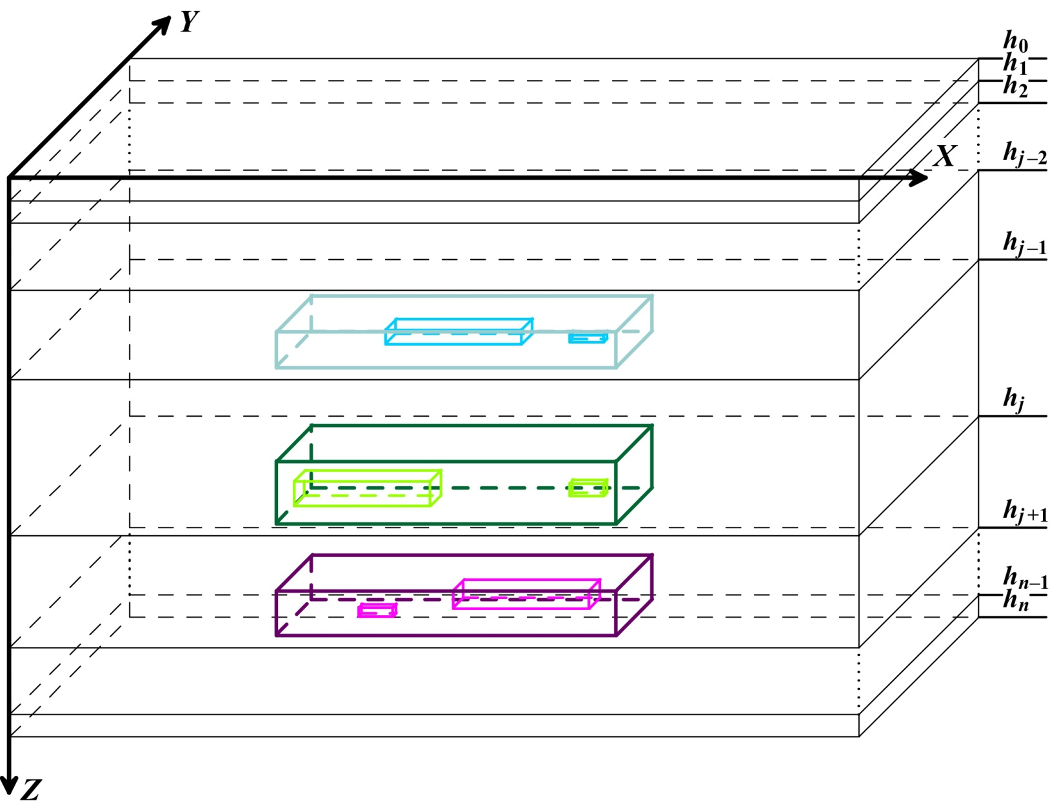
Figure 1. Scheme of a block layered medium with hierarchic inclusions of different physical and mechanical features.

Slide 13
ALGORITHM FOR SOLUTION OF THE inverse PROBLEM OF 2-D SOUND DIFFRACTION IN N-LAYERED MEDIUM WITH COMPOSITE HIERARCHICAL INCLUSIONS.
The inverse problem of the diffraction of a linearly polarized elastic shear wave by a two-dimensional elastic heterogeneity of a hierarchical type located in a layer ν of an N-layered medium was solved in [ Hachay O.A. et al., 2017b]. Here we consider this problem for a source of a longitudinal wave in the framework of a complicated model: the anomalously stressed hierarchical heterogeneity of the l-th rank will be located in the layer ν-1, the maximum value of the l-th rank is L, the initial value of the l-th rank is ll = 1; the anomalously elastic hierarchical heterogeneity of the m-th rank is located in the layer ν, the maximum value of the m-th rank is M, the initial value of the m-th rank is mm = 1, and the anomalously densed hierarchical heterogeneity of the s-th rank is located in the layer ν+1, the maximum value of the s-th rank is equal to S, the initial value of the s-th rank is ss = 1. We consider the algorithm for recovering 2D surfaces of hierarchical heterogeneities in the case when L <M <S. Let us write the equation of the theoretical inverse problem [ Hachay O.A. et al., 2017b ] for the scalar Helmholtz equation, to which our problem for the layer ν-1 reduces:

Slide 14
ALGORITHM FOR SOLUTION OF THE inverse PROBLEM OF 2-D SOUND DIFFRACTION IN N-LAYERED MEDIUM WITH COMPOSITE HIERARCHICAL INCLUSIONS.
;
;
;
(1)
By this:
(2)
the values of the elastic parameter Lamé λ and the density in the (ν-1) -th layer, in the layer where point M₀ is located inside the heterogeneity in the layer, with:
(3)

Slide 15
ALGORITHM FOR SOLUTION OF THE inverse PROBLEM OF 2-D SOUND DIFFRACTION IN N-LAYERED MEDIUM WITH COMPOSITE HIERARCHICAL INCLUSIONS.
;
;
;

Slide 16
ALGORITHM FOR SOLUTION OF THE inverse PROBLEM OF 2-D SOUND DIFFRACTION IN N-LAYERED MEDIUM WITH COMPOSITE HIERARCHICAL INCLUSIONS.
;
;
;

Slide 17
ALGORITHM FOR SOLUTION OF THE inverse PROBLEM OF 2-D SOUND DIFFRACTION IN N-LAYERED MEDIUM WITH COMPOSITE HIERARCHICAL INCLUSIONS.
;
;
;

Slide 18
ALGORITHM FOR SOLUTION OF THE inverse PROBLEM OF 2-D SOUND DIFFRACTION IN N-LAYERED MEDIUM WITH COMPOSITE HIERARCHICAL INCLUSIONS.
;
;
;

Slide 19
ALGORITHM FOR SOLUTION OF THE inverse PROBLEM OF 2-D SOUND DIFFRACTION IN N-LAYERED MEDIUM WITH COMPOSITE HIERARCHICAL INCLUSIONS.
;
;
;

Slide 20
;
;
;

Slide 21
Conclusions
When solving the inverse problem, it is necessary to use observation systems set up to study the hierarchical structure of the environment as basic monitoring data. On the other hand, the more complex the environment, the each wave field introduces its information about its internal structure, therefore, the interpretation of the seismic and electromagnetic fields must be conducted separately, without mixing these databases. From the constructed theory it follows that with an increase in the degree of hierarchy of the environment, the degree of spatial nonlinearity of the distribution of the components of the seismic and electromagnetic fields increases, which indicates the impossibility of using the methods of linearizing the task when creating interpretation methods.

Slide 22
References
Goldin S.V.(2002). Lithosphere destruction and physical mesomechanics. Physical mesomechanics.V.5. 5: 5-22.
Nikolis G., Prigozin I.(1979). Self-organization in non-equilibrium systems. Mir. Moscow. Nikolis G.(1989). Dynamics of hierarchical systems. Mir. Moscow.
Nikolis G., Prigozin I. (1990). Knowledge of the complex. Mir. Moscow.
Panin V.E. et al.(1985). Structural levels of solids deformation. Nauka SB AN USSR. Novosibirsk.
Hachay O.A. et al.,(2001). Three-dimensional electromagnetic monitoring of the state of the rock massif. Earth of Physics. 2: 85-92.
Hachay O.A., Novgorodova E.N., Khachay O.Yu.,(2003). A new technique for the detection of zones of disintegration in the near-working space of rock massifs. Mining Information and Analytical Bulletin. 11: 26-29.
Hachay О.А. (2004). To the question of studying the structure and state of a geological heterogeneous unsteady medium in the framework of a discrete hierarchical model. Russian geophysical journal. 33-34:32-37.
Hachay О.А. (2007). Investigation of the development of instability in the rock mass using the method of active electromagnetic monitoring. Earth Physics. 4: 65-70.

Slide 23
References
Hachay O.A., Khachay A.Yu.(2015). Determination of the surface of fluid-saturated porous inclusion in a hierarchical layered-block medium according to electromagnetic monitoring data. Mining Information and Analytical Bulletin. 4:150-154.
Hachay, O. A., Khachay, O. Yu. and Khachay A. Yu. (2015). New methods of geoinformatic for monitoring wave fields in hierarchical environments. Geoinformatics, 3: 45-51.
Hachay O.A., Khachay A.Yu. (2016a).Simulation of seismic field propagation in a layered-block elastic medium with hierarchical plastic inclusions. Mining Information and Analytical Bulletin. 12: 318-326.
Hachay O.A., Khachay A.Yu. (2016b) Determination of the surface of abnormally intense inclusion in a hierarchical layered-block medium according to acoustic monitoring data. Mining Information and Analytical Bulletin. 4:354-356.
Hachay, O. A., Khachay, O. Yu. and Khachay A.Yu.(2016). New methods of geoinformatic for the integration of seismic and gravitational fields in hierarchical environments. Geoinformatics. 3:25-29.
Hachay, O., Khachay A. (2017). Acoustic wave monitoring of fluid Dynamic in the Rock Massif with anomaly of density, stressed and plastic hierarchic inclusions. Computational and experimental studies of Acoustic waves. InTech open. Chapter 4: 63-80.
http://dx.doi/org/10/5772/intechopen 70590.

Slide 24
References
Hachay O.A., Khachay O.Yu. and Khachay A.Yu. (2017a)Integration of acoustic, gravitational, and geomechanical fields in hierarchical environments. Mining Information and Analytical Bulletin. 4: 328-336.
Hachay O.A., Khachay O.Yu. and Khachay A.Yu.(2017b). On the question of the inverse problem of active electromagnetic and acoustic monitoring of a hierarchical geological environment. Geophysical research. V.18. 4:71-84. DOI:10.21455/gr2017/4-6.
Hachay O.A., Khachay A.Yu., Khachay O.Yu. (2018a). To the question of modeling acoustic monitoring of a hierarchical two-phase geological environment with different physical and mechanical properties. Monitoring Science and technology. issue1: 45-49.
Hachay, O. A., Khachay, A. Yu. and Khachay O. Yu. (2018b).Modeling algorithm of acoustic waves penetrating through a medium with composite hierarchical inclusions.// AIP Conference Proceedings 2053, 030023; https://doi.org/10.1063/1.5084384 .
Khachay A.Y. (2006a). Algorithm for solving the direct dynamic seismic problem when excited by a horizontal point force located in an arbitrary layer of an N-layer elastic isotropic medium. Informatics and mathematical modeling. USSU. Ekaterinburg,
Khachay A.Y.(2006b).Algorithm for solving the direct dynamic seismic problem when excited by a vertical point force located in an arbitrary layer of an N-layer elastic isotropic medium. Informatics and mathematical modeling. USSU. Ekaterinburg.
Shemjakin E.I., Fisenko G.L., Kurlenja M.V., Oparin V.N. et al.(1986).The effect of zonal disintegration of rocks around underground holes. DAN USSR. V. 289.5:1088-1094.
Shemjakin E.I., Kurlenja M.V., Oparin V.N. et al. (1992).Discovery number 400. The phenomenon of rocks zonal disintegration around underground holes. Bulletin of discoveries. 1.

