Slide 1




BG1.3/NH8.5
Trace element concentrations in road deposited sediments of Athens, Greece: A comparison with baseline data
P. Kourgia, A. Argyraki
Department of Geology and Geoenvironment, NKUA
Department of Chemistry, NKUA

Slide 2
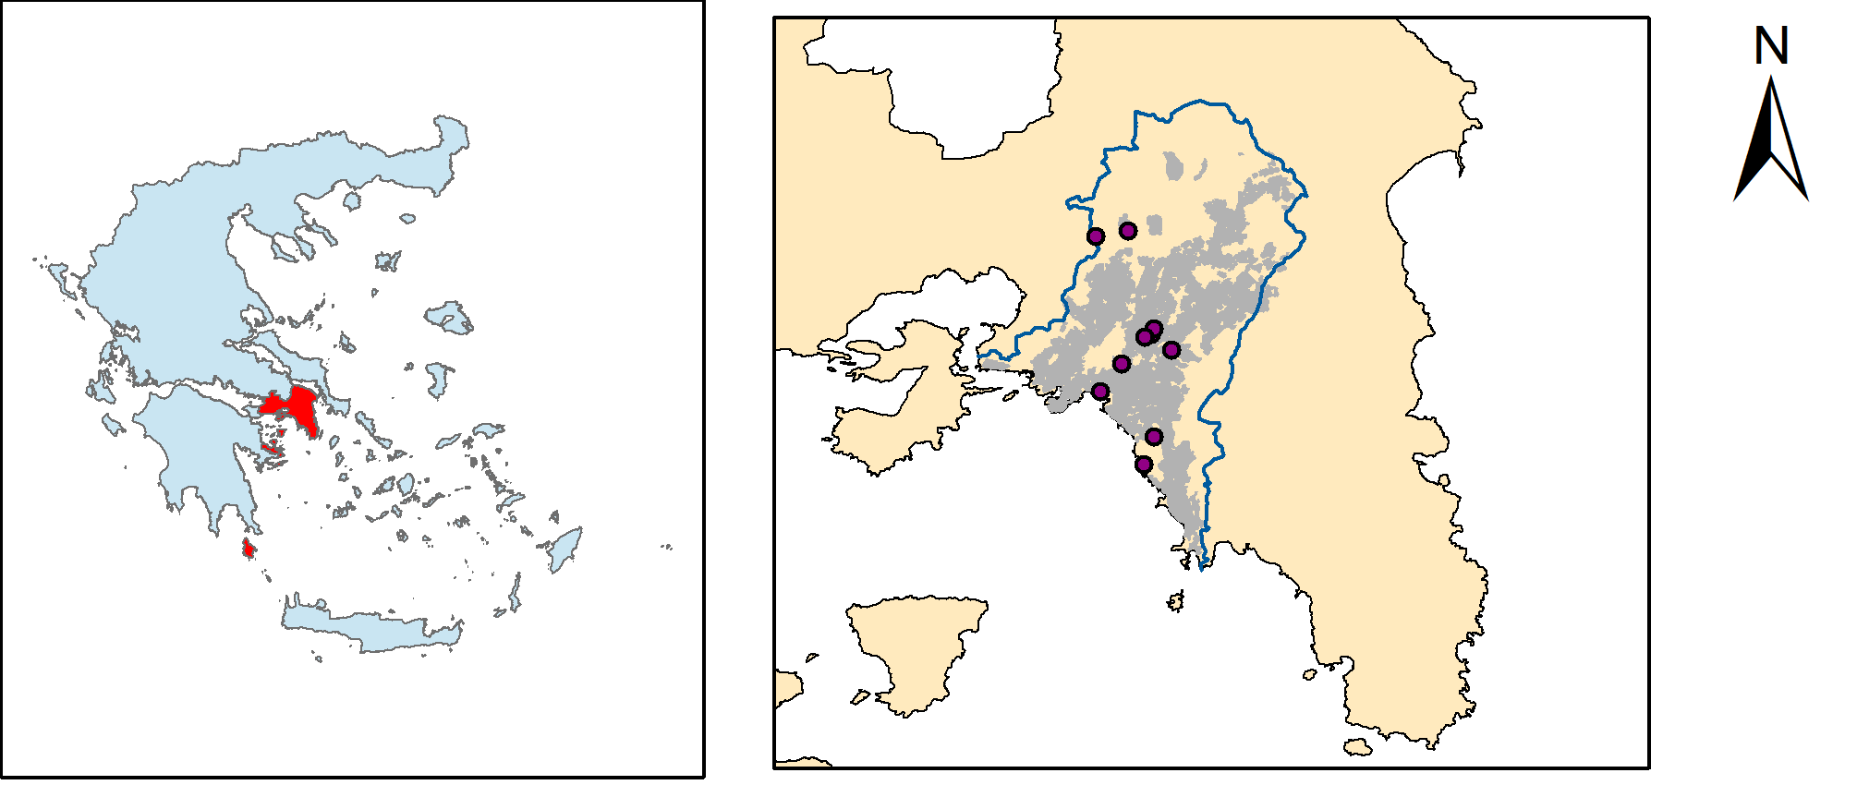
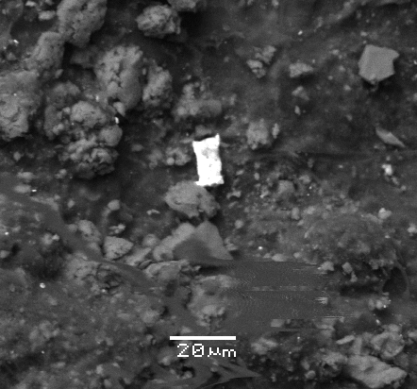
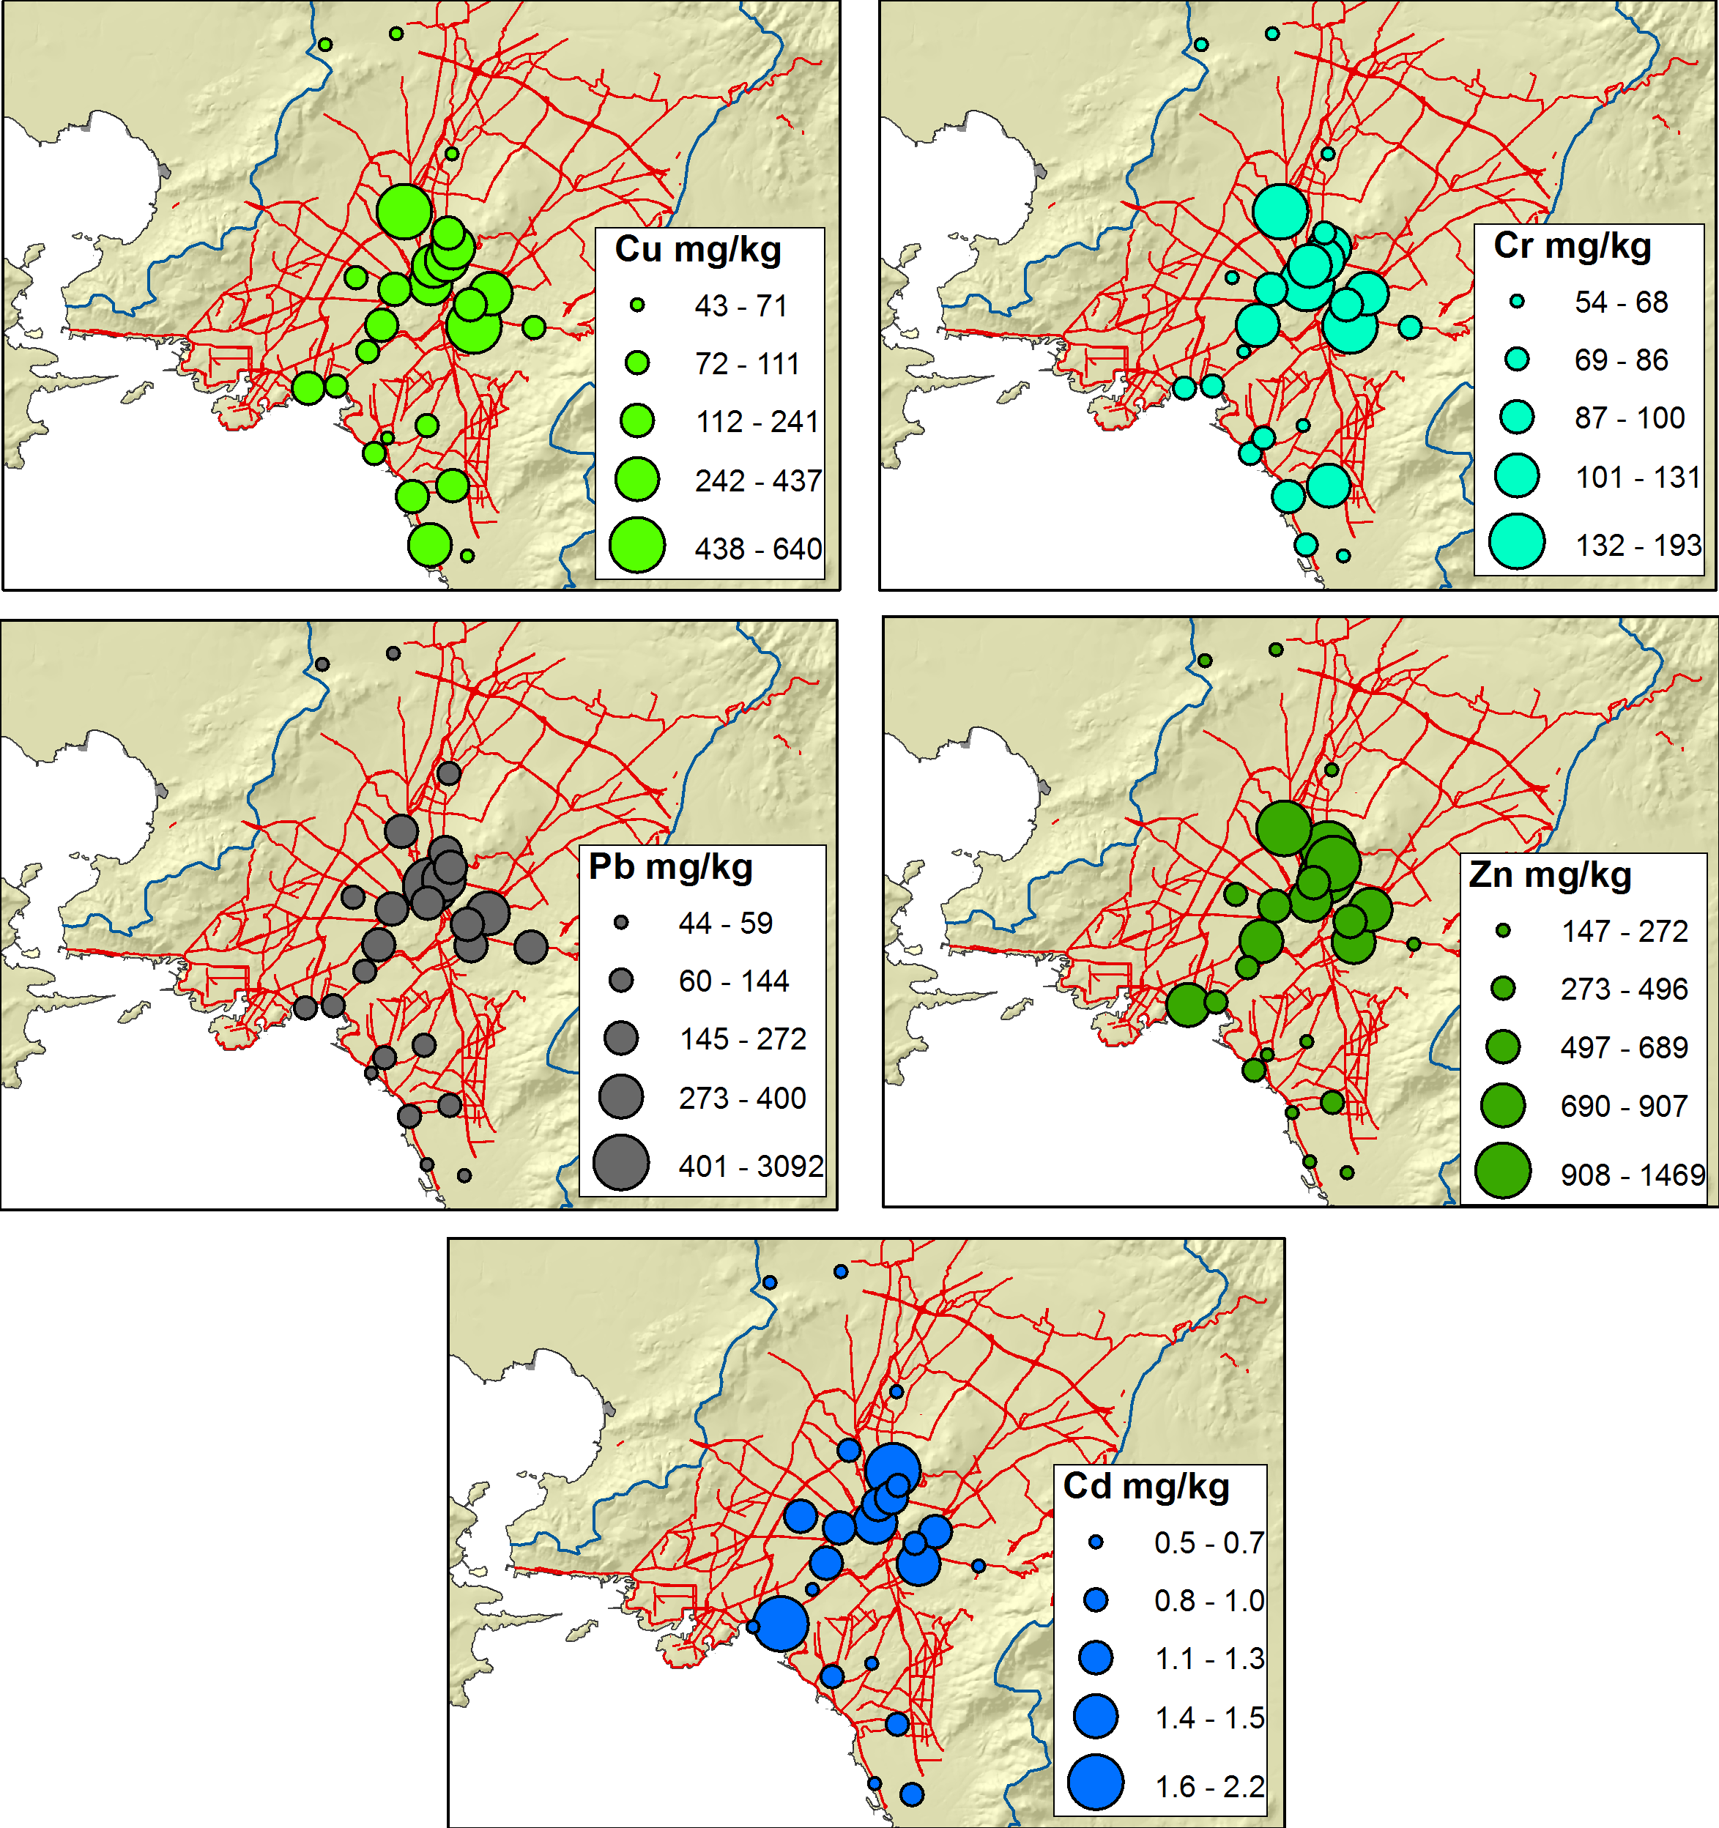
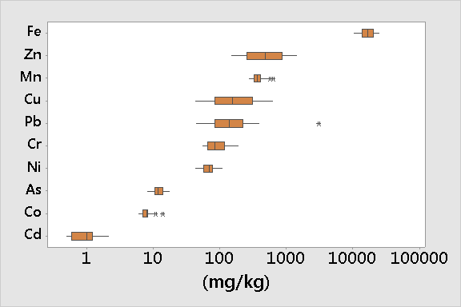
Study Area and example of spatial distribution of measured parameters (n=26)
XRD- seasonal patterns
KOU09 –SEM image
Pb ~50%
Results – Total concentrations (aqua regia, n=26)
Comparison with median values in Athens soil reported by Kelepertzis and Argyraki, 2015.

Slide 3
Dendrogram showing grouping of measured parameters in surface drainage deposits of the Athens Basin (n=26)
Results of BCR analysis (n=10)

Slide 4
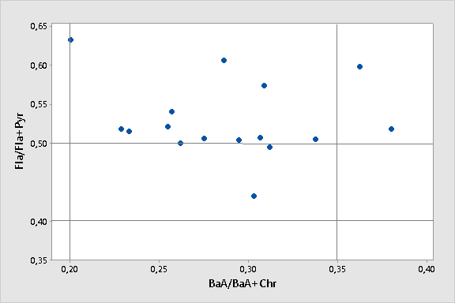
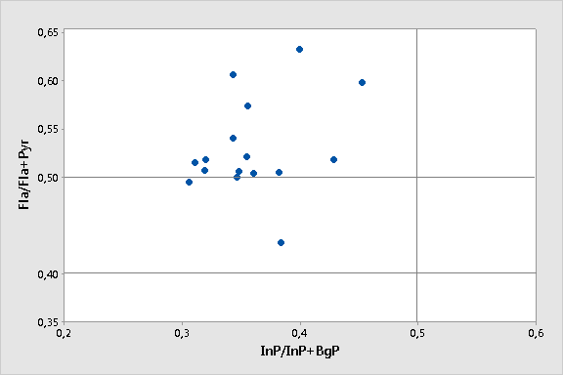
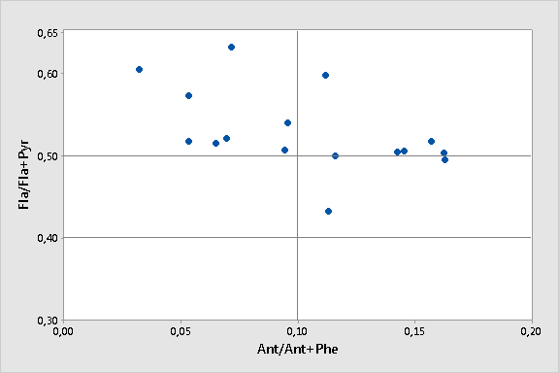
petrogenic
Cross-plots for the isomeric ratios: BaA(BaA + Chr) ratio against
Fla/(Fla + Pyr), InP/(InP + BgP) versus Fla/(Fla + Pyr) and Ant/(Ant + Phe) versus Fla/(Fla + Pyr)
Coal combustion
Traffic emission
Coal and biomass combustion
Variation of PAHs sources expressed in (ng/g) across the seasonal sampling points
Fuel combustion
petrogenic
Fuel combustion
Coal and biomass combustion
Fuel combustion
Variation of the BaP toxicity equivalent quantity (TEQBaP) values in the survey area in seasonal sampling points
petrogenic
Mobile sources of combustion
Dormant sources of combustion
pyrogenic
petrogenic

