Slide 1
EGU 2020
MiniPINS – Miniature Planetary In-situ Sensors
Maria Genzer¹, Maria Hieta¹, Antti Kestilä¹, Harri Haukka¹, Ignacio Arruego², Victor Apéstigue², Jose Antonio Manfredi³, Cristina Ortega⁴, Manuel Dominiguez-Pumar⁵,Servando Espejo⁶, Héctor Guerrero⁷, Matti Palin¹, Jarmo Kivekäs¹, Petri Koskimaa¹, and Matti Talvioja⁸
Affiliations on next page

Slide 2
Background
MiniPINS is an ESA study led by the ¹Finnish Meteorological Institute to develop and prototype miniaturized surface sensor packages (SSPs) for Mars and the Moon. Phase 0 of the study has just been completed, and the study has entered phase A.
The other partners of the study are: ²Instituto Nacional de Técnica Aeroespacial (INTA), ³Centro de Astrobiología (SCIS-INTA), ⁴Added Value Solutions (AVS), ⁵Universitat Politècnica de Catalunya (UPC), ⁶Instituto de Microelectrónica de Sevilla (IMSE), and ⁷IMDEA Nanociencia. Also ⁸Talvioja Consulting Oy participates in the work.
Mars SSP is a penetrator with max. 25 kg mass, piggy-backed by another Mars mission spacecraft to the Martian orbit and deployed from there
Moon SSP is a 5 kg station deployed from a rover or a drone

Slide 3
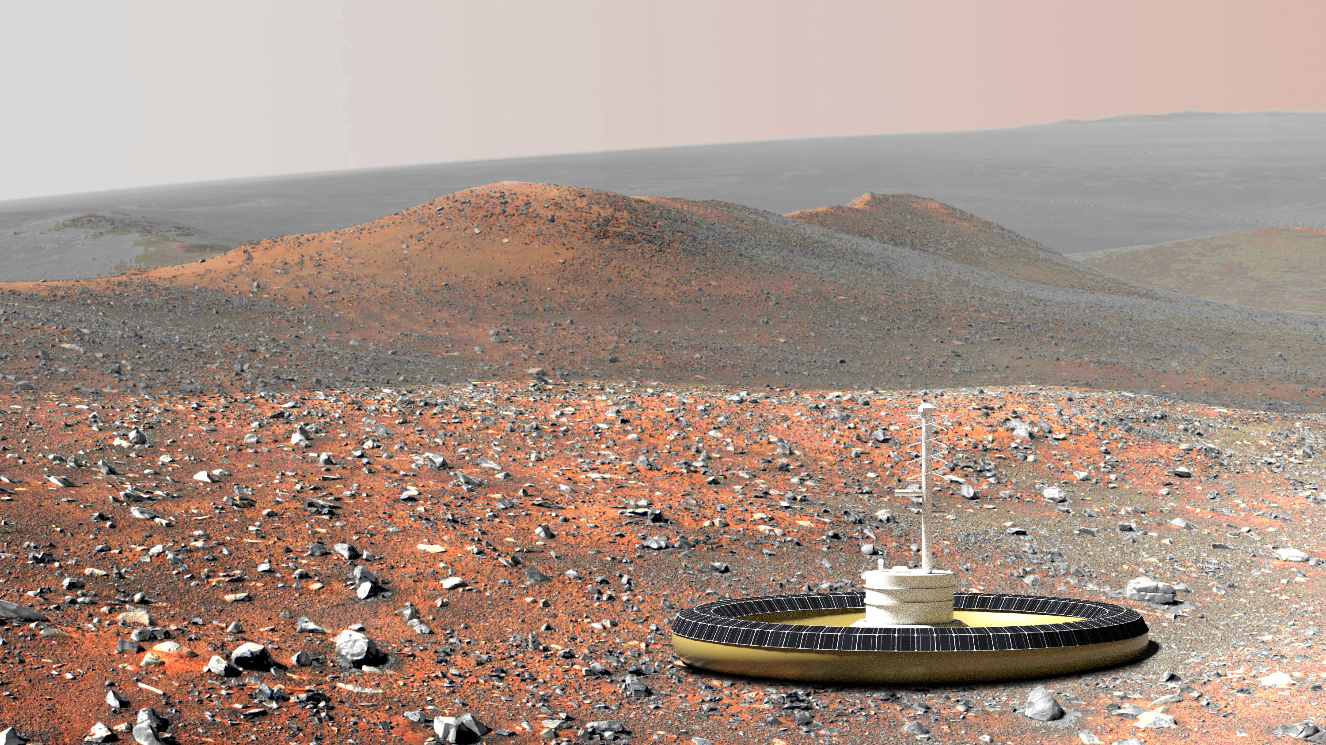
Mission objectives - Mars
Mars SSPs is a contribution by ESA to another Mars mission, or other mission of opportunity
Up to 4 penetrators are deployed from Martian orbit to various landing sites on Mars.
From 25 kg total mass, 4.5 kg is reserved for the payload
Once landed, the SSPs will perform surface and sub-surface environmental measurements, for a minimum of 1 Martian year (2 Earth years)

Slide 4
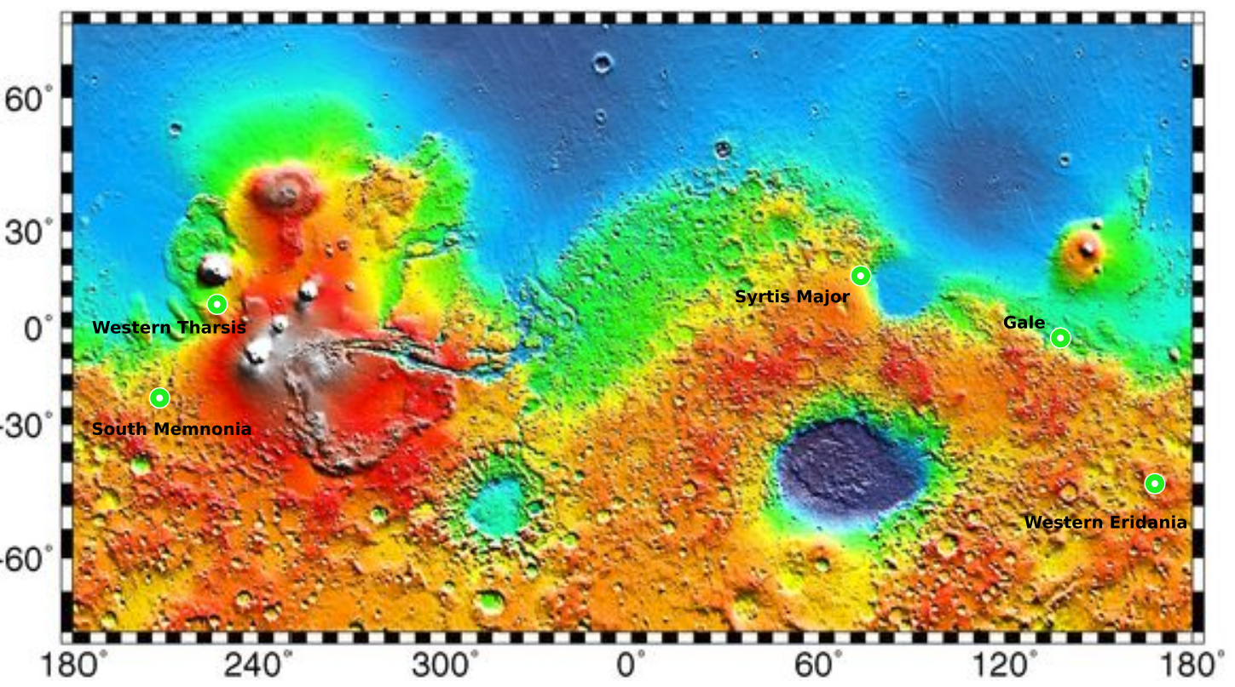
Mars landing sites suggested for MiniPINS
Name | Location | Elevation | Crustal magnetic field | Soil penetrability
Gale Crater | 5S, 140E | -4 km | Not active | Sand and duricrust (cemented regolith), not much dust
Western Tharsis, South of Olympus Mons | 10N, 135W | -1 – 0 km | Not active | Thick covering of dust (2-6 m)
Syrtis Major | 15N, 70E | 0 – 1 km | Slightly active | Coarse sand and duricrust, little dust
Western Eridania (Crater) | 45.5S, 169.5E | 0 – 1 km | Active | Sand and duricrust, not much dust, possibly subsurface ice
South Memnonia (Bernand Crater) | 23S, 154W | 0 km | Active | Mixture of dust and sand

Slide 5
Approach and delivery trajectories
All suggested landing sites can be reached from a hyperbolic or a parabolic delivery orbit with given entry conditions:
Entry altitude 120 km
Entry velocity from ~3.6 km/s (parabolic) to ~5.8 km/s (hyperbolic)
Target impact velocity 60-80 m/s.
The landing unit is spinned when released from the spacecraft; no propulsion necessary

Slide 6
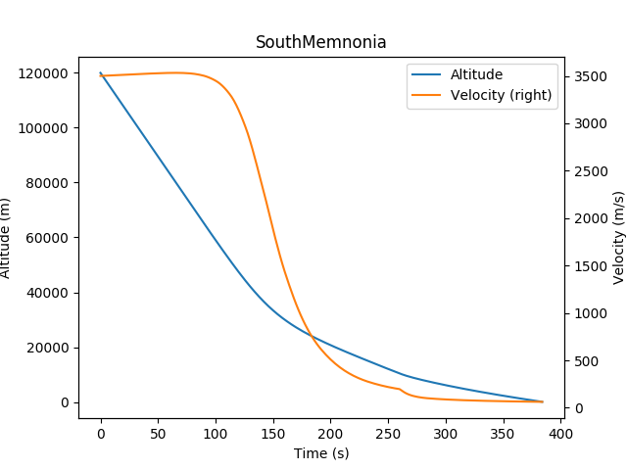
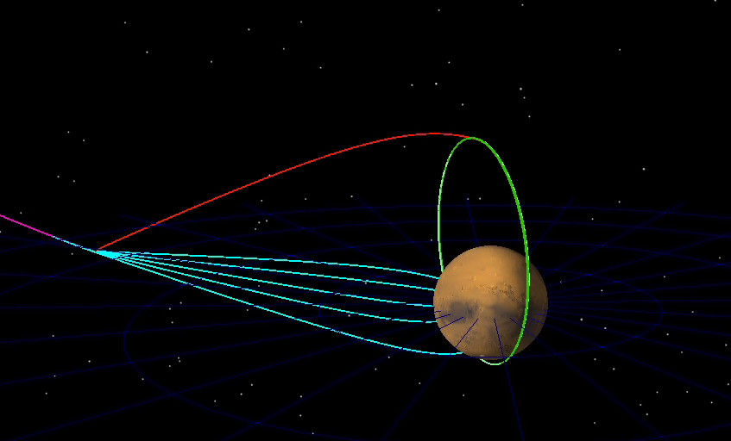
Landing orbits and an entry profile example
25kg MetNet^{[1]}-like lander

Slide 7
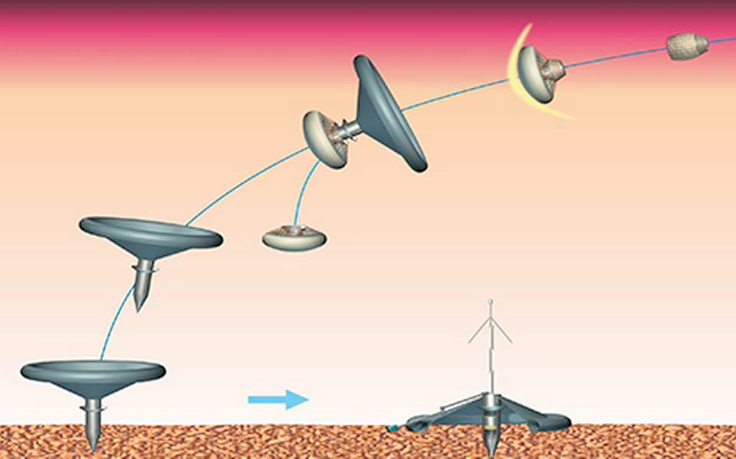
Mars lander concept - MINS
MINS lander system concept is based on MetNet^{[1]} semi-hard landing vehicle concept by FMI
Very good match in terms of mass, impact velocity, EDL requirements and lifetime
Aerodynamic braking in the atmosphere is achieved with inflatable braking units
^{[1]} Ari-Matti Harri et al., The MetNet vehicle: a lander to deploy environmental stations for local and global investigations on Mars, Geosci. Instrum. Method. Data Syst., 6, 103-124, 2017.

Slide 8
Main questions for MINS design
Penetration depth: requirement vs. feasibility
Target depth 2 m, backup option 0.5 m
Impact velocity
Mechanical configuration: separatable forebody-aftbody vs. solid structure
Dumping
Non separable
Dumping
Separable
No dumping
Non separable
No dumping
Separable
Final design will be chosen during Phase A.
Total mass, nose mass, target impact velocity and shape of the penetrator drive the achievable penetration depth.

Slide 9
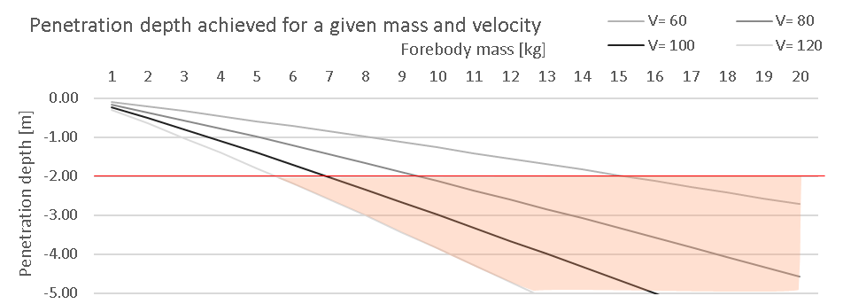
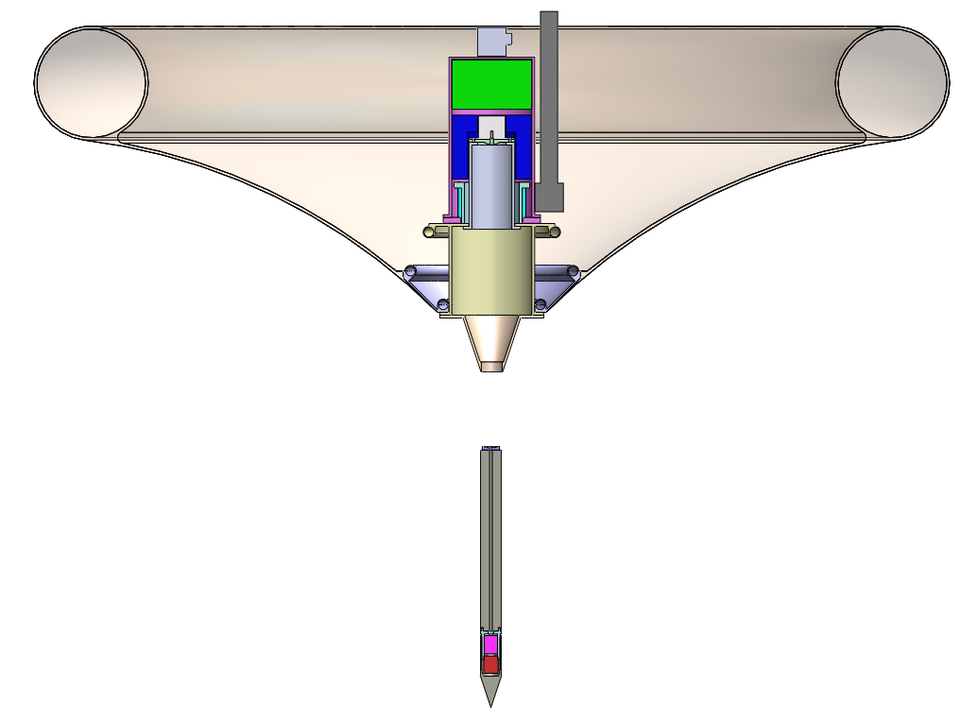
MINS: 2 m separable concept
Dimensioning of parameters for 2 m depth penetration
Soil penetrability S = 6 (conservative value)
Min. Ø forebody limited by structural integrity & preliminary selected sensors
Forebody mass driven by length. Maximum length = 0.5m → Tungsten forebody
↓ Øf → ↑ Depth
Feasible at the cost of high mass and high impact velocity
V = 90-100 m/s →
m = 7-9 kg
Restrictive at mission level
(target speed: 60-70 m/s)
D = 2 m
Tungsten
High density
Lowest volume
Mass of the forebody only!
Total probe mass not considered
9

Slide 10
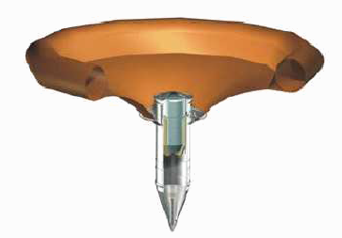
MINS: 0.5 m non-separable concept
MetNet-like penetration probe
V = 60 m/s
m = 5 kg
D = 0.5 m
Mass of the forebody only!
Total probe mass not considered

Slide 11
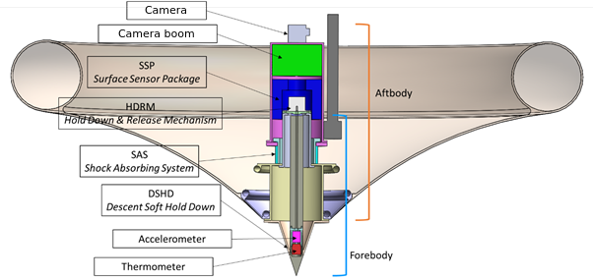
Scientific payload for MINS
The preliminary payload contains the following sensors, miniaturized as necessary:
Camera
Visual Spectrometer
Meteorological/environmental package
Pressure sensor
Relative humidity sensor
Wind sensor
Air temperature sensor
Dust sensor
Solar irradiance sensor
Chemistry package
Magnetometer
Radiation monitor
Accelerometers
Soil thermoprobes
Seismometer

Slide 12
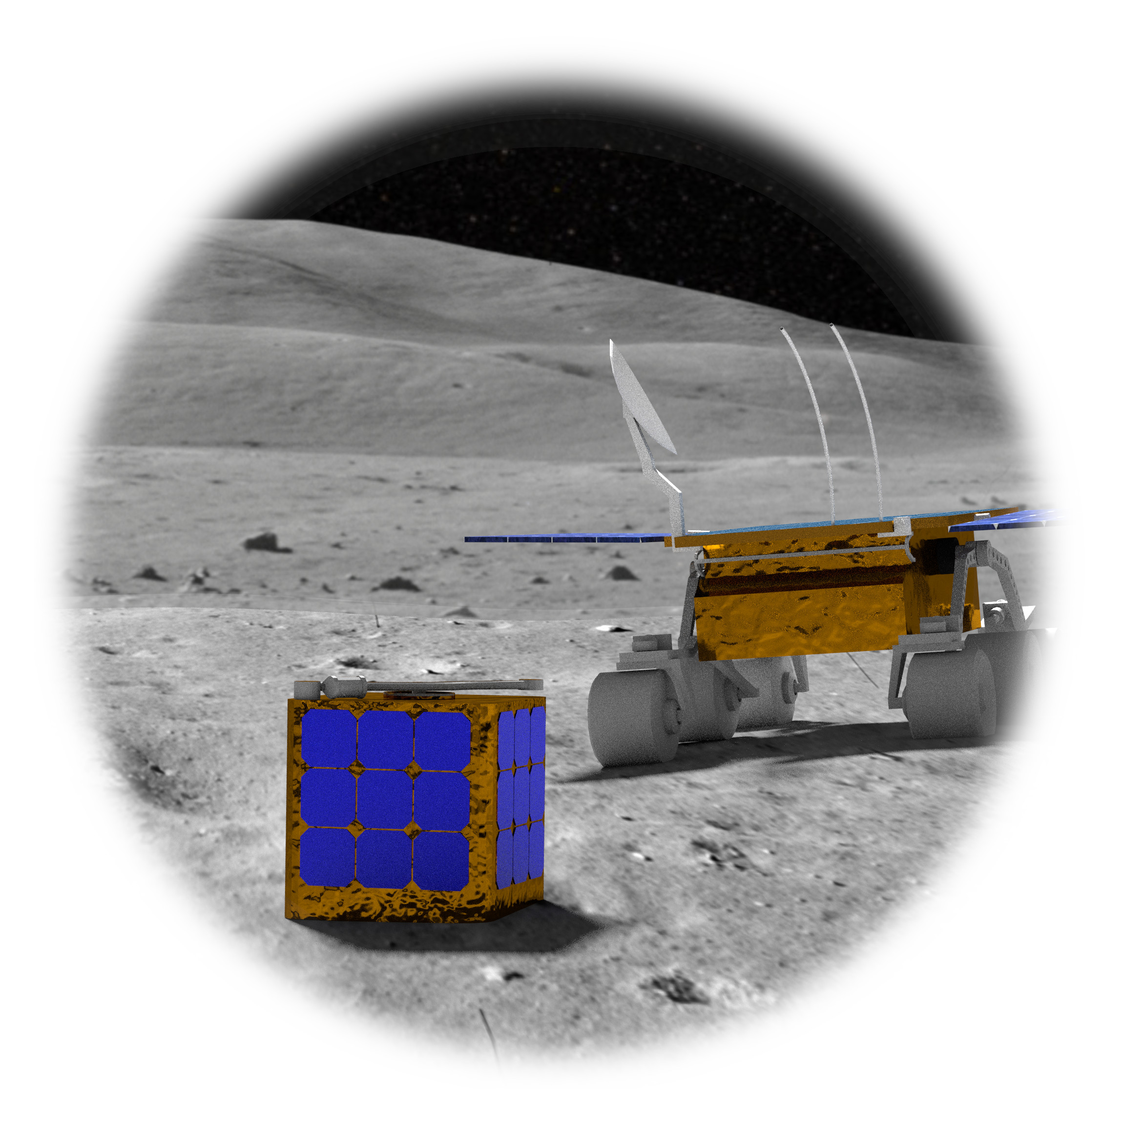
Mission objectives - Moon
Moon SSPs will be a contribution by ESA to another Moon mission, or other mission of opportunity
Up to 4 surface packages will be placed on the Moon surface by a rover or a drone
From 5 kg total mass, 1.5 kg is reserved for the payload
Once placed, the SSPs will perform environmental measurements for a minimum of 2 years

Slide 13
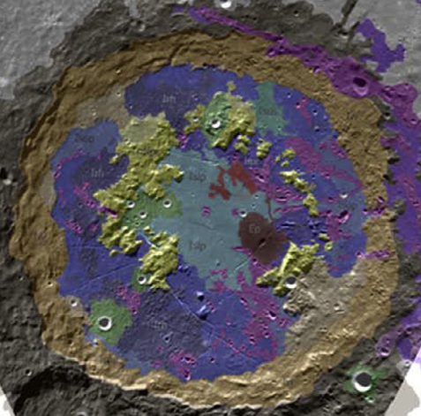
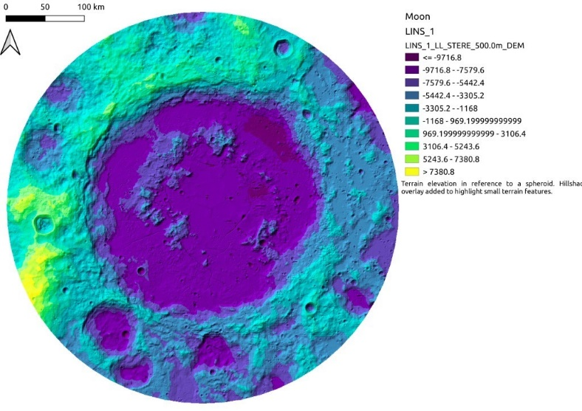
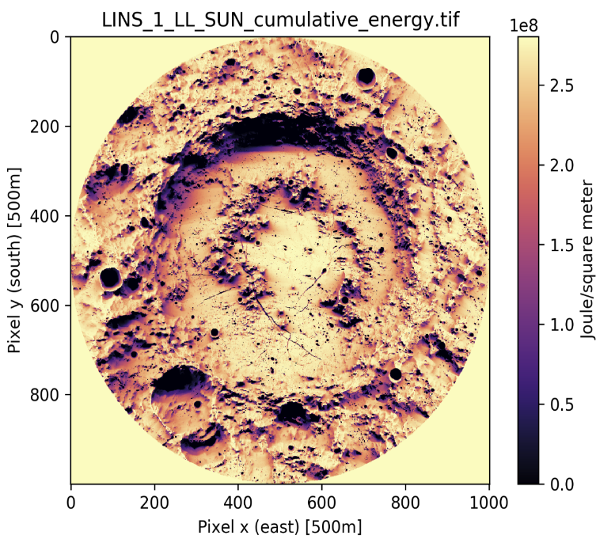
Moon landing site – Schrödinger crater
Moon SSPs can be dropped anywhere in rover/drone reach, but taking into account solar visibility => energy and thermal conditions

Slide 14
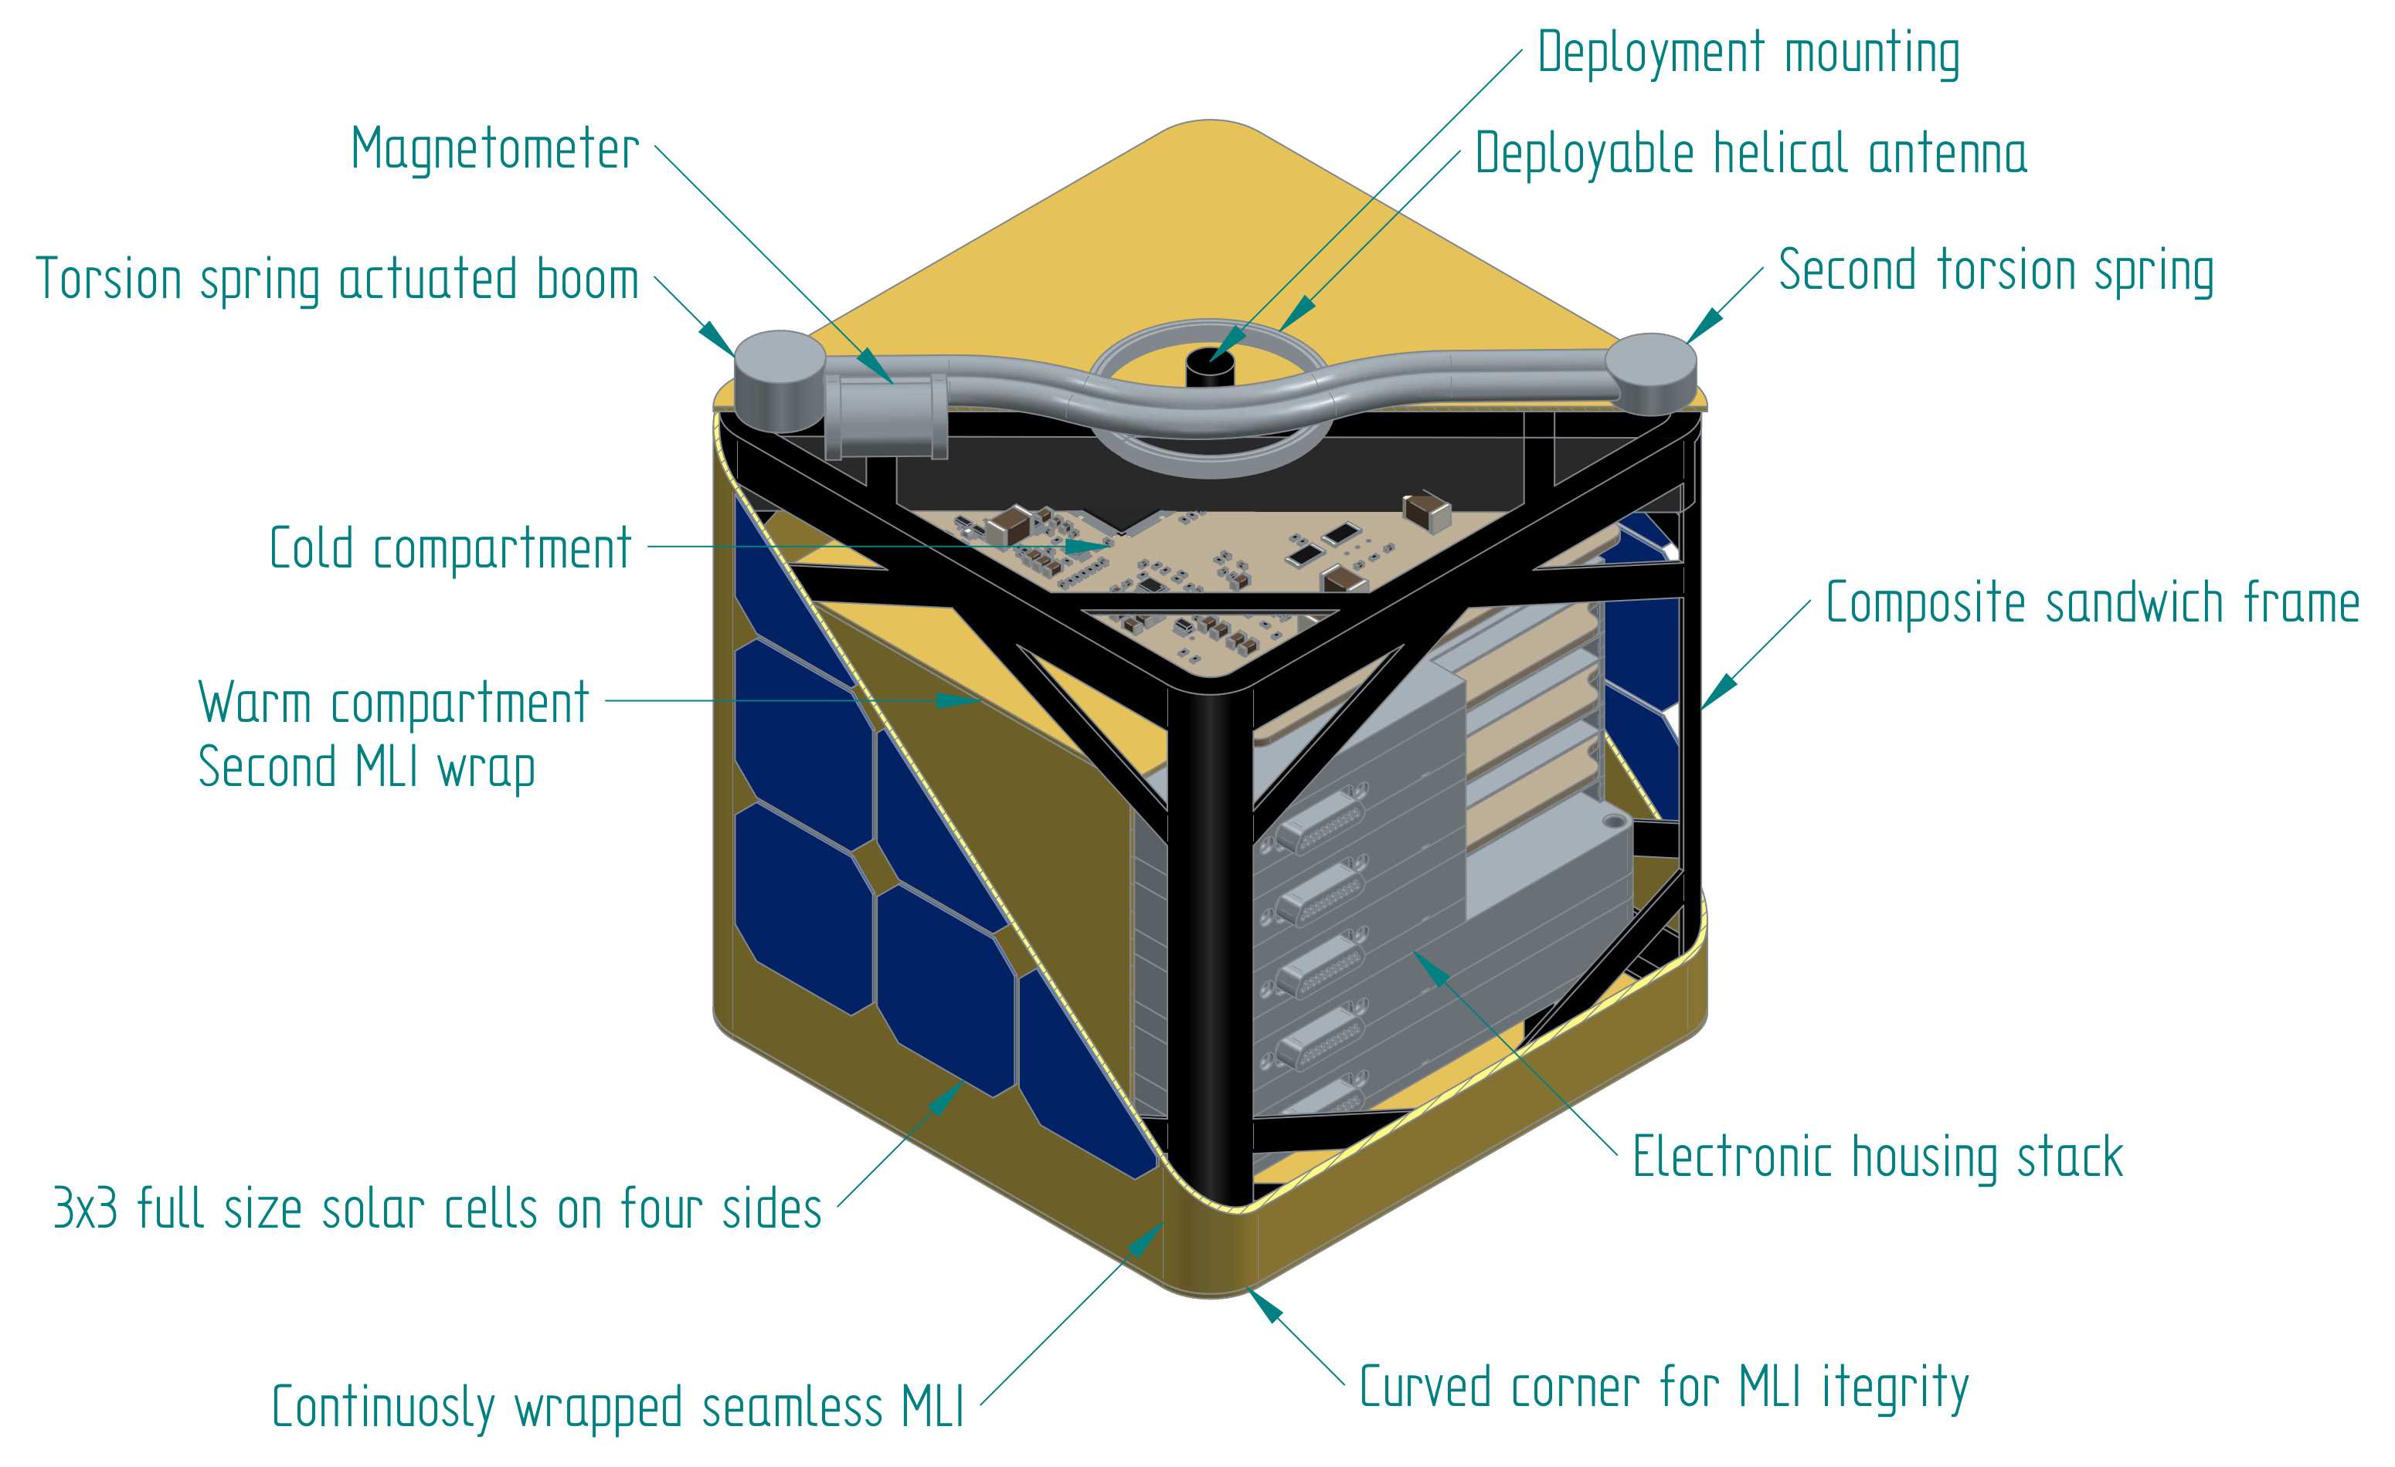
Lunar SSP concept – LINS

Slide 15
Main questions for LINS design
Survival during Lunar night, temperature ranges
Heating and thermal control
Energy production: solar panels and batteries vs. RHU
Energy storage
Final design will be chosen during Phase A.

Slide 16
Electrical Power Budget estimation - LINS
INPUTS
ASSUMPTIONS
OUTPUTS
Illumination :
- 28-days profile of landing site
- 14 + 14 days (day/night)
- 1/27 to 27/1 scenarios
Energy Budget at the end of 28-days
Thermal:
Surface Temp.
Solar panel Th. Des.
Heater needs
- Max number of panels for feasible heating
Solar panels Surface actually needed
Energy storage needs → number of batteries
- Equivalent constant power consumption
- With / without RHU
Electrical:
El. params. of Solar panel
El. params. Of Battery and EPS
CONCLUSIONS
- Feasibility of scenario
- Preferred case
16

Slide 17
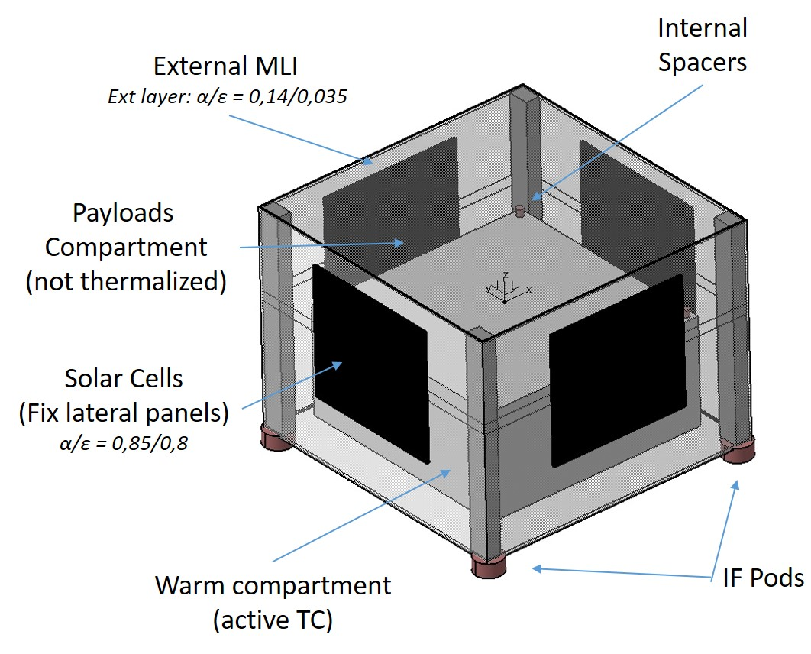
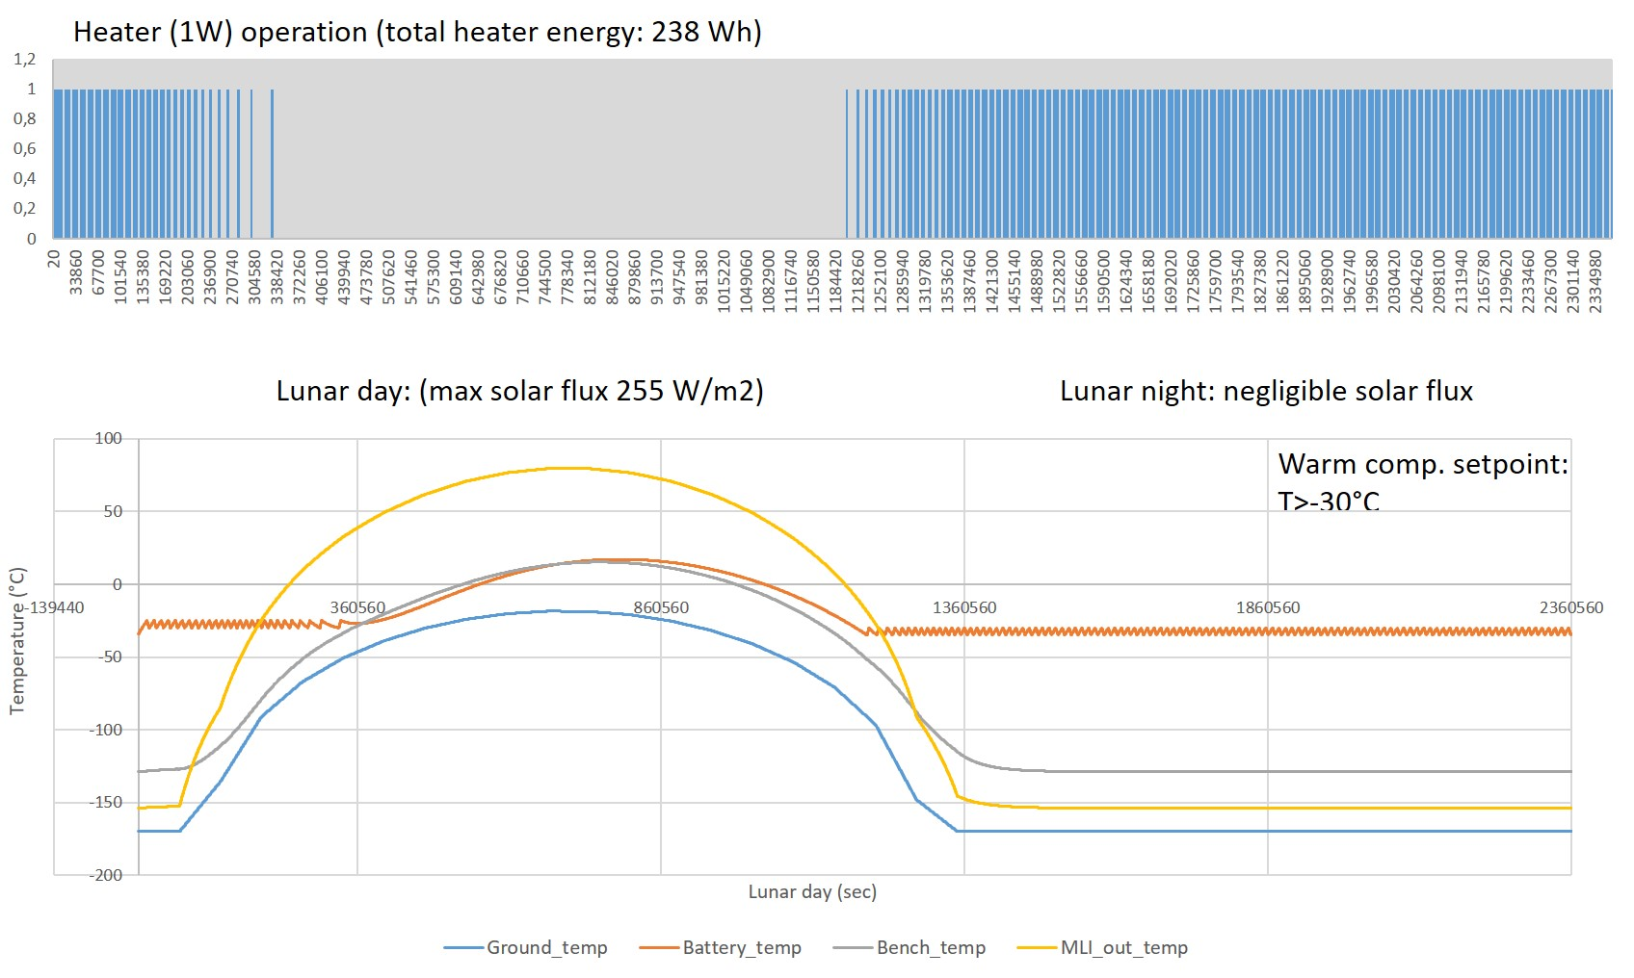
LINS Thermal Design
Baseline Concept: Batteries + Solar cells
Passive thermal control → to insulate the unit from the extremely changing external environment: ext/int MLI/SLI, Low conductive spacers/pods, etc.
“Warm compartment” with an active heater control → it allows a separated temperature-controlled environment to allocate critical elements.
Solar cells: target lowest allowable temp. (NonOP): –170 °C. → Consider the need of dedicated panel TC (heater).
Th. Analysis: Simple TMM + Schrödinger environment. → Calculate batteries need energy storage to maintain “warm compart.” set-point.
LINS Baseline Design Concept.
Alternative concept: RHU
Provide necessary power for the whole unit thermal conditioning thus reducing number of batteries.
Need completely new TCS design to manage internal RHU dissipated heat: Heat pipes (VC), radiators…
SHRÖDINGER 14 day + 14 night transient analysis.
17

Slide 18
LINS payload
Payload mass 1.5 kg
Baseline payload 1
Camera
Visual Spectrometer
Radiation package
Microdosimeter
X-ray monitor
Accelerometer
Thermoprobes
Seismometer
Magnetometer
Alternative payload 2
Camera
Visual Spectrometer
Radiation package
Microdosimeter
X-ray monitor
Accelerometer
Thermoprobes
Magnetometer
Dust-plasma package
Dust sensor
Langmuir probe
Ion and electron spectrometer
18

