Slide 1
Lomonosov Moscow State University,
Department of Petrology,
Laboratory of Experimental and Technical Petrology
Phase Relations Experimental Study In The Ca-Ongonite From Ary-Bulak Massive (Transbaykal Region, Russia) at 700–800 °C
The authors:
Novikova Anna
(novikova-a-s@yandex.ru),
Alferyeva Yana
(yanaalf@ya.ru)
Moscow, 2020

Slide 2
Introduction
The main objectives of this investigation are as follows:
to determine the composition of the liquidus phases and the order of crystallization;
to estimate the water influence on sodification of ongonite melt;
to confirm formation of Сa-F melts in experiments.
The main objectives of the study :
to conduct an experiment on Ary Bulak rocks at 700 and 800 Celsius degrees and pressure – 1 kBar, fO2 – (Ni-NiO) with different amount of water;
to determine the influence of oxygen fugacity on ongonite crystallization melt by Т= 750°С, Р = 1kBar and fO2. (Mt/Hem);
to identify composition of crystalline and liquid phases

Slide 3
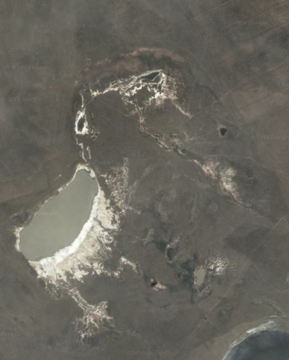
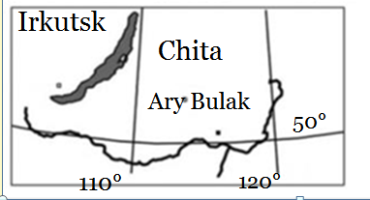
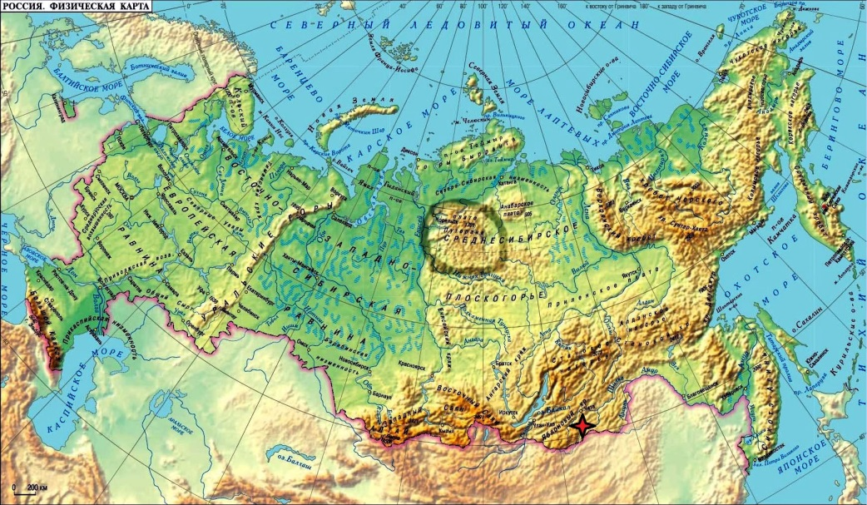
Geological structure*
Ary Bulak intrusion is situated in Transbaykal Region in Russia, to south-west of Ongonite lake.
It forms a concentric zonal laccolith.
In current erosion level is outlined as NE-SW oblong ellipse hill 900×500 m.
Ongonite lake
* Geological structure is taken from article Antipin,2009 and location area has been found in Google Earth .

Slide 4
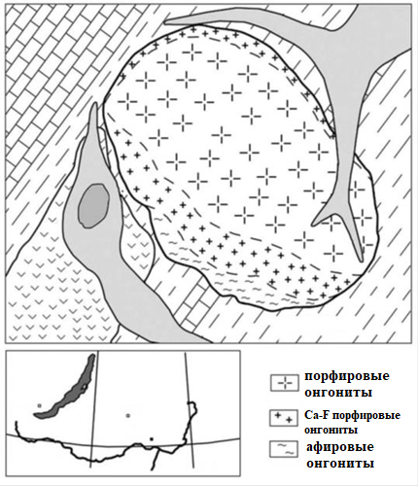
Geological structure
The host rocks are J3 – K1
Ust-Borzin rocks, such as limestones, metavolcanics, schists and sandstones.
The absolute age of ongonites was dated by the Sr-Sr method (⁸⁷Sr/⁸⁶Sr isotopic ratios) and is 142 ±0.4 Ma. [Kostisyn Уu.А, 1998]
There is a facies zonation in massive. The central zone, that occupies a large area, is composed of porphyritic ongonites, the middle zone, forming the ring-structure, 50-100 meters wide, previously consist of high Ca and F porphyritic ongonites, and the marginal zone, situated at the southwestern flank of massive, is composed of aphyric rocks.
APБ-28
APБ-24
Ongonite lake
APБ-19
Irkutsk
porphyritic ongonites
Chita
high Ca-F ongonites
Ary Bulak
50°
aphyric ongonites
110°
120°
* Information about geological structure is taken from article Antipin,2009 and location area has been found in Google Earth .

Slide 5
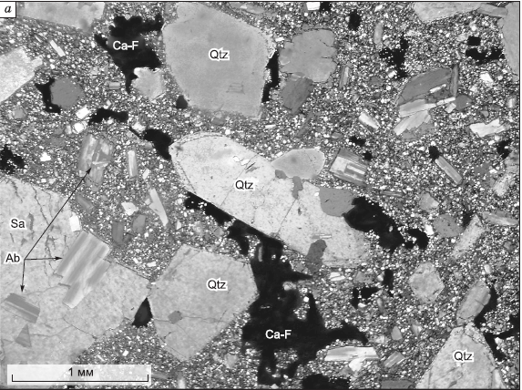
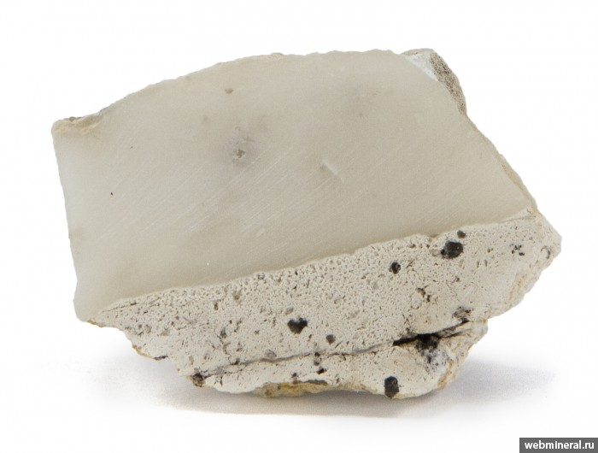
Petrology and geochemistry of ongonites
Оngonites – subvolcanic analogue of rare metal Li–F granites
Minerals: Q (50%), Kfs(35%), Ab (5%), Toz и Fl. The groundmass structure is microlitic.
Accessory Minerals: Ilmenite, Rutile, galena, columbite-tantalite, wolframite
It contains SiO2 - from 68 to 73 %, Al2O3 -14-19%, and are quite sodic (K₂O+Na₂O = 8,05÷9,47)
Q
Ab
Thin section of ongonite*
White prozopite veins in aphyric ongonite**
* Picture is taken from Peretyazhko, I.S., 2009
**Is taken from https://webmineral.ru/deposits/item.php?id=4502

Slide 6
Ongonites
Ongonites form small subvertical dikes, that crosscut stratification in a stratified sequence, or is roughly vertical in an unstratified sequence and series of lodes from 3 to 30 sm.*
Ongonite dike in biotitic granites
Biotitic granite xenolith in ongonite rock
Scree ignimbrite debris in ongonites
* For more information [V.I. Alekseev,2013]

Slide 7
Petrology and geochemistry of Ary Bulak ongonites
Ary Bulak porphyric ongonite mineral composition conforms to normal ongonite composition, but differ from the last one in phase proportion.
The central zone: Porphyric ongonites.
Phenocrysts (40%): Q (45%), Kfs(20%), Ab (30%).
The groundmass (60%) contains isometric Q grains, tabular Ab crystals, rimmed with K-feldspar and elongated acicular Toz crystals in glass.
The middle zone: Ca-F rich porphyric ongonites
Phenocrysts (40%) : Q (50%), Kfs(15%), Ab (25%), Mica (5%), Toz (5%).
The groundmass (60%) contains submicrometric “fluoritic” and “K-feldspathic”
phases.
The marginal zone: Aphyric ongonites
Phenocrysts (10%): Q (60%), Kfs(10%), Ab (30%).
The groundmass (90%) mostly consist of prosopite. (26 wt %). Intestitions are filled with elongated acicular Toz crystals and “fluoritic” and “K-feldspathic”
phases.
Phenocrysts mineral composition in Ary Bulak ongonites

Slide 8
Petrography of the Ary Bulak ongonites
Q
Pl
Q
Pl
Q
Pl
Kfs
To
Kfs
Fl
Pl
Q
Fl
Fl
Here Q - Quartz; Pl – Feldspar; Kfs - Potassium feldspar; To – Topaz; Fl - Fluorite

Slide 9
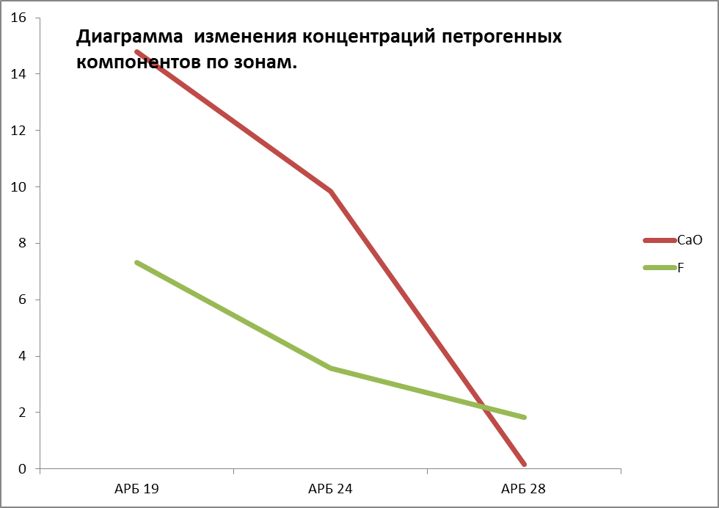

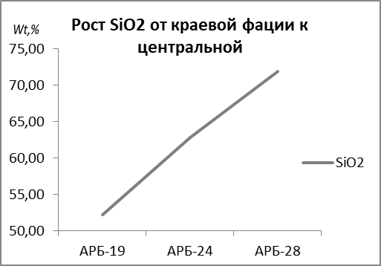
Geochemical characteristics of rocks
F, CaO decreasing from boundary to center rocks
SiO2 increasing from boundary to center rocks
SiO2
CaO
CaO
F
F
Porphyritic ongonites are equal to normal ongonites from Ongon-Hayerkhan with СaO<0,5 mass% and amount of F – 1,15 mass%.[Peretyazhko, I.S., et al., ,2010].
In boundary aphyric rocks F and CaO amount increaces from 5,2 to 18,8 mass% and from 5,4 to 22 масс%.

Slide 10
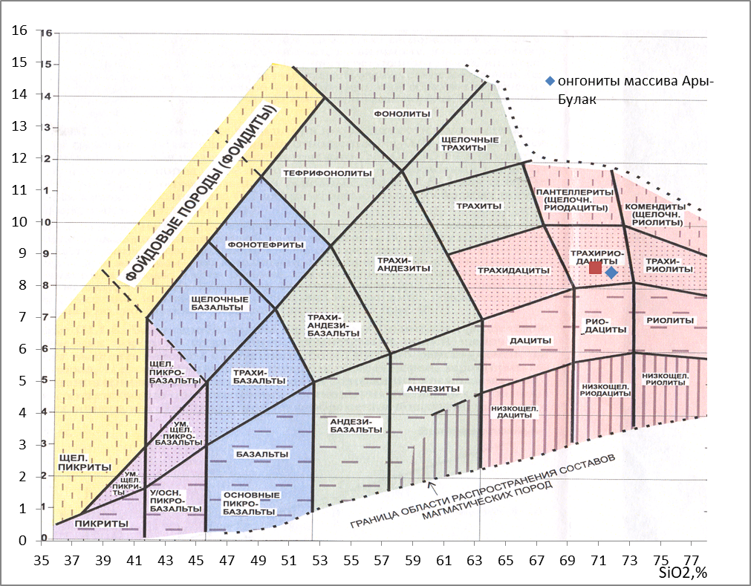

ТAS diagram
Classical ongonites
Ary Bulak ongonites

Slide 11
Experimental studies of ongonite systems
Fusion range of typical ongonites (550 – 870 ◦С)
Crystallization sequence (with H2O):
Albite ->Quartz -> Potassium feldspar -> Topaz -> Mica
In excess of (HF) the order of crystallization changes to:
Quartz-> Topaz
Model experiments had shown the expanding of Q-field in higher F activity systems.
[Kovalenko, 1979, Kovalenko, 1976, Manning, 1981].

Slide 12
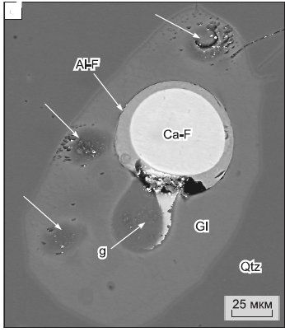
Experimental studies of Ary-Bulak ongonite systems (by Peretyazhko I.S)
Fluid and melt inclusions are situated in Q. Their exploration has shown the existence of Ca-F melt.*
The calcium fluoride and residual aluminosilicate melts coexisted at a temperature below the β → α transition
of quartz (595–585°C).
Ca-F gl
FI
Ca-F gl
The magmatic crystallization of quartz began at a temperature
not lower than 750–650°C.
MI
MI
The residual glass starts to melt at 450–500° C and became liquid at 700–750°C and even 1000–1050°C .
Ca-F melt inclusions in Q and melt (MI) and syngenetic gas-rich fluid inclusions (FI)
* [Peretyazhko, I.S., et al., 2007a, Peretyazhko, I.S., et al., 2007b, Peretyazhko, I.S., et al., . 2010]

Slide 13
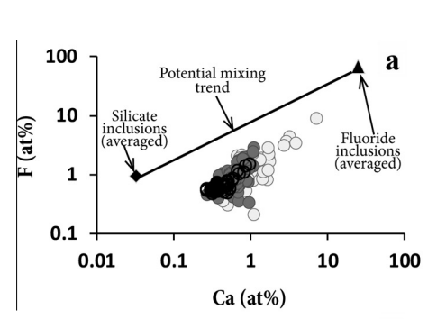
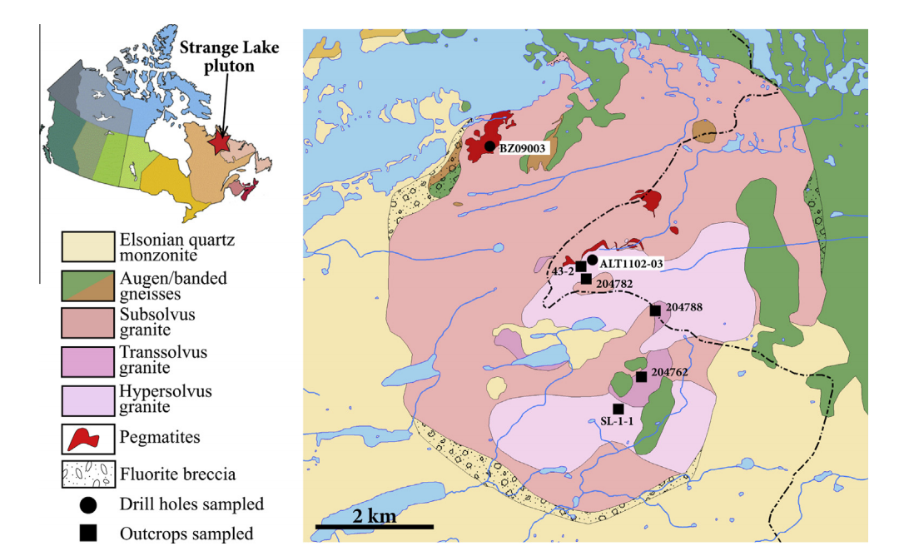
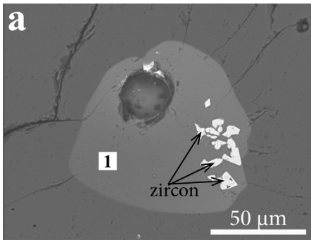
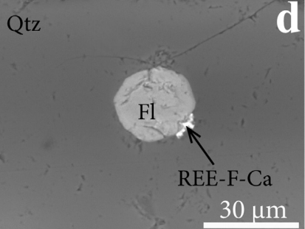
Other Ca-F founded inclusions*
Ca-F inclusions in pegmatites and adjacent subsolvus granites (two alkali feldspars) of the Mid-Proterozoic Strange Lake pluton (Quebec-Labrador, Canada)
gl
A BSE image of inclusion containing silicate melt, zircon crystals and a fluid bubble.
A BSE image of Ti-rich silicate glass containing a globule of
calcium-rich fluoride glass with a high concentration of the REE.
Geological map of the Strange Lake pluton showing the distribution of the principal rock types, the locations of the pegmatite-rich
areas
* [Vasyukova O. et all, 2014]

Slide 14
Experiment № 1: melting rocks at T = 800 and 700˚С, P = 1 kBar, buffer Ni-NiO

Slide 15
The experimental method.
Instrumentation : analytical balance, arc welding set, hydrothermal cold seal pressure vessels, binocular microscope.
Source material: three powders of three types of rocks from marginal (АРБ19), middle (АРБ24) and central (АРБ28) zone.
Termodinamical parameters:
Samples from three different zones were explored at the temperatures 700 and 800
Celsius degrees and pressure 1 kBar at different amount of water 3, 5 10 per cent on hydrothermal high-pressure plant.
Experiments (800 °C) have lasted 7 days, and at 700 °C – 14 days.

Slide 16
Experiment № 2: melting rocks at T = 750˚С, P = 1 kBar, buffer Mt-Hem

Slide 17
The experimental method.
Instrumentation : analytical balance, arc welding set, binocular microscope, IHPV («gas bomb»)
Source material: two powders of two types of rocks from marginal (АРБ19) and middle (АРБ24) zone.
chemical reagent Fe2O3 ( ACS) , natural magnetite powder, distilled water
Termodinamical parameters:
Т =750 ° С , р 1 kBar, fO₂. (Mt/Hem).
Experiment have lasted 2 days.

Slide 18
Binary ampoules method
External ampoule
Method principle:
Internal
ampoule
Internal ampoule containing buffer mixture in Mt/Hem proportion 1:9 is places inside external ampoule containing the same buffer mixture in the same Mt/Hem proportion.
With temperature rises the chemical reaction between Mt and Hem is going on.
The determined oxygen fugacity has been established upon the reaction completion.
H2 migration results in ampule heat in gas bomb.
H2
Small amp.1
Fe2O3+Fe3O4
Small amp.2
Small ampoules: ongonite powder+distilled water
Fe2O3+Fe3O4
Internal and external ampoule: buffer Mt/Hem + distilled water
3 Fe2O3 + H2 = 2 Fe3O4 + H2O.

Slide 19
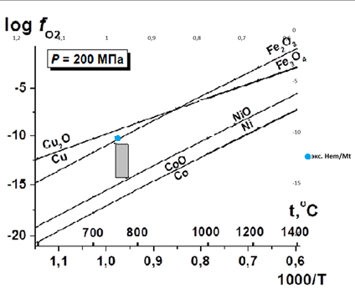
Binary ampoules method
fO2 – oxygen fugacity (atm),
А,В,С – thermodynamical constants,
Т – temperature (К),
Р – pressure (Bar)
Oxygen fugacity (fO2) determination in experiments on IHPV.
Point on the figure is a theoretically calculated oxygen fugacity for Mt-Hem buffer under determined experimental parameters.

Slide 20
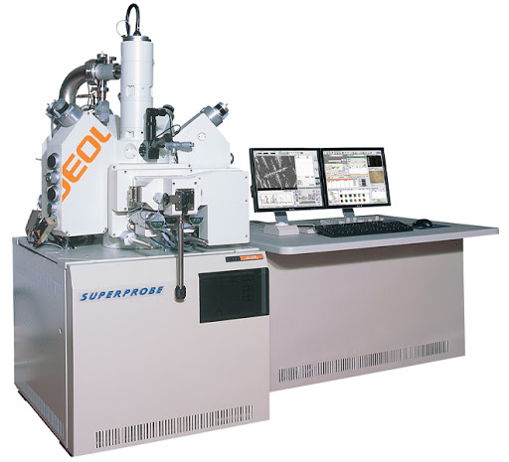
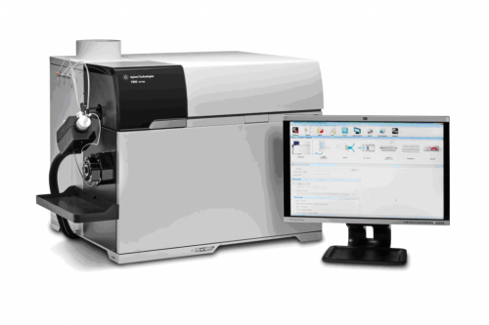
Analysis procedure
X-ray diffraction methods measured such components as (Si, Al,Ti, Mg, Fe, Mn, Na, Ca, K, F, O, Cl, Ba, Nb, Ta, Sr, W, Sc)
Acquisition parameters: I- 0,7 nA, U - 20 v.
Standarts: for glass- Plagioclase, for fluorite– fluorite
РФА - bulk composition for general elements determination (SiO2, TiO2 ,Al2O3, Fe2O3, MnO ,MgO, CaO,Na2O, K2O, P2O5). Measurement error- (5 ppm)
ICP MS – bulk composition for all elements determination ( Li ,Sc , Ti ,V ,Cr ,Mn ,Co ,Ni ,Zn ,Rb, Sr ,Y, Zr, Nb ,Cd ,Sn ,,Sb ,Cs,,Ba,La,Ce, Pr ,Nd ,Sm ,Eu ,Gd ,Tb ,Dy ,Ho ,Er ,Tm ,Yb, Lu, Hf,Ta, W,Pb ,Th, U )
Electron probe micro-analyzer
ICP-MS

Slide 21
Experimental results

Slide 22
Chemical composition

Slide 23
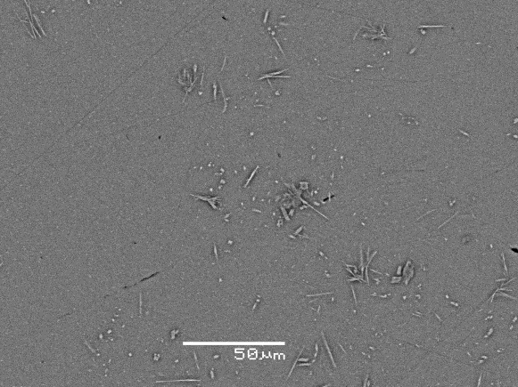
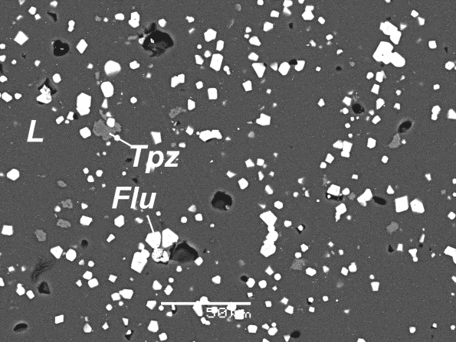
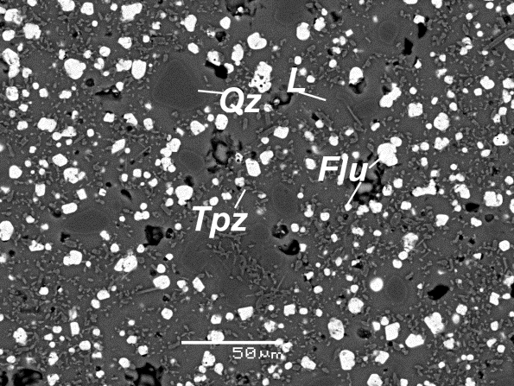
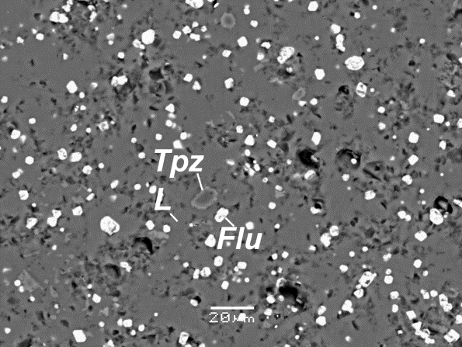
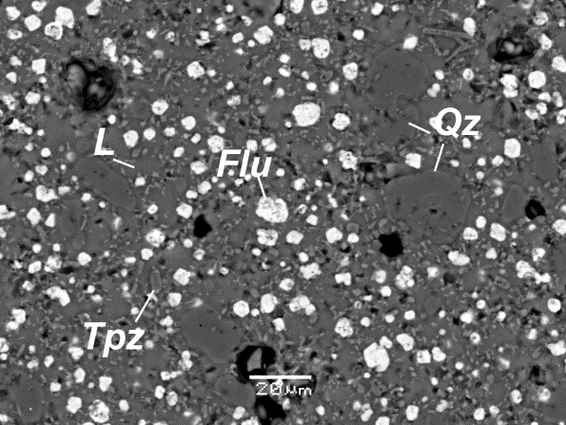
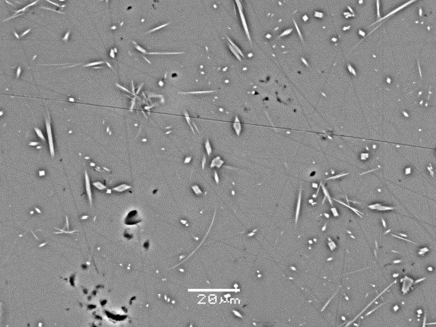
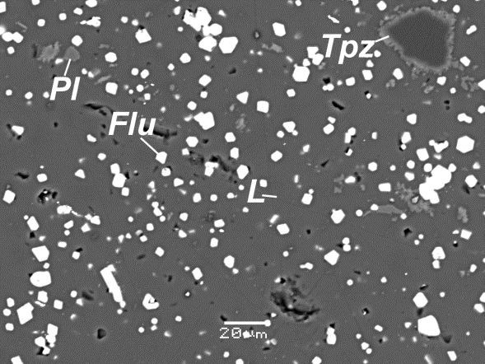
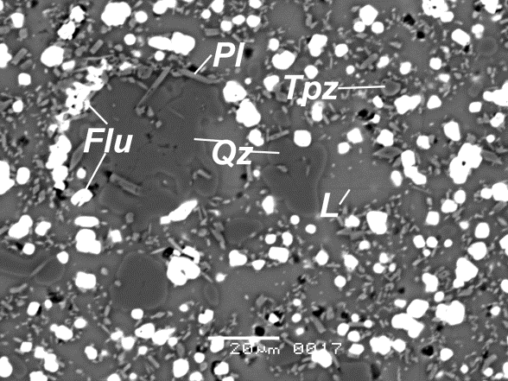
Phase relationships
 | АРБ-28 | АРБ-24 | АРБ-19
800 Ni-NiO
 | L | L, Flu, Tpz | L, Flu, Tpz, Qz
750 Mt-Hem | -
 | - | L, Flu, Tpz | L, Flu, Tpz, Qz
700 Ni-NiO
 | L | L, Flu, Tpz, Pl | L, Flu, Tpz, Qz, Pl

Slide 24
Phenocrysts composition
T=800˚C, P=1 kbar
T=750˚C, P=1 kbar
T=700˚C, P=1 kbar
Here Q - Quartz; Pl – Feldspar; Mu- Mica; Toz – Topaz; Flu – Fluorite; Al-phase – high Al hardened phase; gl – glass.

Slide 25
Summarizing results
SiO2
Inherent composition
L by 800˚C
L by 700˚C
Variation in F/SiO2 ratio with temperature decrease (800-750- 700 ˚ С).

Slide 26
Conclusions
Conducted experiments didn’t reproduce phase relationships in Ary Bulak rocks. This data shows that Ca-F melt is not stable at predetermined conditions. Liquidus phases for high Ca-F ongonites are fluorine and topaz.
Variability in oxygen fugacity didn’t affect phase relationships significantly.

Slide 27
Conclusions
The middle and marginal zone liquidus temperature is higher than 800˚C. That is not typically for F-riched granites.
Only Ca-poor porphyric ongonites measure up normal liquidus conditions conforming temperatures below 700˚C.

Slide 28
Conclusions
General trend in crystallization of ongonite melt is directed towards F content decrease in residual liquid and alkalies and silicium increase.
It shows that the mechanism of crystal differentiation doesn’t appreciably represent naturally formed mineral association.

Slide 29
Literature sources
Antipin, V.S., Andreeva, I.A., Kovalenko, V.I. and Kuznetsov, V.A. (2009) Geochemical specifics of ongonites in the Ary-Bulak Massif, eastern Transbaikalia. Petrology, 17, 558–569.
V.I.Alekseev., Ongonitic magmatism of the badzhalsky ore district (Amur river region), Geology and metallogeny, Saint Petersburg, 2013 , P.114-125
Kostisyn Уu.А. Age and genesis of thc spodumene-bearing granites of the SW Altai (Russia): ап isotopic and geochemical study // Acta Unirversitatis Carolinae-Geologica. 1998. У. 42. Р. 60-63.
Kovalenko N. I. , Experimental Study of the Formation of Rare Metal Li-F Granites (Nauka, Moscow, 1979) [in Russian].
Kovalenko V. I. and Kovalenko N. I. , Ongonits (Nauka, Moscow, 1976) [in Russian]
Manning D.A.C. The effect of fluorine on liquidus phase relationships in the system Qz—Ab—Or with excess water at 1 kb // Contr. Miner. Petrol., 1981, v. 76, p. 206—215.
Peretyazhko, I.S. and Savina, E.A., Fluid and magmatic processes in the formation of the Ary-Bulak ongonite massif (eastern Transbaikalia), Russ. Geol. Geophys., 2010d, vol. 51, no. 10, pp. 1110–1125.
Peretyazhko I.S., Zagorsky, V.E., Tsareva, E.A., and Sapozhnikova A.N. Immiscibility of calcium fluoride and aluminosilicate melts in ongonite from the Ary-Bulak Intrusion, Eastern Transbaikal Region, Dokl. Earth Sci., 2007a, vol. 413, pp. 315–320.
Peretyazhko, I.S., Tsareva, E.A., and Zagorsky, V.E., A first finding of anomalously Cs-rich aluminosilicate melts in ongonite: evidence from melt inclusion study, Dokl. Earth Sci., 2007b, vol. 413A, pp. 462–468.
Vasyukova, O. and Williams-Jones, A.E., Fluoride–silicate melt immiscibility and its role in REE ore formation: evidence from the Strange lake rare metal deposit, Québec–Labrador, Canada, Geochim. Cosmochim. Acta, 2014, vol. 139, pp. 110–130.
https://webmineral.ru/deposits/item.php?id=4502

Slide 30
Thanks for attention.

