Slide 1

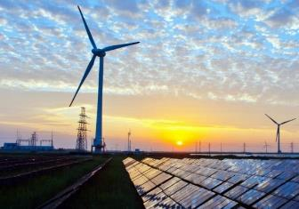
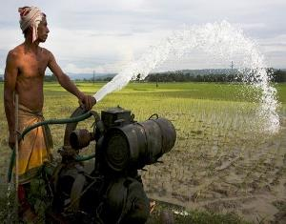
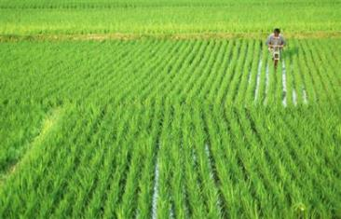





Benefits of Cross-Border Cooperation for Achieving Water-Energy-Land Sustainable Development Goals in the Indus Basin
AUDIO EXPLAINATION
EGU display, May 2020
Adriano Vinca, Simon Parkinson and Keywan Riahi
International Institute for Applied Systems Analysis
Laxenburg, Austria

Slide 2
Summary
Basin overview: highly populated and growing region that will face multi-sectoral challenges in the coming decades
Issues in Business-as-usual future
Achieving necessary water-energy-land SDGs
Benefits and changes with transboundary cooperation

Slide 3
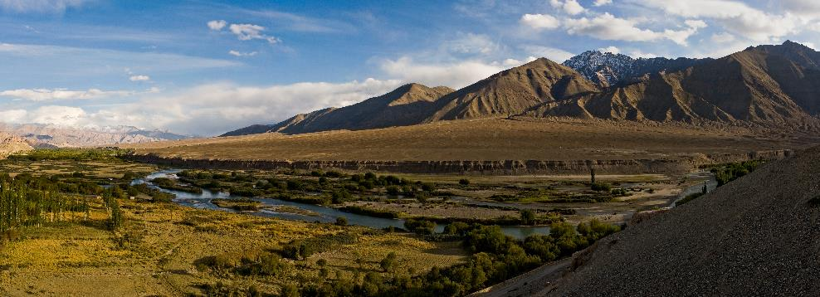
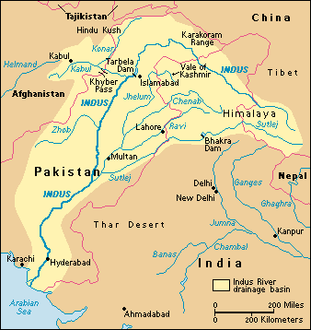
Basin Overview
About 300 million people:
Pakistan 61 %, India 35 %, Afghanistan 4 % and China < 1 %
Population growth rate: 1.1-2.5%
Surface: 1.1 million km²: 50% mountain. Greatest glacier area in Asia
Economy: mostly agriculture, 95% of total water withdrawals
Political tension, especially in border-zones between India and Pakistan

Slide 4
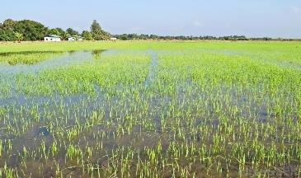

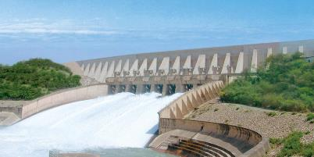
Cross-sectoral Challenges
LAND
Soil salinization
Food self-dependence
Air pollution due to burning of crop residues
WATER
Complex canal and irrigation system
Groundwater depletion and water storage:
up to 800 mm/year groundwater depletion
Low flow reaches the sea, ecosystems at risk
Lack of wastewater treatment and
access to sanitation
ENERGY
Electricity can be unreliable
Air pollution and GHGs increasing
Hydropower generation:
34 GW large hydro planned by 2030, 800 km³ storage capacity

Slide 5
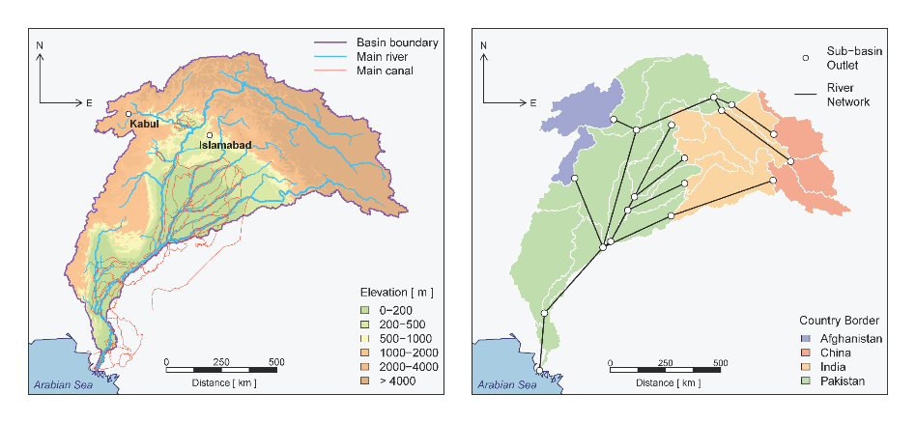
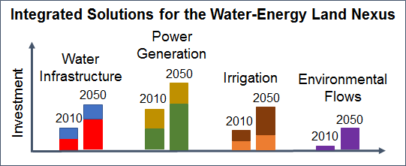
The core model
NExus Solutions Tools (NEST)
Distributed Hydrology
Community Water Model (CWatM)
(Burek et al., 2018)
Infrastructure Planning
MESSAGEix
(Huppmann et al., 2018)
CWaTM
MESSAGE
Upscaling
Potential ET
Effective precipitations
Runoff availability
Water
Techs
Land
Techs
Energy
Techs
Minimize total system cost
Detailed model description:
Vinca et al., 2020

Slide 6





Integrated Policy Analysis
How to strike a balance between objectives and challenges?
… and at what cost?
SDGs
Transboundary Agreements
India
Afghanistan
Pakistan

Slide 7
Insights
Challenges to water system stability if no change occurs
SDG: less water stress, benefits for society and environment
SDG agenda requires 91 billion USD/year, 15% higher than BAU
Benefits and changes with transboundary cooperation

Slide 8
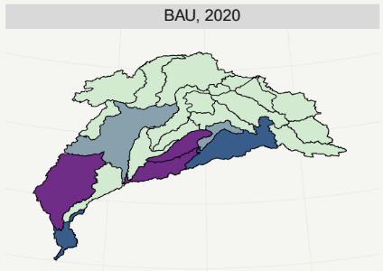
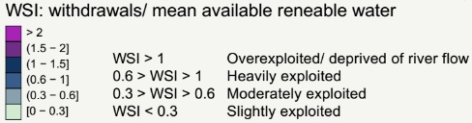
1.Challenges to water system stability if no change occurs
Expected growth in demand for agriculture products, energy and fresh water
Water stress indicator

Slide 9
2.SDG: benefits for society and environment, less water stress
 | BAU | SDG
Energy | NDC implementation | NDCs + GHG targets for carbon neutrality in 2050
Increasing penetration of renewable energy production in urban and rural areas up to 50%
2050
BAU
Reductions
with
SDG implementation
100%
50%
Notes:
Explain what are the assumptions for SDG scenario. How and which investment lead to benefits

Slide 10
2.SDG: benefits for society and environment, less water stress
 | BAU | SDG
Energy | NDC implementation | NDCs + GHG targets for carbon neutrality in 2050
Water treatment/ sanitation | Projection of current rates with GDP growth | Increased access: i.e Urban sanitation access 95%
Water efficiency | No measures | Limits to water withdrawals for agriculture
Environmental flows | No policy | Satisfy minimum requirements at Indus Delta
2050
BAU
Reductions
with
SDG implementation
100%
50%
Notes:
Explain what are the assumptions for SDG scenario. How and which investment lead to benefits

Slide 11
2.SDG: benefits for society and environment, less water stress
 | BAU | SDG
Energy | NDC implementation | NDCs + GHG targets for carbon neutrality in 2050
Water treatment/ sanitation | Projection of current rates with GDP growth | Increased access: i.e Urban sanitation access 95%
Water efficiency | No measures | Limits water withdrawals for agriculture
Environmental flows | No policy | Satisfy minimum requirements at Indus Delta
Land | Projected trend of flood irrigation use | Diverse irrigation possibilities and crop shifts
2050
BAU
Reductions
with
SDG implementation
100%
50%
Notes:
Explain what are the assumptions for SDG scenario. How and which investment lead to benefits

Slide 12
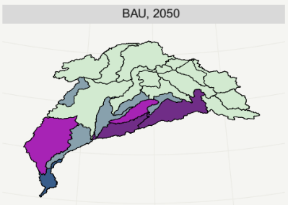
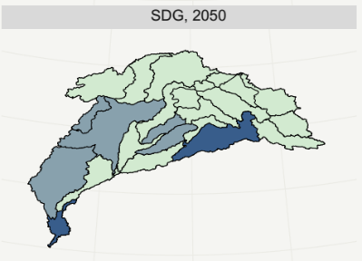
2.SDG: benefits for society and environment, less water stress
Reduction of water stress across the whole basin
Notes:
Explain what are the assumptions for SDG scenario. How and which investment lead to benefits

Slide 13
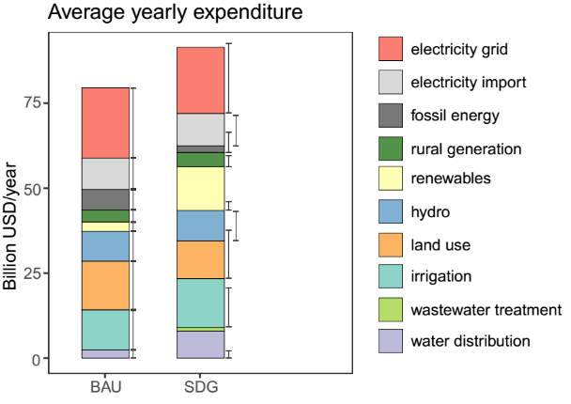
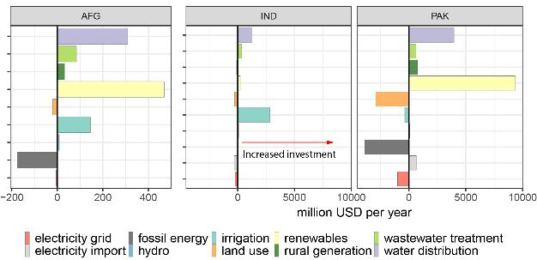
3.SDG agenda requires 91 billion USD/year, 15% higher than BAU
Increased investments in:
renewable energy and water distribution (PAK, AFG)
irrigation (AFG, IND);
Savings:
fossil fuels sector (PAK,AFG)
land use for agriculture (PAK)
+ 15%

Slide 14
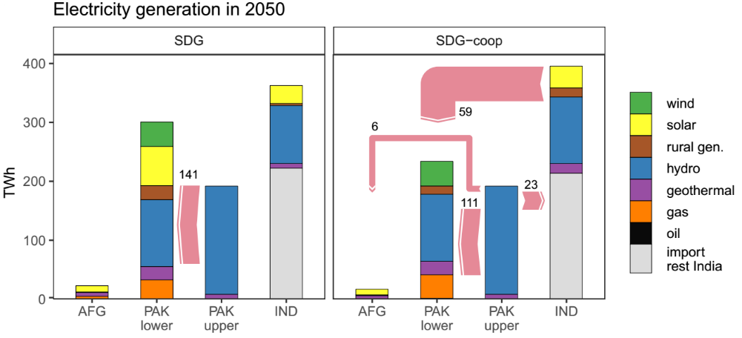
4.Benefits and changes with transboundary cooperation
Allowing electricity trade across Indus countries could lead to amore effective distribution of energy sources.
Reduction in electricity production in lower Pakistan, increase in India and diversification of trade
59
23
6
111
Comparison of electricity generation and transmission (pink arrows) in 2050 in by region for SDG and SDG-coop scenarios

Slide 15
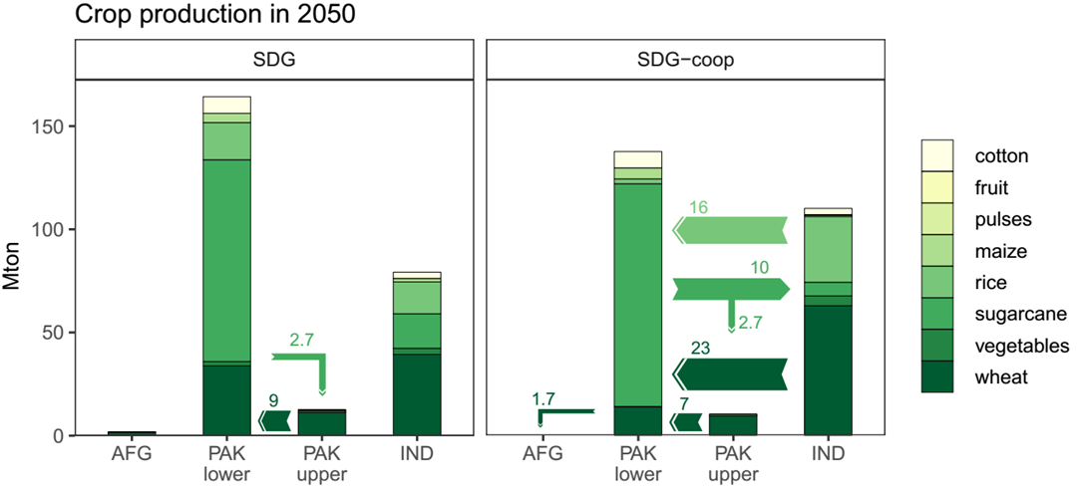
4.Benefits and changes with transboundary cooperation
Assuming a basin-wide agriculture market and allocating crop to minimize water consumption and maximize farmers’ profit, it could result in:
Reduction in agriculture production in lower Pakistan, increase in India and diversification of trade
16
23
2
2.7
7
Comparison of agriculture production and trade

Slide 16
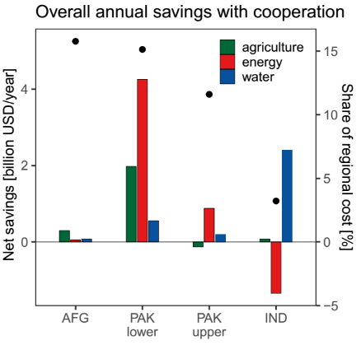
4.Benefits and changes with transboundary cooperation
Significant river flow increase in the lower part of the basin
Economic benefits, net of trades, are positive for all countries and sectors, but Electricity in India.
Tradeoff between energy and water costs in India
Sectorial annual savings (cost ± trade) implied with cooperation (bars) and the percentage of total regional saving over total regional annual costs (black dots, right axis)

Slide 17
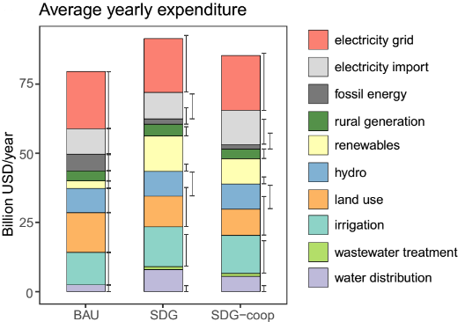
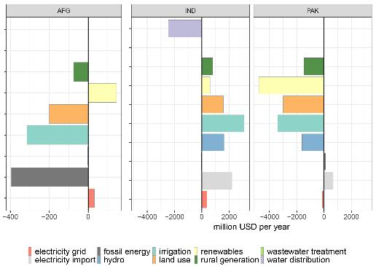
4.Benefits and changes with transboundary cooperation
Ideal cooperation:
Electricity trade
Common food hub
Optimal river flow allocation
Cost differences SDG and SDG-coop
Major savings: - 16 % in renewable energy production
- 15 % in agriculture costs
Higher influence of the Indian side
Major change: shift of electricity and food production upstream, changes in fresh water availability and river flow.
- 7 %

Slide 18
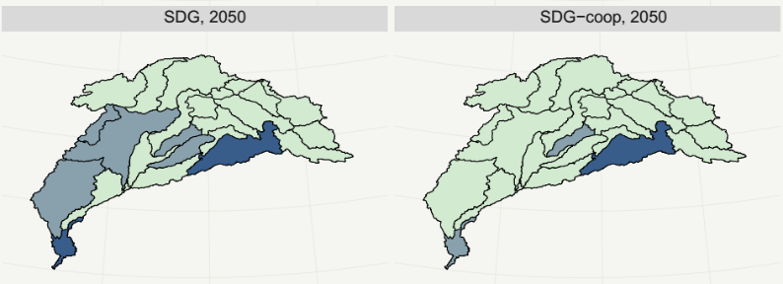
4.Benefits and changes with transboundary cooperation
Reduction of water stress across the whole basin
Seven additional regions reduce the Water Stress Index value under the cooperative scenario
Notes:
Explain what are the assumptions for SDG scenario. How and which investment lead to benefits

Slide 19
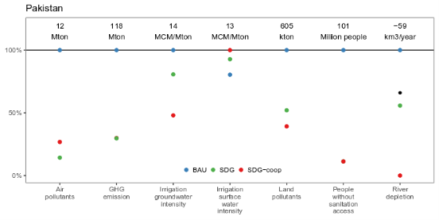
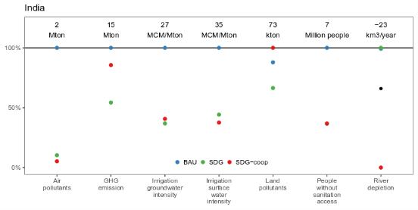
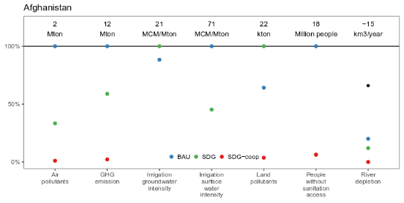
Pakistan obtains more surface water, reduces groundwater intensity
Increased emissions/pollution related to:
- fossil-fueled production
- increased land use
Only positive benefits of cooperation, or neutral impact

Slide 20
Insights
Challenges to water system stability if no change occurs
SDG: less water stress, benefits for society and environment
SDG agenda requires 91 billion USD/year, 15% higher than BAU
Benefits and changes with transboundary cooperation
  reduced costs: 10-15% for Pakistan and Afghanistan, 3.5% India
  opportunity to attract new investments: energy sector India
  environmental benefits, surface and groundwater availability, higher river flows

Slide 21


























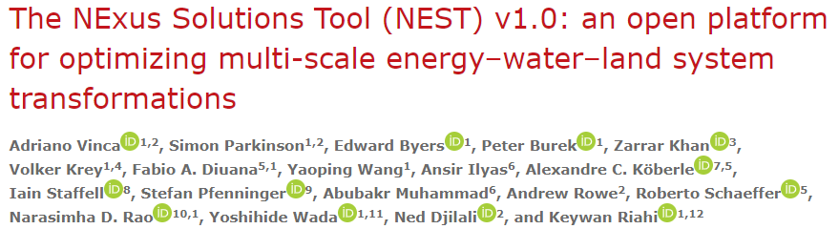

Thank you very much for your attention!
Adriano Vinca
Energy Program
International Institute for Applied Systems Analysis (IIASA)
Laxenburg, Austria
vinca@iiasa.ac.at
Vinca et al., 2020

