Slide 1
MARVEL (Mass And Reference Variations for Earth Lookout): high-low SST laser link
Jean-Michel Lemoine, Mioara Mandea, Benoit Meyssignac, CNES (France)
& the MARVEL Team
jean-michel.lemoine@cnes.fr

Slide 2
MARVEL – NEW SCIENCE
In its nominal configuration, MARVEL aims at reaching in one single mission two major and complementary goals:
          The monitoring of mass transfers within the Earth system with increased precision
          The realization, at the mm level, of the terrestrial reference frame.
          The goal of monitoring mass change with enhanced precision is reached through the use of high-low SST laser tracking
          The goal of contributing to the realization of the terrestrial reference frame at the mm level is achieved by equipping the MEO satellites with the four geodetic techniques (SLR, DORIS, VLBI, GNSS), accurately tied together

Slide 3
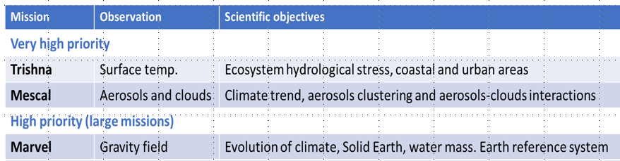
Why MARVEL ?
Top priority of the recent CNES Scientific Prospective Seminar
Multi-thematic interest (Climate, Solid Earth, Land, Hydrology, Ocean, Geodesy)
Science
  Large scientific community in France on MARVEL
  (>30 lead investigators over >7 major scientific topics)
  Heritage of multi-decade science (POD, GRACE, GRACE-FO, GOCE)
  Scientific lead in the European science community
Technology: several mission concepts
  Technology Readiness Level (TRL) for key elements: all components TRL~ 8-9, except Laser Ranging Instrument TRL ~ 4
Partnering Opportunities:
  NASA in the frame of the current Decadal Survey (Mass Change Designated Observable)

Slide 4
MARVEL – Scientific rationale
                Climate: estimate of the energy imbalance of the Earth, estimation of water mass transfers in response to climate change → Top priority in WCRP (GC Sea level, GC Melting ice, GEWEX, CLIVAR, CLIC)
                Hydrology: changes in total water content on continents, assessment of available water stocks, drought forecast energy imbalance of the Earth, estimation of water mass transfers in response to climate change → Top priority in WCRP (GC water for food basket, GEWEX)
                Cryosphere: mass gains & losses of polar ice caps and glaciers, contribution to sea level rise → Top priority in WCRP (GC Sea level, GC Melting ice, CLIC)
                Oceanography: assessment of mass transfers between the ocean and the continents (global and regional scales), ocean transport resolution → Top priority in WCRP (CLIVAR)
                Earthquakes: gravitational signature of great earthquakes
                Post-glacial rebound: measurement of its gravitational component, observational constraints
                Geodesy: Time-varying gravity field, precise orbitography, reference system, sea level (through precise orbitography)

Slide 5


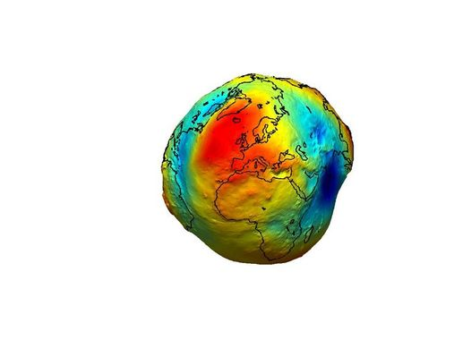
Basic Concepts
Nominal configuration:
        LEO constellation (min. 1 satellite) in polar orbit at ~ 400 km = Gravity field sensor
          The low satellite(s) is equipped with: laser ranging device with pointing system / 3-axis accelerometer / GNSS receiver
        MEO constellation (3 satellites) in polar orbit at ~ 7000 km = targets for the LEO satellites and reference frame determination
          The MEO satellites are equipped with: SLR reflector / GNSS and DORIS receivers / VLBI transmitter / 3-axis micro-accelerometer
MEO tracked by GNSS and tracking ground stations via:
SLR / DORIS / VLBI
GNSS satellites
GNSS measurements
LEO
LRI
MEO
Alternative options: A- The MEOs are at 1500 km altitude (but 6 MEOs are then necessary);
B- We do without MEOs and the LEO LRI system shoots directly on GNSS (with specific laser reflector)
Pre-decisional – For Discussion Purposes Only
5
5/6/2020

Slide 6
Gravity field sensor
            Compared to along-track low-low ranging formations (GRACE & GRACE-FO), the improved detection of mass transfers within the Earth system is expected through the high-low laser link between the two constellations:
          Observation of the radial component of gravity-induced orbit perturbations
          Error structure close to isotropic:
GRACE-type error structure
MARVEL-type error structure
(MOBILE proposal for EE-10, Pail et al. 2018)

Slide 7
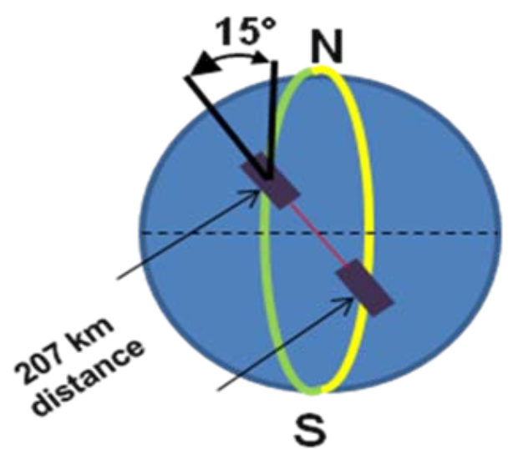
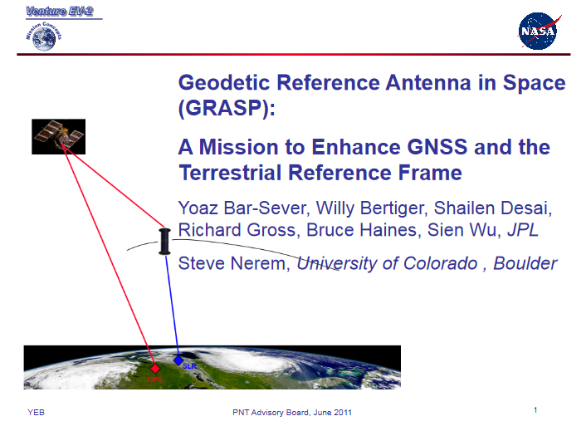
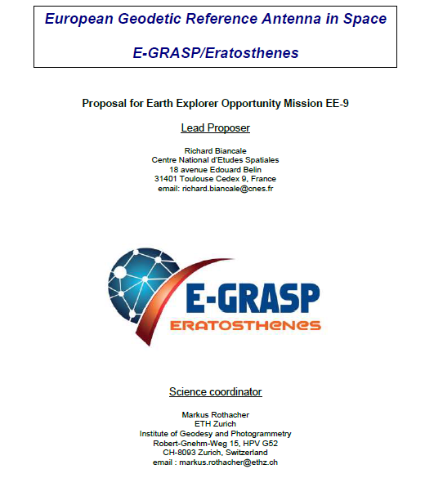

Heritage
ESA EE8 Call "E.motion"
2010
GNSS receiver
DORIS receiver
SLR reflector
VLBI transmitter on S-, X-, and Ku-band
Electrostatic accelerometer (10⁻¹¹ m s⁻² Hz^{-1/2} class)
Attitude determination at 10⁻⁴ rad
ESA EE9 Call "E2.motion"
2016
2011
ESA EE9 Call "E-GRASP"
2016
ESA EE10 Call "MOBILE"
2017

Slide 8
MARVEL – STATUS
Phase 0 MARVEL started on 28/01/2020
    Mioara MANDEA – CNES Programme Manager
    Louise LOPES – CNES Phase 0 Project Manager
    Joel MICHAUD – CNES Co-Phase 0 Project Manager
    Jean-Michel LEMOINE – PI for geodesy and scientific instrumentation
    Benoit MEYSSIGNAC – PI for climate, oceanography, cryosphere, and hydrology
  Significant involvement / investment in MARVEL from international Science Team, CNES, subcontractors (> 40 people)
MARVEL – concept
  5 nominal scenarios + backup scenarios
  Analysis of feasibility
  Consolidation of the performance assessment
  Evaluation of the global TRL
MARVEL – actions
  Two studies have been launched (intermediate results by mid-May, complete results by mid-July):
    Technological study: Study a SLR-type link between the low and high constellations
    Closed-loop Numerical Simulations: Perform numerical simulations to consolidate the performance assessment of the radial SST concept

Slide 9
Technical feasibility of the high-low SST device
Microwave ranging (GRACE / GRACE-FO type):
  Less stringent pointing requirements than for an optical link
  Needs active instruments on board the LEO and MEO satellites (weight, cost, power consumption)
  Difficult to point correctly the KBR horns
  Can the micrometer be attained in such conditions?
Laser ranging interferometry (GRACE-FO type):
  Needs active instruments on board the LEO and MEO satellites (weight, cost, power consumption)
  Acute pointing difficulties
  Phase locking has to be re-acquired at each target swap (i.e. every 45 to 70 minutes, depending on the altitude of the target)
  Need for significant dynamics in the frequency range and phase-tracking (frequency range up to 10GHz, phase-tracking up to 10MHz/s)
  Interesting only if the sub-micrometer accuracy is sought
Laser ranging by time measurement (SLR type):
  Only one active instrument on one satellite (the other satellites have passive reflectors)
  Pointing accuracy requirements are stringent
  Re-acquisition at each target swap is straightforward
  Depending on the laser instrument architecture, a 5 to 10 micrometer accuracy could be reached
  By opposition to the KBR and LRI ranging, the SLR ranging provides an absolute (unbiased) ranging measurement

Slide 10
MARVEL – 1ST PHASE 0 study
TECHNOLOGICAL STUDY OF THE CHRONOMETRIC LASER LINK FOR THE MARVEL MISSION
Global concept of the measurement chain (SNR, error evaluation, metrological concepts)
Instrumental Architecture (oscillator, timer-tagger, laser, photo-detector, telecom components, target, opto-mechanical architecture, electronics)
Laboratory probationary experience (test-bench experience with single-photon detection)
Pre design
Mass balance, Volume, Power

Slide 11
MARVEL – 1st PHASE 0 study
Configurations to be tested
Configuration | LEO at 470 km, MEO at 1500 km | LEO at 470 km, MEO at 7000 km | LEO at 470 km, GNSS at 23000 km
Measurement distance (min / max) | 1000 / 4000 km | 6500 / 12000 km | 23000 / 30000 km
Relative velocity (max) | 1.44 km/s | 4.83 km/s | 8.38 km/s
Duration of uninterrupted visibility | 81 minutes | 49 minutes | 45 minutes
Temporal resolution | 5 s | 5 s | 5 s
Elevation min / max of the measurement on the LEO | 0 – 180 ° | 0 – 180 ° | 0 – 180 °
Elevation min / max of the measurement on the MEO | 30 – 150 ° | 60 – 120 ° | 77 – 103 °
Maximum angular velocity of measurement on the LEO | 0.034 °/s | 0.058 °/s | 0.070 °/s
Maximum angular velocity of measurement on the MEO | 0.022 °/s | 0.019 °/s | 0.010 °/s

Slide 12
MARVEL – 2nd PHASE 0 study
CLOSED-LOOP NUMERICAL SIMULATIONS OF PERFORMANCE FOR MARVEL (and other NGGM)
Simulation of measurements:
  SST measurements simulation
  GNSS measurements simulation
  Adding noise to the measurements
  Adding noise to the models (gravity field, tides, dealiasing)
List of scenarios to be tested:
  GRACE alone
  MARVEL alone
  GRACE + MARVEL
  « Bender » (i.e. one GRACE pair at 90° inclination + one GRACE pair at 70° inclination)
  GRACE + MARVEL + « Bender »
  GRACE + MARVEL link to GNSS
Obtaining solutions: monthly solutions up to dg 90 over 1-year, via NEQs addition + Choleski inversion
Solutions assessment metrics: dg-spectral errors, geographical RMS, dg-order triangle of errors

Slide 13
Technical feasibility for Reference Frame determination
Instruments:
  GNSS receiver
  DORIS receiver
  SLR reflector
  VLBI transmitter on 3 frequencies (S-, X-, and Ku-band)
  Electrostatic accelerometer (10-11 m s-2 Hz-1/2 class)
  Attitude determination at 10-4 rad
TRL: ~ 8-9
  All these instruments, except for the VLBI transmitter, are currently flying on different space missions.

Slide 14
MARVEL - SUMMARY
                MARVEL Phase 0 started a CNES in February 2020 and is progressing rapidly
                All scientific questions addressed by MARVEL (except internal Earth) are complementary to the scientific issues of altimetry. The combination of MARVEL and altimetry data makes it possible to answer fundamental questions of climate change
                Combining MARVEL data and altimetry opens up the possibility of new climate services: monitoring the energy imbalance, the loss of polar ice sheet mass, surface freshwater resources and aquifers, forecasting drought…
                MARVEL relies on the know-how of CNES in the domains of satellite laser ranging, measurement and performance of the measurement chain
                MARVEL is a very modular concept (LEO satellites can be replaced or supplemented, MEO satellites can be replaced or supplemented by other agencies)
                It has the potential to be the origin of a new generation of Mass Change missions

Slide 15
NEXT STEPS
Complete the two studies launched in February (mid-July)
          Start the definition of the satellites architecture: list all instruments on-board each satellite; estimate weight, power consumption, price; evaluate the global TRL
          Continue discussions with our American colleagues working on « Mass Change »

Slide 16
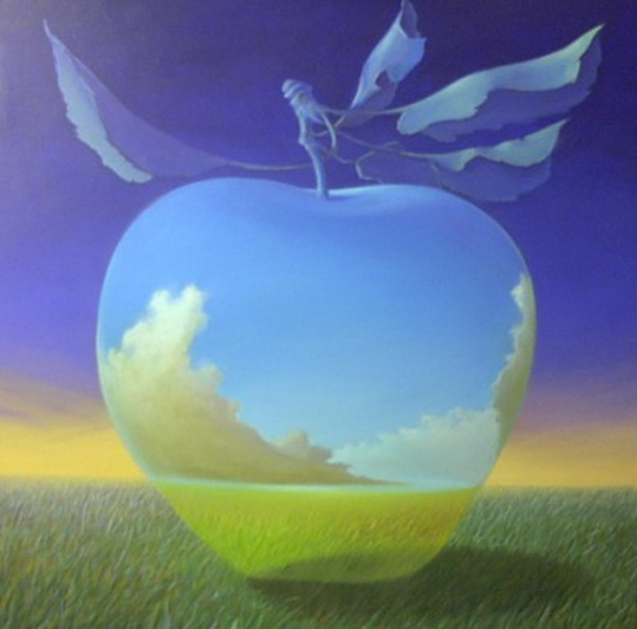
Backup slides

Slide 17
Publications
Markus Hauk & Roland Pail (2019). Gravity Field Recovery Using High-Precision, High–Low Inter-Satellite Links, Remote Sens. 2019, 11(5), 537; https://doi.org/10.3390/rs11050537
Daras I., Pail R. (2017). Treatment of temporal aliasing effects in the context of next generation satellite gravimetry missions. J. Geophys. Res: Solid Earth, 122(9): 7343–7362, doi: https://doi.org/10.1002/2017JB014250
Daras I., Pail R., Murböck M., Yi W. (2015). Gravity field processing with enhanced numerical precision for LL-SST missions. 89:99-110, doi: https://doi.org/10.1007/s00190-014-0764-2
Wiese D.N., Visser P.N.A.M., Nerem R.S. (2011). Estimating low resolution gravity fields at short time intervals to reduce temporal aliasing errors. Adv Space Res 48:1094–1107, DOI https://doi.org/10.1016/j.asr.2011.05.027
Biancale R. et al. (2017). E-GRASP/Eratosthenes, Proposal for Earth Explorer Opportunity Mission EE-9 in response to the Call for Proposals for Earth Explorer Opportunity Mission EE-9 (ESA/EXPLORER/EE-9 rev. 1), June 2017.
E-GRASP: http://adsabs.harvard.edu/abs/2016AGUFM.G41A1009S

Slide 18
The MARVEL Team
Zuheir Altamimi, IGN, Paris, France, Zuheir.Altamimi@ign.fr
Georges Balmino, GET, Toulouse, France, georges.balmino@get.omp.eu
Alejandro Blazquez, CNES/LEGOS, Toulouse, France, alejandro.blazquez@legos.obs-mip.fr
Stéphane Bourgogne, Stellar Space Studies, Toulouse, France, stephane.bourgogne@stellarspacestudies.com
Jean-Paul Boy, CNRS, Strasbourg, France, jeanpaul.boy@unistra.fr
Sean Bruinsma, CNES, Toulouse, France, sean.bruinsma@cnes.fr
David Coulot, IGN, Paris, France, David.Coulot@ign.fr
Pierre Exertier, CNRS/GET, Toulouse, France, pierre.exertier@get.omp.eu
Frank Flechtner, GFZ, Potsdam, Germany, frank.flechtner@gfz-potsdam.de
Thomas Gruber, TUM, Munich, Germany, thomas.gruber@tum.de
Martin Horwath, TU-Dresden, Germany, martin.horwath@tu-dresden.de
Frank Lemoine, GSFC, Greenbelt, USA, frank.g.lemoine@nasa.gov
Jean-Michel Lemoine, CNES/GET, Toulouse, France, jean-michel.lemoine@cnes.fr
Laurent Longuevergne, CNRS/DIMENV, Rennes, France, laurent.longuevergne@univ-rennes1.fr
Louise Lopes, CNES, Toulouse, France, Louise.Lopes@cnes.fr
Mioara Mandea, CNES, Paris, France, mioara.mandea@cnes.fr
Benoit Meyssignac, CNES/LEGOS, Toulouse, France, benoit.meyssignac@legos.obs-mip.fr
Joel Michaud, CNES, Toulouse, France, Joel.Michaud@cnes.fr
Roland Pail, TUM, Munich, Germany, pail@bv.tum.de
Isabelle Panet, IGN, Paris, France, isabelle.panet@ign.fr
Arnaud Pollet, IGN, Paris, France, Arnaud.Pollet@ign.fr
Markus Rothacher, ETH, Zürich, Swiss Confederation, markus.rothacher@ethz.ch
Etienne Samain, Sigmaworks, Saint Vallier de Thiey, France, etienne.samain@sigmaworks.fr
Paul Tregoning, ANU, Canberra, Australia, paul.tregoning@anu.edu.au

