Slide 1
Physical interpretation of hydrologic model complexity revisited
Saket Pande and Mehdi Moayeri

Slide 2
Summary
Model complexity as a measure of instability in hydrological system representation (in terms of stream flow by SAC-SMA model)
More complex models needed in basins with more difficulty in predicting historically similar stream flow events..
..which are either drier, or wet with more seasonal rainfall, vegetation with less storage capacity, and faster responsive soils

Slide 3

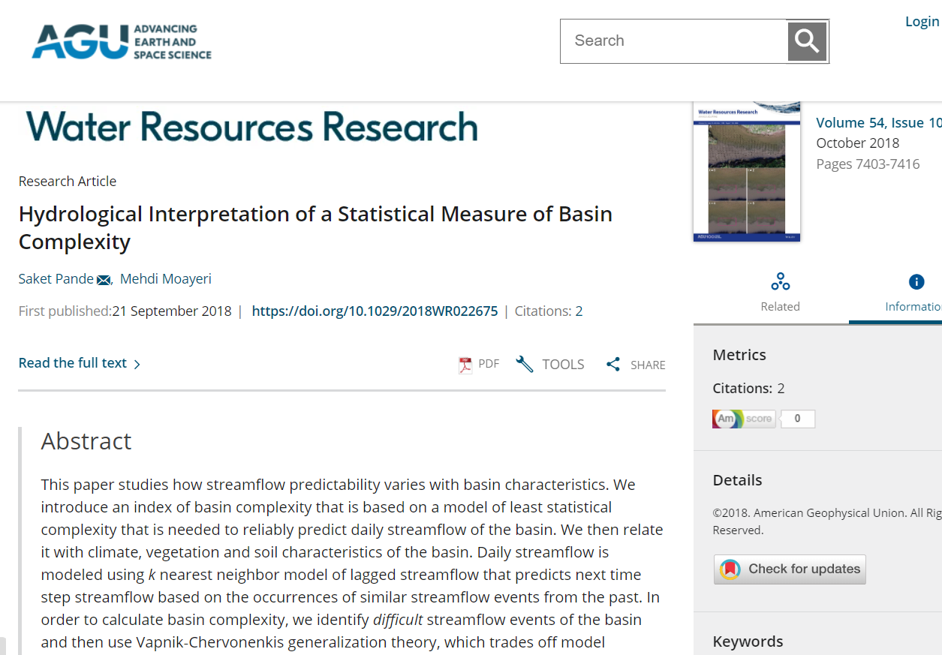
Background

Slide 4


CAMELS data set

Slide 5
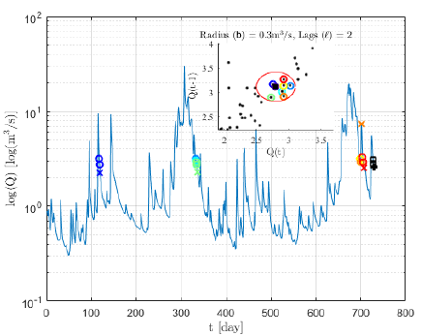
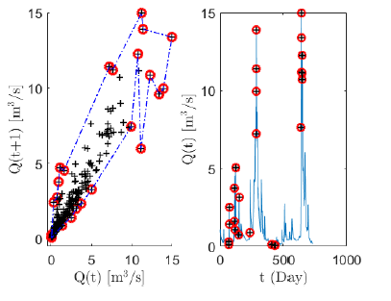
Difficulty in predicting historically similar stream flow → complexity controlled k-nearest neighbor modeling

Slide 6
Drier basins or those with more seasonal rainfall, less storage capacity, faster soils → more difficult to predict

Slide 7
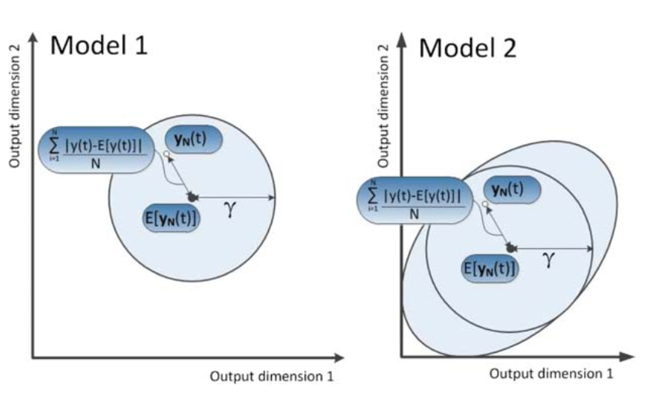
Complexity: measure of instability in system representation by SAC-SMA

Slide 8
Difficulty in predicting stream flow ↔ More unstable system representation
 | Difficult stream flow to predict | Model complexity
1/Aridity | -0.51 | -0.16
Seasonality | 0.43 | 0.53
% forests | -0.29 | -0.25
Porosity | 0.13 | 0.32
Slope | -0.47 | -0.54
Soil storage | 0.18 | 0.36

Slide 9
Complexity required to model a basin depends on its climate and landscape characteristics

Slide 10


