Slide 1
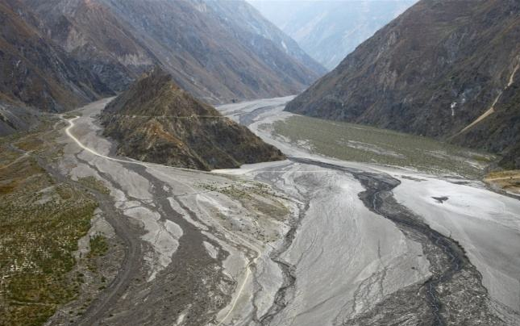
An experimental evaluation of impact force on a fiber Bragg grating (FBG)-based device for debris flow warning
Shaojie Zhang, Jiang Chen

Slide 2
Main Content
Introduction
Fiber-Grating Bragg (FBG)-based monitoring device
Boulder impact force measurement
Warning about impact energy of debris flow
Conclusions

Slide 3
Introduction
Why we want to develop the FBG-based monitoring device
Monitoring and early warning techniques are effective ways for mitigations.
The key component in monitoring and early warning applications is the sensor system.
Conventional sensors for debris flow monitoring have several drawbacks.
Service
life
Strong
resistance
effect
Influenced by thunder
replacement of the sensors
Stability and Precision
Monitoring application

Slide 4
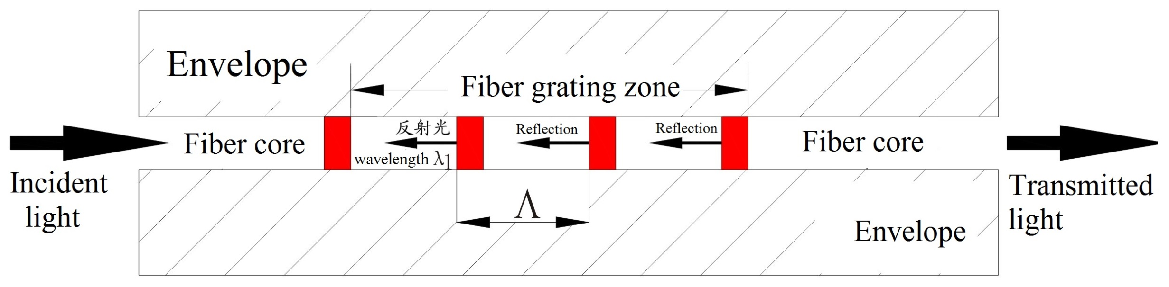
FBG-based device for monitoring debris flow
Why we want to develop the FBG-based monitoring device
Advantages: anti-corrosion properties; waterproofness; high sensitivity; immunity to
electromagnetic interference; and long term stability
∆λ_{B} = K_{ε}∆ε+ K_{T}∆T: Sensitive to temperature and strain
following a linear relationships

Slide 5
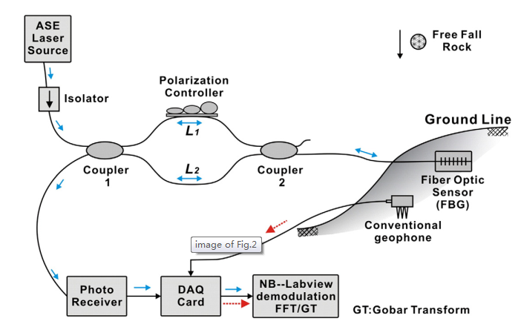
FBG-based device for monitoring debris flow
Recent investigations of using FBG to monitor debris flow
FBG-based acceleration sensor
monitor earth sounds resulted from the debris flow movement.
It is reported that the signal-to-noise ratio (SNR) of the earth sounds detected by the FBG-based sensors is significantly higher compared to the conventional geophone, indicating higher sensitivity of the FBG-based sensors.
One big problem is that the earth sounds are easily affected by noises and the denoising methods are required.
Huang et al., 2012, Optics Communications

Slide 6
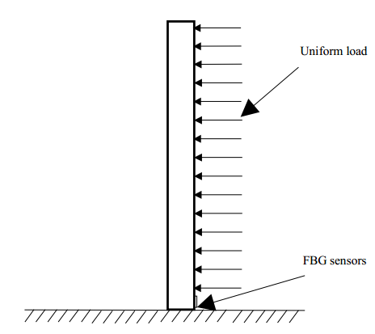
FBG-based device for monitoring debris flow
Recent investigations of using FBG to monitor debris flow
FBG-based acceleration sensor
monitor debris flow through directly contacting this solid-water fluid.
A FBG-based sensor (a column net) to monitor the strain at the bottom of debris flow along steel pipes;
When this FBG-based column net attached to the bedrock is subject to the impact force of debris flows, it may be easily damaged.
Pei et al., 2011, Journal of Mountain Science

Slide 7
FBG-based device for monitoring debris flow
Purpose of this study
Measurement of the impact force of the boulder within debris flow was the main focus point.
A new FBG-based device was developed to achieve high reliability and effectiveness under different impact forces.
The relationship between the impact forces and the measured strain was investigated.
Based on this relationship, a method was proposed for monitoring and warning debris flow energy, which directly correlates with the damage to building structures.

Slide 8
Main Content
Introduction
Fiber-Grating Bragg (FBG)-based monitoring device
Boulder impact force measurement
Warning about impact energy of debris flow
Conclusions

Slide 9
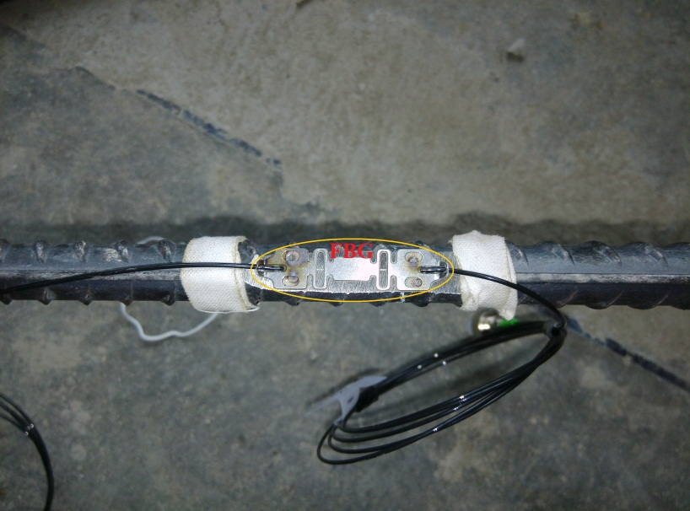
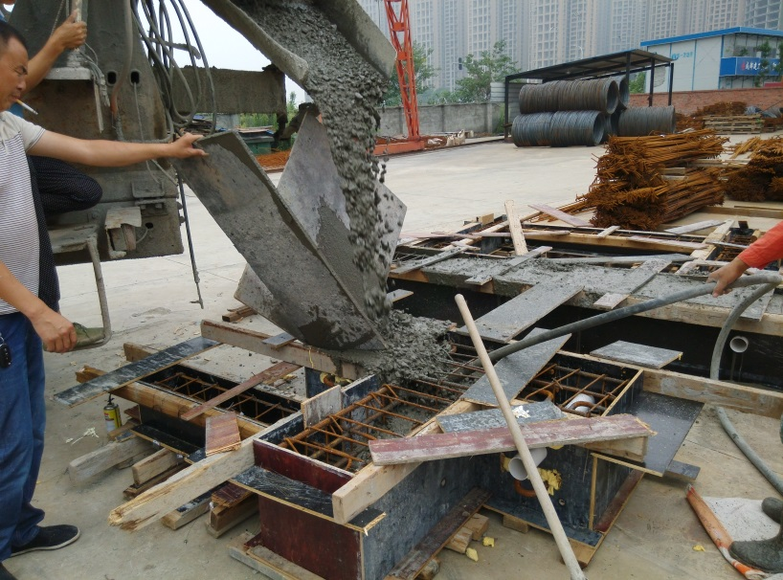
Fiber-Grating Bragg (FBG)-based monitoring device
FBG welded to steel bar
Poured by concrete for protecting sensor
Device in debris flow valley
Debris flow impacts the reinforced concrete beam (RCB) causing a deformation of RCB as well as a deformation of the steel bar inside. This deformation is measured by the FBG-based device in terms of the strain. Hence, the measured strain is correlated to debris flow energy. The relationship between the measured strain and the debris flow energy can be built using a two-step approach: (1) the relationship between the strain of steel bar and the impact force must be calibrated, and (2) the measured strain data must be related to debris flow energy correlating with the damage to building structures.

Slide 10
Main Content
Introduction
Fiber-Grating Bragg (FBG)-based monitoring device
Boulder impact force measurement
Warning about impact energy of debris flow
Conclusions

Slide 11
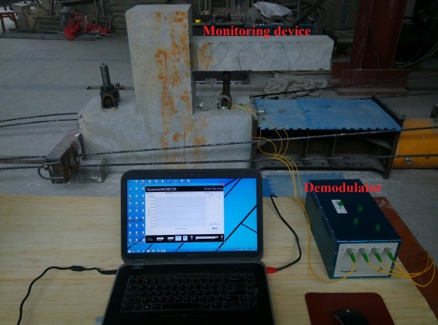
Boulder impact force measurement
FBG 1# mainly for measurement;
FBG 2#, 3# and 4# mainly for locating the impact position.
FBG sensor #1 was close to the fixed end, and the sensor interval was 20 cm.
The monitoring device was attached to the rigid column and foundation beam. The foundation beam was fixed on the ground using anchor bolts. It is noted that the rigid column and foundation beam are much larger and stiffer compared to the monitoring device, so that there is almost no deformation in the rigid column and foundation when an impact force is imposed on the monitoring device.
Measurement range | 1500nm-1600nm
Resolution | 5pm
Sensors per. channel | 25
Optical channels | 4
Sample rate | 100Hz
Operation temperature | 10-40º C

Slide 12
Boulder impact force measurement
The impact force of debris flow consists of the hydrodynamic pressure and the boulder collision, and the boulder collision is the key factor contributing to building damage and engineering structure failure.
The boulder impact effect is closely related to the translational and rotational movement of the boulder.
Debris flows with different densities can have different boulder movements. A debris flow with a high density is capable of keeping boulders in a suspended state, such that only translational energy is carried by the boulders. In contrast, boulders within the low-density debris flow roll forward, carrying both translational and rotational energy.
In this study, we focus on the translational impacts, and a hammer was used to simulate the boulder within debris flow
Falling heights: 0.2, 0.4, 0.6, 1 m and 2 m

Slide 13
Boulder impact force measurement
Falling height: 0.2m
Falling height: 0.4m
Falling height: 0.6m
Falling height: 1m
Falling height: 2m
The dynamic strain process started from the strain value of zero and ended at the zero point after a peak crest of strain value.
This behavior implies a dominantly elastic deformation within the monitoring device during the impact test.
The whole dynamic process was neglected, only the peak value was considered and further analyzed.
The peaks of dynamic strain under different free-falling heights are measured by the FBG sensors and listed in Table.
Work conditions | Height/m | Impact force/kN | Peak value of dynamic strain/10⁻⁶
1 | 0.2 | 49.30 | 473.1
2 | 0.4 | 69.71 | 952.3
3 | 0.6 | 85.39 | 1233.5
4 | 1 | 110.24 | 1562.8
5 | 2 | 155.90 | 2103.2

Slide 14
Boulder impact force measurement
A formula for calculating the boulder impact force based on the elastic collision assumption as follows:
(Zhang et al., 1989)
Application Conditions: contacting mode between the hammer and the monitoring device was assumed to be elastic;
all of the impacting energy can be effectively transferred into the elastic strain energy of the device.

Slide 15
Boulder impact force measurement
Work conditions | Height/m | Impact force/kN | Peak value of dynamic strain/10⁻⁶
1 | 0.2 | 49.30 | 473.1
2 | 0.4 | 69.71 | 952.3
3 | 0.6 | 85.39 | 1233.5
4 | 1 | 110.24 | 1562.8
5 | 2 | 155.90 | 2103.2
From the Equation, it is seen that the impact force (F) is proportional to the square root of the falling height (h).
The figure shows that the peak value of the dynamic strain measured by FBG #1 has an approximately binomial correlation to the hammer falling height (h). Hence, the hammer impact force (F) is proportional to the peak value of the dynamic strain measured by FBG #1.

Slide 16
Boulder impact force measurement
Work conditions | Height/m | Impact force/kN | Peak value of dynamic strain/10⁻⁶
1 | 0.2 | 49.30 | 473.1
2 | 0.4 | 69.71 | 952.3
3 | 0.6 | 85.39 | 1233.5
4 | 1 | 110.24 | 1562.8
5 | 2 | 155.90 | 2103.2
The relationship between the hammer impact force and the peak value of the dynamic strain measured by FBG #1, confirming this linear relationship.

Slide 17
Boulder impact force measurement
Fitting Equation: F=0.0659ε_{peak}+10.741, where F is the hammer impact force (kN), and ε_{peak} is the peak value of the dynamic strain measured by 1# FBG.
The fitting equation indicates that the larger measured elastic strain value reflects the larger impact force from boulders within debris flow. Taking the boulder impact force as a link, the measured strain value is expected to have a positive correlation to the energy of debris flow
impacting position is located at the free end of the monitoring device, however, in reality, the impact position of boulder within debris flow is not always located at the free end of the monitoring device
Impact position
in the test
Noted
Impact position
in reality
Noted
Identify the impact position before calculating impact force using the fitting Equation.

Slide 18
Boulder impact force measurement
Static force condition:
Strain induced load on any position:
F=0.0659ε_{peak}+10.741
Impact force: F
Strain induced load on free end:
Impact force condition:
A simple finite element model of a beam was established for investigating that whether the peak value of the dynamic strain is linear to the force arm.
Testing cases | Impact position vs. the peak value of dynamic strain/10⁻⁶
 | L=1m | L=0.9m | L=0.7m | L=0.5m | L=0.3m | L=0.1m
t=0.0001s | 13.02 | 9.21 | 7.13 | 6.44 | 5.34 | 1.78
t=0.001s | 72.6 | 62.58 | 42.88 | 25.08 | 10.62 | 1.596
t=0.01s | 81.8 | 72.69 | 54.51 | 36.62 | 19.49 | 3.76

Slide 19
Boulder impact force measurement
Case 1: acting time of impact force t=0.0001s
Case 2: acting time of impact force t=0.001s
Case 3: acting time of impact force t=0.01s
It is seen that the peak value of dynamic strain has a positive correlation to the force arm of the impact force and the linearity is better as t increases;
It is also seen that the peak strain value at the fixed end is approximately a linear function of the force arm, which is similar to the static force condition.
Next task was to identify the impacting position depending on the strain variations rule of FBG 1#, 2#, 3# and 4#.

Slide 20
Boulder impact force measurement
Cases | Impacting conditions | Impacting conditions | FBG #1 | FBG #2 FBG #3 |  | FBG #4
Case 1 | L_{arbi}=41 cm, height=40 cm |  | 340.1 | 237.3 | 114.4 | 115.4
Case 2 | L_{arbi}=50 cm, height=20 cm |  | 413.4 | 306.7 | 169.0 | 149.2
Case 3 | L_{arbi}=50 cm, height=40 cm |  | 736.5 | 611.2 | 330.5 | 305.6
It is seen that the normalized peak value of the dynamics strain for each case decreases significantly from FBG #1 to FBG #2 to FBG #3. However, from FBG 3# to FBG #4, the change is very small. This rule can be used to determine the pounding position of the drop hammer, and the pounding position should be located between FBG #3and FBG #2.

Slide 21
Main Content
Introduction
Fiber-Grating Bragg (FBG)-based monitoring device
Boulder impact force measurement
Warning about impact energy of debris flow
Conclusions and discussions

Slide 22
Warning about impact energy of debris flow
the warning index for dangerous debris flows can be classified as follows: (1) measured peak value of the dynamic strain ε_{peak}=0 means no debris flow occurrence; (2) ε_{peak}>0 means debris flow occurrence.
When a debris flow occurs, the monitoring device can also assess the energy of debris flow using the fitting equation. In the case of elastic deformation of the monitoring device, a larger peak strain value measured by FBG #1 means a stronger impact effect, and more serious damage to the area downstream.
The fitting equation established a linear relationship between the measured peak strain value and the energy of a debris flow, which can be used to help the monitoring device to linearly warning the energy of debris flow using the measured peak strain value.
Strain data | 0<ε_{peak}≤0.2ε_{max} | 0.2ε_{max} <ε_{peak}≤0.4ε_{max} | 0.4ε_{max} <ε_{peak}≤0.6ε_{max} | 0.6ε_{max} <ε_{peak}≤0.8ε_{max} | 0.8ε_{max} <ε_{peak}≤ε_{max}
Energy | 1 | 2 | 3 | 4 | 5
Warning color | none | Blue | Yellow | Orange | Red

Slide 23
Main Content
Introduction
Fiber-Grating Bragg (FBG)-based monitoring device
Boulder impact force measurement
Warning about impact energy of debris flow
Conclusions

Slide 24
Conclusions
The dynamic response of an elastic cantilever beam is very complex due to the presence of the inner elastic zone. The wave crest of the complex dynamic process was chosen as the key parameter and the whole vibration process was neglected. Our results show that the relationship between the peak value of the dynamic strain and the impact force was approximately similar to the static force condition.
A reinforced concrete beam is one of the most important reference structures in many debris flow susceptible areas. Failure of this key structure within a building will significantly influence the building’s stability. An effective assessment of its deformation tendency and failure criteria can provide clear pre-warning information to residents downstream. Our proposed monitoring device was simply made of a reinforced concrete beam. The inner peak value of dynamic strain, as measured by FBG, was demonstrated to have a linear correlation to boulder impact force. This linear relationship allows us to linearly monitor debris flows and provide warnings as long as the device is in the elastic state.

Slide 25
Thanks for your attentions!

