Slide 1

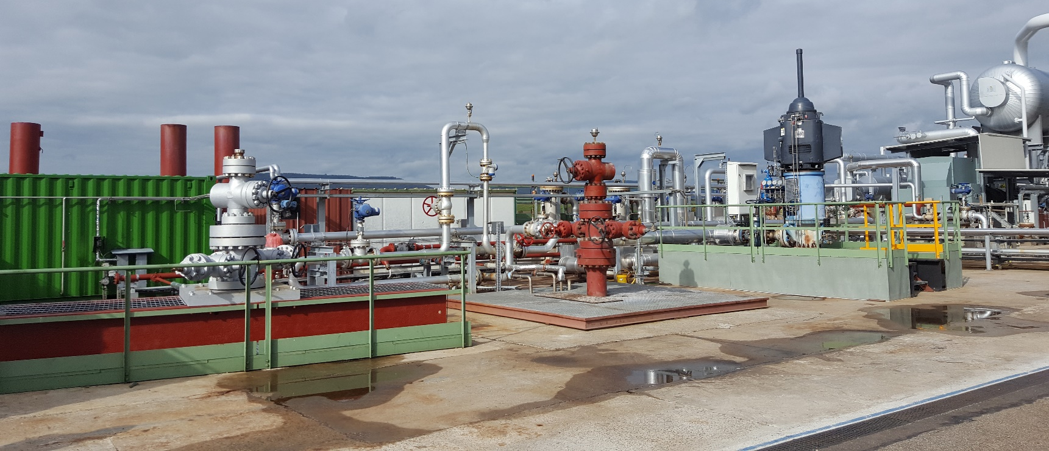


Seismic asperity size evolution during fluid injection: case study of the 1993 Soultz-sous-Forêts injection
EGU 2020, 4-8/05/2020 Sharing Geosciences Online
Cauchie L.^{1,*}, Lengliné O.¹, Schmittbuhl J.¹
(1) EOST/IPGS, University of Strasbourg/CNRS, France
(*) now at University of Liege, Belgium

Slide 2
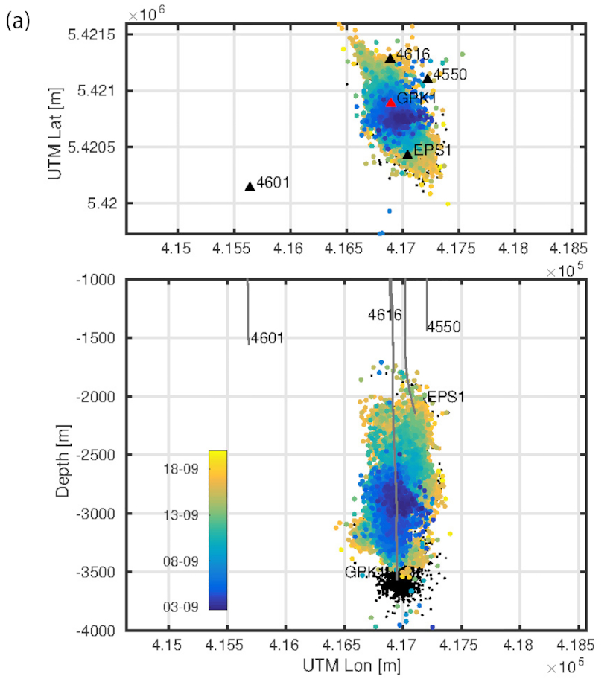
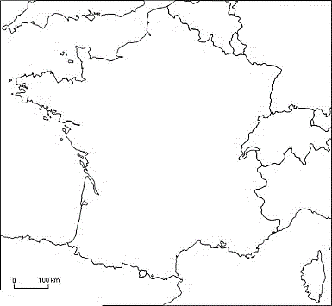
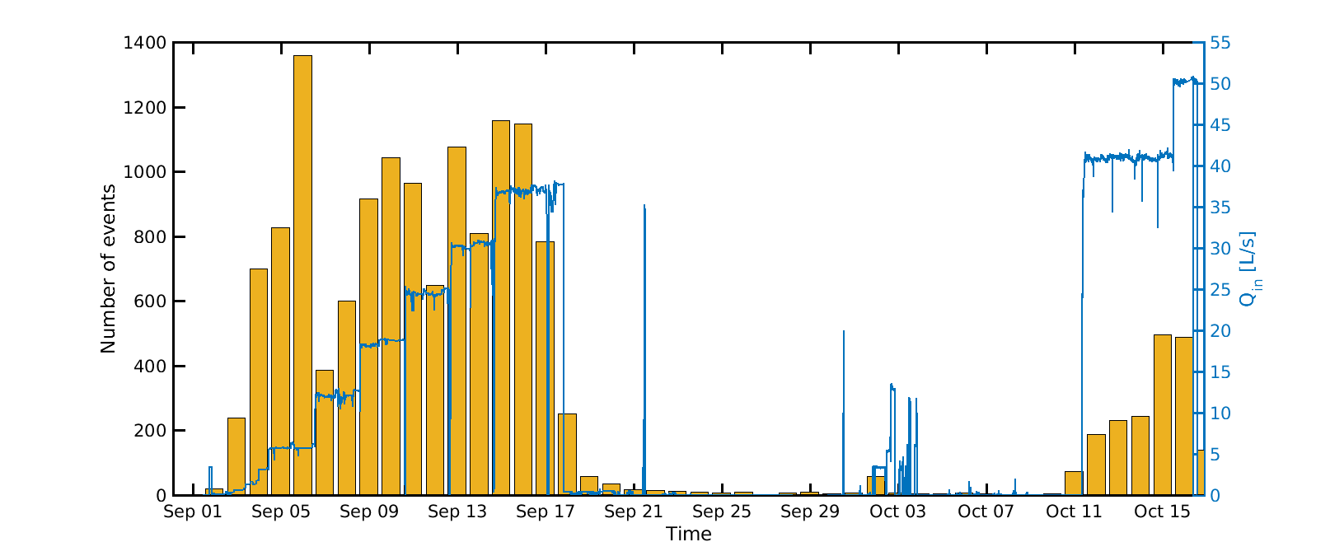
Soultz-sous-Forêts EGS reservoir, France
In this study, we investigate the sources of the microseismic events that were recorded during the 1993 hydraulic stimulation in order to detect any possible links between the source parameters of the seismic events and the injection history.
In particular, we investigate if the repeating events possibly associated with aseismic slips within the reservoir have a distinct signature from the events that result from the creation of new fractures that appeared at later times and in a different part of the reservoir.
Hydraulic stimulation, September – October 1993:
Fluid injection at GPK1 well: injection source between 2900 and 3400 m
Abundant seismicity: About 15000 recorded seismic events by 4 borehole seismic stations (only 166 events were recorded at the surface network)
repeated borehole imagery, before and after the injection, identified planar structures intersecting the borehole that slip aseismically (Cornet et al. 1997)
Analysis of repeating earthquakes on one of this structure: cumulative slip matches the one observed from borehole measurement (Bourouis & Bernard 2007)
Fig. : Seismicity induced by the hydraulic stimulation in 1993. Location of the seismic events, the sensors and the well trajectories. The coloured dots refer to the seismicity recorded during the first part of the stimulation (September). The colourscale shows the date scale in September 1993. The black dots show the seismicity in the second part of the stimulation October)
Fig.: Daily number of seismic events associated with the stimulation, flow-rate at GPK1.

Slide 3
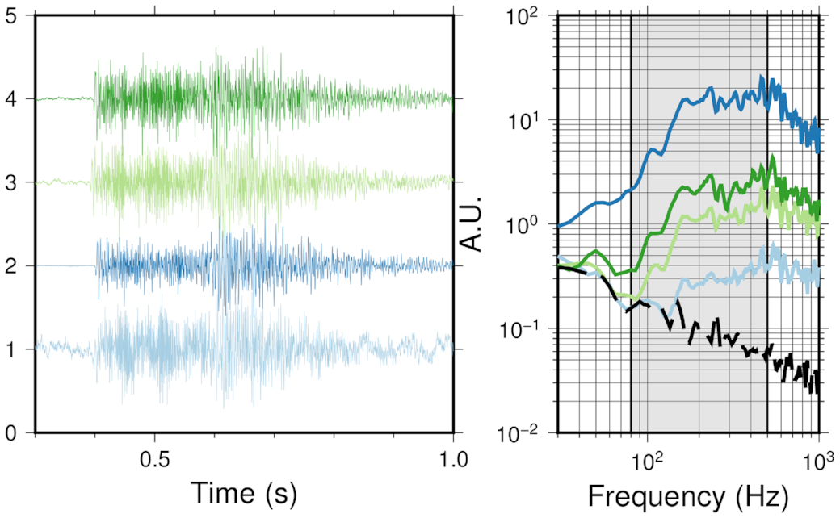
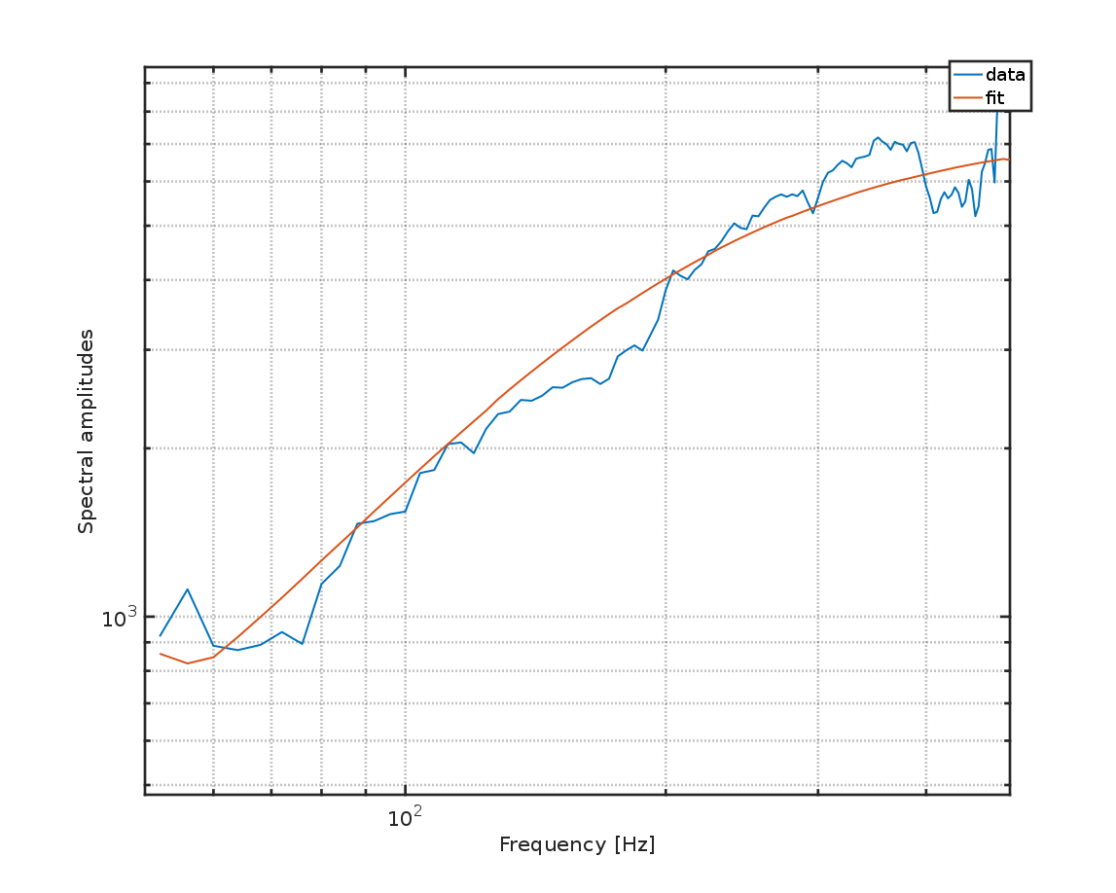
Events Characterization
We first computed source properties for all events recorded, using a typical Brune’s spectral model (Brune 1970).
Modeling the event amplitude spectra with a Brune’s model (Brune, 1970):
Estimation of SEISMIC MOMENTS Mo
Estimation of CORNER FREQUENCIES Fc
    SOURCES DIMENSIONS (circular model, Madariaga, 1976):
c=constant
V=S-wave velocity
D=Source Dimension
- data
- fit
Fig. Example of a 3-d-long sequence of four repeating earthquakes with a corner frequency of 98 Hz. On the left, the normalized vertical-component waveforms of the four occurrences using different colours at seismic station 4550 (see Table S1 and Fig. 1). On the right the associated acceleration amplitude spectra using the same colour code for the time occurrence of the event and an arbitrary absolute scale (A.U.). The strong similarity of the spectra shows the similarity of the event waveform. The dashed black line corresponds to the averaged background noise spectrum computed on the 0.25-s-long windows preceding the events.
Spectral Amplitudes
Frequency [Hz]

Slide 4
Repeating earthquakes identification
We then isolated repeating event sequences on individual asperities and obtained refined source parameters for these events.
1. Cross-correlation analysis and clustering: families of similar waveforms
2. Colocation of repeating earthquakes
2.1 Event size estimation: Application of a spectral ratio method to compare corner frequencies and seismic moments between pairs of events of each sequence (Lengliné et al. 2014)
        Higher accuracy in the estimation of Mo and fr
2.2 Interevents distances: assessment of inter-event distances from time variation between P- and S-waves arrival times estimation through high-resolution cross-correlation analysis
2.3 Overlapping criterion: Elements are kept in a sequence if R_{i}+R_{j}<D_{ij}
R= source radius
D= inter-event distance
f1=f2
f1~f2
f1≠f2
Results: 4252 seismic events are classified in 663 sequences of repeating earthquakes
R_{i}
D_{ij}
R_{j}
D_{ik}
D_{jk}
R_{k}
Fig. Schema illustrating the verification of overlapping criterion
Figure extracted from Lengliné et al., 2014 illustrating the spectral ratio method applied on pairs of events.

Slide 5
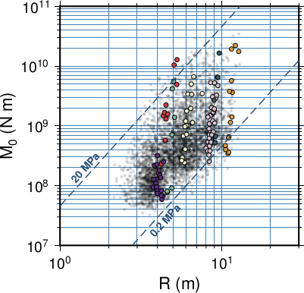
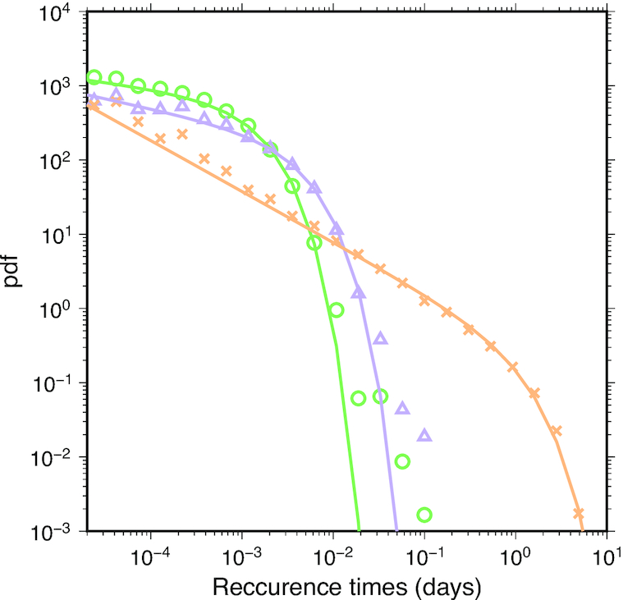
Results: Scaling of repeating events
Globally, the scaling between moments Mo and source radii R is of the form M₀∝R³ as observed from numerous earthquakes worldwide (e.g. Kanamori & Anderson 1975).
At the scale of the asperity, this scaling law is not fulfilled and the moment M₀ is evolving independently of the radius R over a range that explains the typical broad dispersion of such (r, M₀) scaling law (Kanamori & Anderson 1975)
The variation in moment within a repeating sequence is not a monotonic time evolution but is randomly distributed in time with no clear history of the moment evolution.
The distributions of recurrence times between consecutive events for all events of the catalogue and only events that belong to a sequence are fitted by a gamma-distribution with slow decay and short time cut-off (1hr).PDF for recurrence times of events within repeating sequence but treating each sequence independently and not mixing times of the different sequences presents a best-fitting gamma-distribution with a higher decay exponent and a larger time cutoff (8days).
The events in sequence have a different temporal organization compared to the overall behaviour of the seismicity.
Fig: Seismic moments as a function of sources radii. The dashed lines represent constant stress drop values. The coloured circles are attributed to individual sequences of repeating earthquakes
Fig. : Probability density functions (pdf) of differential times for all events in the catalogue (green circles), for all events in a repeating sequence (purple triangles). The orange crosses represent the pdf of differential time within repeating sequences. The colour lines represent the best-fitting gamma distribution for each population

Slide 6
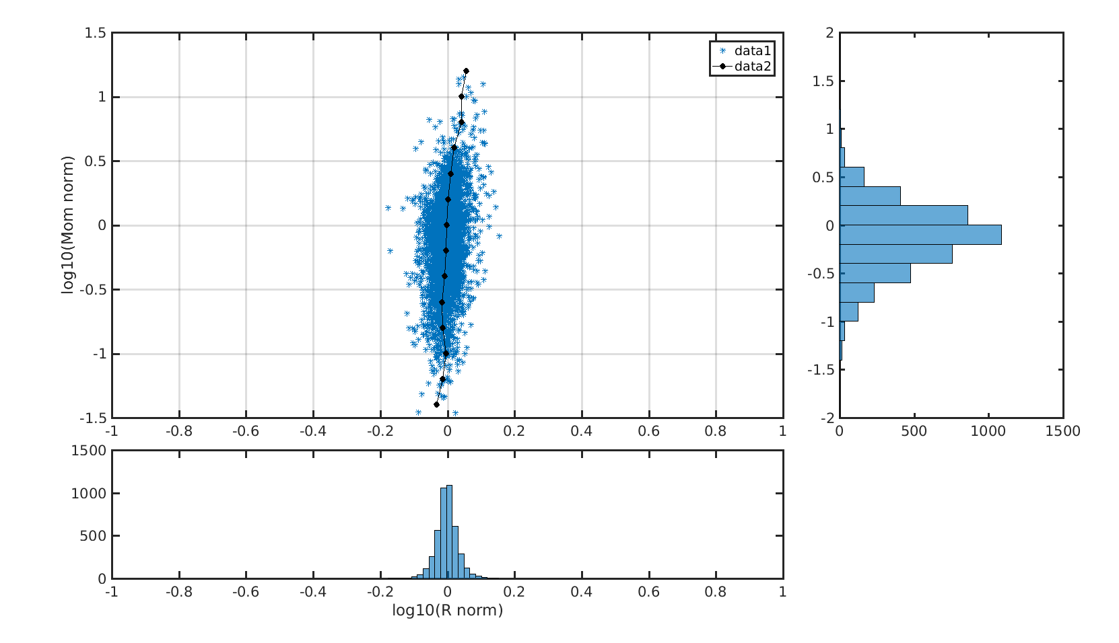
Results: Scaling within repeating sequence
The normalized moments within a sequence span two orders of magnitude while at the same time there is no significant variations in the source radius. This was already observed during the 2010 water circulation test in Soultz-sous-Forêts (Lengliné et al. 2014) and for repeating micro-earthquakes sequences in Taiwan (Lin et al. 2016).
The dispersion that we observe is at the scale of a repeating asperity possibly implies a mechanism that controls either the radius of the rupture event (quenched disorder on the fault plane, stress distribution), or/and the proportion of seismic slip taking place on a given asperity.
Fig: (a) Normalised moments vs normalised sources Radii for all repeating earthquakes; (b) distribution of normalised moments;(c) distribution of normalised source radii

Slide 7
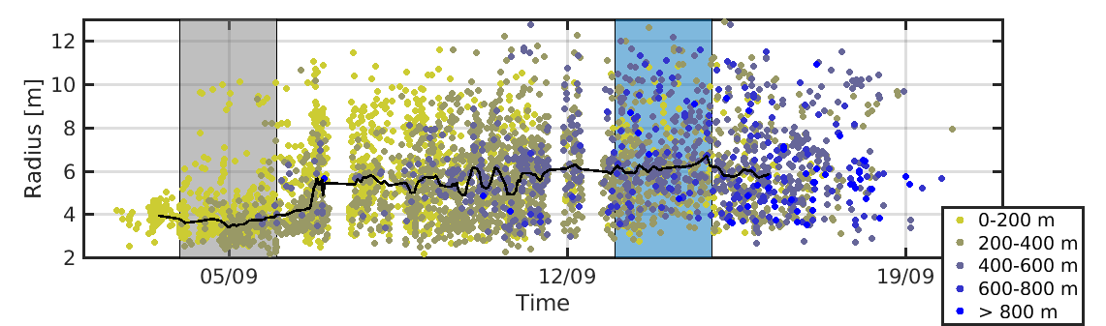
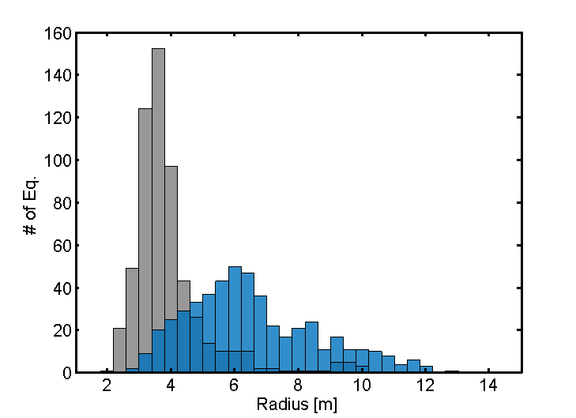
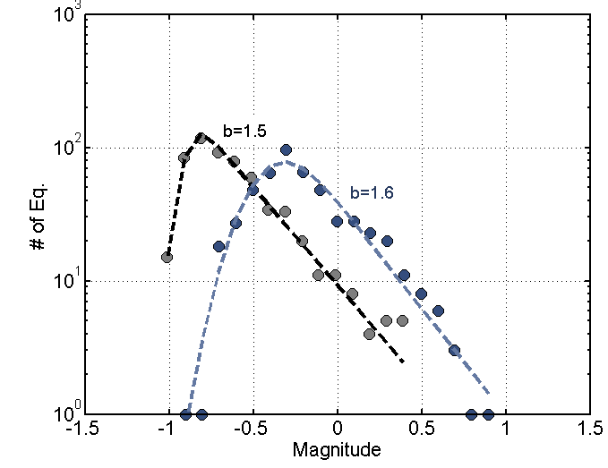
Results:
Two populations of asperities
In order to look at the possible mechanisms that control the variations of the source parameters, we investigated how they do change over the course of the injection.
We identified two representative periods of the same duration (2 d) during two regimes -at the beginning (gray) and later during the stimulation (blue)-: one around the 5th of September and one around the 14th of September.
During the first period, the radius distribution is peaked around 4 m which is significantly different from the second period when it appears larger and broader.
The magnitude distributions are similar as a Gutenberg–Richter power law distribution with the same b-values [b ≈ 1.5 evaluated using the maximum-likelihood method of Ogata & Katsura (1993)] but a different prefactor (i.e. a-value).
We conclude that there exists two populations of events that can be hardly distinguished by a b-value monitoring but better evidenced by a source radius characterization.
Fig. Evolution of the source radius of all sequence events with time.
Bottom left-hand panel: distribution of source radius for each period.
Bottom right-hand panel: distribution of the event magnitude, m for each period.

Slide 8
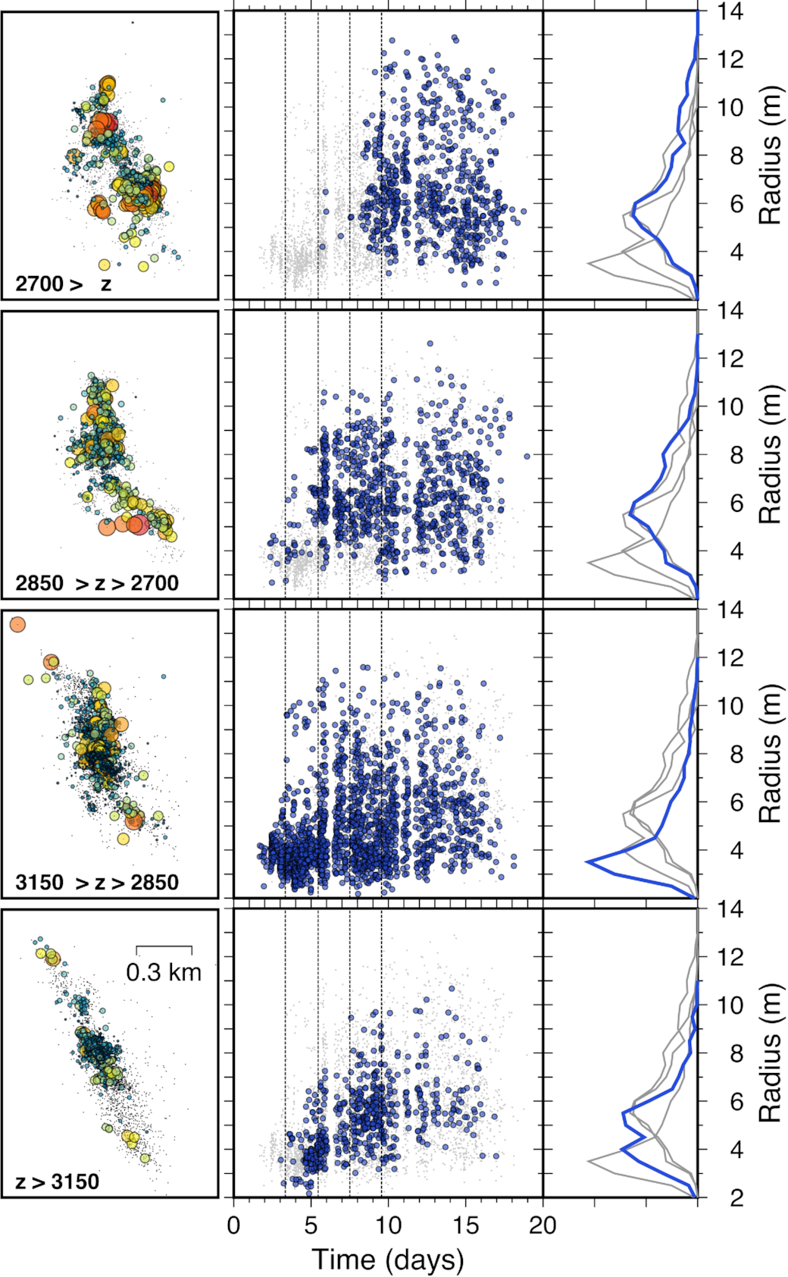
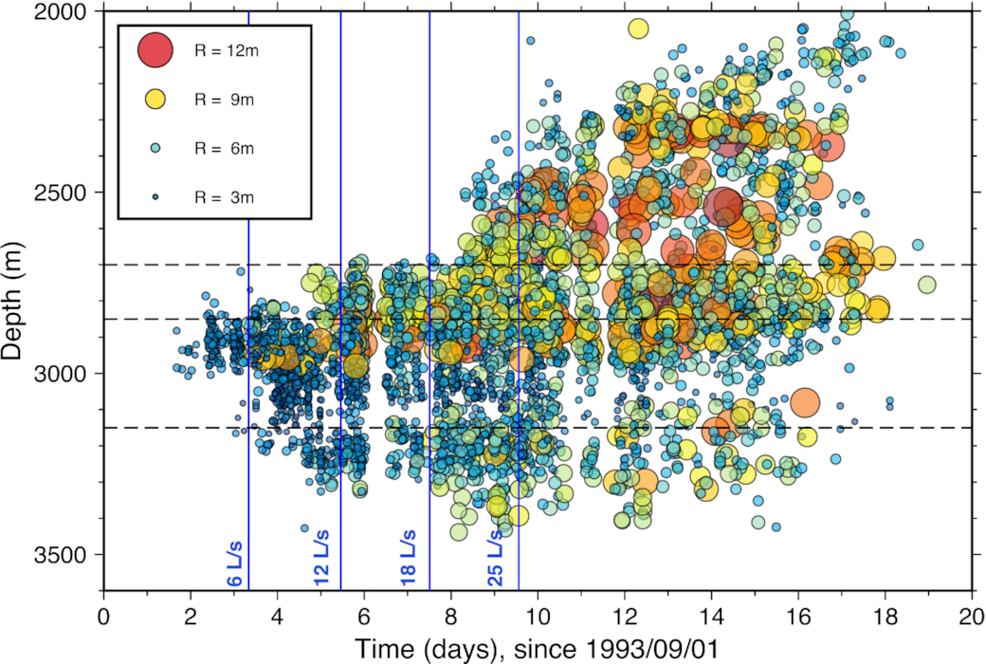
Results: Evolution of source parameters with time and depth
As the injection progressed we clearly evidence an increase of the source dimension of the earthquakes that occurred in the reservoir, this increase does not occur everywhere in the reservoir:
(i) the depth section around the open hole (2850–3150 m) hosts mostly the first population of small and peaky distributed events over the whole course of the injection;
(ii) the upper domain (2000–2700 m) corresponds to the second population of large and broadly distributed events
(iii) the two other domains show a mix between these two populations.
Fig. Evolution of the earthquake source sizes (radius of the rupture area) as a function of time and depth. The blue vertical lines represent the flow-rate steps. The horizontal dashed lines represent the various depth intervals chosen for analysing the seismicity.
Fig. Left-hand panel: map of the events within sequences (colour circles) and the whole earthquake data set (grey dots), for the different depth intervals. The size and colour of the circles refer to the radius of the inferred rupture area. Middle panel: evolution of the earthquake radius as a function of time for repeating events within the considered depth interval (blue) and within the other depth intervals (grey).
Right-hand panel: distribution of event size for the data shown in the middle panel.

Slide 9
Discussion and Conclusions
Based on accelerometer records of the 1993 injection experiment in the geothermal reservoir of Soultz-sous Forêts, we estimated source parameters of repeating earthquakes.
We show that the rupture area of these events is dependent on the mechanism at the origin of the seismicity. We first evidence that at the asperity level, a deviation from the typical scaling law between moment and radius is observed suggesting that the stress drop on each asperity is significantly fluctuating during a repeating sequence.
We also show that the source radius of repeating events is a relevant feature for identifying two populations of events:
  The change in source radii observed is not attributed to quenched disorder: time evolution is still observed in different reservoir locations
  a first population of small radius events is evidenced close to the injection well, in the zone of the reservoir that experienced aseismic slip on pre-existing faults.
  Similarly to Bourouis & Bernard (2007), we interpret the events close to the injection well as associated with slow aseismic movements on pre-existing faults within the reservoir. This is in agreement with the mechanical interpretation of Cornet (2016) that proposes that during the first injection steps, the fluid pressure is sufficient for the stress state in the reservoir to reach the slip onset condition on pre-existing structures.
  As the fluid pressure is increased in the reservoir and the seismicity develops farther away from the injection zone, a second population of repeating events emerges with a wider range of radii and a different recurrence behaviour.
  We propose to relate this second population to the initiation of new large fractures that are fluid induced.
    This is in agrrement with Cornet (2016) who proposed that the shallower earthquakes during the 1993 injection episode, are related to the generation of new fractures. Indeed, after having reached the Byerlee’s friction criterion on pre-existing faults around the open hole domain during the first part of the stimulation, the reservoir is entering a second phase with the increase of the fluid pressure corresponding to failure in the bulk of the reservoir.
Cauchie et al., Seismic asperity size evolution during fluid injection: case study of the 1993 Soultz-sous-Forêts injection, Geophysical Journal International, Volume 221, Issue 2, May 2020, Pages 968–98. https://doi.org/10.1093/gji/ggaa051

