Slide 1
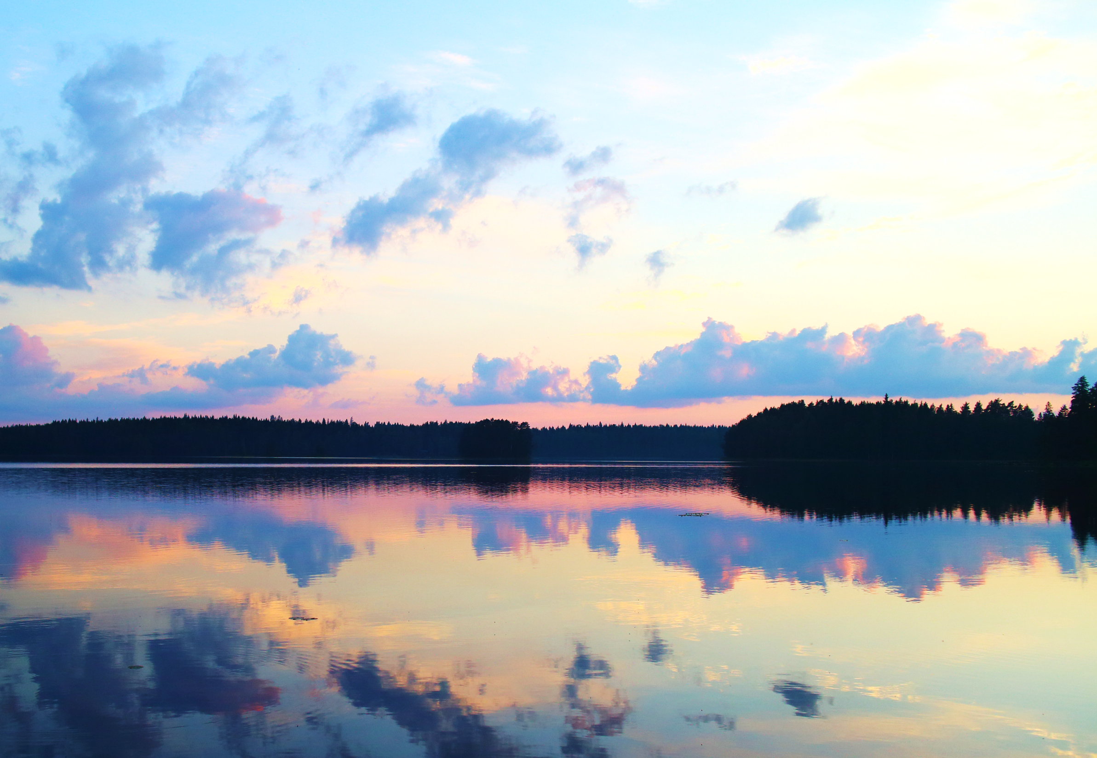









Anthropogenic salinization of naturally dilute boreal lakes in Finland
D540, EGU2020-1344
¹Mira Tammelin, ²Tommi Kauppila, ²Jari Mäkinen
¹University of Turku / Finnish Environment Institute
²Geological Survey of Finland
@MiraTammelin

Slide 2
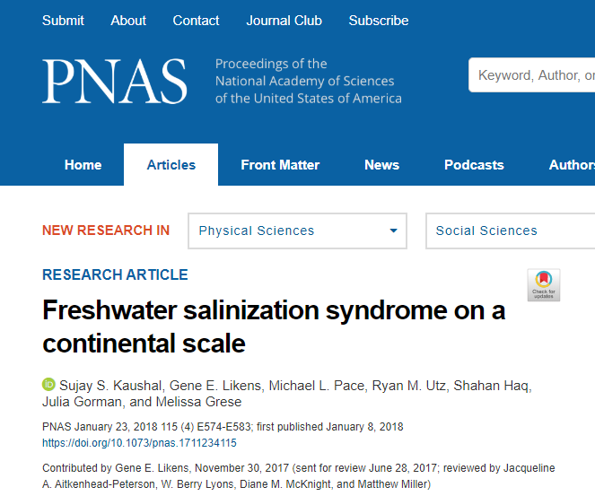
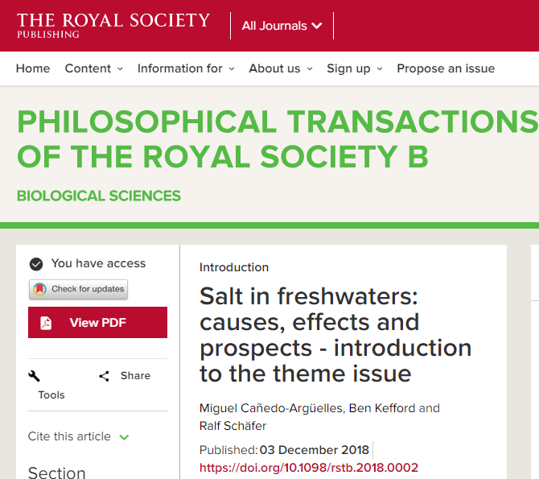
Motivation
2
3
Increases in
electrical conductivity (proxy for salinity)
common in addition to eutrophication
Articles about widespread freshwater salinization start to appear
1
PhD project:
Spatial variability in natural trophic states of Finnish lakes and their anthropogenic eutrophication
4
Freshwater salinization is an emergent threat in the Northern Hemisphere
Is salinization affecting also dilute boreal lakes?
Causes of salinization:
Irrigation
Water abstraction
Resource extraction
Accelerated weathering
Road de-icing
Sewage
Kaushal et al. 2018.
PNAS 115:E574-E583
Cañedo-Argüelles et al. 2018.
Phil. Trans. R. Soc. B 374:20180002
@MiraTammelin

Slide 3
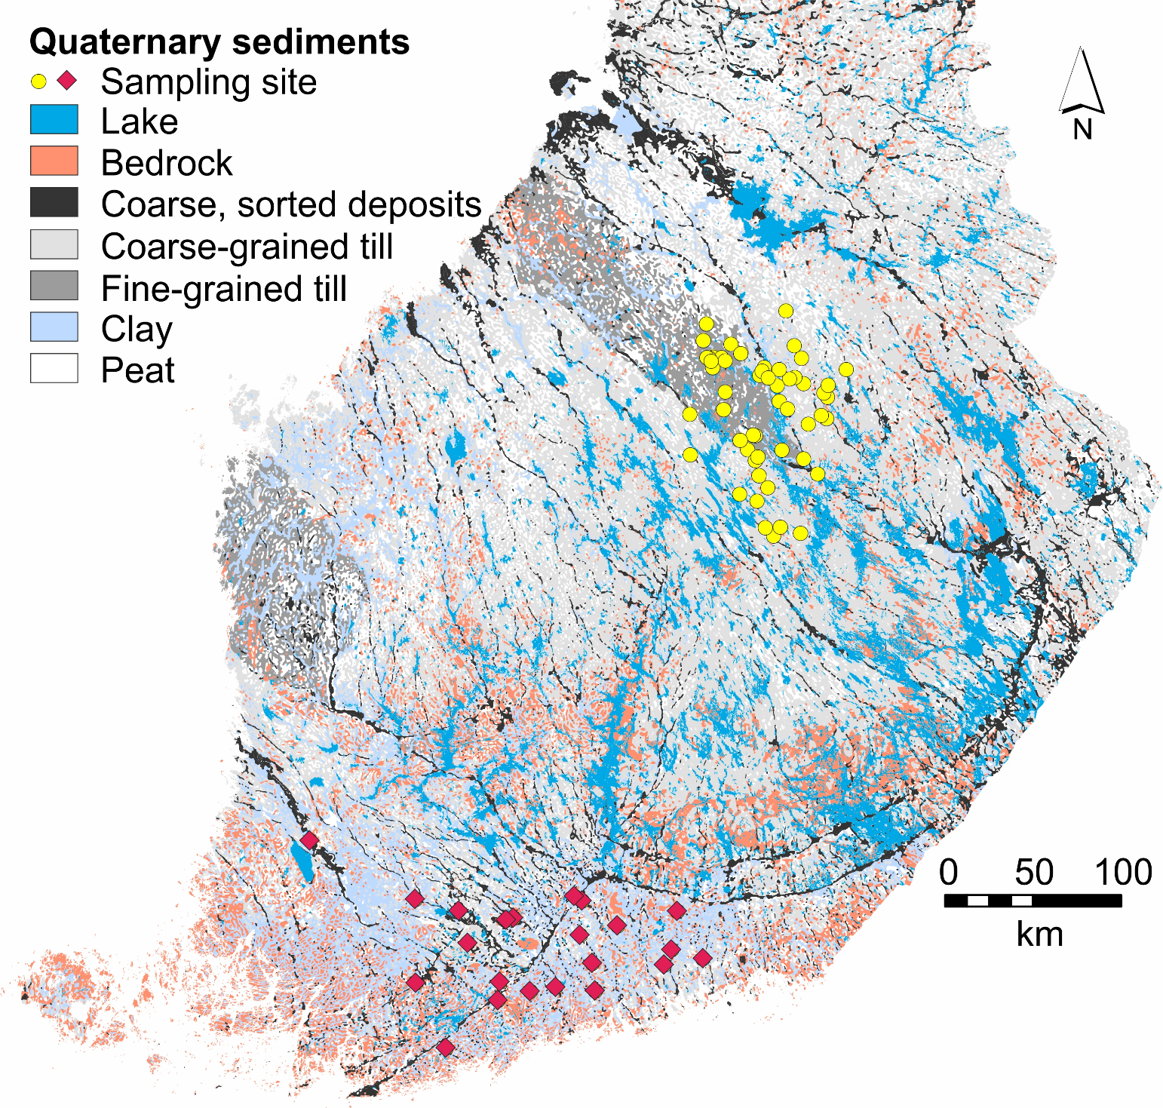
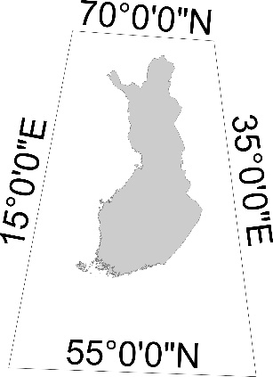
Study sites
Slowly weathering bedrock
→ Dilute lakes
Basin | Min | Md | Max
Average depth (m) | 0.7 | 2.6 | 8.3
Lake surface area (km²) | 0.004 | 2.6 | 114
Catchment area (km²) | 0.2 | 31 | 5564
(granitic/gneissic)
51 sites
82-160 m a.s.l.
Modern water quality | Min | Md | Max
Electrical conductivity (mS m⁻¹) | 0.5 | 5.2 | 17
pH | 5.5 | 7.1 | 9.3
Total phosphorus (µg l⁻¹) | 3.0 | 43 | 228
Total nitrogen (mg l⁻¹) | 0.15 | 0.78 | 3.60
Color (mg Pt l⁻¹) | 5.0 | 93 | 340
GTK open license CC BY 4.0, modified from GTK’s Superficial deposits of Finland 1:1 000 000 data, imported from Hakku service on 3 July 2019. Original material: https://hakku.gtk.fi/en
N
Catchment land use (%) | Min | Md | Max
Forest | 25 | 75 | 86
Agriculture | 0 | 12 | 56
Built areas | 0 | 3 | 23
Wetland | 0 | 2 | 9
Water | 1 | 9 | 30
19 sites
15-111 m a.s.l.
Summarizations in the tables are based on Pintavesien tilan tietojärjestelmä, vedenlaatu PIVET and Corine Land Cover 2012 of the Finnish Environment Institute (CC BY 4.0). Original data: https://www.syke.fi/en-US/Open_information
@MiraTammelin

Slide 4
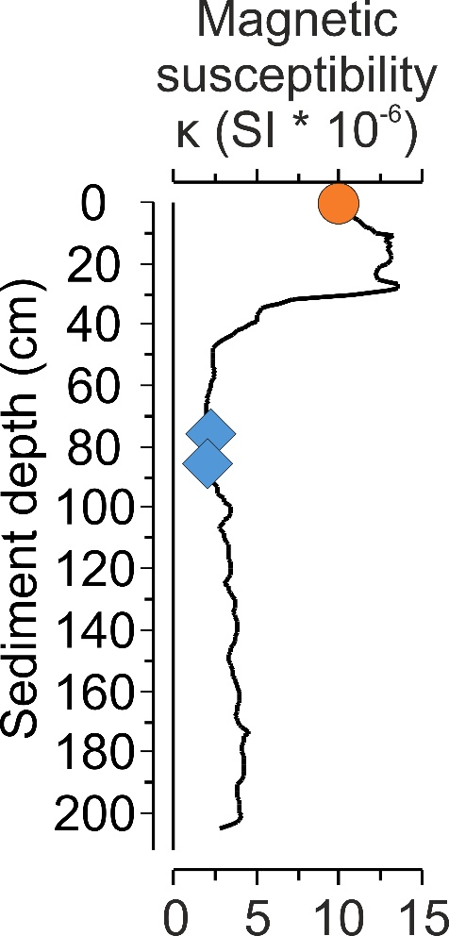
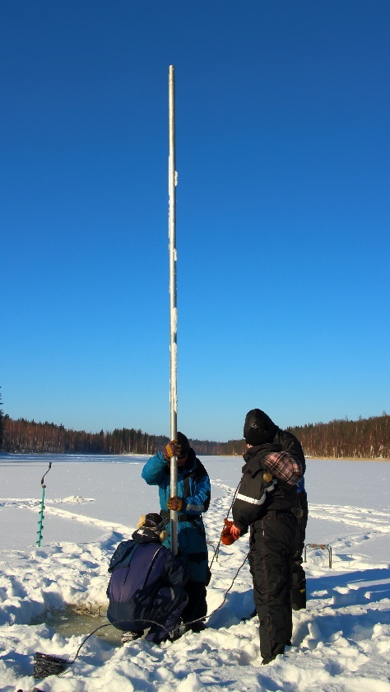
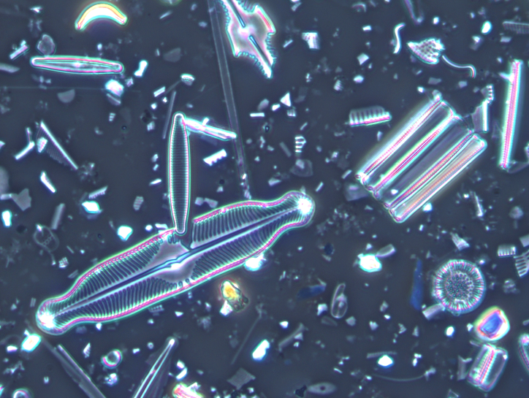
Methods
Top-bottom sediment sampling
Post-disturbance conditions (top samples)
  Taken with Limnos gravity corer
  From sediment surface
Pre-disturbance conditions (bottom samples)
  Taken with rod-operated piston corer
  Sample depths based on magnetic susceptibility profiles of sediment cores (2 samples, 10 cm apart)
Human
disturbance
Sediment coring
Diatom assemblages
  Identified from top & bottom samples
Quantitative paleolimnology
Ordinations
  Ecologically important water quality variables
  Pre- to post-disturbance change
WA-PLS regression
  Based on: Post-disturbance water quality + diatoms
  Input: Pre-disturbance diatoms
  Output: Pre-disturbance epilimnetic electrical conductivity
Magnetic susceptibility
Proxy for intensified catchment erosion
Often the first sign of human impact
Diatoms (phytoplankton)
@MiraTammelin

Slide 5
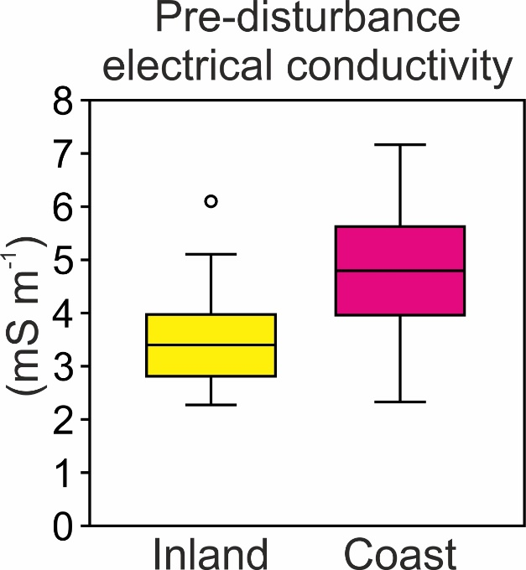
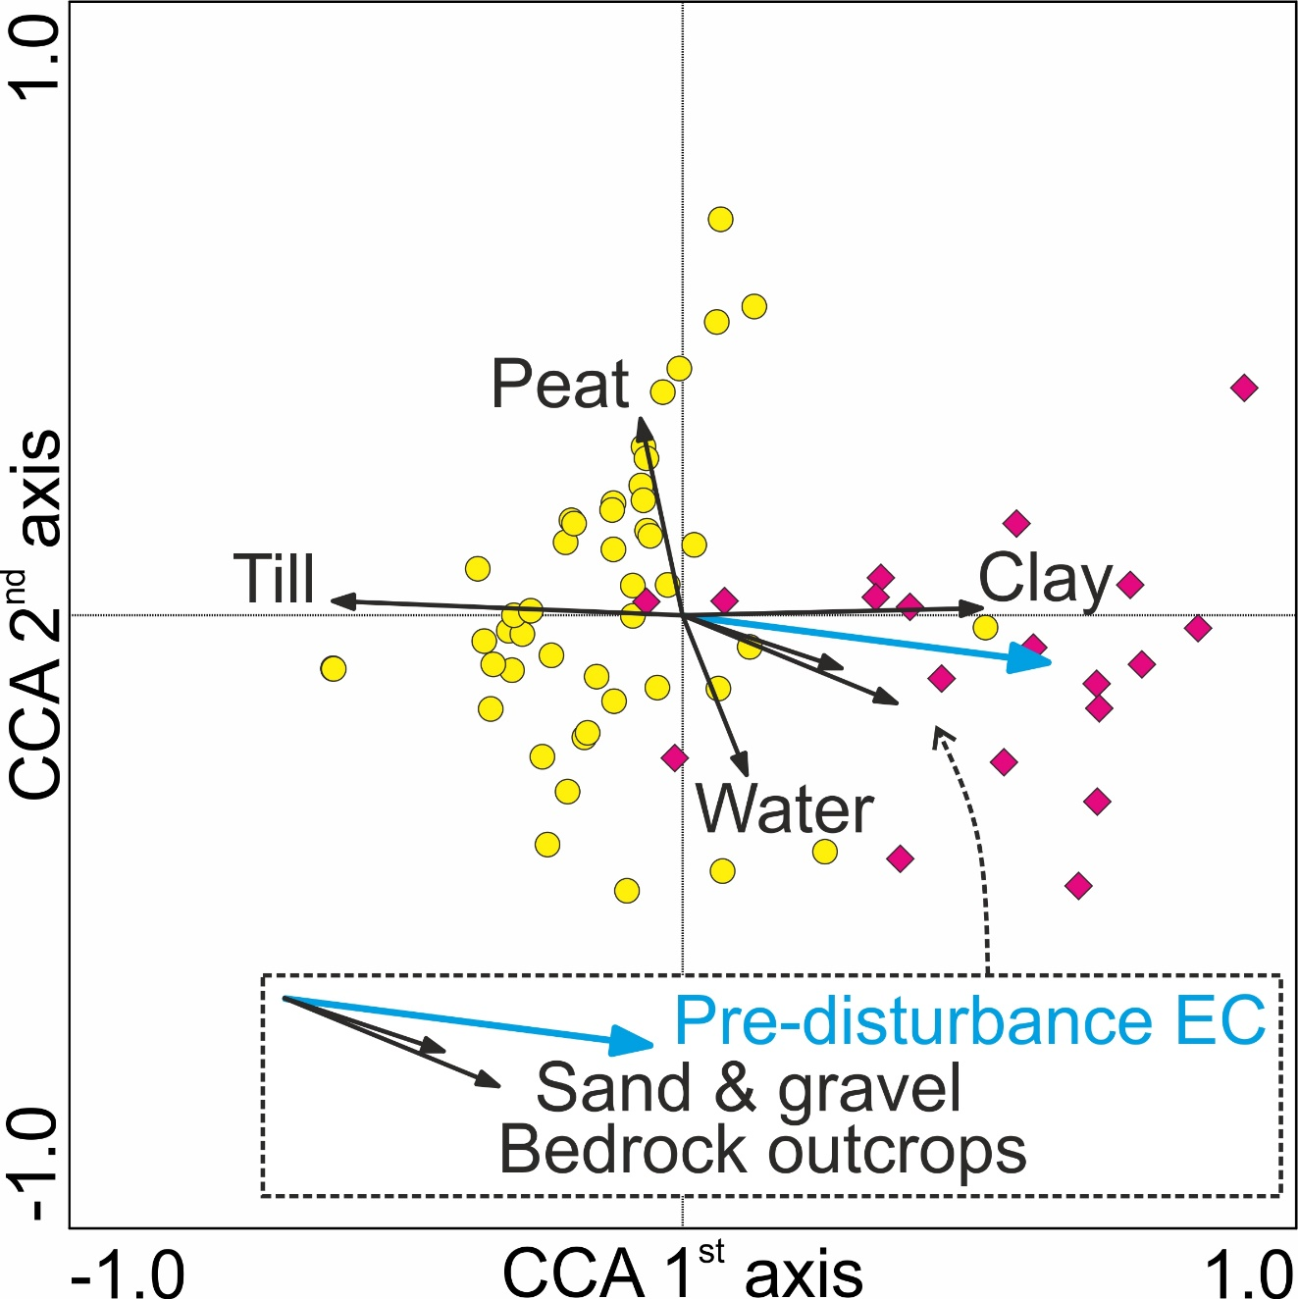
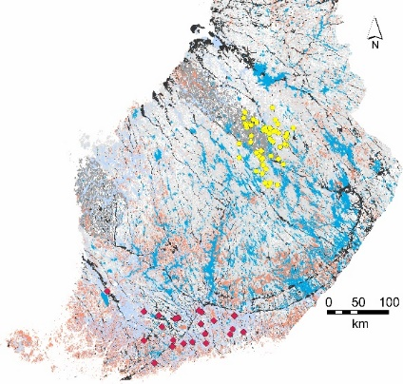
Results – Natural variability
Pre-disturbance electrical conductivity (EC) very low
Lower EC in till-rich inland
Higher EC on clayey coast
Pre-disturbance EC correlation with
 | r | p
Glacial till | -0.62 | < 0.001
Clay | 0.54 | < 0.001
Bedrock outcrops | 0.39 | 0.001
Water | 0.33 | 0.005
Peat | -0.25 | 0.035
Sand & gravel | 0.25 | 0.040
Tammelin et al. 2017.
Hydrobiologia 799:309–325
Tammelin et al. 2018.
Front. Ecol. Evol. 6:65
Tammelin et al. In prep.
@MiraTammelin

Slide 6
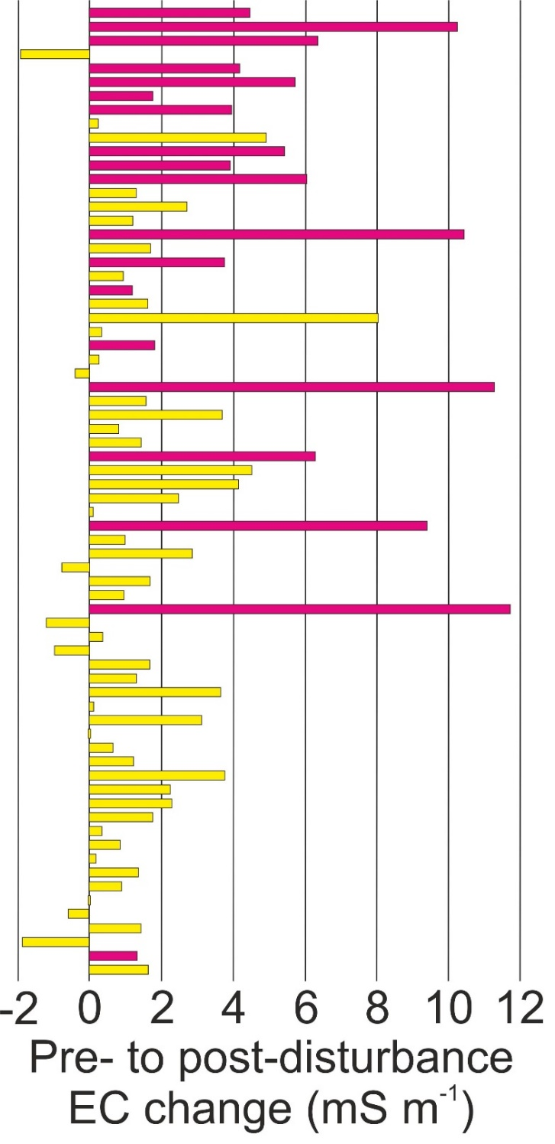
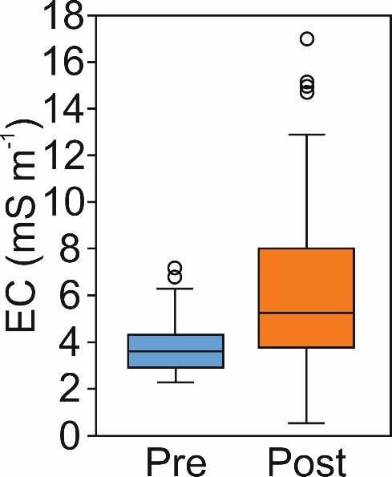
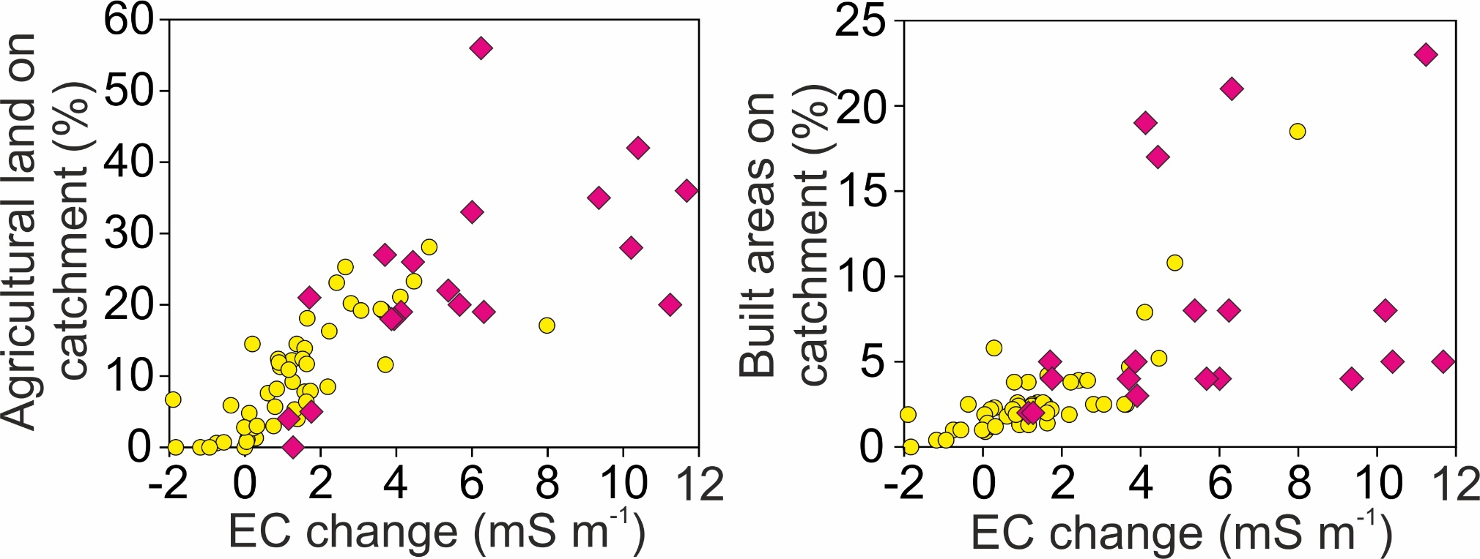
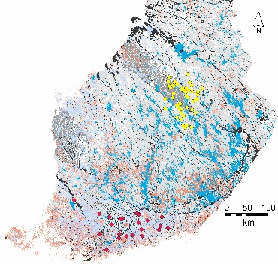
Results – Salinization
EC important driver of modern diatom assemblages
Pre- to post-disturbance EC increase in 61/70 sites
  Average increase 3.0 mS m⁻¹
  Maximum increase 11.7 mS m⁻¹
Average EC increased 65% from 3.8 to 6.3 mS m⁻¹
Coastal region more affected than inland
  Land use more intense in southern Finland
Sites in the order of increasing pre-disturbance EC
@MiraTammelin

Slide 7
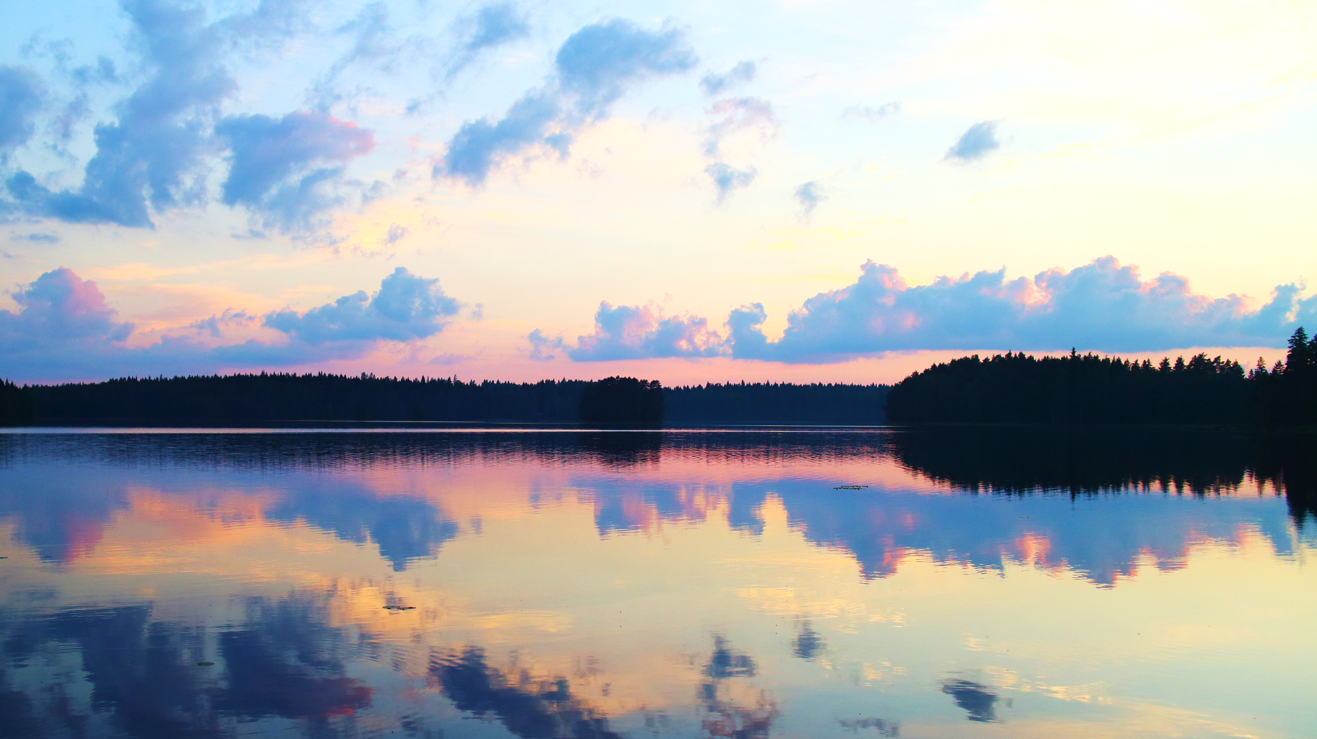
Take home message
Finnish lakes very dilute in natural conditions (< 7.5 mS m⁻¹)
  Small-scale natural variability related to catchment geology
Dilute boreal lakes also threatened by salinization
  → Need for management!
@MiraTammelin

Slide 8
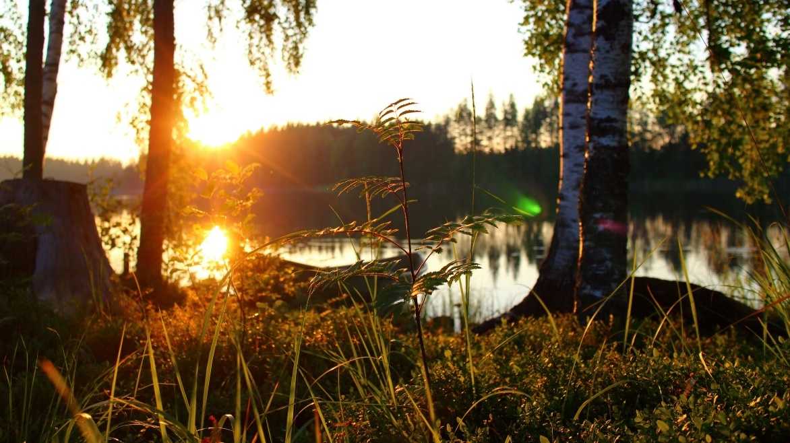





Acknowledgements
Travel grant for EGU2020
Research funding
@MiraTammelin

Slide 9
Thank you!
@MiraTammelin

