Slide 1


Inverting a comprehensive crop model in parsimonious data context using Sentinel 2 images and yield map to infer soil water storage capacity.
Karen Lammoglia, André Chanzy
UMR INRA/université d’Avignon EMMAH (Avignon, France)
UMR INRA/CIRAD System (Montpellier, France)
This project was funded by EU Grant 633945 — FATIMA — H2020-
SFS-2014-2015/H2020-SFS-2014-2. S2 data were provided by BOKU

Slide 2
Introduction
Soil hydraulic properties control many processes as water flows in the soil and at its boundaries or water availability for plants.
Soil water available for plants is governed by the climate, runoff/drainage and the Soil Water storage Capacity (SWC), which represents the maximum amount of water stored in the soil available for the plant (soil water between field capacity and wilting points)
SWC depends on the soil depth and the porosity (soil structure and texture). Its strong spatial variability and difficulties to determine it with direct methods make spatial assessment of soil water dynamic very difficult while it is a key parameter to assess crop potentialities (a basis for precision farming)
Proxys being used as an alternative of direct measurement
  Geophysic
  Pedotransfer functions
  Model inversion.
Reconsider these approaches thanks to the potentialities offered by new satellite missions as Sentinel and sensors deployement in agriculture
K. Lammoglia-Chanzy/EGU 2020

Slide 3
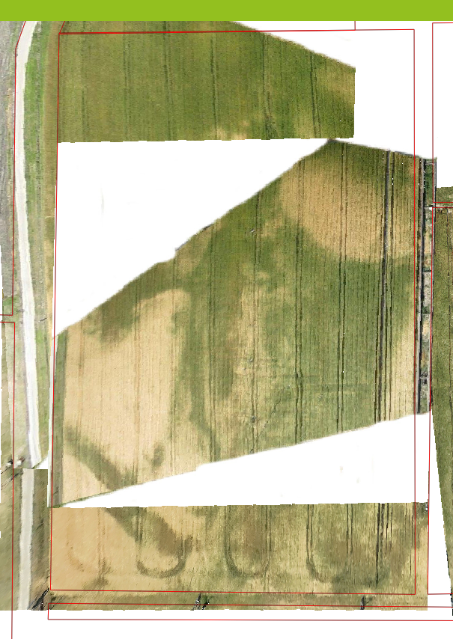
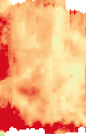
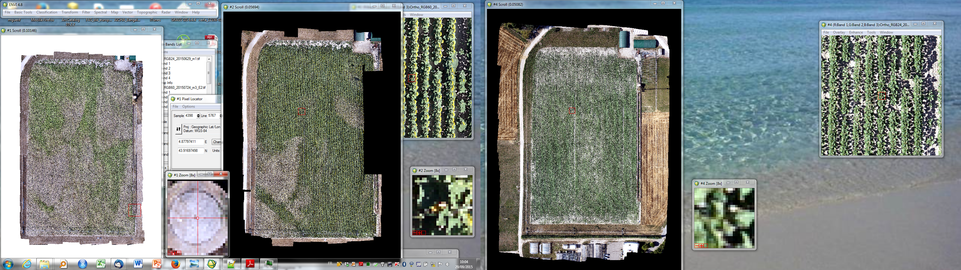
Why can we be optimistic
Wheat
Sunflower
Electric resistivity
K. Lammoglia-Chanzy/EGU 2020
06/05/2020
Notes:
The quick drying of the vegetation (Wheat and suflower correspond to the electric resistivity reflecting shallow soils

Slide 4
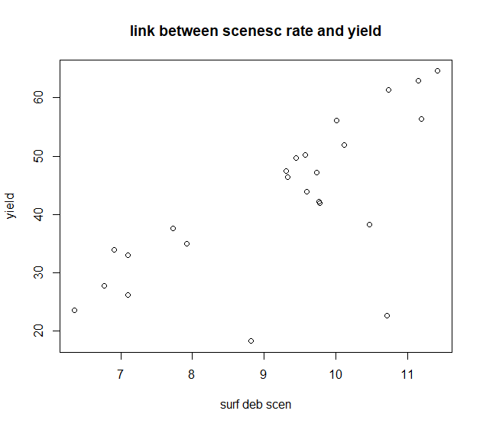
Why can we be optimistic
LAI
LAI
Late sowing
Senescence Indicator
K. Lammoglia-Chanzy/EGU 2020
06/05/2020
Notes:
On the left are displayed LAI dynamic of different pixel within a field. Pixel are selected according to the observed yield
Signal in the senescence indicator : is the sum of LAI (2 values) during the senesence periode

Slide 5
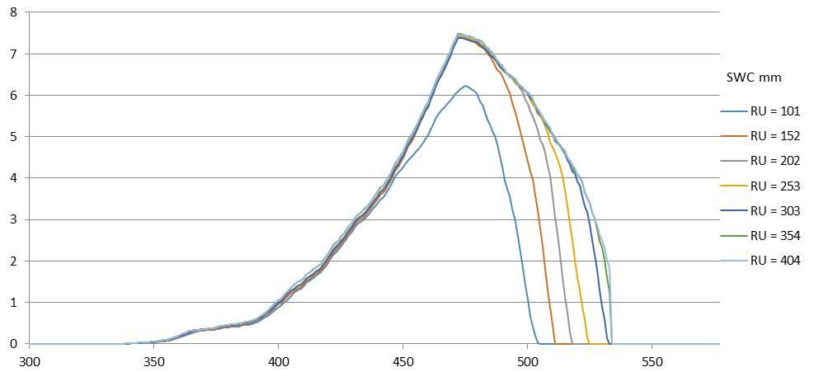
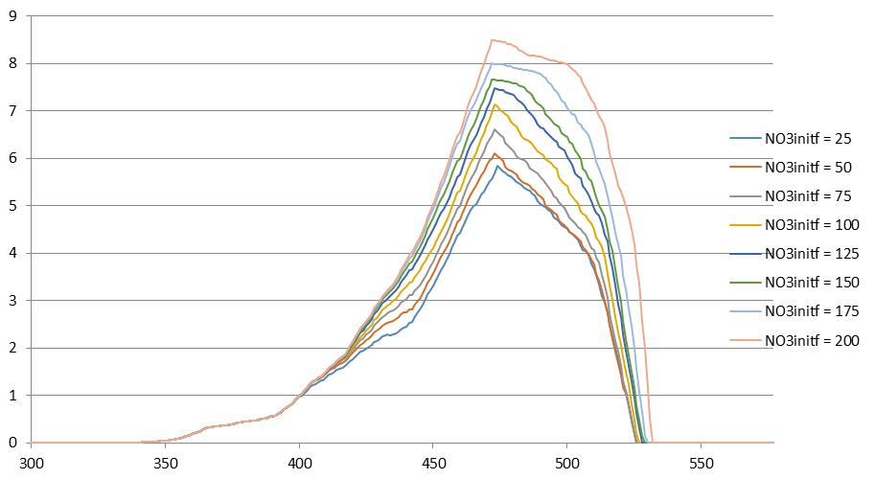
Not a straigthforward story
Increasing SWC
Early LAI
LAI
Use of crop model to delineate the effects of the factors
Yield
Increasing Nitrogen
LAI
Interaction of factors
Water (SWC and initialization)
Nitrogen (initialization, fertilisation, Organic matter)
Crop installation
Pest and diseases
Crop model simulation (STICS)
K. Lammoglia-Chanzy/EGU 2020
06/05/2020

Slide 6

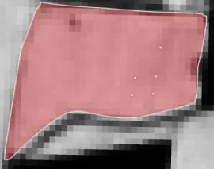
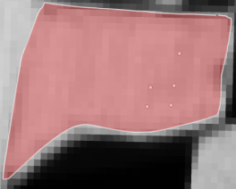
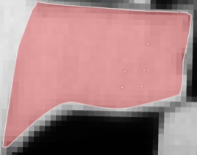
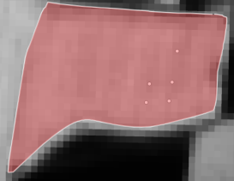
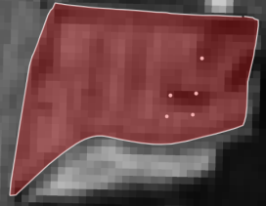
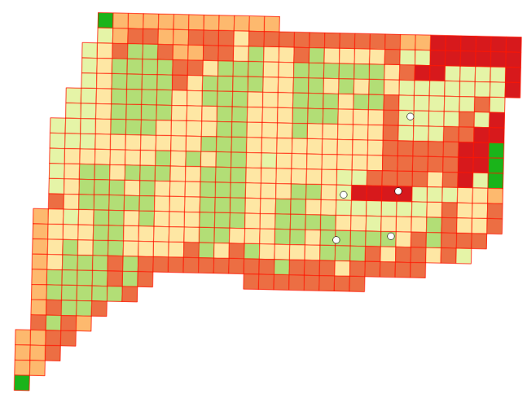

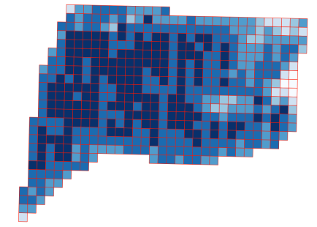

Climate Farmer : Crop operation
Approach
Cultivar Parameters
Simulation plan (Nitrogen initialisation, Organic matter, SWC (soil depth and/or hydraulic properties), sowing depth/emertgence date
and density )
multisimulations
Remote sensing temporal series (LAI, FaPAR)
Inversion (GLUE)
Soil water storage map, Initial Nitrogen, Crop installation, organic matter
Farmer : Yied map
06/05/2020
Notes:
Here STICS is the crop models used. In the simulation the climate and farmer operation are assumed to be known. Cultivar parameter were calibrated independantly

Slide 7
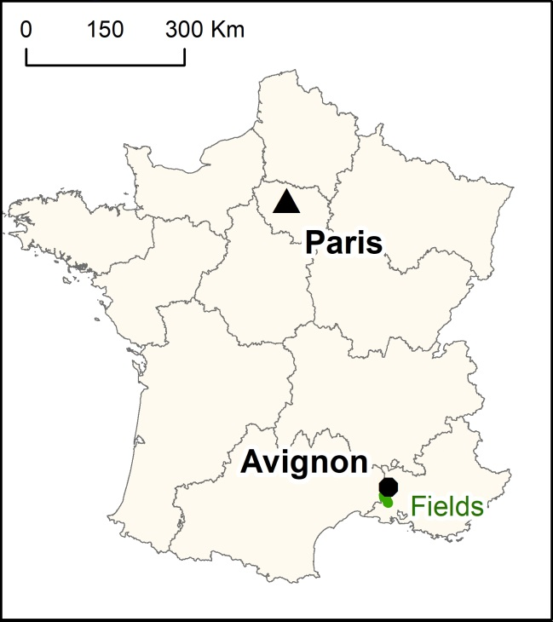
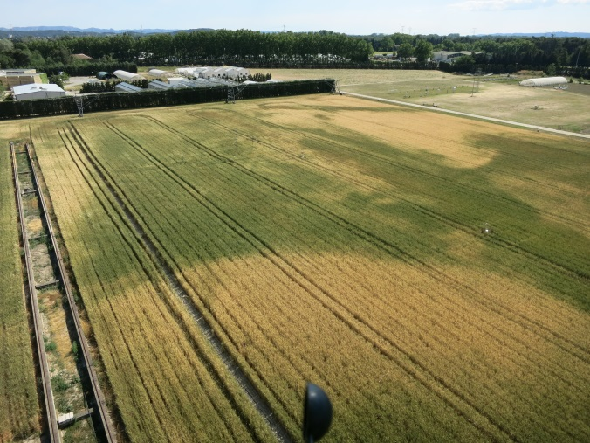
Experiments
Studied fields: Farmland with durum wheat (6 fields), INRA experimentation centre no irrigation,
Localisation: South of France
Precipitation is the main limiting factor for wheat growth
Soils : deep fluvisol (mainly silty clay loam); alluvial deposit of the Durance river; with heterogeneities (texture or soil depth)
K. Lammoglia-Chanzy/EGU 2020
06/05/2020

Slide 8
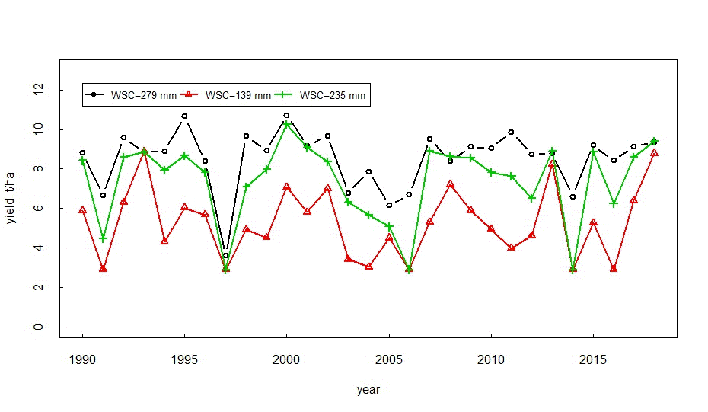
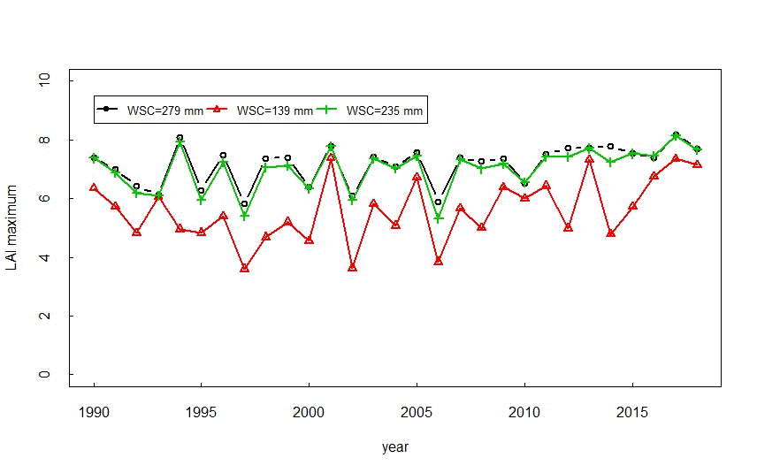
Sensitivity Analysis
K. Lammoglia-Chanzy/EGU 2020
06/05/2020
Notes:
Impact of WSC on the yield and max LAI during the 1989-2018 period. SWC impact depends on the climatic year. The coming results will be collectede in 2016.

Slide 9
Sensitivity Analysis (Morris method)
Crop establishment
SWC
Nitrogen
K. Lammoglia-Chanzy/EGU 2020
06/05/2020
Notes:
Simulation made in 2016

Slide 10
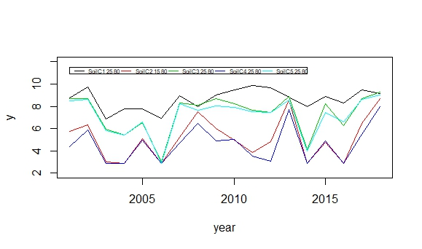
Reduction of the space of parameters
Same SWC but with different HU and EPC
Default parameters
Cultivar parameters
> 300 parameters
7 parameters
Soil depth (epc)
Hu = f(FC, WP)
Sowing density
Sowing depth/emergence
Soil NO3 init.
Norg= f(organic matter)
Hinit
EPC or HU
*Sowing depth or emergence date and Sowing density
4 parameters to be retrieved
Soil No3 init
K. Lammoglia-Chanzy/EGU 2020
06/05/2020
Notes:
To simulate the date of emergence (very important in STICS) we either play on t

Slide 11
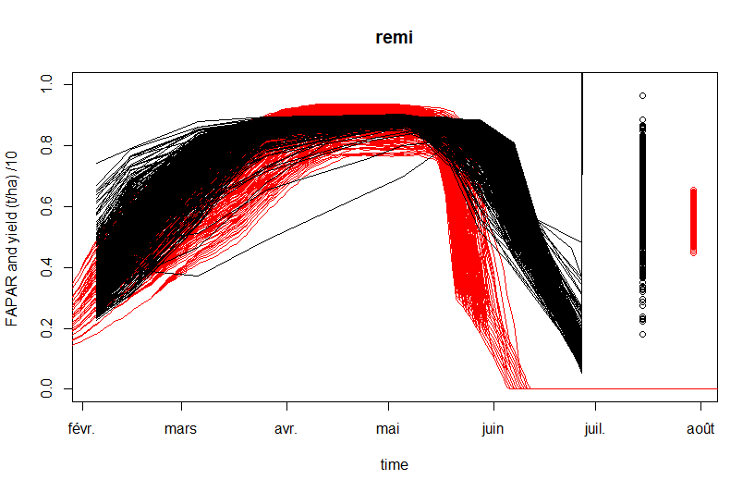
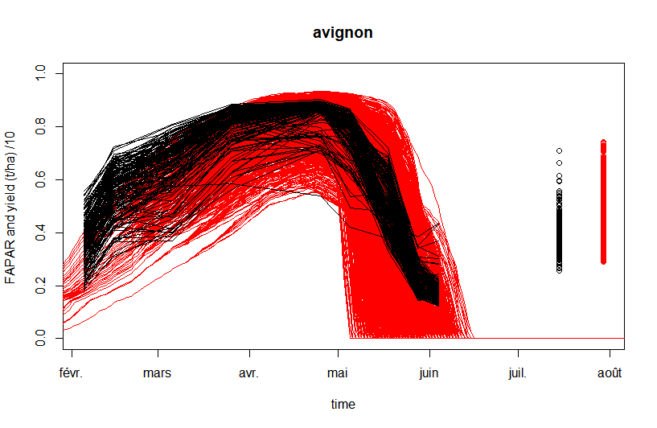
Cultivar parameterization
Existing cultivars (~10 for bread wheat and durum wheat) are quite old
Calibration strongly dependant on calibration strategies (operator effect)
Difficult to separate environmental stress (soil water and nitrogen) and cultivar behavior
Calibration
  Use of catalog date (yield potential)
  Use of phenology observations
  Use of remotely sensed LAI or FAPAR
  Use of yield
  (Nitrogen of plant and organ)?
Field 1
Field 2
K. Lammoglia-Chanzy/EGU 2020
06/05/2020
Notes:
In the graf the black curve corresponds to the observation (dot are the yield/10 ) and space of simulation is given in red.
The calibration of the cultivar in field 1 was made with very sparse data resulting in problems at the end of the curve. With data on the cultivar of field 2 is much better simulated

Slide 12
Soil Inversion Field 1
Ru=225 mm
Ru=158 mm
Ru=267 mm
K. Lammoglia-Chanzy/EGU 2020
06/05/2020

Slide 13
Soil Inversion Field 1 (2 steps, 1) Nitrogen/installation 2) SWC
Ru=225 mm
Ru=158 mm
Ru=267 mm
K. Lammoglia-Chanzy/EGU 2020
06/05/2020
Notes:
The beginning of the growing can be well simulated if we calibrate crop installation parameter and NO3 init with the first date. The subsequente calibration of the SWC is however disaspointing

Slide 14
Soil Inversion Field 1 (1 step installation/SWC, initial nitrogen fixed 36 and 72 kg/ha)
SWC
NO3 init= 36 kg/ha
SWC
NO3 init= 72 kg/ha
K. Lammoglia-Chanzy/EGU 2020
06/05/2020

Slide 15
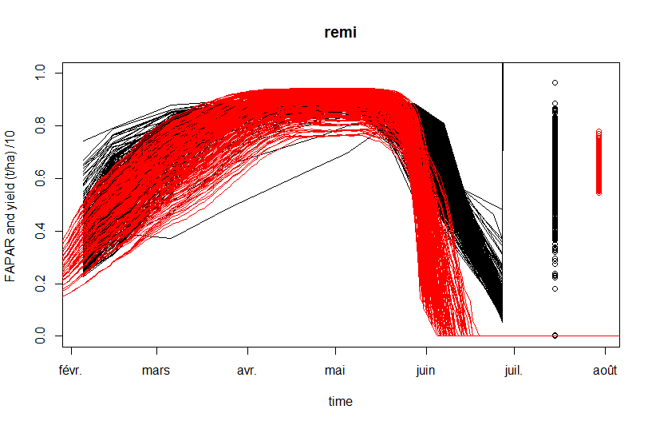
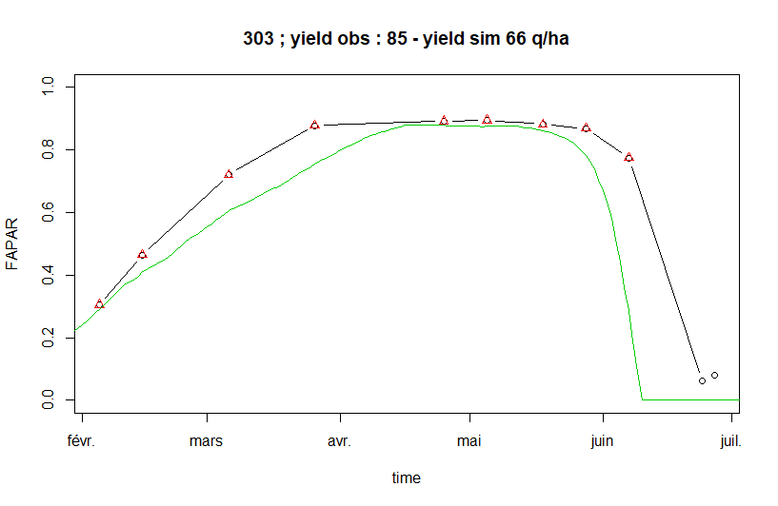
Soil Inversion Field 1 (1 step installation/SWC, initial nitrogen fixed 36 and 72 kg/ha)
Red = simulations (SWC= 260 mm)
Black = observations
Dot (yield t/ha/10)
Green= Simulation
Black = observations
Triangle (data used in inversion)
Circle (data not used)
K. Lammoglia-Chanzy/EGU 2020
06/05/2020
Notes:
The bias at the end led to overestimate the initial NO3 and or SWC .

Slide 16
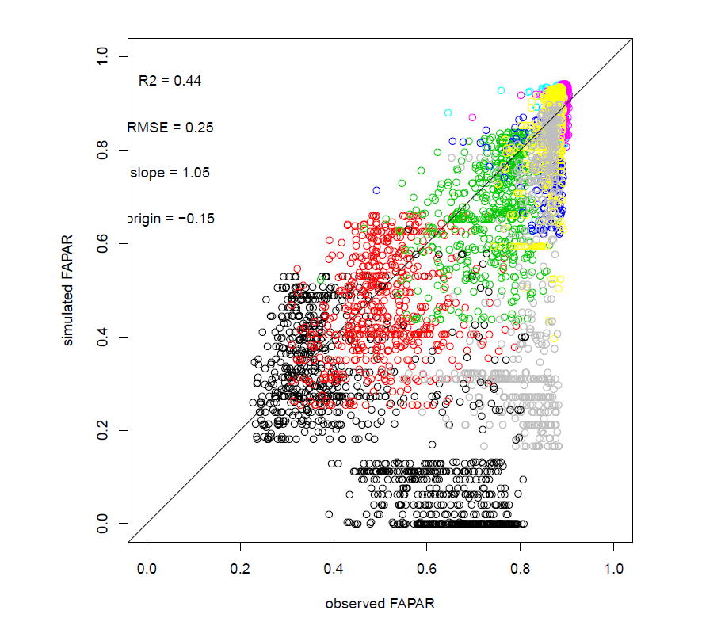
Soil Inversion Field 1 (Influence of the cost function)
SWC, priority to Fapar
SWC, priority to Yield
K. Lammoglia-Chanzy/EGU 2020
06/05/2020
Notes:
The results are better with yield when its weight in the cost function is strong. The problem of temporal phasing was mitigate allowing to reach more reasonable values

Slide 17
Field 2
Electric resistivity
Wheat (RGB)
Wheat (Fapar Sentinel)

Slide 18
Field 2 (results)
Electric resistivity
SWC
Soil Initial Nitrogen
Notes:
SWC map show that the pattern with low electric resistivity are well simulated.

Slide 19
Field 2 (results)

Slide 20
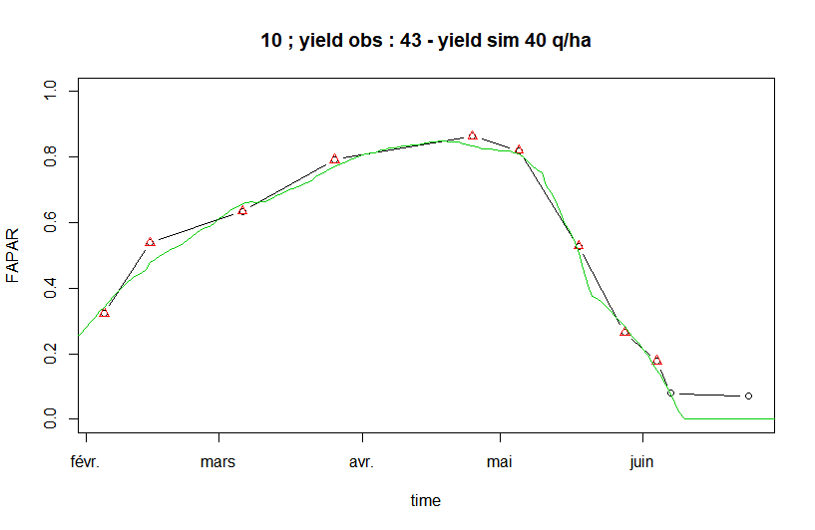
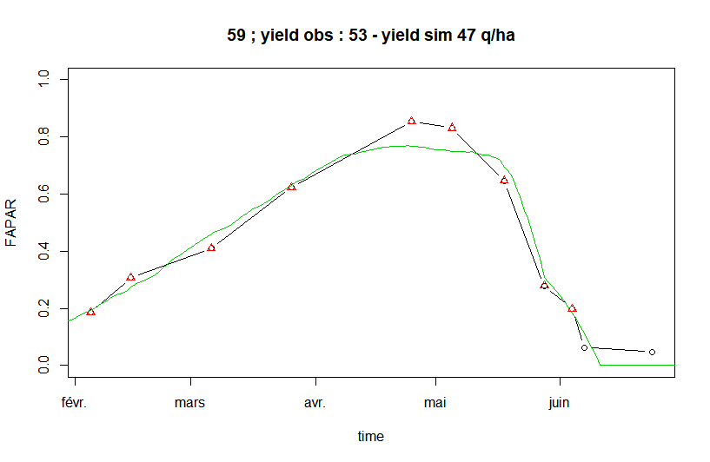
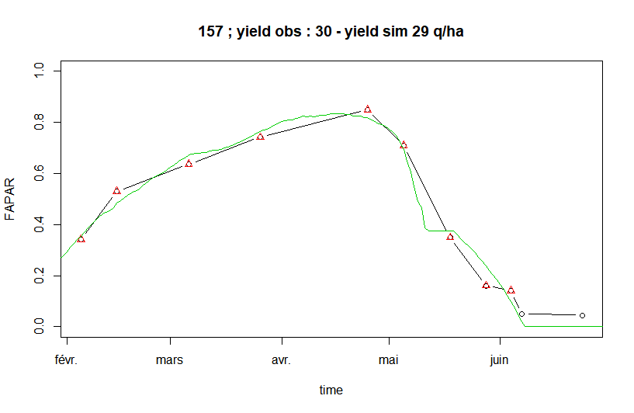
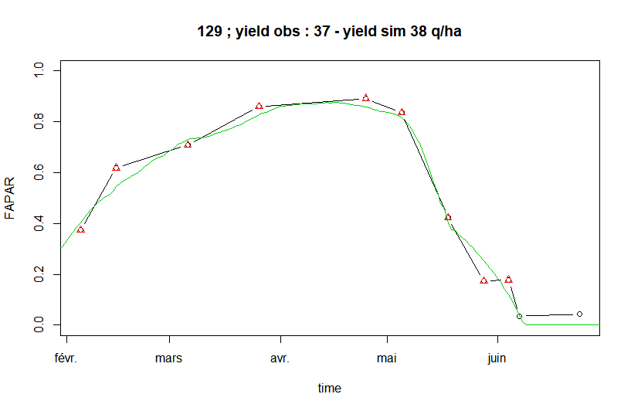
Field 2 (results)
Soil thickness= 125 cm
Soil thickness= 125 cm
Soil thickness= 90 cm
Soil thickness= 150 cm

Slide 21
Conclusions
This has shown that LAI or FAPAR time series combined with yield map enable mapping of effective SWC features, when water stress affect the crops.
However, other factors might affect foliar dynamic and yield. Crop models (as STICS) offer a mean to consider part of those factors (crop installation, Nitrogen supply, water supply)
Known SWC variations were detected (Soil depth in the Avignon site, Texture in Tarascon 1 site )
The study also underlines the importance of having frequent image acquisition, as it allows capturing short feature as the senescence rate, which appears as an important proxy of the availability of water in the soil.
Choice of the cost function might be crucial when cultivar parameterization is poor (need of more flexible cost function and better use of LAI/yield obs).
K. Lammoglia-Chanzy/EGU 2020
06/05/2020

