Slide 1
Atmospheric measurements over oceans on German research vessels
S. Kinne
MPI-Meteorology

Slide 2
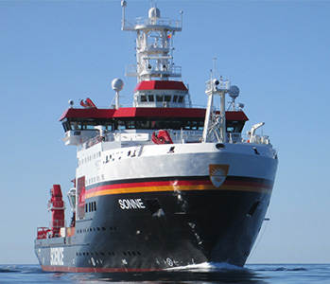
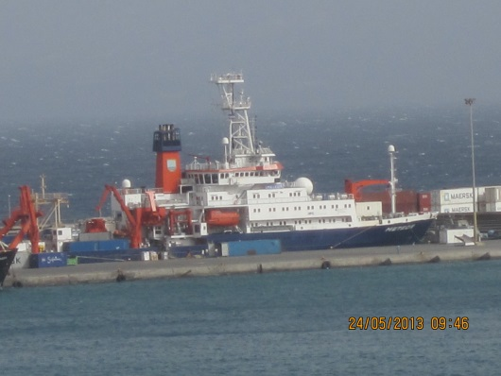
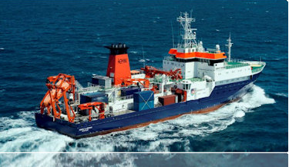
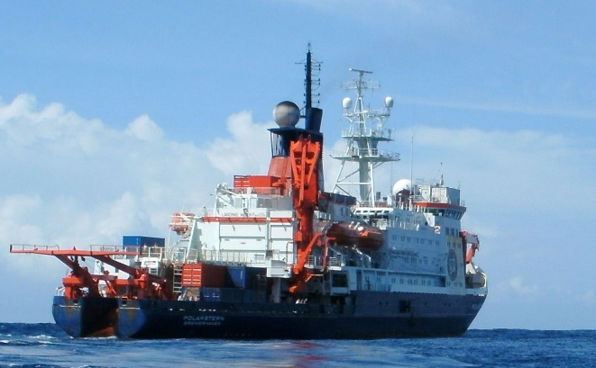
r
SONNE
METEOR
MARIA S MERIAN
POLARSTERN
vessel home-port coordinating institute
R/V SONNE Wilhelmshaven Leitstelle, Hamburg
  40 science slots
R/V METEOR Hamburg Leitstelle, Hamburg
  29 science slots
  DWD station
R/V MARIA S MERIAN Rostock Leitstelle, Hamburg
  22 science slots
R/V POLARSTERN Bremerhaven AWI, Bremerhaven
  40 science slots
  DWD station

Slide 3
for the atmosphere ?
The main purpose of these vessel to support oceans research
  Marine geology
  Marine biology
  Marine geophysics
  Oceanography
atmospheric data are (at best) complementary
  basic meteorology (met data and radiation) are sampled
  – especially on ships with DWD stations (POLARSTERN, METEOR)
  opportunity to add instruments - if they are out of the way (upper deck)
  possibility to add staff to operate these extra atmospheric instruments

Slide 4
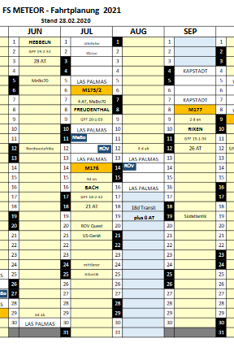
extra atmos instruments and operating staff
How to add instruments?
  contact wiemer@deutsche-meeresforschung.de
    transport and maintenance on your own
How to add staff and instruments ?
  contact the science leader of a planned cruise
  to ask for open science slots
    transport of instrument and travel on your own
  write a proposal for a transit cruises (light blue)
    relatively easy to get, but no stops (station time)
    transport for German scientists/instruments can be applied for
  write a full experiment proposal
    challenging as in full competition to oceanic proposals
    transport for German scientists/instruments can be applied for
https://www.ldf.uni-hamburg.de/

Slide 5
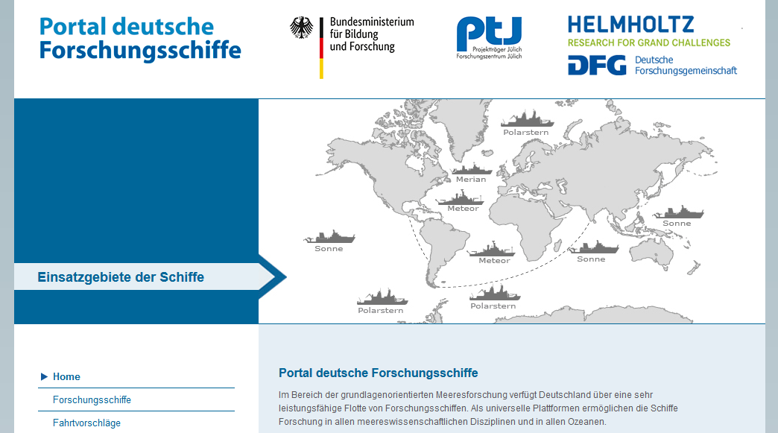
How to write a ship proposal ?
https://www.portal-forschungsschiffe.de/
Next deadline for application: June 8 2020 → independent science review → info on acceptance after 6 months

Slide 6
why atmospheric data ?
reference data for satellite remote sensing and modeling
  high accuracy solar attenuation data (photometers)
atmospheric processes via profiling
  active remote sensing (e.g. lidar, radar)
  passive remote sensing (e.g. microwave radiometer, imagers)
  in-situ (radiosondes, cloud kite, UAV)
atmospheric – ocean exchange
  surface data (air vs ocean, eddy fluxes)
  profiles ( CTD-down, radiosondes-up)

Slide 7
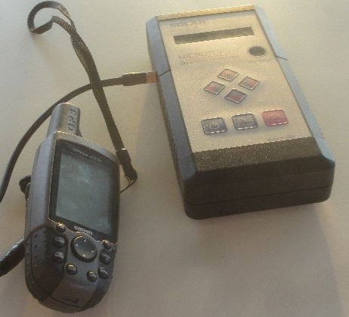
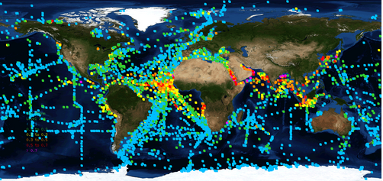
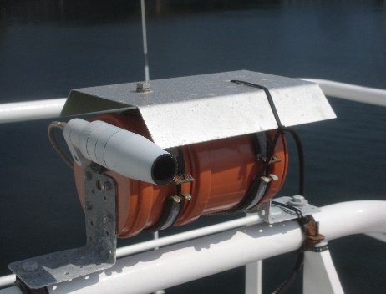
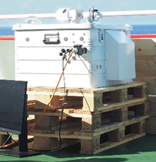
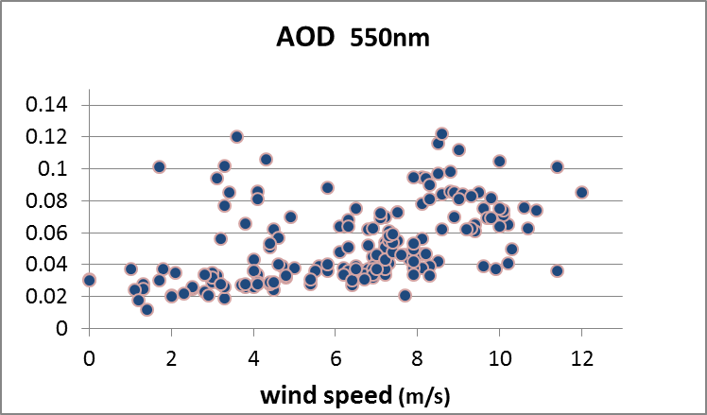
example 1 aerosol and trace-gases
MICROTOPS
  aerosol
  water vapor
MAX-DOAS
  Trace-gases
EM27/SUN Fourier Transform
  greenhouse gases
oceanic aerosol loads from ship cruises
blue(small AOD) to pink (large AOD)
low background AOD depends
on surface wind speeds

Slide 8
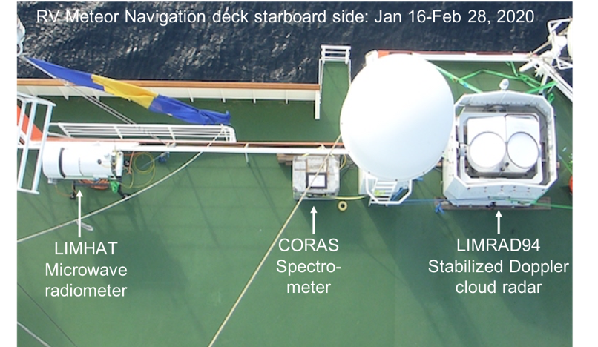
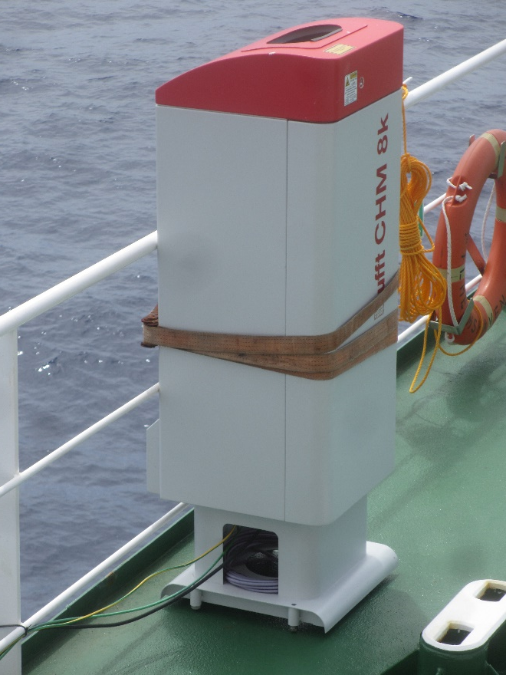
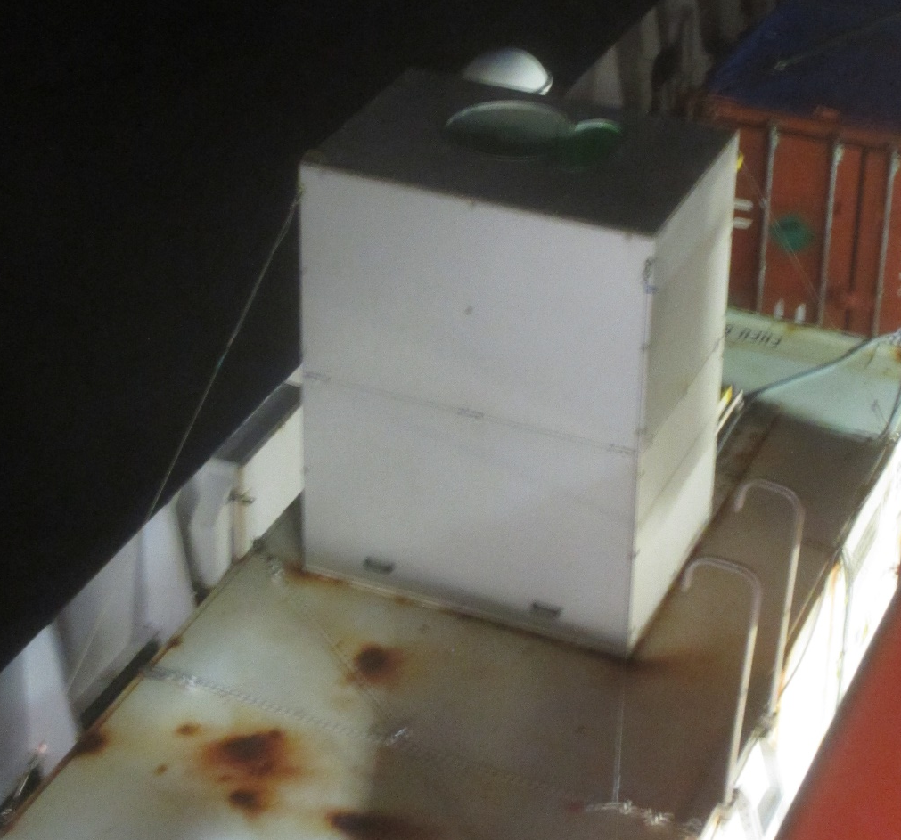
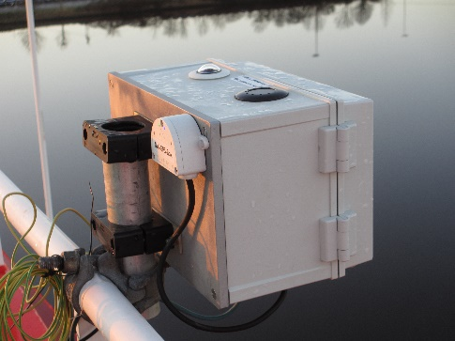
example 2 cloud
Radar
microwave
radiometer
Raman Lidar
cloud ceilometer
camera

Slide 9
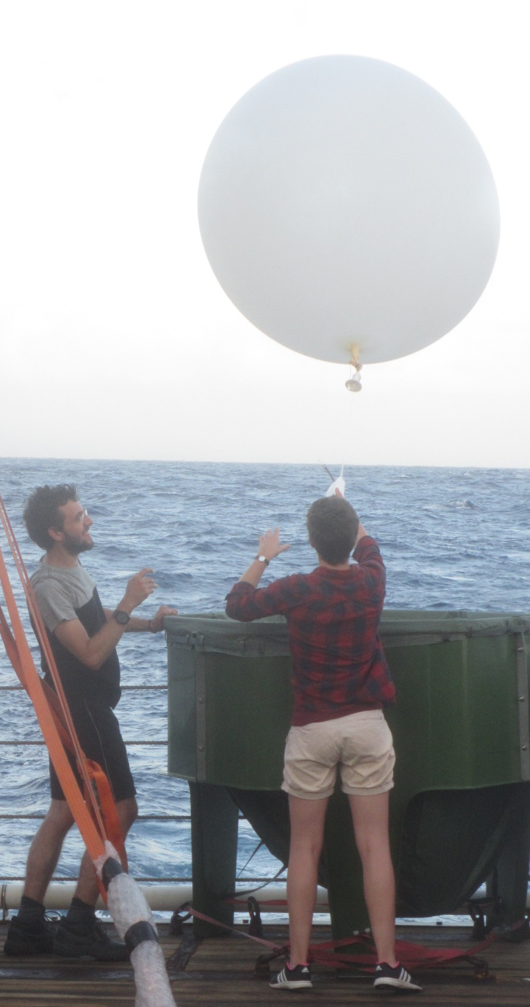
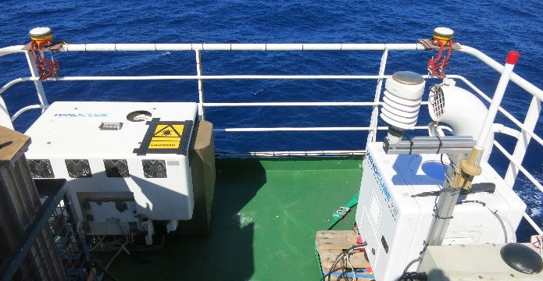
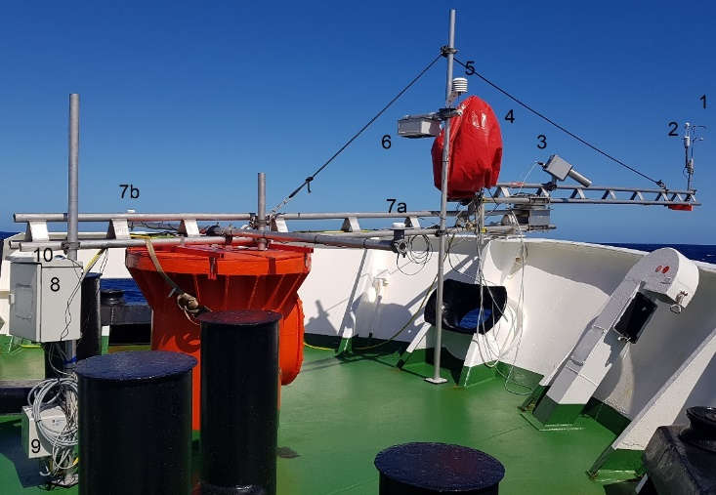
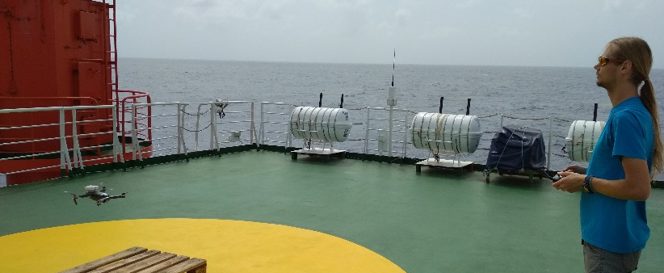
example 3 atmospheric state
radiosondes
cloud- wind-
kite lidars
UAV eddy fluxes

Slide 10
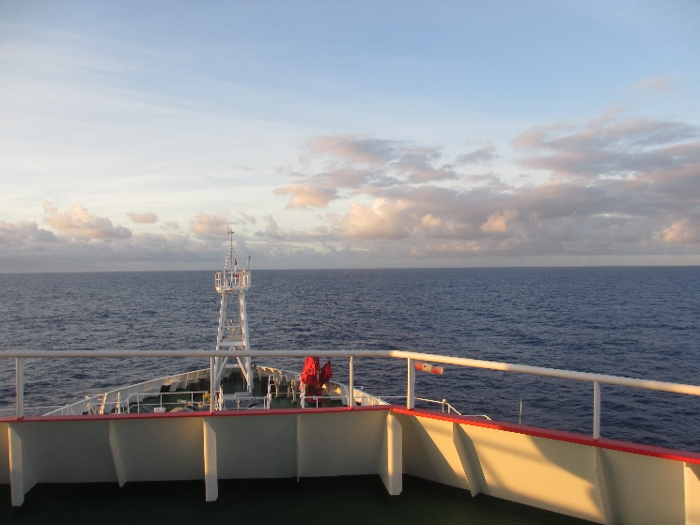
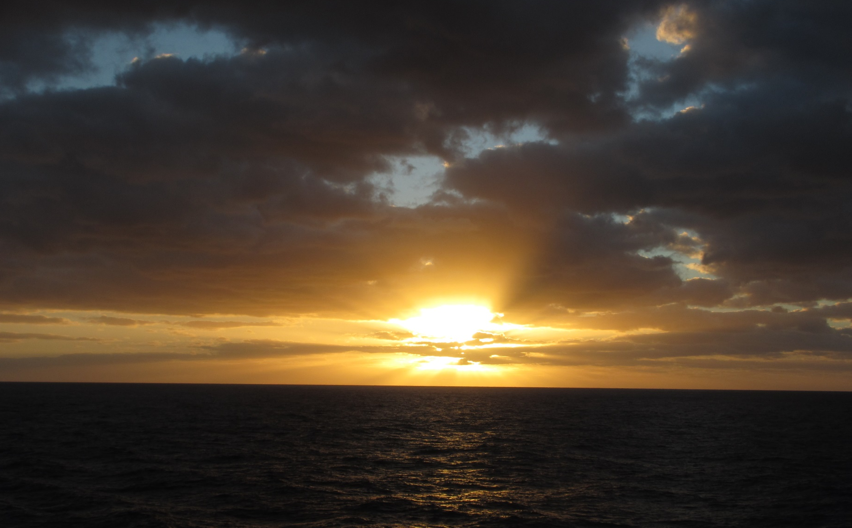
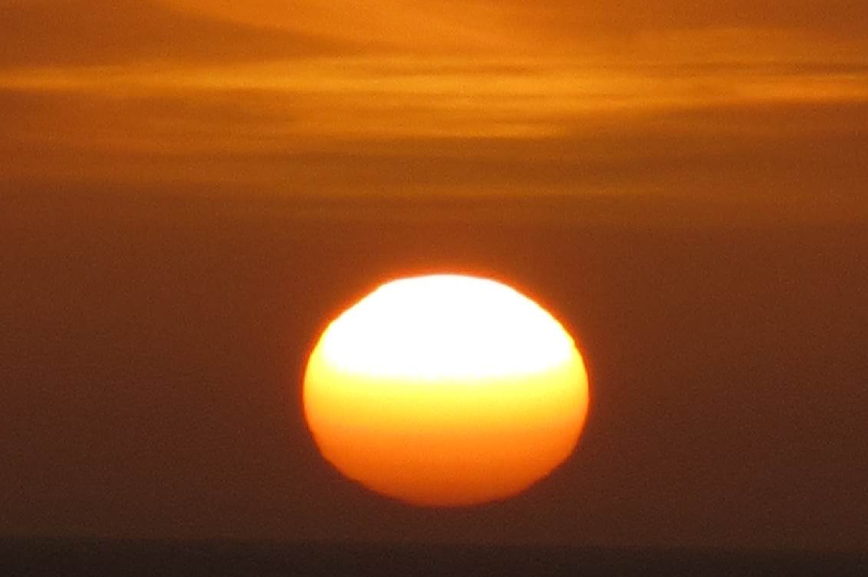
an experience … not to be missed
gg

