Slide 1
Induced seismicity associated with fluid injection into a fractured rock mass
Federico Ciardo¹, Brice Lecampion^{1,2},
Alexis Saèz Uribe¹, Andreas Möri¹
¹Geo-Energy Lab, Ecole Polytéchnique Fédérale de Lausanne, Switzerland
Permeability from micro-seismicity?
Critically stressed vs marginally pressurized condition
²Correspondence to: brice.lecampion@epfl.ch

Slide 2
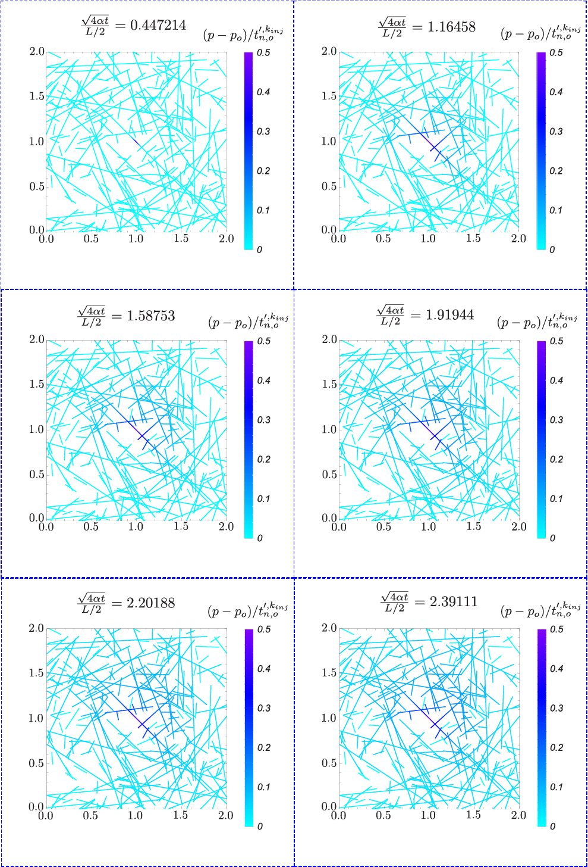
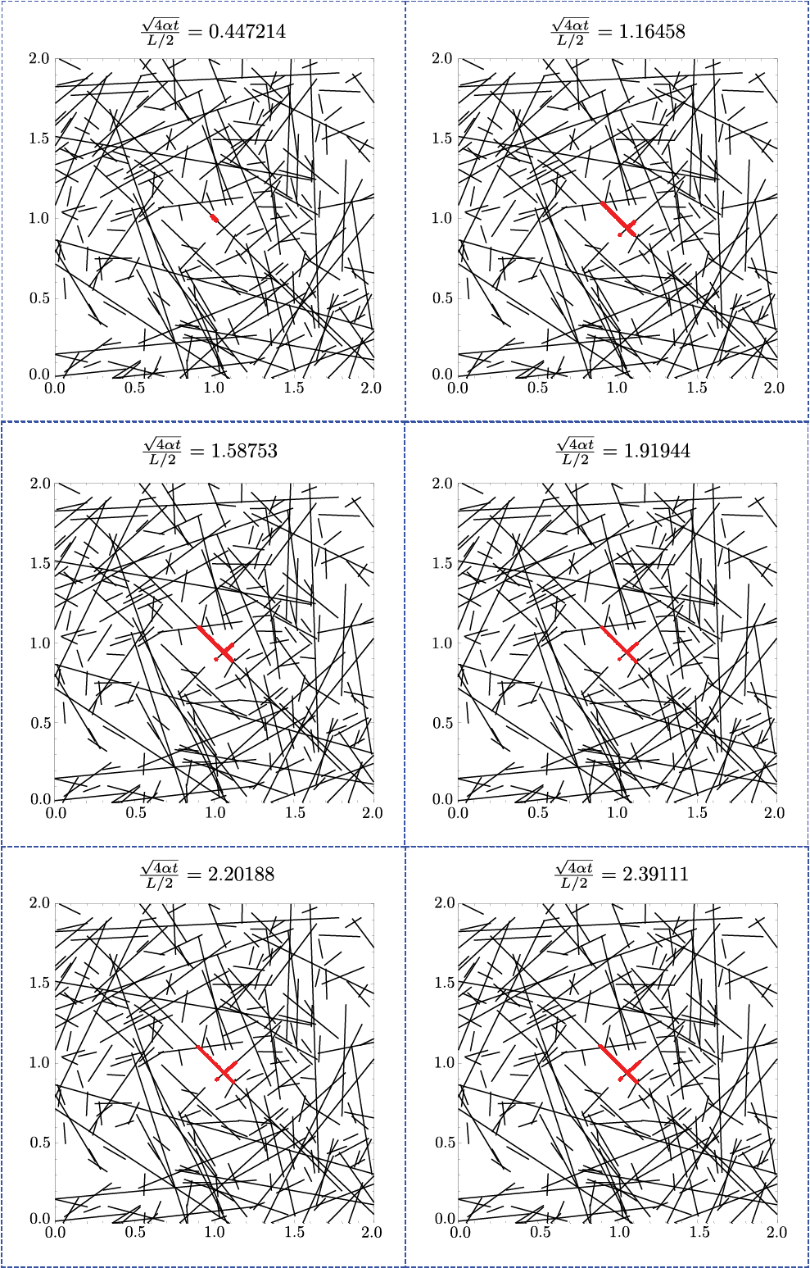
Over-pressure evolution
Friction coefficient
Aseismic slipping patch evolution
Effective stress anisotropy ratio
Normalized injection over-pressure
Marginally pressurized condition
Stress criticality ratio

Slide 3
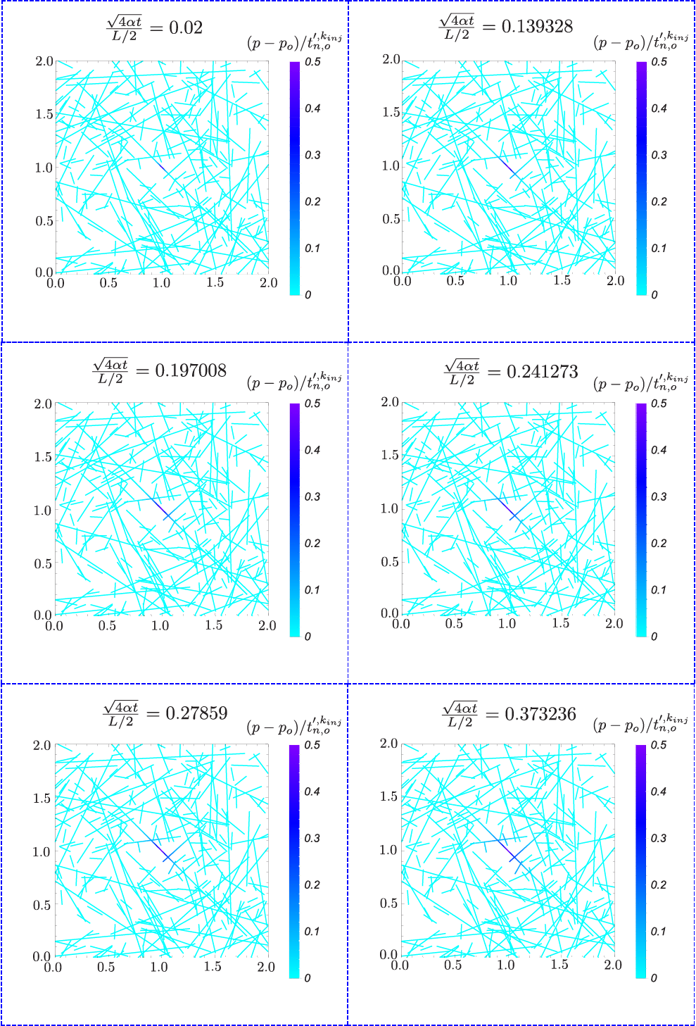
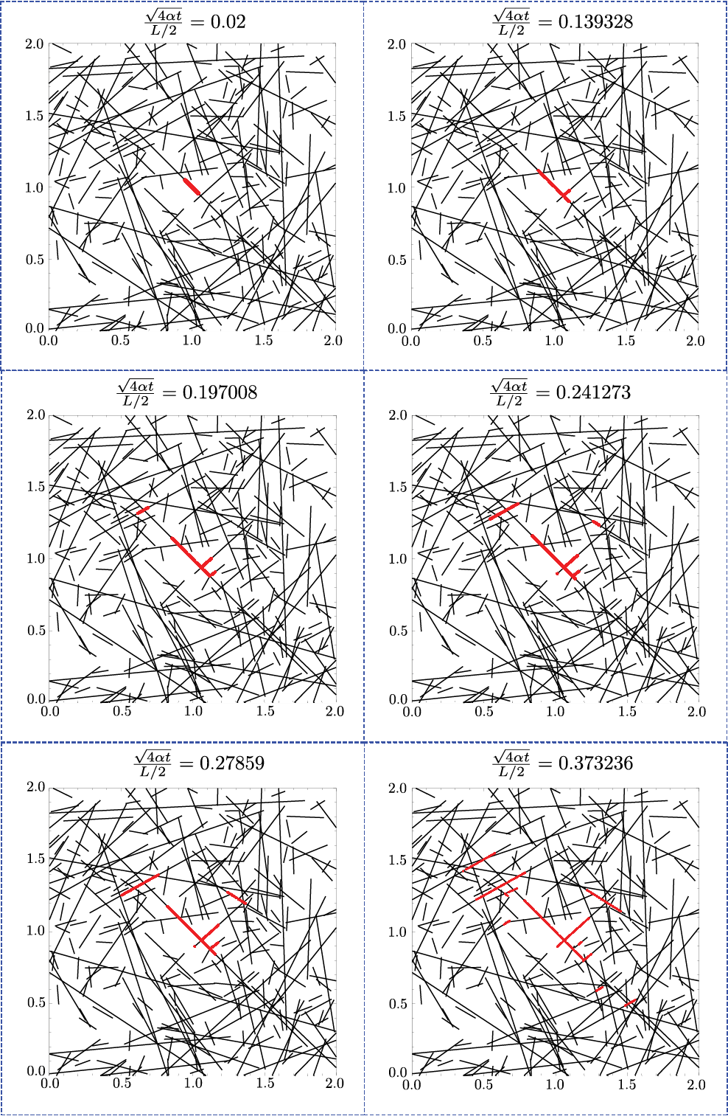
Over-pressure evolution
Friction coefficient
Aseismic slipping patch evolution
Effective stress anisotropy ratio
Normalized injection over-pressure
Critically stressed condition
Stress criticality ratio

Slide 4
Observations & Concluding points
One governing dimensionless parameter, similar to Bhattacharya & Viesca (2019).
In a critically stressed DFN the aseismic front is much faster than fluid diffusion within pre-existing fractures.
  Percolation value and injection over-pressure do not affect considerably the fast slipping patch growth (stress-interactions are dominant).
  The driving and triggering force of (micro-)seismic events thus corresponds to the fast aseismic slipping patch propagation and NOT to the pore-pressure front.
This can explain the reason why the inferred permeabilities from the evolution of (micro-)seismicity over-estimate values obtained from pumping tests.
On the other hand, in a marginally pressurized DFN the aseismic slip propagation is directly affected by pore-pressure diffusion.
  The corresponding percolation parameter plays an important role. Low percolation values may lead to fluid localization and thus restricted aseismic slipping patches.
Our 2D HM numerical solver allows to simulate accurately problems of fluid injection in fractured rock masses, involving large number of fractures and intersections.
It includes a family of solutions!

Slide 5
Induced seismicity associated with fluid injection into a fractured rock mass
Federico Ciardo^{1,2}, Brice Lecampion¹,
Alexis Saèz Uribe¹, Andreas Möri¹
¹Geo-Energy Lab, Ecole Polytéchnique Fédérale de Lausanne, Switzerland
Additional information:
Numerical solver & Bibliography
²Correspondence to: federico.ciardo@epfl.ch

Slide 6
Elasticity
Plane strain condition
Infinite or finite domain
Homogeneous, isotropic and linear elastic
Impermeable medium
Boundary integral elasticity equations (quasi-static formulation):

Slide 7
Constitutive relations for Displacement Discontinuity segments
Rigid-plastic like constitutive relation

Slide 8
Shear & tensile failure
Shear failure (inadmissible region 2) - non-associated flow rule:
Tensile failure (inadmissible region 1) - controlled by the value of the effective normal traction
with the additional constraint of non inter-penetrability

Slide 9
Fluid flow in fractures
Conservation of mass
Averaging it across the fracture width
Allowing for a slightly compressible fluid of compressibility
width averaged fluid velocity
Darcy’s law
Fluid compressibility
Fluid viscosity
Fracture permeability
Isothermal conditions
Newtonian fluid
Laminar flow
Hydraulic diffusivity [L²T⁻¹]

Slide 10
Numerical framework
Elasticity Displacement Discontinuity Method
  Piecewise linear approximation
    No continuity at each intersecting mesh node
    Good accuracy even with non-uniform meshes
Fluid flow Finite Volume Method
  Linear and continuous approximation
  Node centered FV scheme
    Intrinsic local mass conservation
    No need of structured mesh

Slide 11
Numerical scheme
Upon discretization..
Displacement discontinuity method for elasticity
It’s ill-conditioned ☹
GMRES iterative solver
Finite volume method with fully implicit time integration scheme for fluid flow
Pardiso direct solver
Hierarchical approximation of fully populated elasticity matrix

Slide 12
Preconditioner
Upper-triangular preconditioner matrix applied on right side
with
The system of equations can thus be rewritten as

Slide 13
Preconditioner (cont’d.)
We never want to compute the inverse of the Schur complement S, so we make a change of variable
such that the system of equations 1 reduces to
Let us have a look at the spectral properties of the matrix of coefficient with and without application of preconditioner
☹
☺

Slide 14
Preconditioner (cont’d.)
The preconditioned system of equations is solved via GMRES iterative method for the unknown vectors u₁ and z₂.
Once the iterative solution converges within a given tolerance, the solution of the preconditioned mechanical problem is given by
No need to solve iteratively 2 system of equations
& no need to invert Schur complement!

Slide 15
Bibliography
Bhattacharya, P., & Viesca, R. C. (2019). Fluid-induced aseismic fault slip outpaces pore-fluid migration. Science, 364(6439), 464–468.
F. Ciardo and B. Lecampion. Effect of dilatancy on the transition from aseismic to seismic slip due to fluid injection in a fault. Journal of Geophysical Research: Solid Earth, 124, 2019.

