Slide 1
Post-flight analysis of the aerosol impact on size distributions of warm clouds’ droplets, as determined in situ by cloud and aerosol spectrometers
Denisa Elena Moacă^{1,2,3}, Sorin Nicolae Vâjâiac¹, Andreea Calcan¹, Valeriu Filip^{1,2}
¹National Institute for Aerospace Research "Elie Carafoli" INCAS - Bucharest, Romania
²University of Bucharest, Faculty of Physics, 405 Atomistilor Str., Magurele 077125, P.O. BOX MG-11, Romania
³POLITEHNICA” University of Bucharest, Faculty of Aerospace Engineering, Gh. Polizu Street 1-5, 011061, Bucharest, Romania

Slide 2
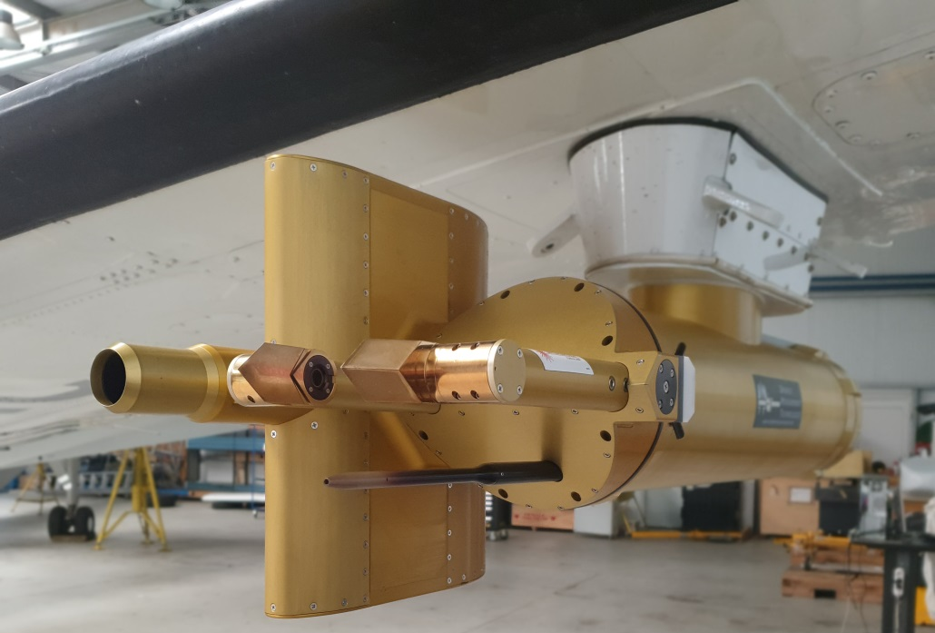
Principle of cloud and aerosol spectrometer measurements
The main task of cloud and aerosol spectrometers (CAS) is to measure cloud particles’ diameters and to construct their statistics (size distribution) by (in situ) picking samples of such particles and by flashing them with a laser beam.
By assuming that the particles are all spherical and made of pure water (for which the chosen laser wavelength should have almost no absorption), the diameters may follow from the comparison with Mie theoretical computations of FWSCS.
CAS
Figure 1: left – Mounted CAPS-DPOL instrument; right – FWSCS for water plotted against the droplet diameter for a wavelength of 658 nm. The real part of the refraction index is 1.331 and the imaginary part is negligible.

Slide 3
Difficulties of the CAS method (1)
1) It is clear that this diagram is overall increasing, but it is far from being a monotonic dependence. This means that, for a given value of FWSCS, there correspond several possible values of the diameter, so the rigorous sizing is impossible.
Our choice is to assume equal chance to every intersection: if a given measured value of the FWSCS occurs for pure water at n₀ values of the diameter, then each size is equally possible with a weight of 1/n₀
Obviously, the detailed statistics can be only obtained from the “particle-by-particle” output files of CAS, which usually represents a fraction of the whole data collected by the instrument.
Figure 2: Illustration of the detailed statistics method.

Slide 4
Difficulties of the CAS method (2)
2) Besides lack of monotonicity, the FWSCS-diameter diagram is also quite sensitive to the values of both the real and imaginary parts of the refraction index.
It is known that real cloud droplets may be “contaminated” by aerosol particles, either by incorporating or by dissolving them (or even both). To describe optically such a “contaminated” droplet, one should use an effective refraction index, which is usually larger (in both its real and imaginary parts) than the one of pure water [1-4]. Consequently, the FWSCS of a “contaminated” droplet should be different than that of the pure water.
[1] C. Erlick, Effective Refractive Indices of Water and Sulfate Drops Containing
Absorbing Inclusions, J. of the Atmospheric Sciences vol. 63, pp. 754-763 (2006).
[2] M. I. Mishchenko, L. Liu, B. Cairns, and D. W. Mackowski, Optics of water cloud droplets mixed with black-carbon aerosols, Optics Lett., vol. 39(9), pp. 2607-2610 (2014).
[3] L. Liu, M. I. Mishchenko, S. Menon, A. Macke, and A. A. Lacis, The e(ect of black carbon on scattering and absorption of solar radiation by cloud droplets, J. of Quantitative Spectroscopy & Radiative Transfer, vol. 74, pp. 195–204 (2002).
[4] H.-H. Wang and X.-M. Sun, Multiple scattering of light by water cloud droplets with external and internal mixing of black carbon aerosols, Chin. Phys. B, vol. 21(5), 054204 (2012).

Slide 5
The effect of the increase in refractivity and/or absorption of the droplet (real and /or imaginary parts of the refraction index) on the FWSCS diagram
(a) An increase of the real part of the refraction index keeps the FWSCS-diameter diagram highly oscillating, but it gets an overall decrease with respect to that for pure water. The decrease is more significant for large droplets.
(b) Even a slight increase of the imaginary part of the refraction index produces strong distortions of the FWSCS-diameter diagram in comparison to that for pure water. There is an overall decrease (which tends to be very large) and a smoothing effect at higher absorption rates and for large droplets.
Overall, it can be seen that, if regarded as made of pure water (as the CAS method does), “contaminated” cloud droplets appear generally smaller than they really are.
Figure 3: (a) Impact of the increase in the real part of the refraction index on the FWSCS-diameter diagram. (b) Impact of the increase in the imaginary part of the refraction index on the FWSCS-diameter diagram.

Slide 6
The forward scattering of sub-micrometer particles is almost unaffected by variations of the refraction index
One very important observation is that even large increases of both refractivity and absorption have little effect on the sub-micrometer range of the FWSCS-diameter diagram.
It means that fine aerosol particles are “seen” by CAS as a lump portion of the size distribution, irrespective of their refractive indexes.
Figure 4: Impact of the increase in the real and imaginary parts of the refraction index on the small-size region of the FWSCS-diameter diagram. The two panels differ only in the type of scale used for the ordinate axis.

Slide 7
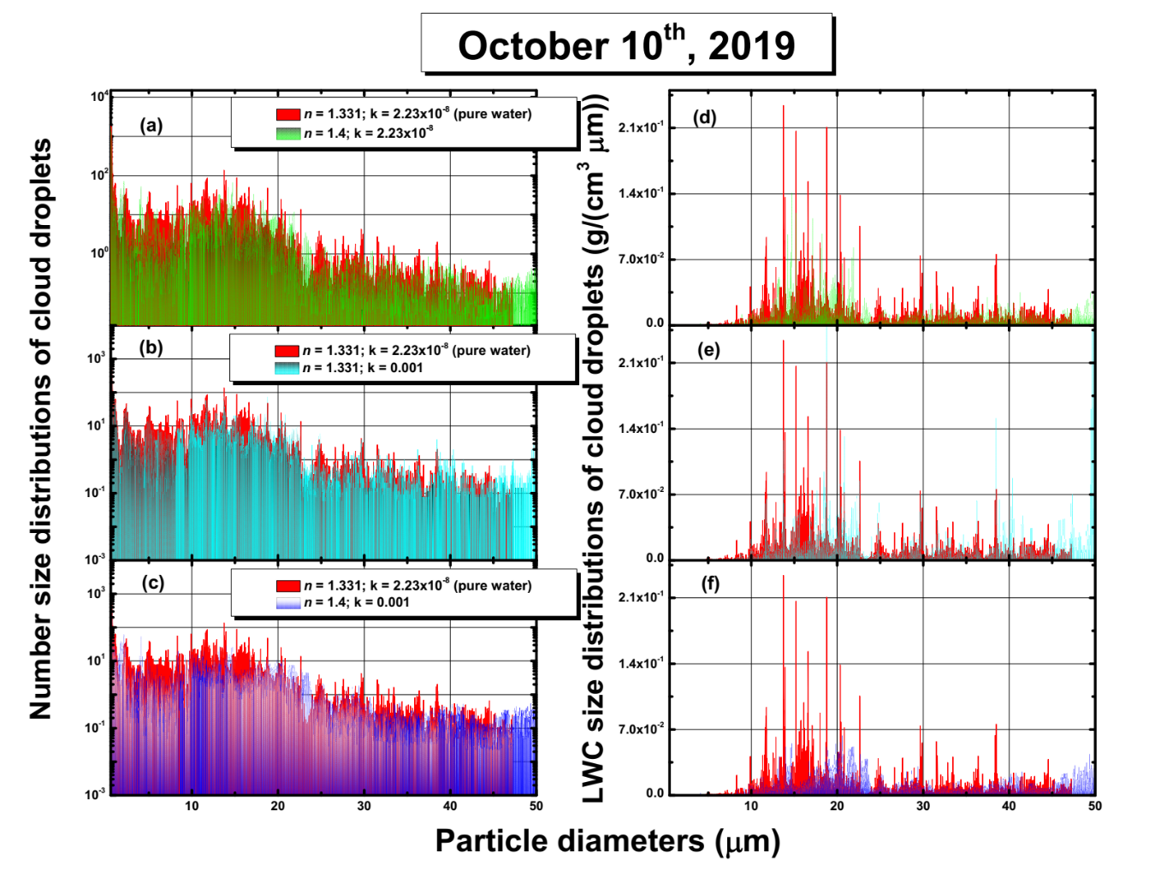
The effect of the increase in refractivity and/or absorption of the droplet (real and /or imaginary parts of the refraction index) on the measured size distributions of cloud droplets
Even moderate increase in either the real or the imaginary parts of the refractive index of a cloud droplet makes it appear smaller in a CAS measurement.
The overall consequence of this fact is that the size distributions of clouds with “contaminated” droplets, as resulted from CAS data, are somehow shifted towards smaller diameters and the size-related properties (like the LWC) are underestimated.
Although the shift of the number distributions may seem not very important, when computing the total LWC, the undervalue may be close to 70%.
Figure 5: Increase in the real and imaginary parts of the refraction index produces right-shifts in both number (a-c) and LWC (d-e) size distributions. Diagrams plotted in red correspond to the CAS evaluation with a pure water FWSCS-diameter diagram.

Slide 8
How reliable could be the cloud droplet size distributions obtained from CAS data?
It is clear that sizing cloud droplets through comparison with pure-water FWSCS diagram may lead to substantial systematic errors.
Such errors should be more important when the cloud droplets are more “contaminated” with aerosol particles, of which the sub-micrometric (likely anthropogenic) ones could make the most damage.
The reliability assessment of the CAS measurements should begin with the inspection of the small-size region of the detailed number distributions. The CAS readings in this range should refer mainly to aerosol particles and should not depend too much on their effective complex refractive indexes. If such particles were relatively not so abundant, then one could rely more confidently on the obtained size distributions (number and LWC).
Figure 6: (a, b) Number size distributions obtained from data collected during two flights in April 2019. The details of the sub-micrometer regions are shown, using identical scales, in the panels (c) and (d).

Slide 9
Conclusions
Cloud droplet “contamination” with fine aerosol particles may significantly influence their response to forward scattering of light beams.
Before practical use, CAS data should be somehow tested for the possibility of such “contamination”.
A handy way of testing consists of inspecting the sub-micrometer tail of the detailed droplet size distribution obtained from the particle-by-particle data files.
Acknowledgments: This research is supported by 20-062/3 PN- PN19010803 .
Contact: moaca.denisa@incas.ro
vajaiac.sorin@incas.ro
calcan.andreea@incas.ro
vfilip@gmail.com

