Slide 1
Intercomparison of PBL height estimations in the framework of HyMeX-SOP1
Donato Summa¹, Paolo Di Girolamo², Benedetto De Rosa², and Fabio Madonna¹
¹CNR-Consiglio Nazionale delle Ricerche, IMAA- Istituto di Metodologie per Analisi Ambientali, Tito, Italy (donato.summa@imaa.cnr.it)
²Scuola di Ingegneria, Università degli Studi della Basilicata, Potenza, 85100, Italy
The evolution of the PBL structure and height has important meteorological role. Accurate measurements of the PBL height are important to validate forecast models or support their development through the improvement of the physical representations embedded in, for example, their boundary layer turbulence and shallow convection parameterizations. Elastic backscatter signals and rotational Raman signals collected by lidar systems can be used to characterize the PBL height and its internal structure. In the present research effort, this technique is compared with measurements from a co-located wind profiler and a potential temperature computed from radio-sounding system coming from IGRA DataBase and ECMWF model

Slide 2
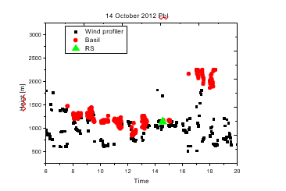
The algorithm which is considered in this paper to estimate the PBL height from the Raman lidar data considers the minimum of the following quantity: where the quantity in the bracket means the Range Corrected signals P(z) at wavelength λ. The potential temperature-based estimate of the PBL height is obtained as the height of maximum gradient in the potential temperature profile θ(z).
Evolution of the PBL (m) during the October month of the HyMex measurement campaign in the Gulf of Lyon in the Mediterranean sea.
A comparison of different approaches is presented to estimate PBL: IGRA DataBase, ECMWF, Wind Profiler and BASIL Lidar From University of Basilicata (BASIL)

