Slide 1
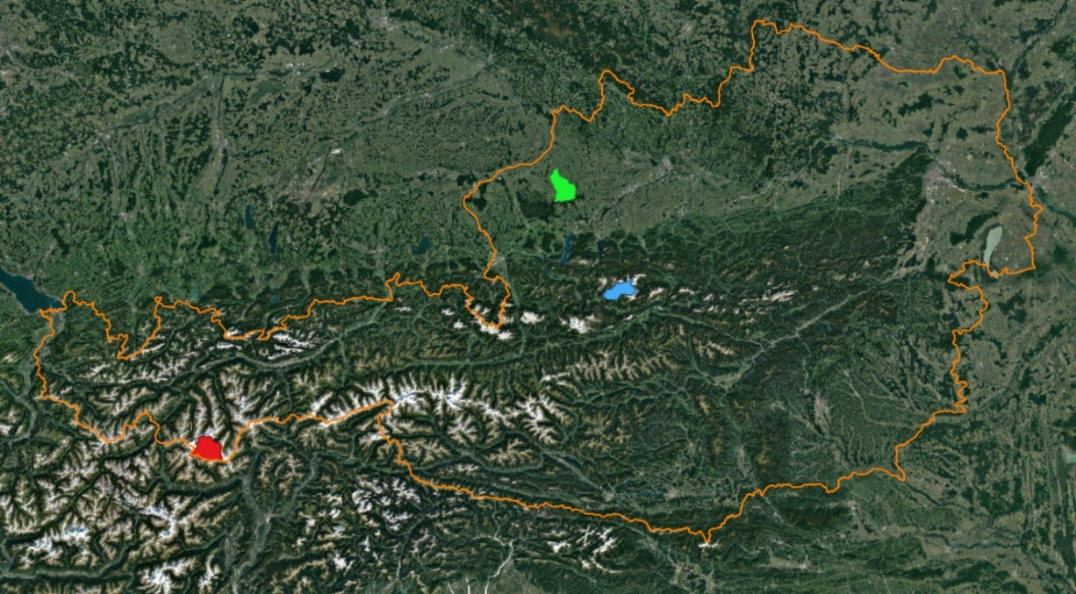
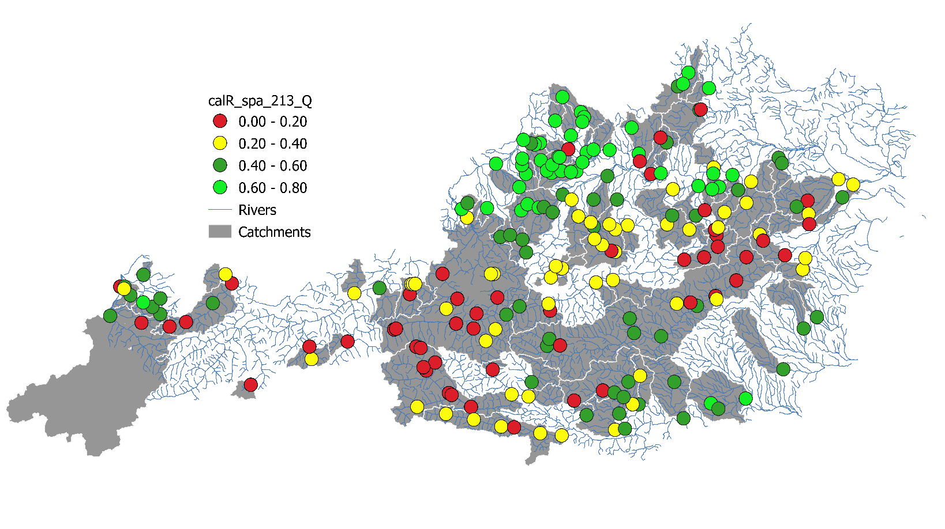
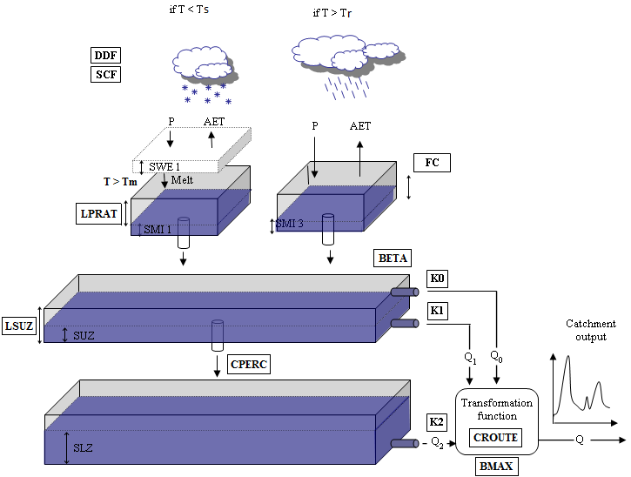
REGIONALIZATION OF THE POTENTIAL TO INCREASE RAINFALL-RUNOFF MODEL PERFORMANCE BY MULTI-OBJECTIVE CALIBRATION USING MODIS DATA OVER AUSTRIA
Martin Kubáň²⁾,Adam Brziak²⁾, Patrik Sleziak¹⁾, Ján Szolgay²⁾, Kamila Hlavčová²⁾, Juraj Parajka³⁾
¹⁾ Institute of Hydrology, Slovak Academy of Sciences, Slovakia;
²⁾ Department of Land and Water Resources Management, Slovak University of Technology, Slovakia; contact email: sleziak@uh.savba.sk
³⁾ Institute of hydraulic engineering and water Resources Management, Faculty of civil Engineering, Vienna University of Technology, Vienna, Austria (parajka@hydro.tuwien.ac.at)
1
INTRODUCTION
4
RESULTS
Multi-objective calibration of the parameters of conceptual hydrologic models has the potential to improve the consistency of the simulated model states, their representativeness with respect to catchment states, and thereby to reduce the uncertainty in the estimation of hydrological model outputs. Observed in-situ or remotely sensed state variables, such as the snow cover distribution, snow depth, snow water equivalent, and soil moisture were often considered as additional information in such calibration strategies and subsequently utilized in data assimilation for operational streamflow forecasting. The objective of this paper is to assess the effects of the inclusion of MODIS products characterizing soil moisture and the snow water equivalent in a multi-objective calibration strategy of an HBV type conceptual hydrological model under the highly variable physiographic conditions over the whole territory of Austria.
The methodology was tested using the Technical University of Vienna semi-distributed rainfall-runoff model (the TUW model), which was calibrated and validated in 213 Austrian catchments. For calibration, we use measured data from the period 2005 to 2014. Subsequently, we simulated discharges, soil moisture, and snow water equivalents based on parameters from the multi-objective calibration and compared these it with the respective MODIS values. In general, the multi-objective calibration improved model performance when compared to the results of model parametrization calibrated only on the discharge time series. Sensitivity analyses indicate that the magnitude of the model efficiency is regionally sensitive to the choice of the additional calibration variables. In the analysis of the results we indicate ranges how and where the runoff, soil moisture, and snow water equivalent simulation efficiencies were sensitive to different setups of the multi-objective calibration strategy over the whole territory of Austria. It was attempted to regionalize the potential to increase the overall model performance and the improvement in the consistency of the simulation of the two-state variables. Such regionalization may serve model users in the selection which remotely sensed variable or the combination is to be preferred in local modeling studies.
Comparison of the different calibration schemes
Selected 3 Austrian catchments – with different hypsometric characteristics, where we are showing simulated soil moisture against measured soil moisture by sensors from MODIS (in the first row) and we also concentrated on the snow model results (second row).
Low-land
High-land
Alpine
2
DATA
Study region and data
This study focuses on the selected catchments in Austria (213 selected catchment without discharge regulation by dams and canals etc. )).
The input data (Spartacus) (2005-2014) precipitation, observed discharge, air temperature and potential evapotranspiration (Blaney Cridle), snow water equivalent (divided into hypsometric zones by 200 m) and soil moisture for the root zone (sensor MODIS).
Soil moisture used for calibration was achieved by sensor MODIS.
Tab. 1: Selected catchment with different hypsometric characteristics, and their calibration efficiencies
Catchment No. | Type | Area (km²) | Station | River | Nash-Sutcliffe coeff. | Logarithmic Nash Sutcliffe coeff. | Volume error (%)
201368 | Alpine | 164,7 | Vent | Venter_Ache | 0,92 | 0,98 | -0,11
204750 | Low land | 164,9 | Haging | Antiesen | 0,70 | 0,63 | 0,10
210526 | High land | 125,1 | Archkogl | Grundlseetraun | 0,76 | 0,82 | 0,02
Fig. 4: Graphics comparison of simulated soil moisture and snow water equivalent against measured soil moisture and snow cover from MODIS.
Finally, we made a correlation between 213 Austrian catchments and compared the difference between single calibration for discharge and multi-calibration for discharge and soil moisture measured by sensors from MODIS (Table 2.).
Fig. 1: Selected catchment with different hypsometric characteristics.
3
METHODOLOGY
Tab. 2: Comparison of the correlation between simulated soil moisture and measured by MODIS, (comparison of the single and multi-calibration ).
TUW model
Calibration strategy
213 Catchments correlation | Single calibration | Multi-calibration
Average = | 0,38 | 0,47
Average Alpine = | 0,22 | 0,35
Average Lowland = | 0,46 | 0,53
Semi-distributed conceptual rainfall-runoff model (Viglione and Parajka, 2014), which follows the structure of the HBV model (Bergström, 1995).
The model has 15 parameters.
The structure of the model (Fig. 2) can be divided into three submodels: snow, soil moisture, runoff (Merz and Blöschl, 2004).
The TUW model was calibrated for the period of 2005 - 2014.
We use the data divided to hypsometric zones by 200 meters.
We use an automatic calibration procedure using a differential evolution algorithm Deoptim (Ardia et al., 2015).
The objective function for the discharge calibration (OF) combines Nash-Sutcliffe coefficient (NSE) estimated from normal and logarithmic transformed (logNSE) daily streamflow values:
Fig. 5: Correlation between simulated soil moisture by TUW model and soil moisture from MODIS, when multi-calibration was used.
Fig. 6: Correlation between simulated soil moisture by TUW model and soil moisture from MODIS, when calibration for discharge was used.
5
CONCLUSIONS
$$OF1=\frac{1−NSE}{2}+\frac{1−logNSE}{2}$$
The main goal of this paper was to calibrate the TUW model for 213 selected Austrian catchments with the use of the MODIS soil moisture data (single calibration for discharge and multi-calibration for discharge and soil moisture). Subsequently, we focused on the soil moisture and snow simulation results and compared these with the data measured by MODIS.
The objective function for the discharge and soil moisture calibration (OF) combines (OF1) with measured soil moisture by sensor MODIS (OF2).
OF = OF1 +OF2
Acknowledgement
This study has been supported by the VEGA Scientific Grant Agency Grant No. 1/0632/19. The support is gratefully acknowledged..
The results show that the calibration performed better in lowland regions also multi-calibration performed better than single calibration Fig. 5 - 6 ). Multi-calibration mainly improved the correlation between simulated and measured data (Tab. 2).
Fig. 2: Structure of the TUW model.

