Slide 1




Séveraisse River flood October 2020
Time-lapse sequence
and supporting information
Maarten Bakker, Florent Gimbert, Clément Misset,
Laurent Borgniet, and Alain Recking
EGU General Assembly 2020 - display
https://doi.org/10.5194/egusphere-egu2020-13821

Slide 2
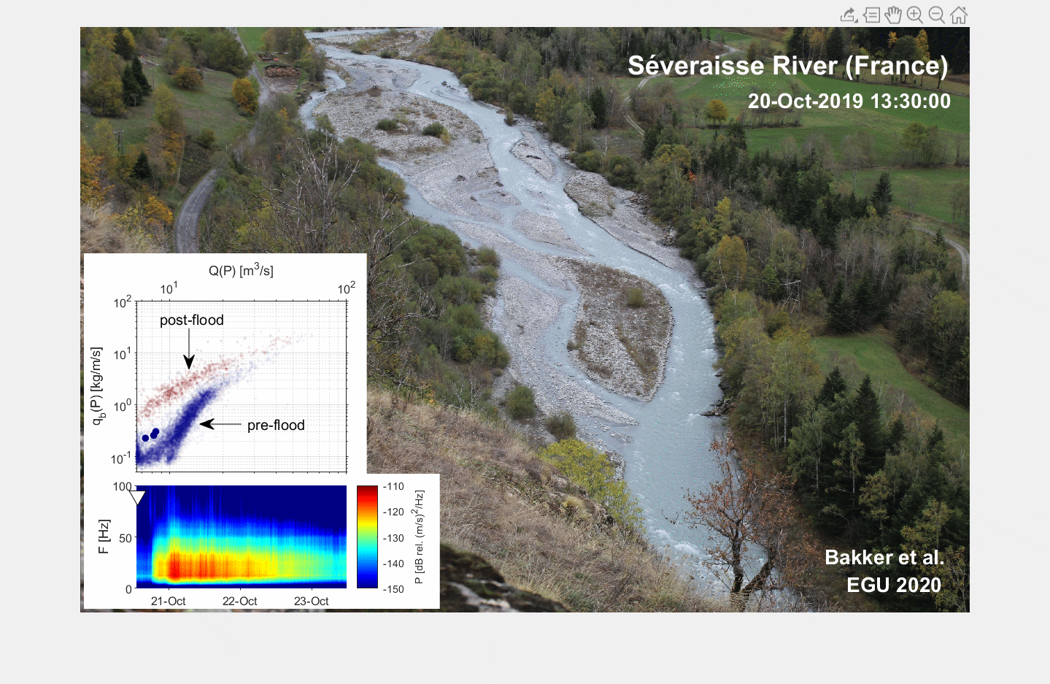

Slide 3
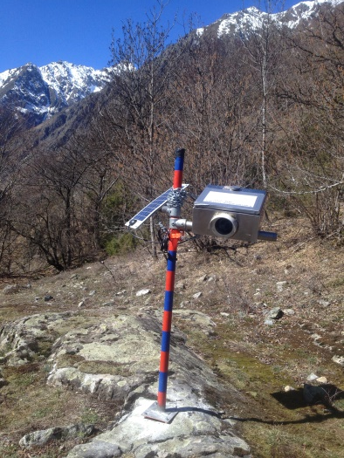
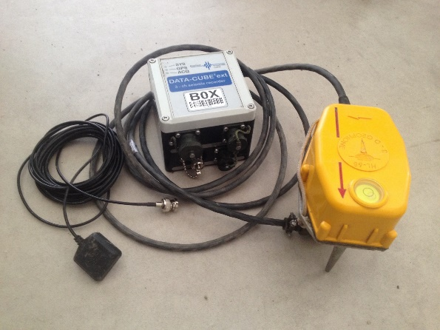
The Séveraisse River in an Alpine river that lies in the French Alps. We are studying a 600 m long and up to 90 m wide braided section (Google Maps).
In the period 20-23 October 2019, there was a flood with an estimated return time of 50 years (based on a 50-year record). The flood was recorded by a time-lapse camera (only day-time images) and a bank-side geophone that was installed at the downstream end of the reach.
The time-lapse camera was installed on a rocky outcrop ~70 m above the channel
Geophone, logger and GPS that was used
flow

Slide 4
From the measured seismic power (bottom inset time-lapse sequence), we quantified continuous bedload transport rates using a physically-based model introduced by Tsai et al. (2012) and refined by Bakker et al. (in press). In the latter study, we show that the inverted rates are in good agreement with independent bedload sampling (Misset et al. 2020): instantaneous values have an uncertainty factor of ~5^{±1} .
From the same seismic measurements, but at lower frequencies (~10 Hz vs. ~40 Hz in our case), we quantified discharge following the turbulent flow model introduced by Gimbert et al. (2014) – we are currently working on a refined version of this model. This was necessary as stage-based discharge measurements were not reliable during the course of the flood due to local bed level changes (decimeters).

Slide 5
erosion
We plotted the derived bedload transport against discharge during the course of the flood (top inset time-lapse). These values are compared to those in the period before (May-October) and after (November) the flood. This figure indicates a change in system response with relatively large amounts of bedload material that are released from the reach during and after the flood. At the same time, the morphological character of the reach changes from braiding to meandering directly at the beginning of the flood. Note the outer bend erosion of alternate river-banks (indicated in image to the right). It is the question whether the original regime will be restored and at what time-scale.
More fundamentally,
what role does the morphological evolution of these reaches play in the storage and downstream transfer of sediment?
erosion
erosion
EGU General Assembly 2020 https://doi.org/10.5194/egusphere-egu2020-13821

